Slide 1
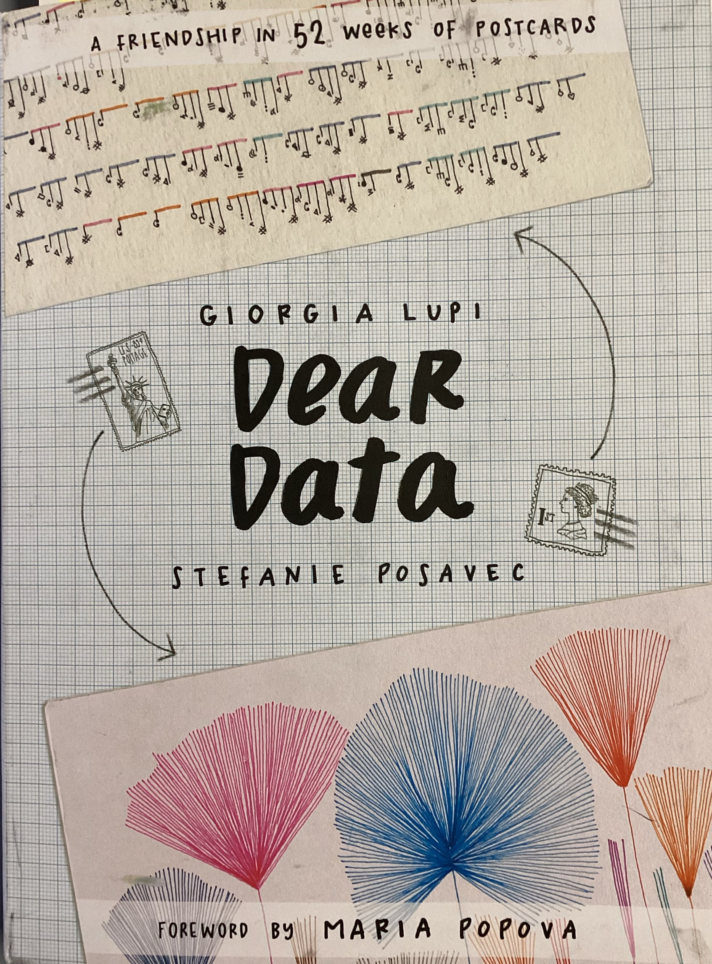

Classroom tool for data literacy
Adaptable for all grade levels

Slide 2

The Value in Data literacy
Science & Engineering Practices
Ask questions and define problems
Develop and use models
Plan and carry out investigations
Analyze and interpret data
Use mathematics and computational thinking
Construct explanations and design solutions
Engage in argument from evidence
Obtain, evaluate, and communicate information
Math Practices
Reason abstractly and quantitatively
Real world statical information gathering
Data expression
Crosscutting Concepts
Patterns
Cause and Effect
Structure and Function
Systems and System Models
Stability and Change
Scale, Proportion, and Quantity
Energy and Matter

Slide 3
Why Choose Dear Data?
Engage students with data in a fun and individualized way
Strengthen data literacy skills
Use to build relationships

Slide 4
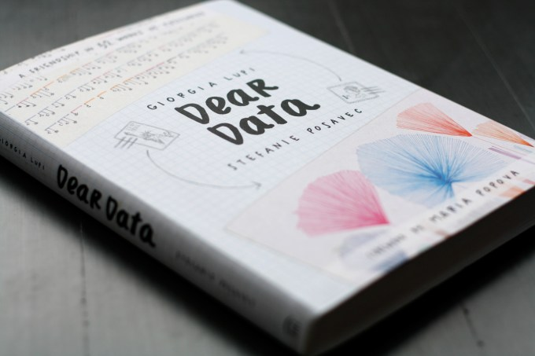

What is “Dear Data”?
Dear Data was a pen-pal data sharing project between two friends.
“Each week, and for a year, we collected and measured a particular type of data about our lives, used this data to make a drawing...”
“We hope Dear Data inspires you to slow down, take stock, and draw – to see the world through a new lens, where everything and anything can be a creative starting point for play, expression and connection.”

Slide 5
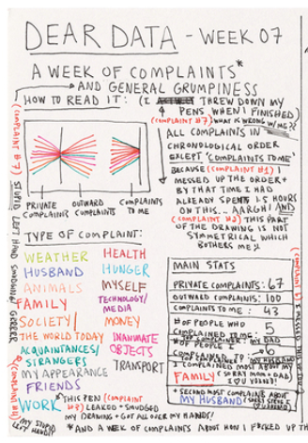
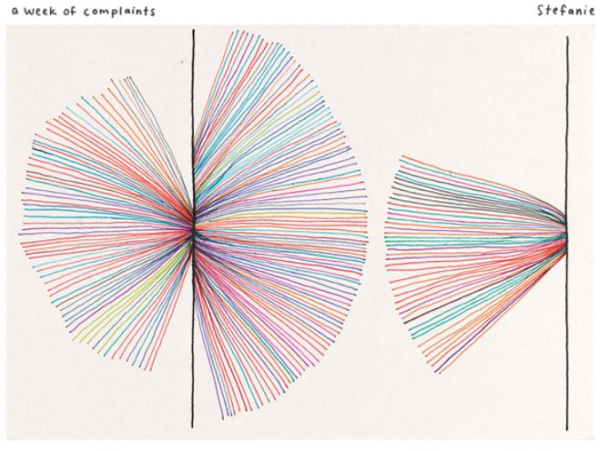
Author’s Example

Slide 6
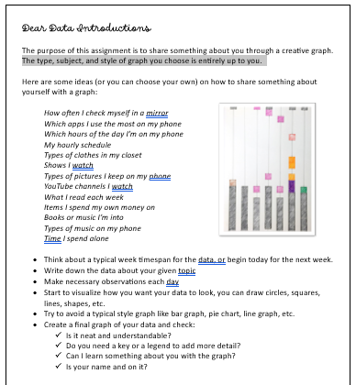
Student Instructions
Step 1: Introduce Dear Data Project
Step 2: Students collected personal data for 7 days.
Step 3: Use class materials to complete a graph
Step 4: Gallery Walk sharing
Download and print

Slide 7
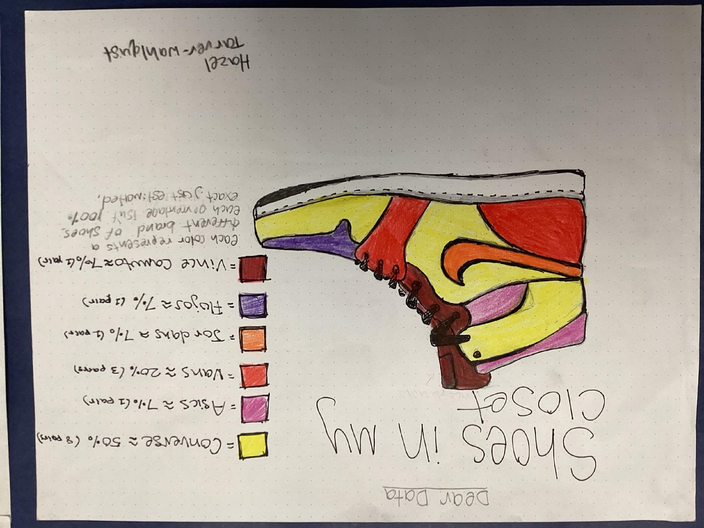
Student Examples

Slide 8
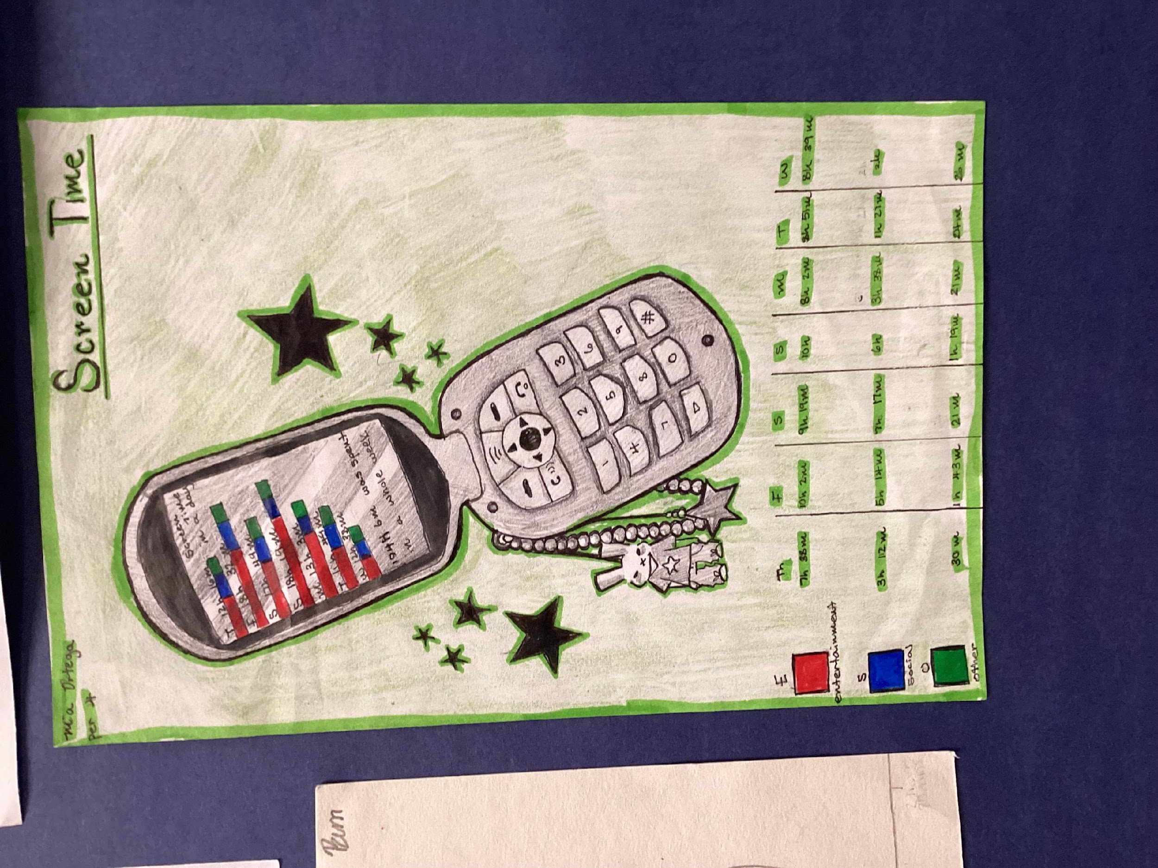
Student Examples

Slide 9
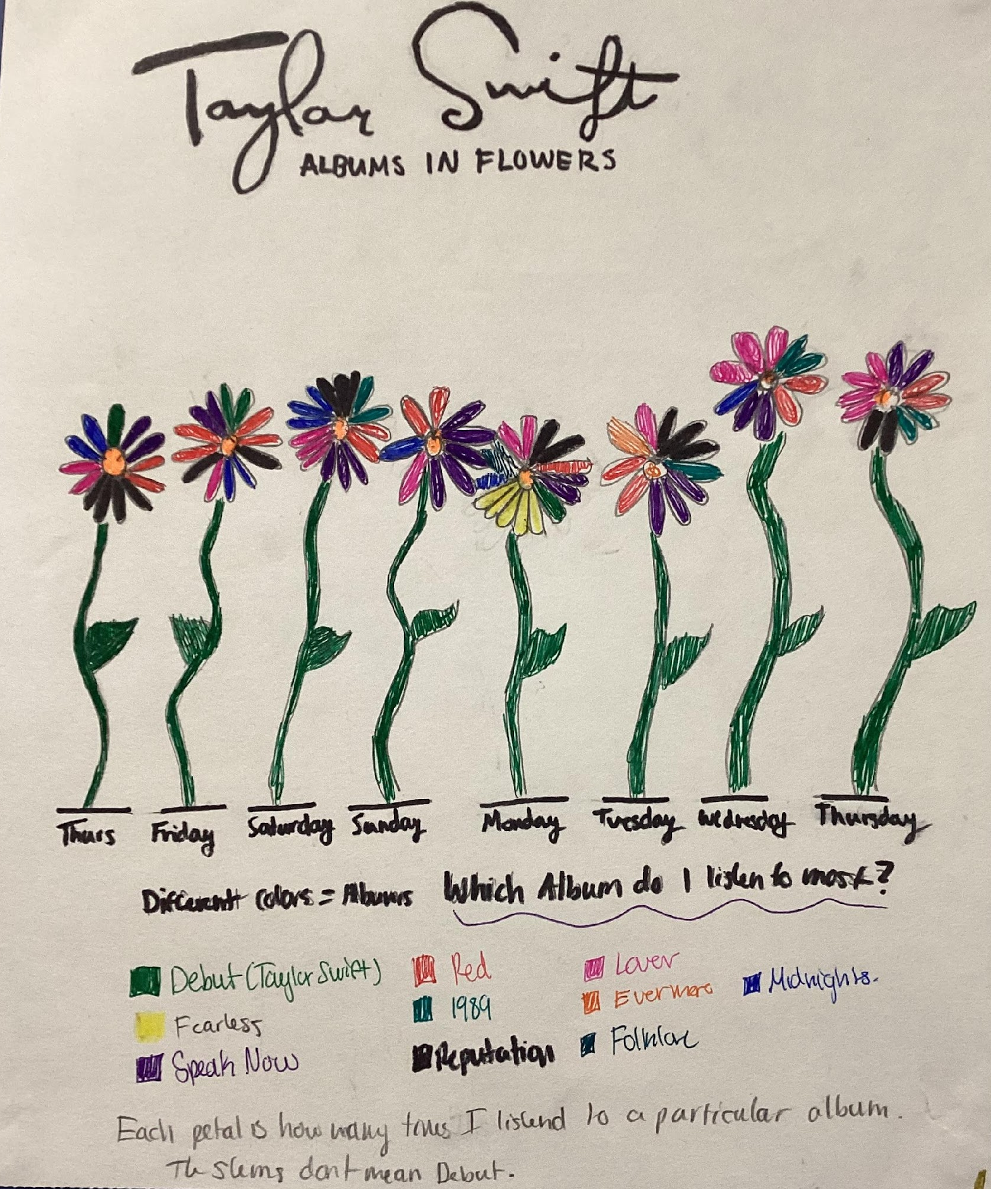
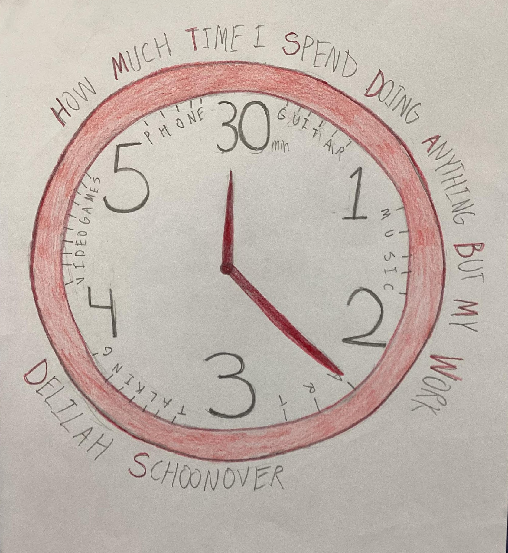
Student Examples

Slide 10
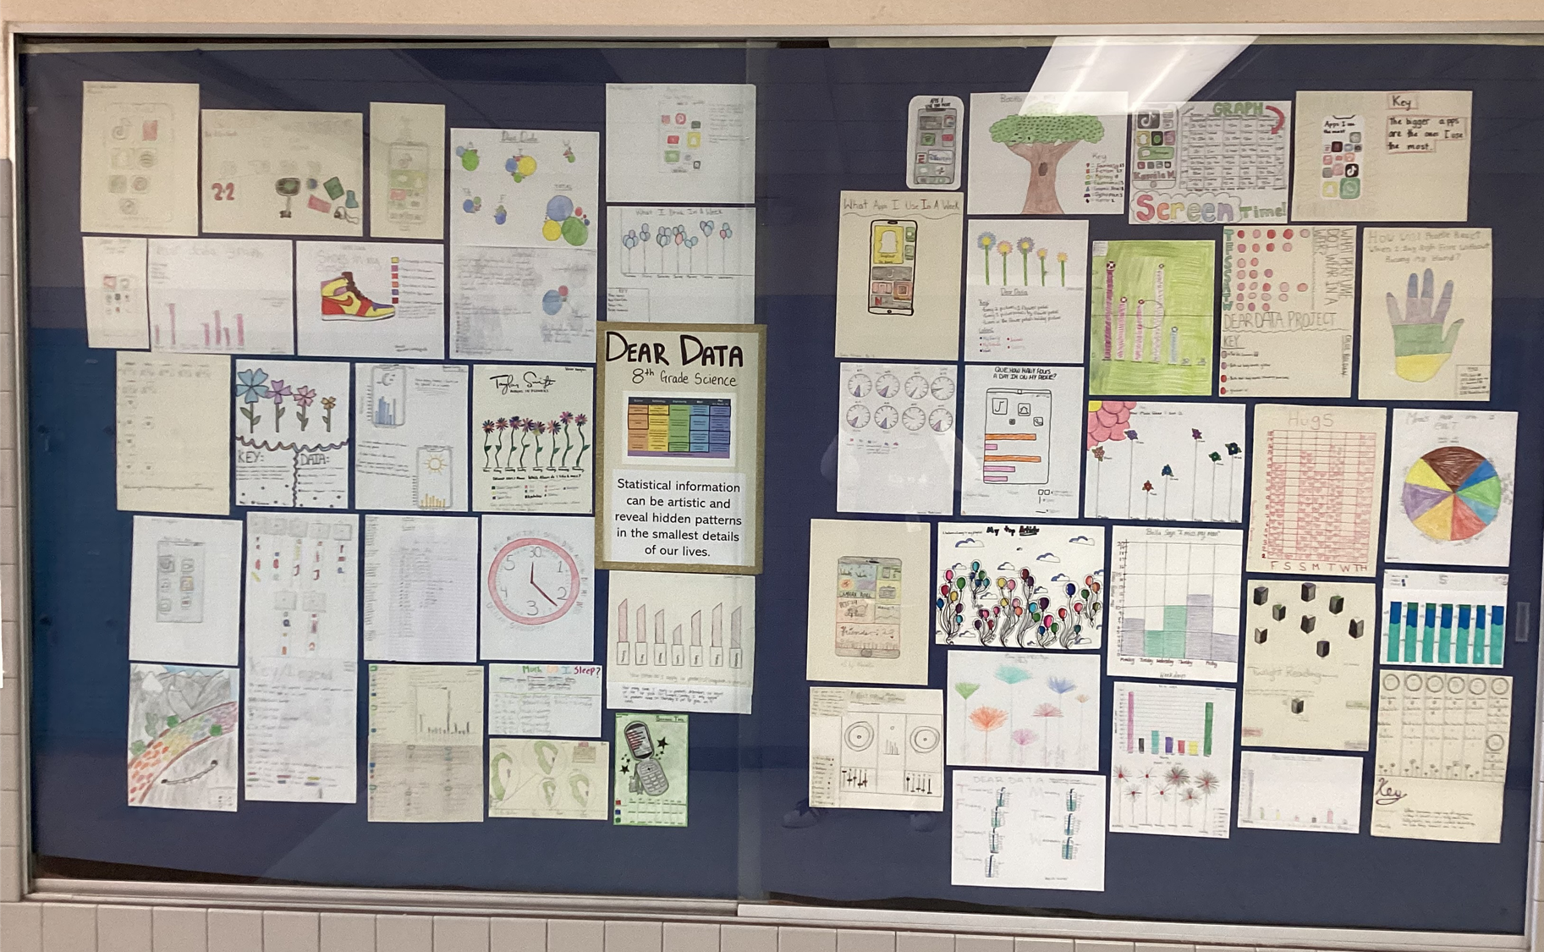

Slide 11
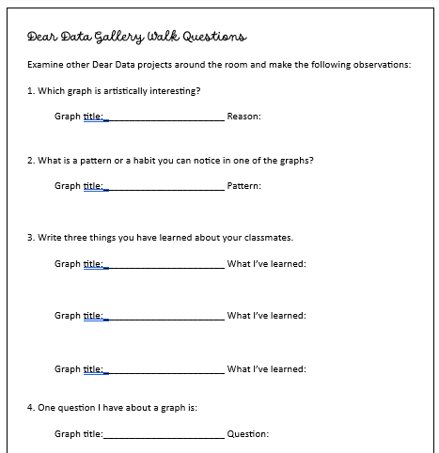
Gallery Walk follow-up class activity
Download and print

Slide 12
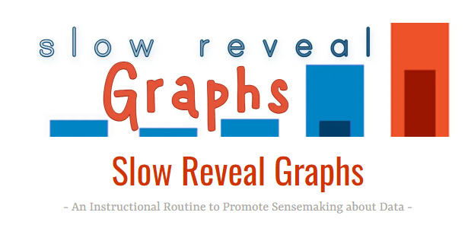
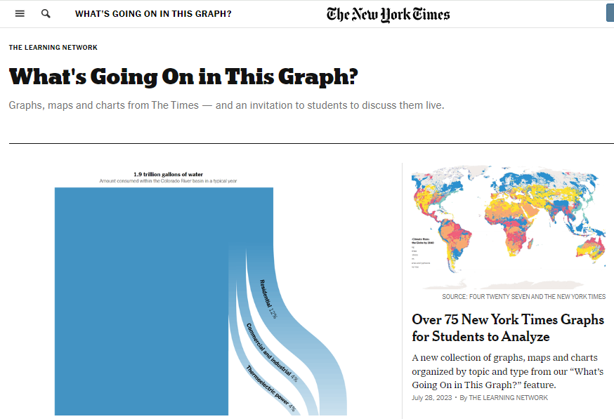
Extension Resources
https://www.nytimes.com/column/whats-going-on-in-this-graph
https://slowrevealgraphs.com/

