Slide 1
First class period

Slide 2
BW: Sketch a profile of this topographic map at cross section A-A’

Slide 3
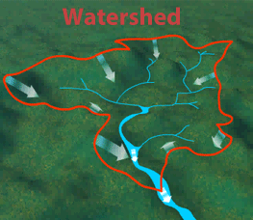
Quarter 1 Watershed Project
Identify a local watershed
Build a model the watershed
Measure how water flows through it with your knowledge of motion
Grading
9 Milestones
√, la, ne
Final gallery walk and reflection (1 month out). Bring snacks

Slide 4
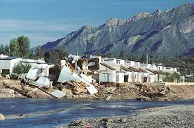

Slide 5
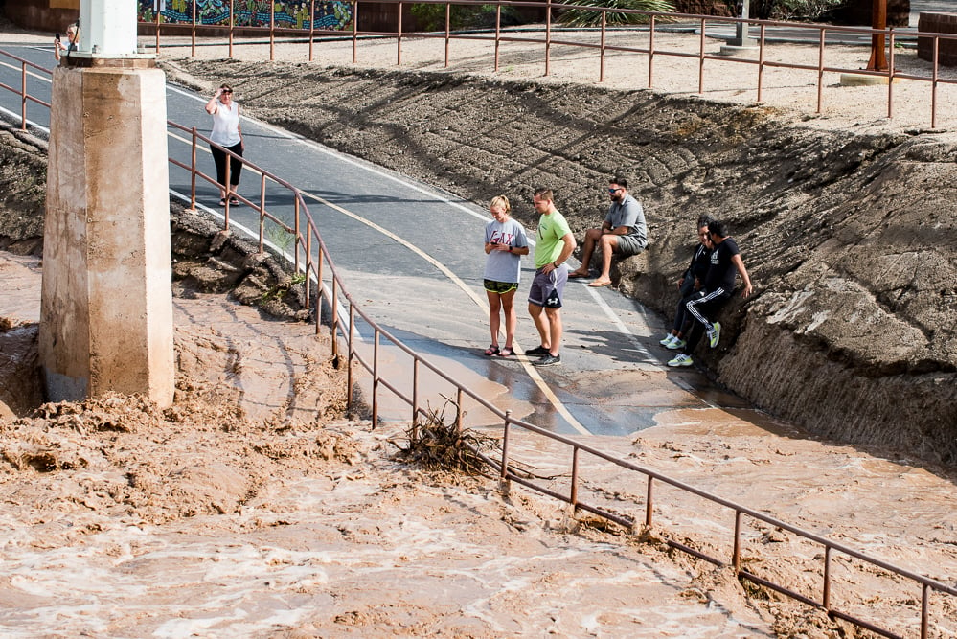

Slide 6
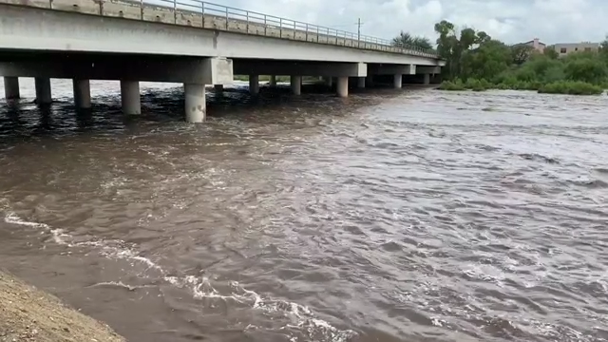

Slide 7
Agenda for today
Milestone 1 (Due Day 1)
Identify a watershed that you would like to study. Use google earth and document coordinates in notebook. Check in with teacher for credit.
Milestone 2 (Due Day 1)
Decide division of labor in your groups. Check in with teacher for credit
Milestone 3 (Due Day 2 or 3)
Bring materials (i.e. cardboard) for your model.

Slide 8
BW: Where along this slice of a river do you think the speed of water would be lowest? Why?
1
2
3
4
5

Slide 9
Kochenderfer Method for Learning New Words
Vocab
Definition
Flow rate
The volume of fluid per every second the fluid is travelling through the cross-section of a moving body of water.
In own words
Drawing/Example

Slide 10
Kochenderfer Method for Learning New Words
Vocab
Definition
Friction
A force that occurs when one object rubs against something else. It always acts in a direction to oppose motion.
In own words
Drawing/Example

Slide 11
Kochenderfer Method for Learning New Words
Vocab
Definition
A surface or shape that is exposed by making a straight cut through something.
Cross section
In own words
Drawing/Example

Slide 12
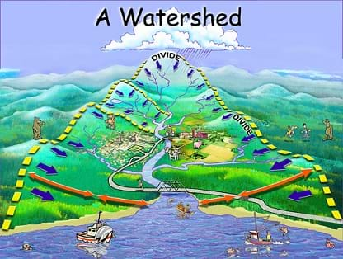
BW: Write a list of what needs to be done today. Do you think that this list is realistic? How much time will you dedicate to each task? Note length of class period.

Slide 13
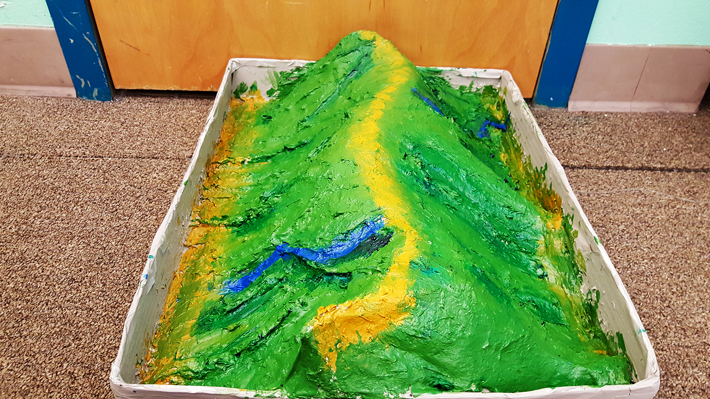
BW: 30 minutes into our first class next week, I will be doing a completeness check for Milestone 4 (skeleton of model). Make a list of what needs to be completed before then.

Slide 14
Next class period

Slide 15
Agenda for today
Milestone 3 (Due Day 2 or 3)
Bring materials (i.e. cardboard) for your model.
Check in with teacher for credit.
Milestone 4 (Due end of week 1)
Complete a skeleton of your model (roughly complete)
Check in with teacher for credit.

Slide 16
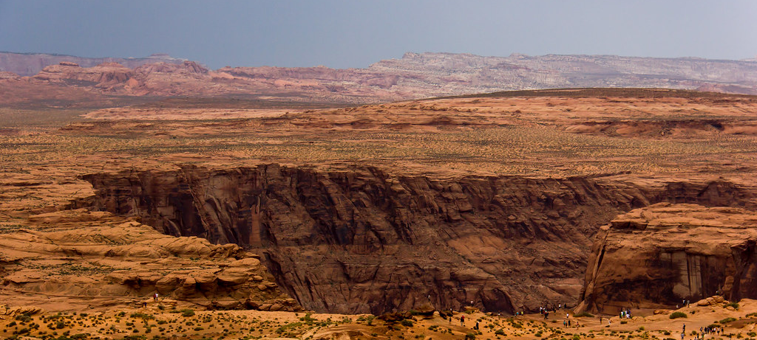
Summarize
For 3 minutes, discuss what you completed today. Write a list in your notebook
For 2 minutes, make a plan for next class, write this in your notebook.

Slide 17
Quarter 1 Watershed Project
Identify a local watershed
Build a model the watershed
Measure how water flows through it with your knowledge of motion
Grading
9 Milestones
√, la, ne
Final gallery walk and reflection 10/4 and 10/5. Bring snacks

Slide 18
BW: Write the definition of a rate in your own words. Use complete sentence(s). What goes in the numerator of a rate? What goes in the denominator?

Slide 19
Next class period

Slide 20
Agenda for today
Milestone 4 (Due 30 mins into class)
Complete a skeleton of your model (roughly complete)
Check in with teacher for credit.
Milestone 5 (Due end of class)
Model is coated with water resistant material
Scale for model established
No more work on model required

Slide 21
BW: Write one thing that you observe and two questions that you have about the following figure. Lastly, does this figure represent data? Write in complete sentences.

Slide 22
Next class period

Slide 23
Agenda for today
Milestone 6 (Due at end of class)
Write 4 testable questions about the motion of water through your model in your notebook individually
Collaborate with your group to decide on one question you will answer. Circle the question in your notebook
Evidence of completion must be in your notebook for credit
Milestone 7 (Due at beginning of next class)
Begin testing your question
For this milestone, you must have recorded numerical data that you can develop into a figure in milestone 8!

Slide 24
Sample Questions
How fast does water flow through the model?
What is the most common path for water?
Where does water tend to travel at any given point on the model?

Slide 25
BW: With your group, discuss the question relating to motion and water that you plan on answering. Collaboratively write a plan for how you will measure this. Remember, you must collect data and represent it in a figure (sort of like Dear Data project) for Milestone 8.

Slide 26
Next class period

Slide 27
Agenda for today
Milestone 7
Begin testing your question
For this milestone, you must have recorded numerical data that you can develop into a figure in milestone 8!
Milestone 8 (Due before next class)
Represent the data that you collected in milestone 7 visually on a piece of paper which you will present next to your model.
Look at other groups or Dear Data projects for inspiration
Milestone 9 (next class)
Reflection

Slide 28
Next class period

Slide 29
Milestone 9
Student Reflection

Slide 30
Examples of student work

Slide 32
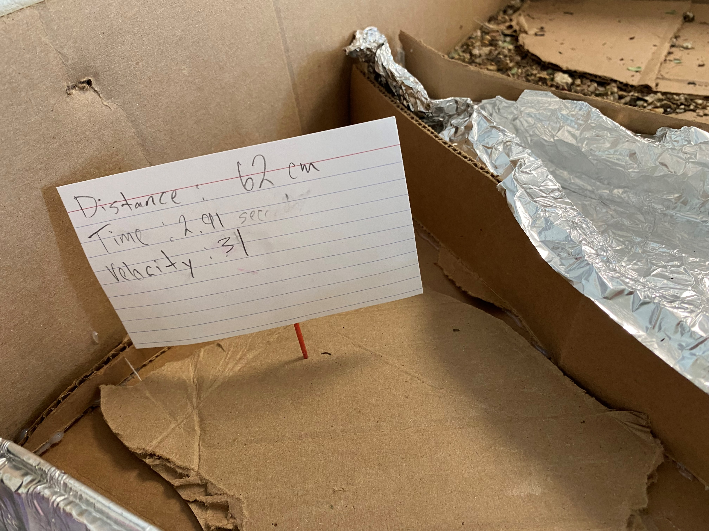

Slide 33
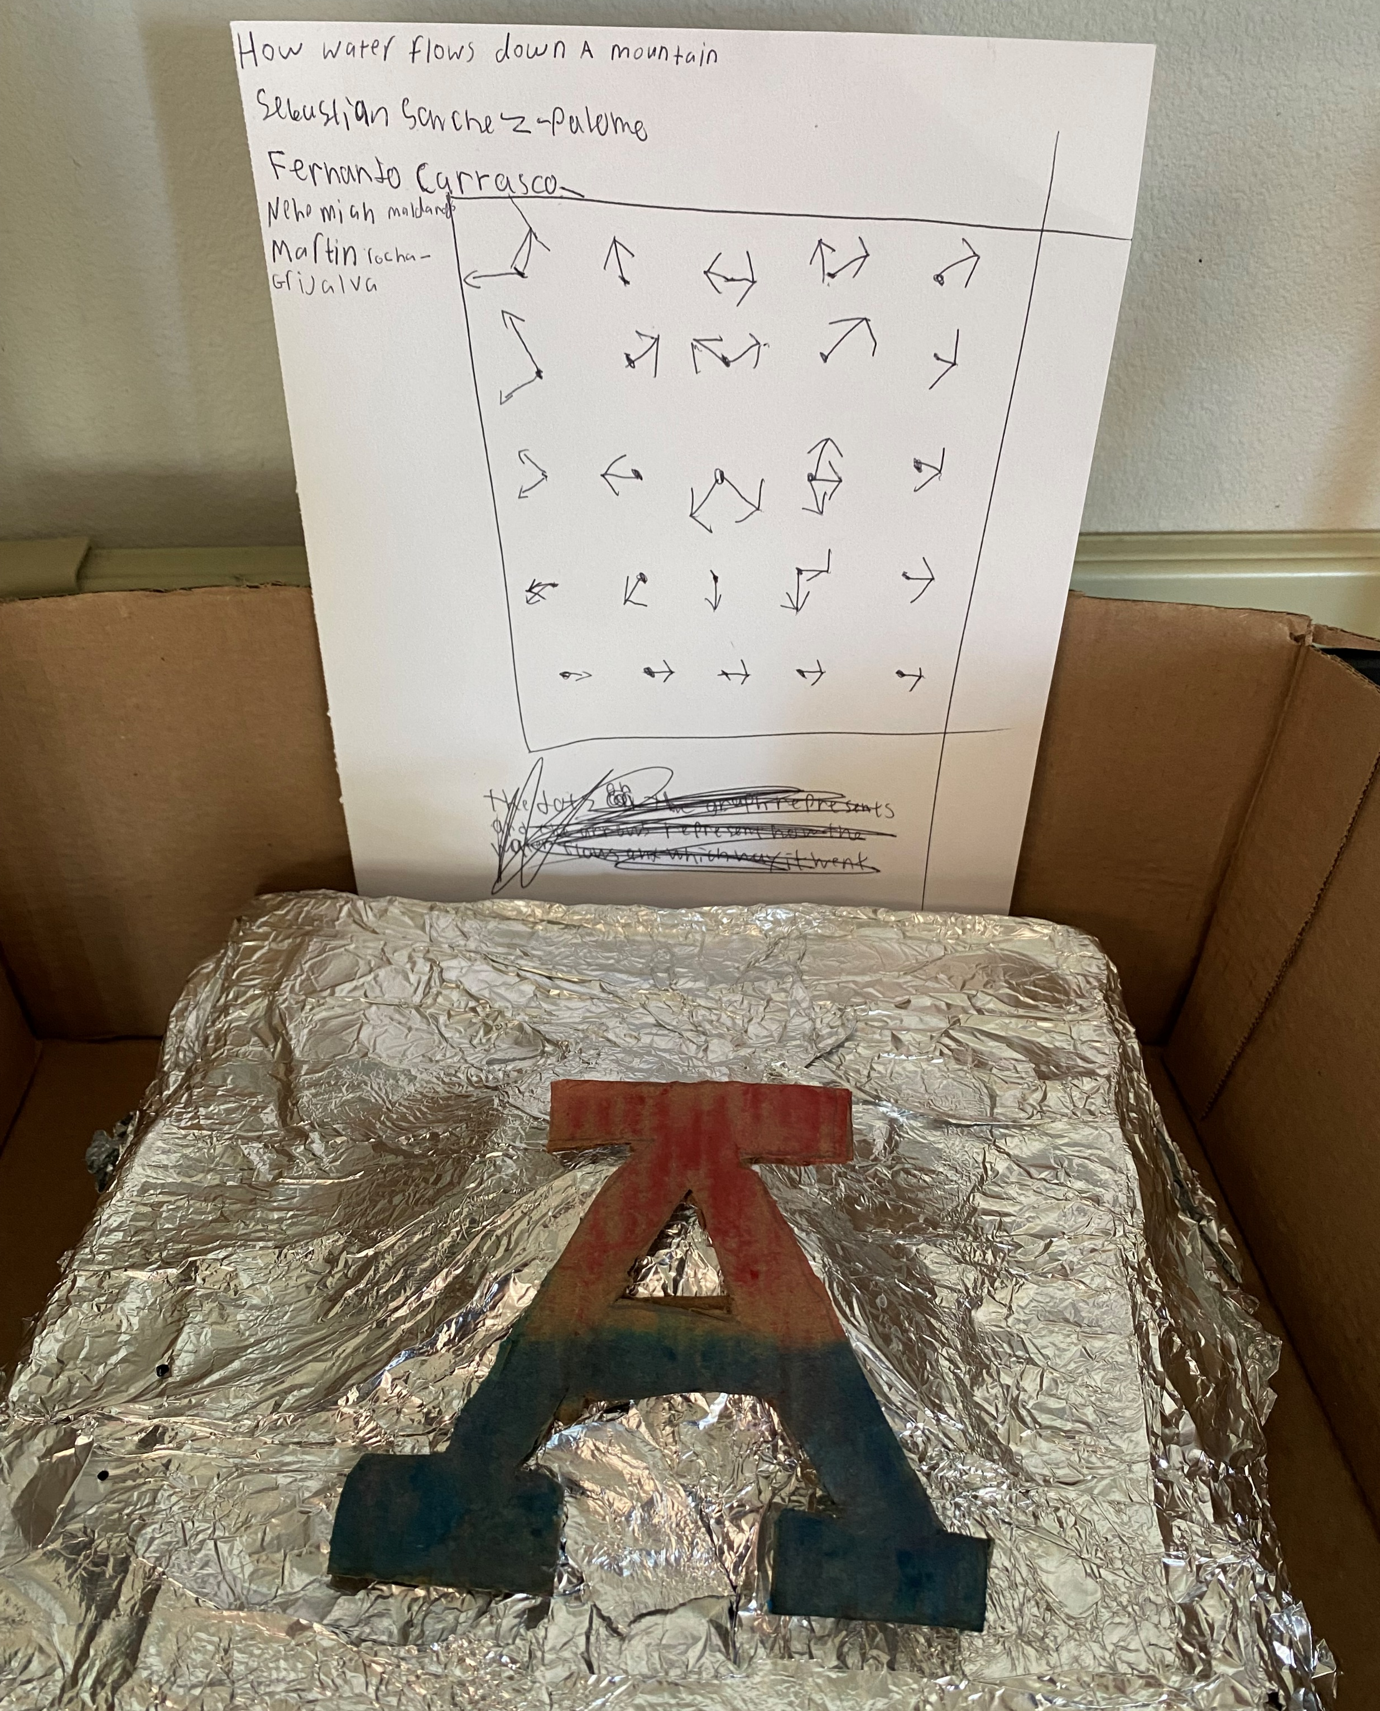

Slide 34
