Slide 1
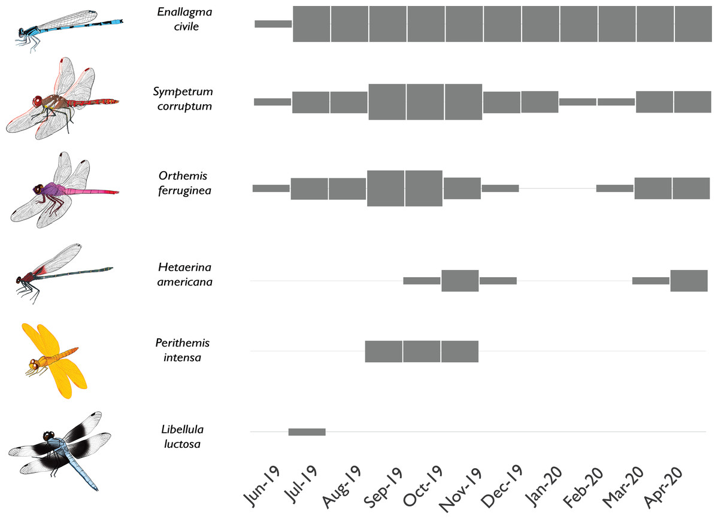
What do you notice/wonder?
What could each different row mean?
What could the thickness of the bars mean?

Slide 2
What new information did you learn?
Does this change any of your answers to the previous slide?

Slide 3
What do you notice now? What do you wonder?

Slide 4
Graph Caption: Phenology of selected Odonata in a newly-flowing reach of the Santa Cruz River.
What does phenology mean?

Slide 5
Graph Description:
Phenology plot illustrating the presence and abundance of different Odonata species through time in the newly flowing Heritage reach of the Santa Cruz River. Thin gray box = rare; medium gray box = uncommon but breeding; thick gray box = common and breeding. Some species rapidly colonized the new reach quickly and were abundant through the study (e.g., Enallagma civile) or were at least abundant during warmer weather (e.g., Sympetrum corruptum, Orthemis ferruginea). Other species took longer to colonize and had limited seasons of adult flight activity (e.g., Hetaerina americana, Perithemis intensa). Other species were vagrants that appeared once or twice but failed to establish populations (e.g., Libellula luctosa).

