Slide 1
How are Trees Important?

Slide 2
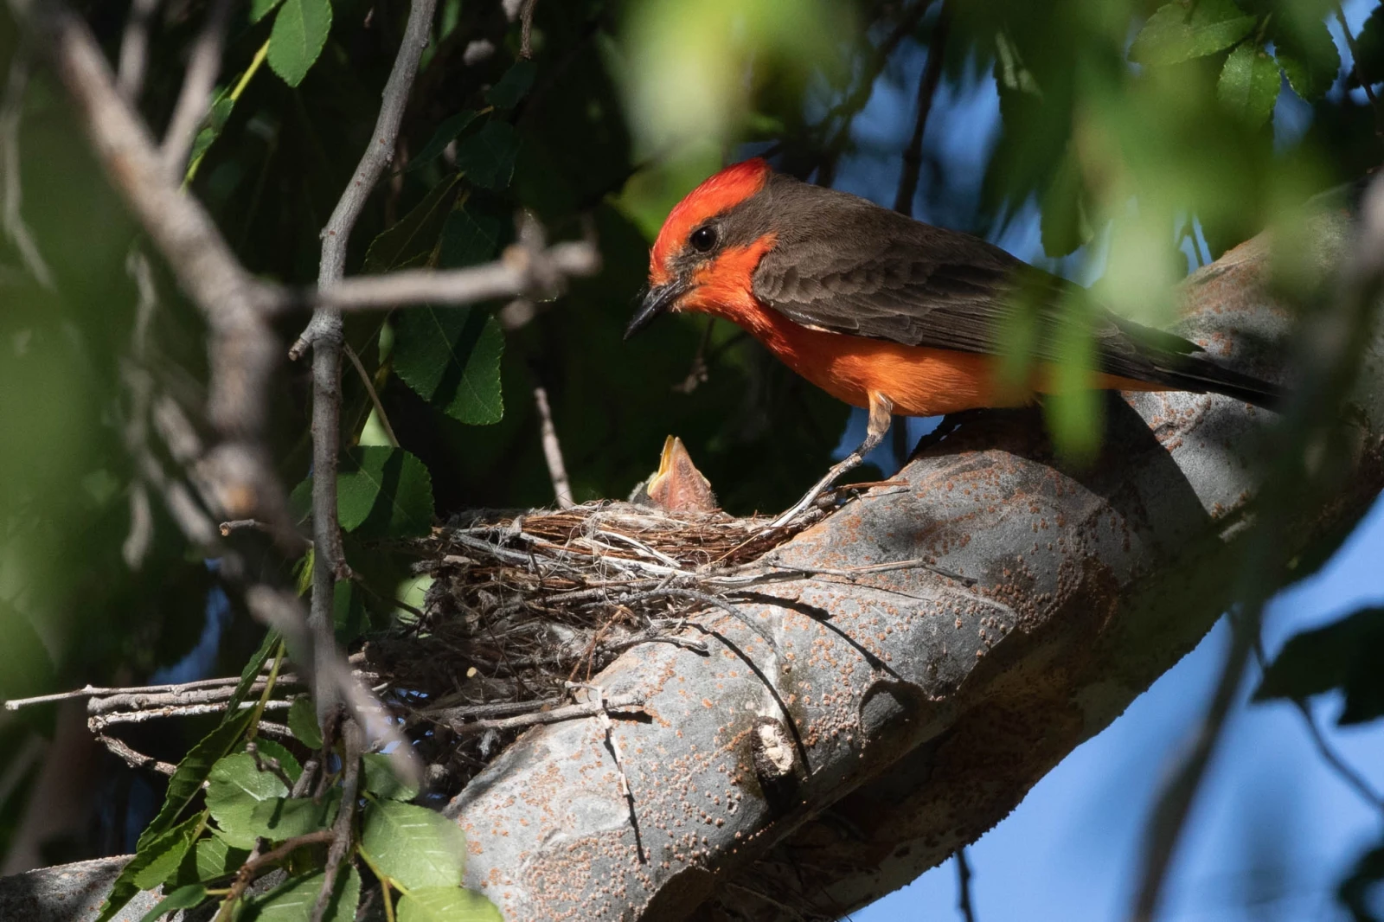
Ways that trees make a difference
Trees Provide Habitat for Wildlife
Notes:
Three main components of wildlife habitat: food, cover, and places to raise young, can all be provided by trees. Wherever trees are established, wildlife and other plants are sure to follow, ensuring a healthier and more biodiverse ecosystem.

Slide 3
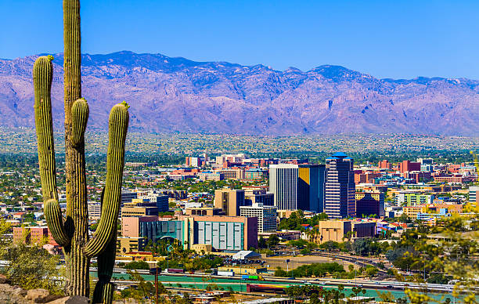
Ways that trees make a difference
2. Trees Cool Cities
Notes:
Trees contribute to urban cooling. Cities develop “heat islands” because dark roofs and pavement absorb solar energy and radiate it back to the atmosphere.

Slide 4
Ways that trees make a difference
3. Trees Reduce Energy Cost
Notes:
Urban tree canopy reduces the urban heat island effect and this shading from trees reduces energy demands and the need for air conditioning.

Slide 5
Ways that trees make a difference
4. Trees Can Boost Local Economies
Notes:
The presence of trees in neighborhoods can aid in economic development by increasing property values.

Slide 6
Ways that trees make a difference
5. Trees Improve Health
Notes:
Research demonstrates that exposure to trees has a relaxing effect on humans, reducing stress and imparting a sense of well-being.

Slide 7
Ways that trees make a difference
6. Trees Combat Climate Change
Notes:
One tree can sequester (or take in) more than one ton of carbon dioxide in its lifetime. Planting trees and preventing deforestation are key measures in reducing the human impact on global climate change.

Slide 8
Ways that trees make a difference
7. Trees Clean Air and Water
Notes:
Trees remove harmful pollution from the air and forested watersheds, and help clean our drinking water.

Slide 9
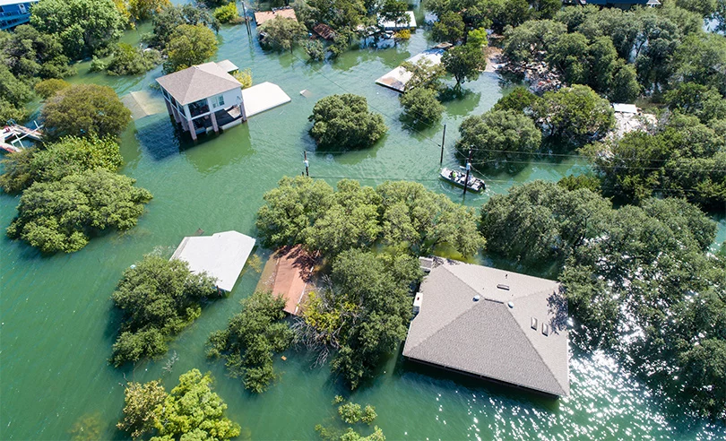
Ways that trees make a difference
8. Trees Reduce Flooding
Notes:
Trees lessen the force of storms and reduce the amount of runoff into sewers, streams and rivers, improving water quality and reducing flooding. How to calculate water flow: https://www.youtube.com/watch?v=W1lUdxE5BGU

Slide 10
Ways that trees make a difference
9. Trees Promote Community
Notes:
Trees can enhance a community’s sense of pride and ownership. Active involvement in tree planting programs leads to a stronger sense of community, environmental responsibility and ethics.

Slide 11
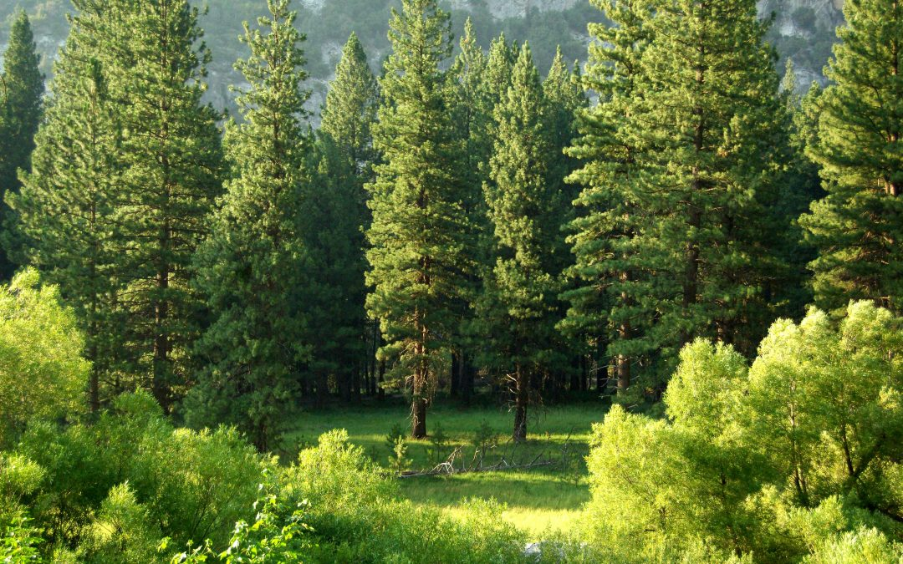
Ways that trees make a difference
10. Many more…?

Slide 12
Research Project
Max 4 people per group
Choose one of the the reasons to focus your research on
Talk about it with your group first
Is it testable? How would you test it?
Open student sheet on google classroom:
HOW ARE TREES IMPORTANT
Start brainstorming your ideas.

