Slide 1
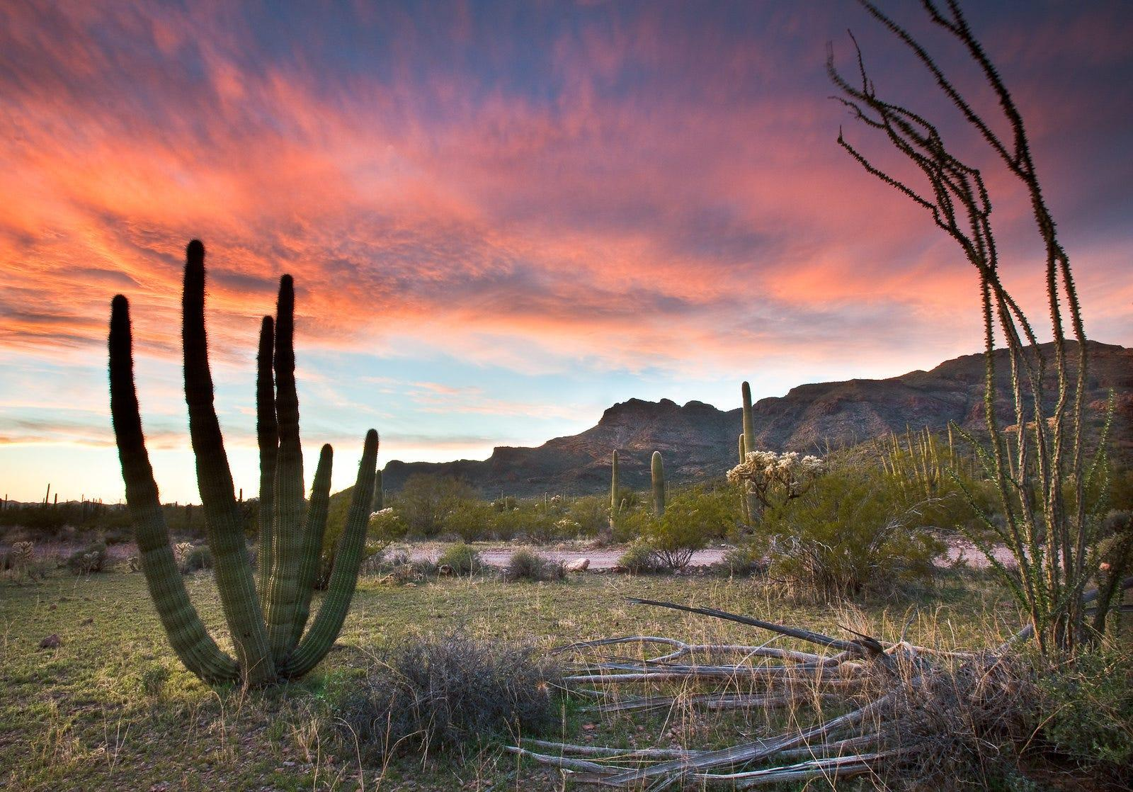
SCIENCE STORYTELLING
MANSFELD MAGNET MS
8TH GRADE SCIENCE

Slide 2
BELLWORK
Think of your favorite story (movie, book, video game, etc.). What do you like about it? What make it engaging?
Write an answer in your notebook, then share with your elbow buddy.

Slide 3
OBJECTIVES
I can think about different ways to tell stories and how storytelling can be helpful in communicating science ideas.
I can write and express myself to share something I care about with my community.
I can think about the relationship between humans and the natural world, and how humans can impact/change natural spaces.

Slide 4
WHAT MAKES A GOOD STORY?

Slide 5
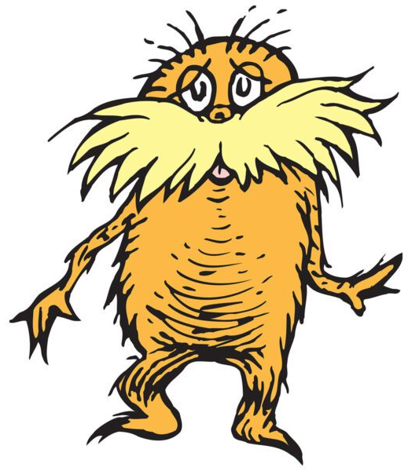
WHAT MAKES A GOOD CHILDREN’S STORY?

Slide 6
WHAT ARE SOME THINGS TO CONSIDER WHEN WRITING FOR KIDS?
Write your idea on a sticky note, then bring it up to the board.

Slide 7
CHILDREN’S BOOKS AS TOOLS
Children’s books can be an introduction for kiddos to big topics
They can help us learn the basics of new things

Slide 8
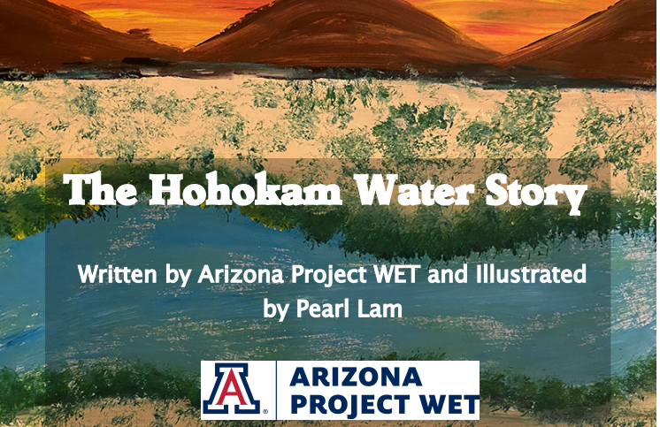
HOHOKAM WATER STORY
We will read an example as a class
As we read think about the following questions:
1. What do you wonder about the relationship that Native Americans, such as the Hohokam, had with water?
2. In what ways, did Native Americans use science to improve their lives?

Slide 9
HOHOKAM WATER STORY
Work in groups to answer the following questions to check your understanding of our reading:
1. What do you wonder about the relationship that Native Americans, such as the Hohokam, had with water?
2. In what ways, did Native Americans use science to improve their lives?
3. How did Native Amercans apply engineering practices to solve problems?
4. Why did the level of surface water in the Santa Cruz River go down as the population of Tucson grew?
5. What is the relationship between the river and groundwater?
6. From your perspective, what is the significance of having water in the Santa Cruz River in downtown Tucson?
Notes:
They would upload answers to our Canvas page

Slide 10
WHAT MAKES A GOOD CHILDREN’S STORY?
Notes:
Day 2

Slide 11
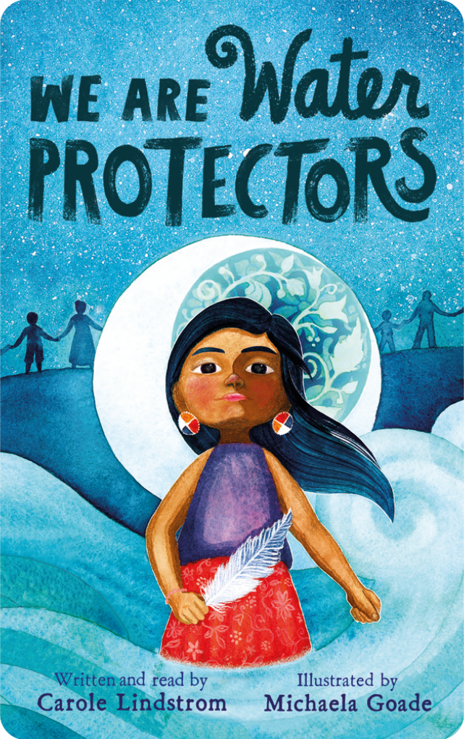
WE ARE WATER PROTECTORS
https://www.youtube.com/watch?v=0yLtBjVG0No

Slide 12
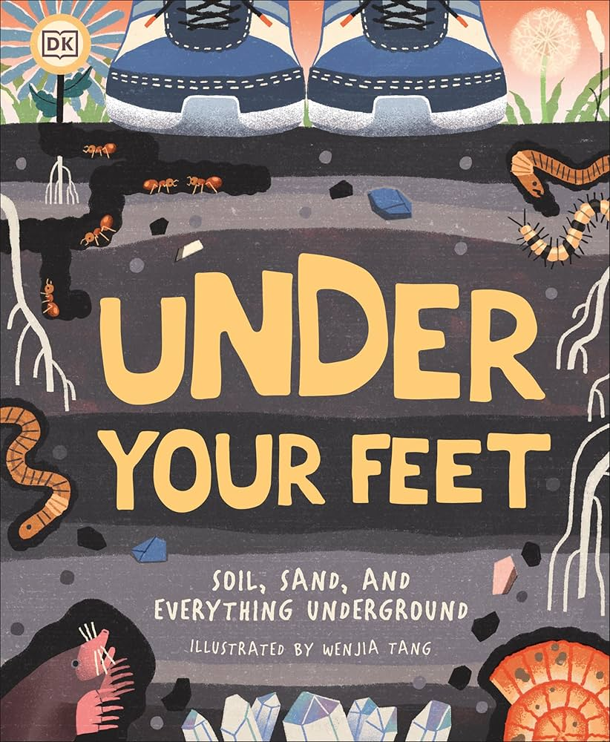
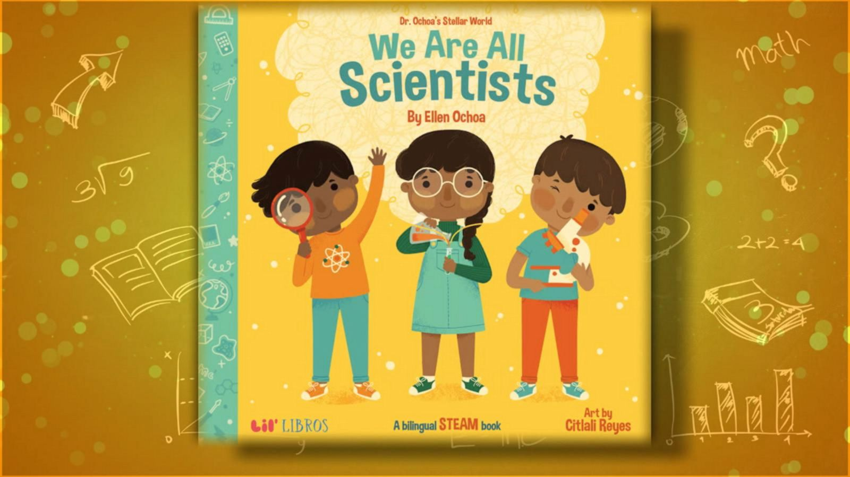
SCIENCE PICTURE BOOK GALLERY WALK
Explore the picture books at the lab tables around you. Answer the questions by yourself or with a partner to guide your exploration.

Slide 13
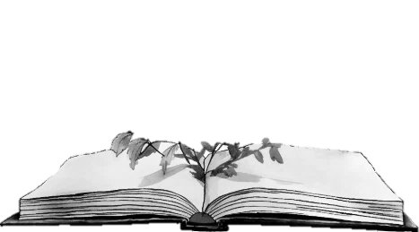
YOUR TASK

Slide 15
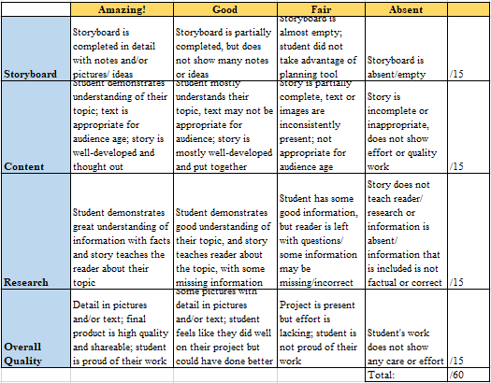
HOW I WILL GRADE YOUR WORK

Slide 16
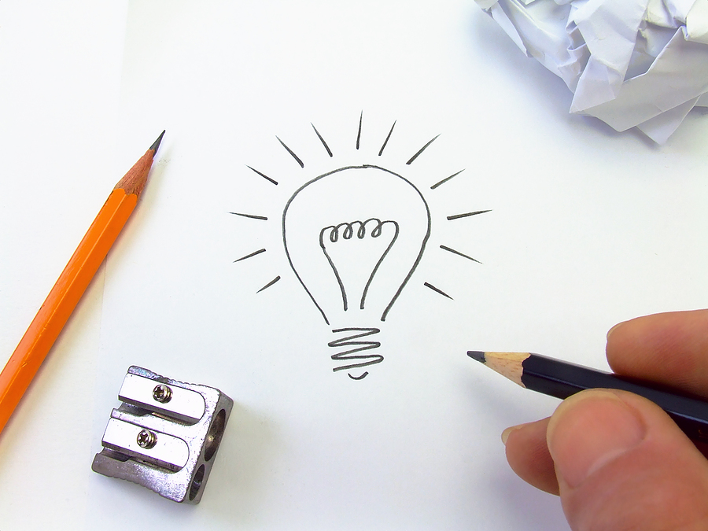
WHAT IS A STORYBOARD?

Slide 17
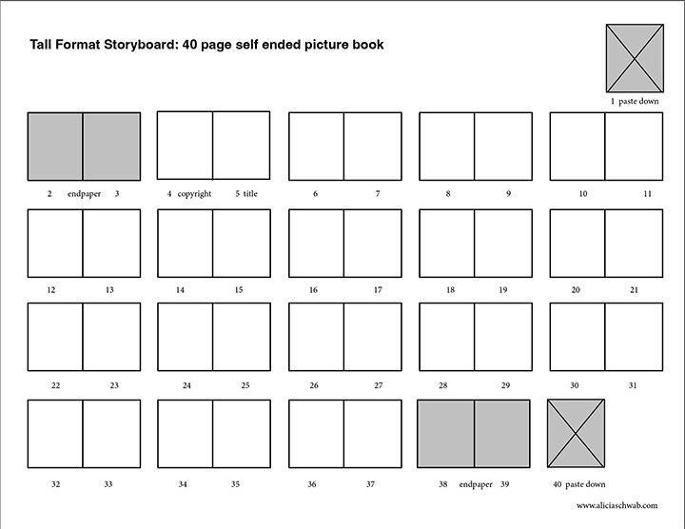

Slide 18
YOUR PLAN TODAY
Start working on your storyboard
What pages will have pictures/ text/ both?
What information will you include?
What kind of story will you tell?
Remember, there are many different ways to tell a story!

Slide 19
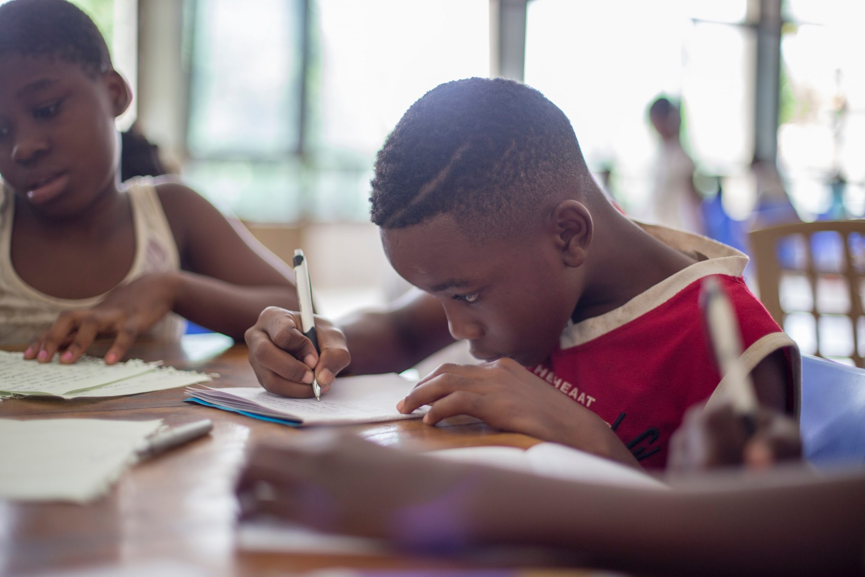
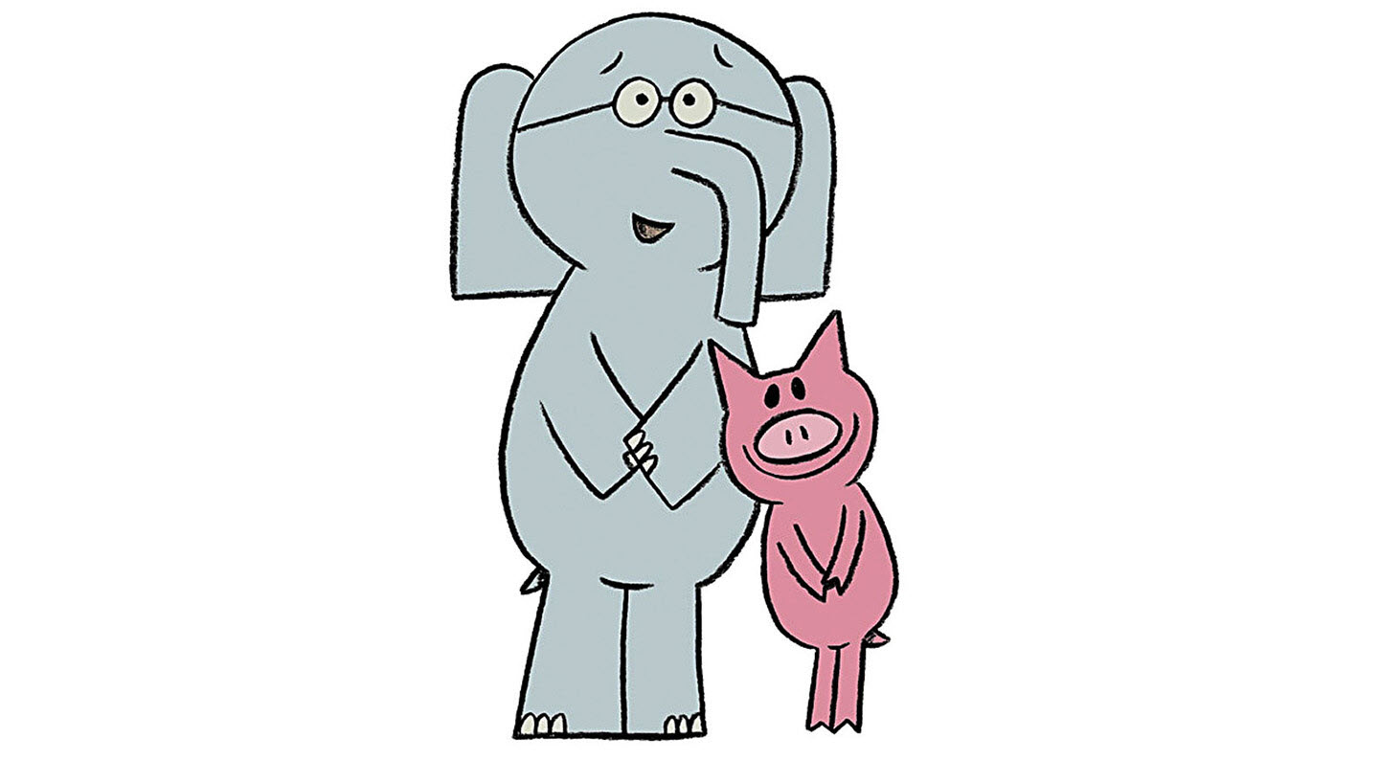
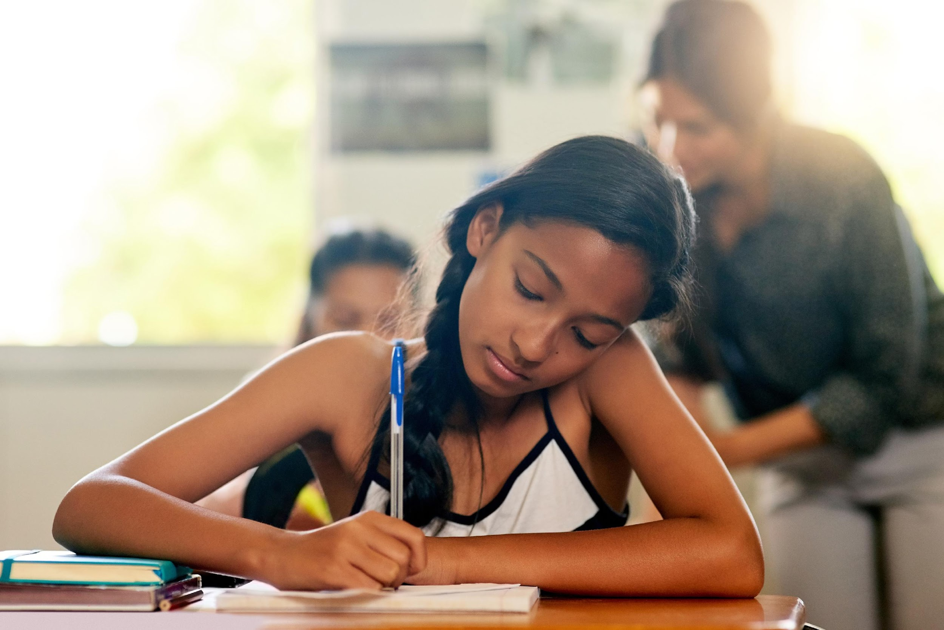
WORK TIME
ASK ME ANY QUESTIONS YOU HAVE!

Slide 20
WORK TIME
ASK ME ANY QUESTIONS YOU HAVE!

Slide 21
WORK TIME
ASK ME ANY QUESTIONS YOU HAVE!

Slide 22
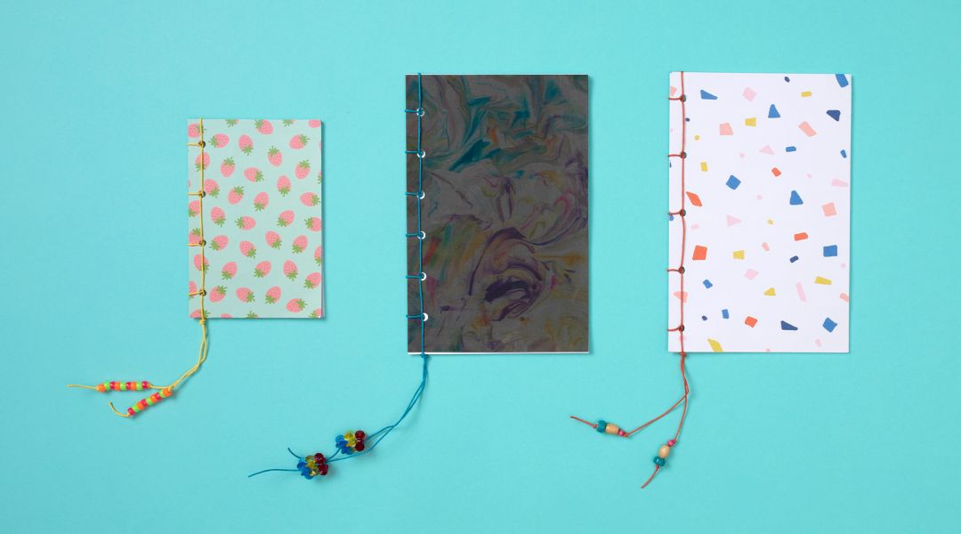
BINDING YOUR BOOK
Notes:
Will get power point from school garden workshop to put in on this slide– they have good directions

