Slide 1
Objective
Student will be able to design an ecosystem, plan a procedure to quantify ecosystem health over time, and defend a claim regarding the health of the ecosystem.
Purpose
Bring field experiences to the classroom
Students design and conduct experiment
Engineering + design in biology
Standards Engaged
HS.E1U1.12: Develop and use models of the Earth that explains the role of energy and matter in Earth’s constantly changing internal and external systems (geosphere, hydrosphere, atmosphere, biosphere).
HS.L2U1.19: Develop and use models that show how changes in the transfer of matter and energy within an ecosystem and interactions between species may affect organisms and their environment.

Slide 2
Project overview
Design Ecosystem (3 weeks) | Plan Investigations (concurrent with Design Ecosystem) | Collect + analyze data (9 weeks)
Benchmarks Using iNaturalist, identify at least one plant that you would like to house in your artificial ecosystem Using the iNaturalist database, document the existence of your plant on the Santa Cruz River Understand the nitrogen cycle and how it applies to agriculture and aquaponics Constructuct an artificial riparian ecosystem using provided instructions. | Benchmarks Design a plan to quantitatively measure the health of the artificial riparian ecosystem. | Benchmarks Measure ecosystem health on a weekly basis. Synthesize a report detailing the construction and monitoring of the artificial riparian ecosystem.

Slide 3
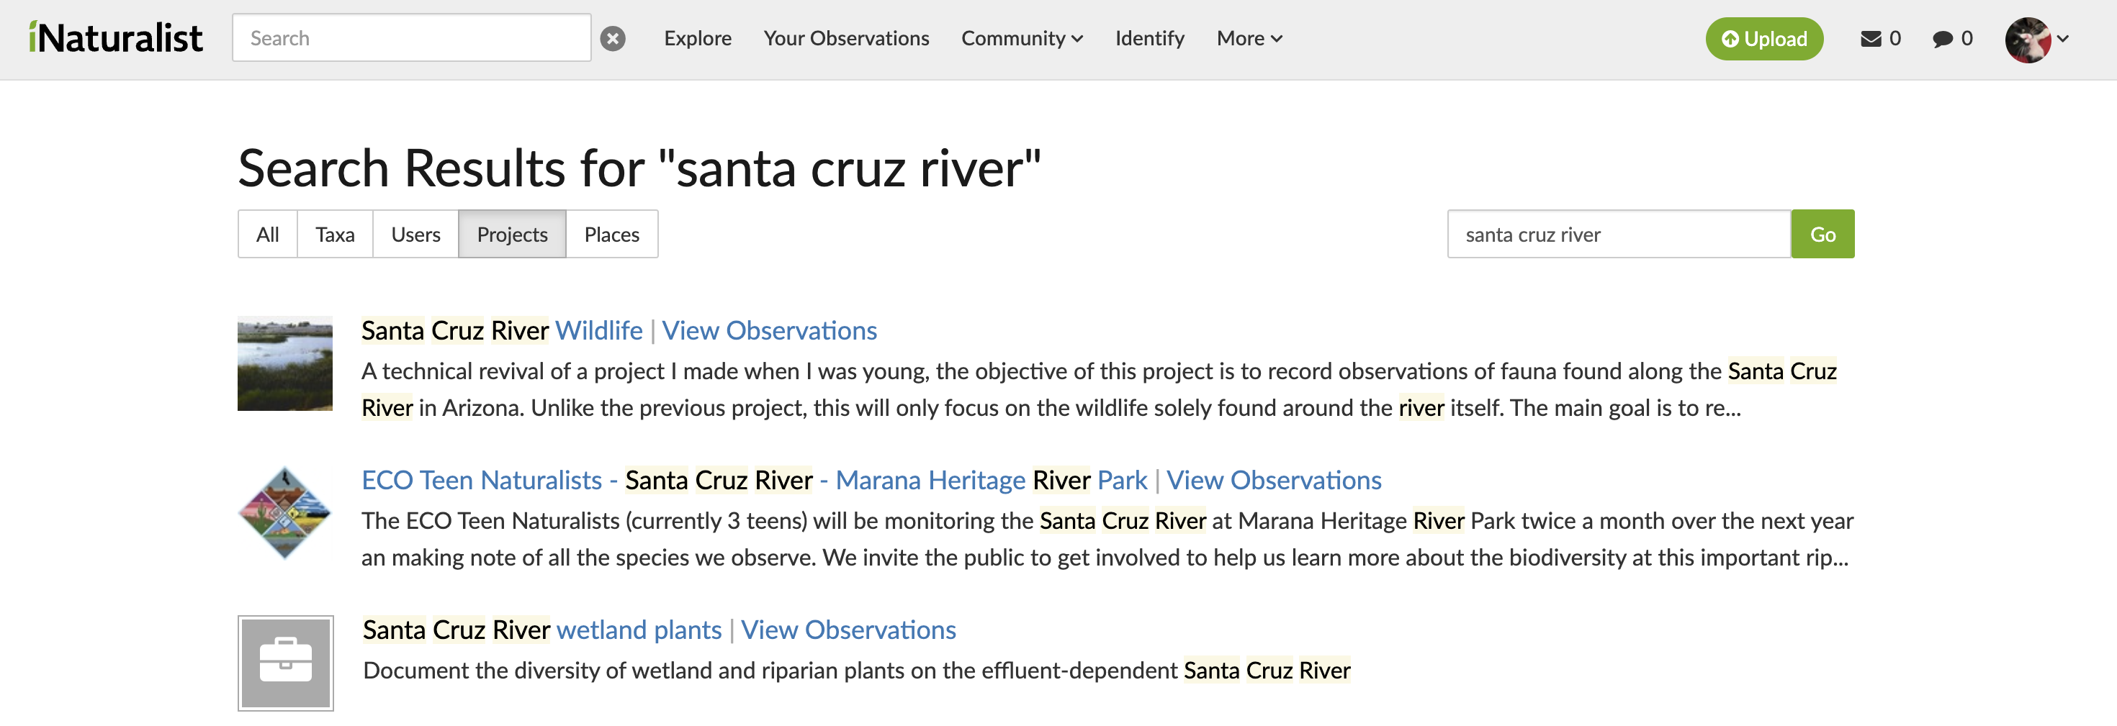
Using iNaturalist by project
On the web browser version of iNaturalist, search for ”Santa Cruz River wetland plants” under the ”Projects” tab and choose the above project.

Slide 4
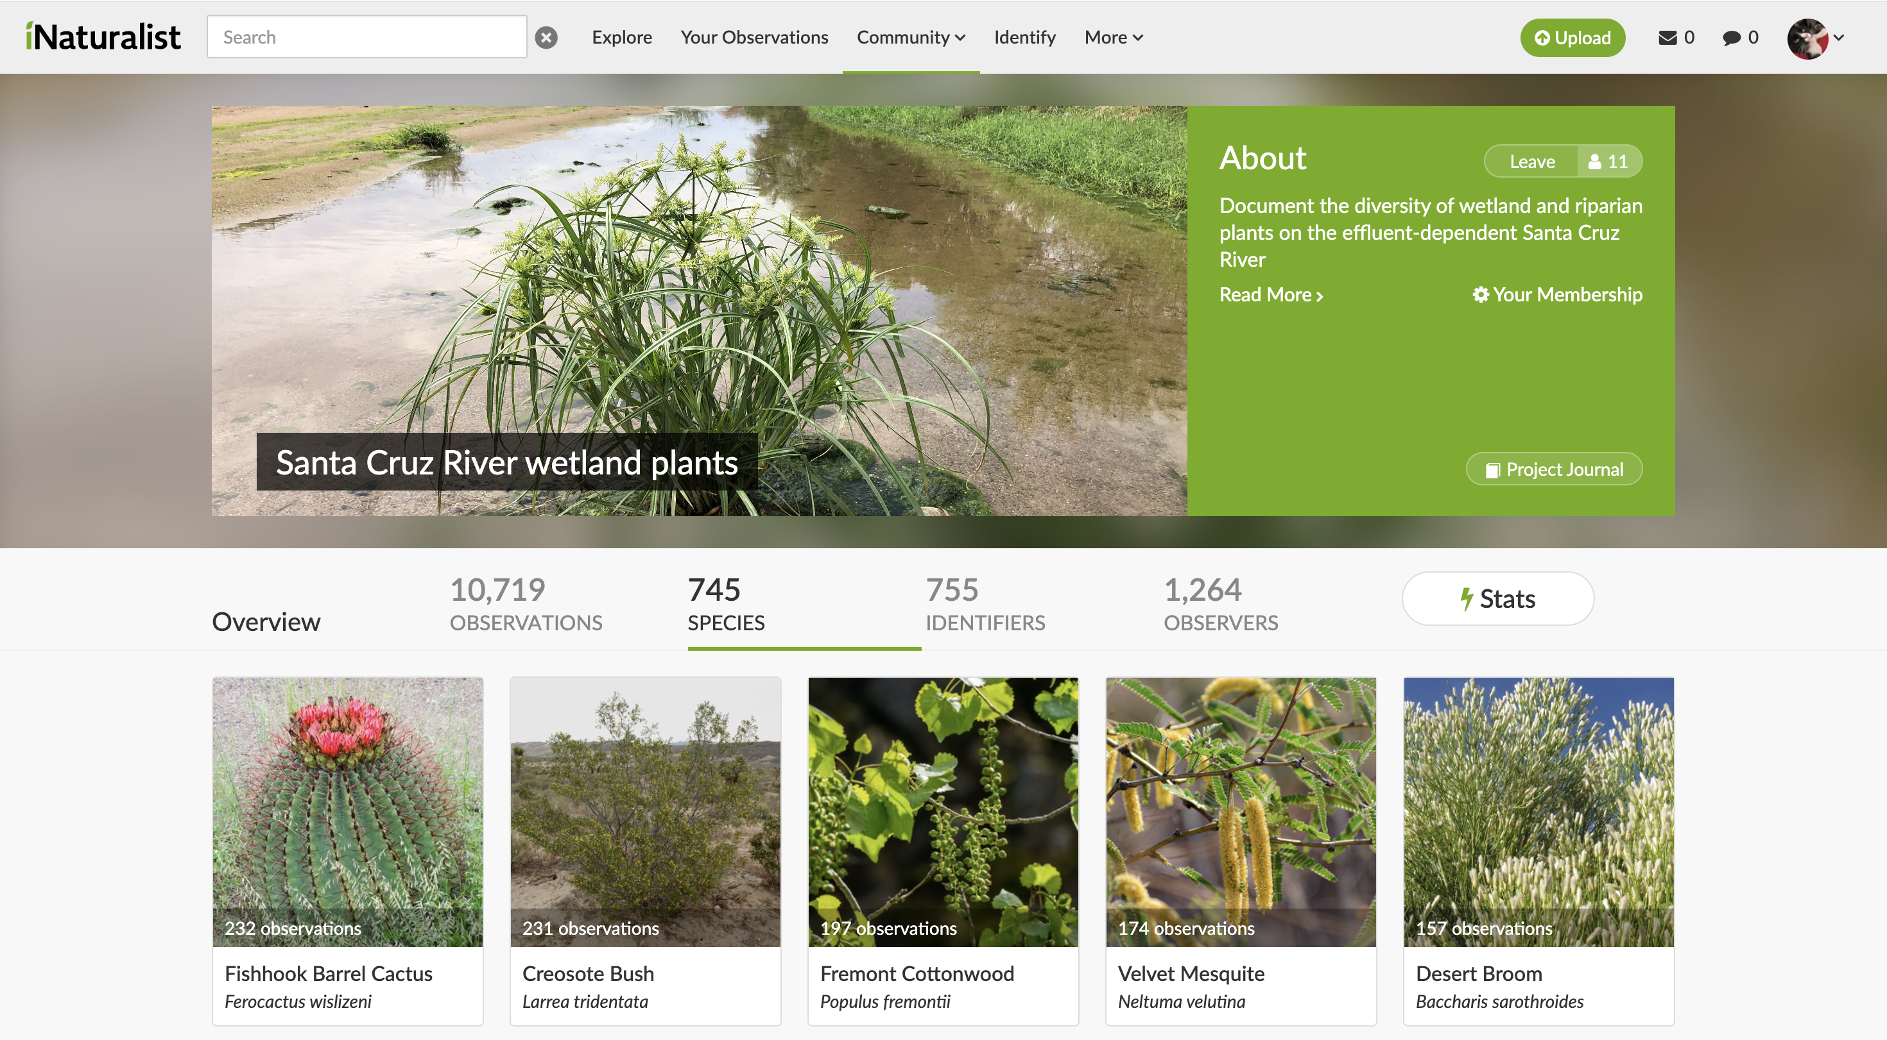
Using iNaturalist by project
On the project, search through species to choose an organism to house in your ecosystem.

Slide 5
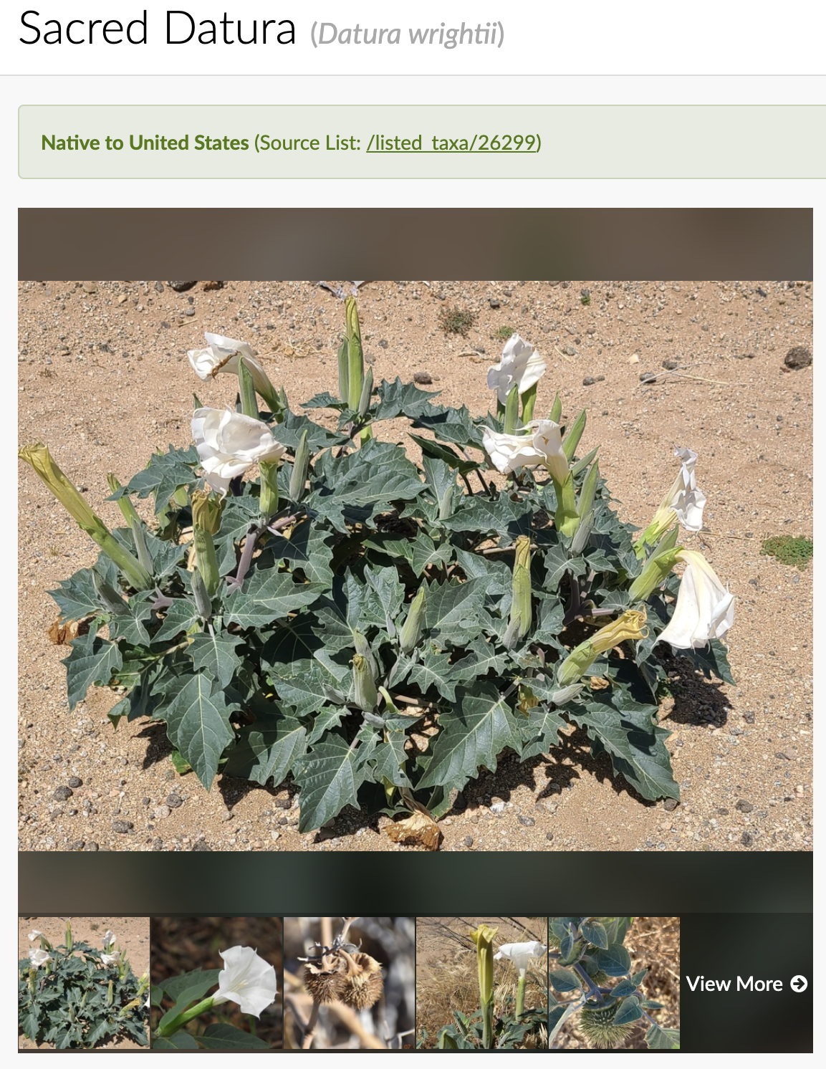
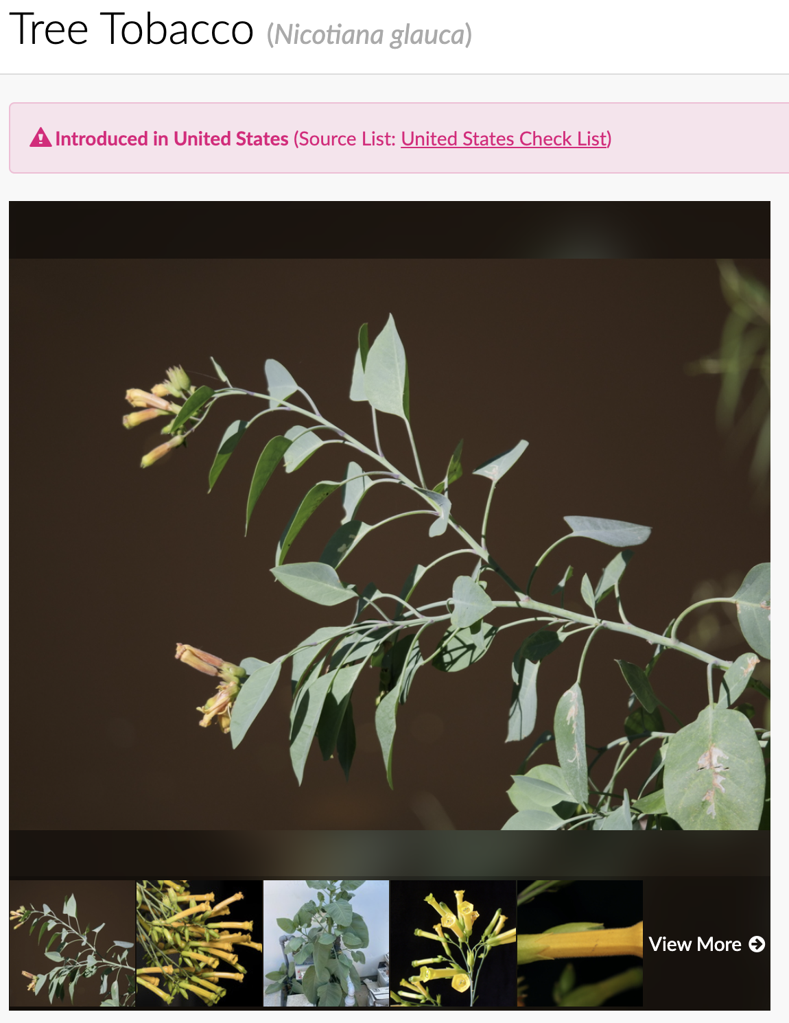


Using iNaturalist by project
Ensure that the species that you choose is a native species. You can tell by clicking on a taxa and inspecting the banner above the image.

Slide 6
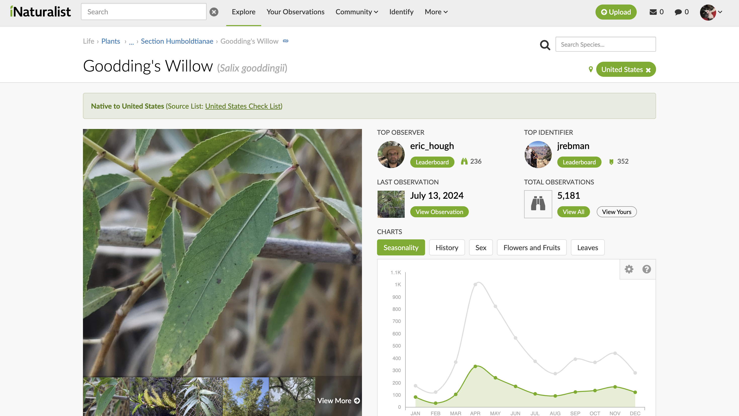
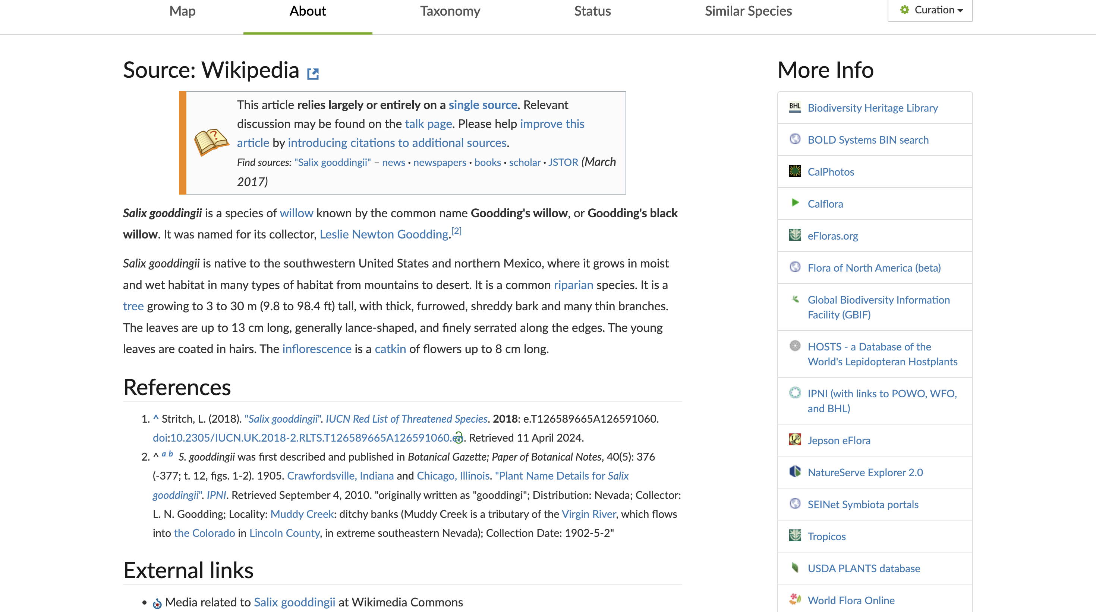
Using iNaturalist by project
Ensure that the species that you choose is a riparian species. You can tell by clicking on the taxa, clicking on “about”, and inspecting whether the plant is a riparian species or not.
https://www.nrcs.usda.gov/plantmaterials/azpmstn7363.pdf
https://awcs.azgfd.com/chapter-7-habitat-profiles/aquatic-and-riparian-ecosystem-group#:~:text=Common%20tree%20species%20in%20riparian,found%20in%20the%20riparian%20zone.
Alternatively, consider using certifiable sources such as the links above from the National Resources Conservation Service or the Arizona Game and Fish Department.

Slide 7
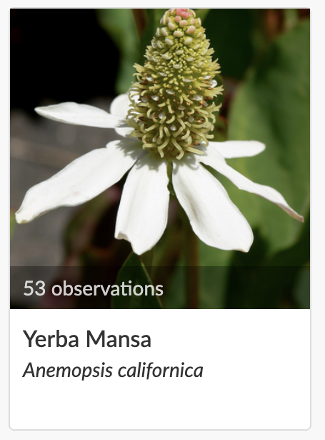
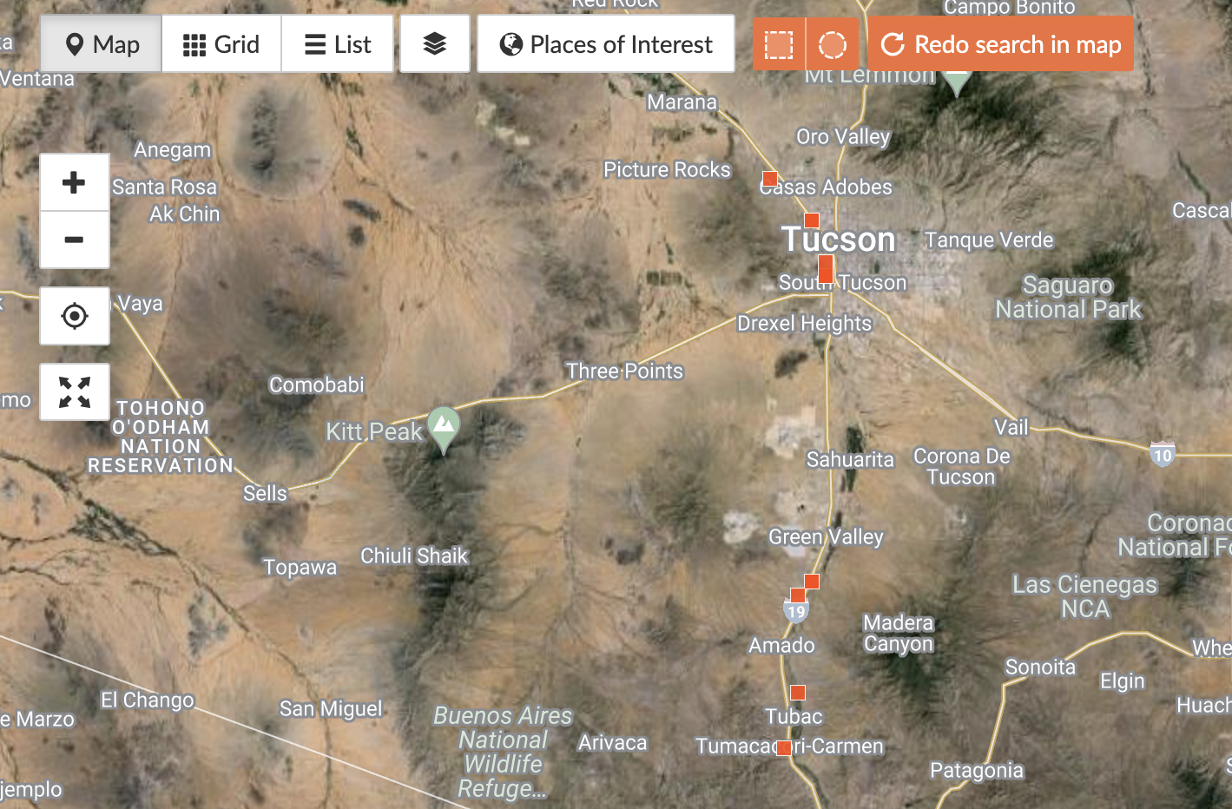
Using iNaturalist to document taxa location
To document the geotagged observations of a species, click the ”# observations” banner. This will take you to a map of the observations.
Make sure that you save an image of the range of your riparian species for your report.

Slide 8
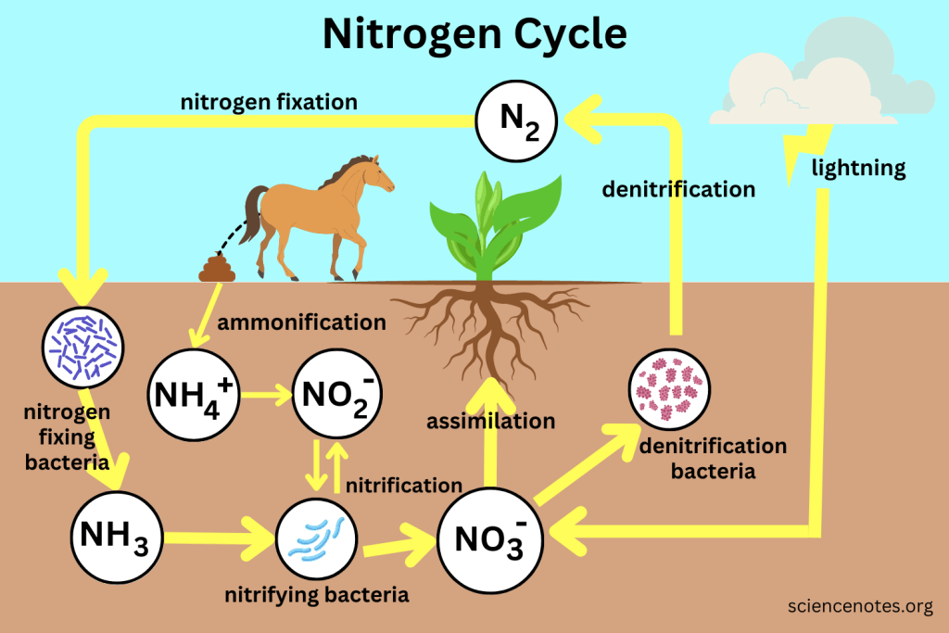
The nitrogen cycle

Slide 9
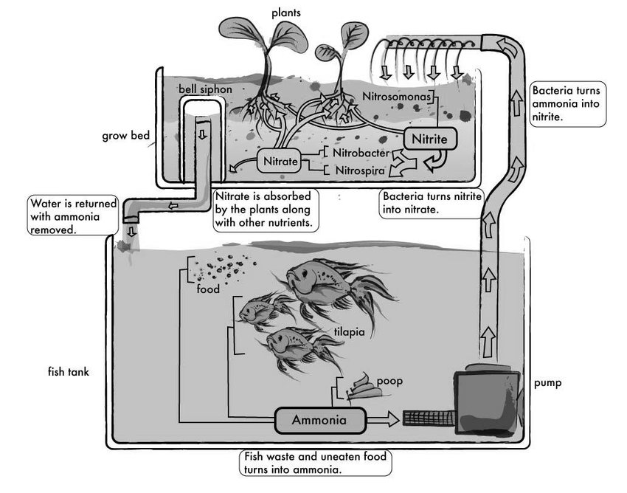
The nitrogen cycle and aquaponics
The Nitrogen cycle in an aquaponic system. Adapted from TilapiaHouse.com, by Tilapia House, 2012, Retrieved from http://tilapiahouse.com/Aquaponics_Water.html. Copyright 2012 by Tilapia House

Slide 10
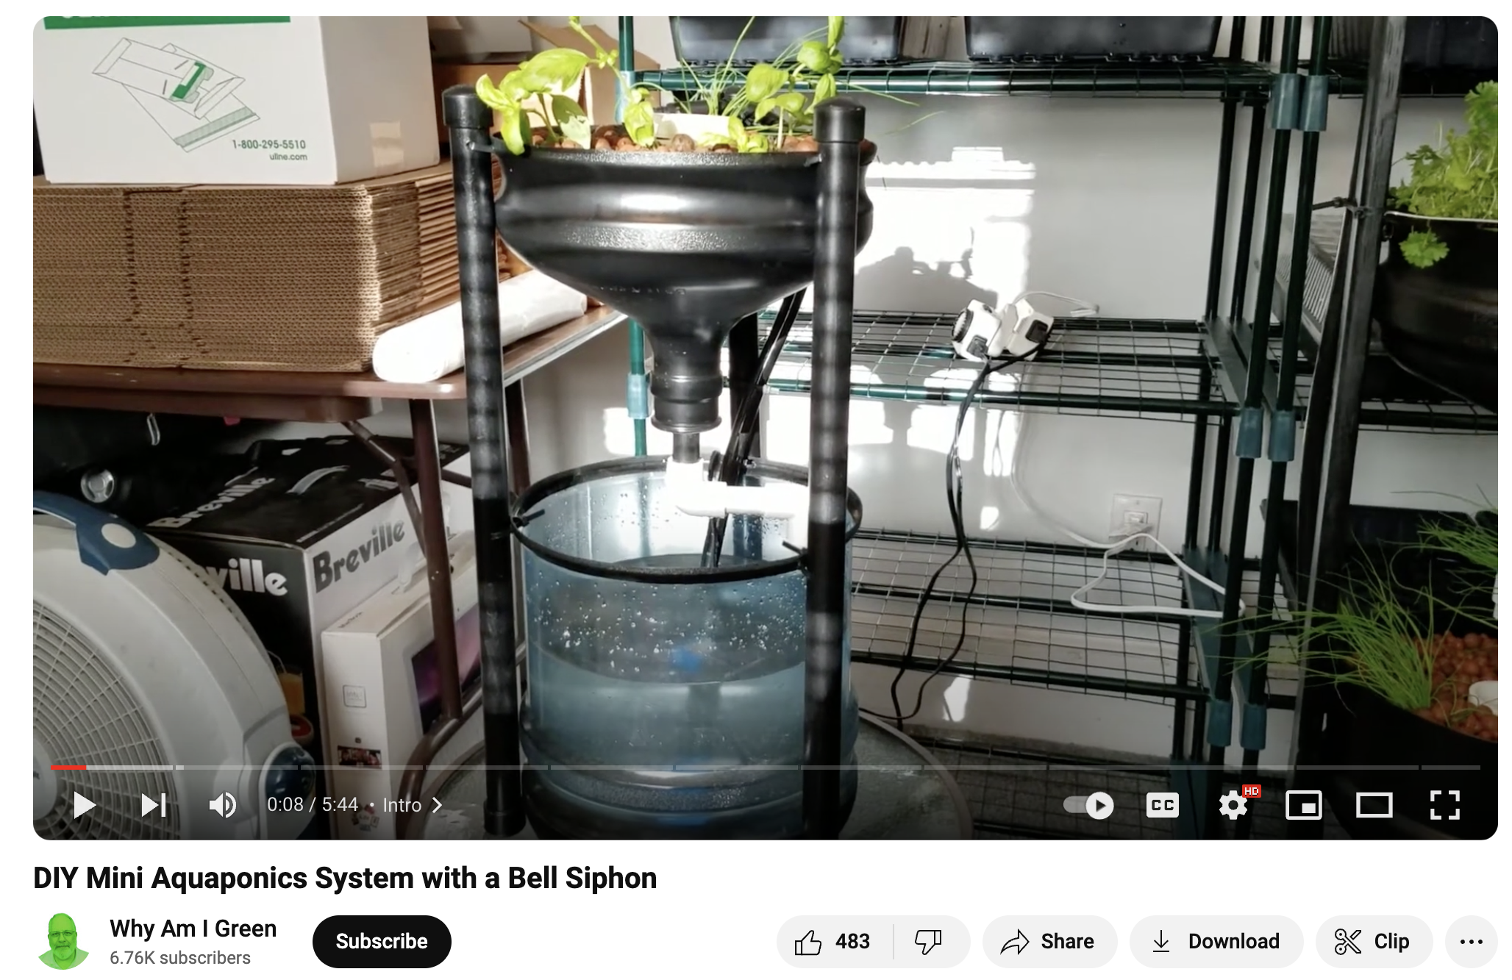
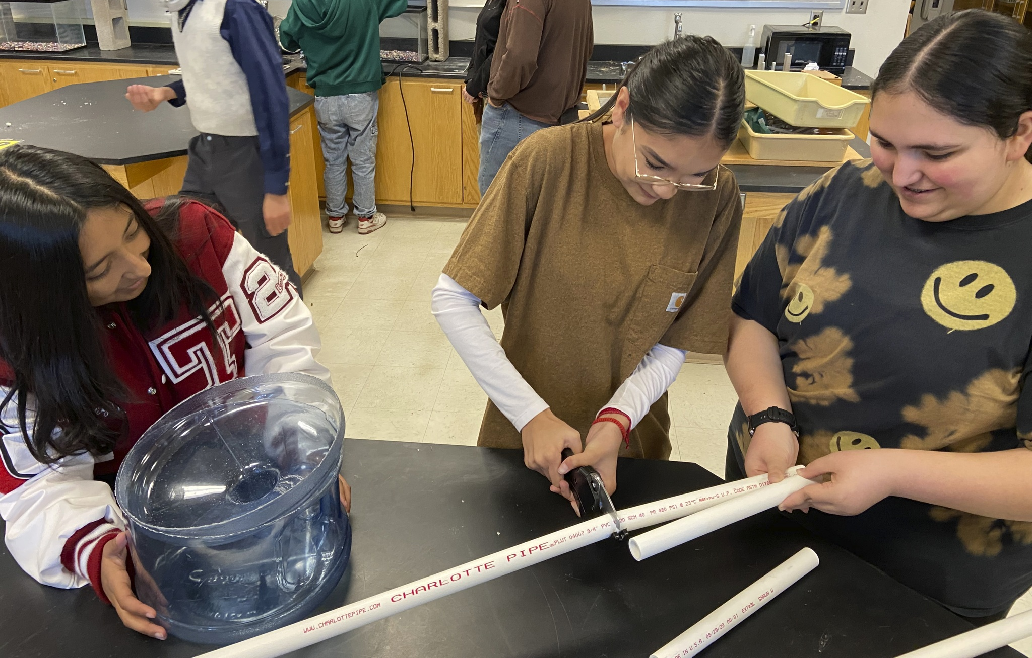
Building ecosystems from recycled materials
Why?
Recycled materials = sustainable
Materials are inexpensive
Low tool requirement
Design is age appropriate for 9-12 grade
Design inspiration
(see here)

Slide 11
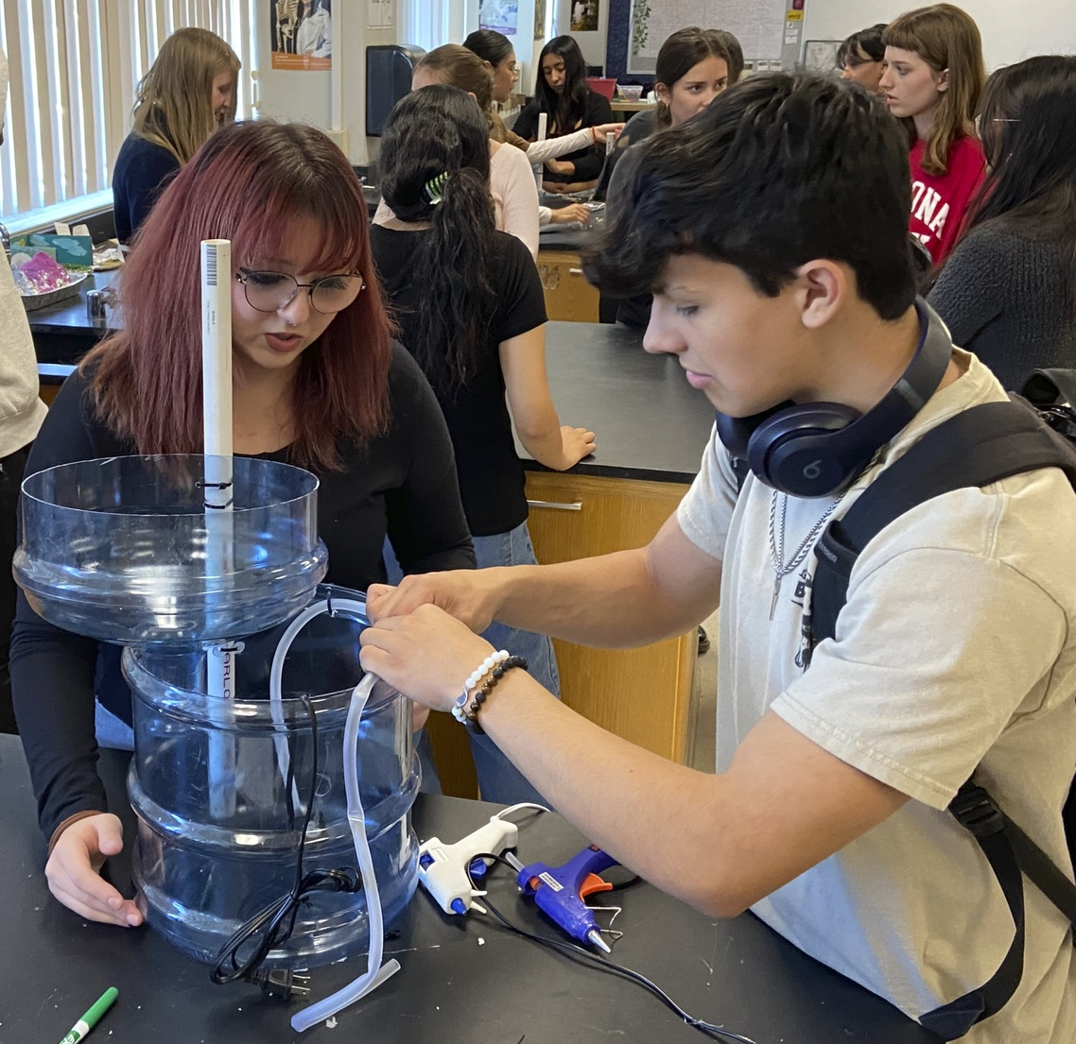
Ecosystem materials and tools
Materials
3 or 5 gallon water jug (qty. 1)
1” D x 18” L PVC pipe (qty. 3)
2” D x 12” L PVC pipe (qty. 1)
8” L zip tie (qty. 6)
Pulaco 95 GPH 5W Mini Submersible Water Pump (qty. 1: link)
1/3” D x 24” L silicone tubing (qty. 1)
2 lbs hydroponic clay pebbles
Freshwater nitrifying bacteria quick start (qty. 1)
Tools
Hand saw
Drill with ~3/16” drill bit
PVC pipe cutter
Hot glue gun

Slide 12
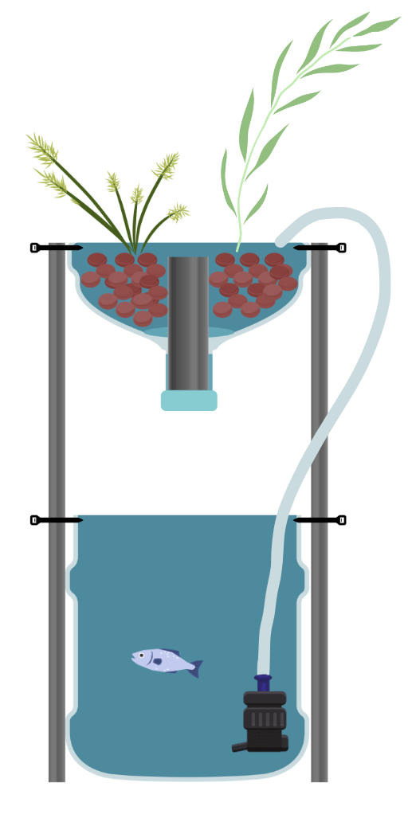
Ecosystem design
Procedure
Saw the gallon jug is sawed in half. Flip the top and stack on bottom.
Cut 1” diameter PVC into 3 x 18” segments with PVC cutter. Drill one zip tie-sized hole at the top of each segment and another hole X” from the other end (where X is the height of the bottom half of the gallon jug).
Schematic 1

Slide 13
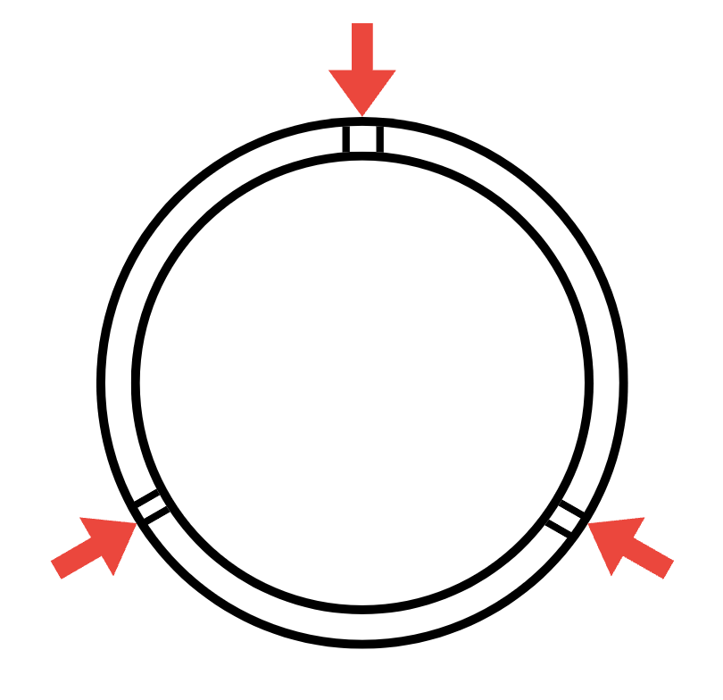
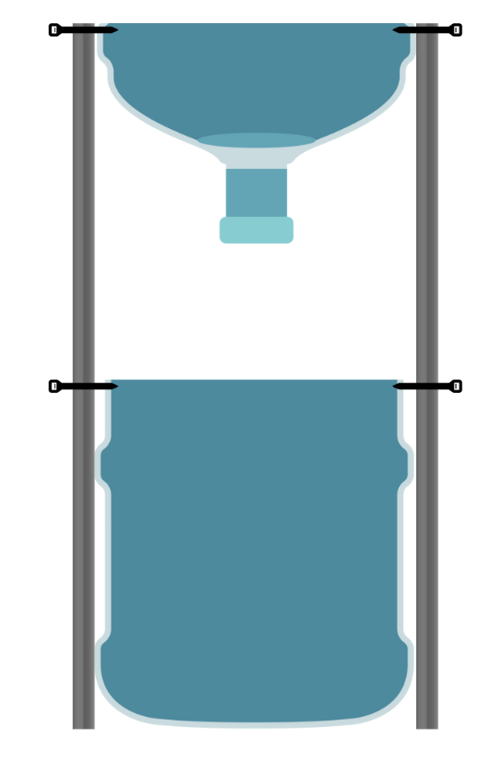
Ecosystem design
Procedure
Drill three equidistant pairs of holes at the cut side of the top and bottom halves of the gallon jug (as shown in schematic 2).
Thread zip ties through each pair of holes on the bottom half of the gallon jug and fix each 18” segment to each pair by the holes midway through the segment.
Thread zip ties through each pair of holes on the top half of the gallon jug and fix each 18” segment to each pair by the holes at the top of each segment. The ecosystem should be freestanding and appear like schematic 3 (third PVC segment not shown).
Schematic 2
Schematic 3

Slide 14
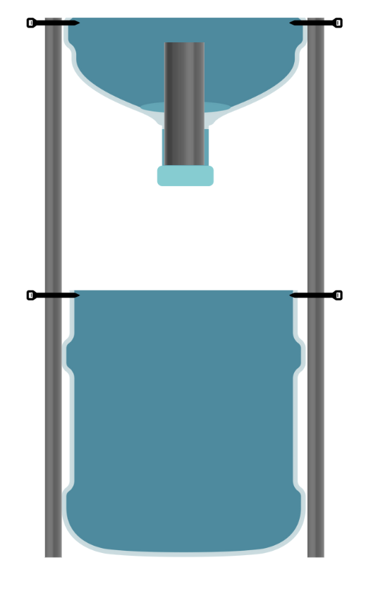
Ecosystem design
Procedure
Cut the 2” diameter PVC such that it sits snuggly against the ‘funnel’ end of the top half of the gallon jug and that its height is ~1” shorter than the lip of the top half of the gallon jug. This is to ensure that there is no overflow.
Fix the 2” diameter PVC by filling the gaps between the PVC and ‘funnel’ end of the jug with hot glue. Be sure that this is water-tight!
Schematic 4

Slide 15
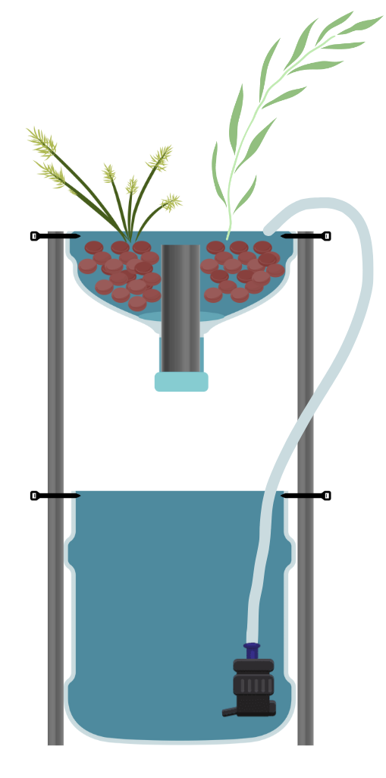
Ecosystem design
Procedure
Add clay media to the top reservoir. Leave enough room to add plants.
Add fish pump and cut silicone tubing to appropriate length and fix to fish pump. The other end of the tubing should be buried in the clay media. You may wish to fix this with a zip tie
Transfer plants to clay media. Depending on the sensitivity of your plants, you may wish to rinse as much soil from the roots prior to transfer. Plug in fish pump and let the water cycle. Water may become turbid/tannic. Do not fret, this will subside over time or once you add nitrifying bacteria quick start.
Schematic 5

Slide 16
Ecosystem design
Procedure
Once the turbidity of the bottom reservoir has subsided, you may add any aquatic life that you see fit. I have had success with small fish, various snails and even some other macroinvertebrates (Coroxidae, Hydrophilidae).
Be sure to monitor the water levels of your ecosystem as it is getting established to prevent an overflow.
Regularly topping off the bottom reservoir with water (tap is acceptable) is necessary.
Schematic 1

Slide 17
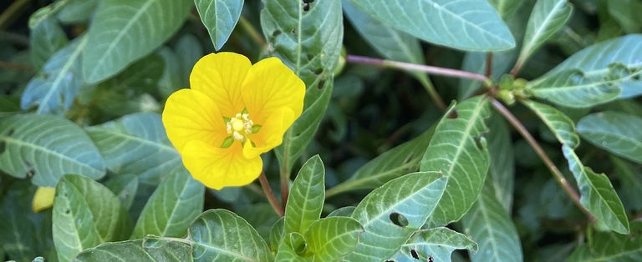
Sourcing plant and aquatic life
Plants
Salix goodingii (propagated from cutting, sourced from Santa Cruz River)
Persicaria lapathifolia (propagated from cutting, sourced from Santa Cruz River)
Passiflora arida (propagated from seed, sourced from landscape plant at my house)
Mirabilis longiflora (propagated from seed, sourced from Swallowtail Garden Seeds)
Cyperus eragrostis (propagated from seed, sourced from seed collected at Santa Cruz River)
Nasturtium officinale (harvested floating plant, sourced from Santa Cruz River)
Anemopsis californica (propagated from cutting, sourced from Santa Cruz River)
*List is not exhaustive of what can be grown in these ecosystems*
Aquatic life
I am fortunate enough to have many colleagues with successful aquariums in their classrooms. They offered guppies from their tanks that were overstocked. Snails and other macroinvertebrates came from soil and water transferred from the Santa Cruz River.
Ludwigia peploides Floating Primrose-Willow

Slide 18

Planning investigations
“HEALTH”
ECOSYSTEM HEALTH
Measurement vs. time
# leaves
# snails
pH
Nitrates
Etc.
mental
physical
cardiovascular
chemical
gastrointestinal
renal
biotic

Slide 19
Planning investigations
Date | [measurement 1] | [measurement 2] | [measurement 3]
*Sample template for collecting data*

Slide 20
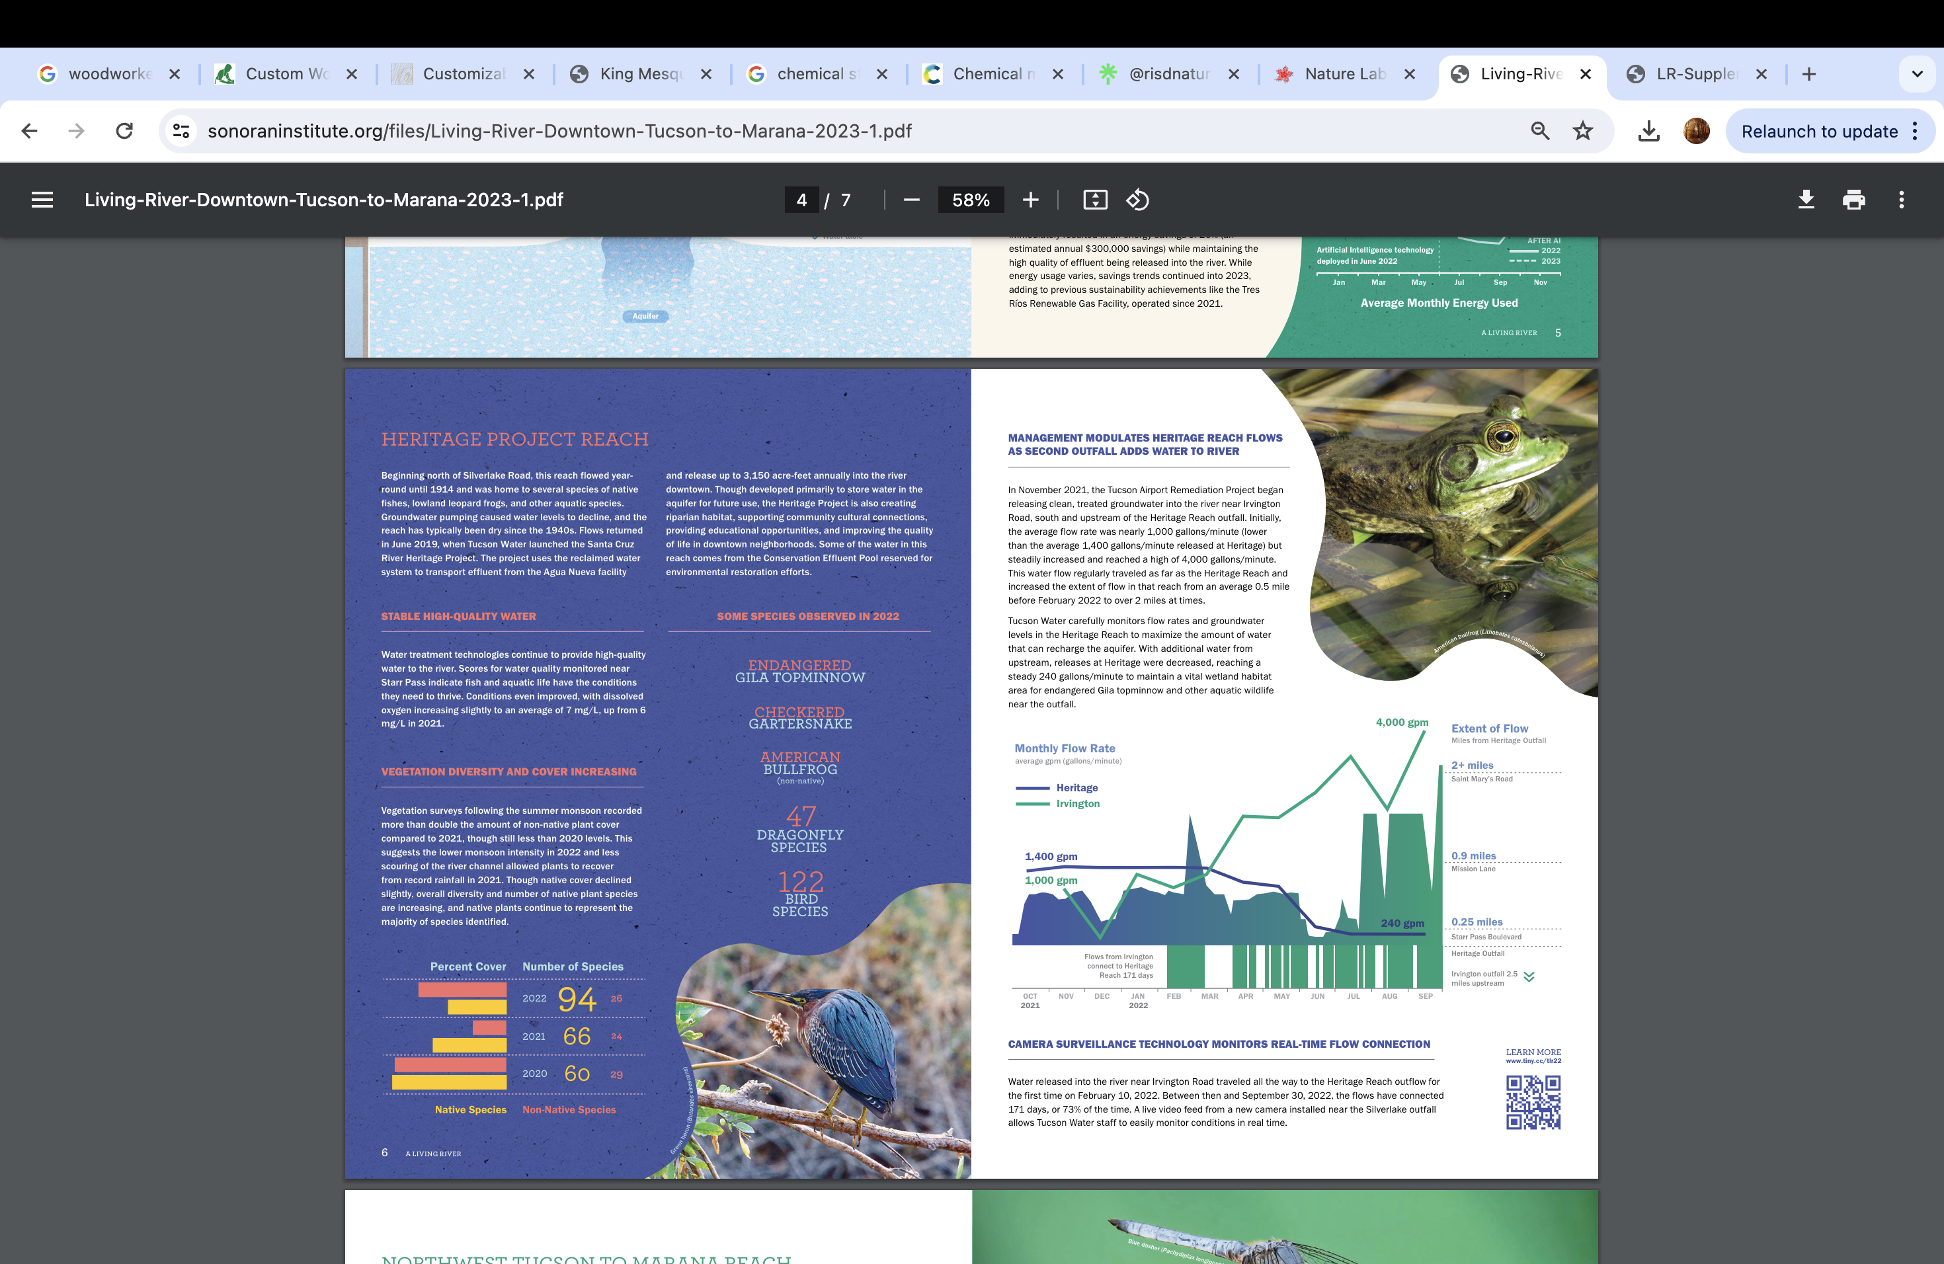
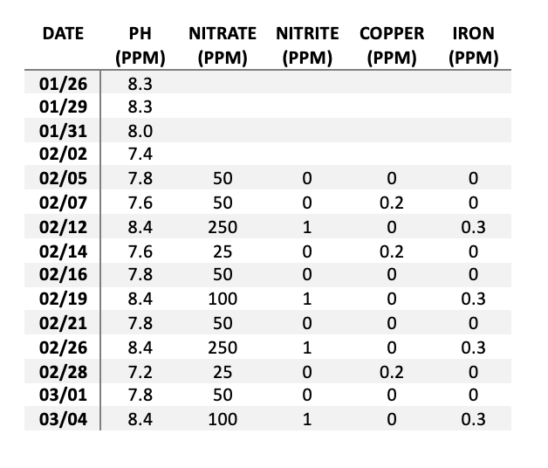
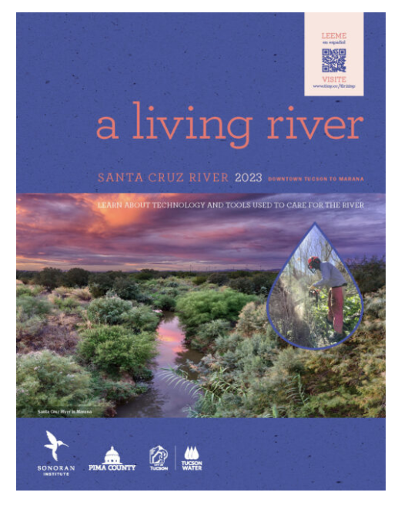
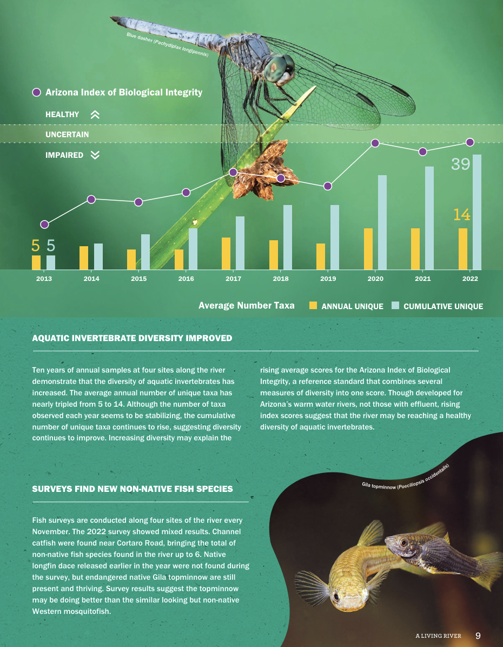
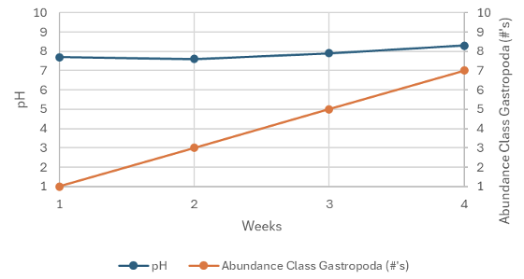
Synthesizing results
Read: A Living River
Students pair off and dissect ALR figures
Students build figures from their own data

Slide 21
Suggestions/comments
I source plants from the Santa Cruz River and online seed sources. I propagate organisms from seed and cutting depending on ease. Some important things to consider: what is the protected status of the land that you plan to harvest from? What is the protected status of species that you plan to harvest? Do you know how to ethically wild harvest? Are you harvesting from a species of local ecotype?
These ecosystems are effective at keeping riparian plants happy. I have had an ecosystem running for over a year straight and have had to transfer three generations of plants to larger systems with no fish deaths. Though I would not expect the same productivity for horticultural endeavors.
I will have a greater volume of students this upcoming year. As such, I plan to attempt using 3L plastic bottles as they are easier to source and less expensive than 3-5 gallon jugs.
If you are having trouble sourcing plants, I would be more than happy to share what I have propagated or share some seeds! Email me: tkochenderfer1@gmail.com.

