Slide 1
Desert Dwellers
Recreating our local ecosystem.

Slide 2
Get thinking…
On your whiteboards
Why is it important to know about food webs or food pyramids?
6.L2U1.14 students will construct a model that shows the cycling of matter and flow of energy in ecosystems.
You will do this by completing an information card on your desert dweller and link it with the other energy roles in the ecosystem.

Slide 3
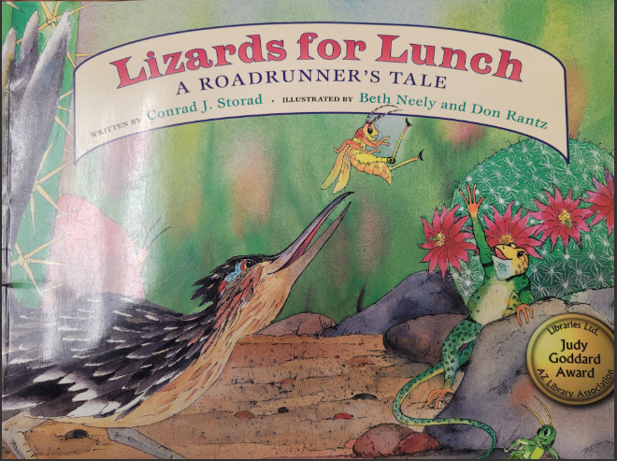
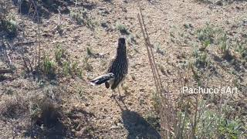
Let’s learn more about one of our local desert dwellers
Lizards for Lunch A Roadrunner’s Tale by Conrad Storad

Slide 4
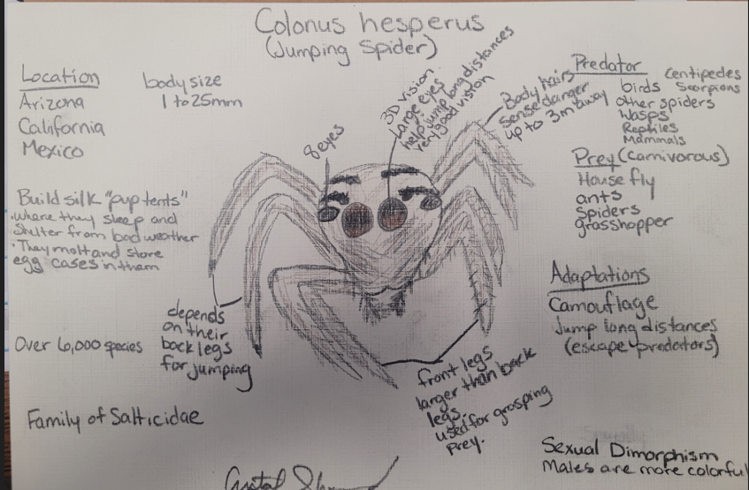
Learn more about your desert dweller.
What do we do??
Research information about your desert dweller.
Draw a picture of your desert dweller.
Include their predators and prey.
Include important adaptations.
Features it has to survive.
Unique traits or features.
Their location and typical shelter
Include as much information you can about your dweller.
Animal Food Web Research on Google Classroom. There will be a link to National Geographic and iNaturalist to do your research.

Slide 5
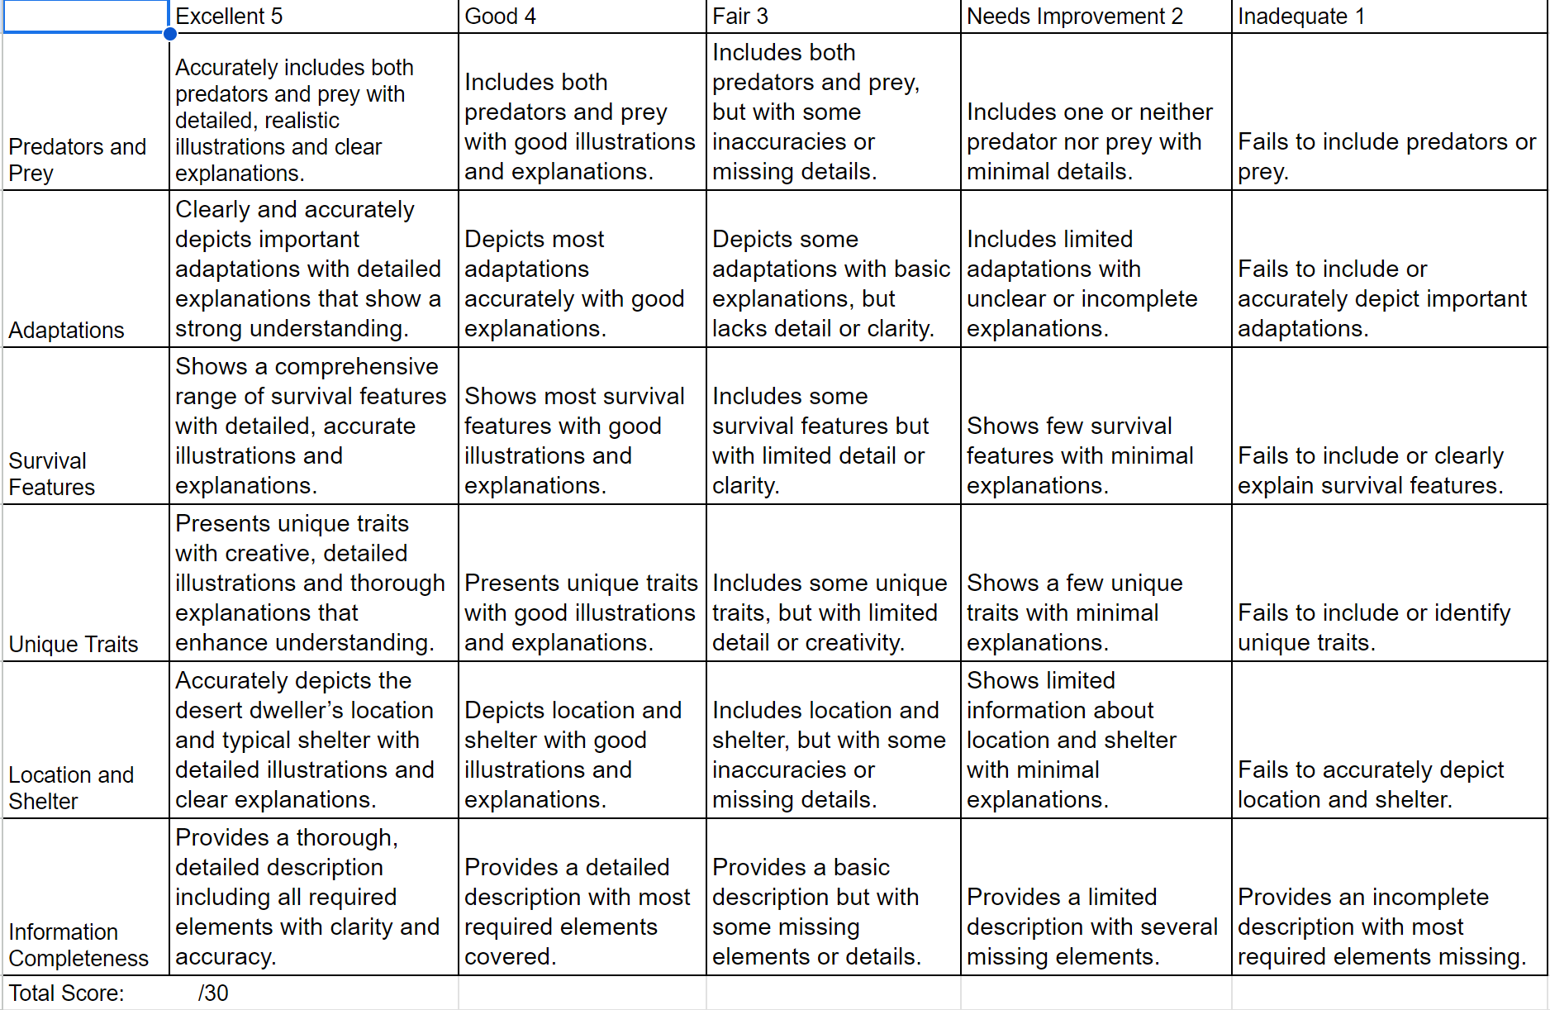
The rubric is how you will be graded on this project.

Slide 6
Anna’s Hummingbird Gila Monster
Sunflower
Greater Roadrunner Chuckwalla
Butterfly Weed
Great Horned Owl Western Diamondback
Arizona Lupine
Gila Woodpecker Arizona Coral Snake
Saguaro
Vermilion Flycatcher Sonoran Toad
Verdin Longfin Dace
Yellow Warbler Gila Topminnow
Lesser Goldfinch Mesquite Tree
Harris’s Hawk Palo Verde
Black Widow Spider Ocotillo
Bark Scorpion Soaptree Yucca
Sonoran Millipede Saguaro
Ground Squirrels Desert Prickly Pear
Sonoran Mud Turtle Goldenrod
Choose your top 3 that you would like to research and make into a food web.
I will be assigning who will get which of these so do not get set on which one you want. I don’t want any duplicate animals in the food webs.
As you are assigned a desert dweller you can begin your research. Start by going on Google Classroom for more instructions.

Slide 7
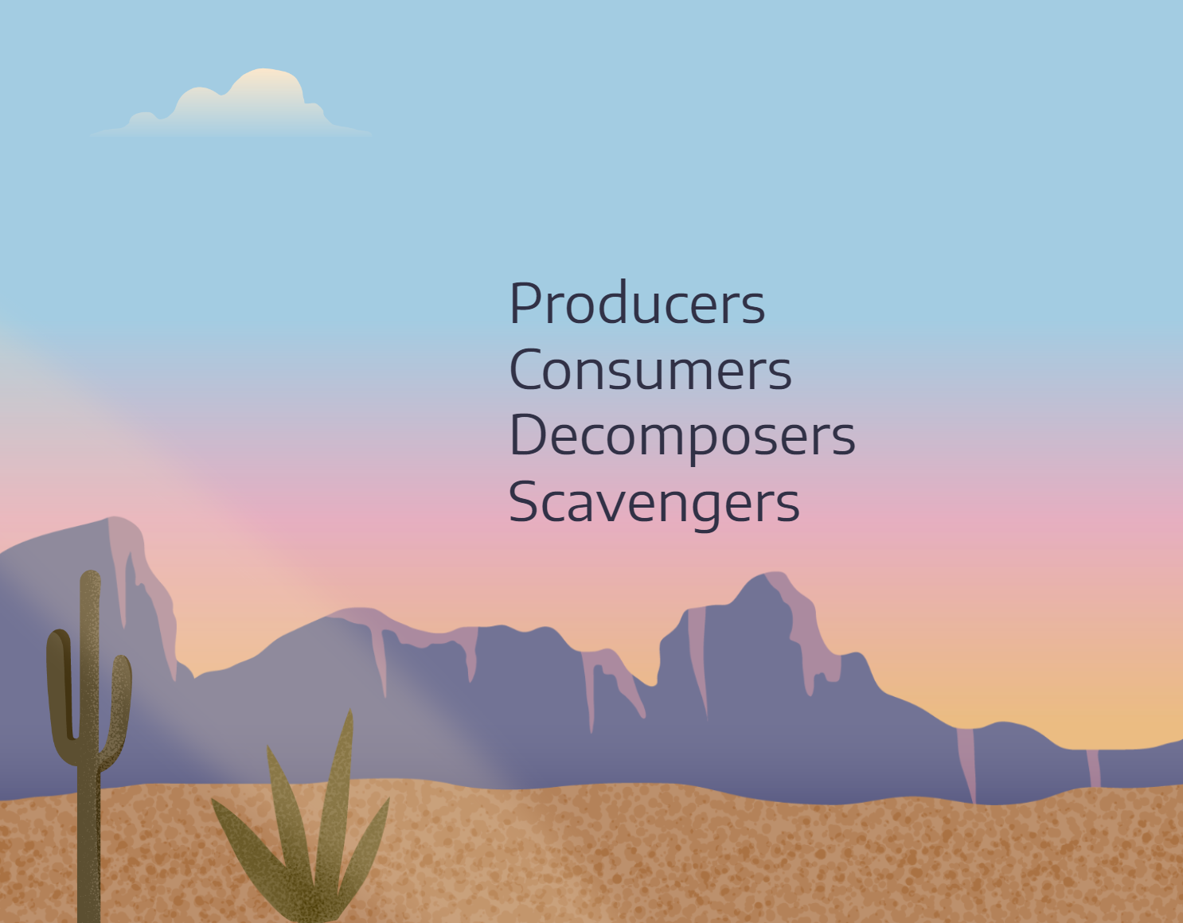
Closing
What type of energy role does your desert dweller have?
Rubric for Desert Dweller Activity

Slide 8
Extension Activity

Slide 9
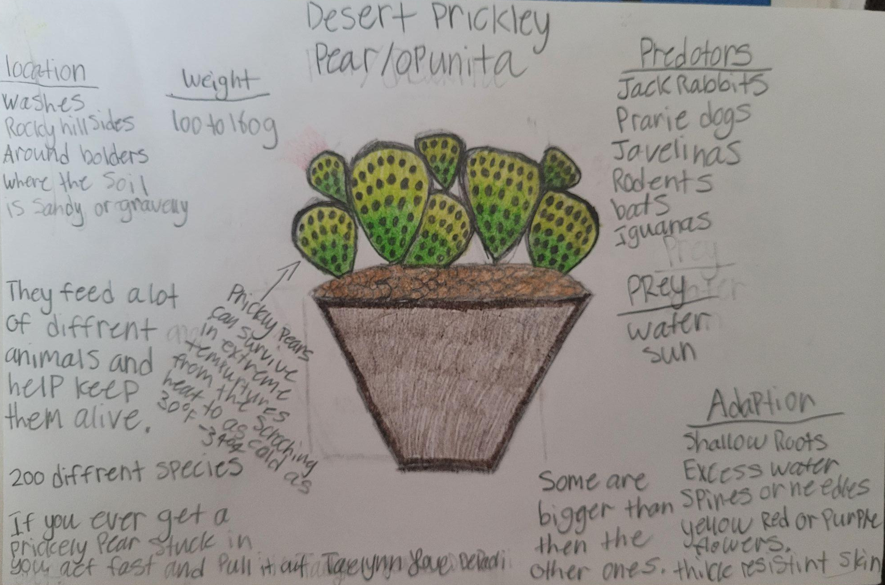
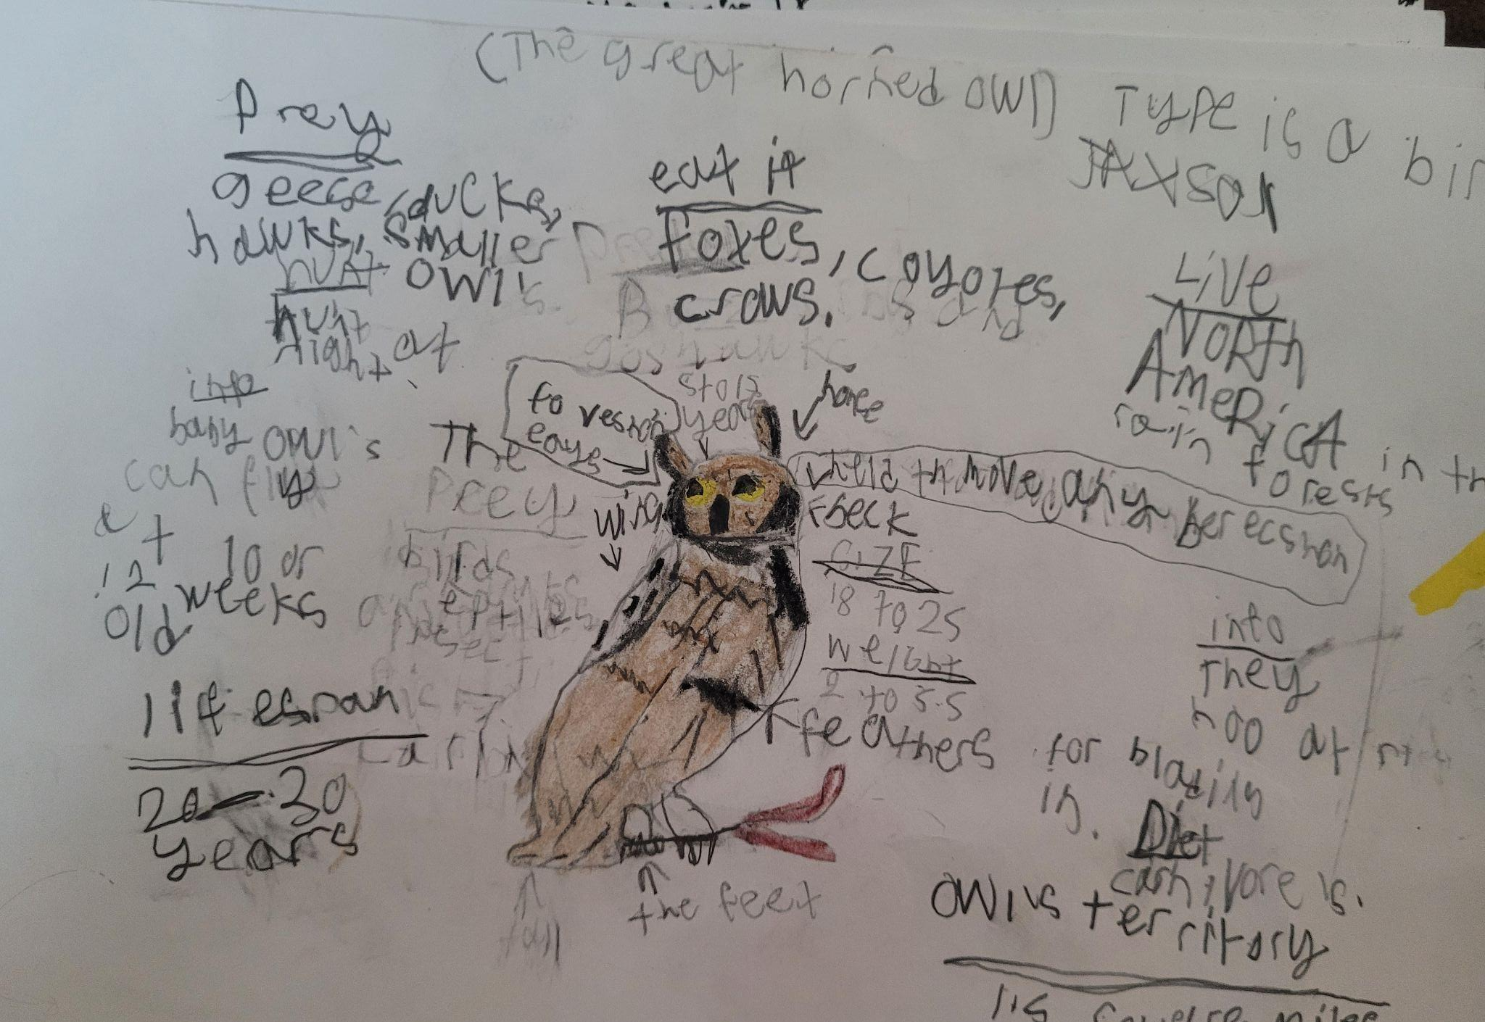
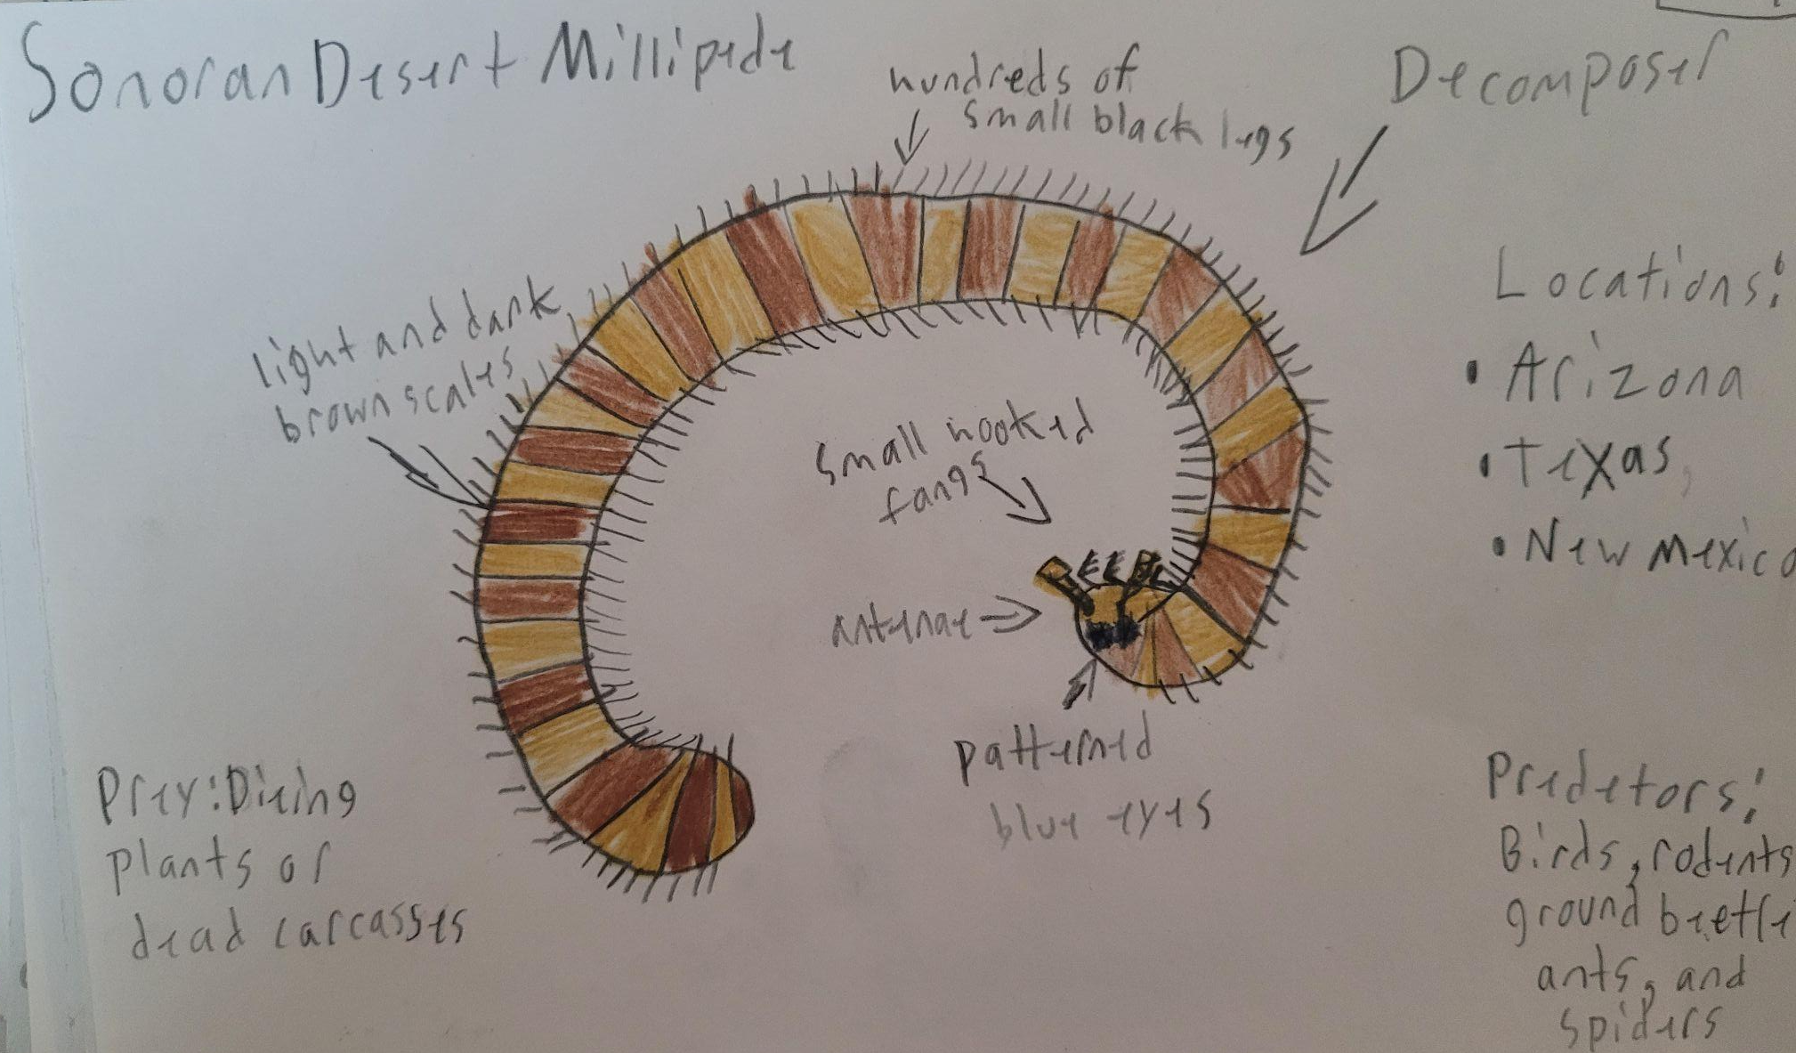
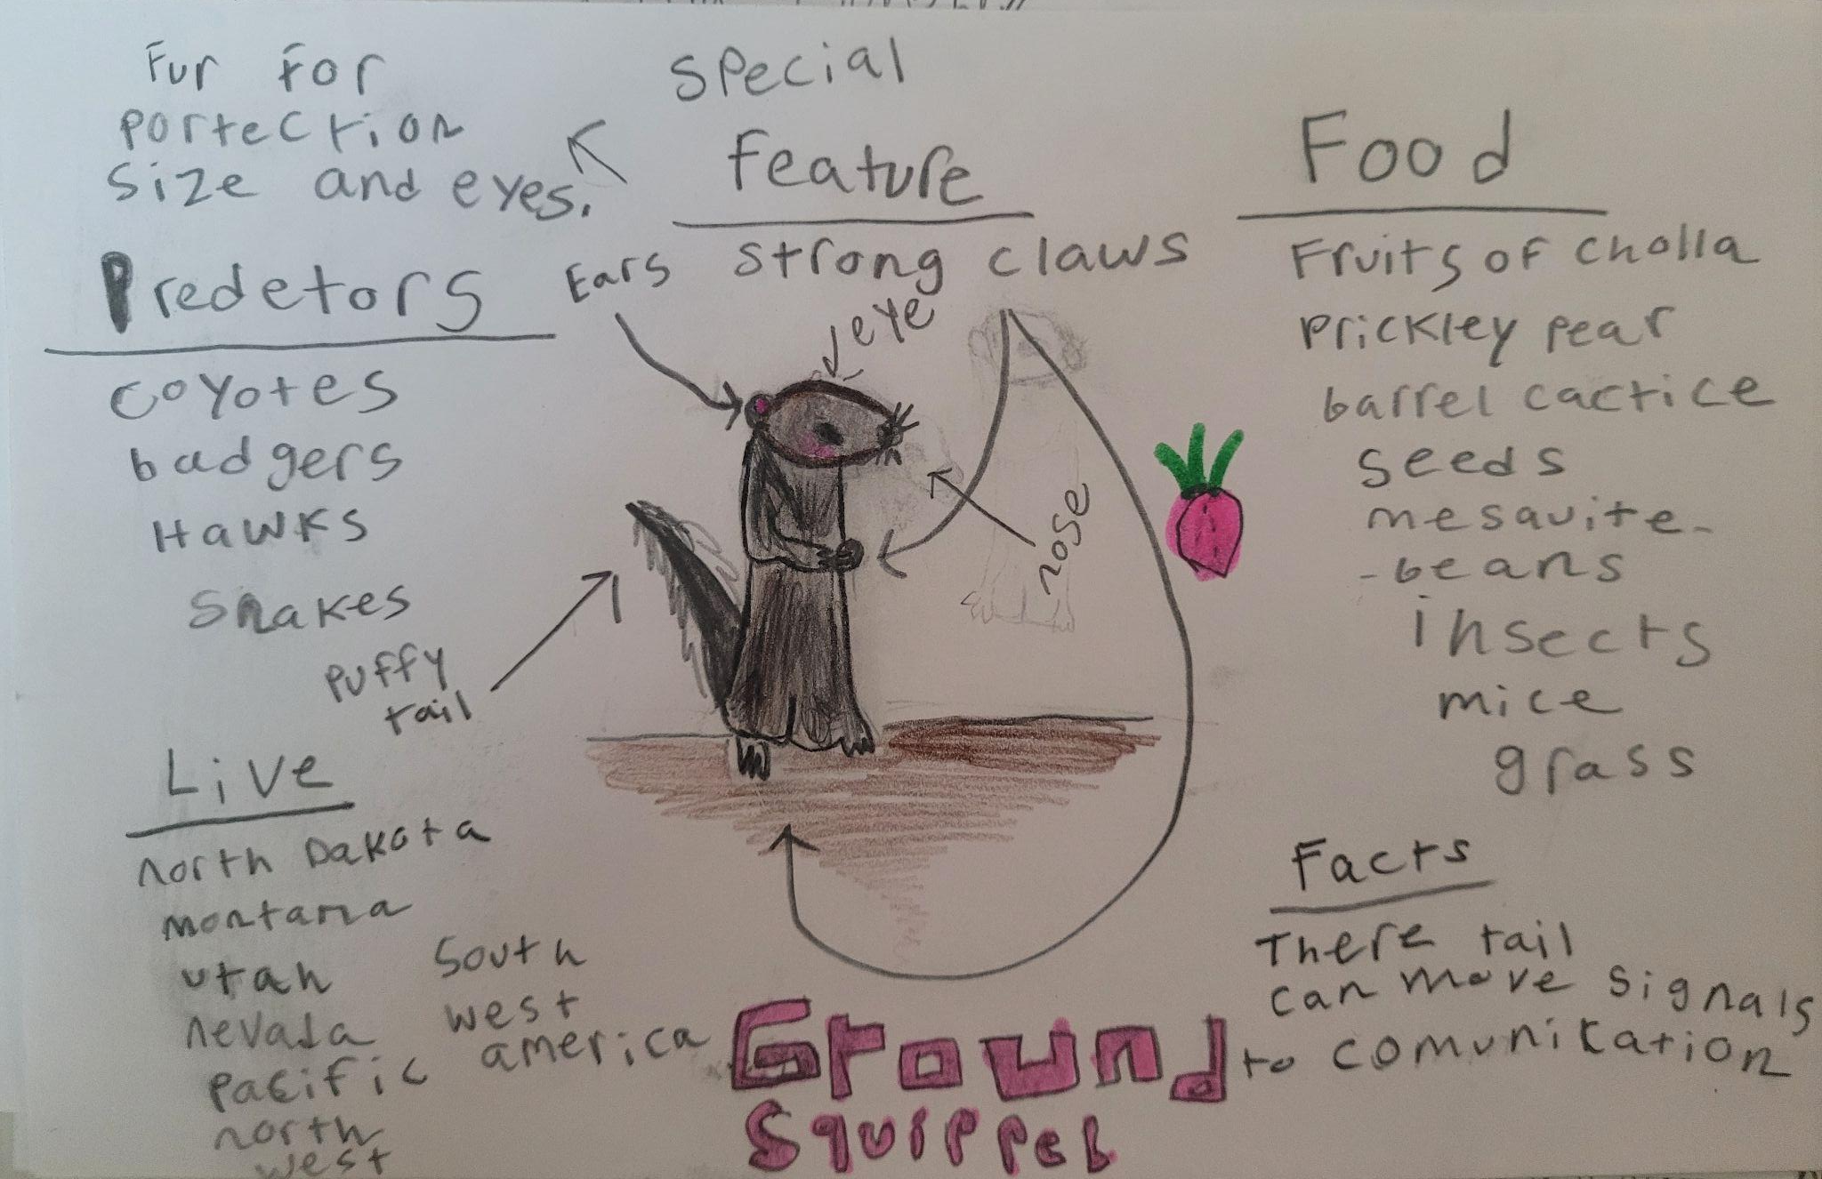
Making a Food Web
Producer
Secondary
Consumer
Put it all together in a food web.
Take yarn and link the different energy sources in our ecosystem.
Decomposer
Primary Consumer

Slide 10
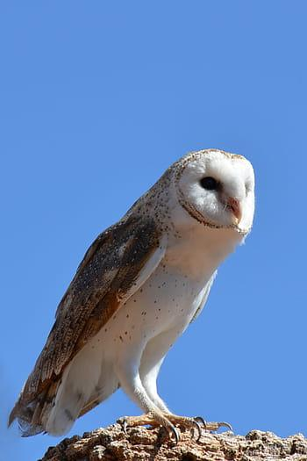
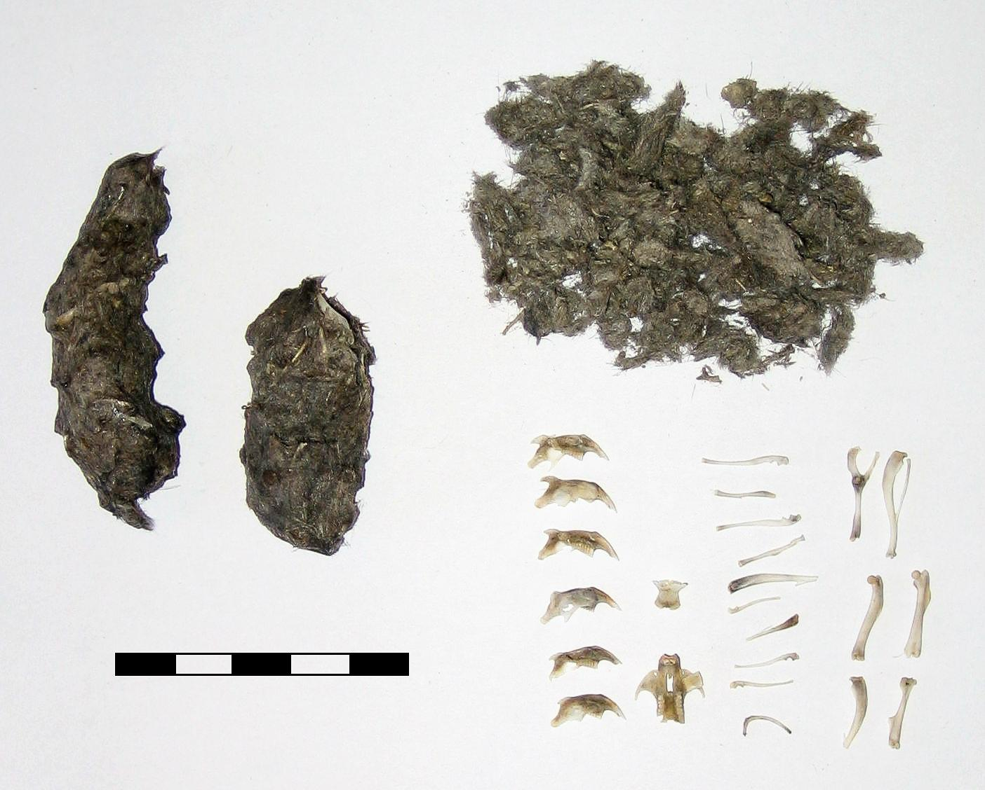
Owl Pellet Dissection
Another idea!
Have students dissecting an owl pellet so they have a hands-on experience with what an owl eats.

Slide 11
Student Examples

Slide 12
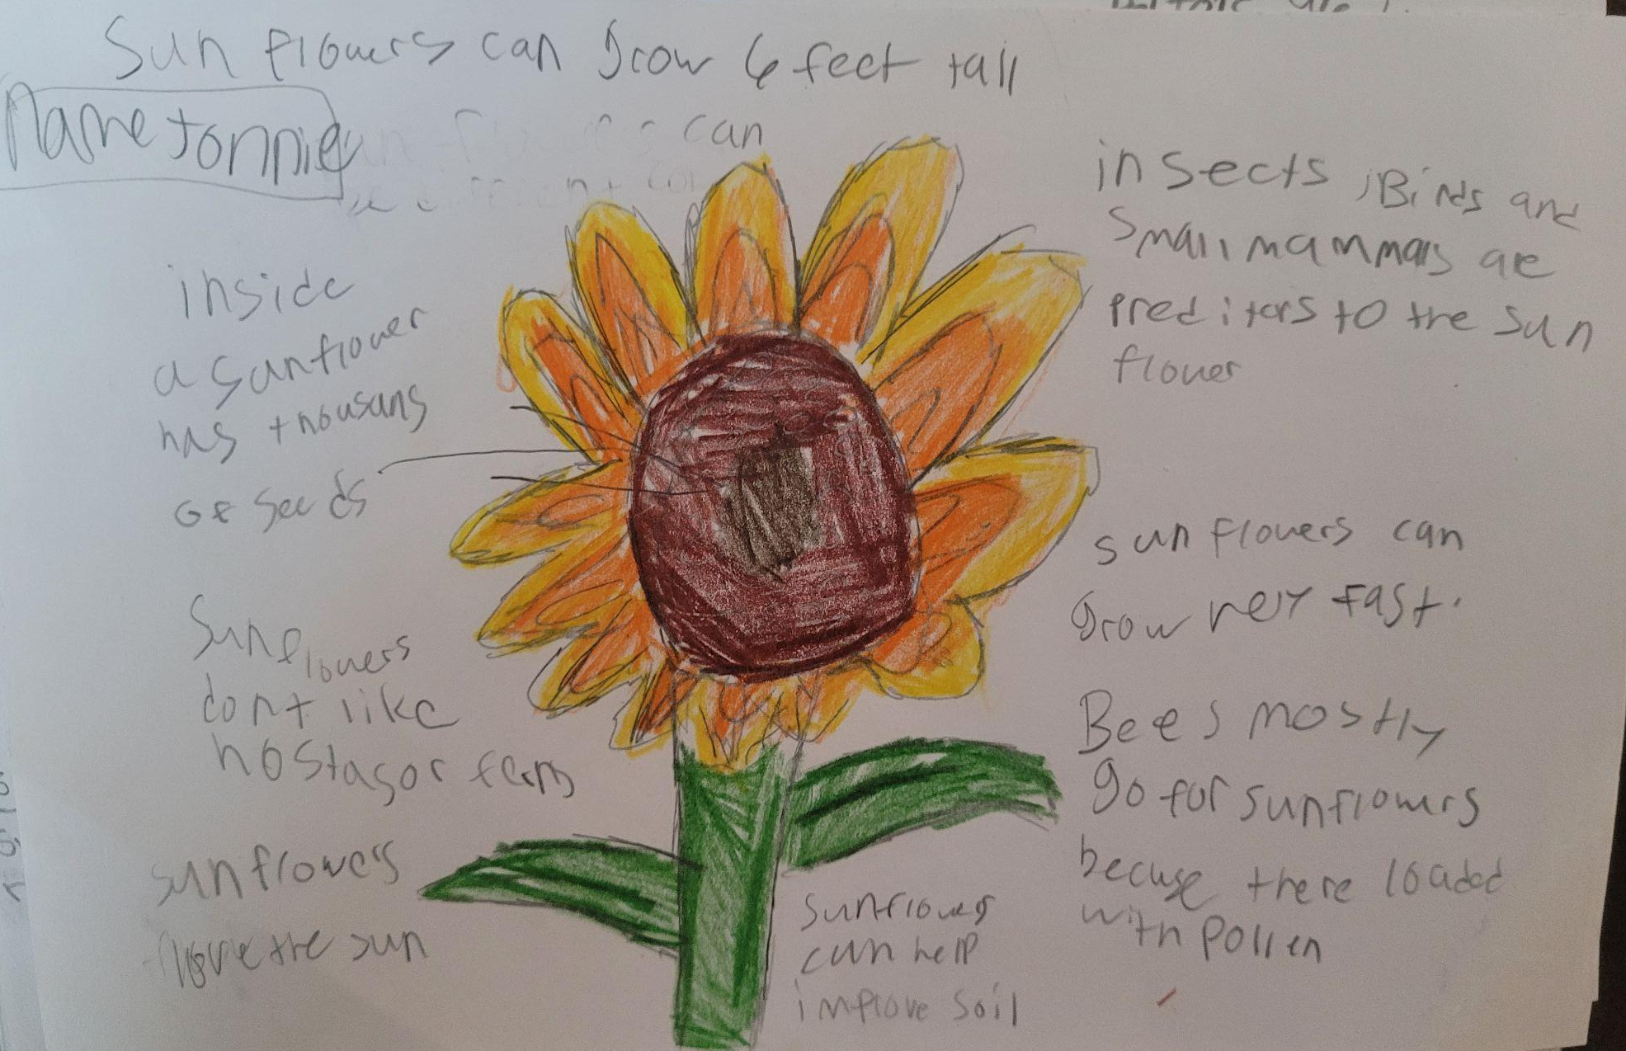
What causes soil erosion?
WIND
WATER
ICE
Mercury is the closest planet to the Sun and the smallest of them all
Venus has a beautiful name and is the second planet from the Sun
Despite being red, Mars is actually a cold place. It’s full of iron oxide dust

Slide 13
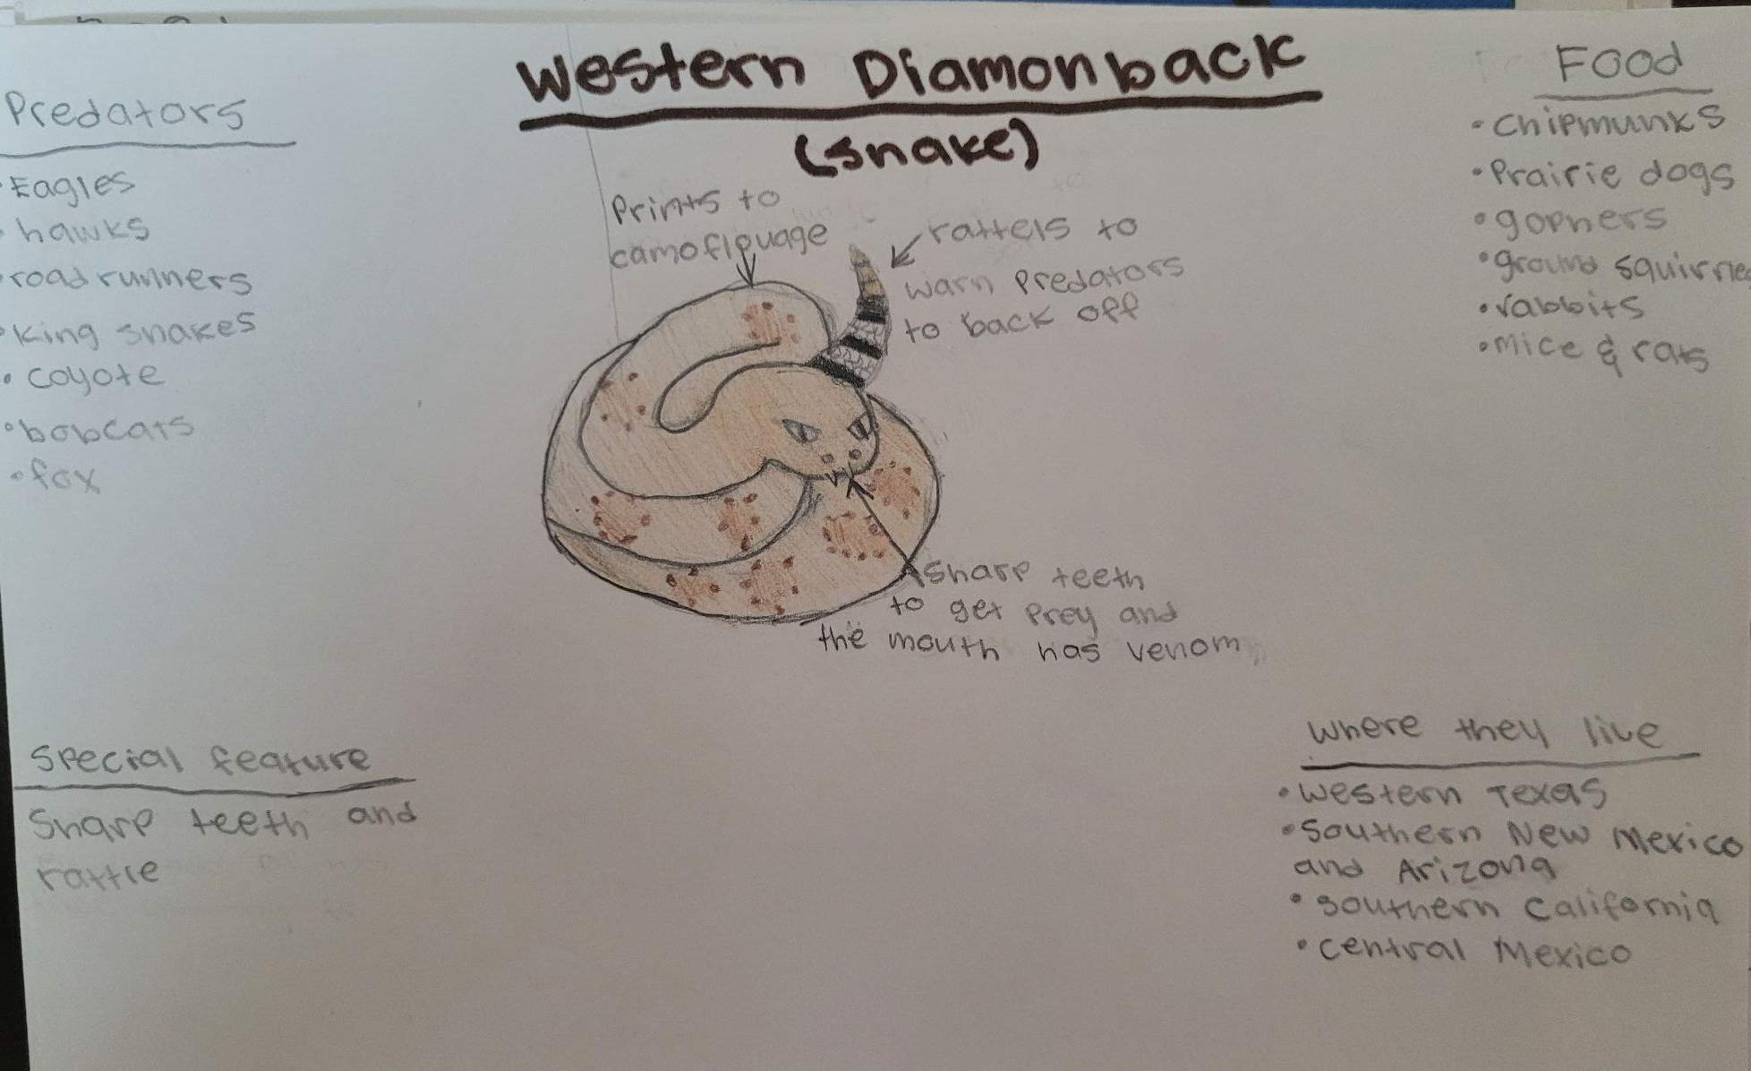
The Main Causes And Impacts
Deforestation
Agrochemicals
Overgrazing
Construction
Venus is the second planet from the Sun
Jupiter is the biggest planet of them all
Despite being red, Mars is a cold place
Saturn is a gas giant and has several rings

Slide 14
What we can do?
MERCURY
VENUS
MARS
JUPITER
SATURN
NEPTUNE
Mercury is the closest planet to the Sun
Venus is the second planet from the Sun
Mars is actually a very cold place
Jupiter is the biggest planet of them all
It’s composed of hydrogen and helium
It’s the farthest planet from the Sun

Slide 15
Producers
Consumers
Decomposers
Scavengers

Slide 16
—SOMEONE FAMOUS
“This is a quote, words full of wisdom that someone important said and can make the reader get inspired.”

Slide 17
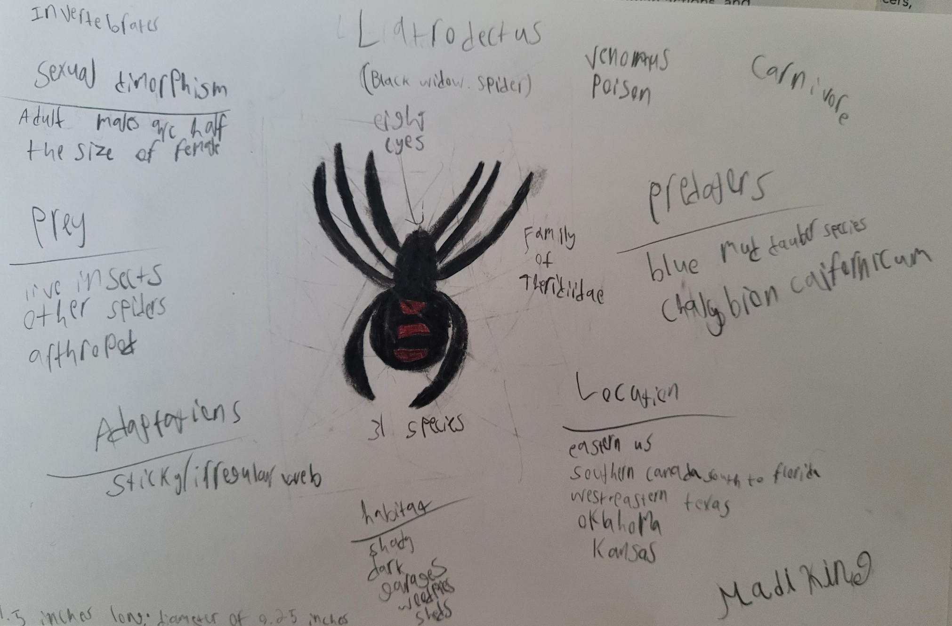
A PICTURE IS WORTH A THOUSAND WORDS

Slide 18
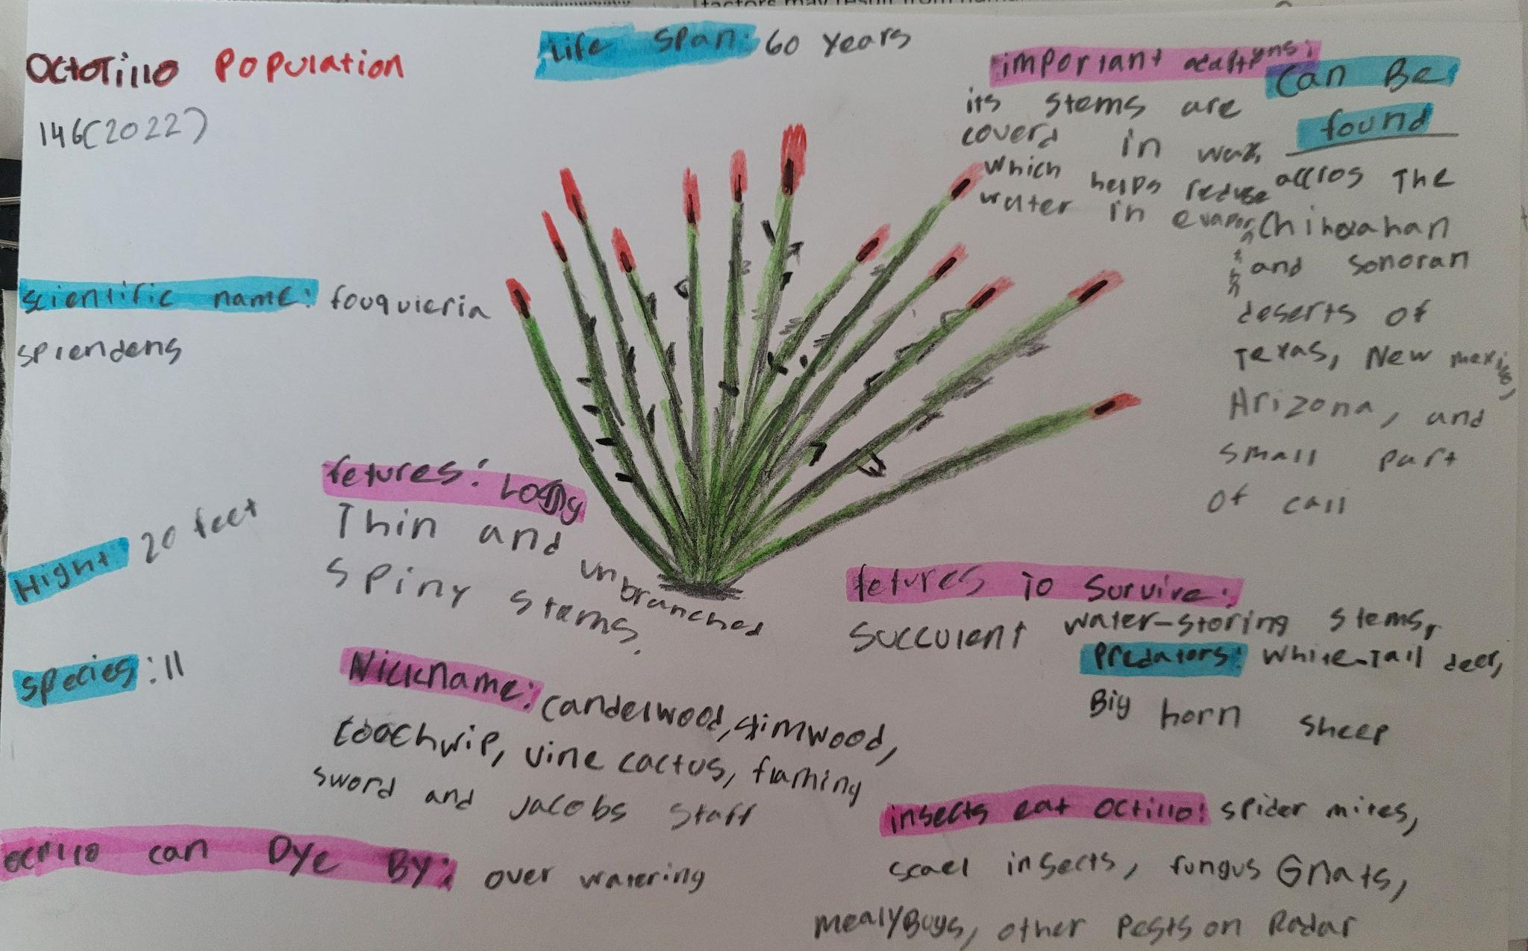
To reinforce the concept, try using an image
Images reveal large amounts of data, so remember: use an image instead of a long text. Your audience will appreciate it

Slide 19
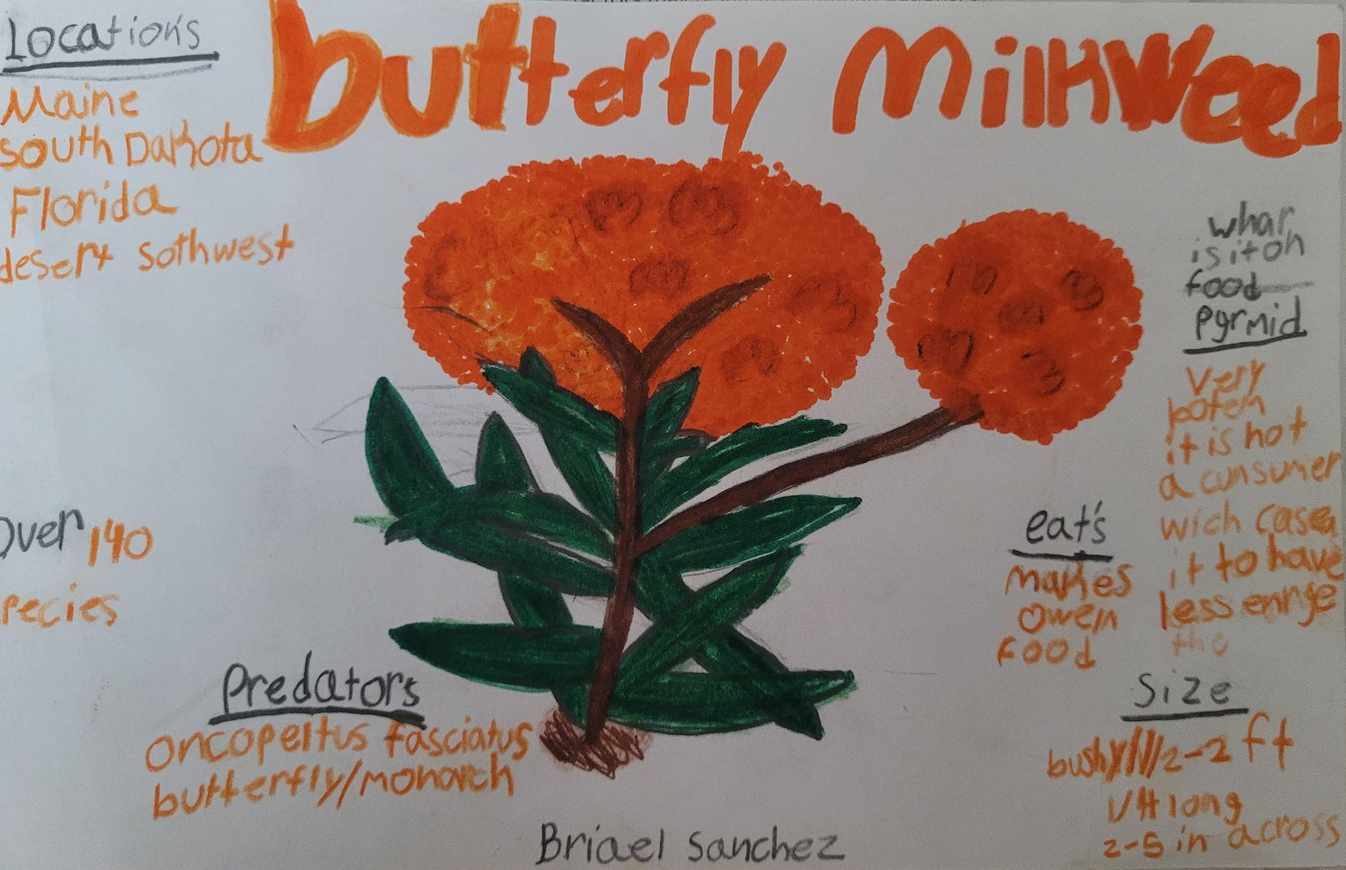
333,000
Jupiter's rotation period
The Sun’s mass compared to Earth’s

Slide 20
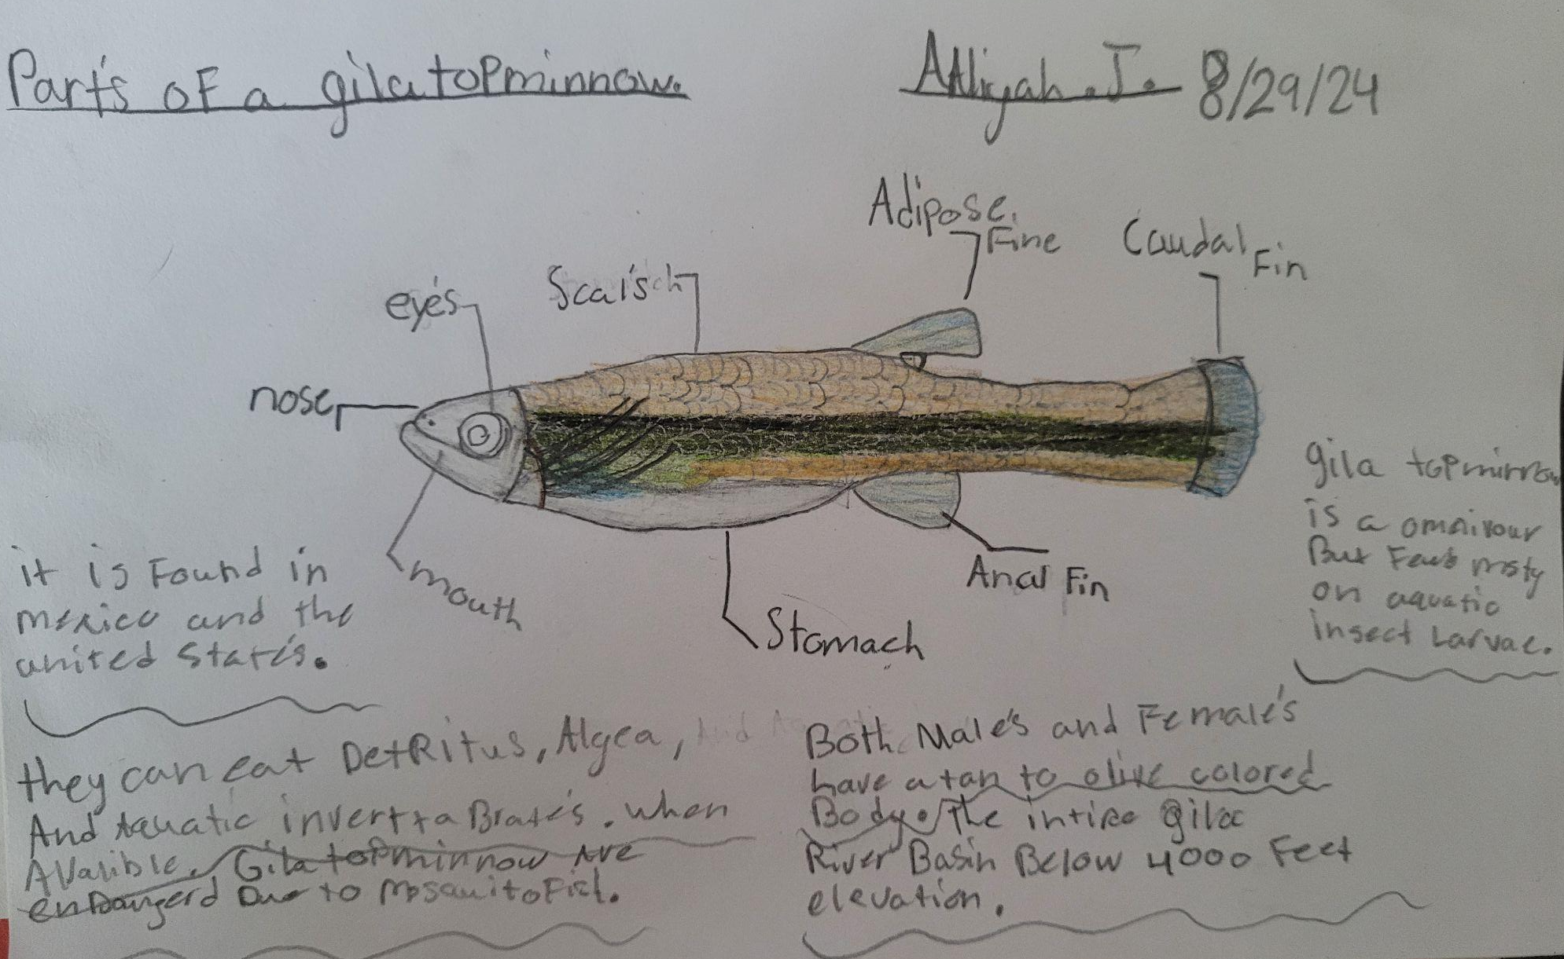
THESE ARE SOME PERCENTAGES
15%
55%
30%
MERCURY
VENUS
NEPTUNE
It’s the closest planet to the Sun
Venus is the second planet from the Sun
It’s the farthest planet from the Sun

Slide 21
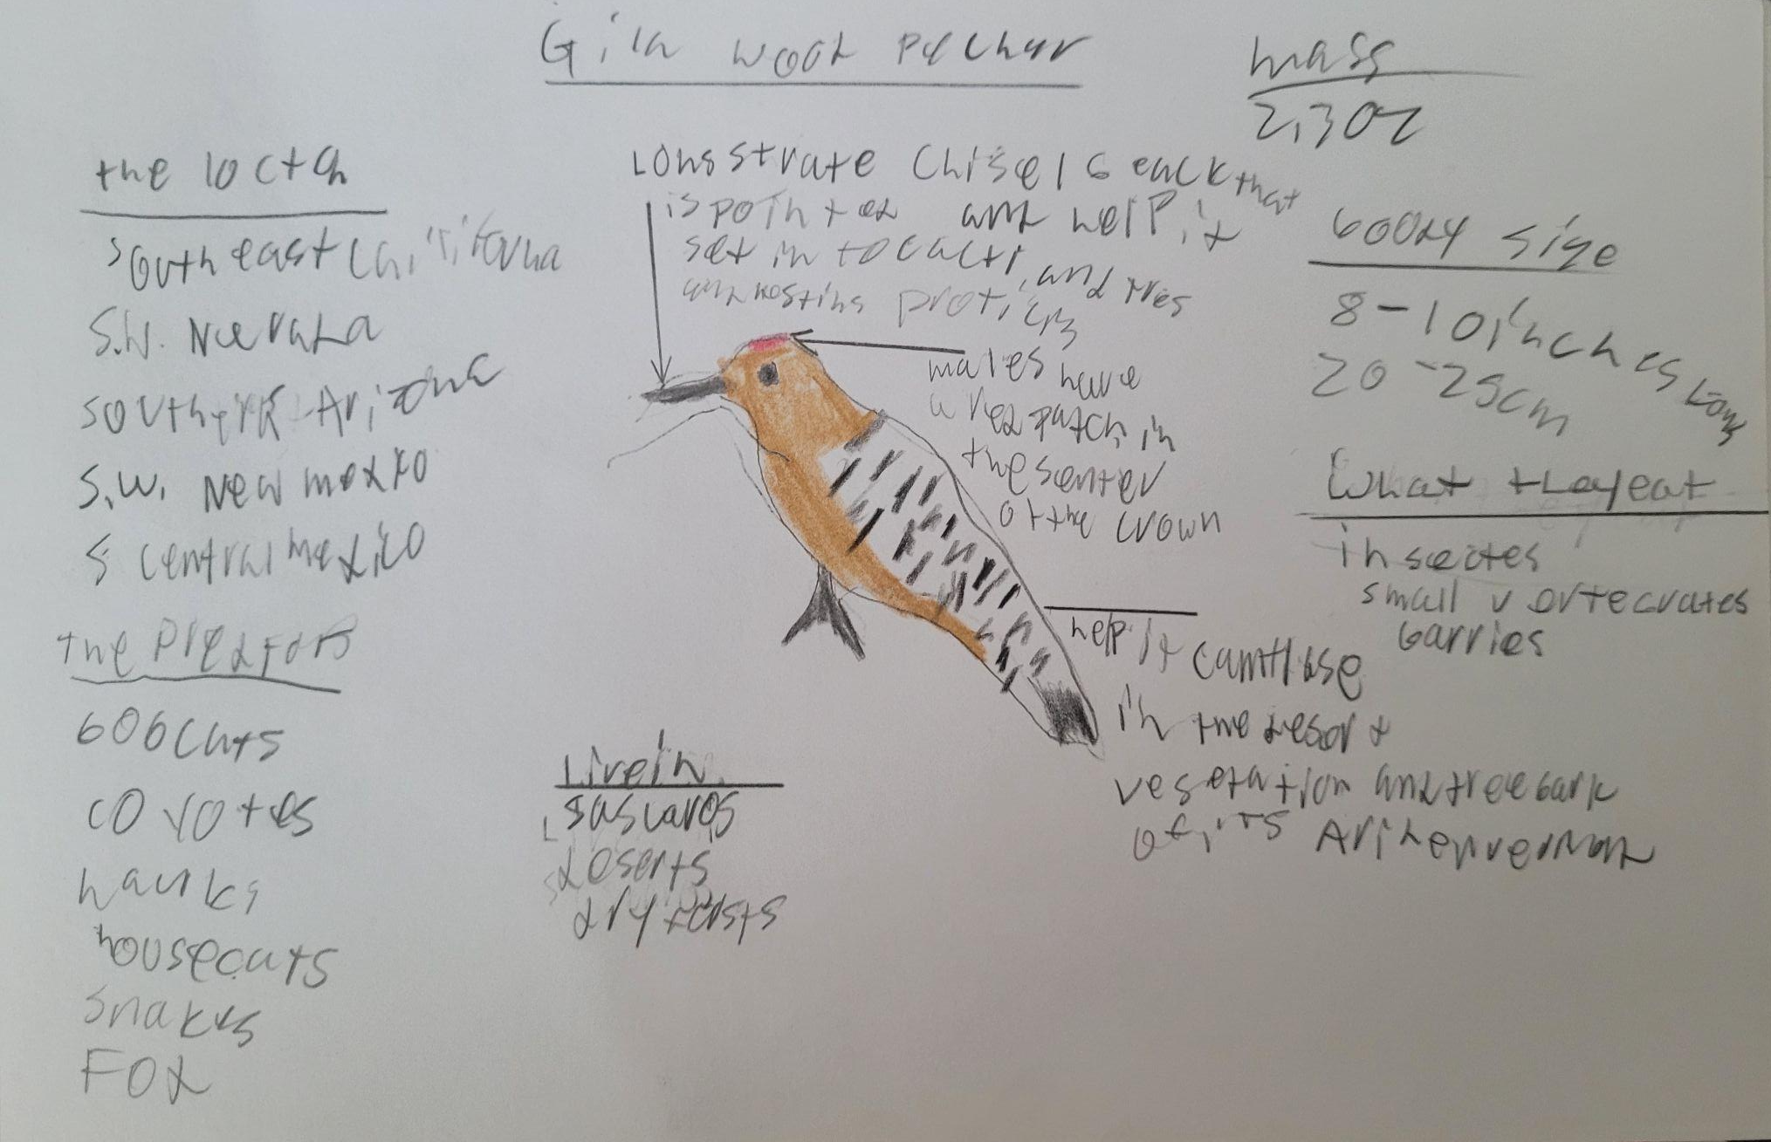

Slide 22
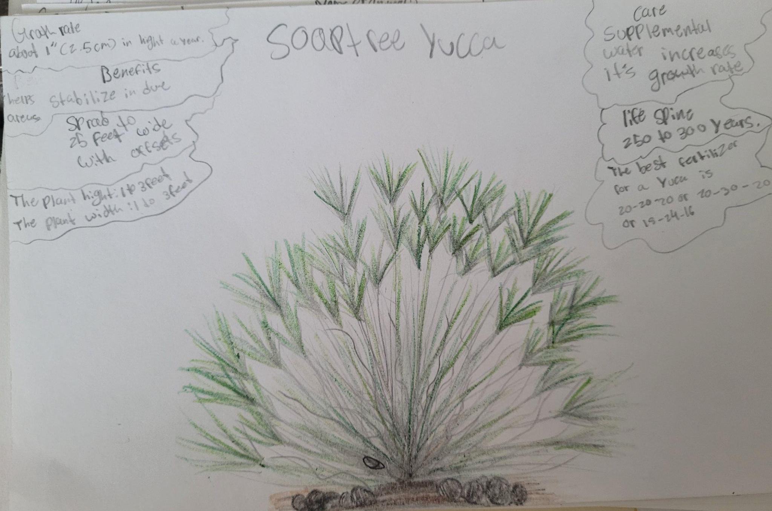

Slide 23
