Slide 1
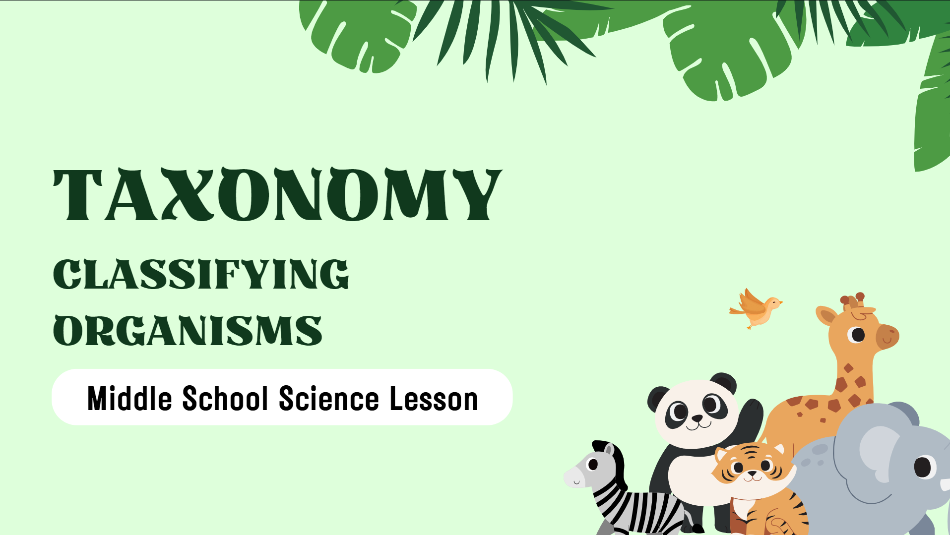
Organism Classification

Slide 2
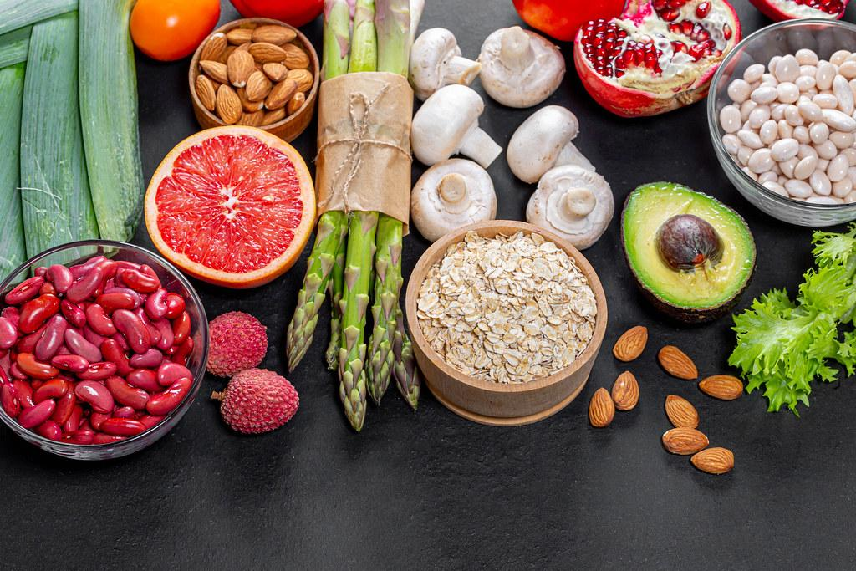
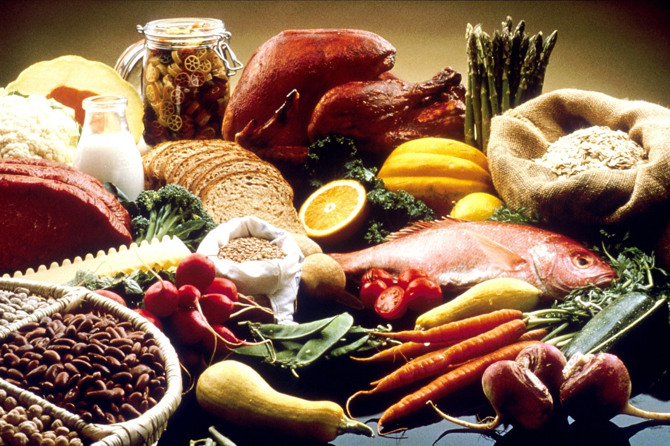
What does it mean to classify something?
Let’s start with an example. How do you classify food?
I am going to split you all up into groups. You will be given 30 food items. I want you to split them into 2 groups that have similar traits.

Slide 3
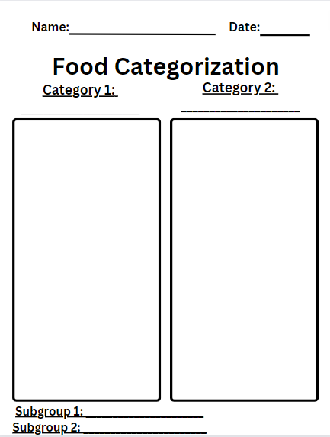
What two groups did you use to sort your food?
Now choose one of your groups. Using the food in this group, create two subgroups. Circle your subgroup 1 in blue and your subgroup 2 in red.

Slide 4
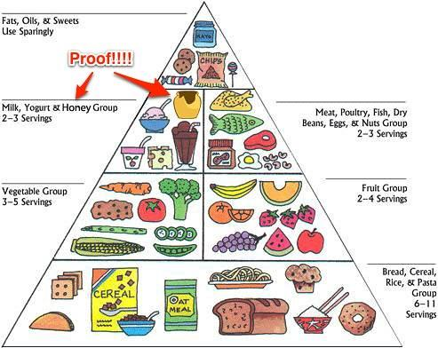
What two subgroups did you use to sort your food?
Do you think you could divide one of the subgroups into even smaller categories?

Slide 5
How does science classify organisms?

Slide 6
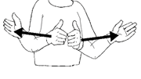
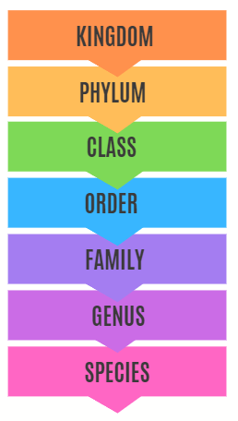
Taxonomy
Taxonomy is the scientific classification of living organisms.
This includes: Plants, Animals, Bacteria, Fungi, Protista, and Archaea
Taxonomy includes a series of levels from the most general to the most specific.
Taxonomy often uses Latin words. Some words used in taxonomy look like and sound like English words.

Slide 7
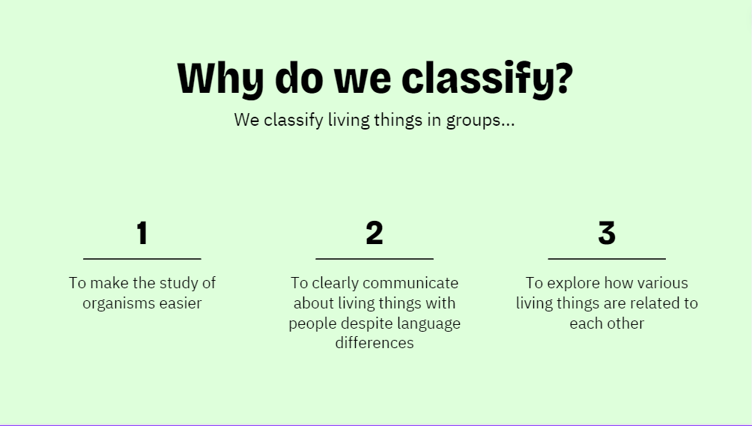

Slide 9
Kingdom
The different kingdoms are Animalia, Plantae, Fungi, Protista, Archaea, and Bacteria.

Slide 13
As we continue to move down on the Taxonomy ladder, the groupings get more specific. We will spend more time looking at specific orders, families, genus, and species later. But as we have just learned, taxonomy makes the study of organisms easier through classifications.

Slide 15
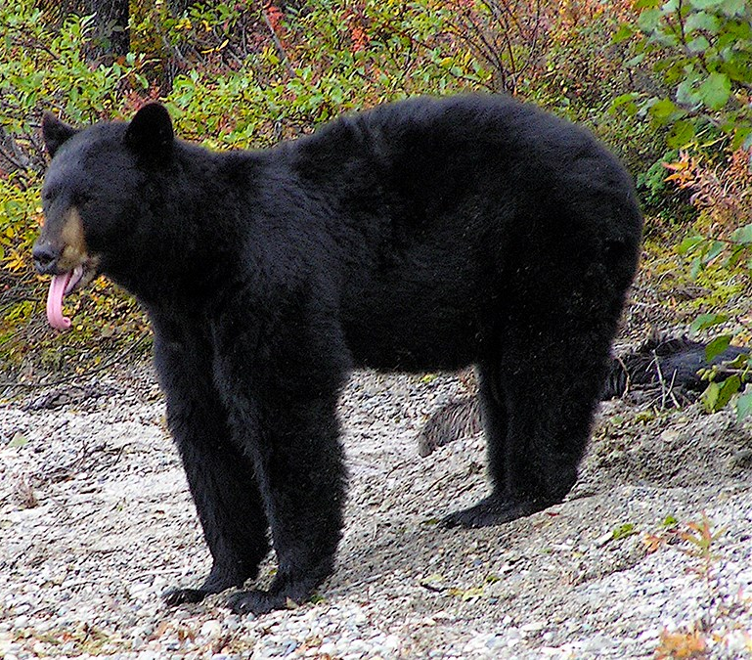
Scientific Name: Ursus americanus
English Non-Scientific Name: Black Bear
Bulgarian Non-Scientific Name:
Черна мечка
Swedish Non-Scientific Name: Svartbjörn

Slide 16
What if all of these

Slide 19
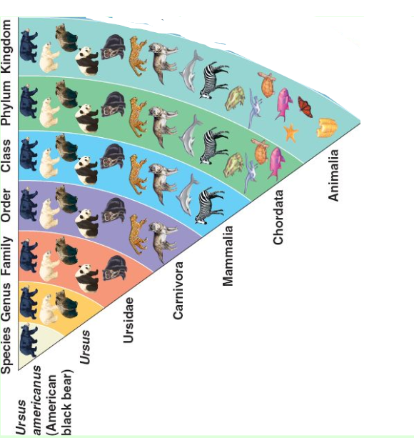

Slide 20
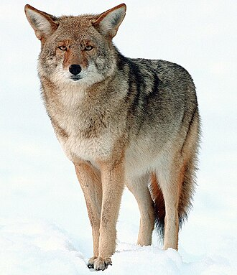
Canis latrans; Coyote

Slide 21
Canis latrans; Coyote

Slide 22
Canis latrans; Coyote
Animalea

Slide 23
Canis latrans; Coyote
Animalea
Chordata

Slide 24
Canis latrans; Coyote
Canis latrans
Notice, the scientific name includes the genus and species. The species is lowercase.
Animalea
Chordata
Mamalia
Carnivora
Canidae
Canis
Latrans

Slide 25
Independent Work
Individually, you will make a slide.
You can choose one of the following: Javelina, Bobcat, Mountain Lion, or Cottontail Rabbit.
Your slide will include your organism’s Kingdom, Phylum, Class, Order, Family, Genus, and Species.
You may use your computer to research the order, family, genus and species. BUT try to determine the kingdom, phylum, and class on your own.
You will include the organisms Scientific and Non-Scientific Name.
You will include one photo of your organism.

Slide 26
Canis latrans; Coyote
Example Slide
Kingdom: Animalia
Phylum: Chordata
Class: Mamalia
Order: Carnivora
Family: Canidae
Genus: Canis
Species: latrans

Slide 27
Scientific Name; Non-Scientific Name
Kingdom:
Phylum:
Class:
Order:
Family:
Genus:
Species:

