Slide 1
Understanding Energy
Urban Heat Island
Effect

Slide 2
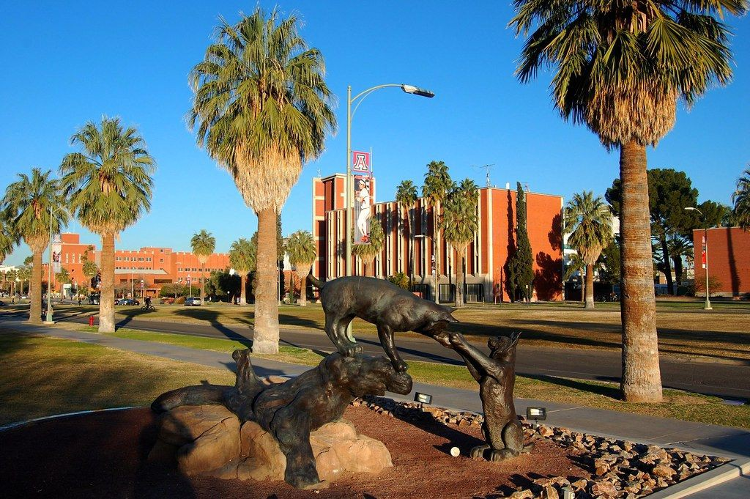
Bellwork
With those around you, answer the questions on the board in your notebook:

Slide 3
Let’s investigate
Temperature changes on different types of materials.
Temperature changes between different environments (urban and rural)

Slide 4
What is an urban heat island?
Have you heard this term before?

Slide 5
Objectives
I can understand what an urban heat island is and how it affects Earth’s energy balance.
I can explain how human activity changes urban, desert, and riparian environments.
I can collect and analyze data to show others about a phenomenon in my community.

Slide 6
Our Plan
01
Background
What is a heat island?
02
Graphs
Looking at the facts
03
Data Collection
Performing our own experiment
04
Data Analysis
Presenting our ﬁndings
05
Extension
How does this phenomenon affect our community?

Slide 7
Background
What is an urban heat island?

Slide 8
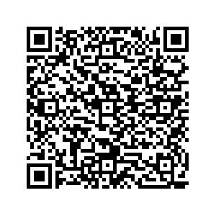
Urban Heat Islands
Read the following:

Slide 9
Key Ideas:
The surface of the Earth emits and absorbs energy
Plants can cool themselves and the environment around them.
Which environment would have cooler temperatures? Desert or river (riparian)?

Slide 10
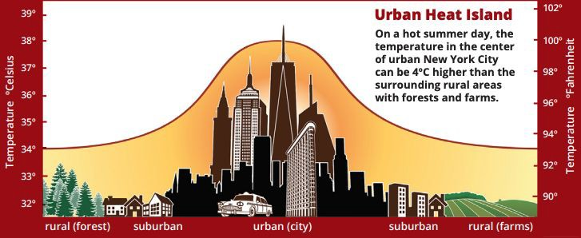
Bellwork
With those around you, answer the questions on the board in your notebook:

Slide 11
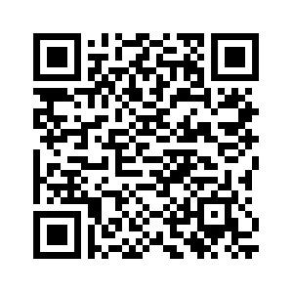
My NASA Data Simulation
Use the simulation to explore more how surface temperature changes in different communities. You may work in lab groups, but turn in one paper per person.

Slide 12
Our Experiment
What ﬁndings do we see in our own school?

Slide 13
Objective
I can collect and analyze data to show others about a phenomenon in my community.

Slide 14
Hypotheses
What do you expect to see? Why?
Record an idea in your notebook before we complete our experiment.

Slide 15
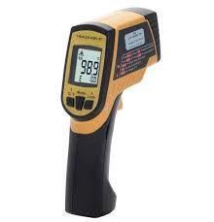
Materials/ Procedure
Working with your lab group, you will take the temperature of at least 10 different spots around our campus, using our point and shoot thermometers. Record data in your notebooks.
Location | Material Type | Temperature
Courtyard | Grass | 86 F

Slide 16
Let’s go!
`

Slide 17
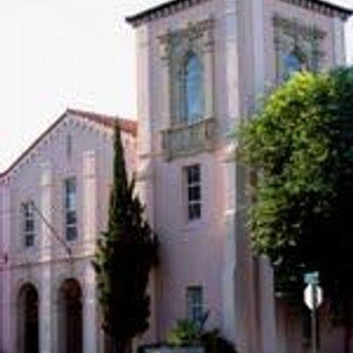
Think-Pair-Share
Talk with your partner about the following:
Did the data show what you would expect?
How could this change at different times of day?/ Seasons?
What would you do differently next time? The same?
How does temperature change when you add water to a system? (e.g. Mansfeld pond)

Slide 18
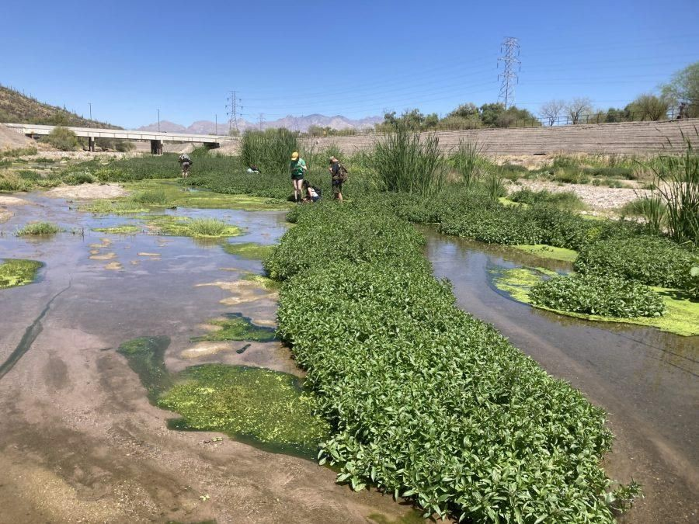
Desert vs. River
What are some beneﬁts of projects like the Santa Cruz River Heritage Project?

Slide 19
Showing off your data!
Create a poster with a partner in your lab group that shows your data ﬁndings:
Should be your best work/ be legible/ have color
Should contain 1 graph or visual that shows your data
Should show your hypothesis
Should show 1 thing you still want to learn

Slide 20
Gallery Walk
`

Slide 21
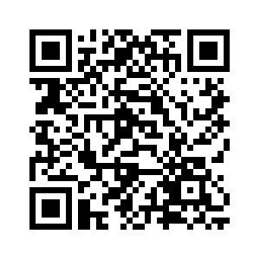
Extension- trees in Tucson
Visit this site on your own. What do you notice/ think/ wonder?
Where do you see trees?
List some thoughts in your
notebook
Then, we will regroup as a class.

