Slide 1
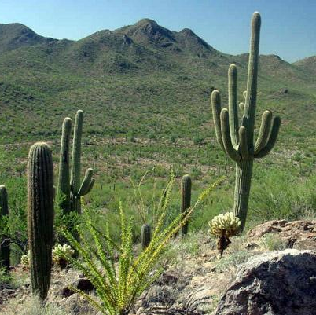
Can you name the birds around us?
Objectives:
Students will be able to use the Merlin Bird ID and recognize the birds around them by using their call.
Students will tally how many times the bird (s) call for 5 minutes and then construct a graph to identify the bird (s) and how many times the bird (s) made calls.
Grade: 7

Slide 2
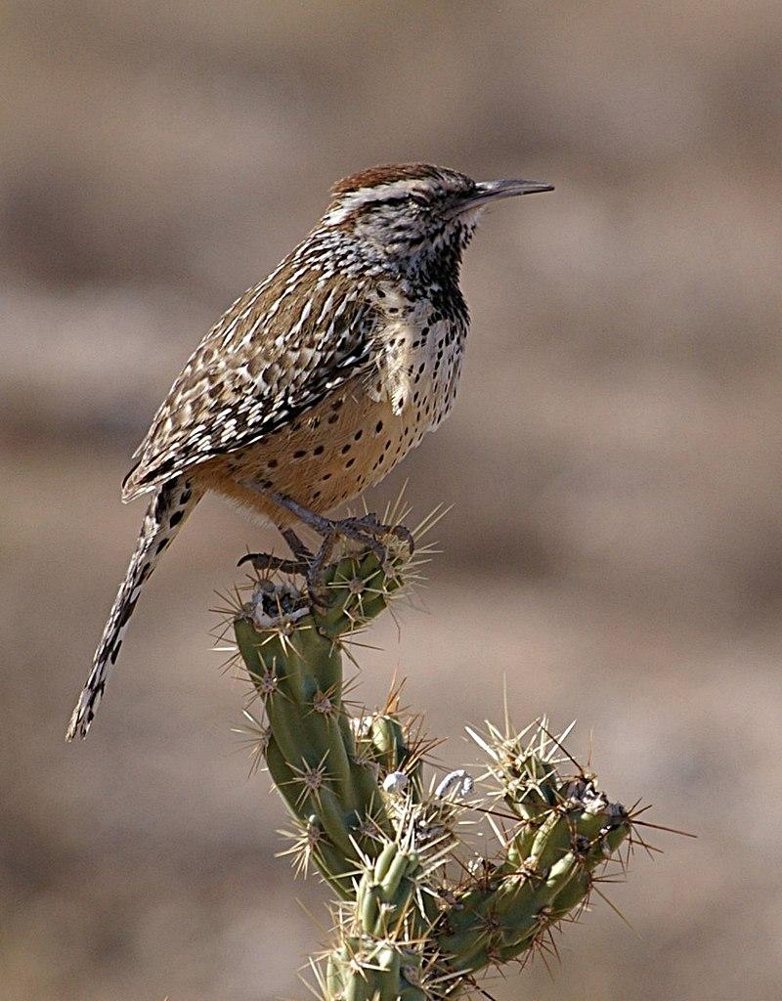
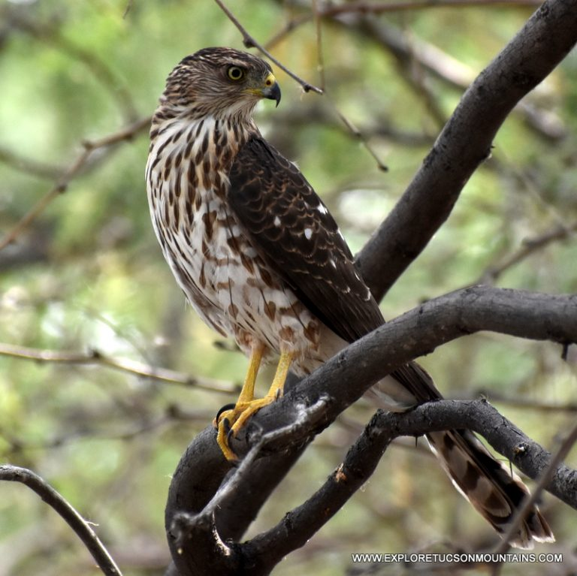
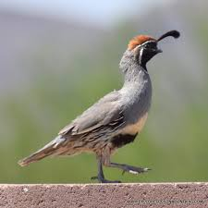
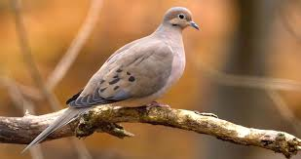
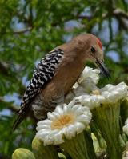
Can you name the birds that live around us?

Slide 3
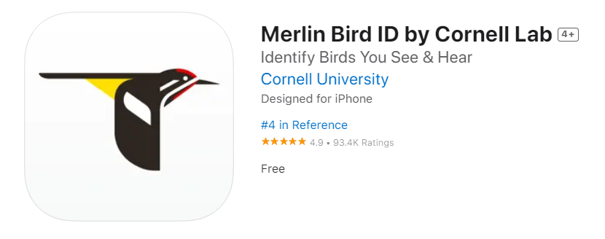
Download this: Merlin Bird ID app
Watch how to use it:
https://youtu.be/xmSUOLxyatY
Link that previews the Merlin Bird ID app
Download the app and make an account on phone : https://merlin.allaboutbirds.org/
Notes:
Many students have their own phone at my school. Students will be grouped in groups of 4 and students will be asked to download the app onto their phone (at least one student per group will be asked to download the app).

Slide 4
Example:

Slide 5
Using the Merlin app, list the birds you hear in this data table.
Bird | How many times did it make a call (place tallies)

Slide 6
Let’s graph your data
Remember to label the “x” and “y” axis and give this graph a title.

Slide 7
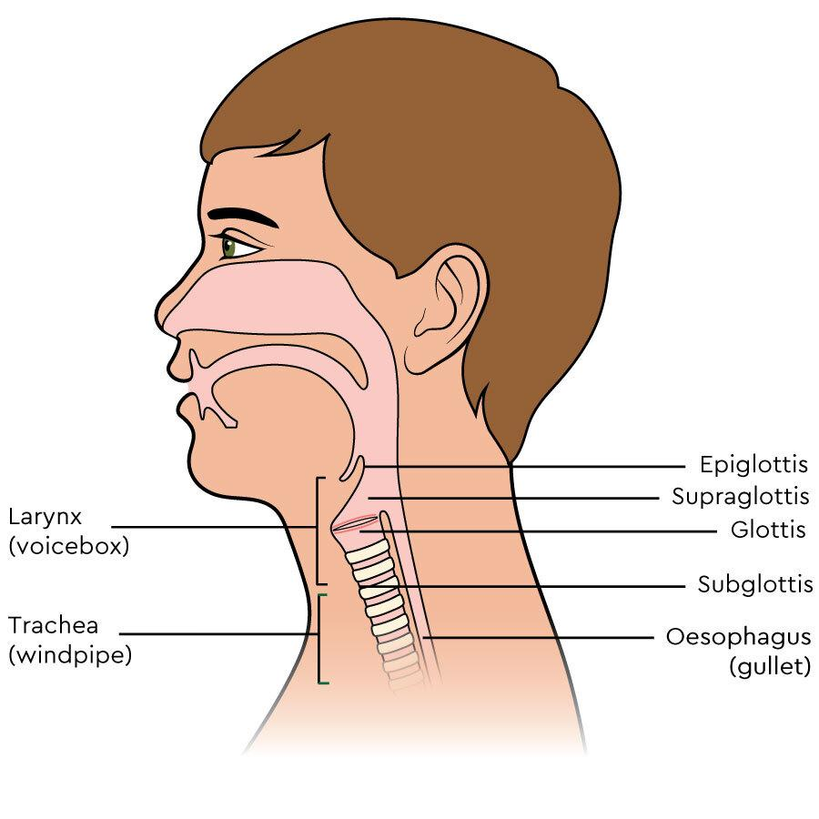
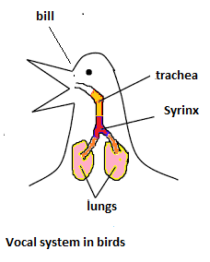
Day 2
Objective:
Students will be able to explain how birds are able to communicate (make calls).

Slide 8
Let’s review: What allows humans to speak?

Slide 9
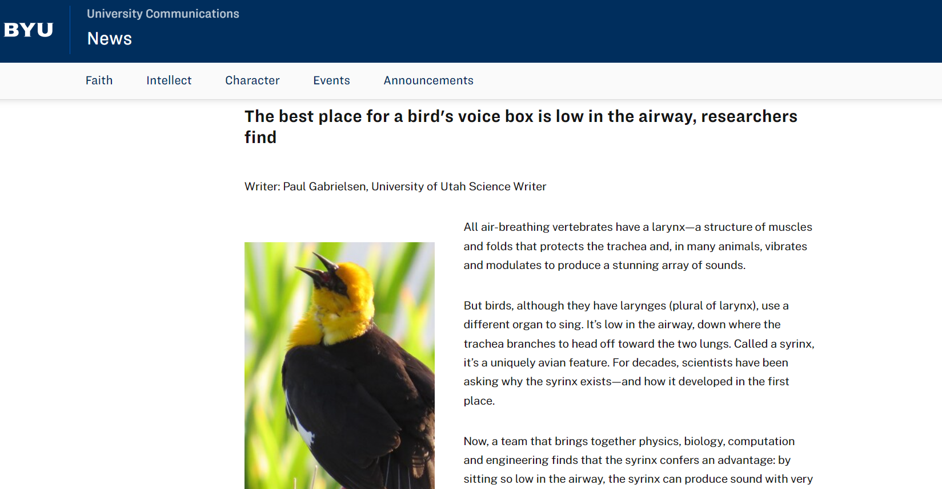
Let’s read about a bird’s voice box: https://news.byu.edu/news/study-reveals-birds-surprising-sound-source (link)

Slide 10
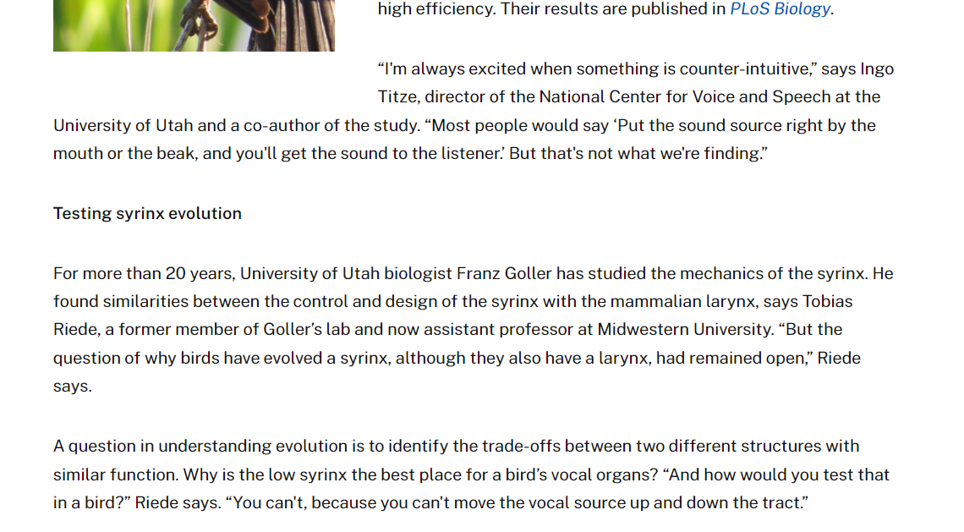

Slide 11
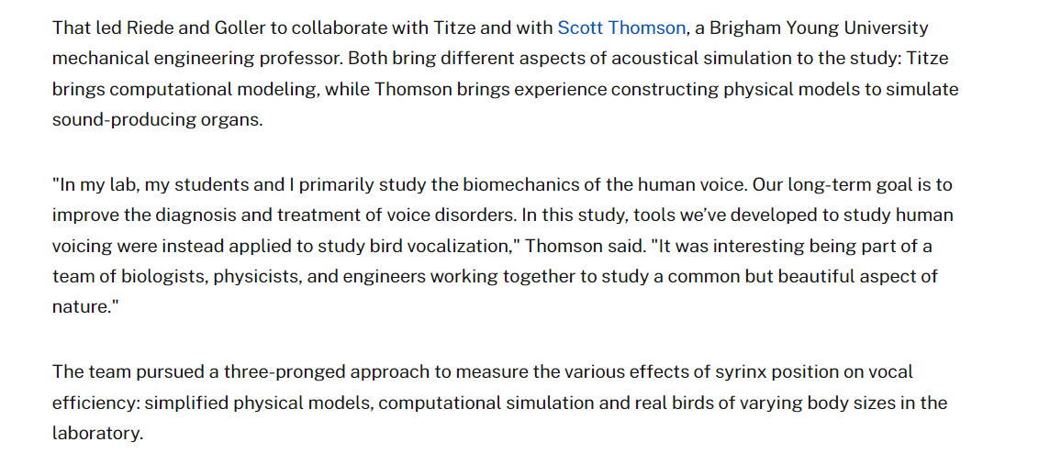
Reading continued:

Slide 12
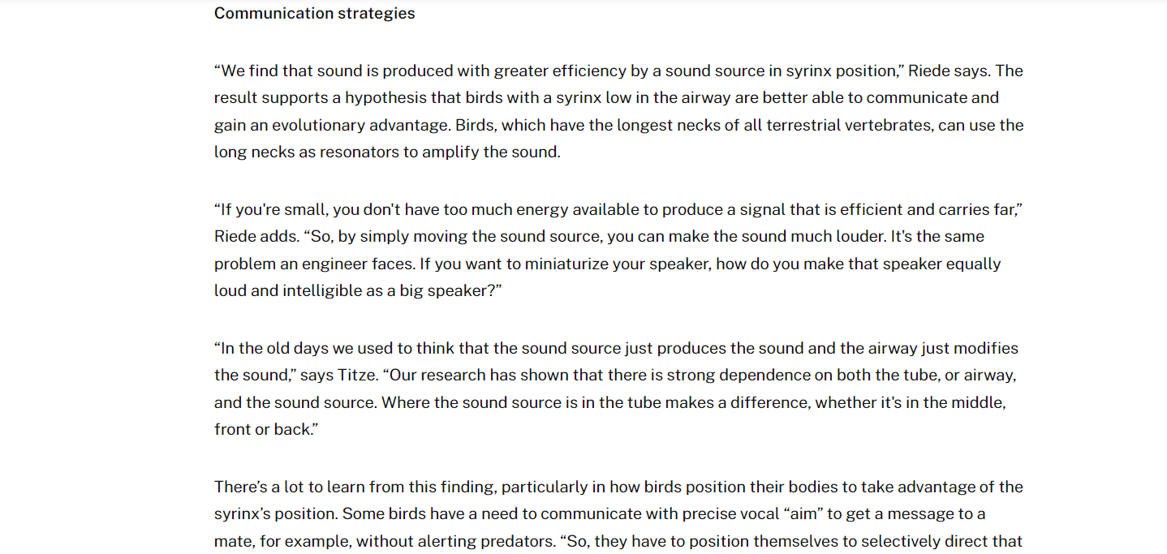
Reading continued:

Slide 13
Reading continued:

Slide 14
Based on the reading, how are birds able to make calls?

Slide 15
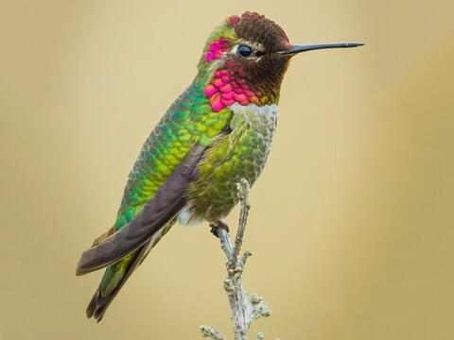
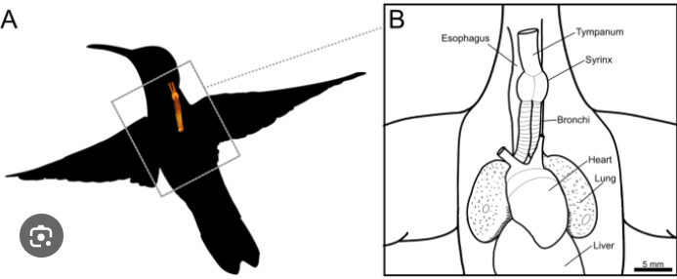
Let’s review
Anna’s Hummingbird

Slide 16
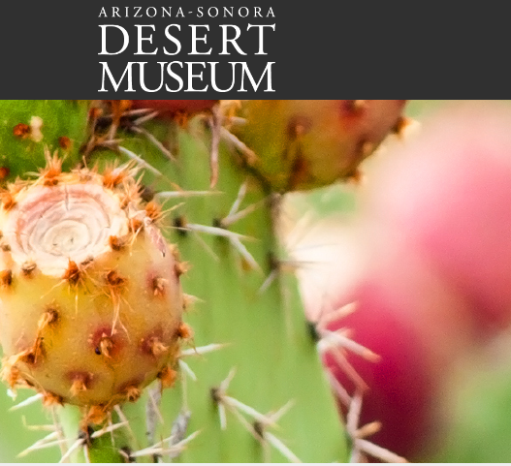
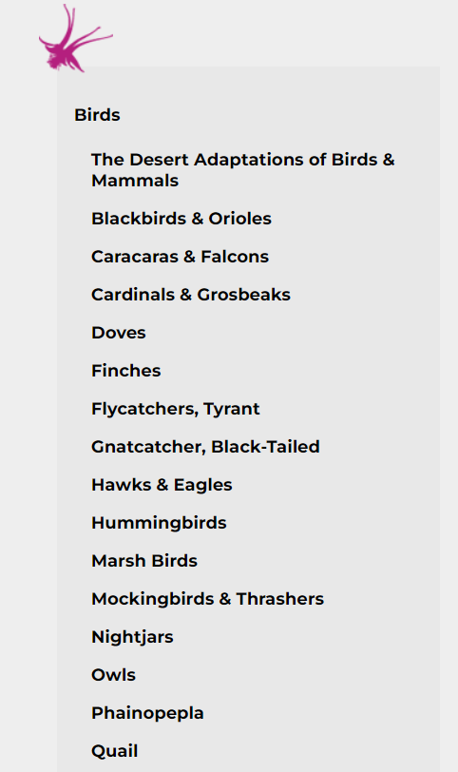
Day 3
Objective:
Students will select one of the birds identified in the Merlin Bird ID and research it to find out more about the bird’s habitat, feeding, and life history.

Slide 17
Bird Name:__________ Scientific Name:____________
Pick one of the birds you heard with the Merlin Bird ID and research the following using this website https://www.desertmuseum.org/books/nhsd_birds.php :
Draw the Bird
Write about their habitat
Write about what they eat
Write about their life history
Write about what makes this bird unique
Use complete sentences, check your grammar and spelling.

Slide 18
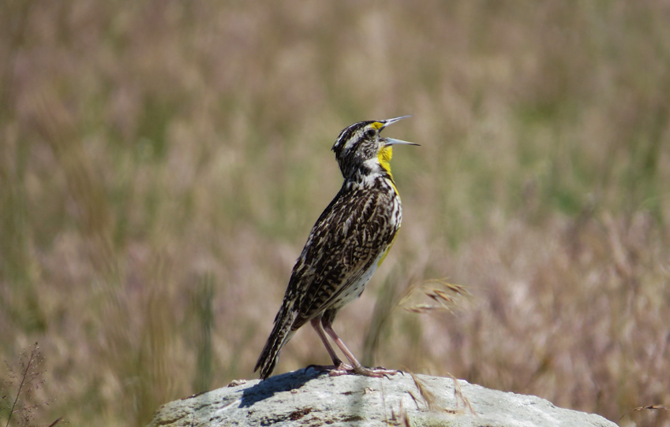
Exit Ticket
Explain the importance of why birds make calls.

