Slide 1
Lesson Overview:
In this lesson, students are introduced to what scientists do by practicing observation skills and using tools in a biology classroom. Students are provided an opportunity to experience blind contour drawing to help them build their observation and drawing skills.
Objective: Students will be able to practice making observations, asking questions about their observations, and connecting with their observations.
Grades: 9th to 12th grades, adaptable to middle school.
Time: 45 minutes
Author: Sokha Wise
Standards:
SIN 202. Understand the tools and functions of tools used in a simple experiment.
Essential HS.L1U1.20 Ask questions and/or make predictions based on observations and evidence to demonstrate how cellular organization, structure, and function allow organisms to maintain homeostasis.
Lesson Components include Lecture slides and student handouts

Slide 2
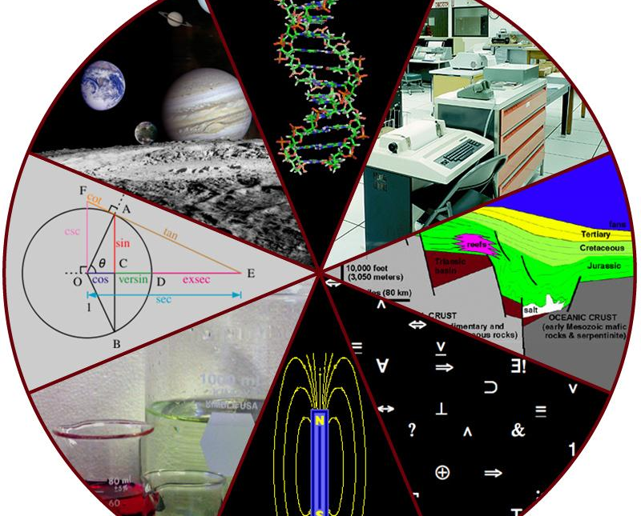
Introduction to Science:

Slide 3
BELL WORK: WHAT DO SCIENTISTS DO?

Slide 4
Learning Target: What am I learning?
I am learning about what scientists do and the different tools used by a scientist.

Slide 5
Success Criteria: How do I know I learned it?
I can use a variety of tools to perform an experiment.
I can identify the names and function of each tool.
I can make observations.
I can ask questions about my observations.
I can make connections with my observations.

Slide 6
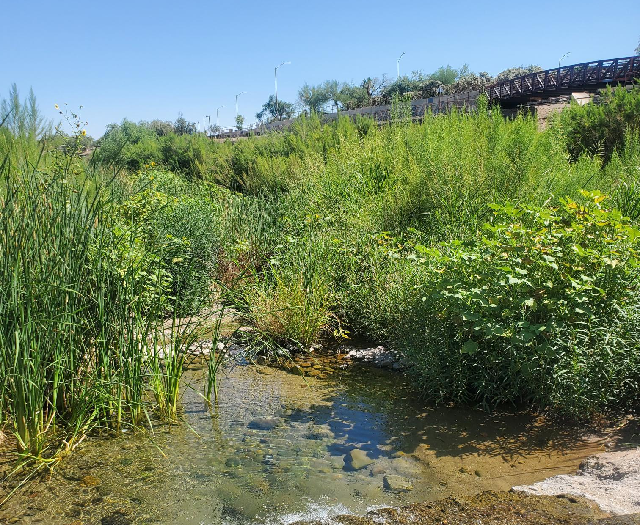
Why am I learning this?
To build awareness of the environment we live in and our connection to it.
Santa Cruz River at the Irvington site.

Slide 7
Agenda:
Lecture: What Do Scientists Do?
Assigned Activity: Blind Contour Drawing Practice
Assigned Activity: River Water Sample under a Microscope

Slide 8
What is science?
Science is about discovering how nature works.
Using that knowledge to predict and explain what is likely to happen in nature.

Slide 9
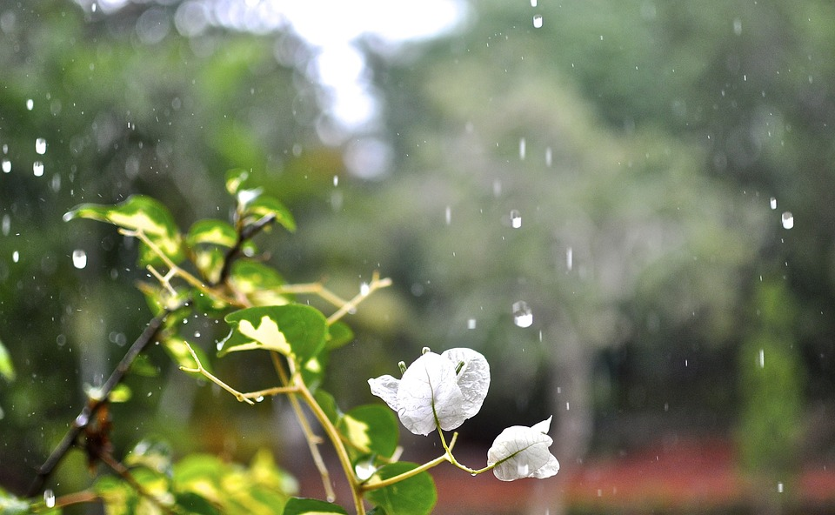
Scientists believe the world functions in a cause-and-effect pattern.
The idea that actions or events (causes) produce certain outcomes or results (effects).
Scientific questions are asked in a cause-and-effect format.
Cause
Verb
Effect
An increase in rain.
Creates
An increase in plant growth.

Slide 10
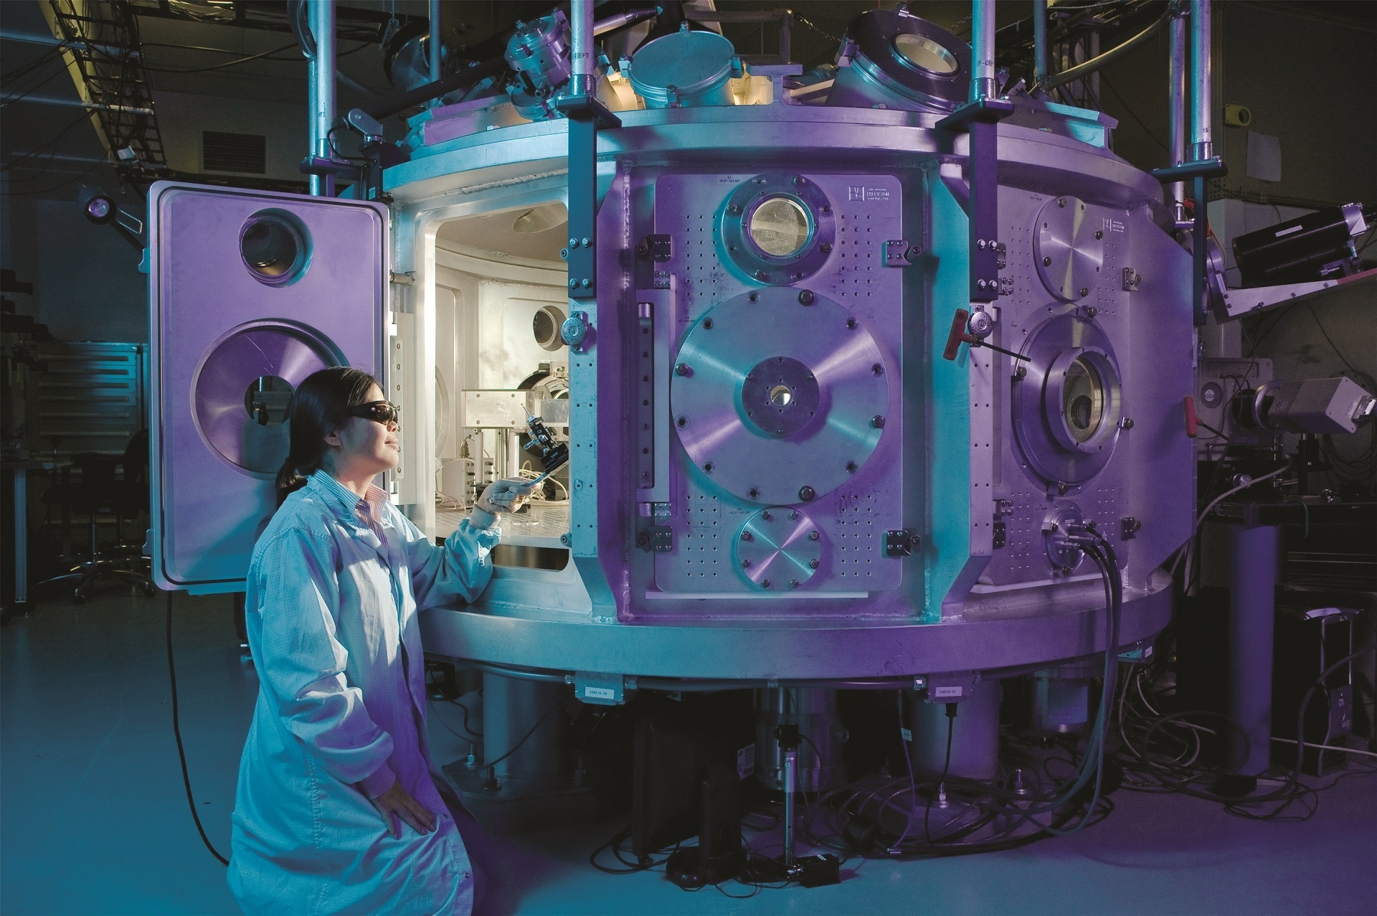
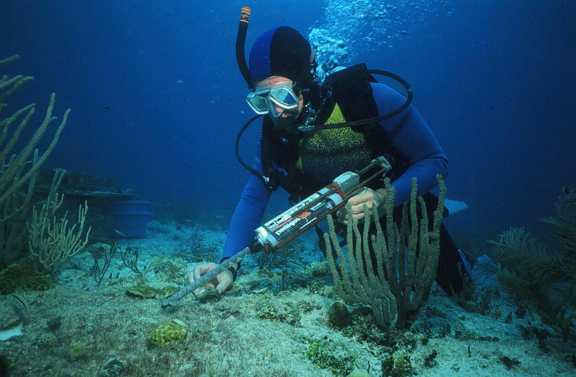
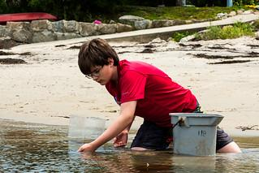
Scientists use observations, measurements, and experimentation to understand these patterns. This is part of the Scientific Method, a research process used by all scientists to learn about how nature works.

Slide 11
Different branches of science focuses on a different part of the natural world.
Natural Science
Earth and Space Science
Life Science
Physical Science
Geology: study Earth physical structure, processes, and history.
Astronomy: study the celestial objects and phenomena that occurs outside Earth's atmosphere.
Biology: study living things.
Chemistry: study elements and compounds that makes up matter and the reactions that occurs between them.
Physics: study of matter, its motion, and how it interacts with one another.

Slide 12
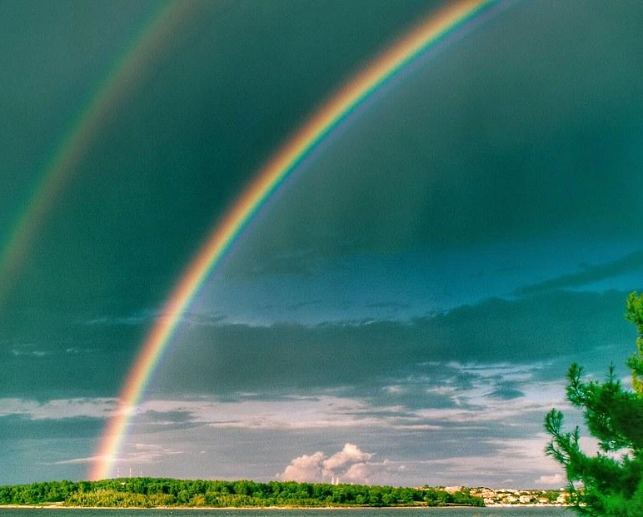
All science usually begin from observing a phenomenon.
A phenomenon is an observable event that occurs which causes you to wonder.
How is a double rainbow created?

Slide 13
There are four essential components to the nature and process of science.
Today we are focusing on this component.
Exploration and discovery
Testing ideas
Community analysis and feedback
Benefits and Outcomes

Slide 14
Exploration and Discovery involves…
Make observations
Scientific investigation usually begins with making observations and forming questions.
However, it can also begin with being inspired, from reading an interesting article, or from sharing ideas with someone.
Asking questions
Finding inspiration
Exploring the literature
Sharing data and ideas

Slide 15
Recording Observations Expectations
Qualitative observations: Using your 5 senses. Describe what you see, smell, taste, touch and hear.
Quantitative observations: Using numbers for measurements or counting the amount of something.
Draw or sketch what you see.
Make sure to always label your drawings.
We will practice using a technique called Blind Contour Drawing.

Slide 16
Assigned Activity: Blind Contour Drawing
Individual work. 10 minutes.
Pick a scientific tool to draw.
Focus your eye on some part of the object and begin moving your pencil to record what your eyes observe.
Do not look at your paper.
Pay attention to the shapes, lines, and contours of the object.
Move your pencil as your eyes move like an ant traveling along the edge of the object.

Slide 17
Class Discussion: Blind Contour Drawing Reflection
How do you feel doing this activity?
What is difficult about it?
What is easy about it?
What is a benefit from blind contour drawing?

Slide 18
Common Tools Use By Biologists. Write down the name of the tool you drew next to your drawing.
Microscopes
Microscope slides
Slide cover slips
Test tubes
Beakers
Graduated cylinders
Petri dishes
Pipette
Balance
Thermometers
Dissection kits

Slide 19
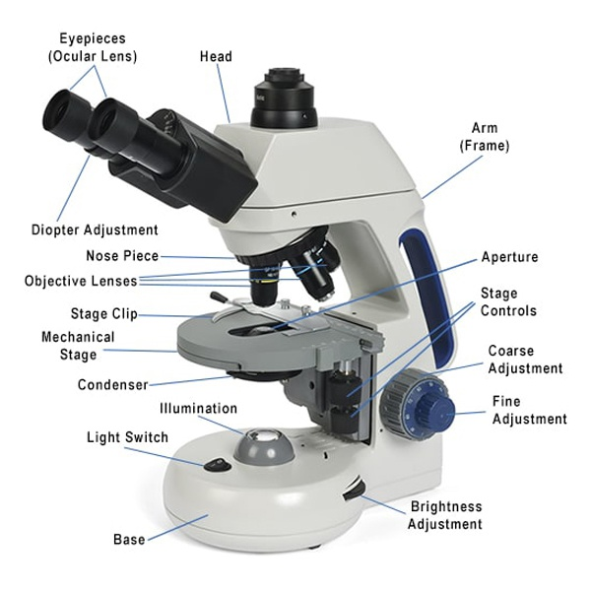
Assigned Activity: River Water Sample Under a Microscope
Use a pipette to collect a sample of river water and drop it onto your slide.
Place a cover slip over the specimen.
Observe specimen at the lowest power 4x. Use coarse knob first and then fine focus knob to see the specimen.
Move to a higher power each time.
Make sure to sketch your observations and label.
In notes, write what you wonder and what your observations reminds you of.

Slide 20
Learning Checks:
What skill does blind contour drawing work on?
Explain the purpose of phenomenon in science.
How do scientists collect evidence?

