Slide 1
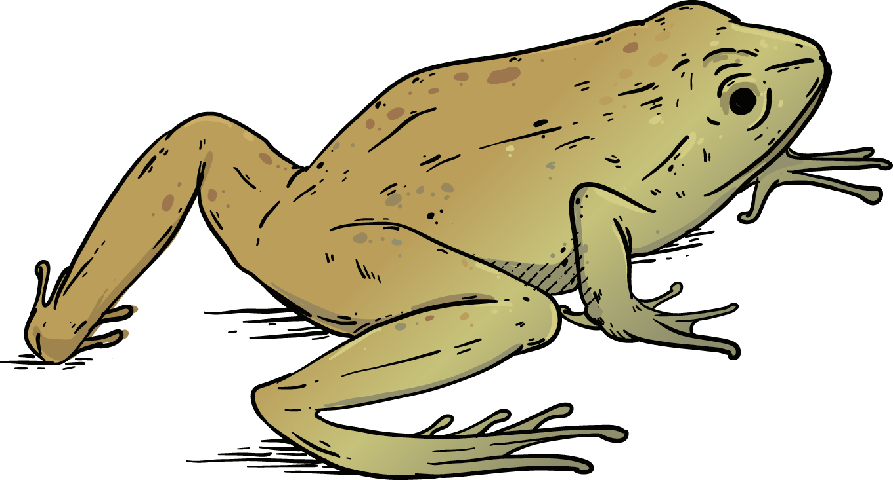
Lesson Details
In this lesson, students will be going outside to record and draw a living animal. They will use words and descriptions to describe the animal and it’s behavior, along with questions they have about the animal. They will also answer questions about limiting factors that species might have.
• Objective: Students will be able to recognize how organisms can be affected by living and nonliving things.
• Grade: 9th Grade
• Time required: 55-60 mins
• Author: Bianca Medina
• Standards: HS+B.L2.U1.1
Develop a model showing the relationship between limiting factors and carrying capacity, use the model to make predictions on how environmental changes impact biodiversity.

Slide 2
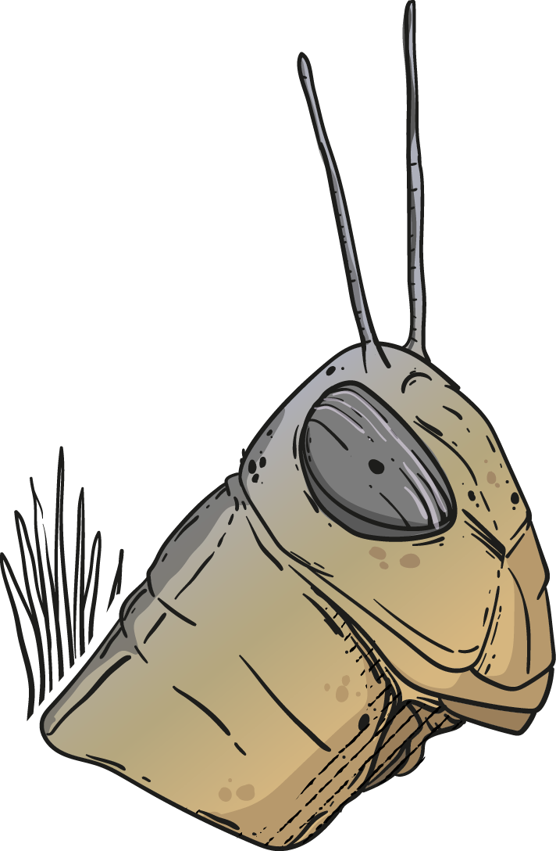
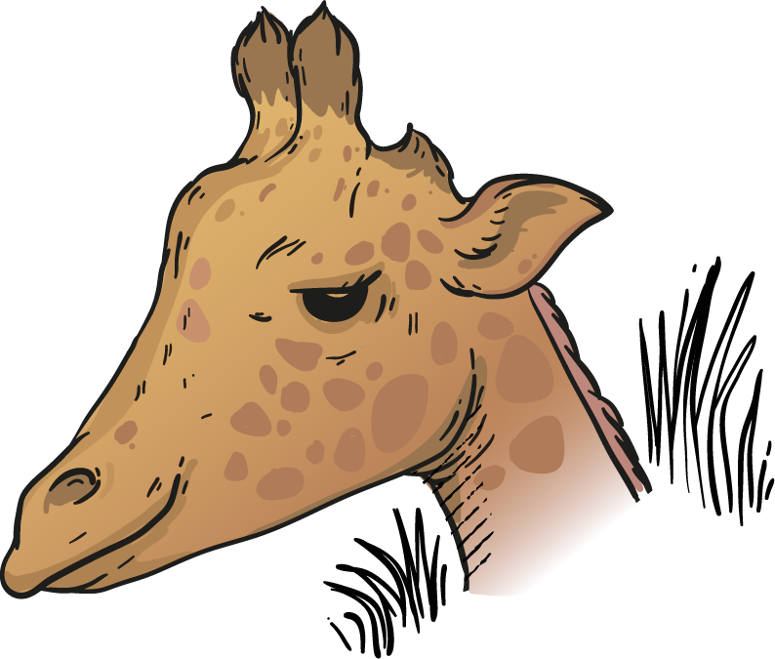
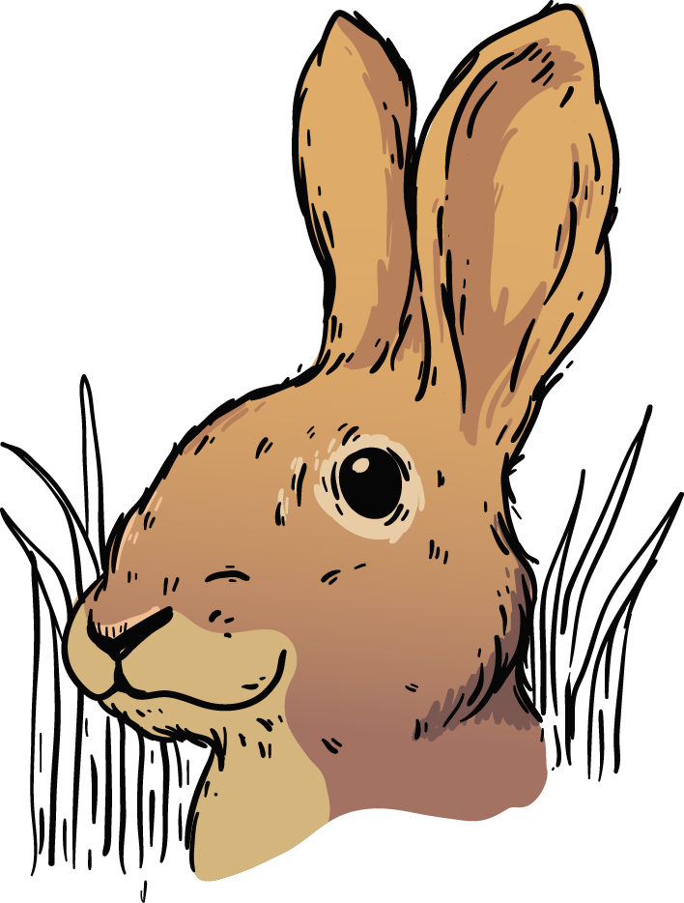
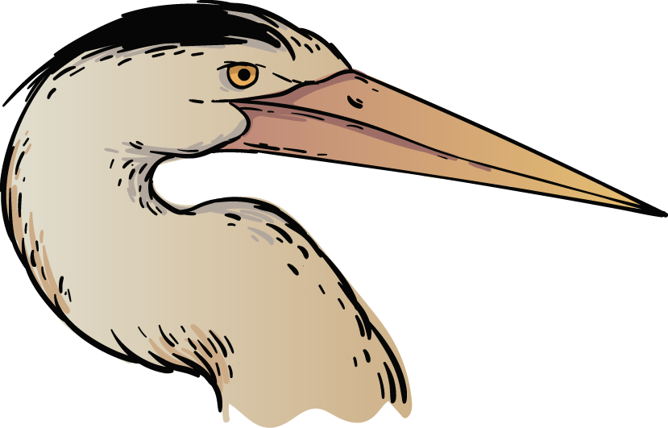
Animal Encounter
9th grade
You will need your nature journal.

Slide 3
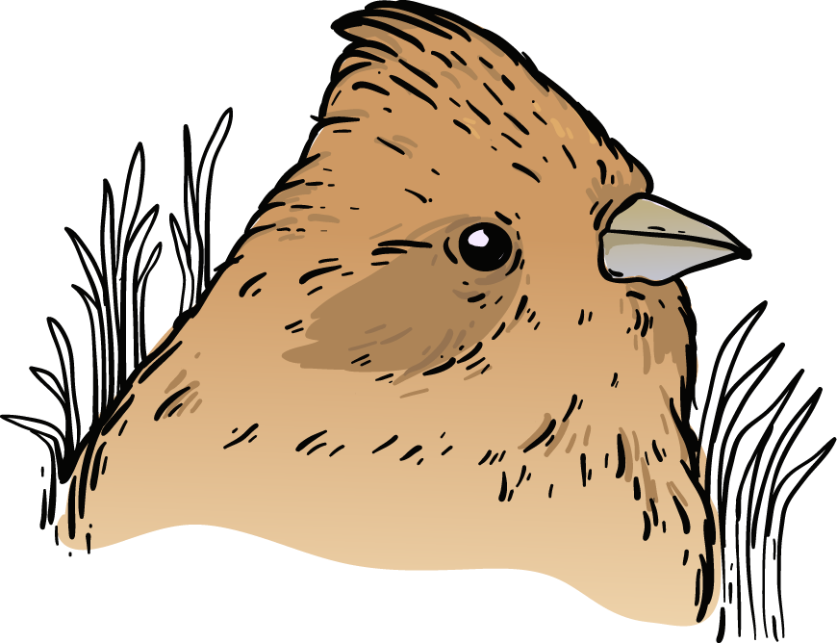
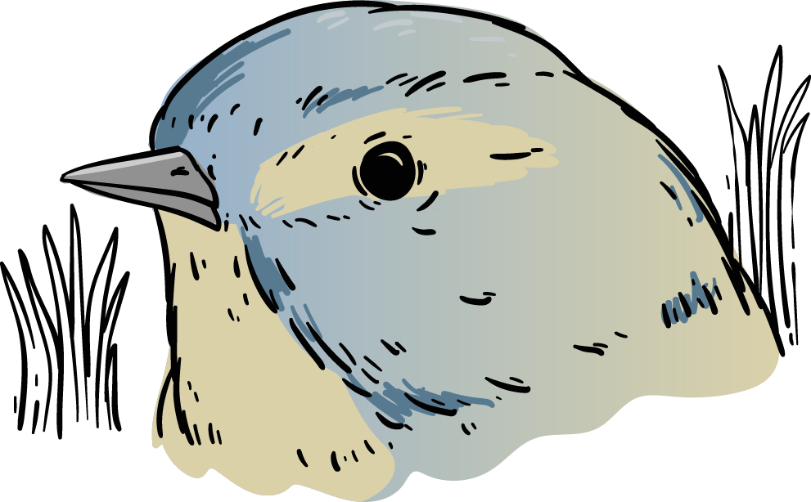
Outside: Select an animal to draw
Use pictures, words, and numbers to describe the APPEARANCE and BEHAVIOR.
At least 3 different drawings.
Observations (noticings)
Questions: I wonder…
“It reminds me of …”

Slide 4
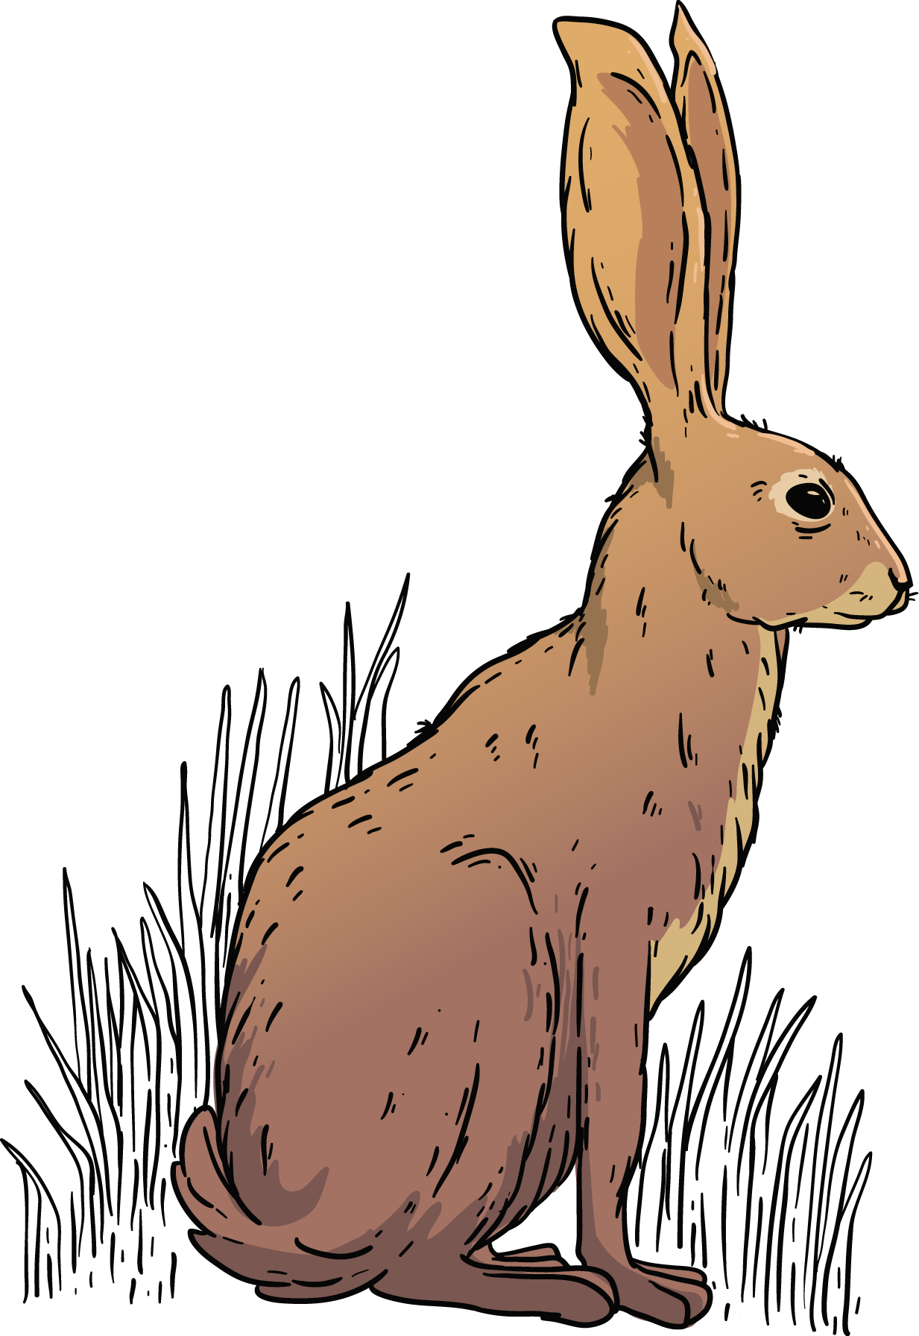
Cause and Effect
On the back of your Journal Entry:
Did you find any evidence that your animal may be affected by living or non living things in the environment? EXPLAIN

Slide 5
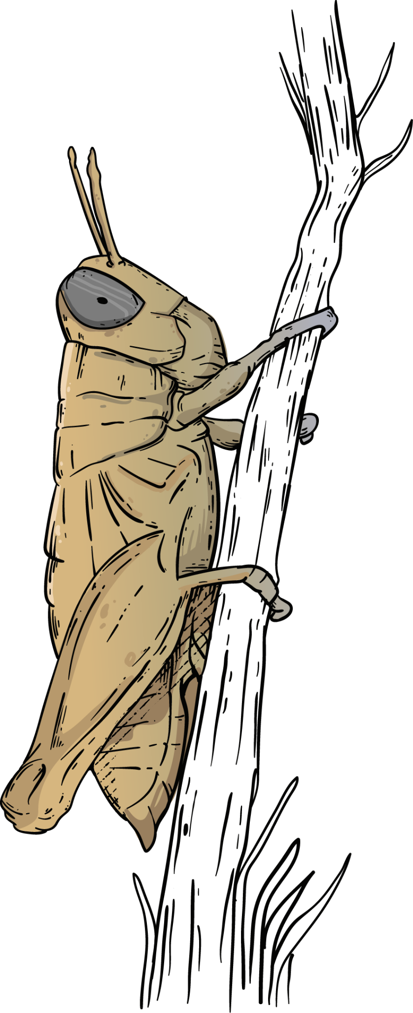
On the back of your Journal Entry:
How do you think your animal might affect living or nonliving things in the environment? EXPLAIN

Slide 6
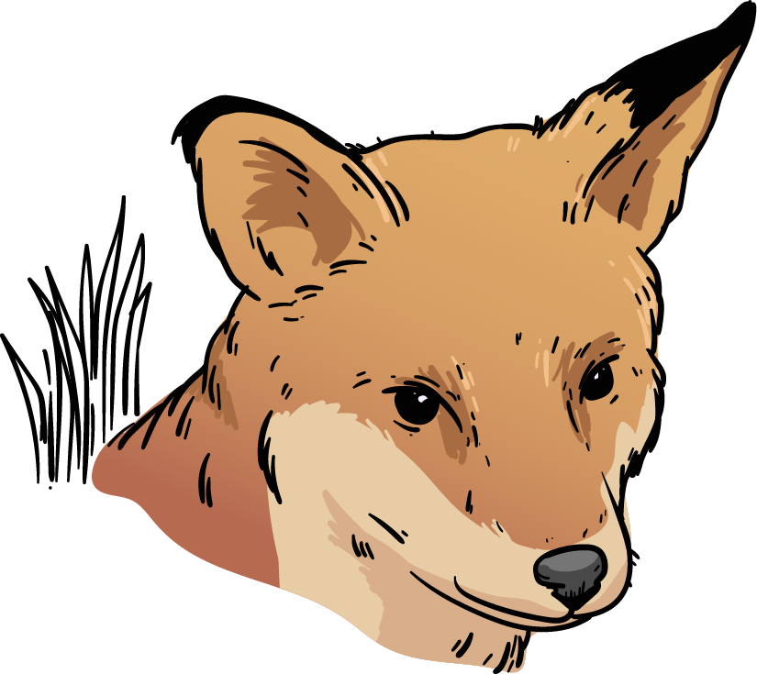
On the back of your Journal Entry:
How might your animal be affected by time of day, year, weather, or location? What kinds of things might cause this animal’s behavior to change?

Slide 7
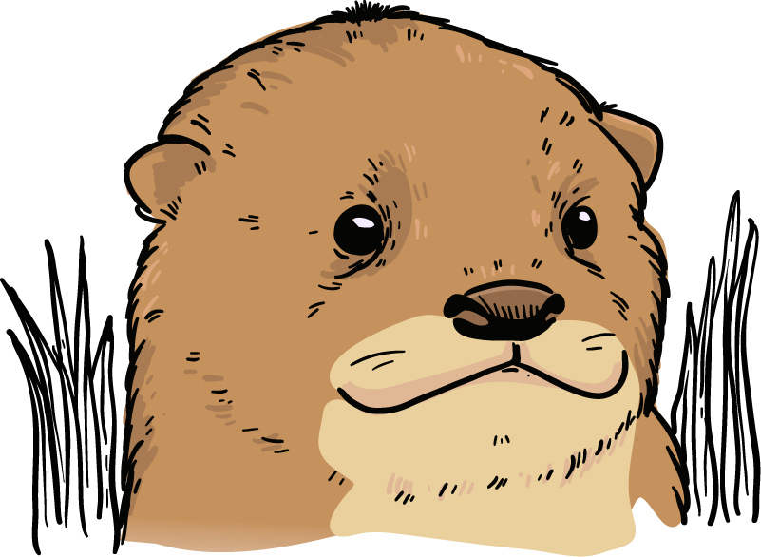
What factors affect your animal?
What does your animal affect?

