Slide 1
Instructions: This is a template for you to modify with your material. You can change the main (green) headings to better fit your project but plan to cover the main topics in the headings. None of the text needs to be kept unless it works for your lesson/activity. Use high resolution photos only. Required elements are the logos on top and the logos + text on bottom.
Reminders:
Tell your story with pictures instead of words!
Bullet points. Only 2 or 3 sentences together, and only in a few places.
You need to able to walk a person through your poster in 2 minutes (try this out with another teacher)
Put your poster on your smart board as 36 x 48 so you can see it printed size. (We are still waiting to confirm the size of provided poster boards. Your poster will be attached to the provided board.)
Make sure to add QR codes:
Your session at NSTA
Your lesson on our website
If your lesson is not on our site, still make a QR code for this URL: https://santacruz.arizona.edu/santa-cruz-river-lessons-and-activities
Poster Due Dates:
February 27 (Thursday): Full Draft Ready for review on Zoom at 5:30pm
March 17 (Monday) Final Presentation on Zoom at 5:30pm
March 20 (Thursday): Final poster emailed to Michael: mbogan@arizona.edu

Slide 2
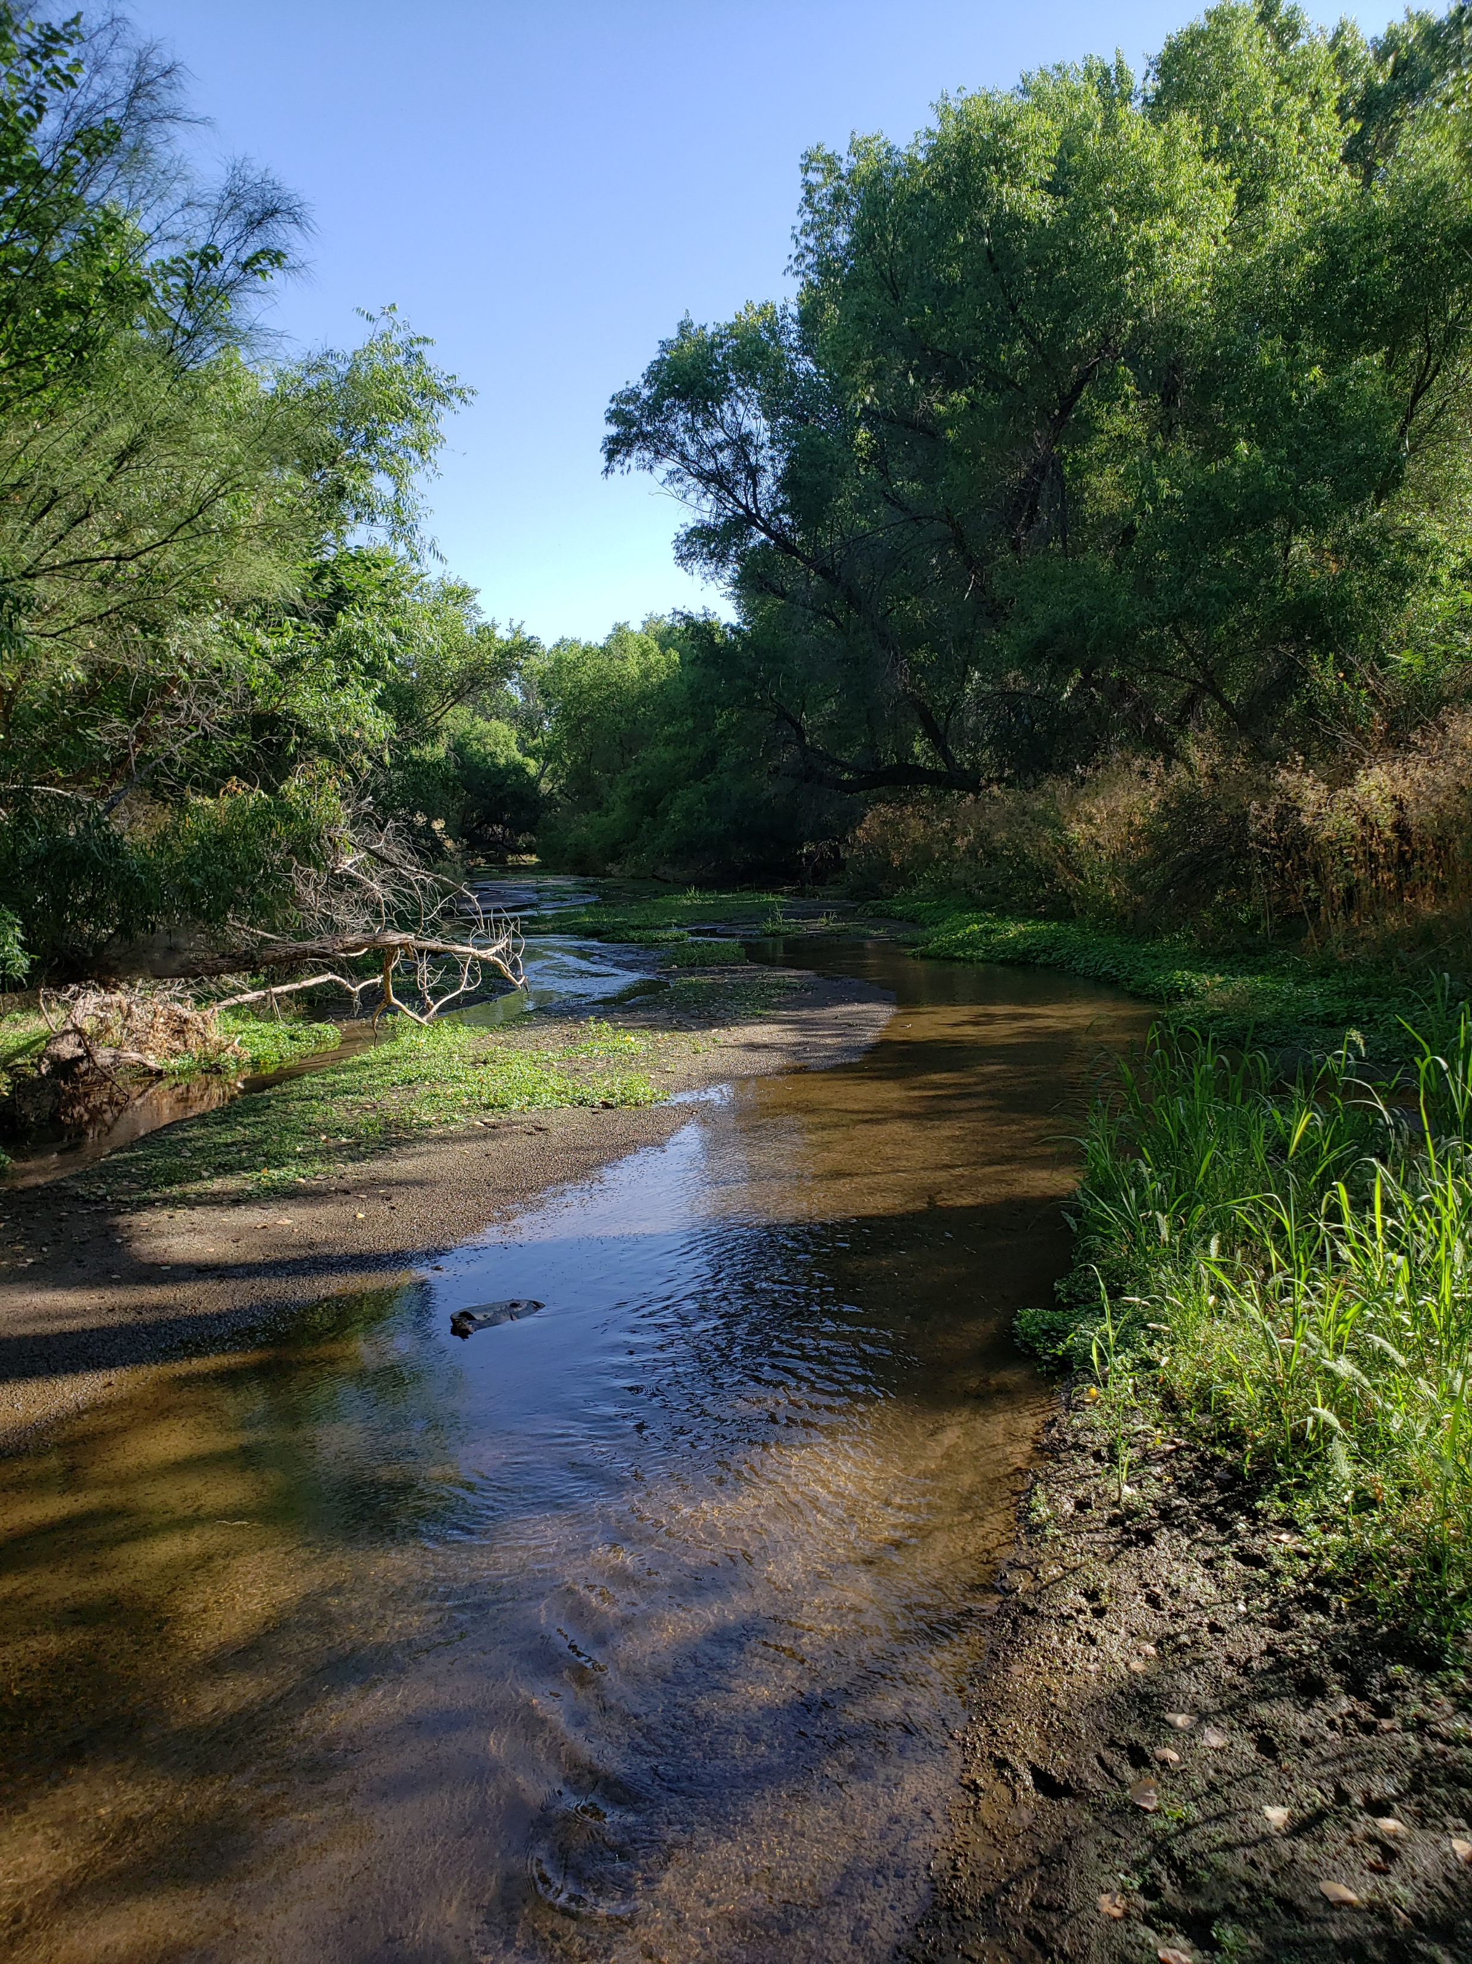
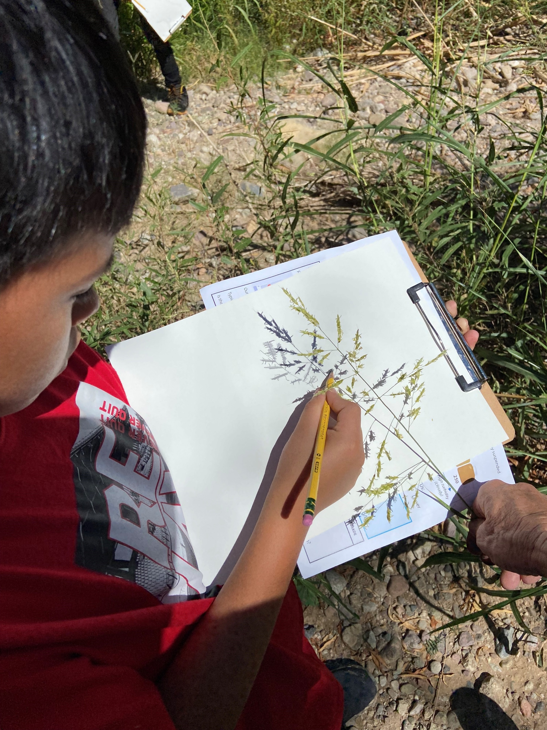
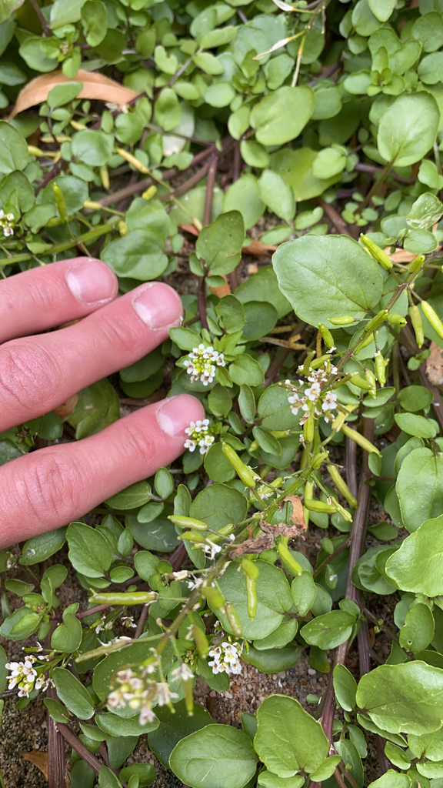
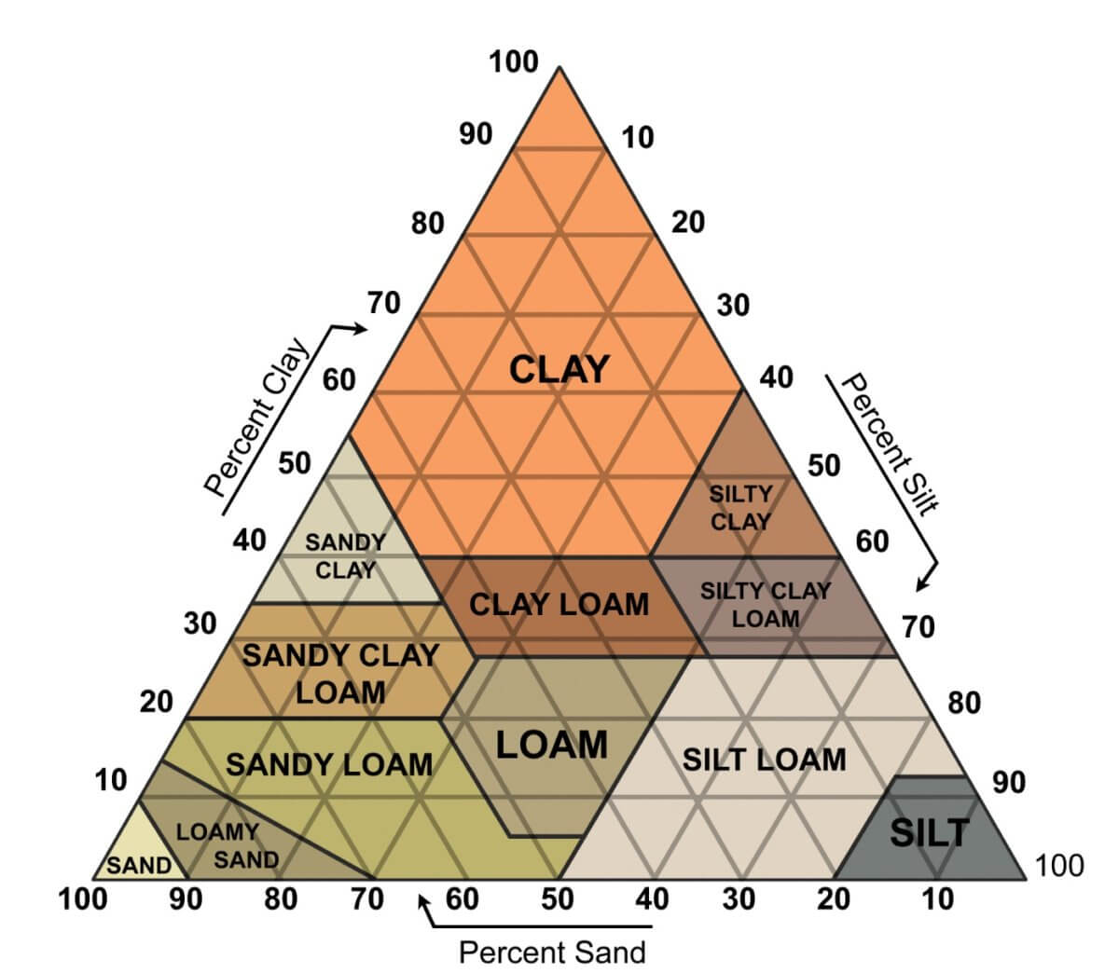
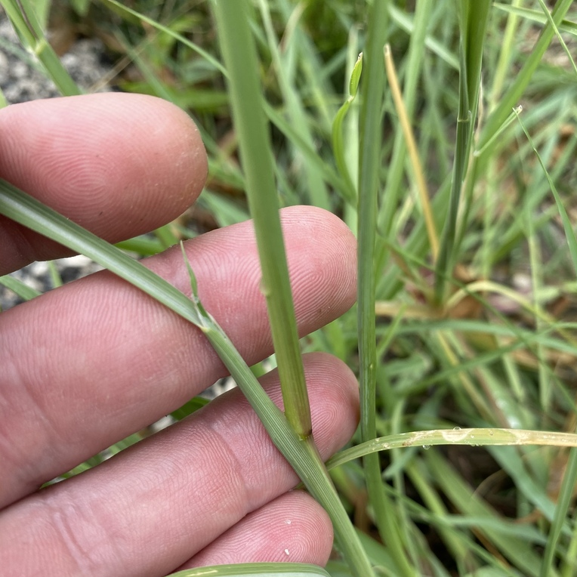
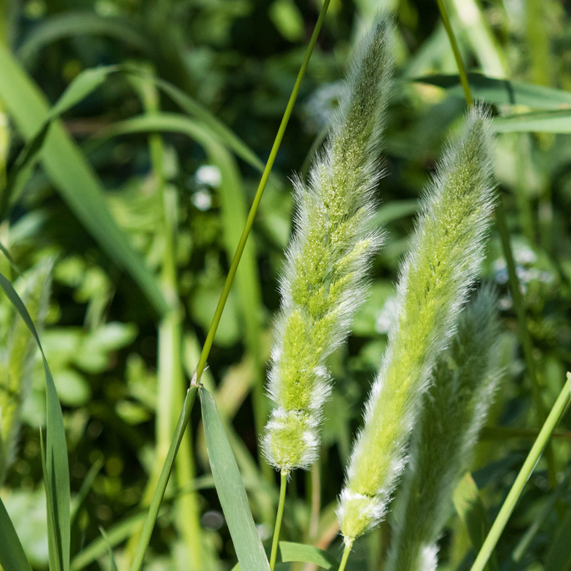
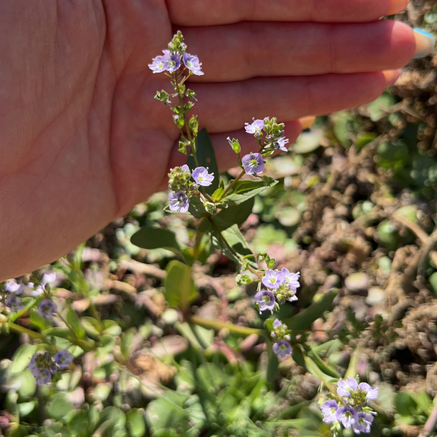
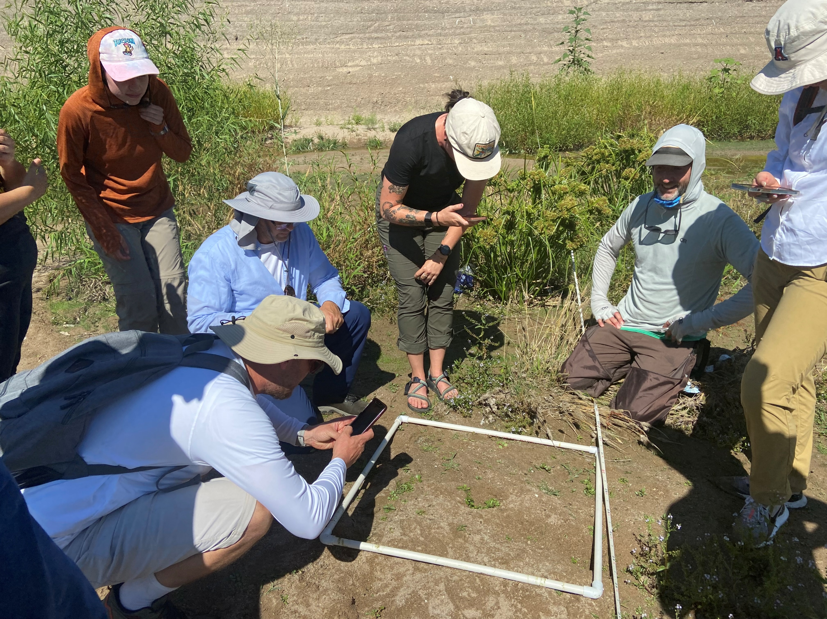
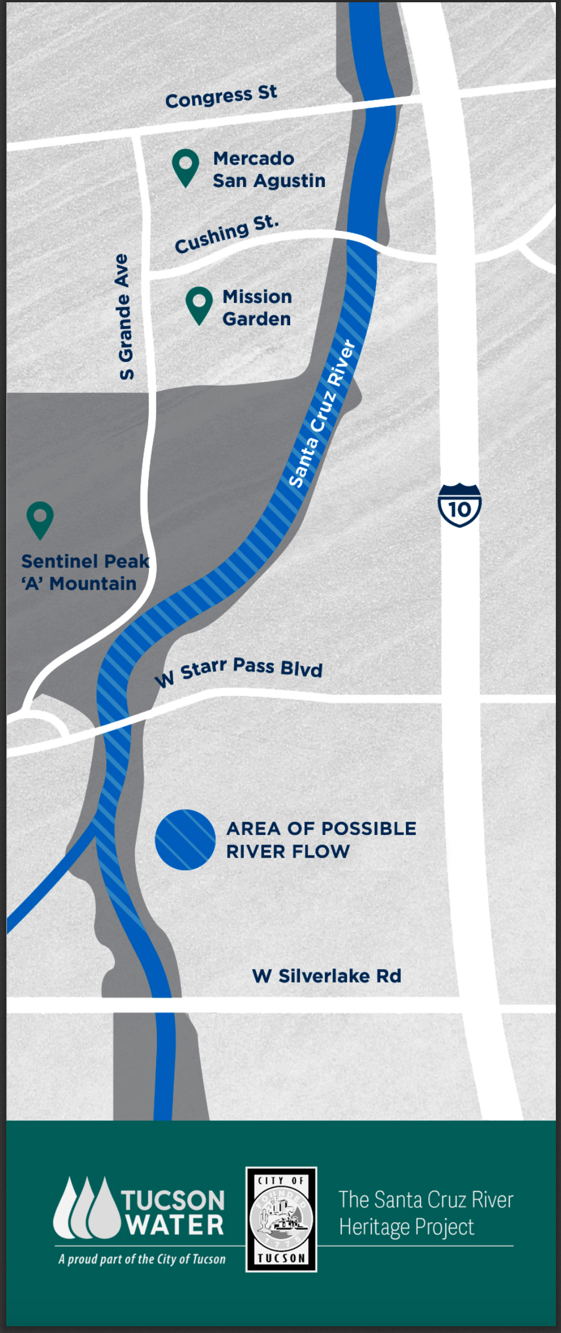
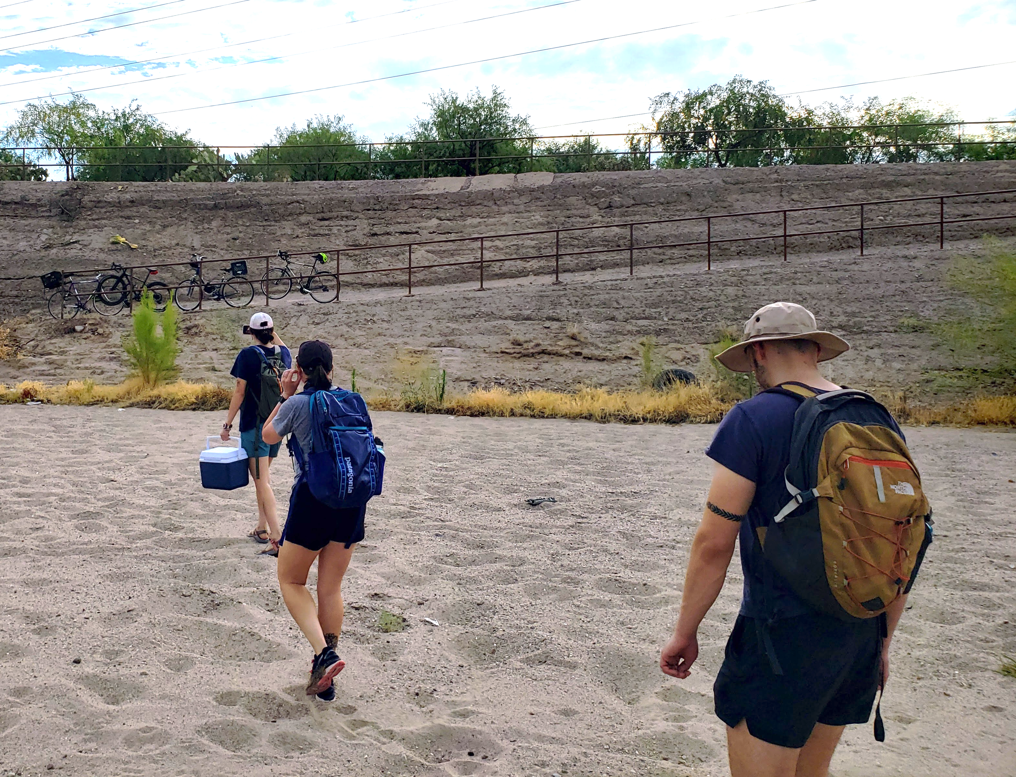
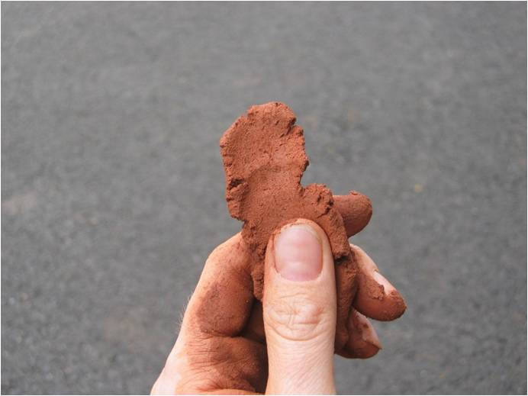
High School Middle School Lesson Title Goes Here
Subtitle if you have it
Your Name ▪ Your School ▪ BIORETS Santa Cruz River ▪ Tucson, AZ . .
Topic and Context
Describe
What are you doing
How are you doing it
Arid/place based context
FUN collage – imagery, students, draw viewers in with photo story telling
Consider large font quotes:
Student: “I love graphing my music choices!”
Student/teacher: “Aha moment”
Testing/teacher: “Test scores have gone up since I begin teaching this material”
Outcomes/teacher: “Everyone made a graph”
Discussion of Outcomes
Connections to other content, cross curricular connections, modifications possible
Student engagement
Academic results
Personal/teacher focused Reflection
What would you do differently? What would you do more of?
Time?
Focus?
Challenges?
Success?
More
Why?
Inspiration?
BIORETS?
Learning Objectives or Goals
State the Objective or list as bullet points
Include teacher objectives ie easy to implement, cost of materials etc
Soil texture field testing
Aerial cover
Leaf mass
Text
The Santa Cruz River
Lesson Skills in BIG letters
graphing
data collection
data visualization
hypothesis generation
Picture caption
Nasturtium officinale
“Watercress”
Picture caption
Materials and/or previous knowledge
Materials:
Water to dampen soil
Trowels to collect soil samples
Reference sheets with the soil texturing flowchart and soil texture triangle
BIORETS Santa Cruz River
The BIORETS Santa Cruz River program is for middle and high school science teachers. The focus is on teachers conducting ecological research alongside University of Arizona professors and graduate students on the Santa Cruz River. Teachers learned from a wide array of stakeholder groups including county, city, and water utilities staff, and non-profit organizations working with the Santa Cruz River. Teachers worked concurrently to develop curriculum to bring the Santa Cruz River back to the classroom. Lessons and activities, including field trips, were implemented during the following school years.
Diplachne fusca
“Sprangletop”
Polypogon monspeliensis
“Rabbitfoot grass”
Veronica anagallis-aquatica
“Blue Water-Speedwell”
Consider adding WHERE (start with US map)
Come to my session!
Put your words here describing your session and other BIORETS sessions at the conference. Consider adding a QR code to the session listing on the NSTA site.
State Standards/NGSS (ideally)
Standard
Standard
Standard
Download Lesson Materials
QR Code to Lesson on website
Santacruz.arizona.edu/educators
Figure 7 – Collecting at Santa Cruz River Heritage Site
Picture caption
Get In Touch
Please feel free to reach out with
any comments or questions to: NAME@SCHOOL EMAIL.ORG
NSF Award #2143228 BIORETS: Conserving water resources and riparian biodiversity in a changing desert climate
Picture Caption
santacruz.arizona.edu

