Slide 1
How to use this slide deck
Hidden slides are teacher notes
Speaker notes include details on data being used in that lesson

Slide 2
Dear Data
A Year-Long Data Collection and Visualization Project!

Slide 3
What is dear data?
Dear Data was a pen-pal project between Giorgia Lupi and Stefanie Posavec. They took stock of their daily lives by creating postcards that displayed the data they collected from their day-to-day in a fun, visually different way.

Slide 4
What are the benefits?
Allow students to engage and analyze data in unique ways.
Encourage students to show how they view data through art.
Helps the development of data literacy and basic science skills (collecting, analyzing, and visualizing data)

Slide 5
Objective:
The purpose of this slide deck is to provide students an opportunity to engage with data, explore creative visualization of data, develop data literacy skills, practice collaboration, and reflection/feedback skills.

Slide 6
Quarter 1

Slide 7
Purpose
Quarter 1 is designed to give students a chance to work with their group to analyze data and display it in non-standard ways.
This will give students a chance to get comfortable with reading data and with exploring visualizations.

Slide 8
Week 1
Over the course of the next few weeks you will be receiving various sets of data that you will analyze and then visualize.
Your visualizations can be done in any way you feel represents the data best. There is only one rule…your visualizations should not be graphs.

Slide 9
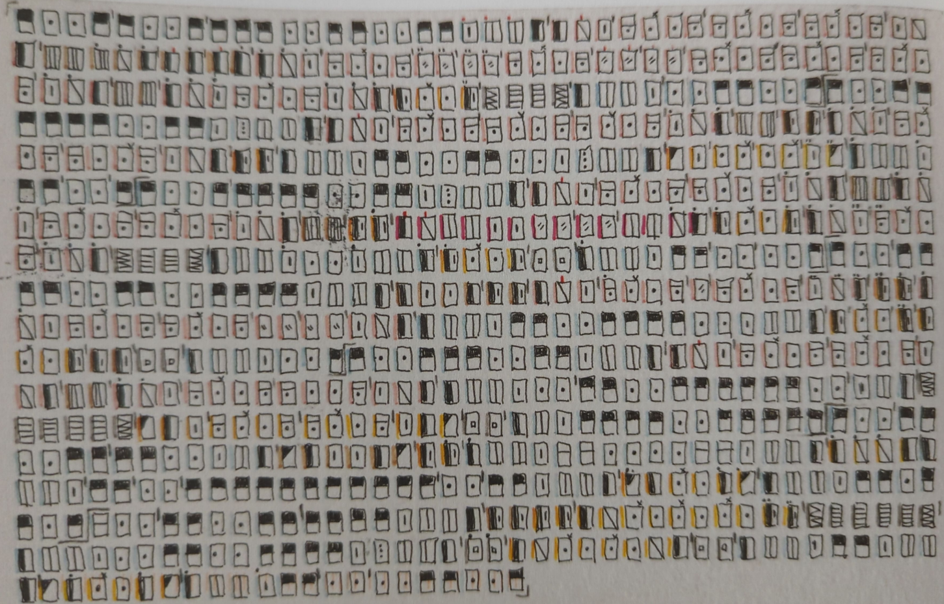
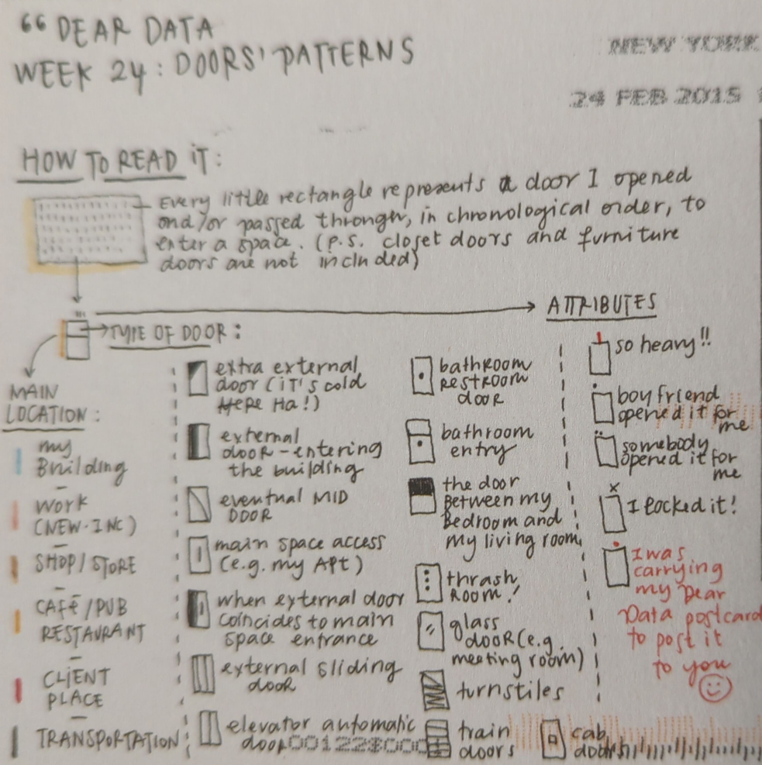
Examples of visualizations

Slide 10
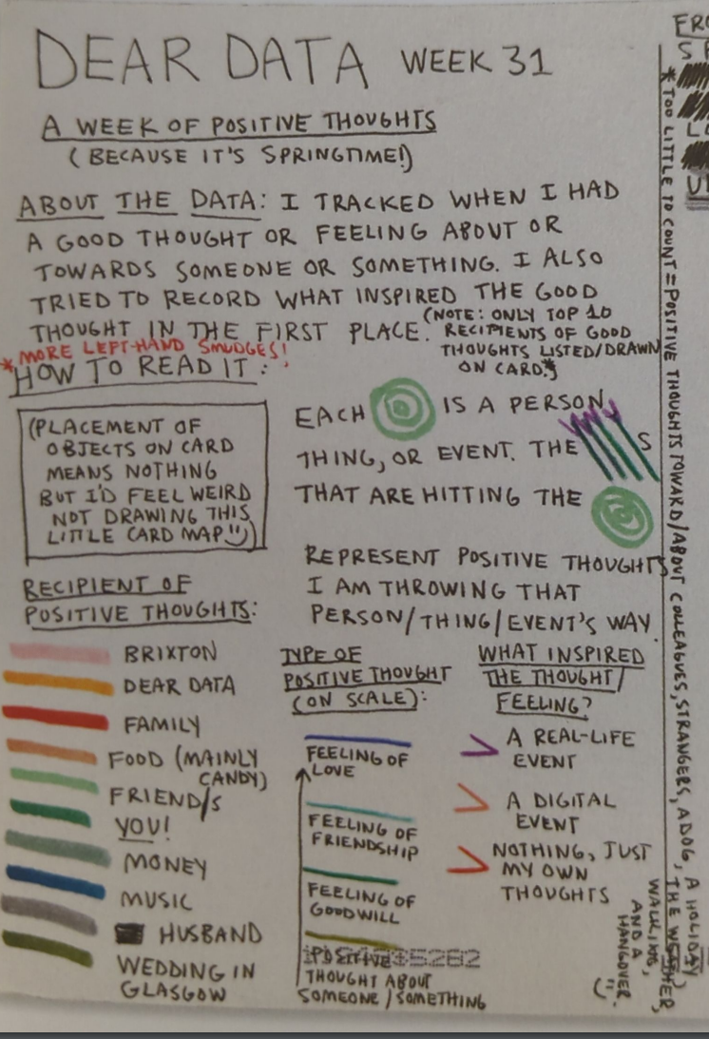
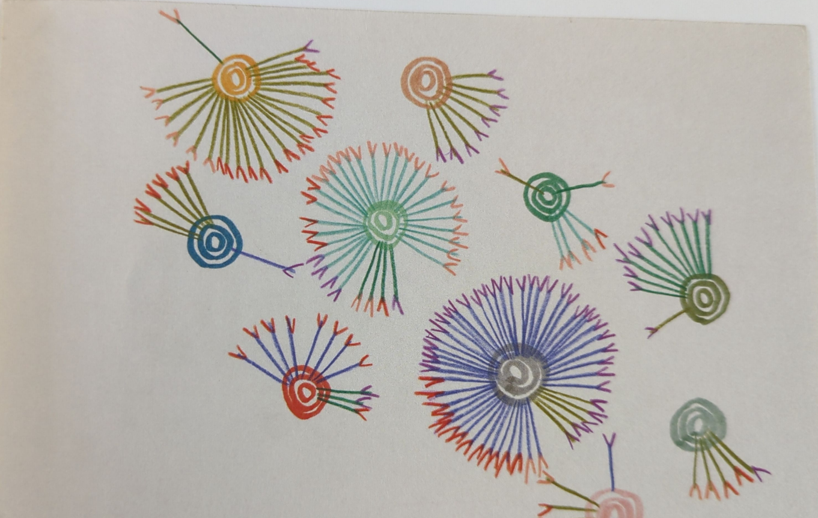

Slide 11
Week 1
Days 1 & 2: Exploring the Data
Activity: Review the attendance data.
Discussion Prompts:
What do you notice?
What do you wonder?
Day 3: Class Discussion on Visualization
Activity: Discuss as a class how to visualize the data.
Group Discussion: Write down all ideas for visualizing the data.
Reminder: There is no right or wrong way to display this data.
Day 4: Planning and Starting Visualizations
Group Activity: With your group decide how you might visualize the data.
Task: Begin working on creating a visualization of the data.
Notes:
Encourage students to display the data in a way that is meaningful to them. They can draw a bunch of people and color them in to represent the different parts (present or absent). They can use different colors to represent different days, for example, green is present on Tuesday and blue if for Wednesday.
Remind students that there is NO right or wrong answers.
*****For Week 4 - Gather boy/girl data from each classroom/grade. If unavailable from the office, ask teachers for their data.

Slide 12
Week 2
Day 1: Continue Visualizing Data
Activity: Continue working your data visualizations with your group.
Day 2: Gallery Walk
Activity: With your group, look at the different visualizations that each group created.
Reflection Prompts:
What do you notice or wonder about the visualizations?
What questions arise from viewing the data in different ways?
Day 4: Class Discussion
Activity: Discuss the observations and questions from the gallery walk.
Day 5: Second Gallery Walk with Feedback
Activity: Conduct another gallery walk.
Feedback Prompts:
What would make the data easier to read?
Which part of the representation is the most effective?
How could you use what you have seen in your own visualizations?
Notes:
****For Week 4 - Gather boy/girl data from each classroom/grade. If unavailable from the office, ask teachers for their data.

Slide 13
Week 3
Day 1: Measuring Heights
Activity: Partner up and measure each other's height.
Task: Write your height on the poster labeled "Student Heights."
Discussion: Observe the data. What patterns do you see?
Day 2: Brainstorming Visualization
Group Discussion: How can we display this data creatively (without using a graph)?
Activity: With your group, select a unique method for visualizing the data and start working on it.
Day 4: Visualization Development
Activity: Continue working on your data visualization.
Day 5: Gallery Walk
Activity: Walk around the room and observe the different data visualizations created by your classmates.
Reflection and Discussion:
What do you notice and wonder about the visualizations?
What questions do you have about the data or the chosen display methods?
Notes:
For Week 4 - Gather boy/girl data from each classroom/grade. If unavailable from the office, ask teachers for their data.

Slide 14
Week 4
Day 1: Exploring the Data
Activity: Look at the data titled: “Boy/Girl numbers by classroom”
Discussion: Observe the data. What patterns do you see?
Day 2: Discussion and Visualization Planning
Class Discussion: How can we visualize this data in a non-standard way?
Activity: Begin creating a visualization with your group based on the discussed ideas.
Day 4: Finalizing Visualizations
Activity: Finish and polish your visualizations.
Day 5: Gallery Walk
Activity: Walk around the room and observe the different data visualizations created by your classmates.
Reflection:
What do you notice or wonder about the visualizations?
What questions arise from viewing the data in different ways
Notes:
Prior to class start: Gather boy/girl data from each classroom/grade. If unavailable from the office, ask teachers for their data.

Slide 15
Week 5
Day 1: Exploring the Data
Task: On the poster labeled “screen time”, estimate the number of hours per day that you are on electronics (phones, video games, etc.)
Discussion: With your group, observe the data. What patterns do you see?
Day 2: Brainstorming Visualization
Class Discussion: How can we visualize this data in a non-standard way?
Activity: Begin creating a visualization with your group based on the discussed ideas.
Day 4: Finalizing Visualizations
Activity: Finish and polish your visualizations.
Day 5: Gallery Walk
Activity: Walk around the room and observe the different data visualizations created by your classmates.
Reflection:
What do you notice or wonder about the visualizations?
What questions arise from viewing the data in different ways

Slide 16
Week 6
Day 1: Exploring the Data
Task: On the poster labeled “How students get home”, place a tally under the category that describes how you go home each day.
Discussion: Observe the data. What patterns do you see?
Day 2: Brainstorming Visualization
Class Discussion: How can we visualize this data in a non-standard way?
Activity: Begin creating a visualization with your group based on the discussed ideas.
Day 4: Finalizing Visualizations
Activity: Finish and polish your visualizations.
Day 5: Gallery Walk
Activity: Walk around the room and observe the different data visualizations created by your classmates.
Reflection:
What do you notice or wonder about the visualizations?
What questions arise from viewing the data in different ways
Notes:
For Week 7 - Ask the office about student Enrollment type - open vs in district enrolled students.

Slide 17
Week 7
Day 1: Exploring the Data
Discussion: Observe the data. What patterns do you see?
Day 2: Brainstorming Visualization
Class Discussion: How can we visualize this data in a non-standard way?
Activity: Begin creating a visualization with your group based on the discussed ideas.
Day 4: Finalizing Visualizations
Activity: Finish and polish your visualizations.
Day 5: Gallery Walk
Activity: Walk around the room and observe the different data visualizations created by your classmates.
Reflection:
What do you notice or wonder about the visualizations?
What questions arise from viewing the data in different ways
Notes:
For this week you will need to ask the office about student Enrollment type - open vs in district enrolled students.

Slide 18
Week 8
Day 1: Exploring the Data
Task: On the poster titled “Siblings”, place a tally under the number of siblings you have.
Discussion: Observe the data. What patterns do you see?
Day 2: Brainstorming Visualization
Class Discussion: How can we visualize this data in a non-standard way?
Activity: Begin creating a visualization with your group based on the discussed ideas.
Day 4: Finalizing Visualizations
Activity: Finish and polish your visualizations.
Day 5: Gallery Walk
Activity: Walk around the room and observe the different data visualizations created by your classmates.
Reflection:
What do you notice or wonder about the visualizations?
What questions arise from viewing the data in different ways

Slide 19
Week 9
Day 1: Exploring the Data
Activity: Each group presents their favorite data visualization project from the term.
Day 2: Continuation and Feedback
Activity: Continue presentations if needed.
Feedback: Provide constructive feedback and celebrate the students' work.
Day 3: Final Review Session
Activity: Summarize key concepts learned throughout the term.

