Slide 1
Air Pollution and Art, part 1
A 6th grade STEM lesson
created by Rachel Carpenter
Notes:
Title Slide
Include the grade level, your name, and the date submitted/created

Slide 2
Notes for teachers
List of Materials
slide deck and ability to display for students
devices for students to access the internet (could be in pairs)
air pollution sources notetaker (copies for students)
air pollution sources info cut into strips (each pollutant on a separate strip without the name of the pollutant)
completed air pollutions grids (per pair of students)
whiteboards and dry erase markers (per student or per small group; could use virtual version or plickers)
This lesson provides context for the 6th grade physical science standards dealing with matter. It enables students to anchor their learning in real world issues.
Students build on this knowledge in the following lesson, Air Pollution and Art, part 2.
Notes:
Notes and Materials: This slide can be hidden or skipped when delivering the lesson.
See the example lesson for ideas of what to include. This should be any specific notes that would be helpful for a teacher who downloads this lesson. You should also include any details of the context (taught in a class, club, etc.) Also, a detailed list of materials needed for the activity.

Slide 3
Standards
Standards
1.a Ask questions that arise from careful observation of phenomena, models, or unexpected results.
1.b Ask questions to clarify or identify evidence and the premise(s) of an argument.
6 e Apply scientific knowledge and evidence to explain real-world phenomena, examples, or events.
6.P1U1.3 Develop and use models to represent that matter is made up of smaller particles called atoms.
Notes:
Standards: A list of standards aligned to the activity.

Slide 4
Objective(s):
Today I will:
interpret air quality data.
research the 6 criteria pollutants to identify sources, health, and environmental effects.
Notes:
Objective(s): Please include one or more objectives for your lesson (1-3 minutes)

Slide 5
Agenda (70 minutes)
slow reveal graph (warm up)
video (whole class)
research criteria pollutants (in pairs)
game (whole group)
Notes:
Agenda & Timeframe: Read (1 minute)
What is the lesson timeline and how long will the lesson take.

Slide 6
Intro/Driving Question/Opening
Slow reveal graph of Most Polluted Cities in America
What surprises you?
What questions do you have?
Share video:
Notes:
Intro/Anticipatory Set/Opening
Please include how the lesson opens and engages students’ interest.

Slide 7
Warm up: study the graph.
Make at least two observations.

Slide 8
What new information do you have?
What do you think this graph might be showing?

Slide 9
What questions do you have?
What do you think the line (marked by a red arrow) represents?

Slide 10
National Standard for PM2.5 (higher than 12.1 is a fail)

Slide 11
How do we know if our air is safe to breathe?
What makes air polluted?

Slide 12
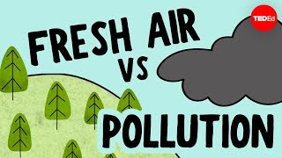
Video
Watch and discuss:
What information do we have now?

Slide 13
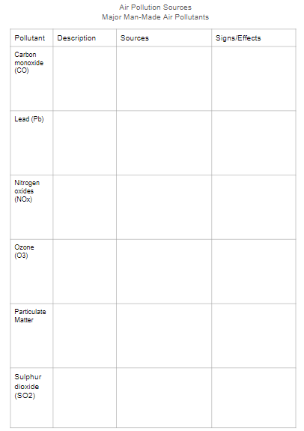
Hands-on Activity Instructions
Students research criteria pollutants using the provided internet resources:
https://flexbooks.ck12.org/cbook/ck-12-middle-school-earth-science-flexbook-2.0/section/10.19/primary/lesson/types-of-air-pollution-ms-es/
https://www.ducksters.com/science/environment/air_pollution.php
https://www.youtube.com/watch?v=gEdAaKHnof8&t=2s
Pairs of students match the information on paper strips(Description, Sources, and Signs/Effects) with each Pollutant.
Notes:
Hands-On Activity: Include step by step instructions, how students are best grouped, and notes that will be helpful to a teacher downloading the lesson. A picture may be helpful that shows how the materials or activity are set up.

Slide 14
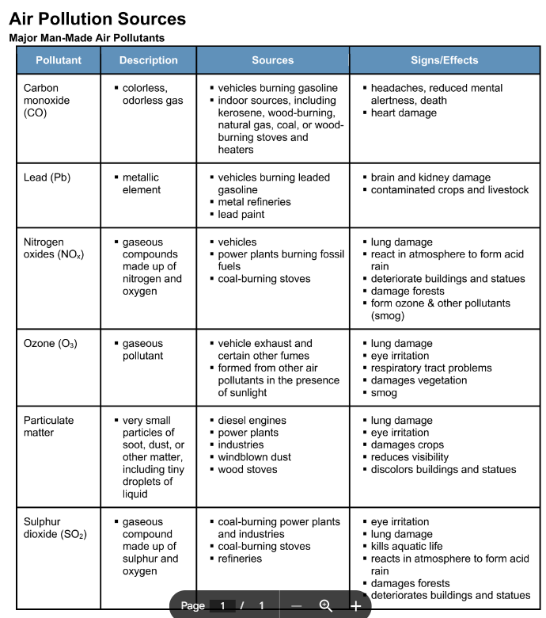
Cut this page into 6 strips across so that the information for each pollutant is on one strip, but not the name of the pollutant (first column).
Give each pair of students one set and one blank grid.
When they think they have them all in the right places, either check their work or give them a completed grid to check for themselves.

Slide 15
Assessment
Game: identify each pollutant using the notes from your research.
Students can play as individuals, pairs, or table teams.
Students use their completed grids as reference.
Display each image and give students time to identify which of the 6 criteria pollutants is being described. Some have more than one pollutant.
Correct answer(s) displayed on click.
Notes:
Assessment: Give specific ideas or suggestions for how this activity might be assessed. It can be helpful to include both formative and summative assessment ideas.

Slide 16
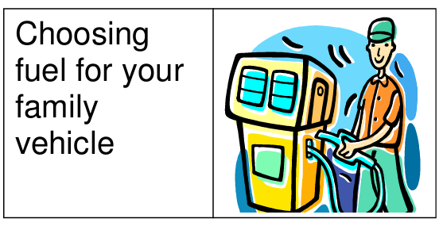
CO, Pb, Nox, O3

Slide 17
Electricity from a coal-fired electrical plant gives off SOx, NOx, and Lead (Pb).

Slide 18
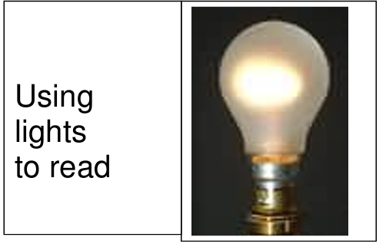
Electricity from a coal-fired electrical plant gives off SOx, NOx, and Lead (Pb).

Slide 19
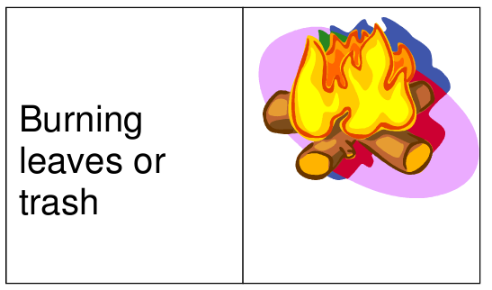
Particulates are produced.

Slide 20
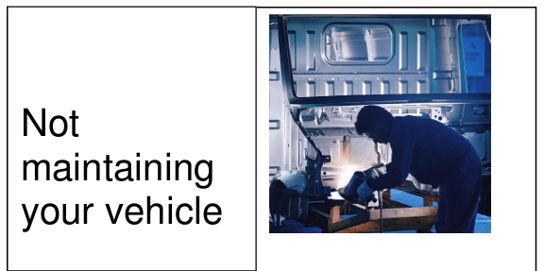
Vehicles’ exhaust gives off SOx, NOx, and CO.

Slide 21
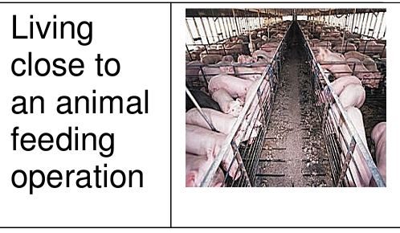
Particulates are produced.

Slide 22
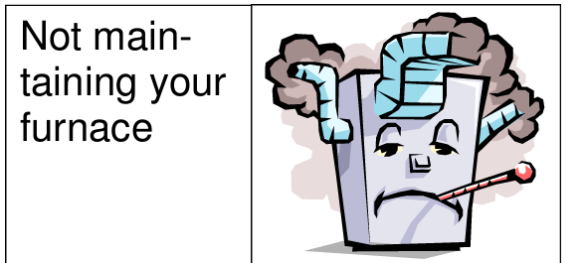
Improperly maintained furnace promotes incomplete combustion and the production of CO.

Slide 23
Fugitive dust (both PM2.5 and PM10 particulates) is stirred up.

Slide 24
Differentiation
Remediation
Extension/Enrichment
Students can be given a partially filled in grid, or the entirely filled in grid, and use it to participate in the game.
Criteria Pollutants readers theater play:
https://uni.edu/storm/downloads/middleschool/Criteria%20Pollutants%20final%20update.pdf
Notes:
Differentiation (remediation and enrichment): This slide should be hidden or not shared with students. This is an opportunity to make suggestions on how to modify the lesson/assessments to reach a wide range of students.

Slide 25
Lesson created with the support of the Arizona STEM Acceleration Project

