Slide 1
Air Pollution and Art, part 2
A 6th grade STEM lesson
created by
Rachel Carpenter
Notes:
Title Slide
Include the grade level, your name, and the date submitted/created

Slide 2
Notes for teachers
List of Materials
slide deck
teacher internet access for websites to display
copies of pollution graphs (slides 8 and 9)
colored pencils or other art materials
optional: internet access for students to research images to help them with their art
This lesson provides context for the 6th grade physical science standards dealing with matter. It enables students to anchor their learning in real world issues as they combine data literacy and art in the style of current working artists.
In this lesson, students build on knowledge in the following lesson, Air Pollution and Art, part 1.
Notes:
Notes and Materials: This slide can be hidden or skipped when delivering the lesson.
See the example lesson for ideas of what to include. This should be any specific notes that would be helpful for a teacher who downloads this lesson. You should also include any details of the context (taught in a class, club, etc.) Also, a detailed list of materials needed for the activity.

Slide 3
Standards
Standards
1.a Ask questions that arise from careful observation of phenomena, models, or unexpected results
1.b Ask questions to clarify or identify evidence and the premise(s) of an argument
6 e Apply scientific knowledge and evidence to explain real-world phenomena, examples, or events.
6.P1U1.3 Develop and use models to represent that matter is made up of smaller particles called atoms.
Notes:
Standards: A list of standards aligned to the activity.

Slide 4
Objective(s):
Today I will:
interpret air quality data.
use what I know about air pollutants to create an art piece.
Notes:
Objective(s): Please include one or more objectives for your lesson (1-3 minutes)

Slide 5
Agenda (70 minutes)
Phoenix data (warm up)
readings (whole class)
art (individual)
feedback (pairs)
Notes:
Agenda & Timeframe: Read (1 minute)
What is the lesson timeline and how long will the lesson take.

Slide 6
Intro/Driving Question/Opening
Display each graph. Ask students to make observations and ask questions.
Help students interpret both lines and describe trends in the graphs:
Use what you learned about ozone and particle pollution previously to try to explain the trends in the graphs.
Use the readings on the next slides to provide further possible explanations for the trends.
Notes:
Intro/Anticipatory Set/Opening
Please include how the lesson opens and engages students’ interest.

Slide 7
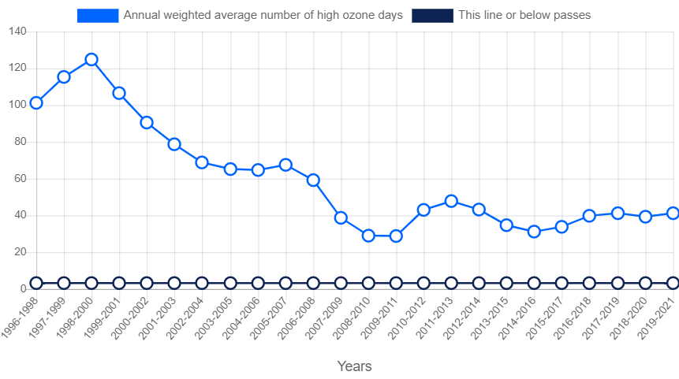
High Ozone Days: Phoenix, AZ

Slide 8
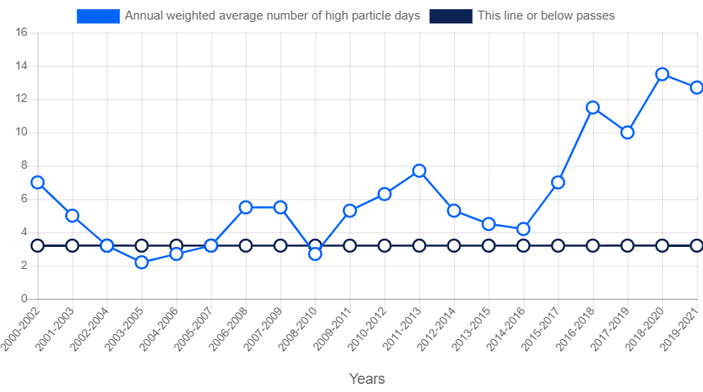
Particle Pollution - 24 Hour- Phoenix, AZ

Slide 9
Ground-level ozone is not emitted directly into the air, but is created by chemical reactions between oxides of nitrogen (NOx) and volatile organic compounds (VOCs) in the presence of sunlight and heat, making it a summertime pollutant. Air pollutants from car exhaust, paint, aerosol products, and manufacturing emissions are some of the major contributions to ground level ozone.
Breathing in ground level ozone can reduce lung function by 20 percent and can trigger health reactions by those most particularly sensitive to poor air quality – children, older adults, those with respiratory or pulmonary conditions, athletes, and those most often outdoors – in addition to our ecosystem. Reactions may look like shortness of breath, coughing, wheezing, fatigue, headaches, nausea, chest pain, and eye and throat irritation.

Slide 10
Unlike ground-level ozone, particle pollution (also known as particulate matter) is a mixture of extremely small particles and liquid droplets in the air, which can occur year-round. Particles enter the air from a variety of sources and may be either directly emitted or may form under a chemical process much like the way ground level ozone forms. Many enter the air directly from power plants, factories, automobiles, construction vehicles, unpaved roads, wood burning, and agriculture sites. Others come from a reaction between gases from burning fuels, sunlight, and water vapor.
High levels of particles in the air can affect our lungs and heart and have been shown to trigger asthma and heart attacks, among other health problems. Particles also contribute to visible haze that obscures our skyline and impacts our scenic vistas.

Slide 11
Intro/Driving Question/Opening
What stories do these data tell?
Notes:
Intro/Anticipatory Set/Opening
Please include how the lesson opens and engages students’ interest.

Slide 12
Hands-on Activity Instructions
Introduce Jill Pelto’s work and Alisa Singer’s work.
notice and wonder
motivation
methods
How does the art tell us a story about the data?
Display Phoenix graphs again.
What stories could we tell about this data?
Students select either graph to begin creating an art piece with.
Notes:
Hands-On Activity: Include step by step instructions, how students are best grouped, and notes that will be helpful to a teacher downloading the lesson. A picture may be helpful that shows how the materials or activity are set up.

Slide 13
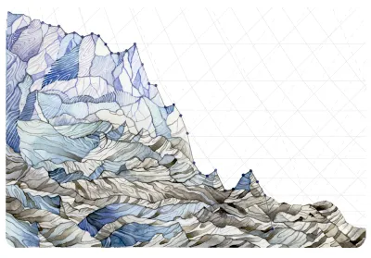
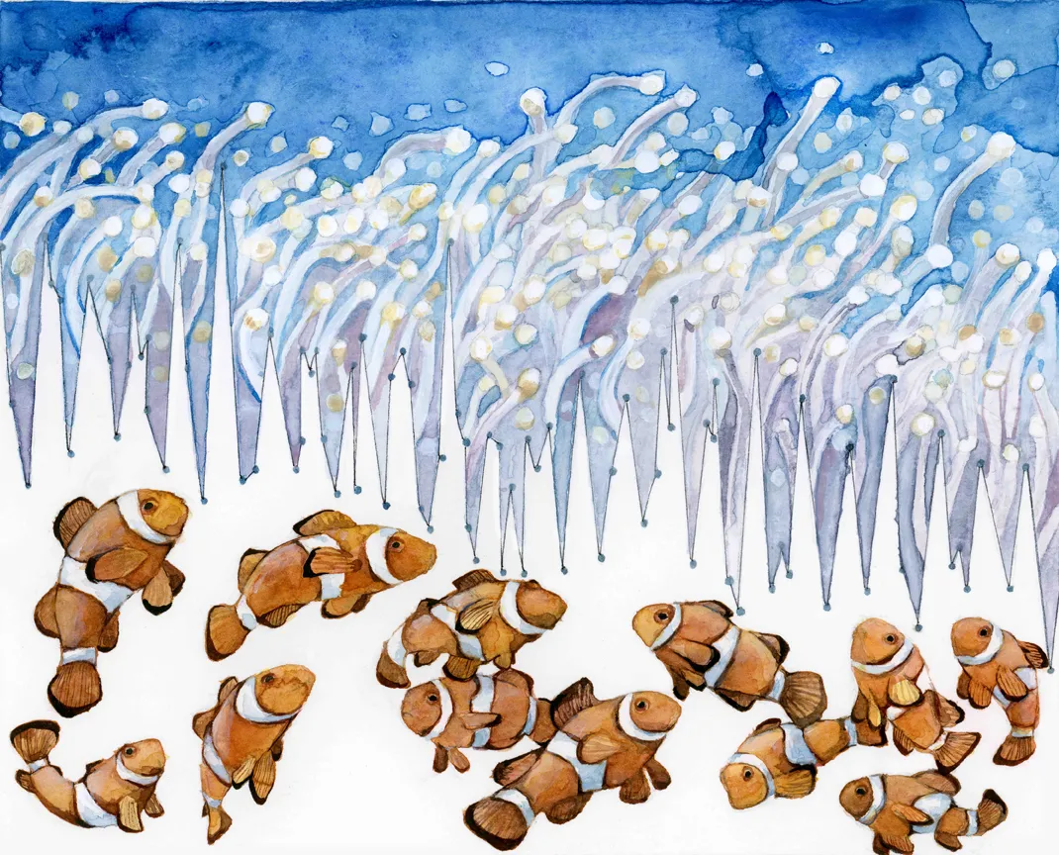
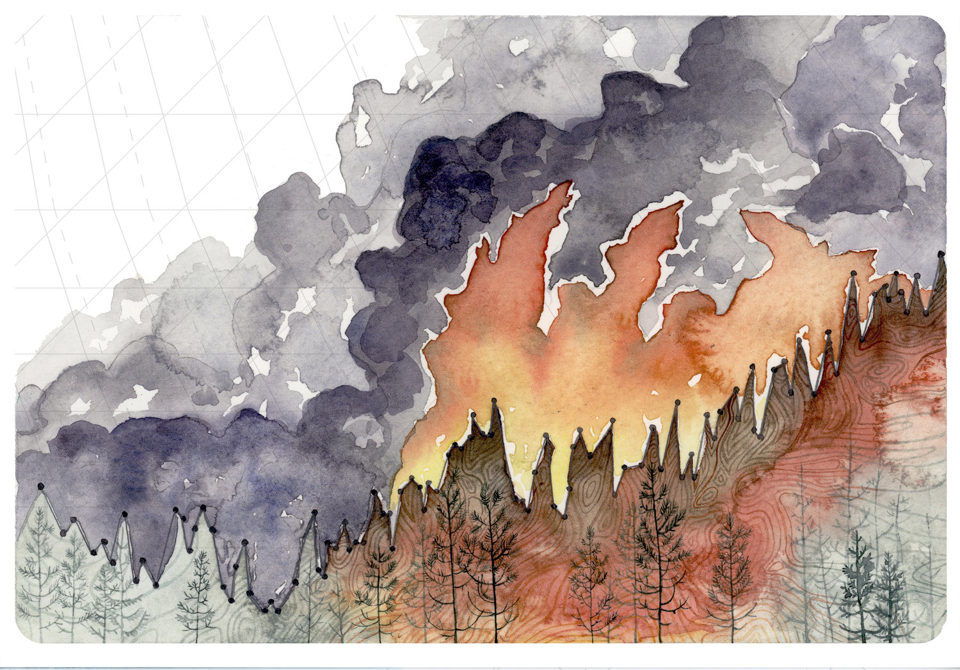

Slide 14
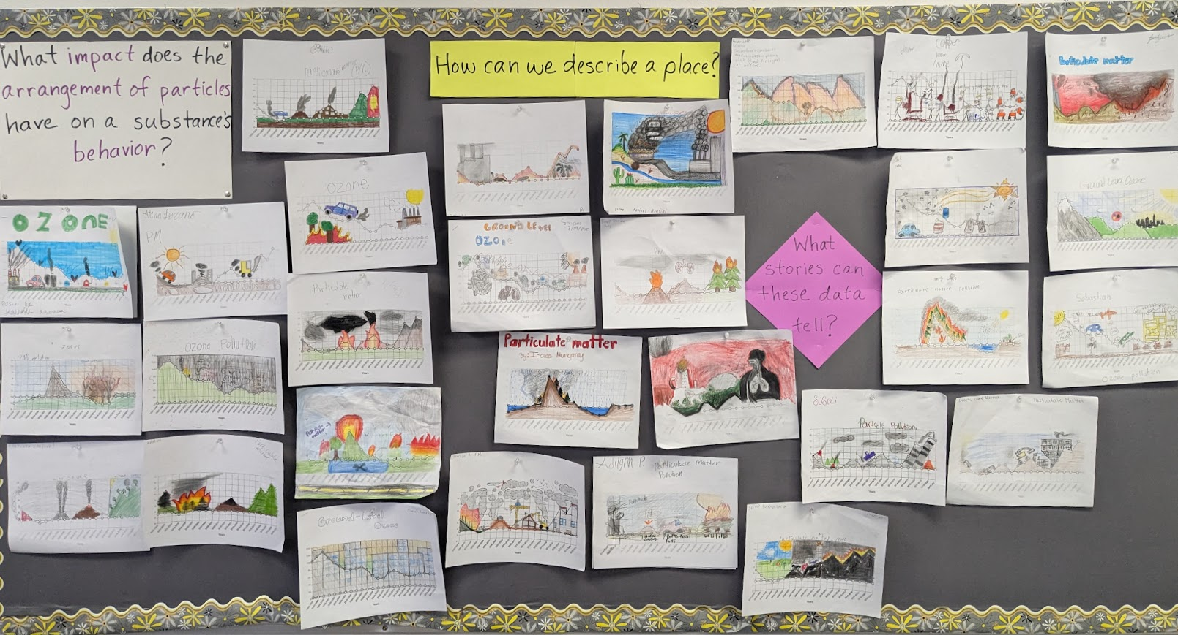

Slide 15
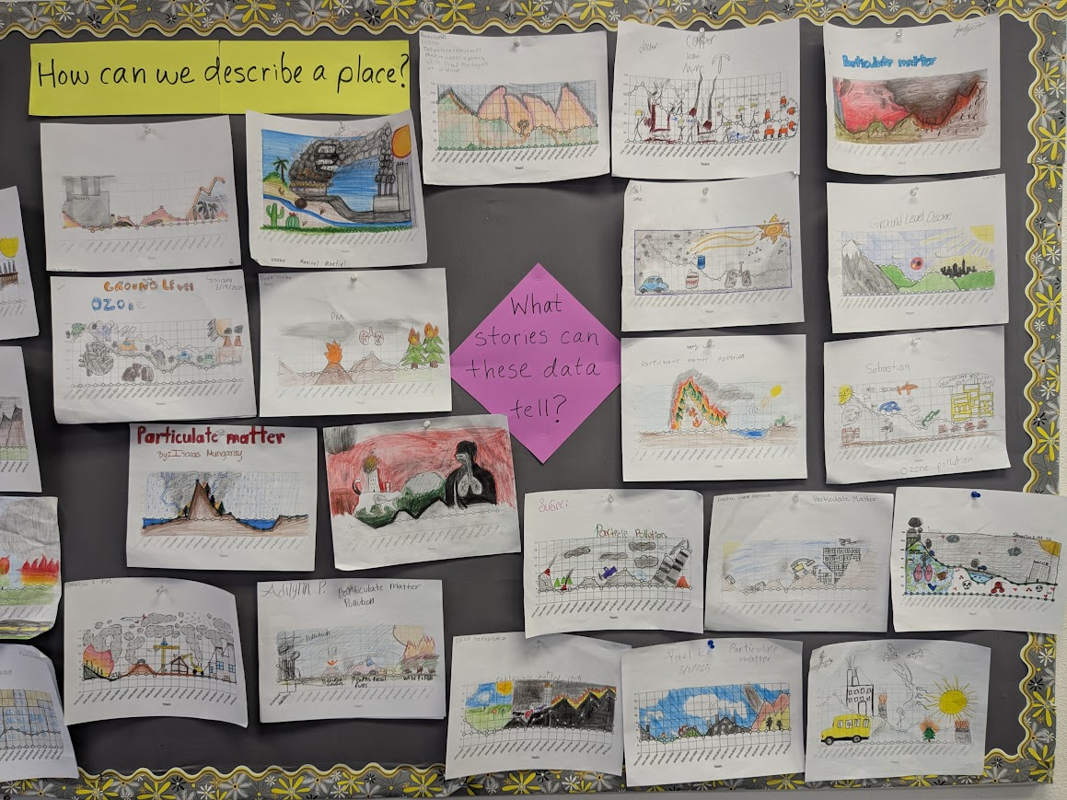

Slide 16
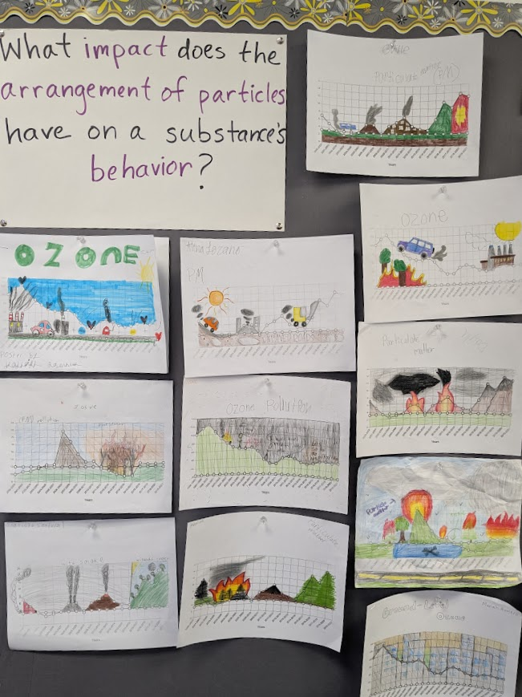

Slide 17
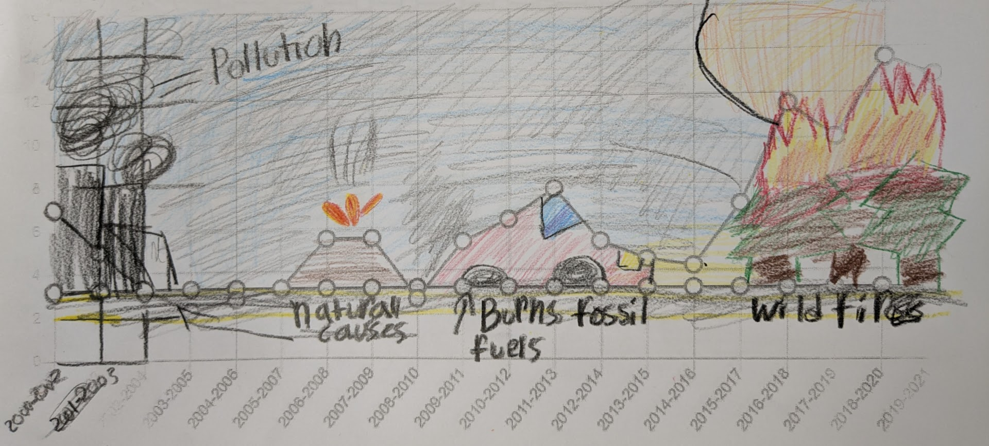

Slide 18
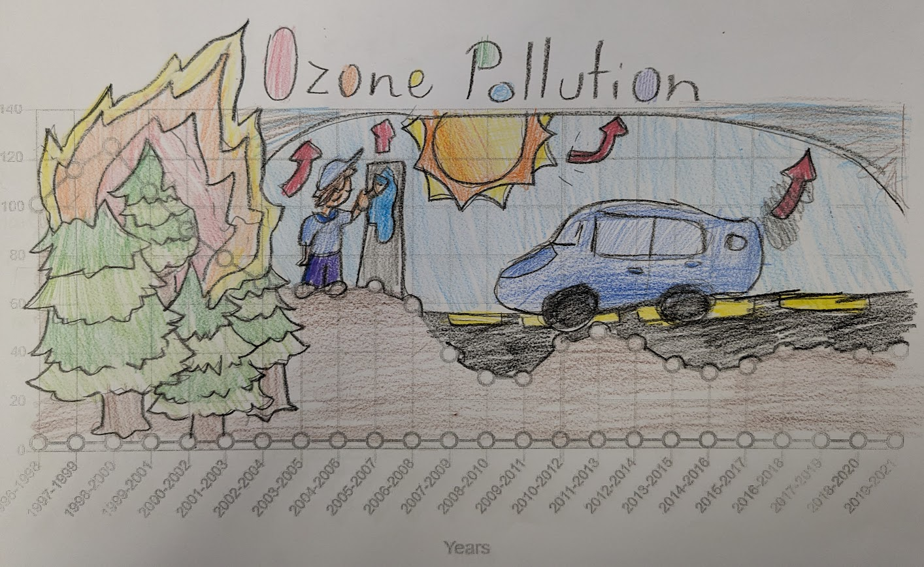

Slide 19
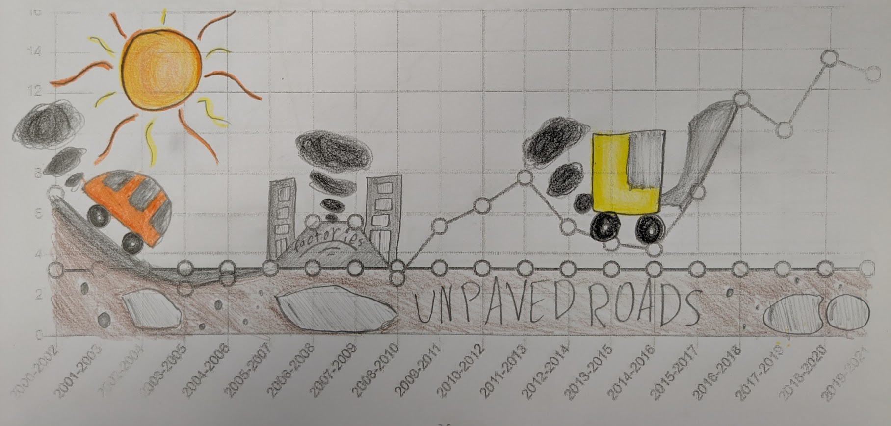

Slide 20
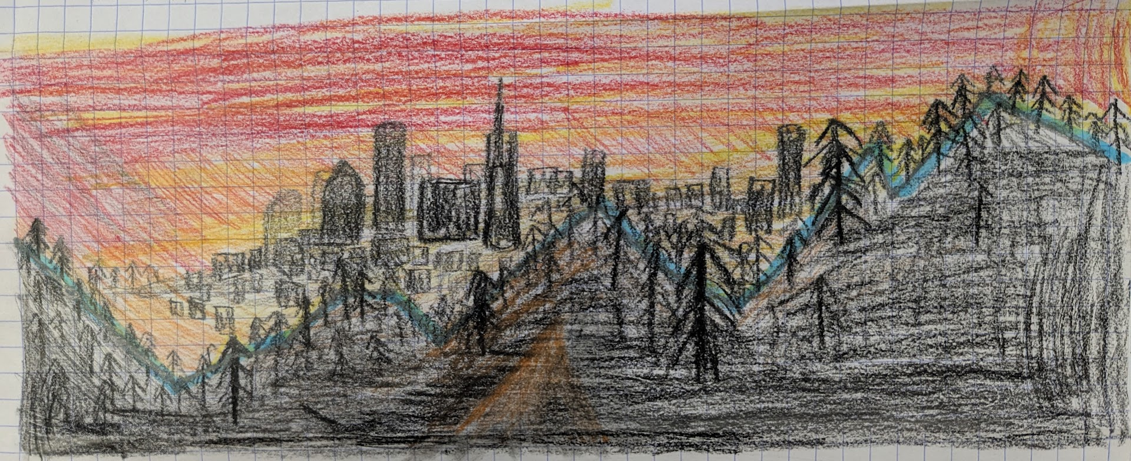

Slide 21
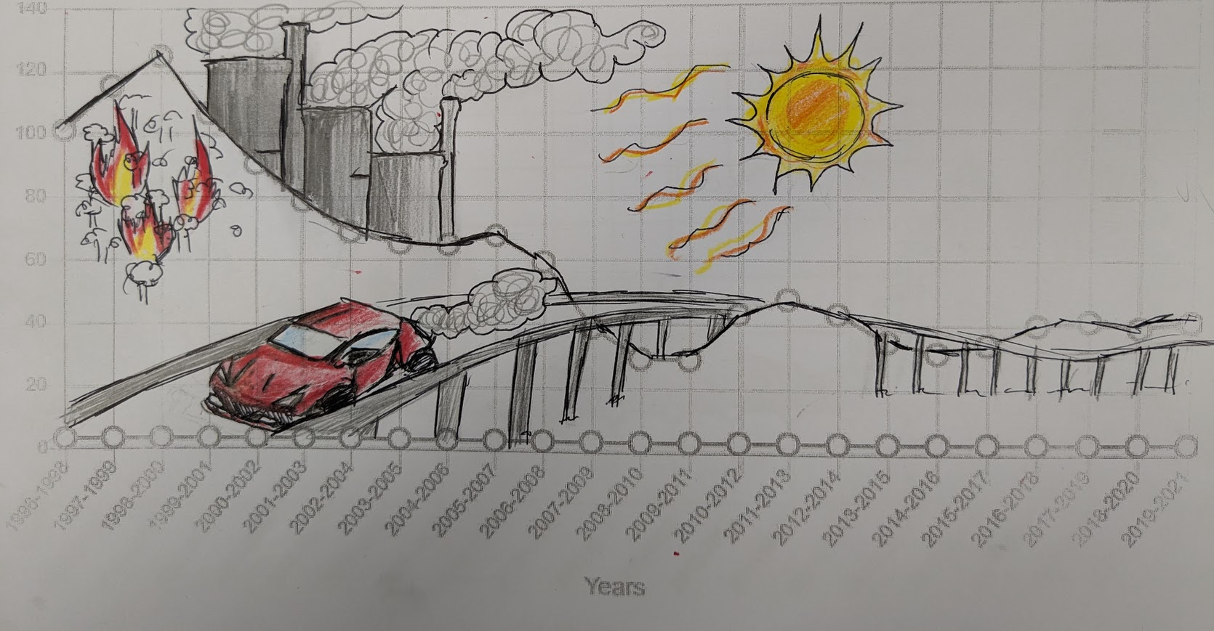

Slide 22
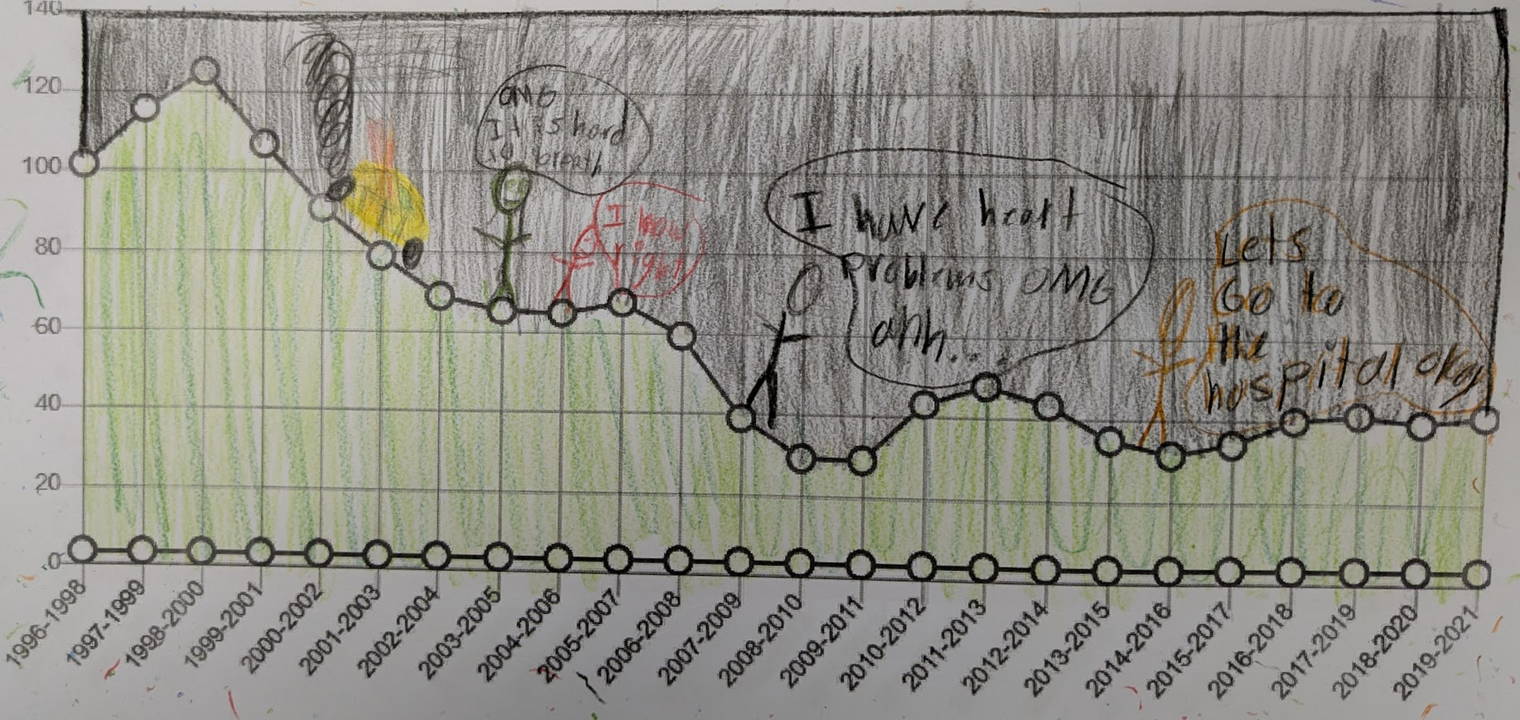

Slide 23
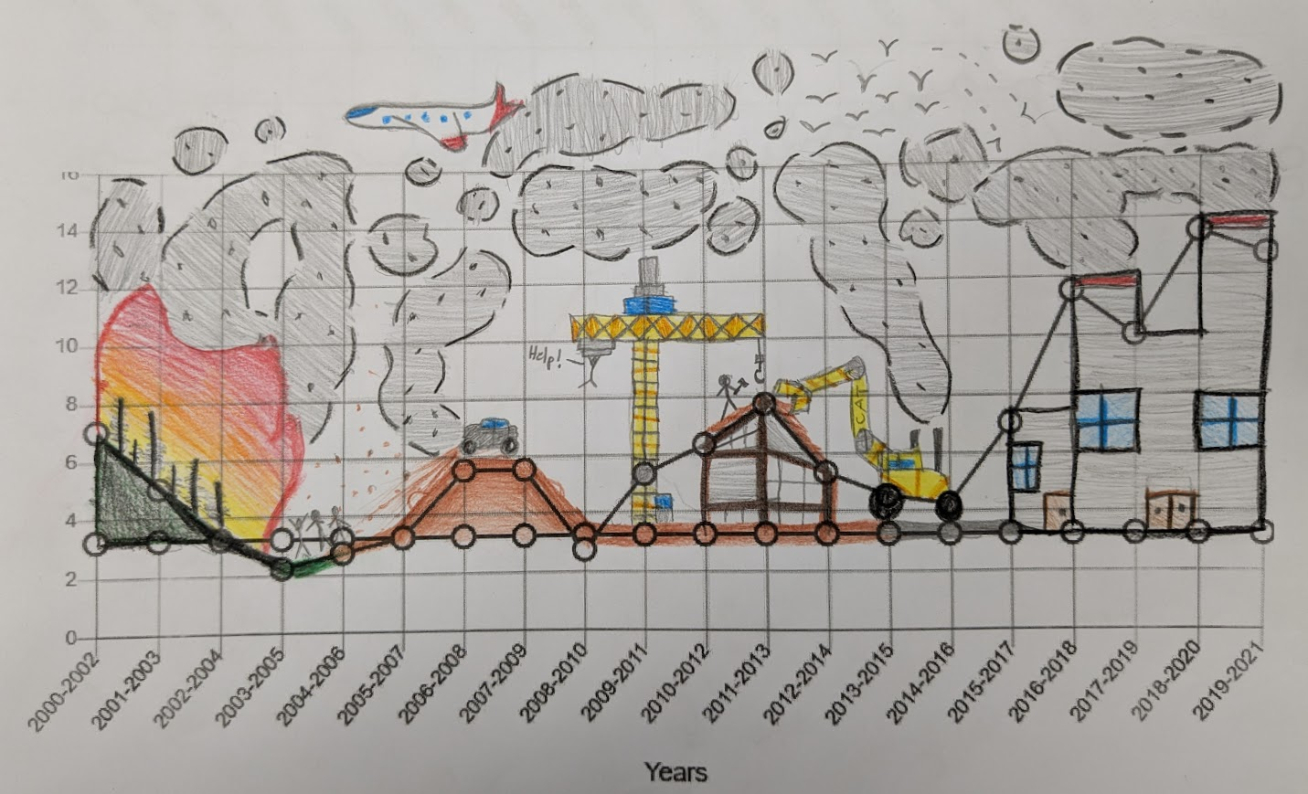

Slide 24
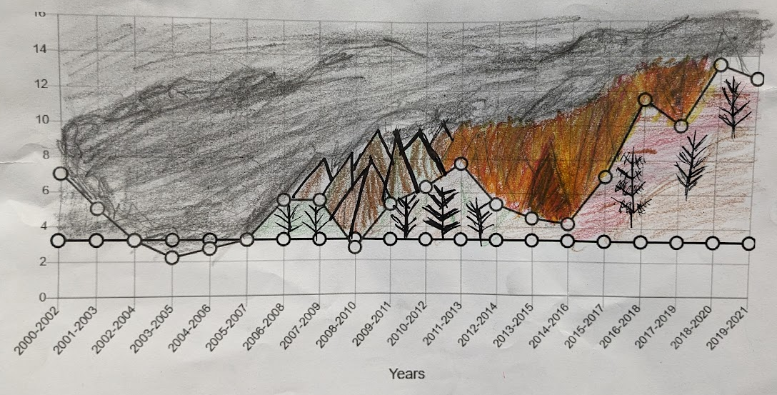

Slide 25
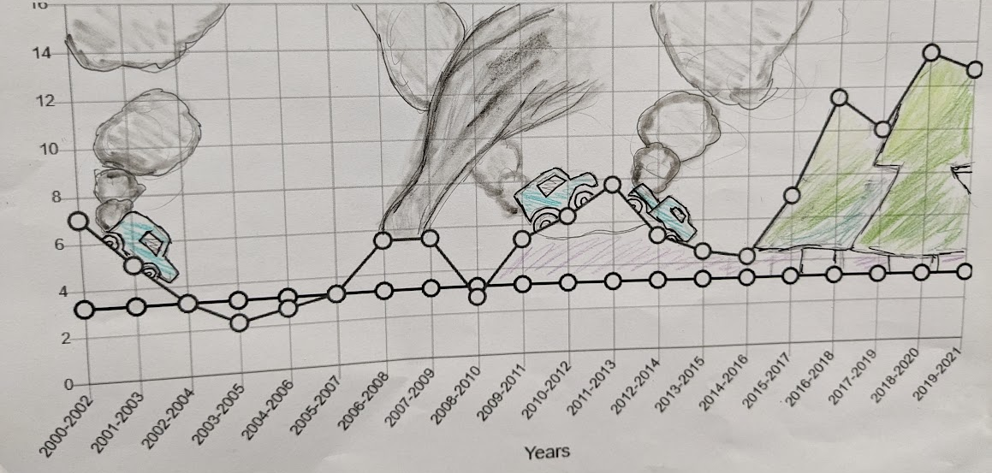

Slide 26
Assessment
Partner Share and Feedback
Explain your art. What did you draw? What were you trying to show?
Give feedback:
Something you like and why (be specific)
A question
A suggestion
Notes:
Assessment: Give specific ideas or suggestions for how this activity might be assessed. It can be helpful to include both formative and summative assessment ideas.

Slide 27
Differentiation
Remediation
Extension/Enrichment
Students can use Google search terms related to their chosen pollutant/ climate change to give them ideas for their art piece.
This art piece can serve as a draft.
Students can get larger paper and draw the line graph on it (approximating the trend as best as possible).
They can redo their art piece, implementing the feedback they received from peers.
Notes:
Differentiation (remediation and enrichment): This slide should be hidden or not shared with students. This is an opportunity to make suggestions on how to modify the lesson/assessments to reach a wide range of students.

Slide 28
Lesson created with the support of the Arizona STEM Acceleration Project

