Slide 1
Instructions: This is a template for you to modify with your material. You can change the main (green) headings to better fit your project but plan to cover the main topics in the headings. None of the text needs to be kept unless it works for your lesson/activity. Use high resolution photos only. Required elements are the logos on top and the logos + text on bottom.
Reminders:
Tell your story with pictures instead of words!
Bullet points. Only 2 or 3 sentences together, and only in a few places.
You need to able to walk a person through your poster in 2 minutes (try this out with another teacher)
Put your poster on your smart board as 36 x 48 so you can see it printed size.
Make sure to add QR codes:
Your session at NSTA
Your lesson on our website
If your lesson is not on our site, still make a QR code for this URL: https://santacruz.arizona.edu/santa-cruz-river-lessons-and-activities
Poster Due Dates:
February 27 (Thursday): Full Draft Ready for review on Zoom at 5:30pm
March 17 (Monday) Final Presentation on Zoom at 5:30pm
March 20 (Thursday): Final poster emailed to Michael: mbogan@arizona.edu

Slide 2
Next slide is guide for teachers going to NSTA

Slide 3
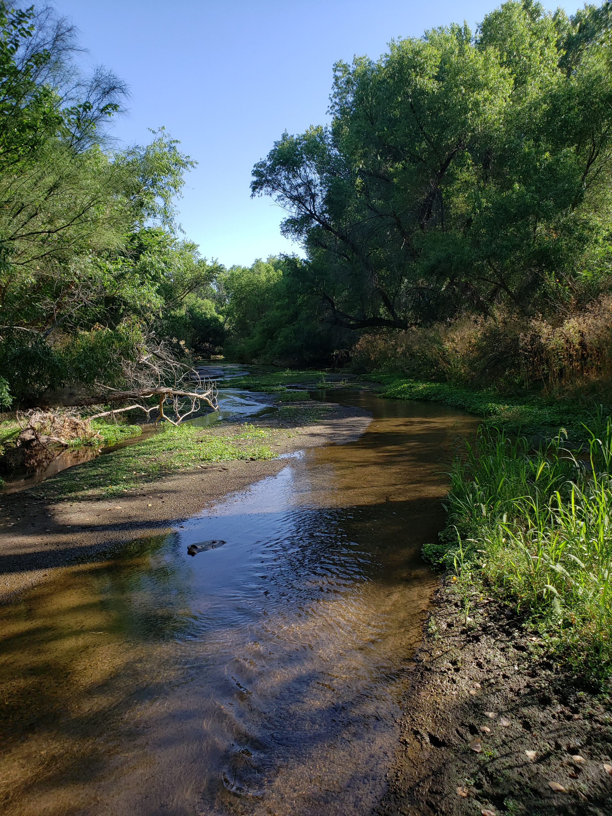
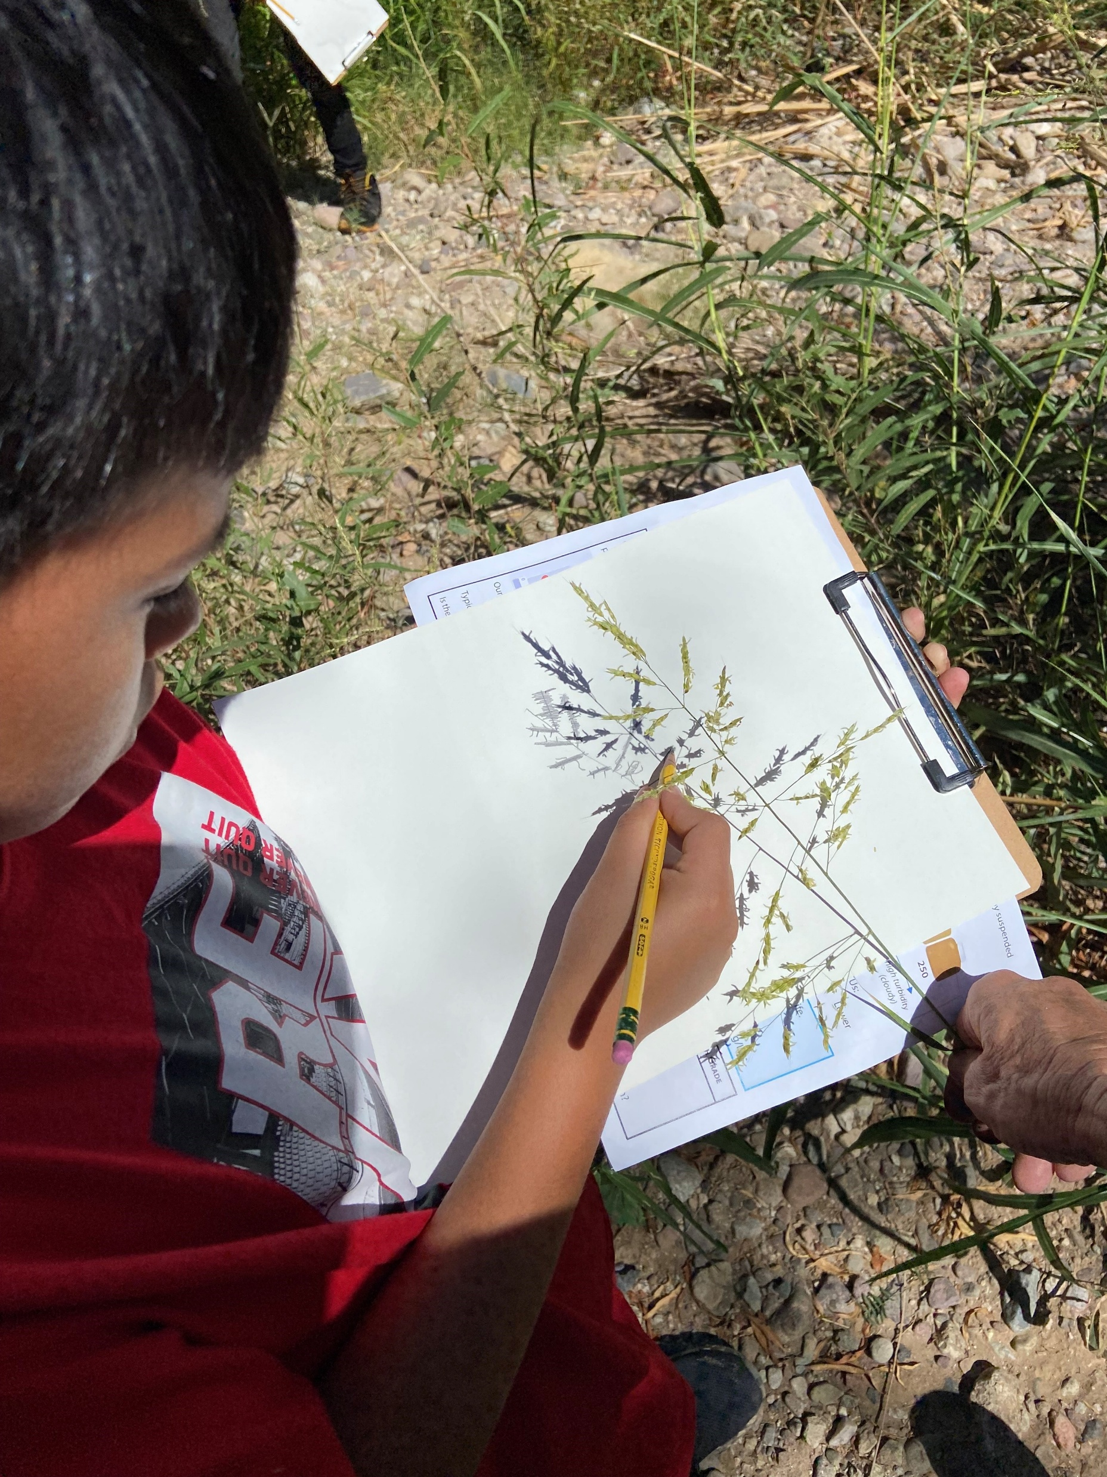
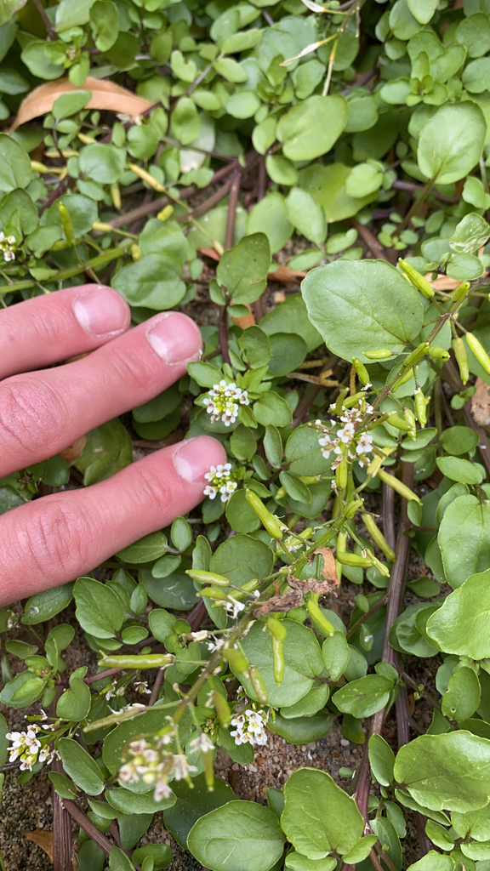
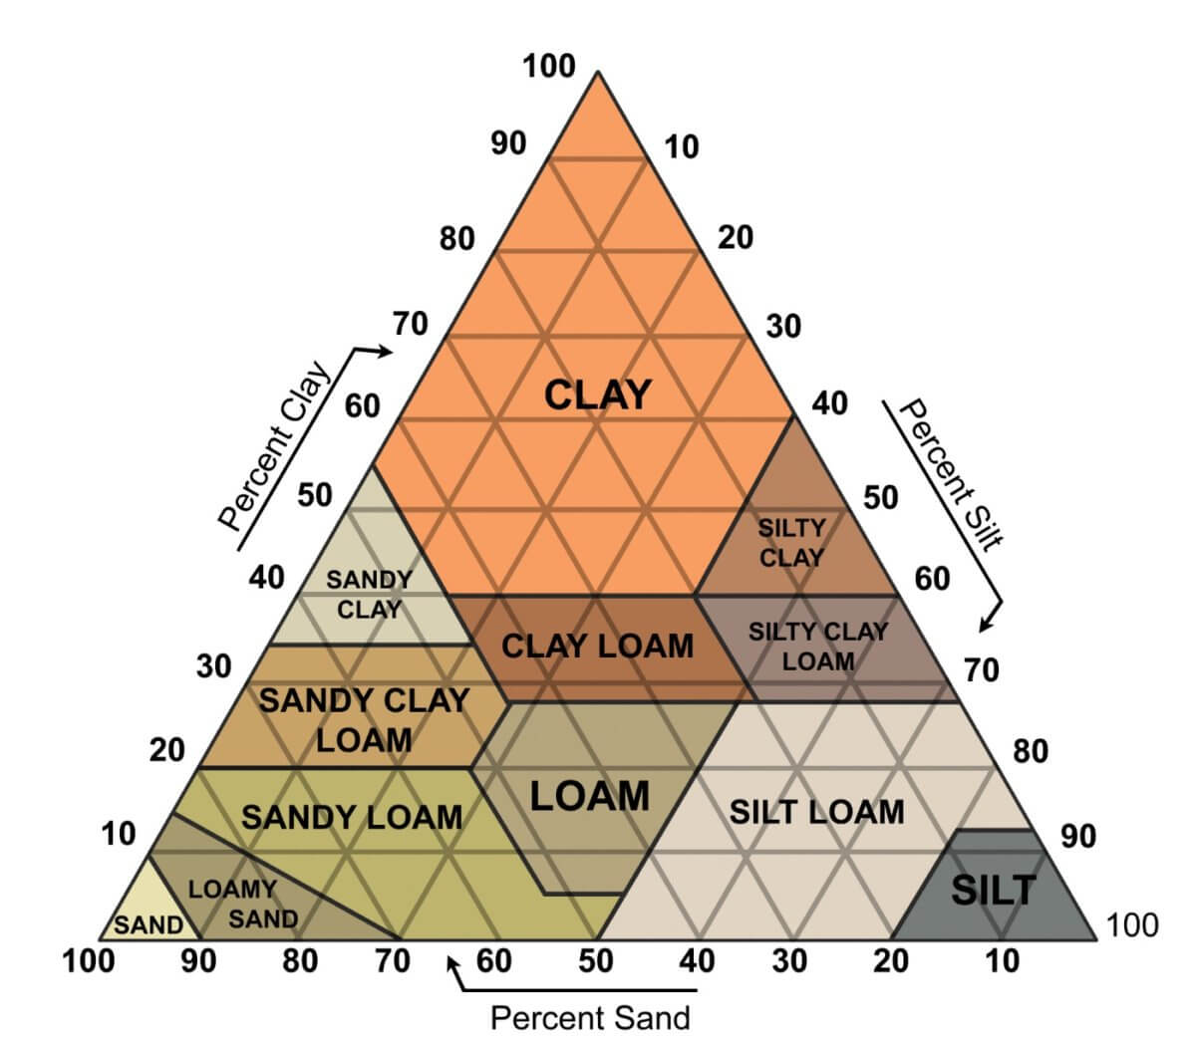
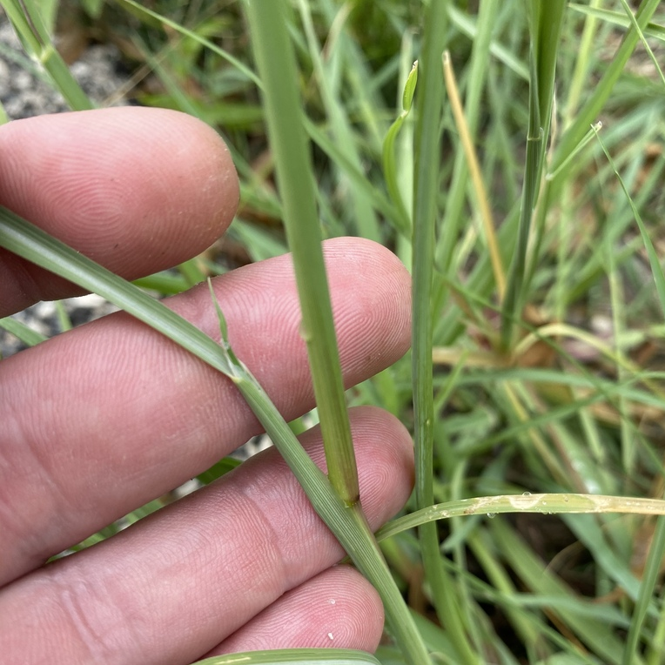
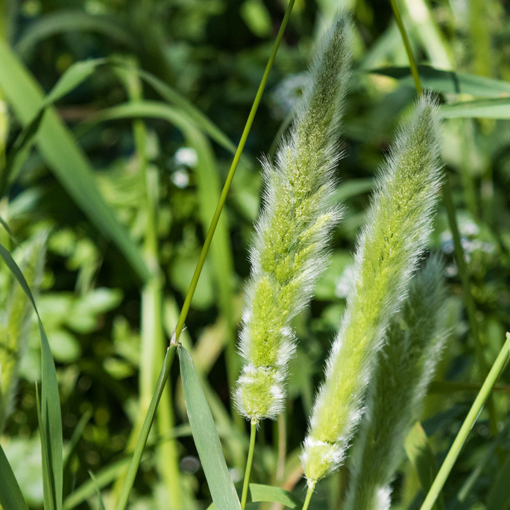
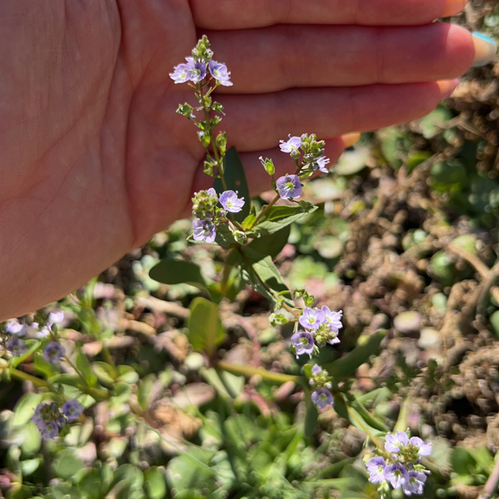
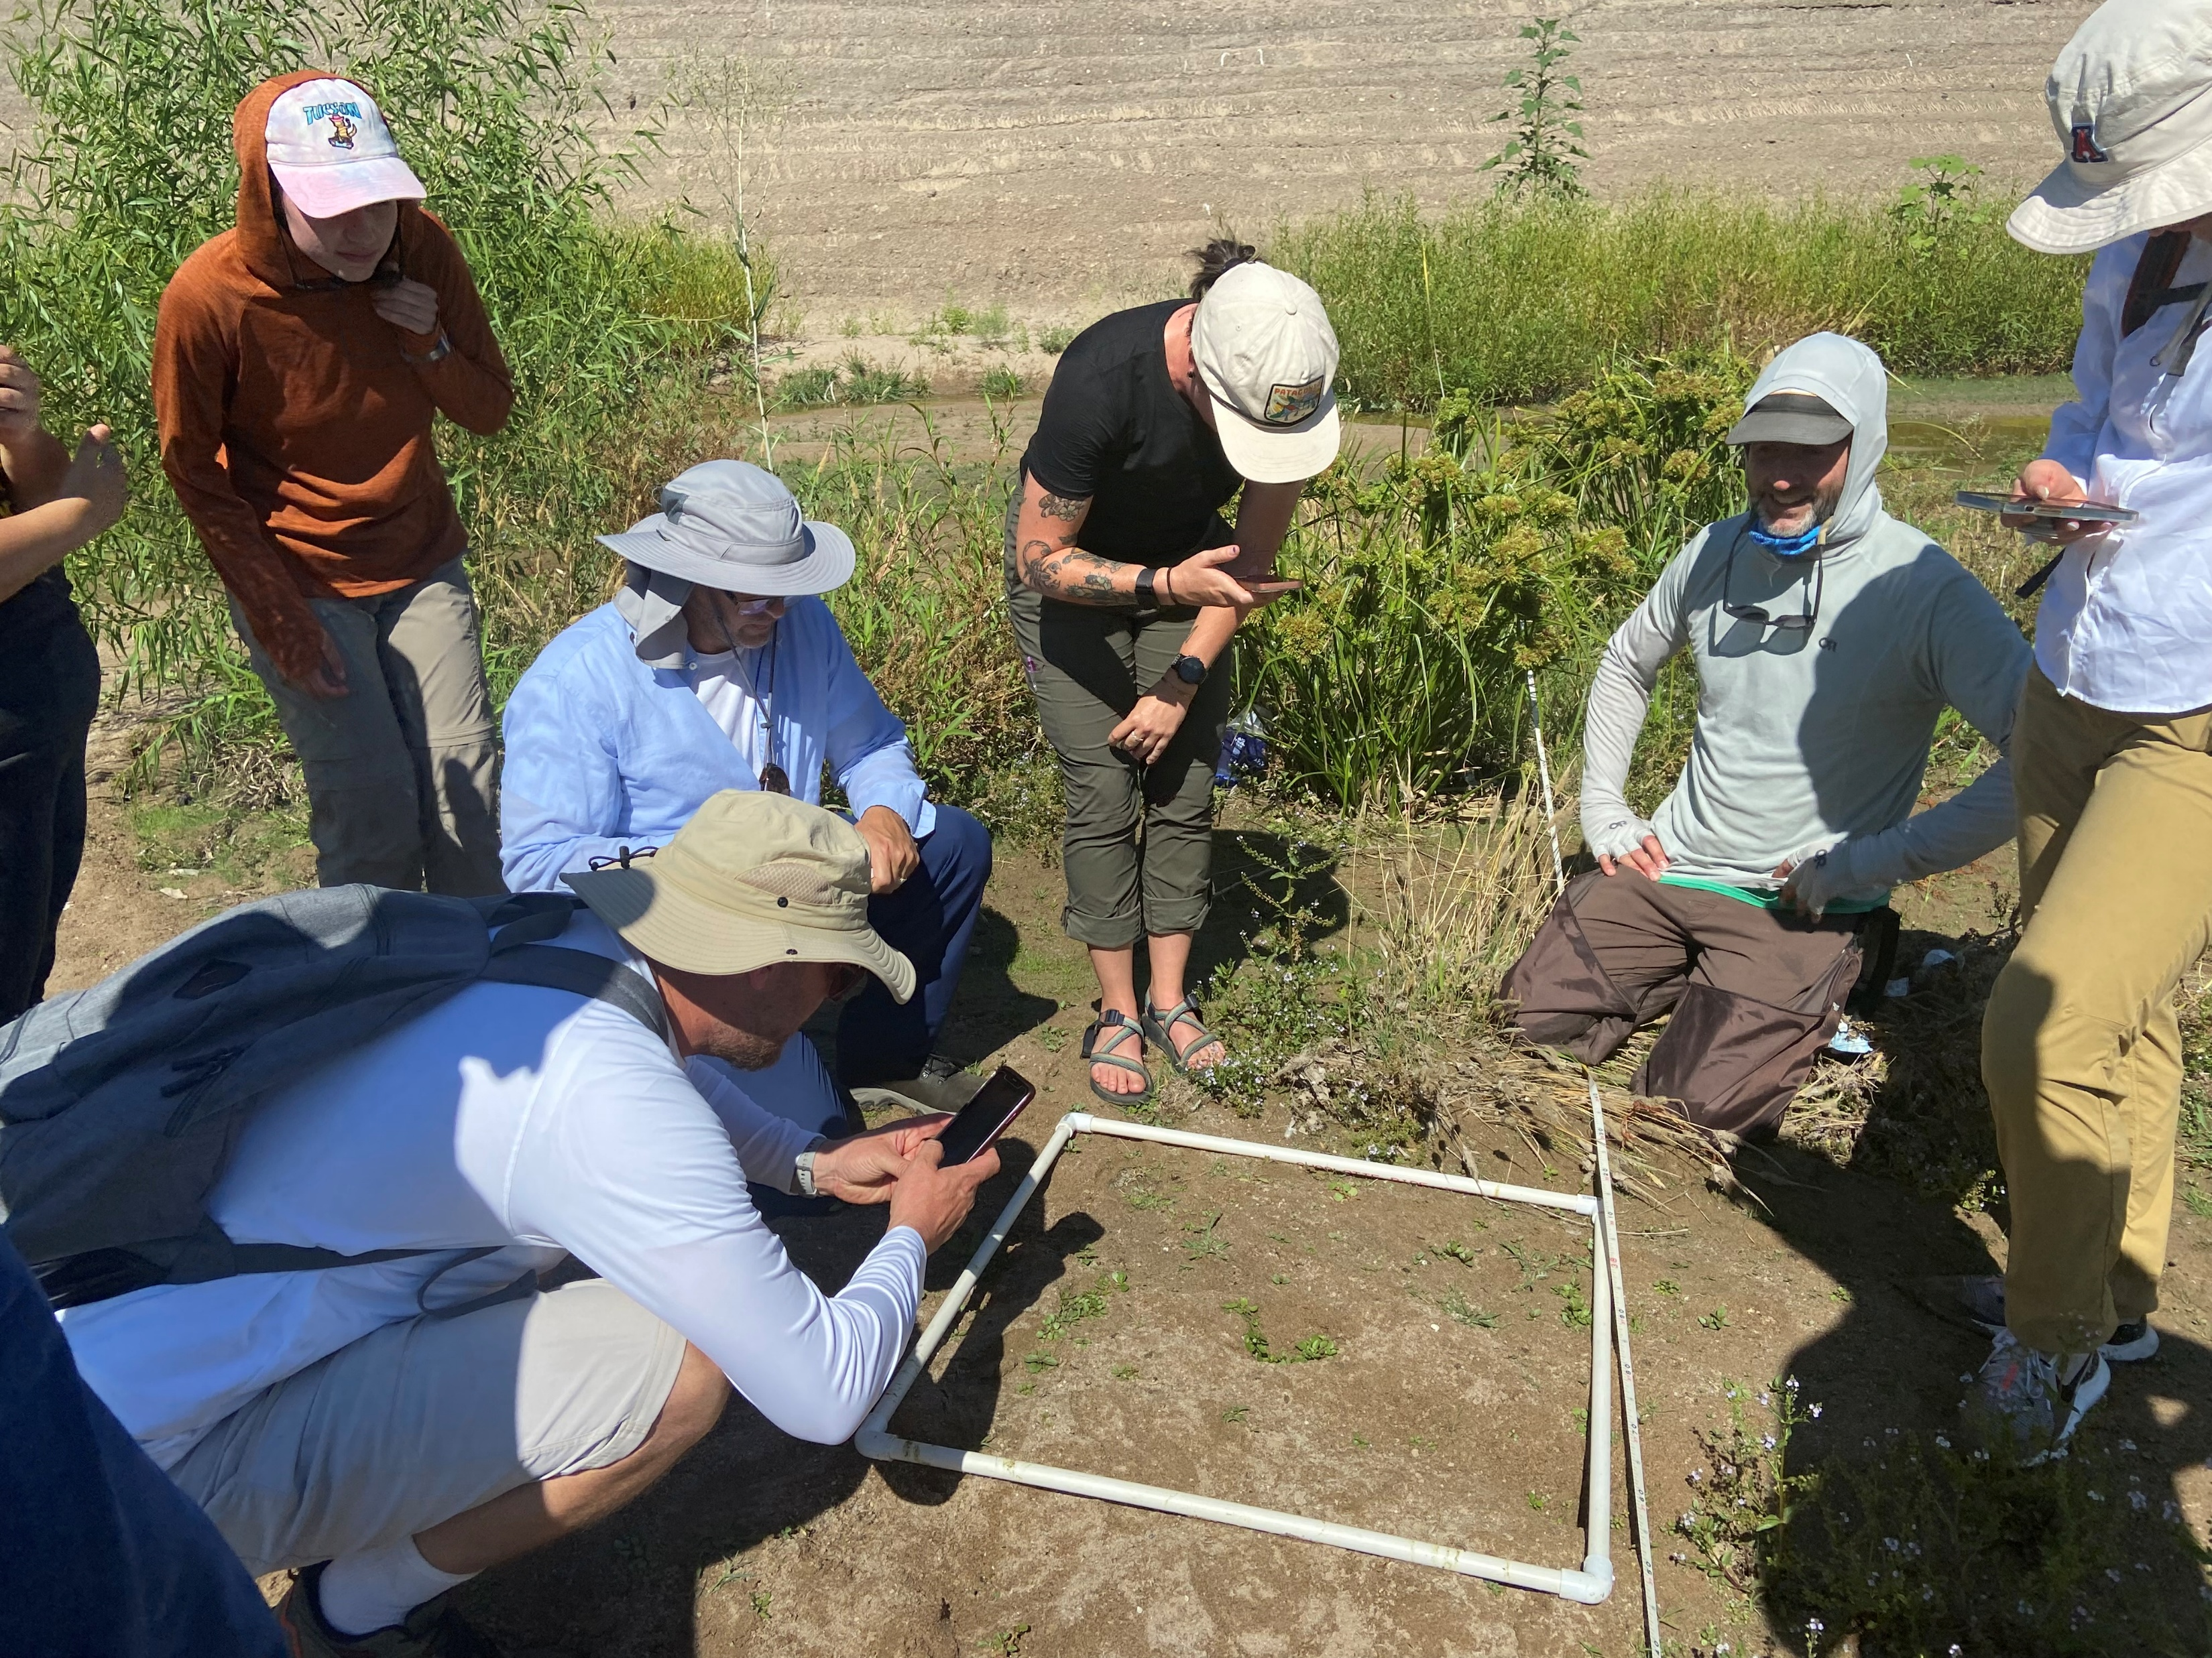
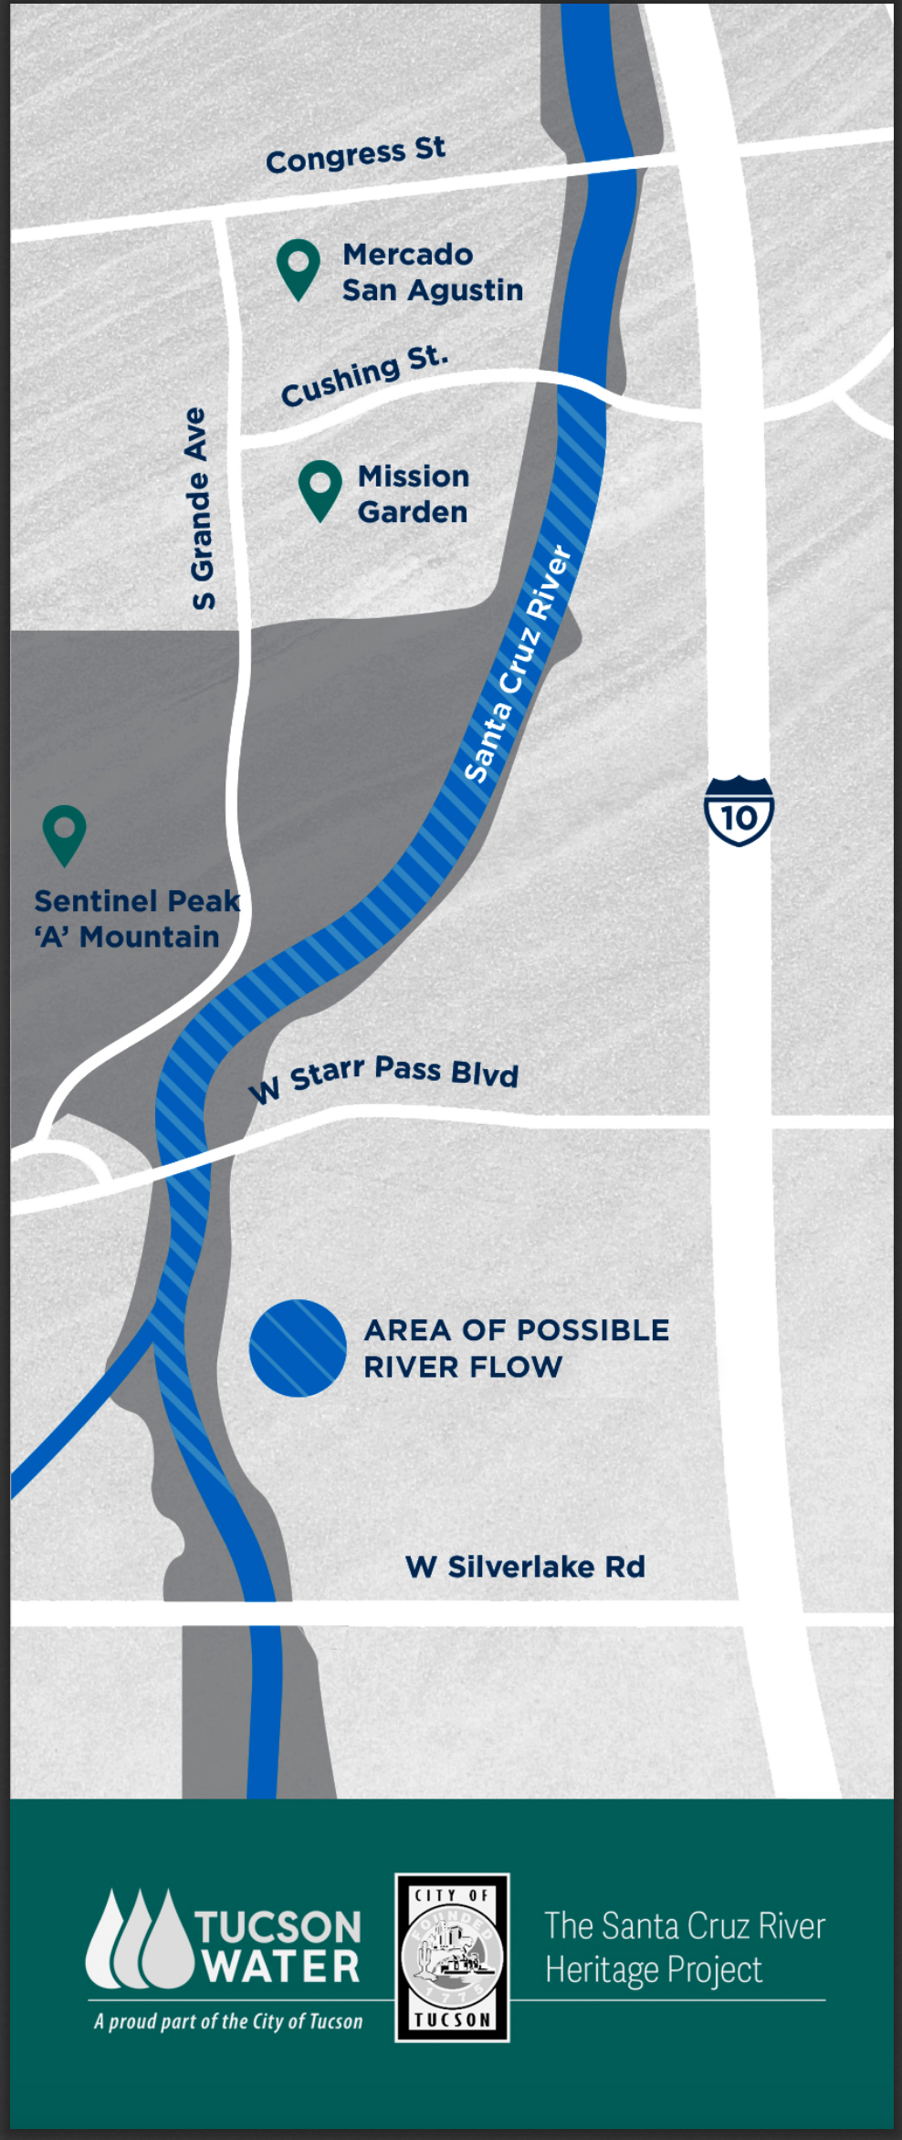
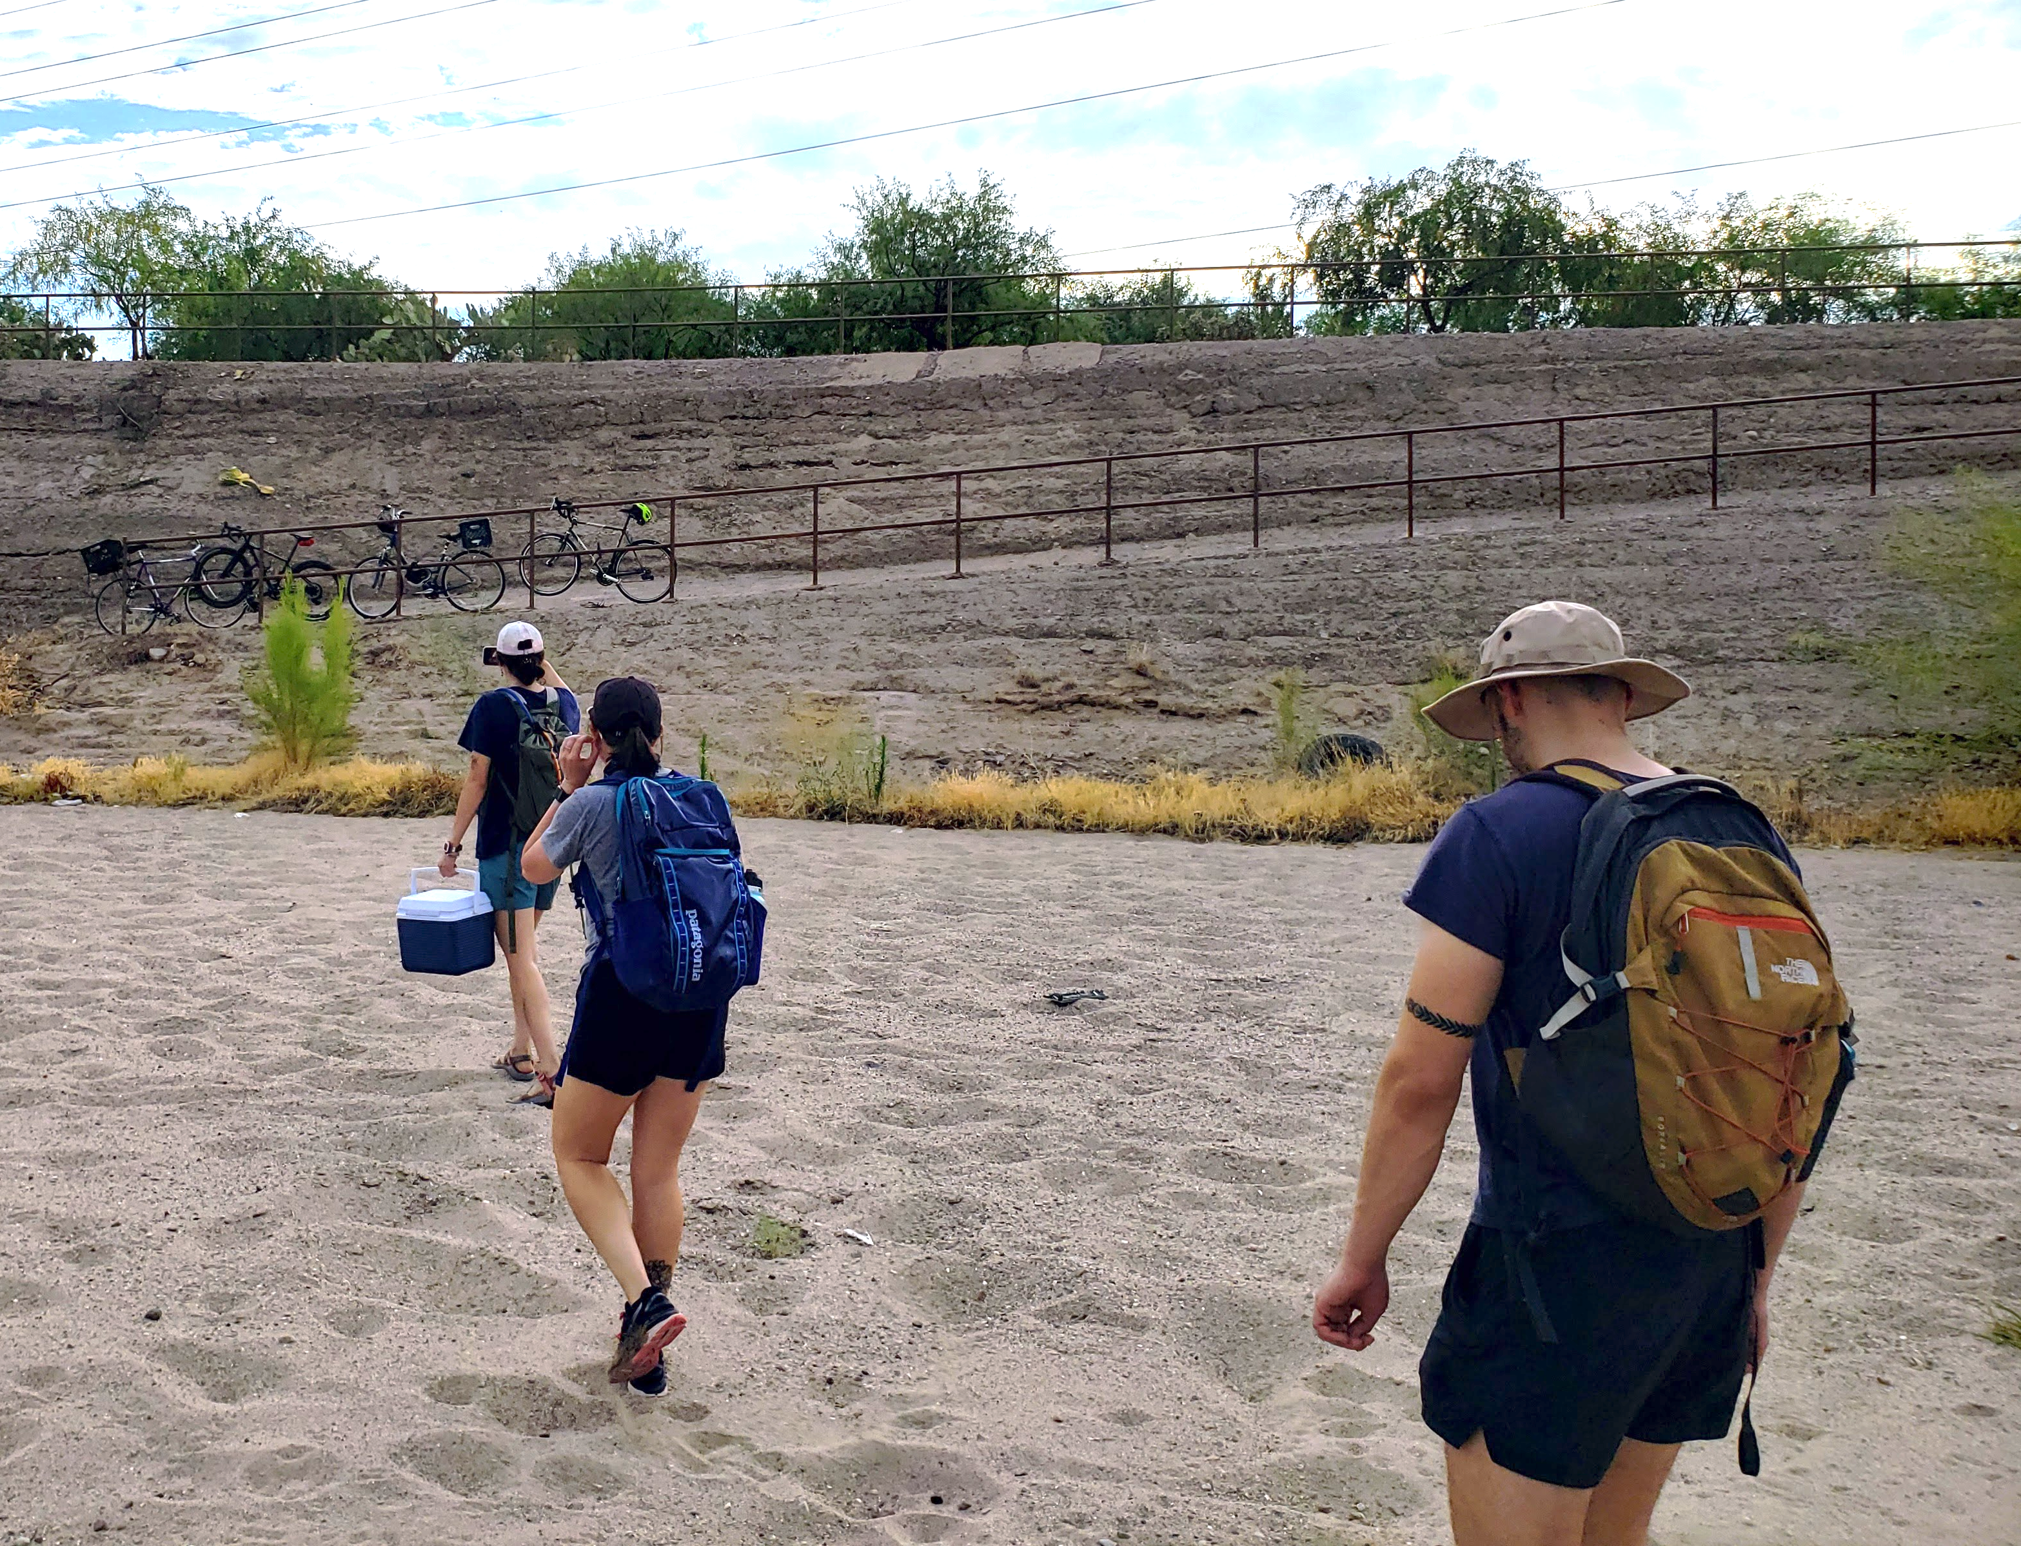
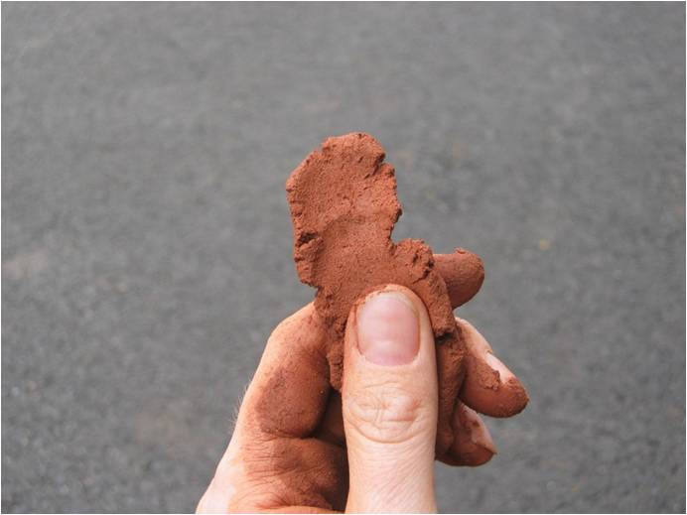
High School Middle School Lesson Title Goes Here
Subtitle if you have it
Your Name ▪ Your School ▪ BIORETS Santa Cruz River ▪ Tucson, AZ . .
Topic and Context
Describe
What are you doing
How are you doing it
Arid/place based context
FUN collage – imagery, students, draw viewers in with photo story telling
Consider large font quotes:
Student: “I love graphing my music choices!”
Student/teacher: “Aha moment”
Testing/teacher: “Test scores have gone up since I begin teaching this material”
Outcomes/teacher: “Everyone made a graph”
Discussion of Outcomes
Connections to other content, cross curricular connections, modifications possible
Student engagement
Academic results
Personal/teacher focused Reflection
What would you do differently? What would you do more of?
Time?
Focus?
Challenges?
Success?
More
Why?
Inspiration?
BIORETS?
Learning Objectives or Goals
State the Objective or list as bullet points
Include teacher objectives ie easy to implement, cost of materials etc
Soil texture field testing
Aerial cover
Leaf mass
Text
The Santa Cruz River
Lesson Skills in BIG letters
graphing
data collection
data visualization
hypothesis generation
Picture caption
Nasturtium officinale
“Watercress”
Picture caption
Materials and/or previous knowledge
Materials:
Water to dampen soil
Trowels to collect soil samples
Reference sheets with the soil texturing flowchart and soil texture triangle
BIORETS Santa Cruz River
The BIORETS Santa Cruz River program is for middle and high school science teachers. The focus is on teachers conducting ecological research alongside University of Arizona professors and graduate students on the Santa Cruz River. Teachers learned from a wide array of stakeholder groups including county, city, and water utilities staff, and non-profit organizations working with the Santa Cruz River. Teachers worked concurrently to develop curriculum to bring the Santa Cruz River back to the classroom. Lessons and activities, including field trips, were implemented during the following school years.
Diplachne fusca
“Sprangletop”
Polypogon monspeliensis
“Rabbitfoot grass”
Veronica anagallis-aquatica
“Blue Water-Speedwell”
Consider adding WHERE (start with US map)
Come to my session!
Put your words here describing your session and other BIORETS sessions at the conference. Consider adding a QR code to the session listing on the NSTA site.
State Standards/NGSS (ideally)
Standard
Standard
Standard
Download Lesson Materials
QR Code to Lesson on website
Santacruz.arizona.edu/educators
Figure 7 – Collecting at Santa Cruz River Heritage Site
Picture caption
Get In Touch
Please feel free to reach out with
any comments or questions to: NAME@SCHOOL EMAIL.ORG
NSF Award #2143228 BIORETS: Conserving water resources and riparian biodiversity in a changing desert climate
Picture Caption
santacruz.arizona.edu

Slide 4
Next slide is Phill’s from previous NSF workshop

Slide 5
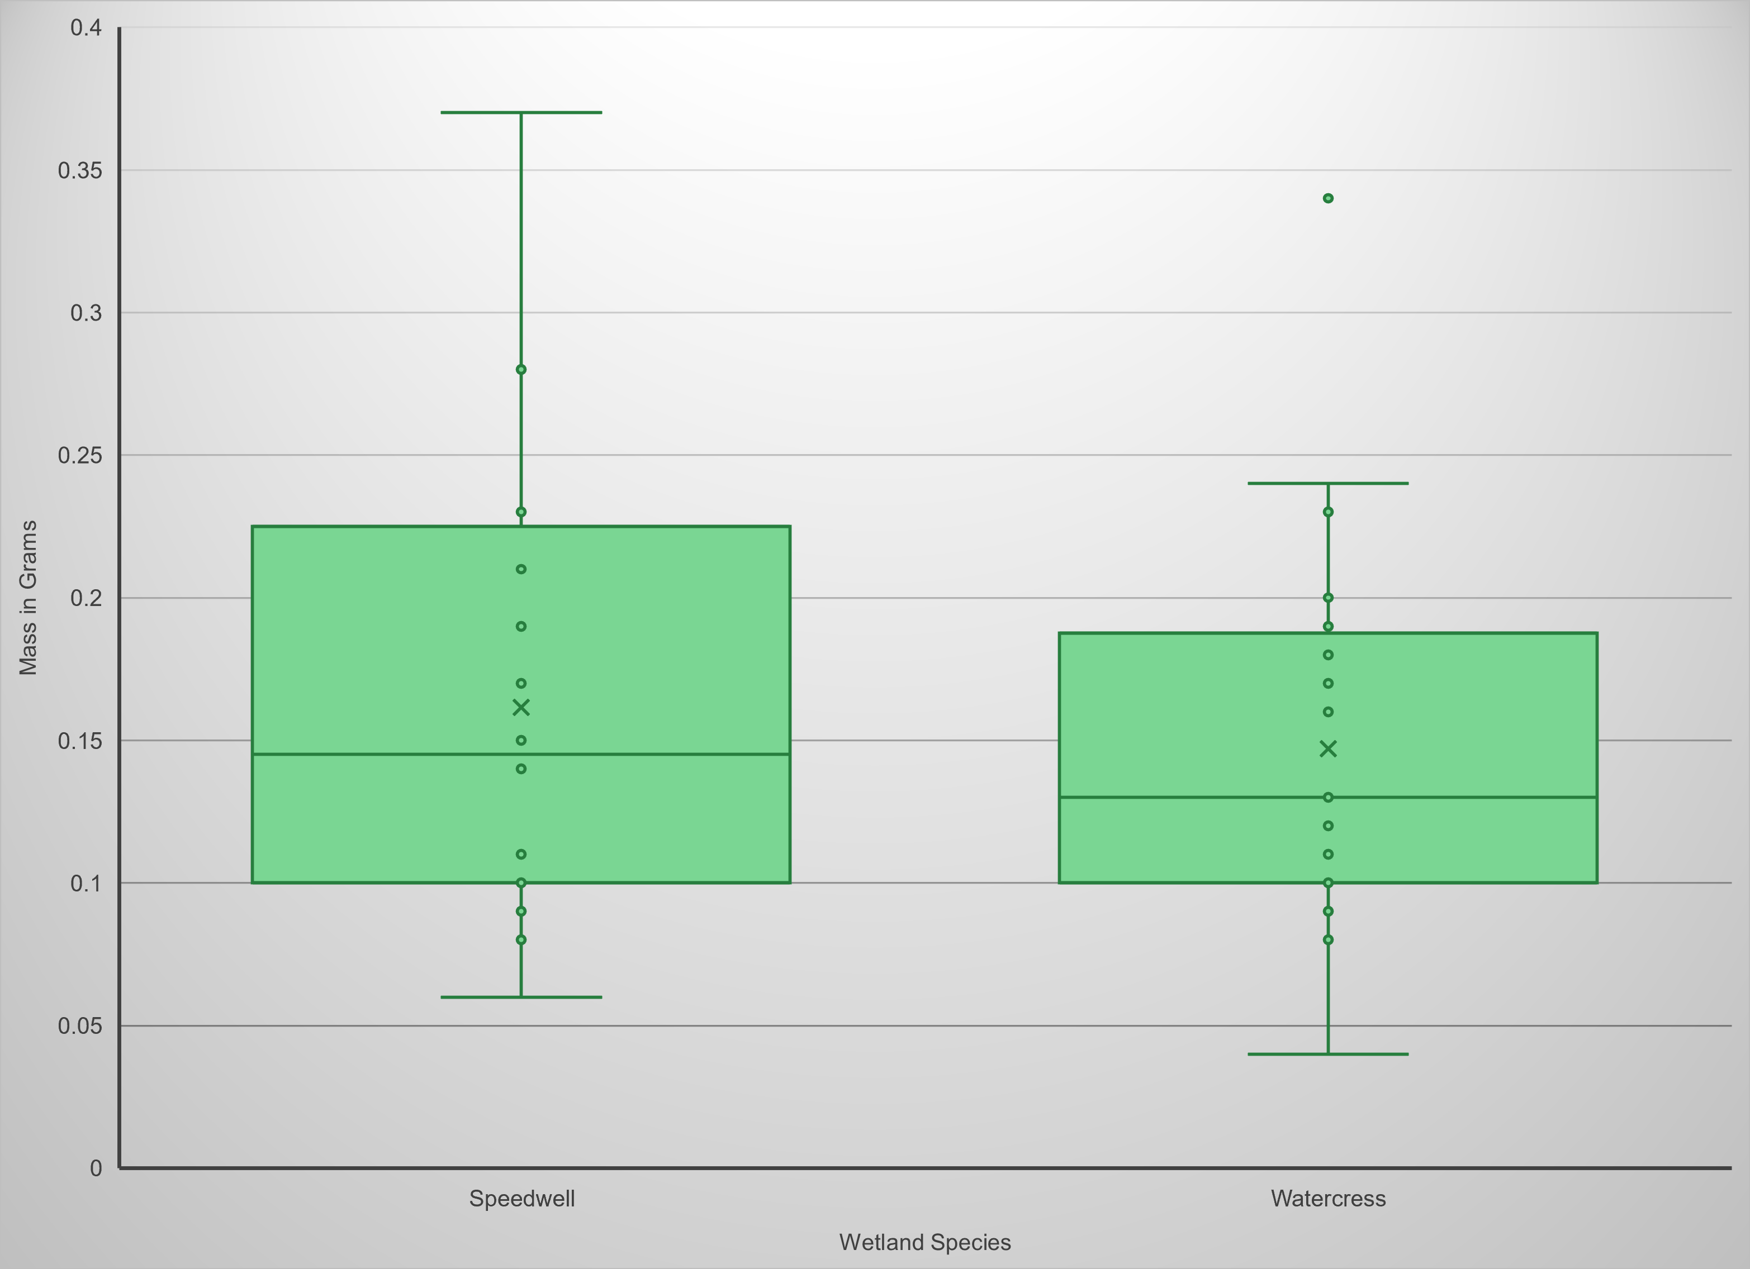
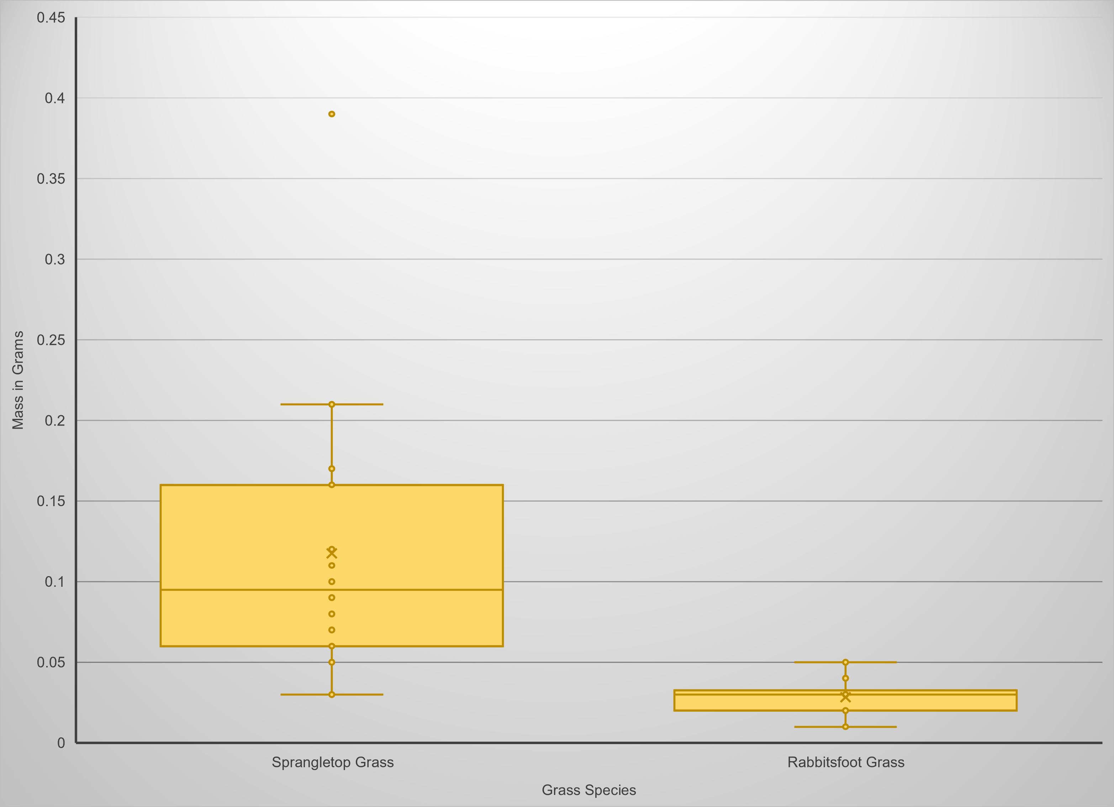
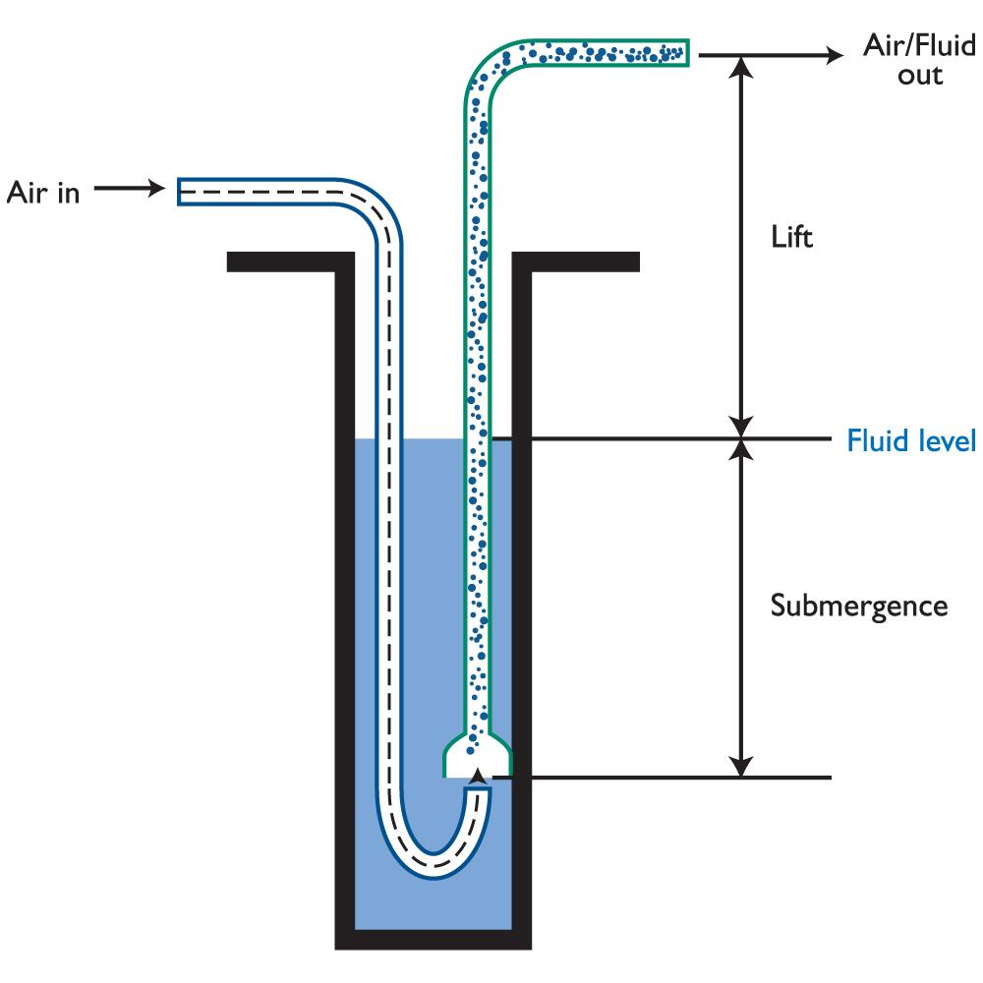
High School Plant Ecology Data Gathering Activities and
Riparian Habitat Tank Construction
Santa Cruz River BIORETS ▪ Tucson, AZ . .
Introduction
The Santa Cruz BIORETS program exposed Tucson area high school teachers to ecological research being conducted on the Santa Cruz River. Teachers learned from a wide array of stakeholder groups including county, city, and water utilities staff, and non-profit organizations working with the Santa Cruz River. Teachers also worked with researchers from several ecological study areas, including dragonflies and damselflies, plants, turtles, and riparian mammals. After an orientation period where teachers were able to learn about the efforts of each of the program research staff, teachers divided into teams to focus on their preferred area of study. This poster summarizes the work of the plant sub-group from the project.
Aerial Cover Testing
Materials:
1 m² quadrats (1 per group)
Any material can be used to create a rigid square, 1 m per side
The plant group quadrat was constructed of unglued PVC, which allowed the quadrats to be disassembled for transport
Students Procedure:
Students can be broken into small groups to share supplies
Place quadrats in their individual study area
Identify all the plant species within the quadrat
Photographs can be taken to identify the species with an app, such as Seek or iNaturalist, or teacher assistance later
For each species in the quadrat, estimate the percent of the quadrat that is covered by the species
A helpful estimating technique is to use forced perspective with a reference object
Close one eye and move the reference object towards and away until it is takes up approximately 1/10th the length of one side of the quadrat
This object is now a rough approximation of 1% of the total area of the quadrat
Curriculum Development
As part of the program, each teacher participant was tasked with developing curriculum to share what they learned with students. Teacher participant Phillip Dukes is in the process of developing an instructional manual for teachers to create their own schoolyard riparian habitat tanks. These tanks will provide habitat for local wildlife and abundant opportunities for student observation, experimentation, and learning!
Riparian Habitat Tanks
Materials:
2’x3’x8’ galvanized steel stock tank
20 cubic feet of sand (approximately 1 ton)
3 cubic feet of potting soil
18-watt diaphragm air compressor
10 ft of 3-in HDPE corrugated drain pipe to serve as the airlift pipe
Up to 100ft of 3/8” hose to move air from the air compressor to the airlift pipe
Air stone
Hose-end water filter
Reduces the amount of chlorine entering the system
Figure 1 – The Santa Cruz River
Aerial Cover by Percentage at the Santa Cruz River Heritage Site
Santa Cruz River BIORETS
High School Plant Ecology Data Gathering Activities and
Riparian Habitat Tank Construction
Tucson, AZ
Data Focused Activities for Students
The plant group’s focus was providing teachers with experience with a variety of data gathering protocols from plant science that could be used for high school science students. The following activities were selected:
Soil texture field testing
Aerial cover
Leaf mass
Air Pump
Bare Ground
Water
Soil Texture Field Testing
Materials:
Water to dampen soil
Lab wash bottles or disposable water bottles with a pinhole in the lid
Trowels to collect soil samples
Reference sheets with the soil texturing flowchart and soil texture triangle
Procedure:
Students can be broken into small groups to share supplies
Each student collects approximately 25 g of soil and then begins to follow the directions on the flowchart to determine the texture of their sample
Nasturtium officinale
“Watercress”
Veronica anagallis-aquatica
“Blue Water-Speedwell”
Sprangletop
Potting Soil
Air Stone
Rabbitsfoot
Sand
Speedwell
Litter
Figure 8 – Riparian Habitat Tank Diagram
https://www.vecteezy.com/png/9313111-cattails-reeds-on-water
Watercress
Walstad Method
The Walstad Method is an approach to keeping a minimalist, uncirculated, planted aquarium pioneered by Diana Walstad. A layer of potting soil capped by a layer of sand supports the growth of aquatic plants that help to regulate the nutrient and dissolved gas levels in the system. This approach will be used in conjunction with the airlift pumps to provide redundancy to support the system’s resilience and robustness.
Diplachne fusca
“Sprangletop”
Polypogon monspeliensis
“Rabbitfoot grass”
Figure 5 – Most common species in our study area
Leaf Mass Testing
Materials:
Sealing plastic bags
Damp paper towels
A cooler
Digital balance scale
Paper bags
Drying oven (optional)
Student Procedure:
Dampen the paper towels and place 2 each in a sealing plastic bag (1 bag for each species)
Harvest 15 leaves total, from as many individual plants as possible
Place the leaves in the sealing plastic bags with the damp paper towel
Take mass measurements when back in class with the digital balance scales and record the wet mass data
Place the leaf samples in a paper bag and dry out the leaves in a 60C oven
Without a drying oven simply leave the leaves in weighed down paper bags for 3 days or until their mass stabilizes
Take mass measurements of the now dry samples
Air Lift Pumps
Airlift pumps use an air pump to inject air into the bottom of a relatively deep column of water in a pipe. The relatively lower density of the aerated water then rises up through the pipe, bringing the water with it!
Advantages compared to a traditional pond pump:
The airlift pump adds a significant amount of oxygen to the water
The water never comes into contact with the pump mechanism, so the pump tends to last longer and require less maintenance, especially with the sediment load in the water anticipated with the habitat tanks
The pumps use less electricity so we could run it on a smaller solar panel
The compressed air from the pump can be sent relatively long distances in the hose, which means that the tank doesn’t need to have to be close to an electrical outlet
The pump could even be kept in the classroom, with just the air hose running out to wherever the tank sits
Figure 6 – Leaf Mass of Riparian Plant Species at the Santa Cruz River Heritage Site
Figure 3 – Soil textural triangle
Helps students conceptualize the relative percentages of sand, silt, and clay
https://soilsensor.com/articles/soil-textures/
Get In Touch
Please feel free to reach out with
any comments or questions to: phillip.dukes@tusd1.org
Figure 2 – Soil texture flowchart
https://kstatelibraries.pressbooks.pub/app/uploads/sites/16/2019/08/image12.jpeg
Figure 4 – An example of a soil ribbon
https://www.engtech.ca/pei-site-assessors-course/red-pei-soil-ribbon/
Figure 7 – Collecting at Santa Cruz River Heritage Site
Figure 9 – Airlift pump diagram
https://www.tekportal.net/wp-content/uploads/2019/02/air-lift-pump-9116.jpg
santacruz.arizona.edu

