Slide 1
Plant Identification: Sonoran Desert vs Riparian Habitat Richness

Slide 2
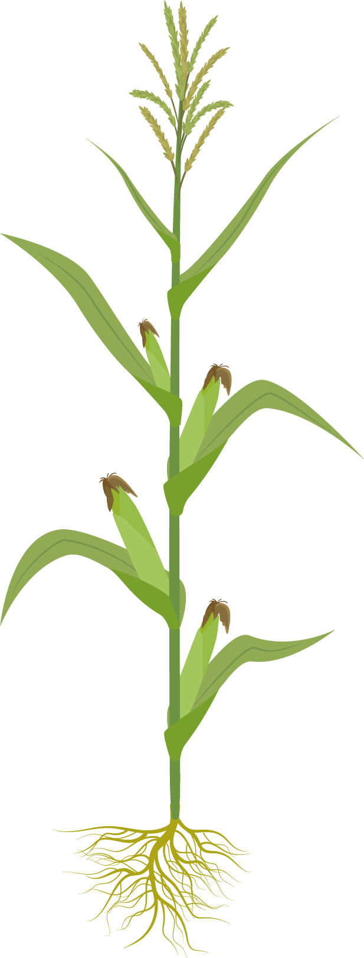
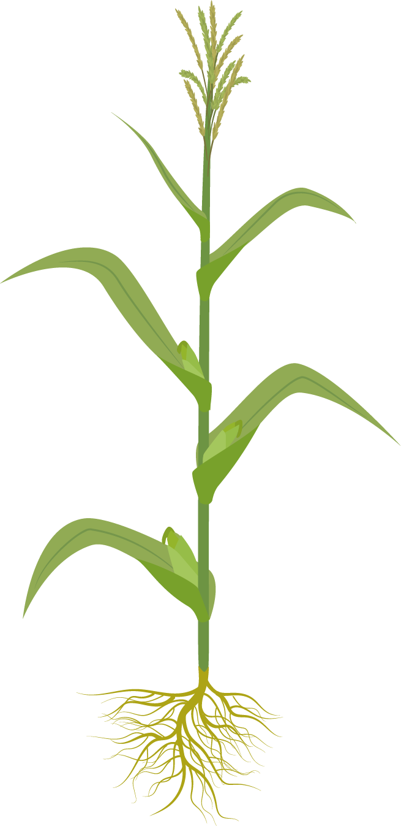
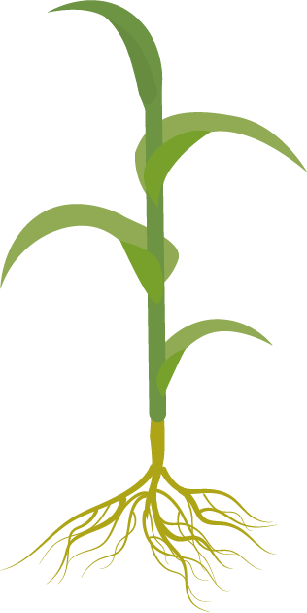
Table of contents
01
05
Native Plants of the Sonoran Desert
Riparian Habitat Data Analysis
02
06
Zoom-In/Zoom-Out Plant Journaling
Conclusion Questions
03
Sonoran Desert Data Collection
04
Sonoran Desert Data Analysis

Slide 3
01
Introduction: Plants of the Sonoran Desert

Slide 4
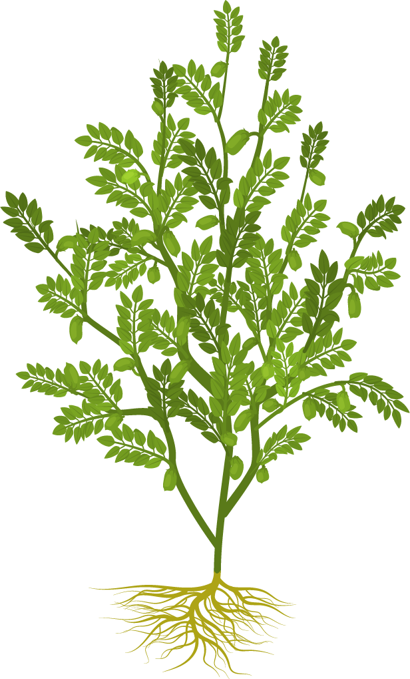
Native Plants of Sonoran Desert

Slide 5
Local School Plant 1

Slide 6
Local School Plant 2

Slide 7
Local School Plant 3

Slide 8
Local School Plant 4

Slide 9
Local School Plant 5

Slide 10
Local School Plant 6

Slide 11
Local School Plant 7

Slide 12
Local School Plant 8

Slide 13
Local School Plant 9

Slide 14
Local School Plant 10

Slide 15
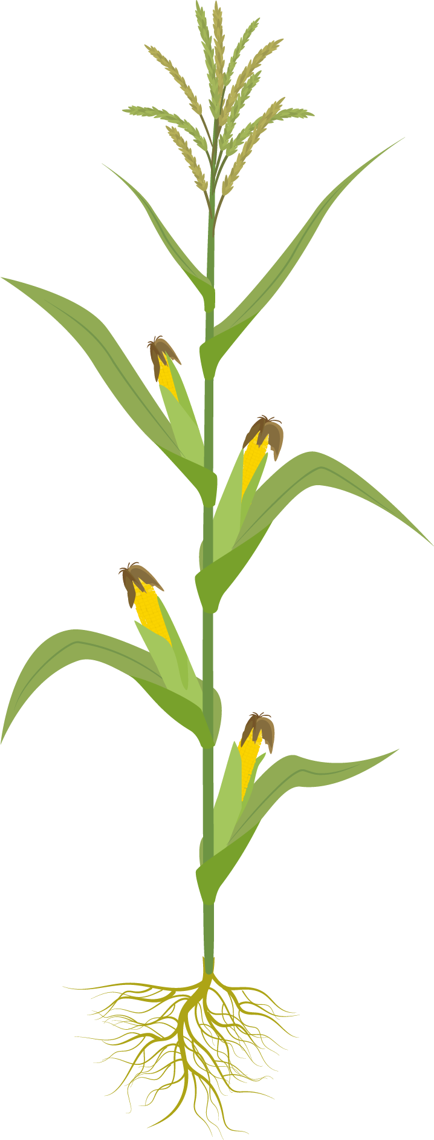
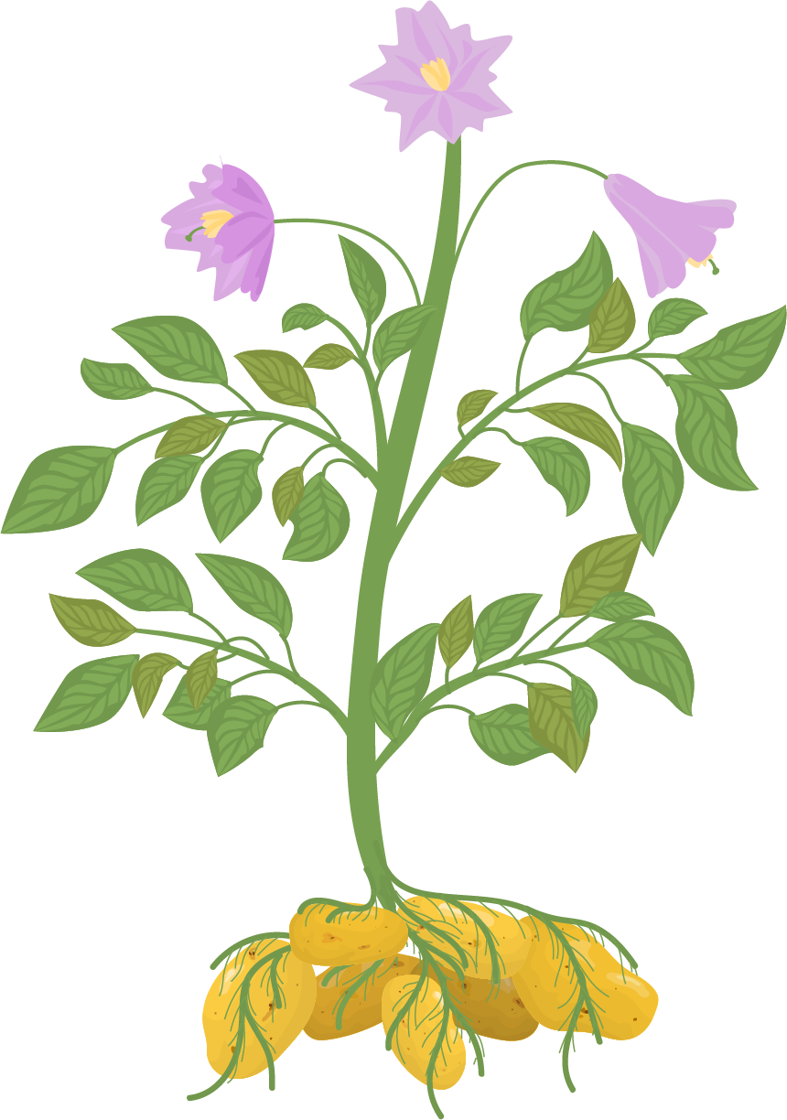
02
Zoom-In/Zoom-Out Plant Nature Journaling

Slide 16
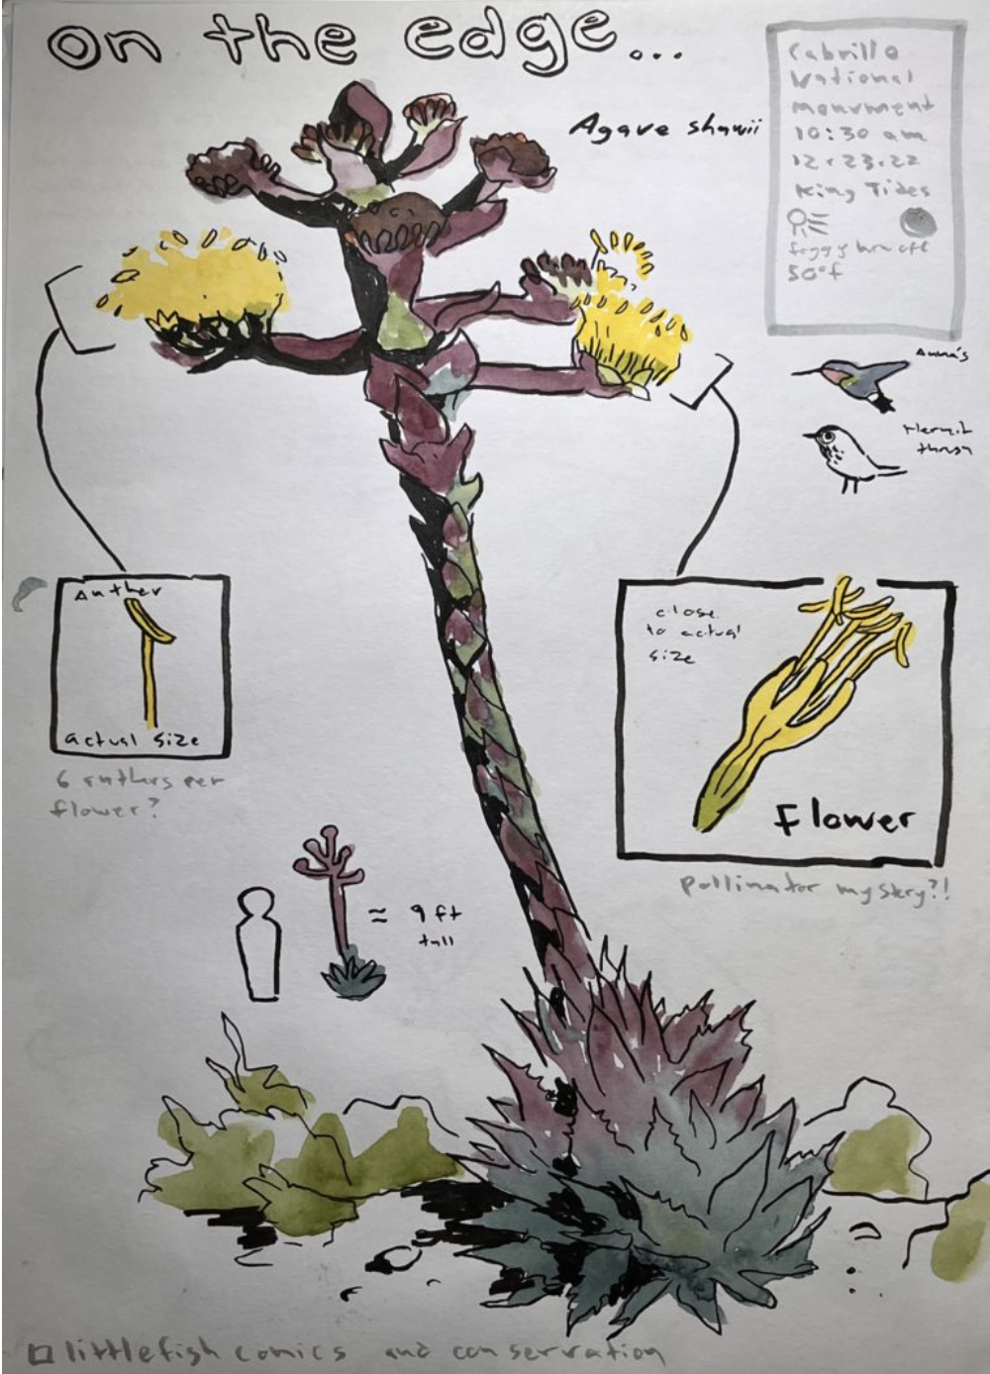
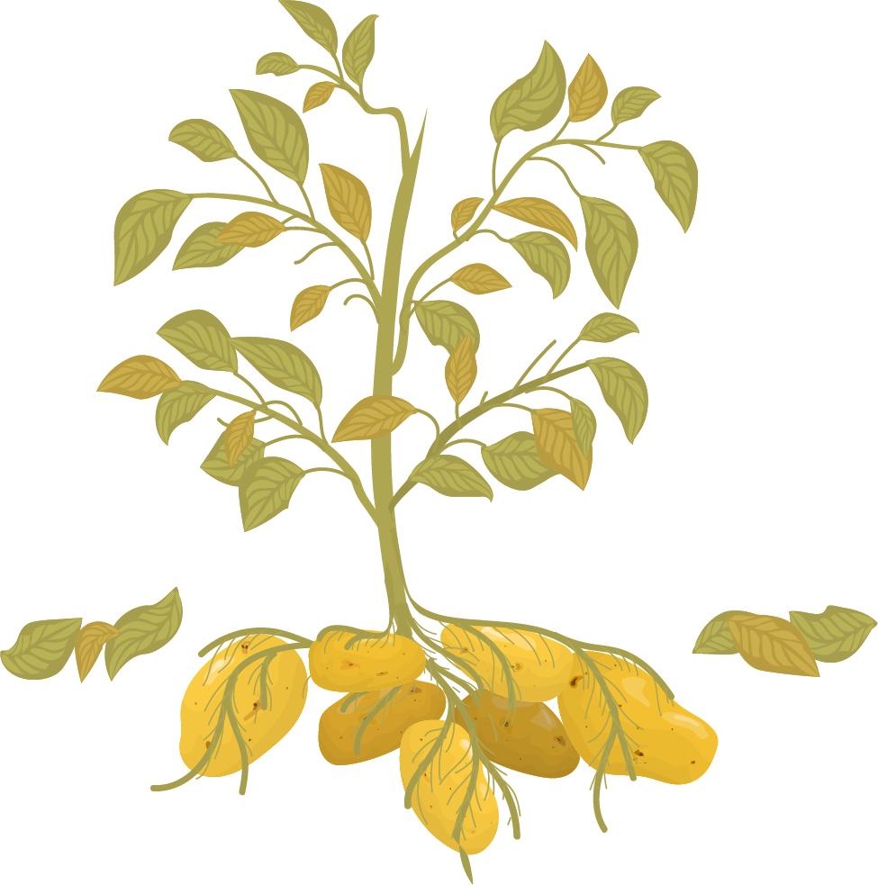
Zoom-in/ Zoom-out Plant Nature Journaling

Slide 17
Sample Student Work:
Place sample student work here

Slide 18
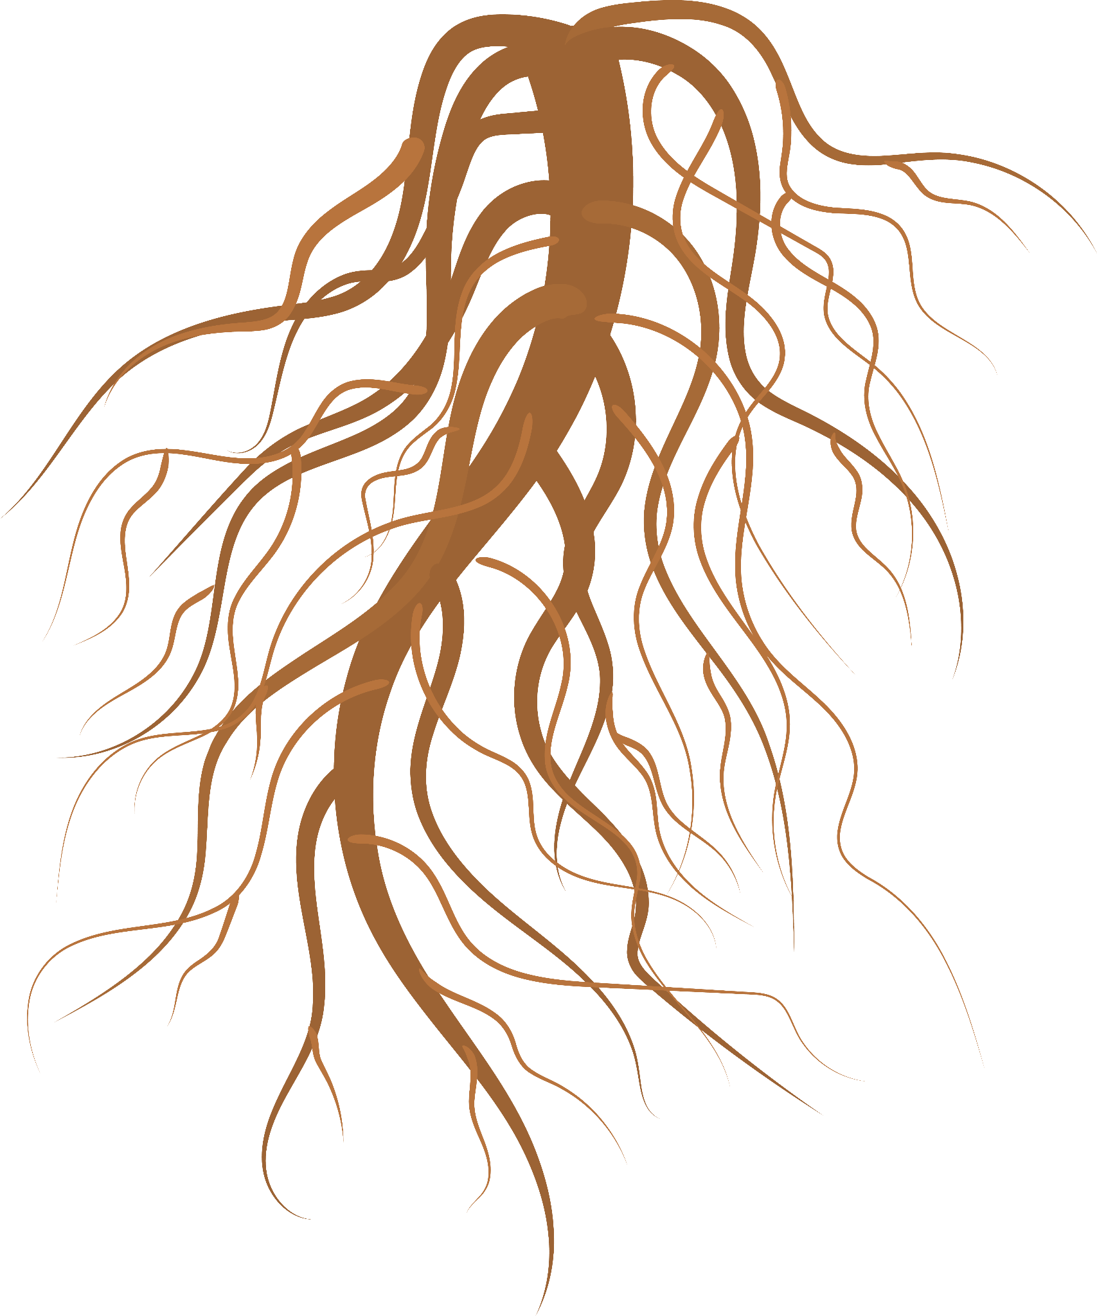
Objective:
SWBAT construct a “Zoom-in & Zoom-out” nature drawing of a single plant found on our local school campus

Slide 19
Instructions
You will record observations of a single plant at three different scales: close-up, lifesize, and far away
You should use writing, drawings, and numbers to record their observations
You should use circles to show the magnified view for the “Zoomed-in” portion of this exercise.
You should include details such as growth forms, where the subject is, or a small map for the “Zoomed-out” portion of this exercise.

Slide 20
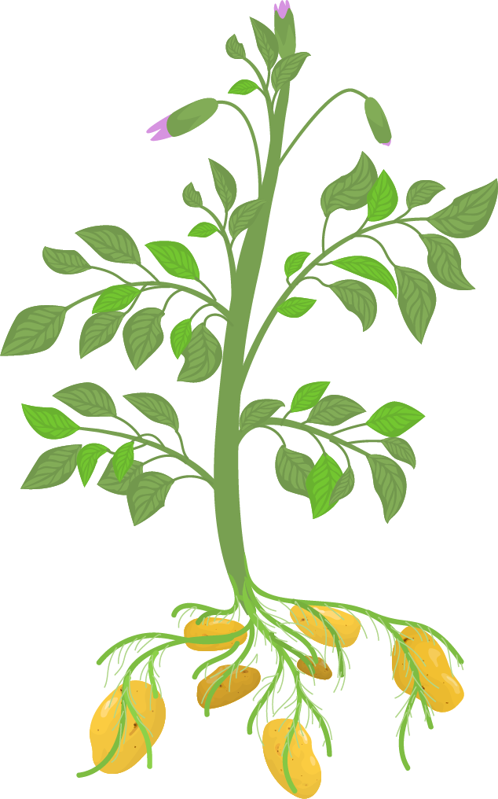
03
Sonoran Desert Plant Transect Data Collection

Slide 21
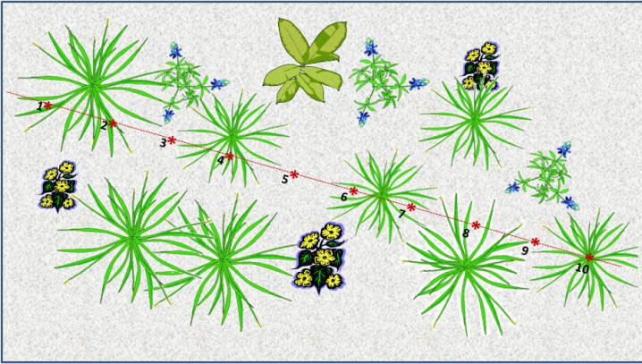

Slide 22
Sample Student Work:
Place sample student work here

Slide 23
Objective:
SWBAT collect data on plant biodiversity/plant richness data by identifying/recording the different types of plants in each quadrant along a transect in a Sonoran Desert Habitat.

Slide 24
Instructions
You will collect data, in a group, along a 50 meter transect line of your choosing.
Each group will record the name of each species of plant located within their quadrants (dimensions of quadrant: 1 meter square).
Quadrants will be located every 5 meters along the transect line, for a total of 10 quadrants (starting at 2.5 meters) along each transect line; transect line = 50 meters total.
Each group will end up with a different transect line and a different set of data points depending on where they placed their transect line.
You should notate on their graphic organizer every species of plant, tree, or shrub they find, in each quadrant, along the transect line!

Slide 25
04
Sonoran Desert Habitat Data Analysis

Slide 26
Objectives:
SWBAT construct & analyze data on plant biodiversity/plant richness data per transect (Sonoran Desert) by making a histogram of species richness for each individual transect.
SWBAT analyze data on plant biodiversity/plant richness by making a graph on total species richness/transect for the entire Sonoran Habitat.

Slide 27
Instructions (P1 - Group Data Analysis):
You will analyze data on plant richness data, for the Sonoran Desert Habitat, by making a histogram (1 per group) of species richness (y-axis) for their group’s transect line (x-axis = quadrant points along transect, 10 total).
You will obtain data by counting the total number of different plant species located in each quadrant (located every 5 meters) along their group’s entire transect (50 meters)
Each group will end up with 10 data points (1 for each quadrant = x-axis) for the entire transect.
Quadrant points along the transect are as follows: 1 = 2.5m, 2 = 7.5m, 3 = 12.5m, 4 = 17.5m, 5 = 22.5m, 6 = 27.5m, 7 = 32.5m, 8 = 37.5m, 9 = 42.5m, 10 = 47.5
*Each group will have a unique set of data points depending on where they placed their transect line.
Each group will make a histogram representing the total species richness (y-axis) per quadrant over the entire transect line.

Slide 28
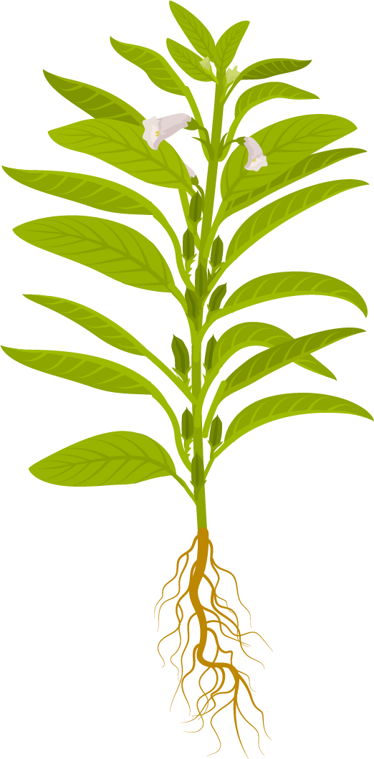
Instructions (P2 - Whole Class Data Analysis):
You will analyze data on plant richness, for the entire Sonoran Desert, by making a graph of the total number of different species (i.e. species richness) per transect line by utilizing the whole class's data.
You will obtain data by counting the total number of different species for each individual transect line and graphing the total number of species (species richness, y-axis) for each individual transect (individual group transects, x-axis, number of points depends on # of groups in class)

Slide 29
Riparian Habitat Data Analysis
05

Slide 30
Objective:
SWBAT analyze data on plant biodiversity/plant richness by making a graph on total species richness/transect for the entire Riparian Habitat.

Slide 31
Instructions: P1
You will construct & analyze data on plant biodiversity/plant richness, for the Sonoran Desert vs. Riparian Habitat, by making a graph on total species richness (y-axis)/transect point (x-axis) for both ecosystems.
Carbon dioxide
Oxygen

Slide 32
Instructions: P2
You will use the whole class's data (for the Sonoran Desert Habitat) and compare it to their group’s Riparian Habitat data.
Riparian data will vary per group as each group will be given a choice on which location they are using for their data analysis (5 locations total).
You will obtain data by counting the total number of species for each individual transect line and graphing the total number of different species or species richness (y-axis) for each individual transect point (x-axis).
Carbon dioxide
Oxygen

Slide 33
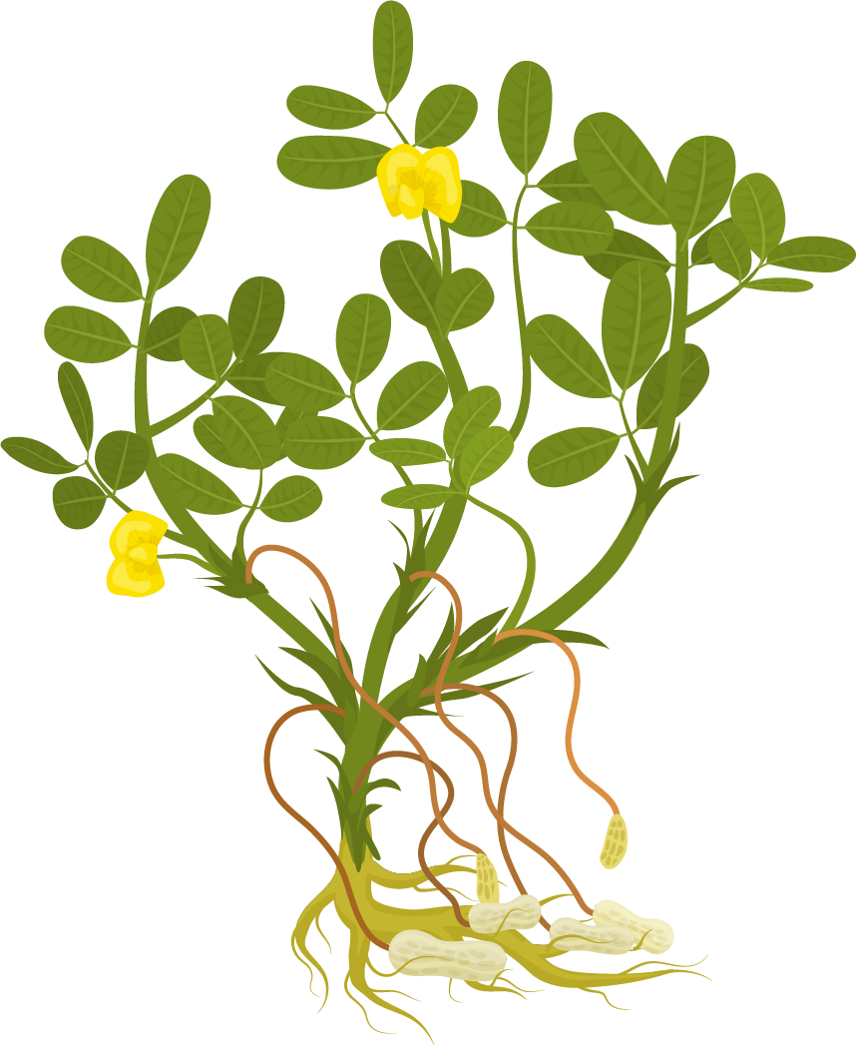
06
Conclusion Questions

Slide 34
Objective:
SWBAT compare and contrast species richness between the two distinct habitats and describe how species richness varies between two distinct habitats.

Slide 35
Conclusion Questions:
What overall trends/patterns were observed in species richness along the transect lines for a Desert and a Riparian Habitat?
What are the differences & similarities in plant species richness/biodiversity in a Southern Arizona Riparian vs Desert habitat?
Which habitat had the highest amount of plant biodiversity? Species richness? Explain your results.
What factors (abiotic/biotic) might lead to the observed changes in richness you observed between the Sonoran Desert and the Riparian Habitat?
How do the diverse ecosystems support increased biodiversity?
Carbon dioxide
Oxygen

