Slide 1
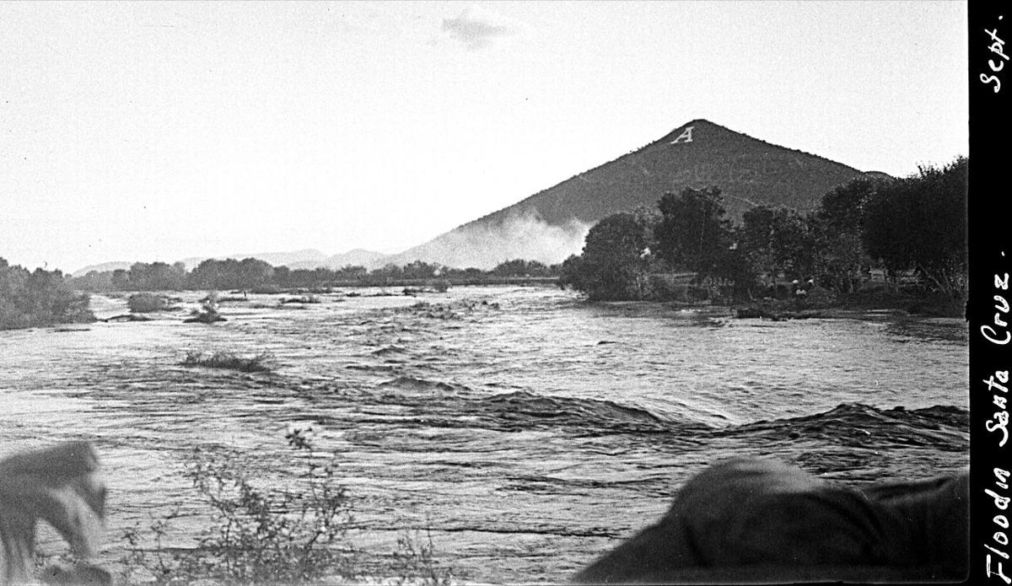
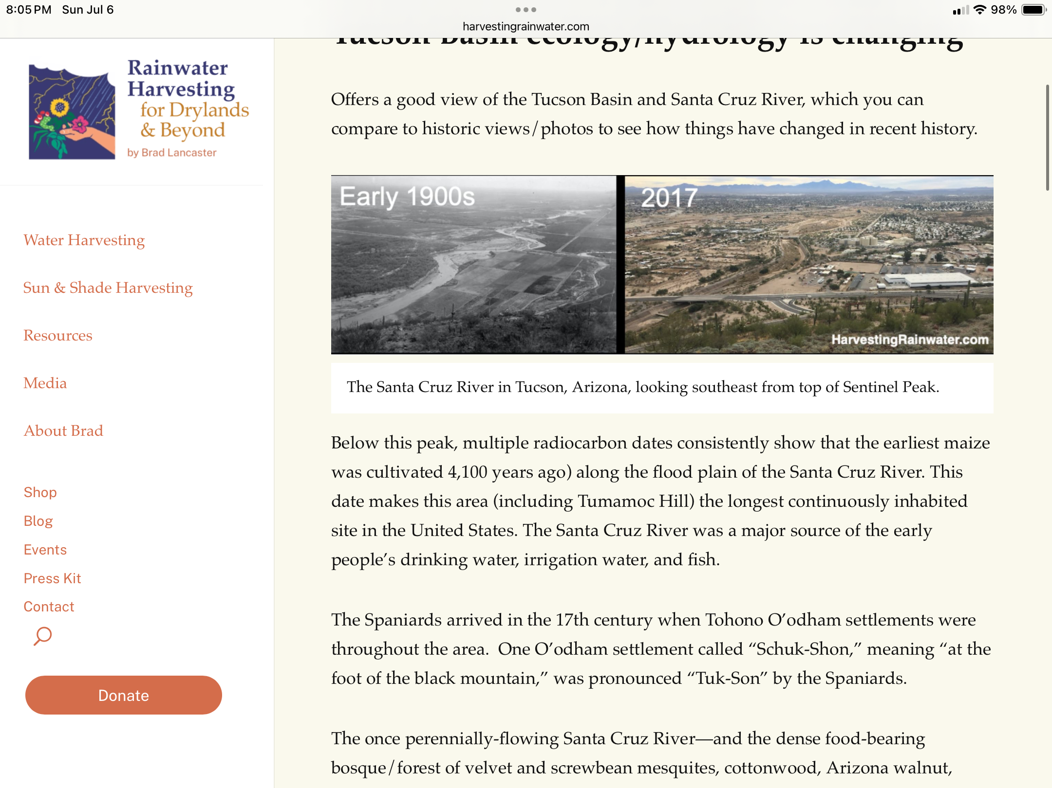
What do you notice, what do you wonder?
Type here:

Slide 2

Mystery in the Santa Cruz River
Use the following clues to explain the phenomenon in the pictures. On most slides you must type in an answer or other information that will lead you to the cause of the phenomenon. On the last slide you must make a claim about what you have discovered that caused it.

Slide 3
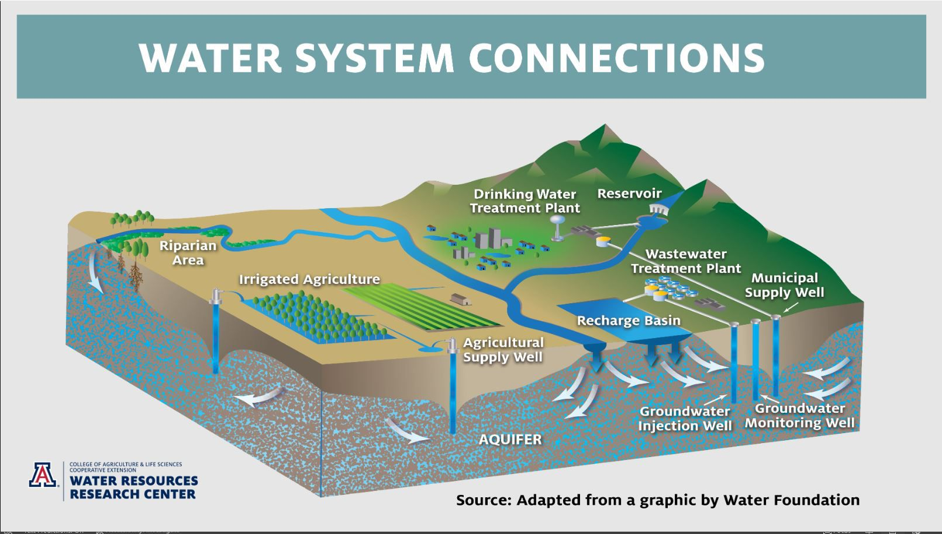
Mystery Clue #1
“Groundwater”
Where do you think our groundwater comes from? Explain why you think that.

Slide 4
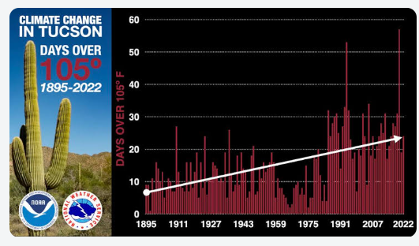
Clue #2
A
B
“Climate Change”
What do you notice about the number of days in Tucson over 105? How could that impact the water cycle in Tucson?

Slide 5
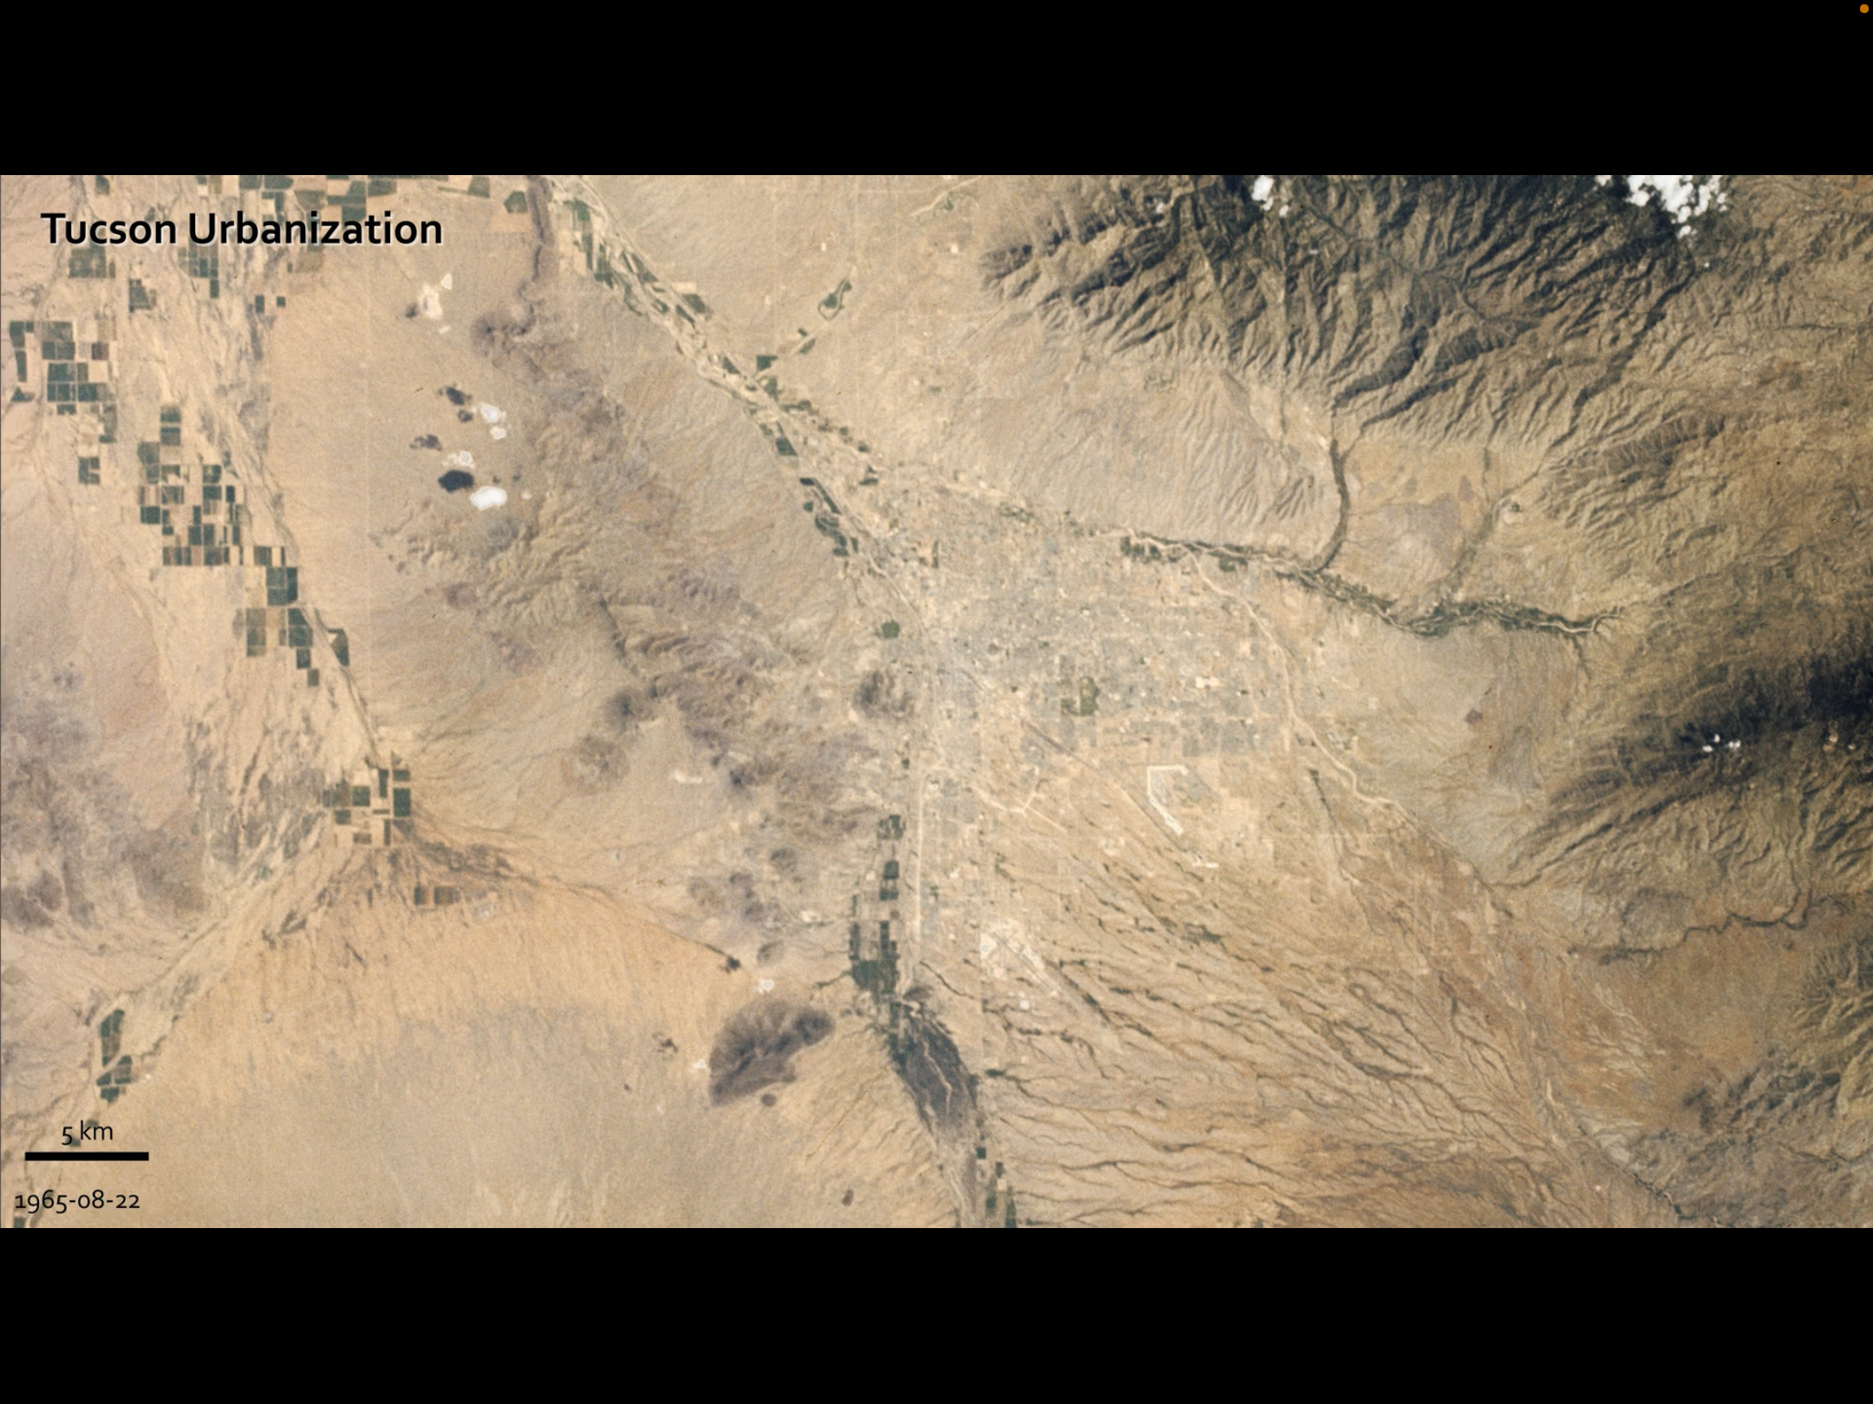
Clue #4
Clue # 3
Tucson 1965

Slide 6
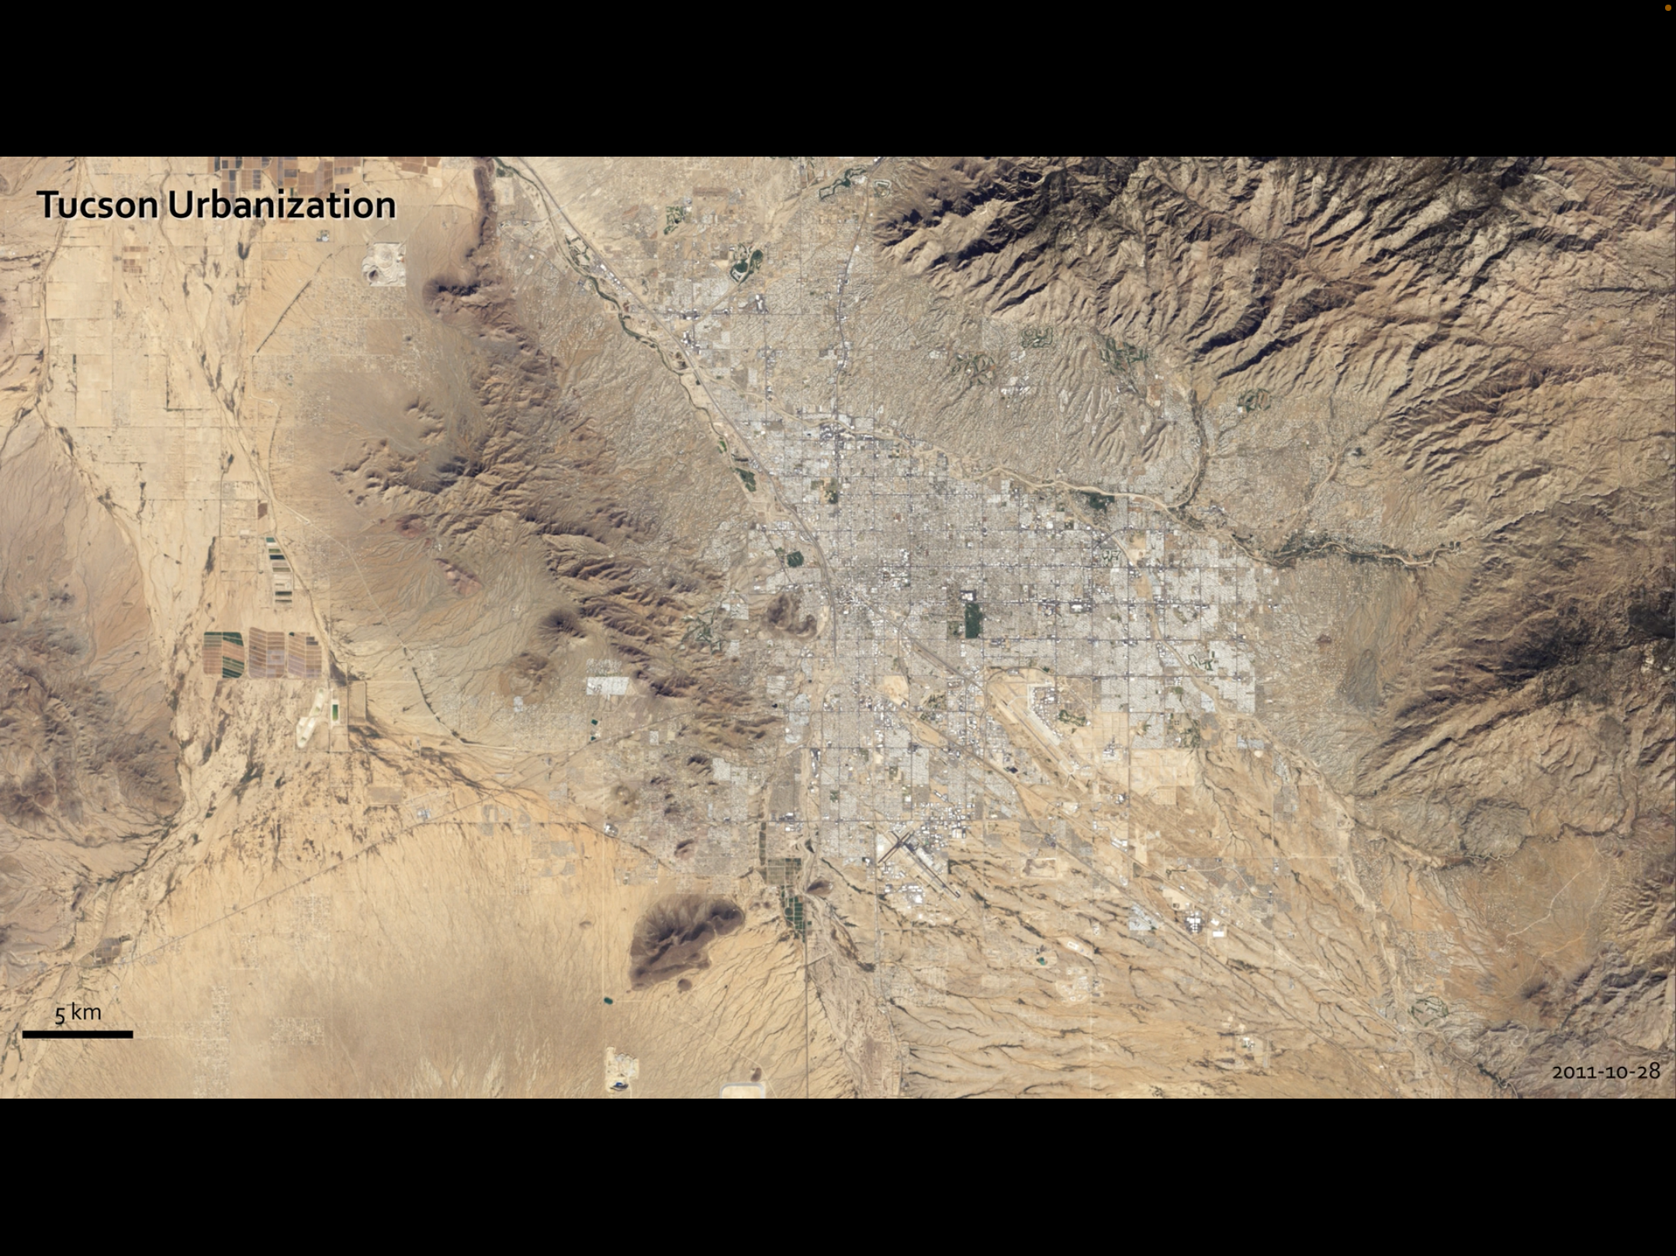
Clue # 3 Continued
Tucson 2011

Slide 7
Clue #3 Continued
What do these two maps show us?

Slide 8
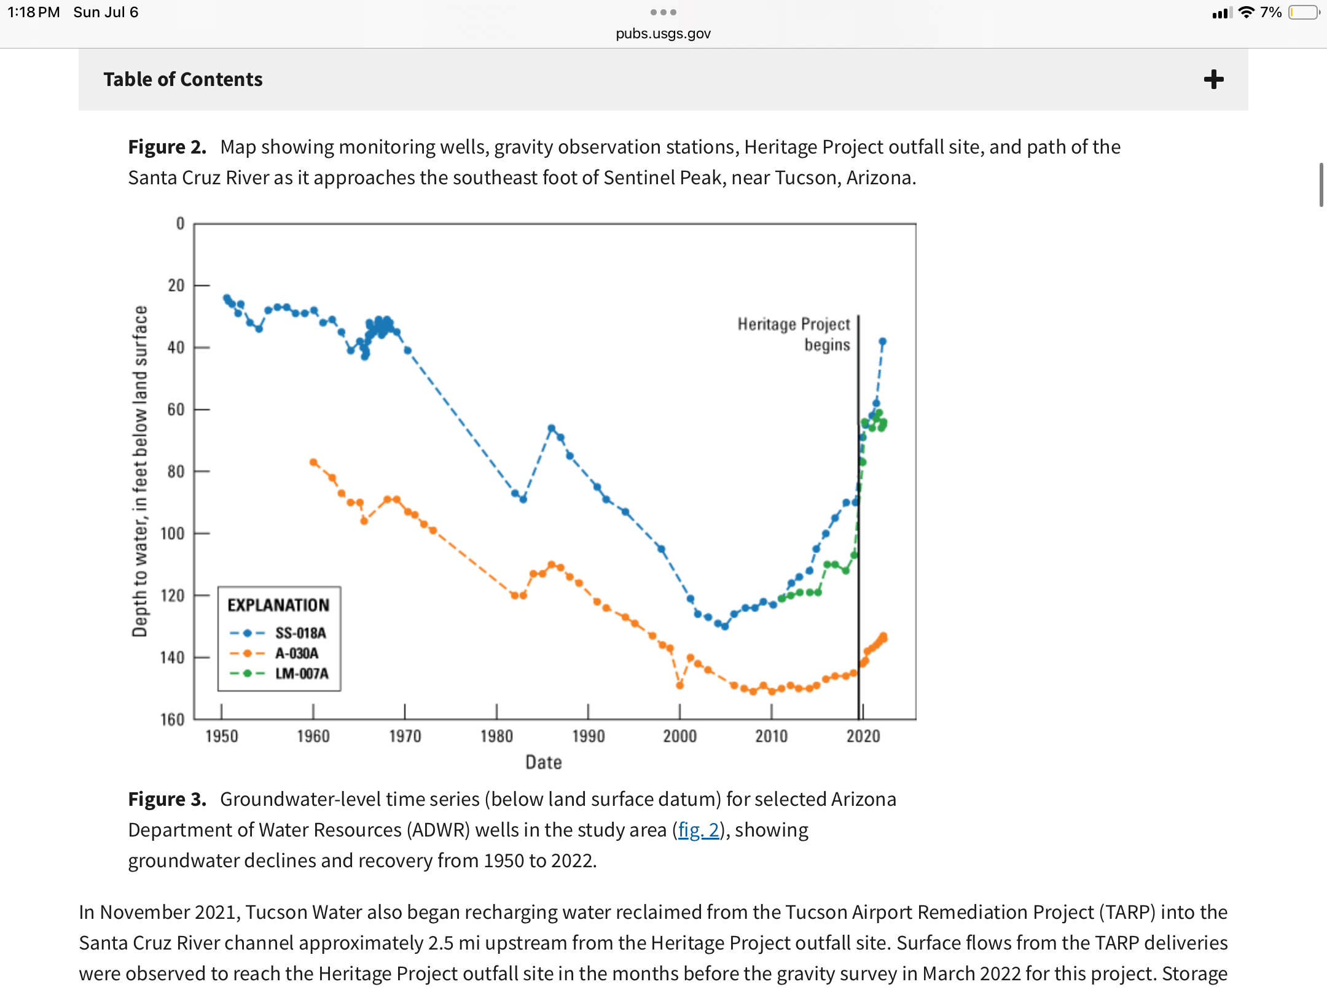
Clue # 4
This graph shows water in monitoring wells, what do you believe is the cause for the overall groundwater decline?

Slide 9
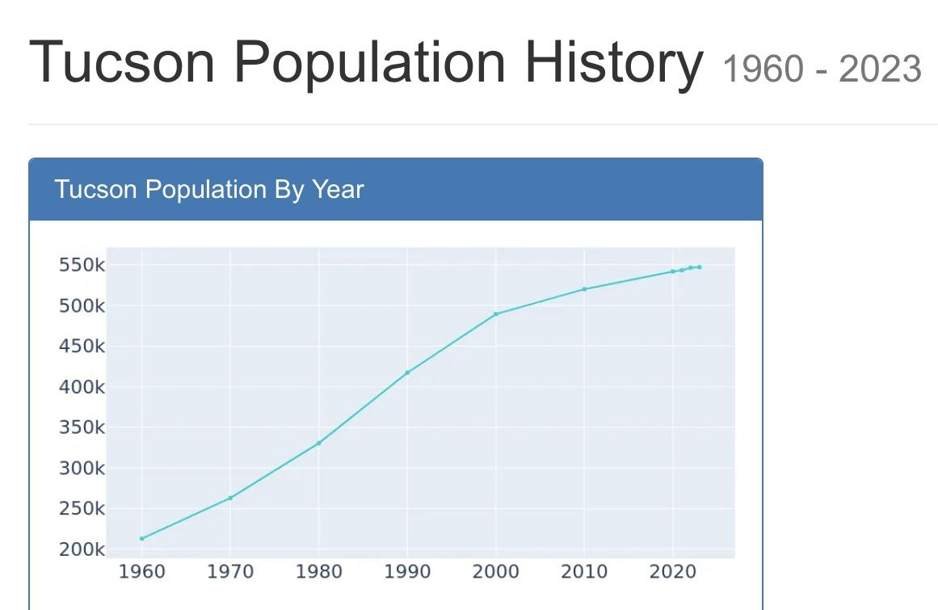
Clue #5
What information does this graph give and why is it relevant to water resources?

Slide 10

Clue #6
What does the video add or confirm about your thoughts on the phenomenon?

Slide 11
Mystery Solved?!
Using evidence from the clues, explain the phenomenon in the pictures on the first slide. What do you think happened to the water in the Santa Cruz?
Type your explanation as a CER. (Claim, evidence, and reasoning)

