Slide 1
The Impact of Human Activity
On Campus

Slide 2
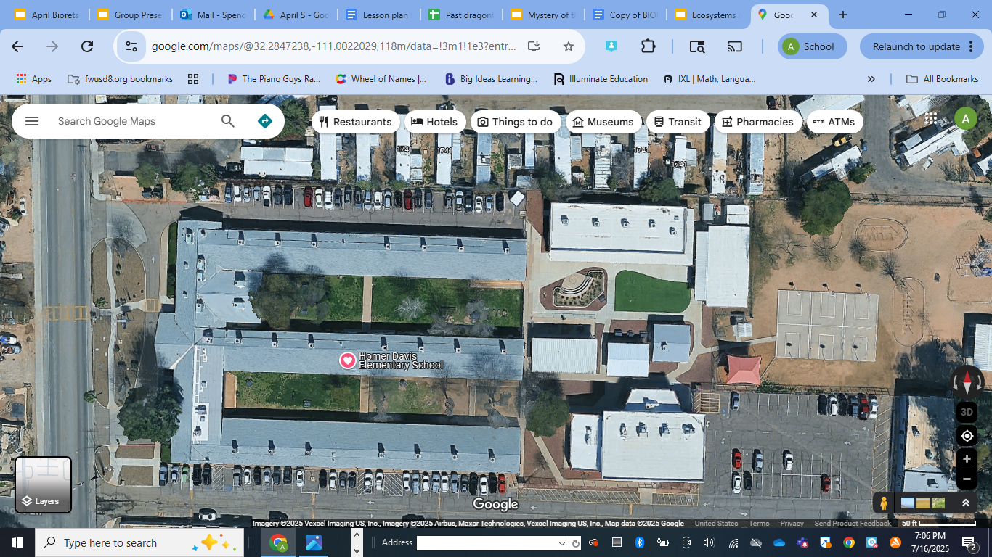
What do you notice?
What do you wonder?

Slide 3

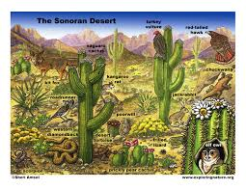


Our School Ecosystem: Understanding Human Impact
What is an Ecosystem?
Ecosystems are communities of living things interacting with their environment. Humans can change ecosystems in many ways, both good and bad. We'll explore our school's ecosystem to see these impacts firsthand.

Slide 4


The School as a Mini-Ecosystem
Objectives: Students will be able to:
Collect ecological data from campus zones.
Identify human impact signs at school.
Analyze data to see most affected areas.
Develop solutions reducing harmful human effects.

Slide 5



Exploring Different Zones
Let's explore different zones in our school! We will investigate grassy areas, paved areas, playground areas, community garden, and even trash zones. Each zone helps us see how humans affect the environment.

Slide 6

What do you notice?
Make observations:
Notice what you see in each zone we visit. Record what you see; plants, insects, birds, animals, grass, dirt, trees, and any other thing you see in the zone. Be specific and record what you see, hear, and smell.
Notes:
References:
- 6th_Grade_Human_Impact_Ecosystem_Activity.pdf (Pages: 1)

Slide 7
Observing Human Impact
Observe and record the human impacts you see in each zone. Look for litter, compacted soil, buildings, structures, and any thing else you see that would be something humans put there.
Notes:
References:
- 6th_Grade_Human_Impact_Ecosystem_Activity.pdf (Pages: 1)

Slide 8
Let's talk about what each zone looked like.
What did you notice? Which zones have the most plants? Which have the most trash? Which areas do you think are most impacted by humans? How do our actions affect these areas? What can we do to help?

Slide 9
Exit Ticket
Think about one way humans affect our school's ecosystem. What is one thing you could do to help?

Slide 10
Solution Design Challenge
Brainstorm ways we can help reduce negative human impacts on our school ecosystem.
Create a mini-poster of your solution to reduce the impact humans have on our school ecosystem.

