Slide 1
Archaeology of Trash
What Can We Learn About a Civilization From the Things They Leave Behind
C1 SW3 Activity
There is an activity sheet for this slideshow.

Slide 2
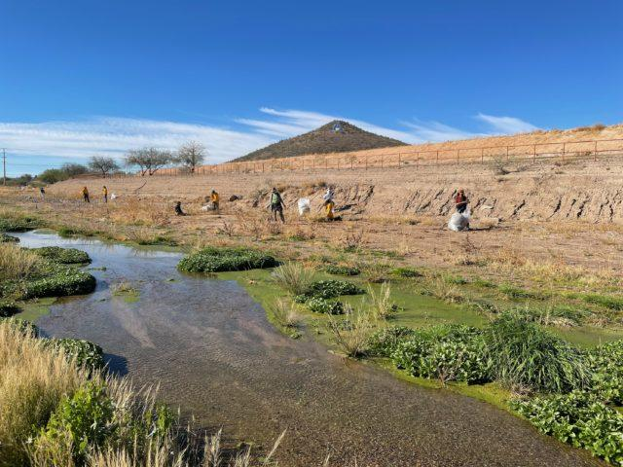
The Santa Cruz River - It’s Got Garbage!
We’ve all been in the Santa Cruz, and we’ve seen the shopping carts and Polar Pops. Ancient civilizations left behind garbage, too! This garbage helps us to learn about what peoples’ lives were like.
Garbage can teach us a lot! During the monsoon, trash that’s left anywhere in Tucson often flows into the Santa Cruz. When volunteers remove it, they count and categorize the trash so we can learn how to keep the river clean.

Slide 3
Directions pt. 1: Documentation
You are going to be looking at, organizing, categorizing, and logging real trash items that were found in the Santa Cruz River (don't worry, it's all clean trash! Well, kind of! I bleached it and we have gloves.) It’s important for scientists to keep detailed records of what you find. In box 1, write several ways you can categorize your findings. (food trash, plastic, clothing, automotive, etc)
Share your thoughts as a class.
As a group, choose 3 or more categories.
Notes:
Students should, as a class, have AT LEAST the following: making a list that describes their trash, categorizing it, drawing it, creating a model of it (like drawing it in the order they pull it out) If they don’t give these answers, you should add them to the list yourself.

Slide 4
Directions pt. 2: Ask a question
What kinds of questions do you think you might be able to answer about these people?
  Example: What kinds of food did these people eat? What was their health like? Was their society wealthy? Be specific. Remember that we’re thinking about what archaeologists might think about the civilization of Tucson.
What kinds of evidence would help you answer those questions?

Slide 5
Directions pt. 3: Dig in some trash
Remember to document what you find.Your graphic organizer includes a space for you to make a bar graph for your categories of trash.
Please do not mix the trash from your group's bag with the trash from another table. We are sharing materials with other classes and we need to make sure each bag stays separate.

Slide 6
Draw Some Conclusions
Were you able to answer your questions about the civilization that left this trash behind?
  What evidence supports your answers?
What other conclusions could your group draw about the people who left this behind?
  What evidence supports your answers?
Before we get started, let’s look at an archeological example!

Slide 7
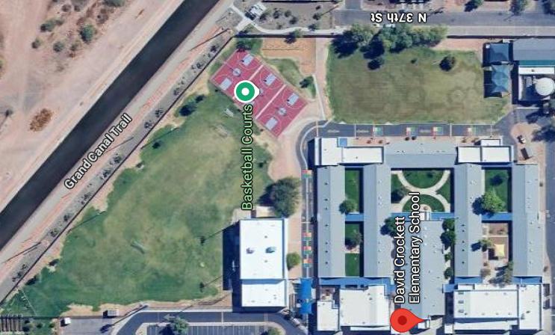
Let’s get some archaeological context!
When Russell was a new teacher, she worked at a school along the canals in Phoenix. The canals were originally dug by the Hohokam, and the Hohokam people had used this site as a garbage dump. Kids were always finding cool stuff on the soccer field like potsherds, arrowheads, charred bones, and jewelry. Let’s look at Hohokam trash archeology!

Slide 8
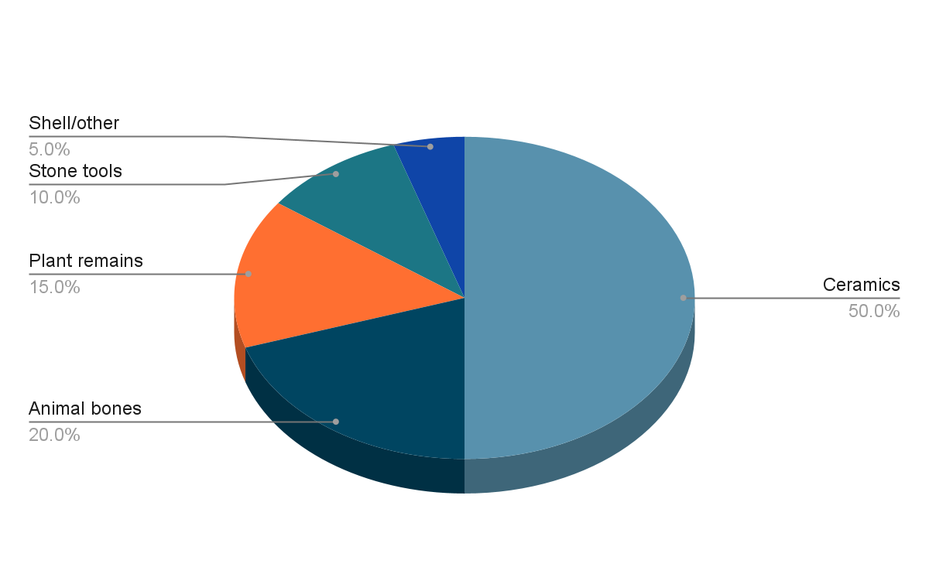
Hohokam trash by category - Snaketown
What did the Hohokam people eat, and how did they get their food? Trash evidence: Deer bones, rabbit bones, and hunting tools
How did they survive Phoenix’s arid climate? Trash evidence: canals, drought-resistant crops, vessels for water
Did they have jobs? Trash evidence: standardized designs on ceramics suggest they had specific jobs

