Slide 1
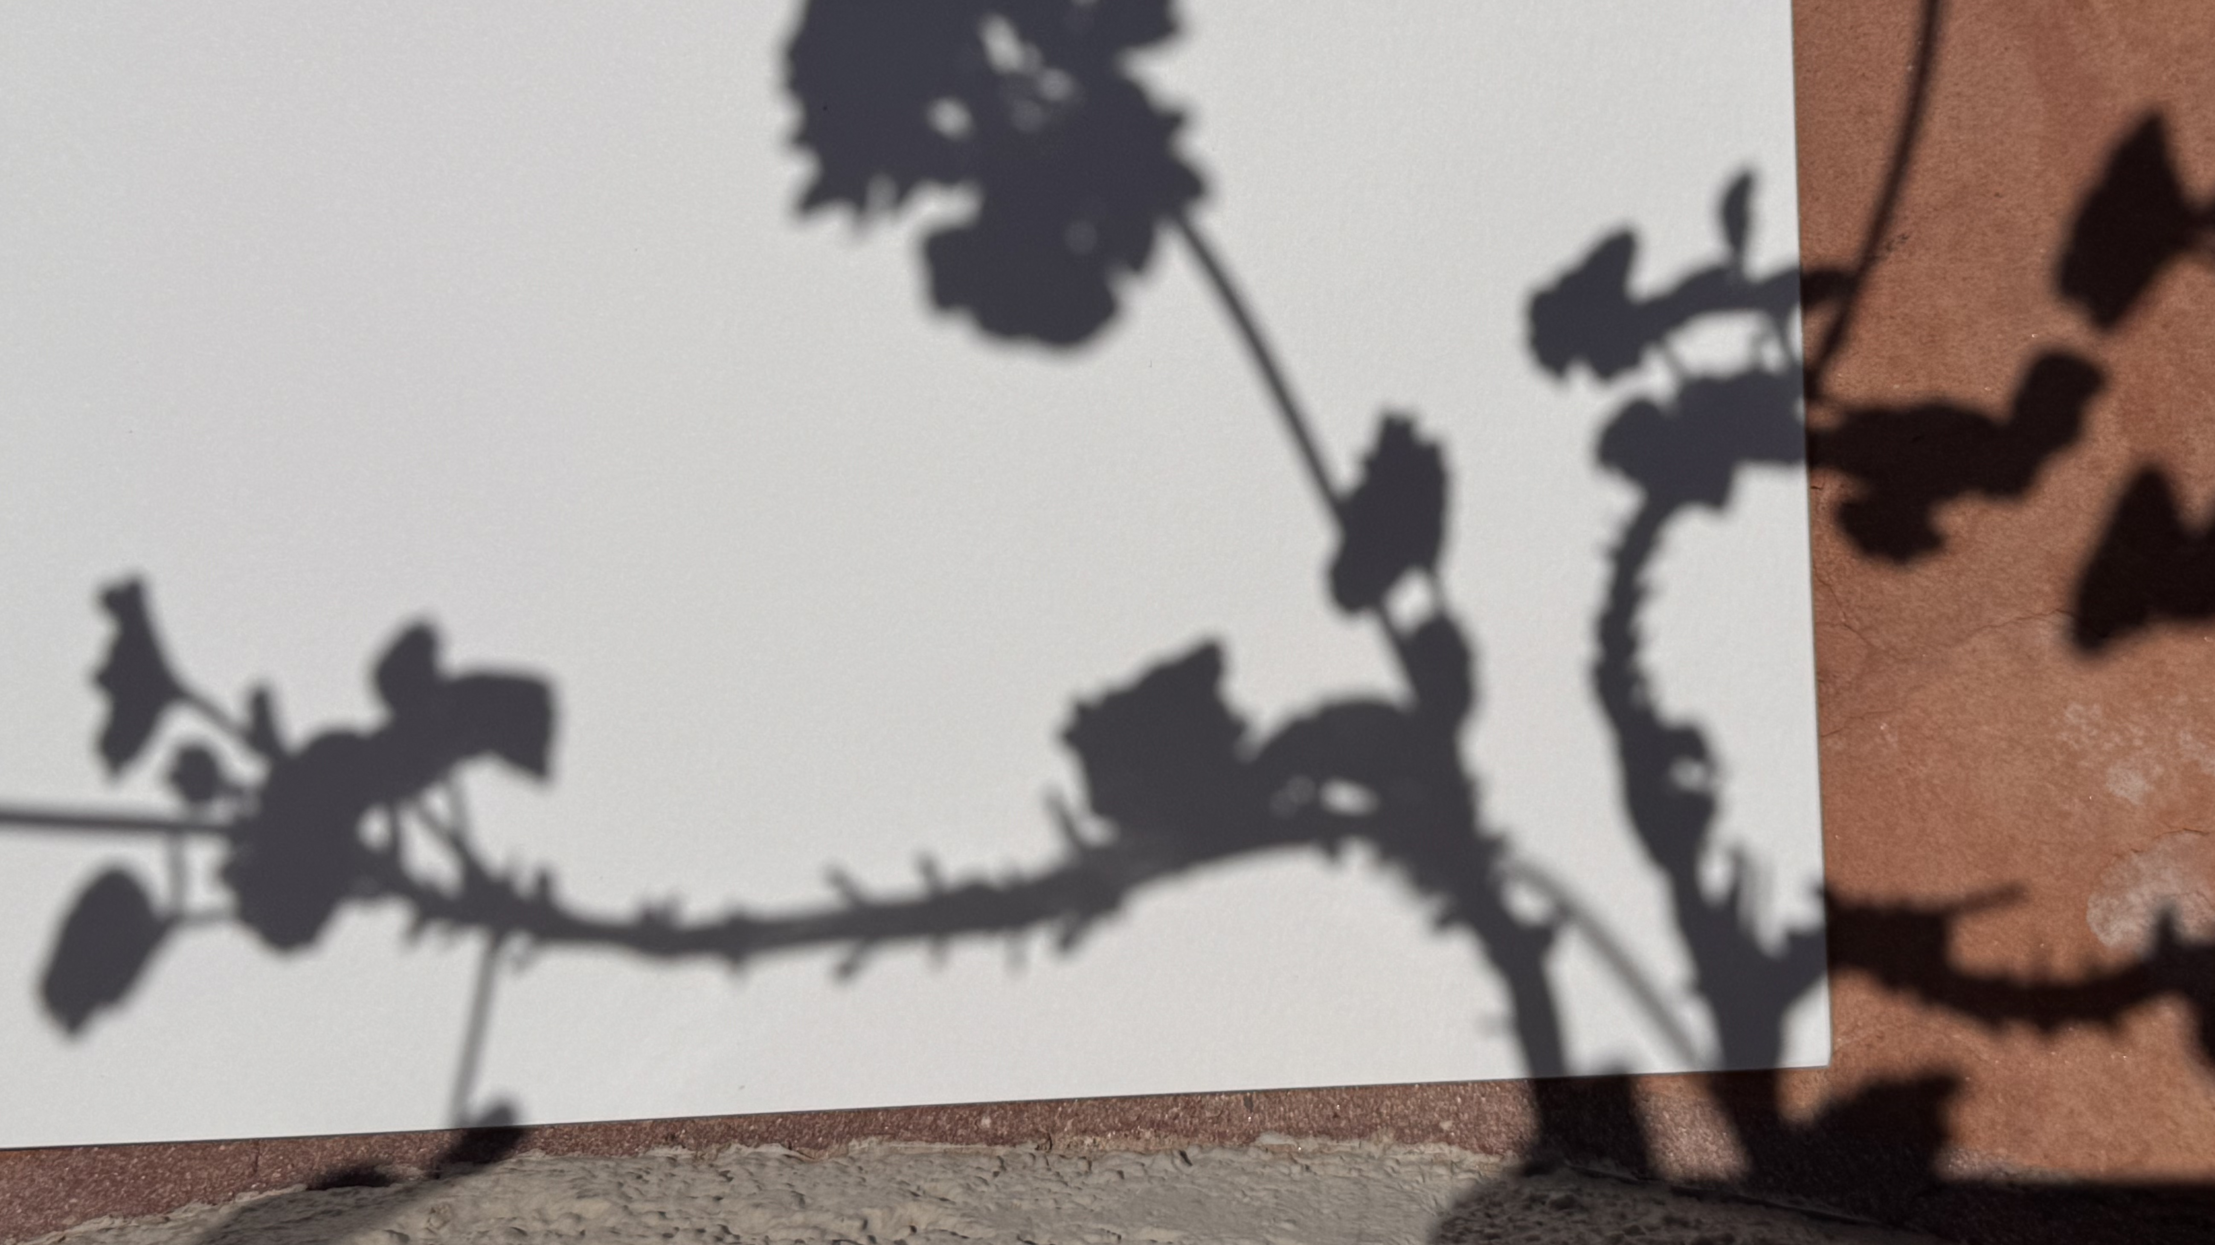
Shadow Art

Slide 2
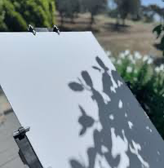
Materials:
Pen or pencil to capture initial contour lines.
Multipurpose paper
Your choice:
paint
colored pencils
watercolor paints
watercolor pencils
pastels
pens
chalk

Slide 3
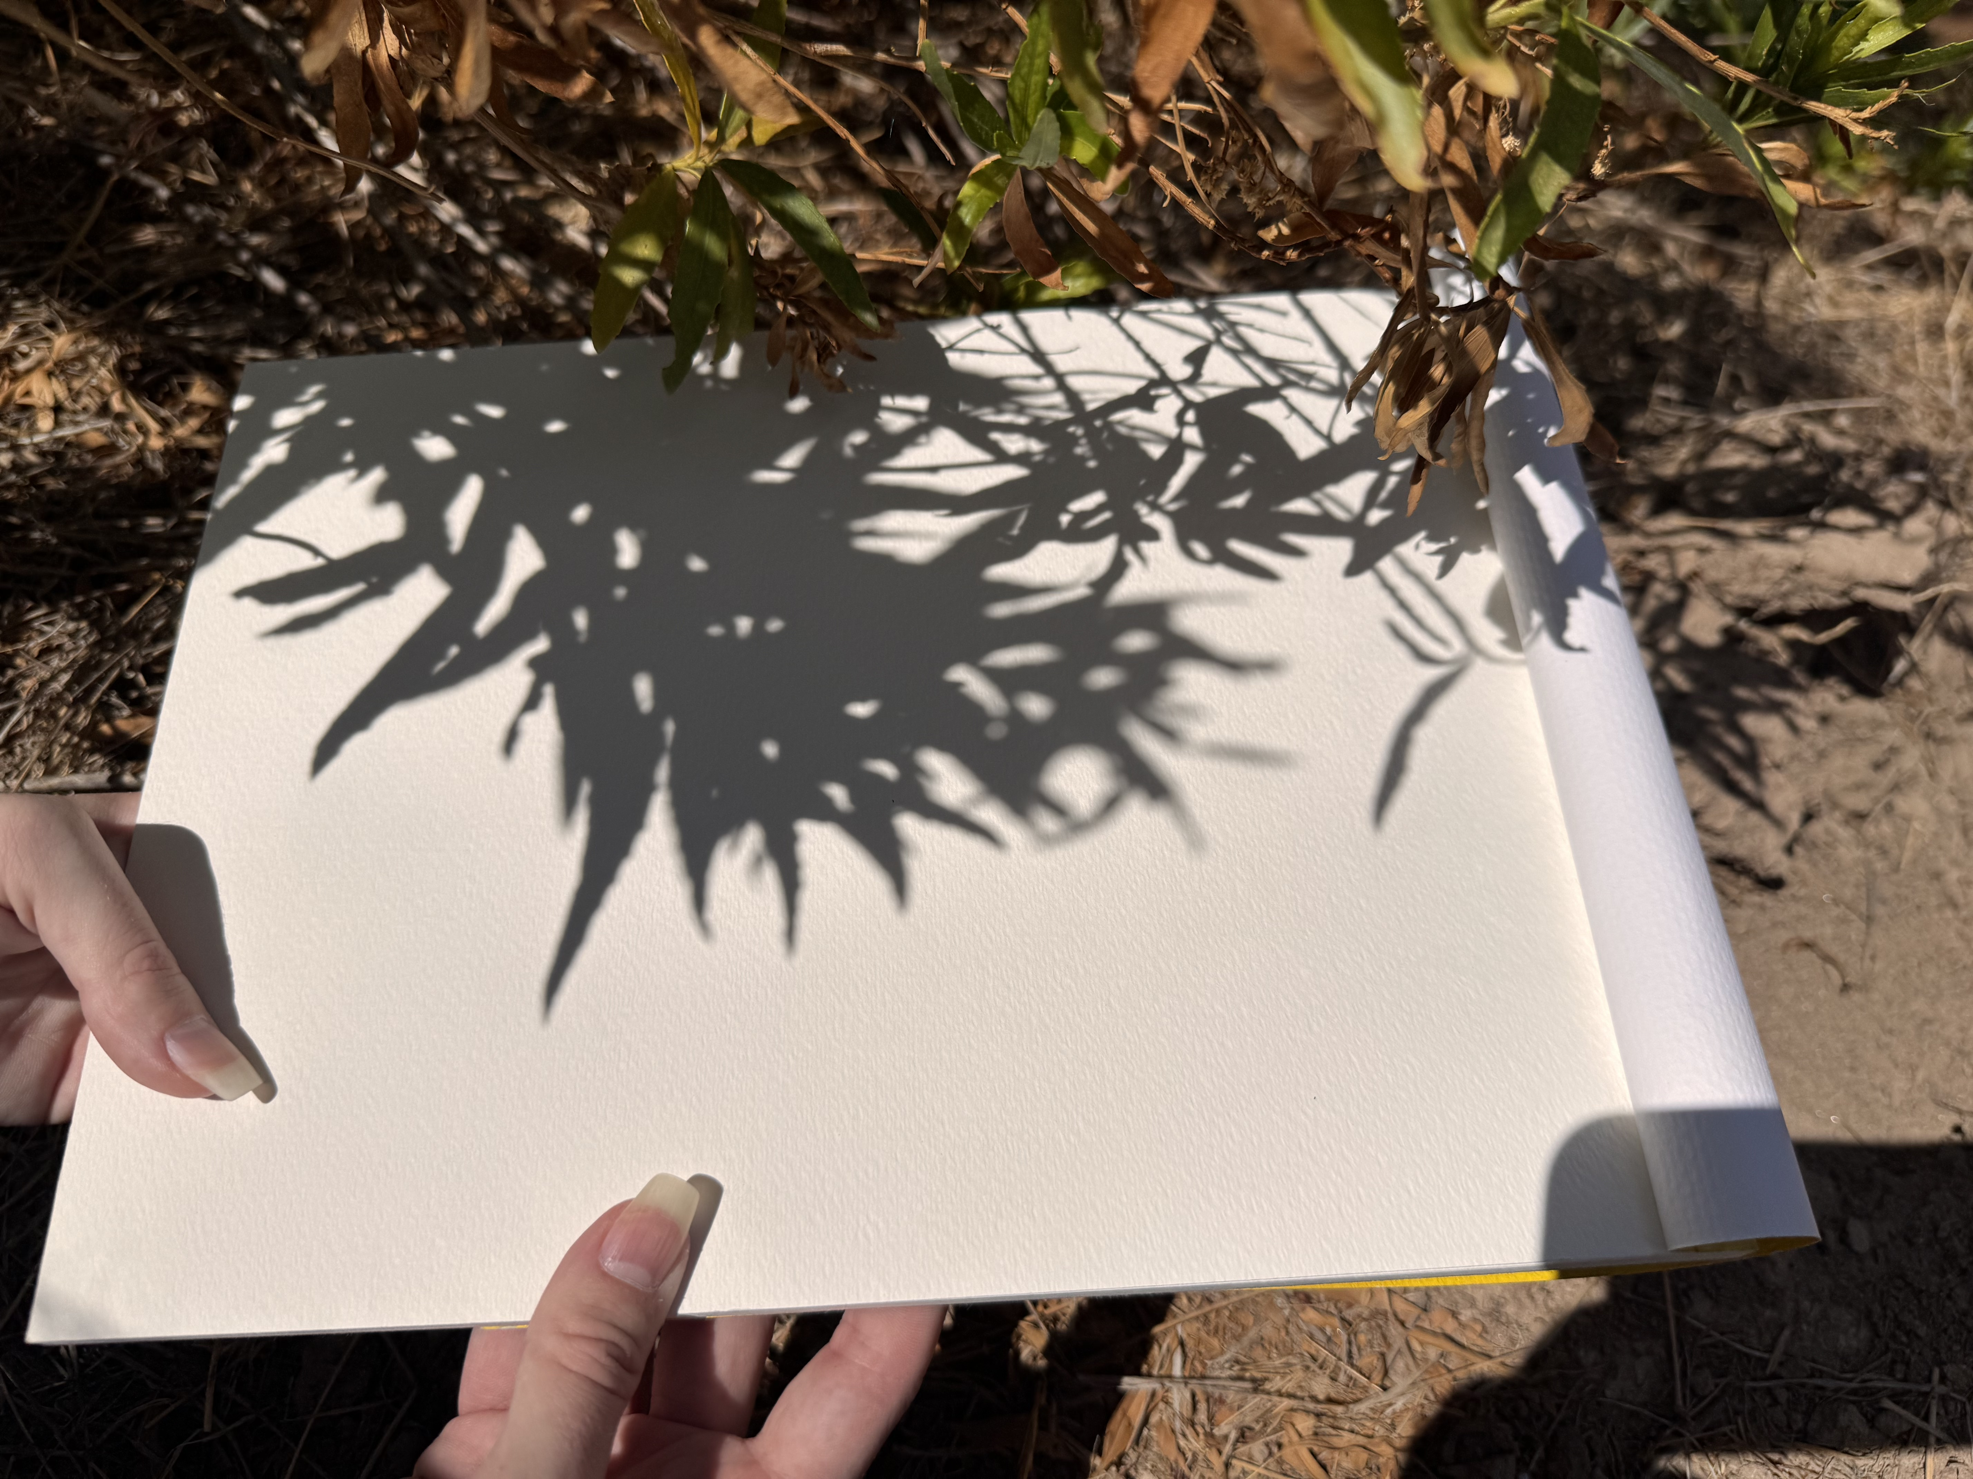
Have you ever noticed the beautiful shadows plants and other objects cast?
Shadow art is a fun and easy way to capture the contour lines of the beautiful shadows around you.
When you find an interesting plant or object, place your paper under the shadow.

Slide 4
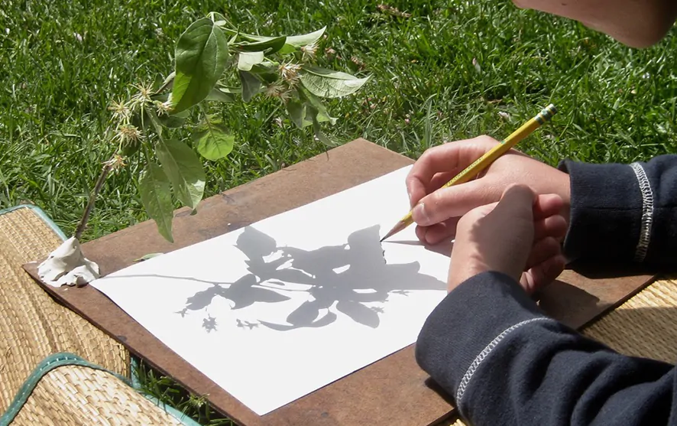
Think about your composition!
Composition is all about choosing what to include, what to leave out and how to position your image on the page.
Try to arrange the shadow on your page in a way that is pleasing to the eye and not too busy.

Slide 5
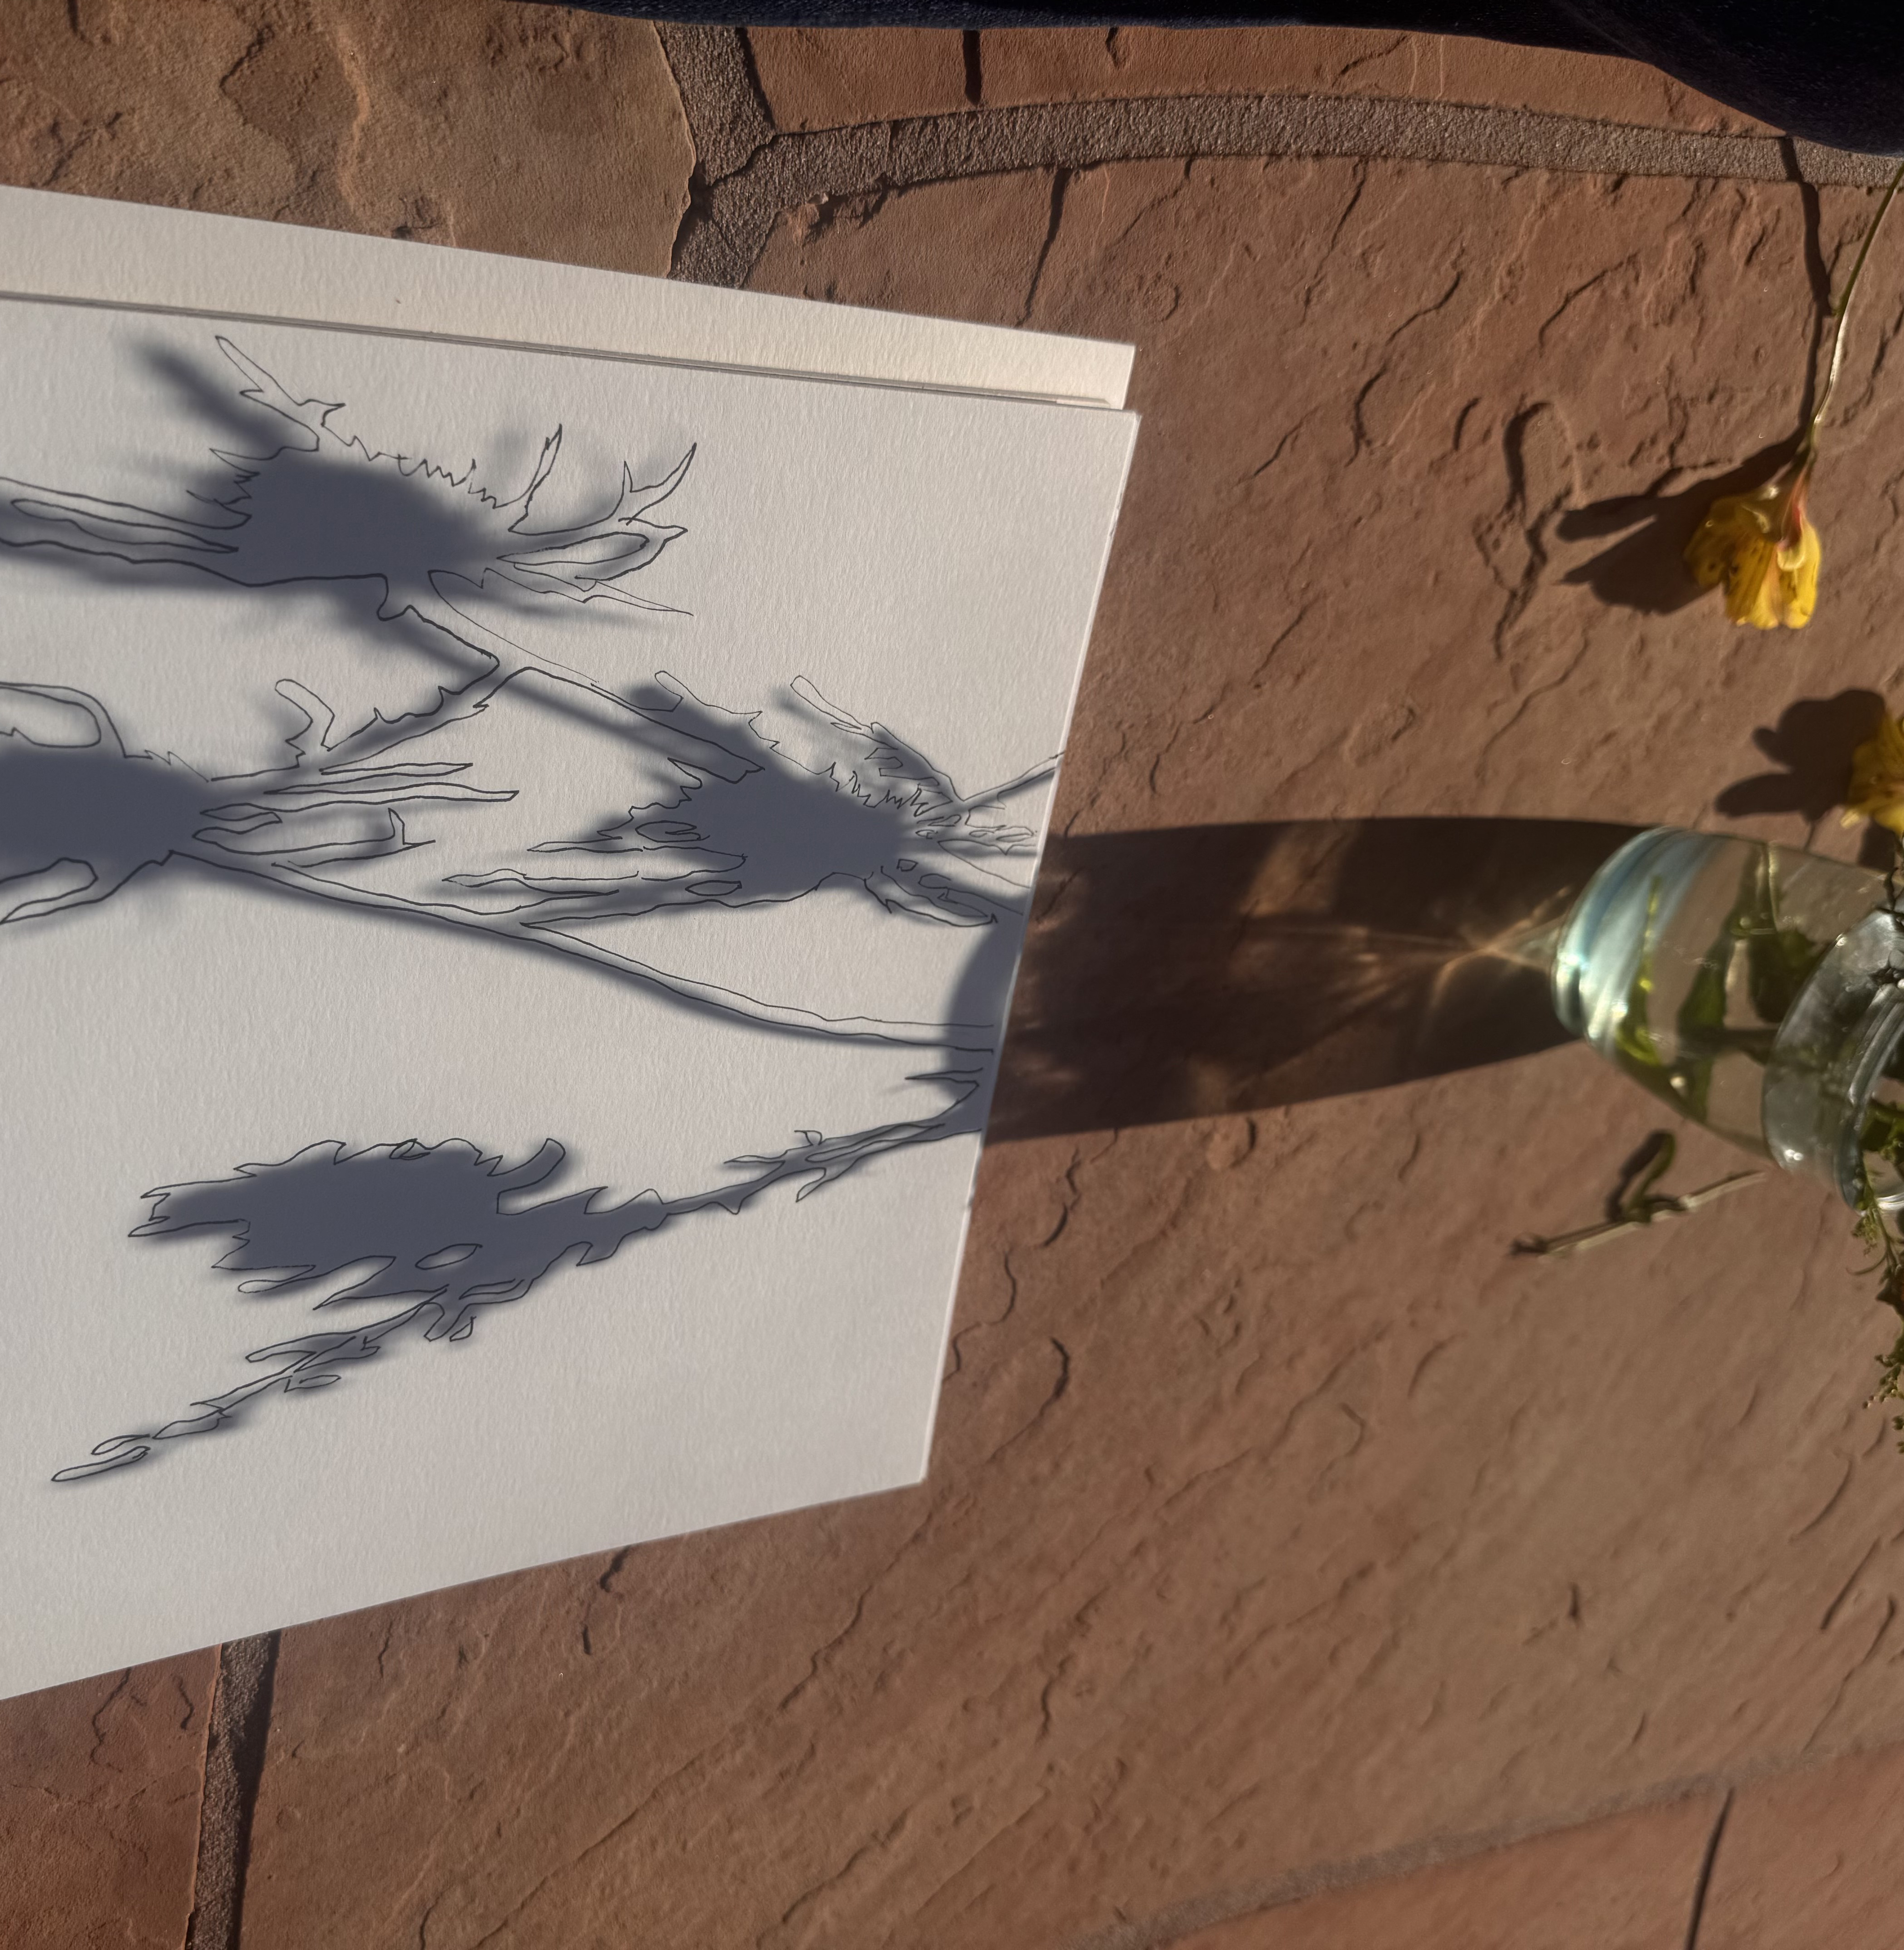
Now take your pen or pencil and trace around the edges of the shadows. This will create contour lines or an outline of the shadows.
Contour lines are beautiful by themselves, but here’s a couple of other fun ideas you might want to try:

Slide 6
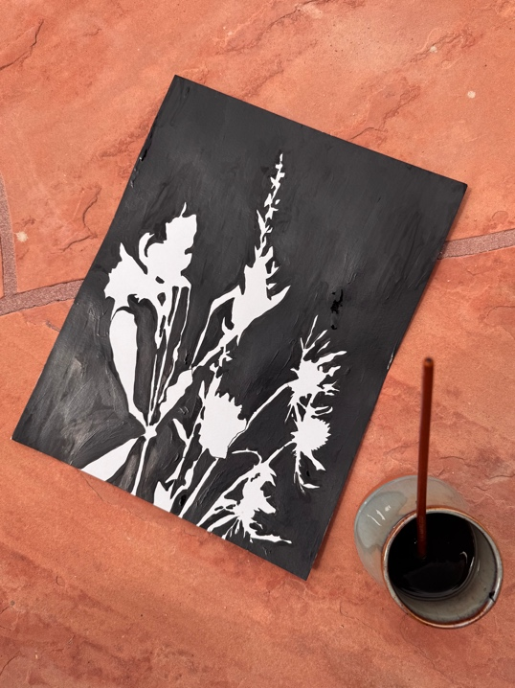
Negative Space Option: Once you’ve captured the outline of your shadow, try painting or decorating only the negative space or background around the plant shadow. (Positive space would is within the contour line of the drawing.)

Slide 7
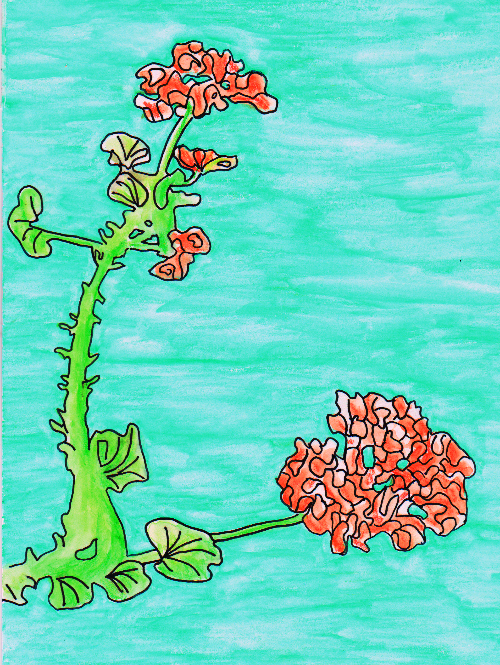
Naturalistic style Option: Naturalism is when artists try to make their art look as realistic as possible.
If you want to give this style a try, use the original plant as a reference and try to copy it as closely as you can.
How can you match the color, texture, and different values in the original plant or object?

Slide 8
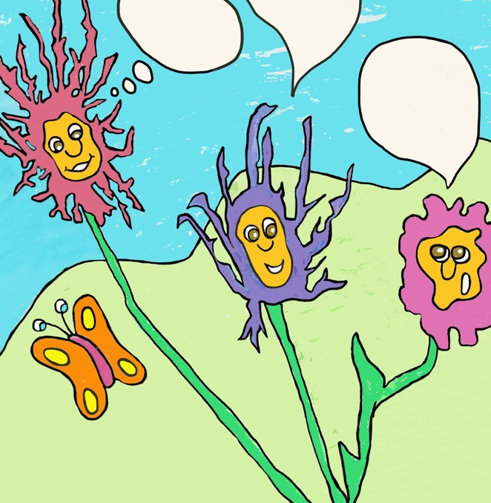
Pretend these flowers are having a funny conversation. What are they talking about??
Cartoon Style Option: Use your shadows outlines to create silly cartoons!

Slide 9
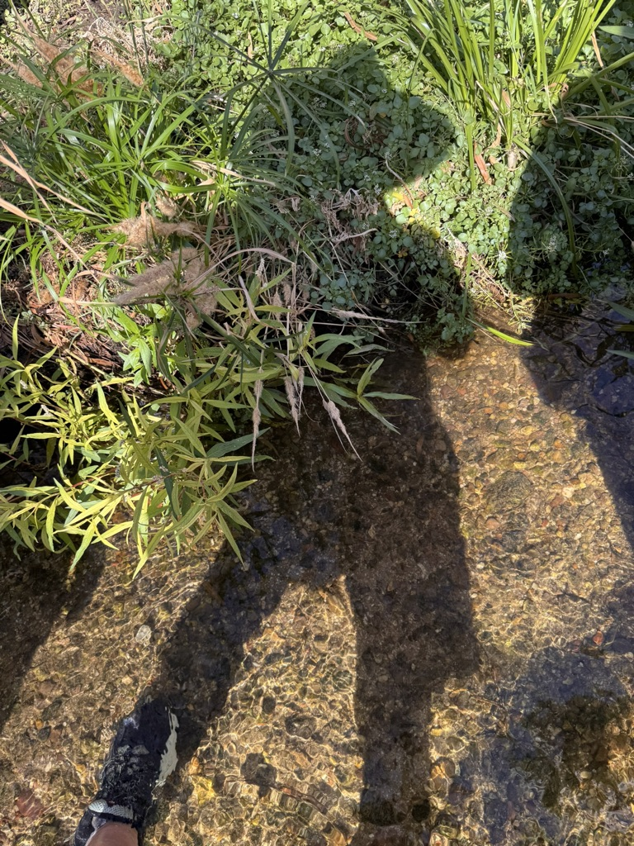
Happy Shadow Art!
Ms. Conners
UHS
Pima College

