Slide 1
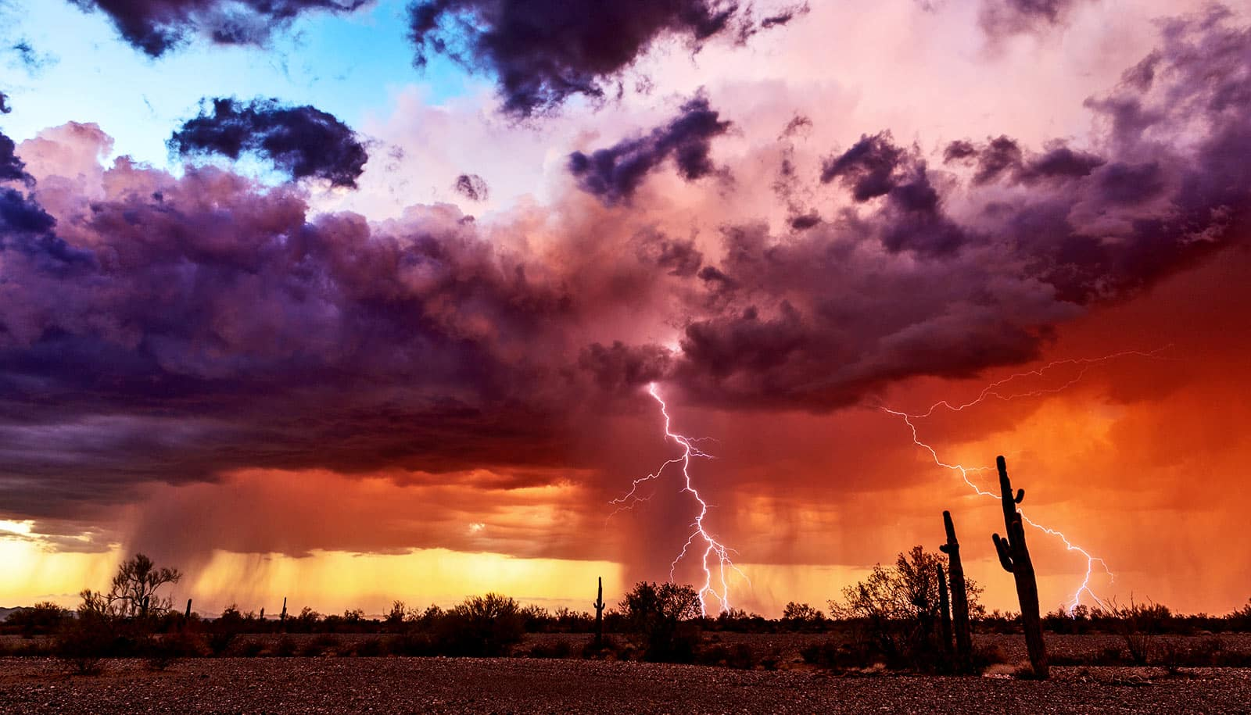
The Weather, and all it affects...
An Observation Project

Slide 2
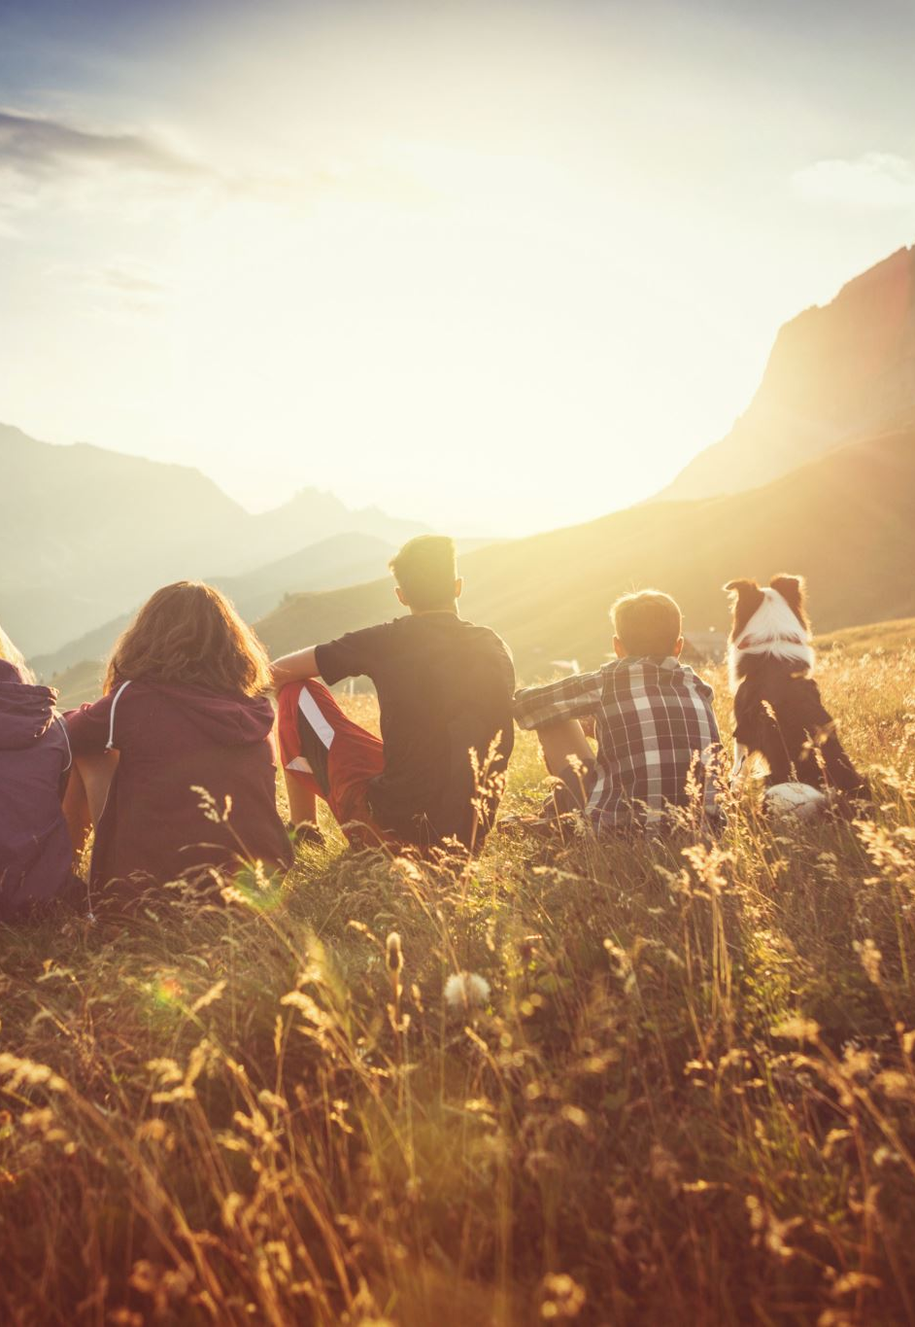
Overview
4 days of small group outdoor journaling
Using our senses (all of them!?) & minds
Observing the Weather & all it affects: - plants, animals, sky, soil, us, etc...
~30min outside in one spot (near a tree?)
Followed by 20min wrap-up, share-out & reflection back in class to improve our skills
Daily themes to guide our observations

Slide 3

Day 1
Start pg1 in a Notebook
Group names at top
Map of your spot (~¼ page)
Observations (all senses) & brainstorm related to "Weather & all it affects" & GQ1: How do changes in weather & the climate affect our lives?
Mostly words, drawings ok

Slide 4
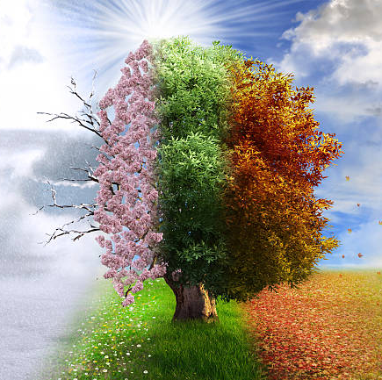
Day 2
Focus: CHANGE (pg2) - since yesterday!?, of seasons, the future... (micro to macro)
TWO related drawings
Further observations and brainstorming, building on what you AND OTHERS did yesterday

Slide 5
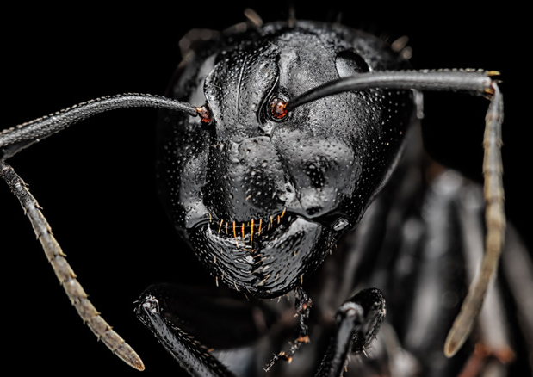
Day 3
ZOOM IN Look closer! Investigate... follow an ant & see what it's up to (for example)
How is weather affecting LIVING THINGS?
Find more changes...
Words & Drawings
Take it to another level, not more of the same

Slide 6

Day 4... what do YOU have to contribute?

