Slide 1

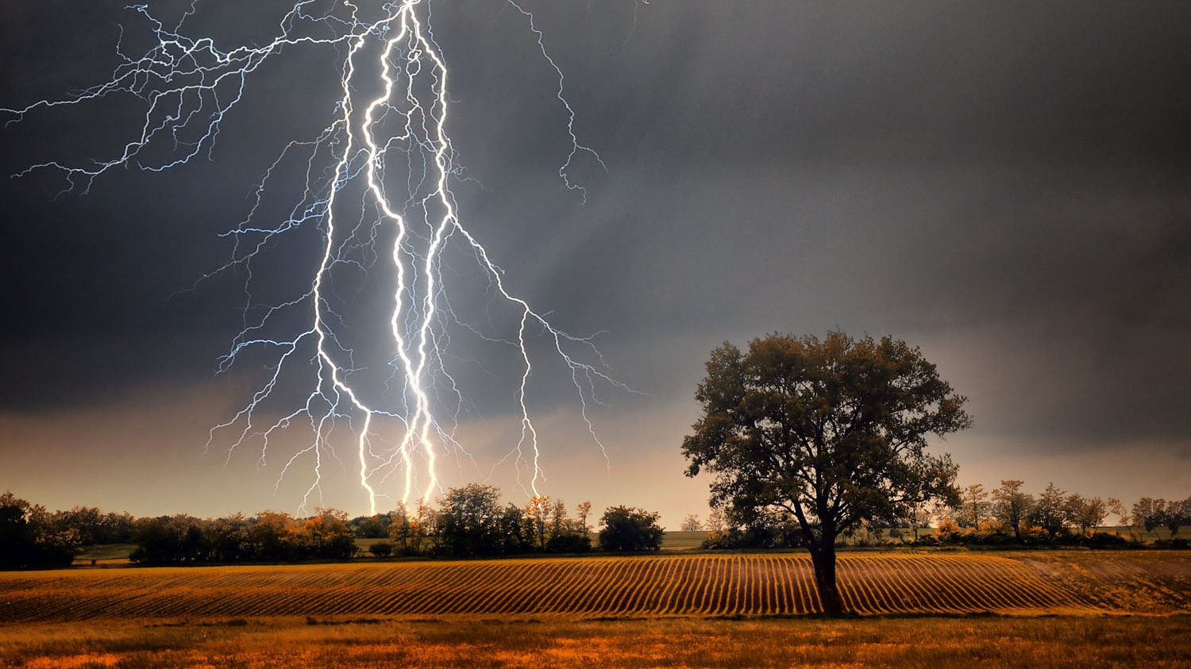

Weather
There IS a graphic organizer for this lesson.

Slide 2
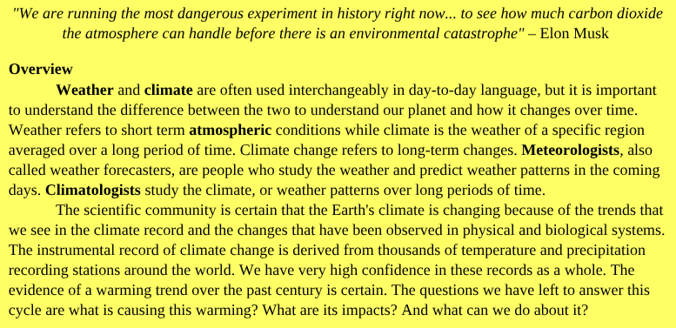
*

Slide 3
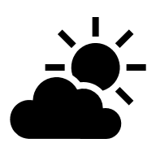
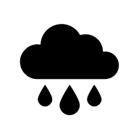

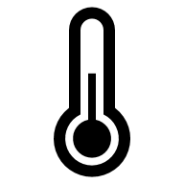
What is the difference between weather and climate?
Weather
Climate
State of the atmosphere at a place and time as regards temp, humidity, cloud cover, wind, precipitation, etc.
When we talk about weather, we are usually talking about conditions within days or weeks or season.
"The forecast says there is a high chance of rain tomorrow." Weather conditions can vary greatly from day-to-day.
Normal weather conditions in an area in general or over a long period
Climate looks at weather conditions over time spans longer than a year.
"The climate in Arizona is hot and dry." This doesn't mean that every single day in Arizona is hot and dry, or that every part of Arizona is hot in dry. But in general, compared to other places, the average climate of Arizona is hot and dry.

Slide 4
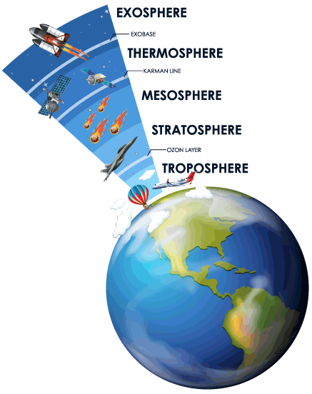
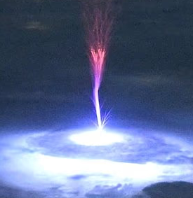
Atmosphere
A layer of gases that envelop a planet and is held in place by the gravity of the planetary body.
AKA "air" (78% NO₂ 21% O₂ 1% etc)
Our atmosphere is divided into 5 different layers.
Almost all weather occurs in the troposphere, the bottom layer.
A rare counter-example: (photo from ISS)

Slide 5
Study of Weather and Climate
Meteorologists
Climatologists
Scientists who study the processes and phenomena of the atmosphere and forecast the weather are called meteorologists.
This week you will do several simulations to predict weather, just like meteorologists do.
In the next few slides, we'll learn about the tools they use to do this.
Scientists who study climate are called climatologists.
We will learn more about climate and climatology next week.
Build models based on data collected by meteorologists

Slide 6
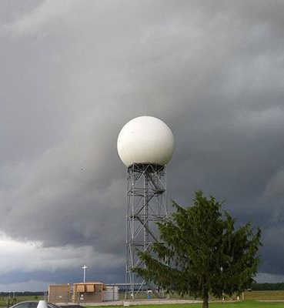
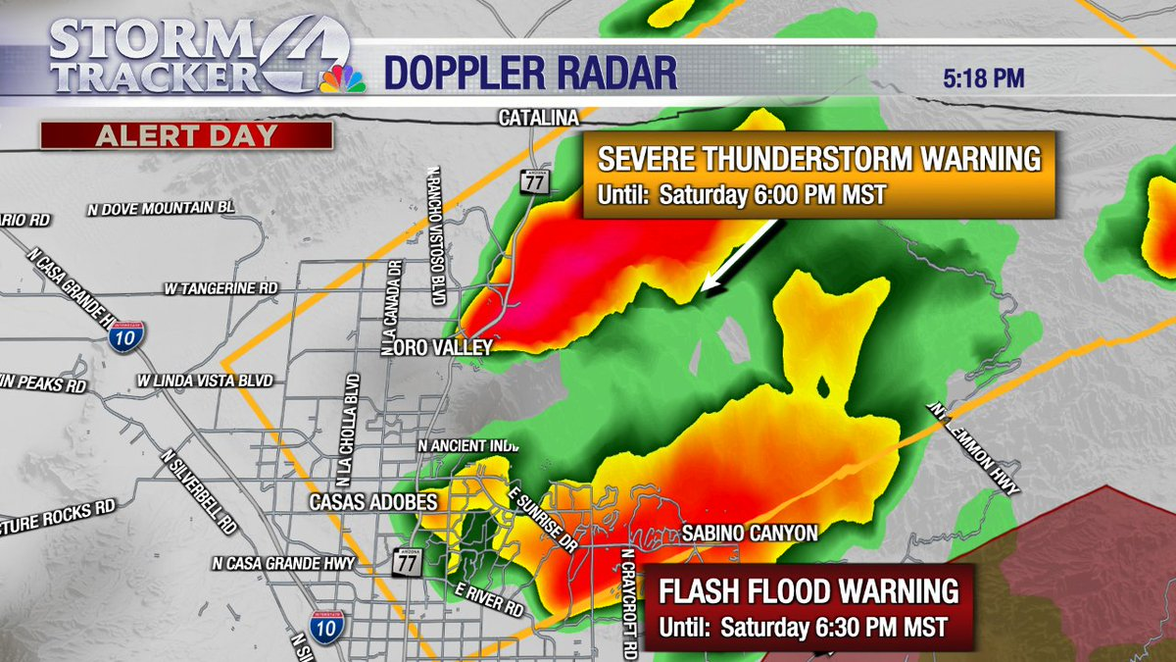
Tools Meteorologists Use—Doppler Radar
A National Weather Service Doppler radar tower in Springfield, Missouri. (NOAA)
How they observe severe storms
There are more than 159 radar towers across the United States
It detects:
all types of precipitation
the rotation of thunderstorms
airborne tornado debris
wind strength and direction
Notes:
https://www.noaa.gov/stories/6-tools-our-meteorologists-use-to-forecast-weather#:~:text=Observational%20data%20collected%20by%20doppler,forecast%20guidance%20to%20our%20meteorologists.

Slide 7
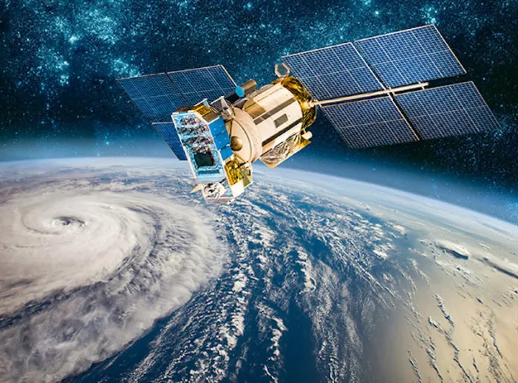
Satellites
They monitor Earth from space, collecting observational data for scientists to analyze. There are three main types of weather satellites:
Polar orbiting satellites orbit the Earth close to the surface, taking six or seven detailed images a day.
Geostationary satellites stay over the same location on Earth high above the surface taking images of the entire Earth as frequently as every 30 seconds.
Deep space satellites face the sun to monitor powerful solar storms and space weather.

Slide 8
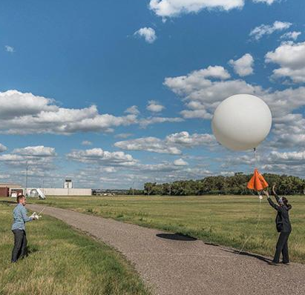
Radiosondes
Primary source of upper-atmosphere data
At least twice per day, radiosondes are tied to weather balloons and are launched in 92 locations across the United States.
In its two-hour trip, the radiosonde floats to the upper stratosphere where it collects and sends back data every second about air pressure, temperature, relative humidity, wind speed and wind direction.
During severe weather, we usually launch weather balloons more frequently to collect additional data about the storm environment.
A NWS weather balloon fitted with a radiosonde launches in Bismarck, North Dakota. (NOAA)

Slide 9
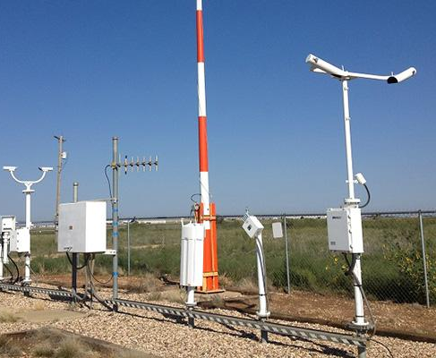
Automated Surface Observing Systems
Constantly monitor weather conditions on the Earth’s surface.
More than 900 stations across the U.S. report data about sky conditions, surface visibility, precipitation, temperature and wind up to 12 times an hour.
Nearly 10,000 volunteer NWS Cooperative Observers collect and provide us additional temperature, snowfall and rainfall data.
The observational data our ASOS and volunteers collect are essential for improving forecasts and warnings.
ASOS at the Childress Municipal Airport in Texas. (NOAA)

Slide 10

Supercomputers
NOAA’s Weather and Climate Operational Supercomputer System (WCOSS) is the backbone of modern forecasting.
Observational data collected by doppler radar, radiosondes, weather satellites, buoys and other instruments are fed into computerized NWS numerical forecast models.
The models use equations, along with new and past weather data, to provide forecast guidance to meteorologists.

Slide 11
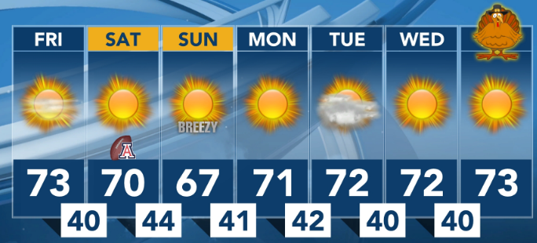
Vocabulary Meteorologists Use- Temperature
Measure of the average kinetic energy of the particles (atoms or molecules) in a substance (e.g. air)
In weather, we often talk about the "high" and "low" for the day. These refer to the highest temperature reached and the lowest temperature reached that day. Meteorologists forecast what they think the high and low will be, but this prediction is usually off by a few degrees. After the day is over, the exact high and low are recorded in the historical record.
Notes:
https://www.richmond.k12.nc.us/rms/Class/475-ms-wikane/11767-Untitled.html

Slide 12
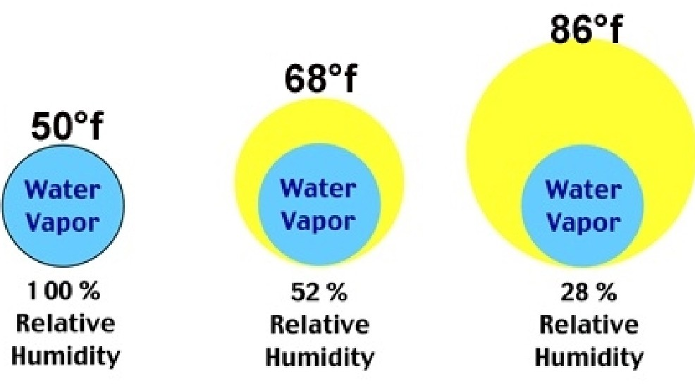
Humidity
Measure of the amount of water vapor in the air.
Meteorologists often include the level of humidity in their weather forecasts. However, what they tell you on the weather report is relative humidity, or the amount of water vapor in the air "relative" to how much the air can hold. The warmer the air, the more moisture it can hold before it starts to rain.

Slide 13
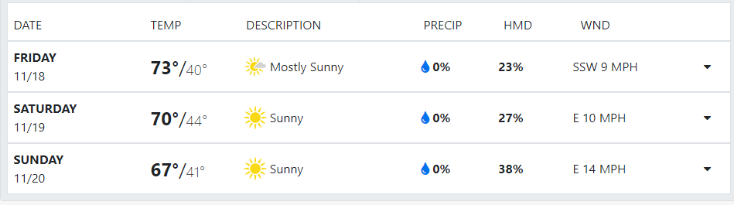
Precipitation
Rain, snow, sleet, or hail that falls to the ground.
When most people say "precipitation," they are referring to rain. But in meteorology, precipitation is any form of condensation of atmospheric water vapor that falls under gravitational pull from clouds.
Weather reports usually express precipitation as a percentage, meaning the chance that it will precipitate that day in a particular location.

Slide 14
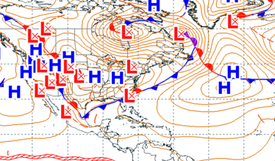
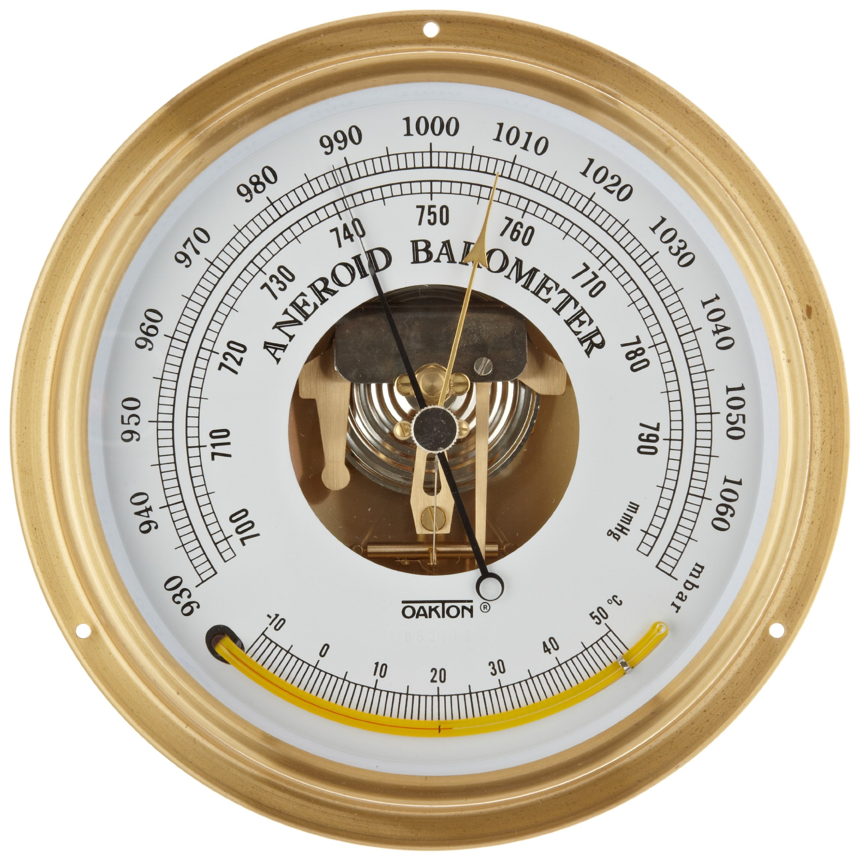
Atmospheric Pressure
The force on a surface by the air above it as gravity pulls it to Earth.
We often just call this "air pressure" because it is the pressure exerted by the weight of the air. How hot or cold the air is affects its pressure. You will learn more about this in group work. When meteorologists refer to "pressure systems" they are talking about areas that are experiencing higher or lower pressure than normal.
A barometer:

Slide 15
