Slide 1
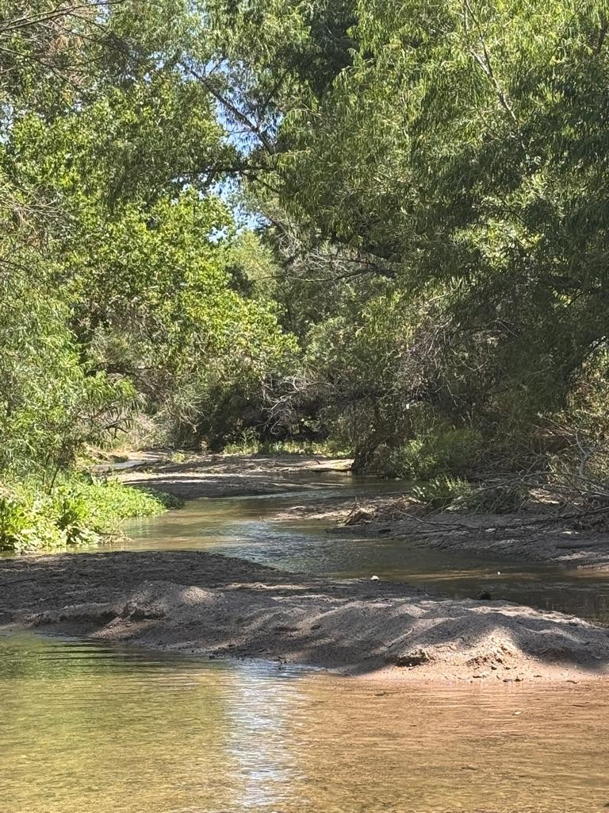

Plein Air on the Santa Cruz River!

Slide 2
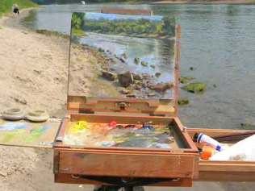
Plein air (pronounced “plen air”) is a French term that means “open air.” It’s about making art outside instead of in a studio.

Slide 3
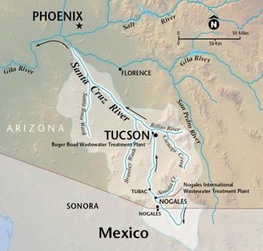
In Tucson, one of the best places to make art outdoors is on the Santa Cruz River!

Slide 4
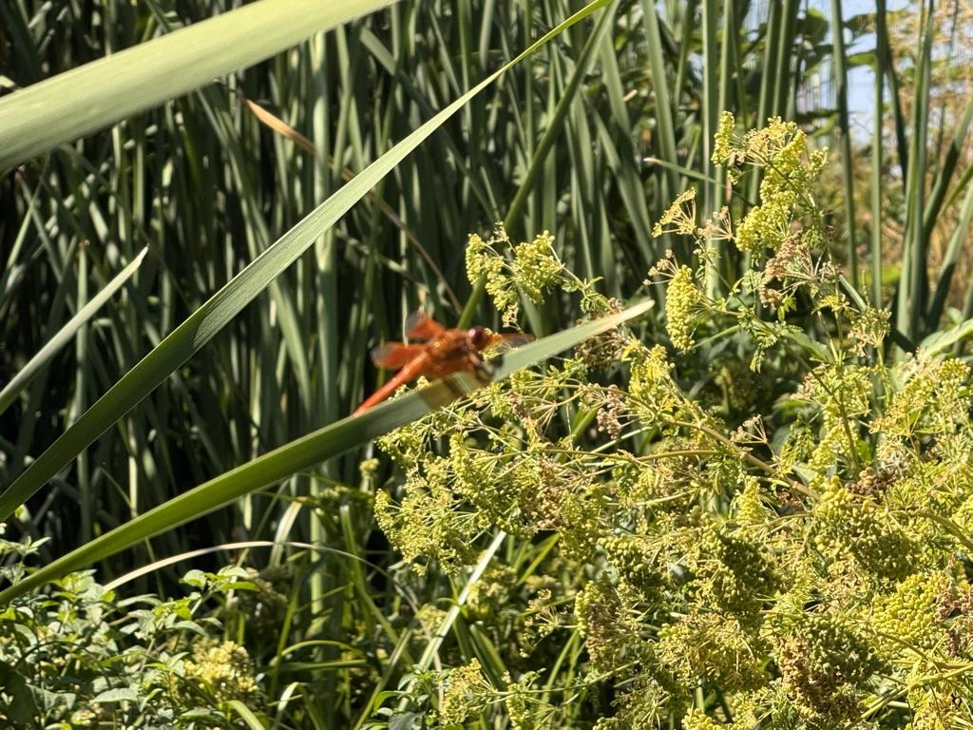
The Santa Cruz River is a desert river that flows north from Mexico through the Tucson area.

Slide 5
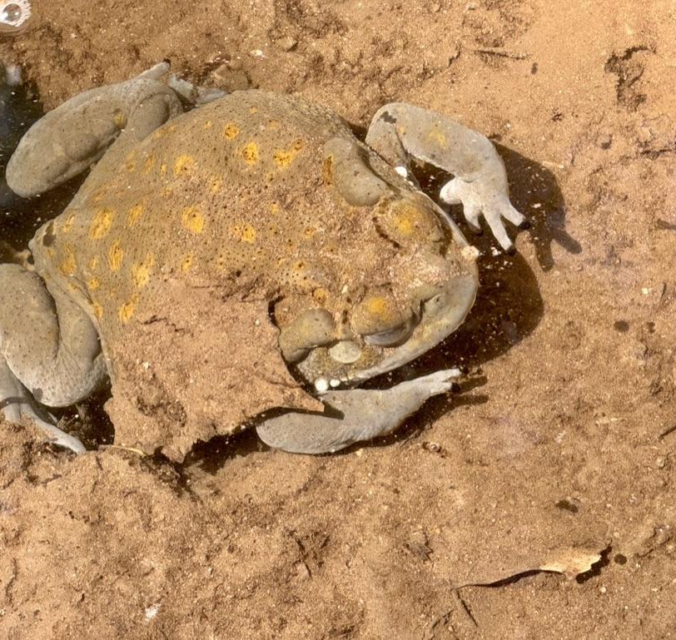
The Santa Cruz River is a great place for plein air because of its beautiful
scenery and abundant wildlife!

Slide 6
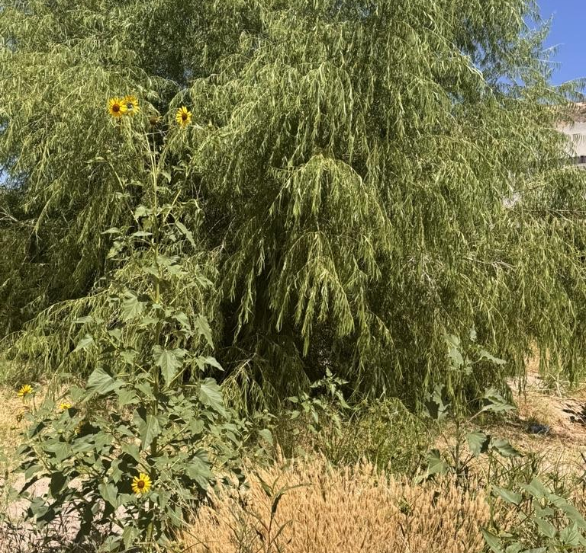
Not all parts of the Santa Cruz River are the same. Sometimes the river shows up above ground, sometimes it hides underground, and sometimes it is resting (dry) until the rain returns.

Slide 7
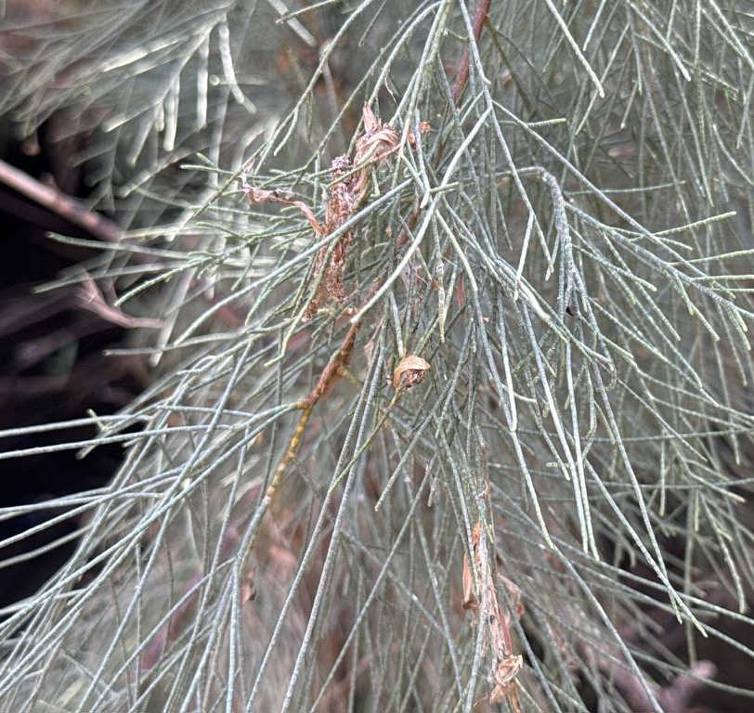
Because of this mix of wet, damp, and dry zones, the river creates different habitats that support biodiversity that we usually don’t find in our desert.

Slide 8
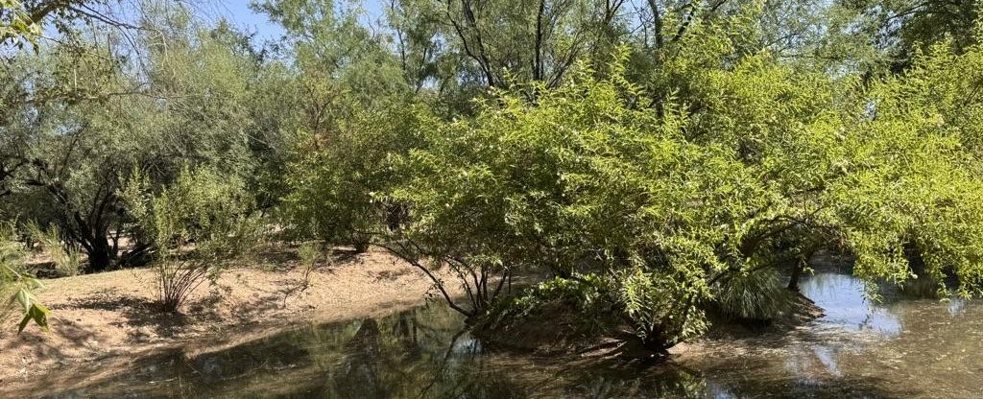
Places where the Santa Cruz River flows year-round are especially wonderful for plein air because artists can observe water, plants, and wildlife all together in one changing, colorful landscape.

Slide 9
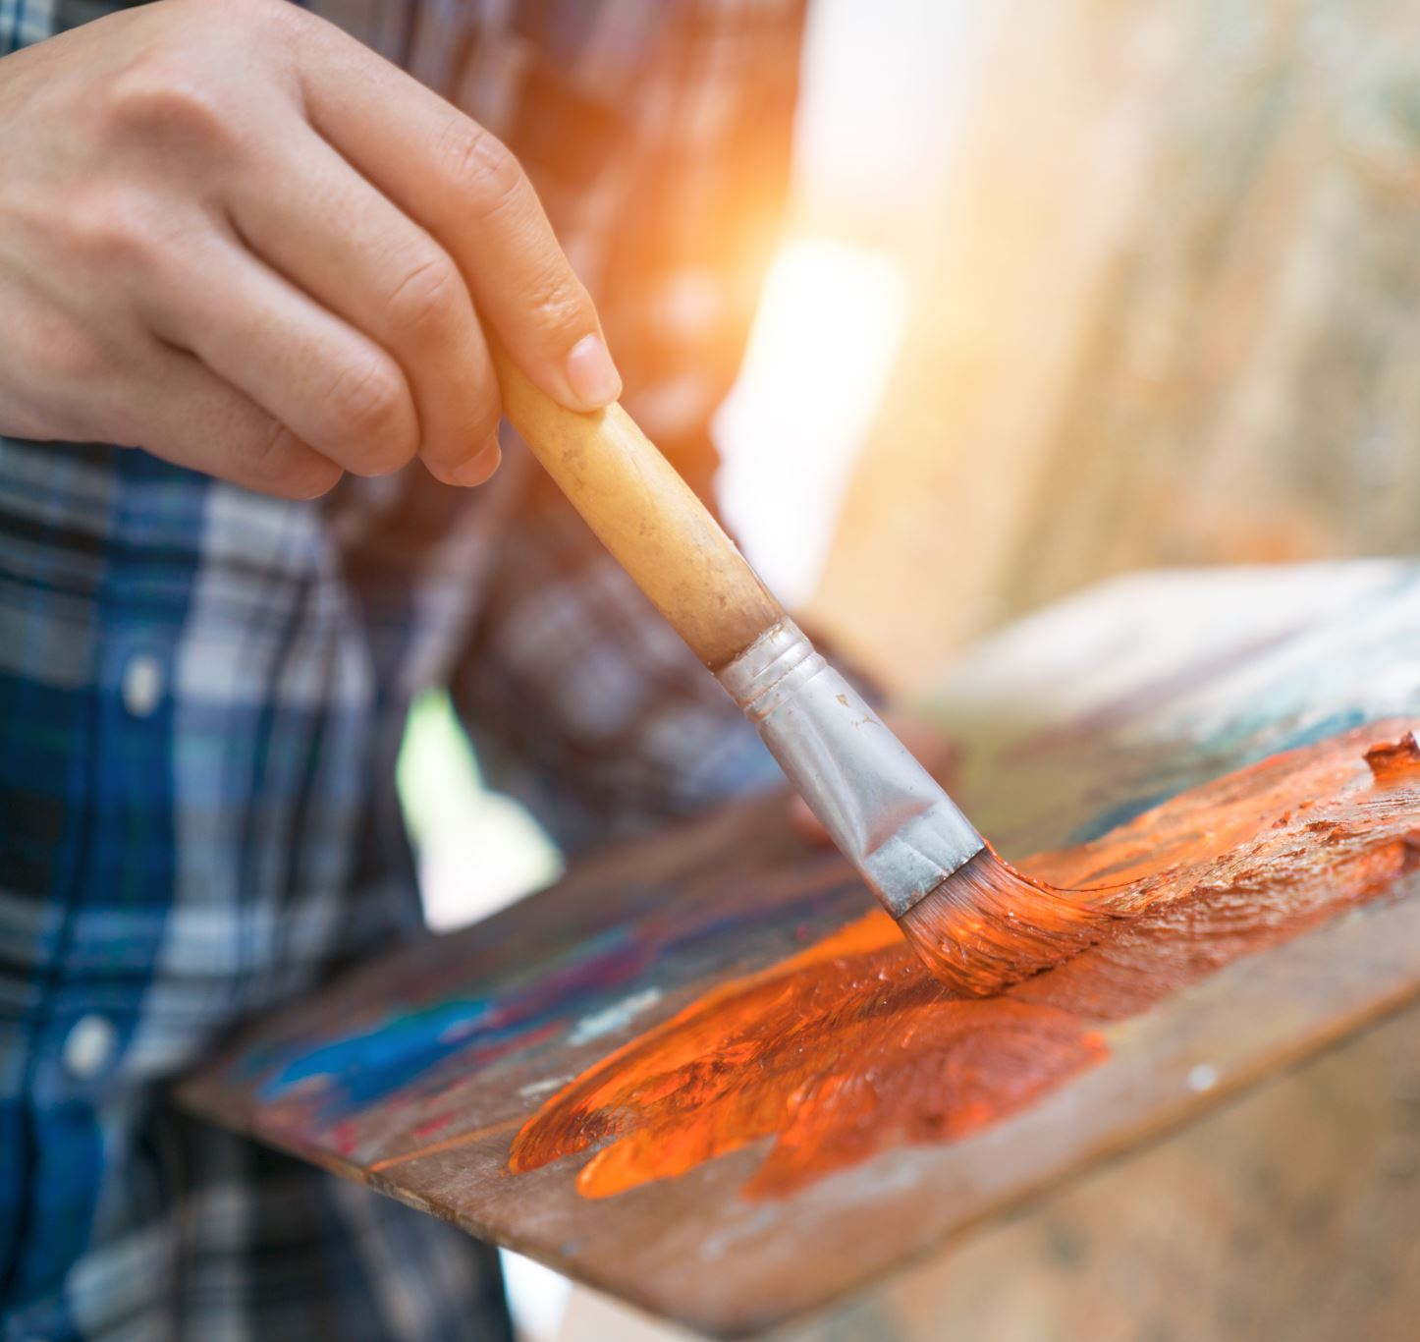
Did you know that many famous artists painted outdoors? Let’s see if you recognize their names!

Slide 10
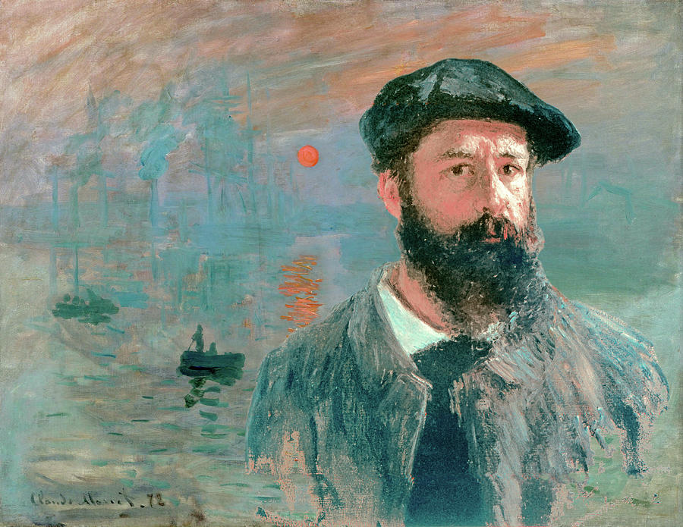
Claude Monet
Monet was a French painter (1840–1926) and leading figure in the Impressionist movement.
He believed in capturing natural light and fleeting moments, often painting the same scene at different times of day.

Slide 11
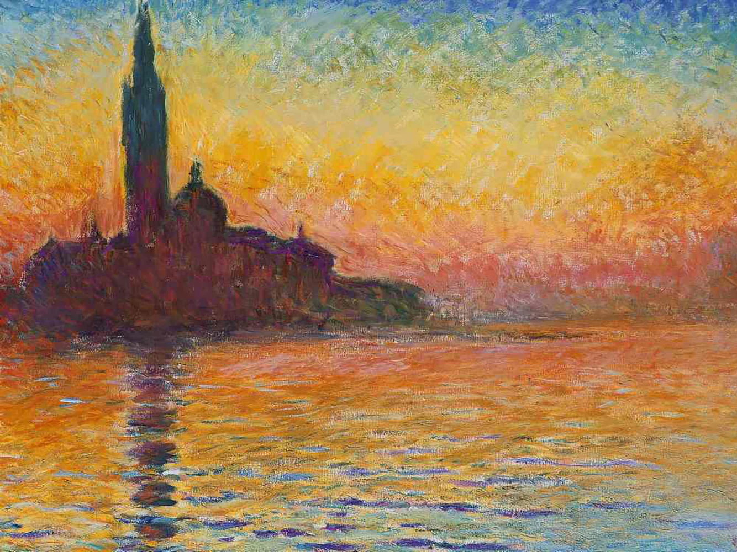

Slide 12
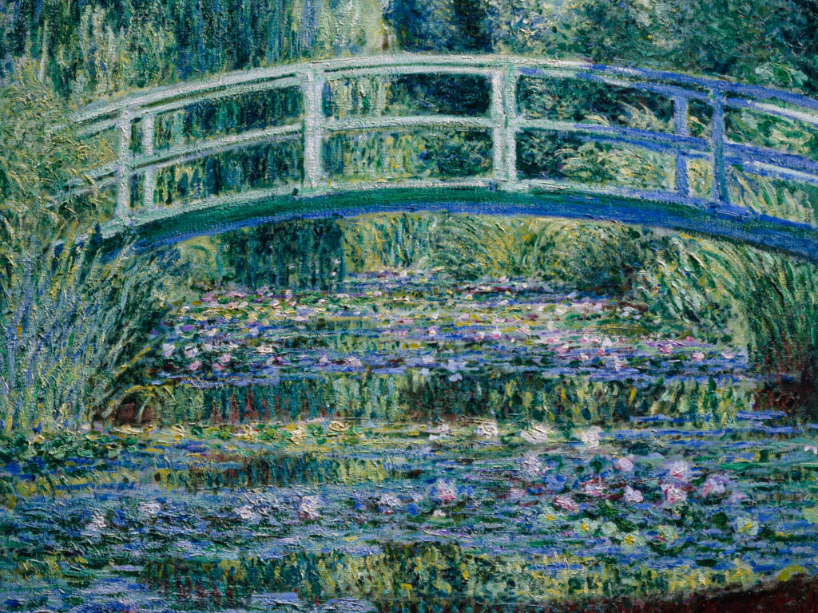

Slide 13
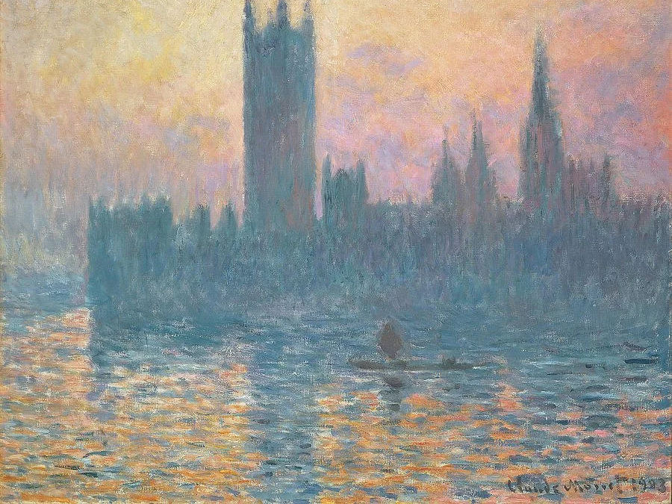

Slide 14
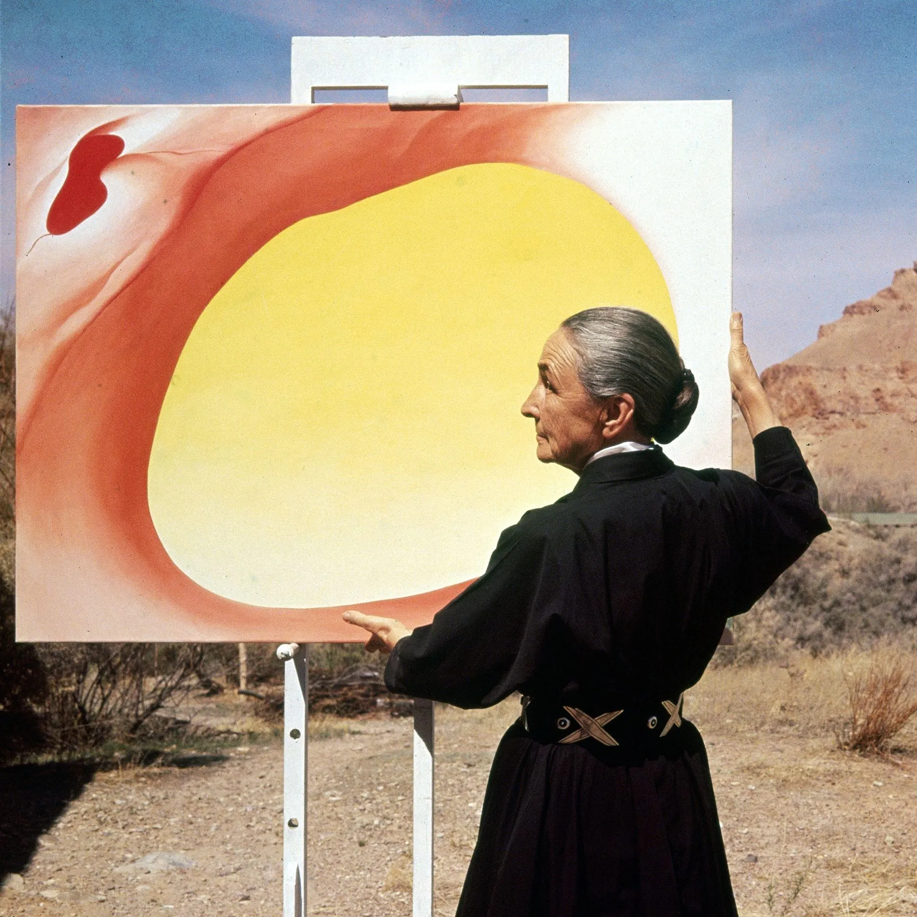
Georgia O’Keeffe (1887–1986)
O’Keeffe is known for her bold paintings of flowers, bones, and New Mexico landscapes.
She painted outside in the desert, often hiking with her supplies.

Slide 15
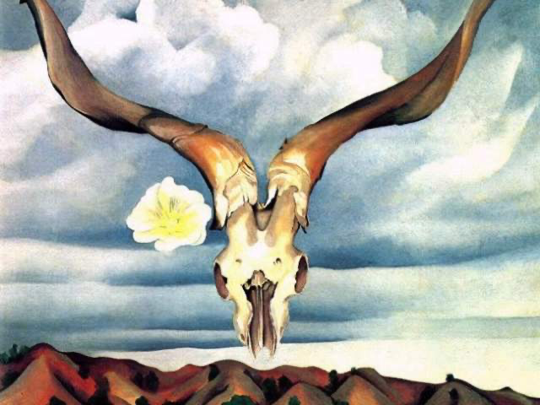

Slide 16
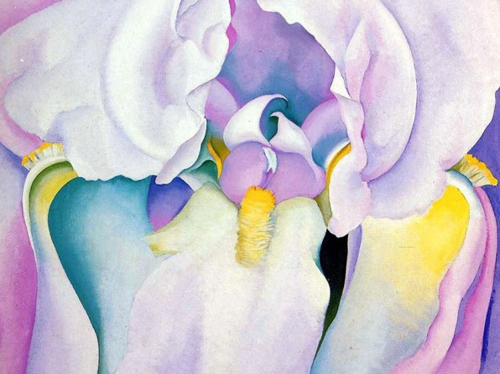

Slide 17
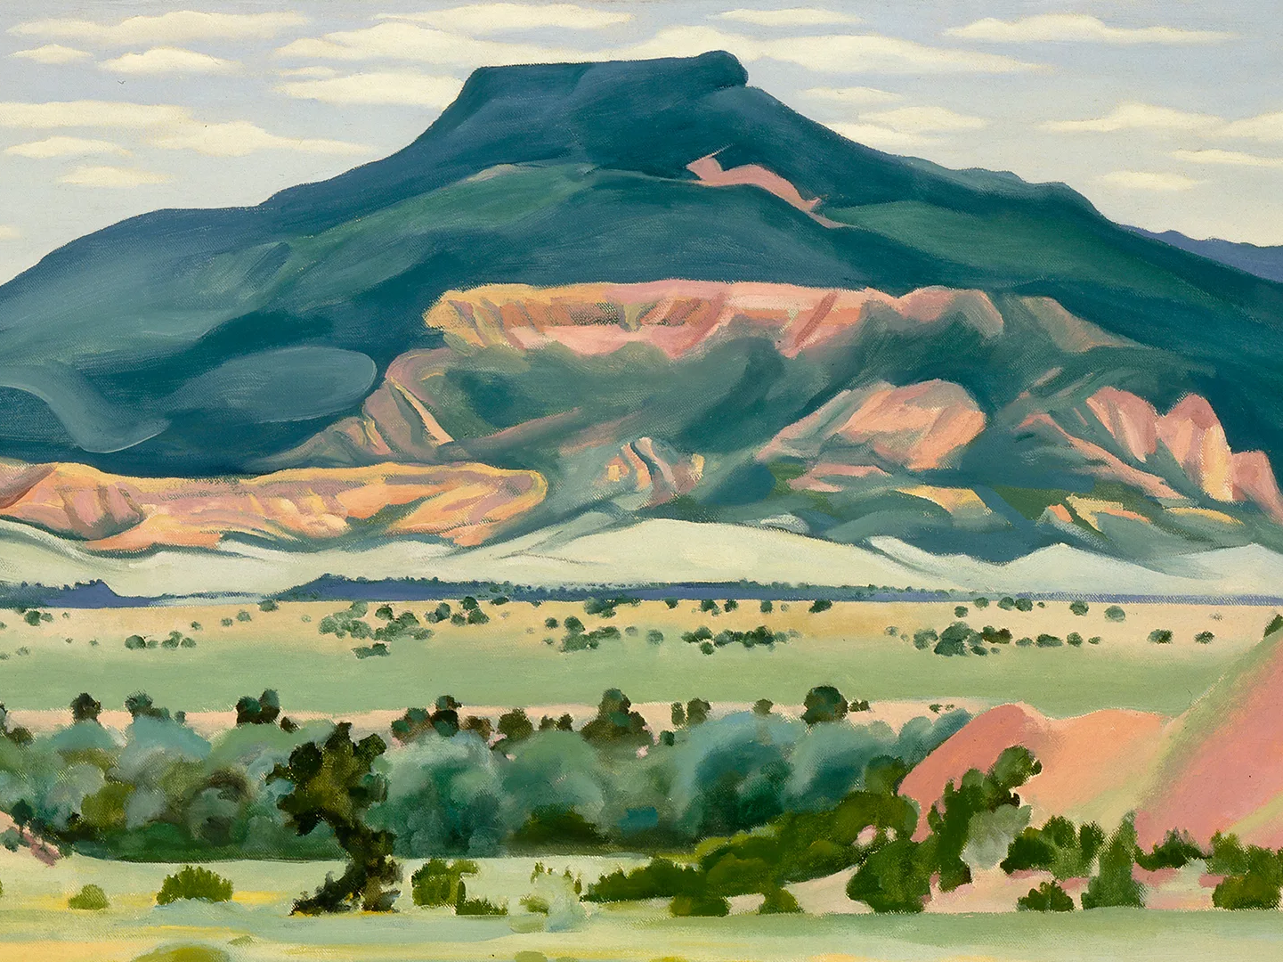

Slide 18
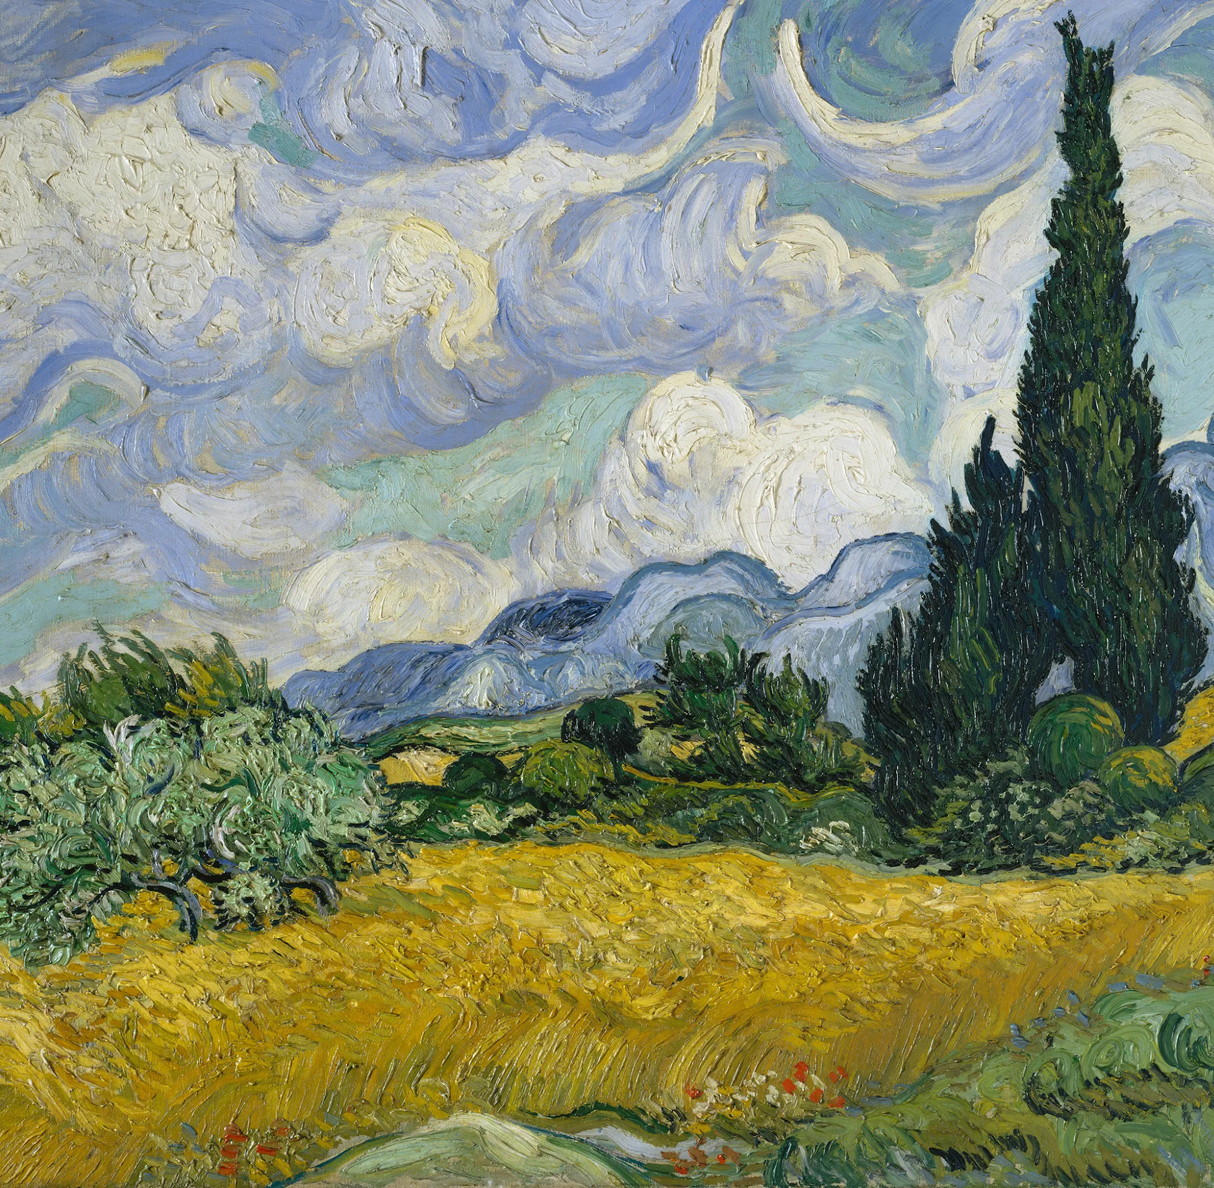
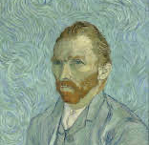
Vincent van Gogh (1853-1890) painted plein air mostly during the late 1880s.
He was inspired by the bright sunlight and vivid landscapes.
He created many of his most famous outdoor works by painting directly in nature to capture light, color, and movement.

Slide 19
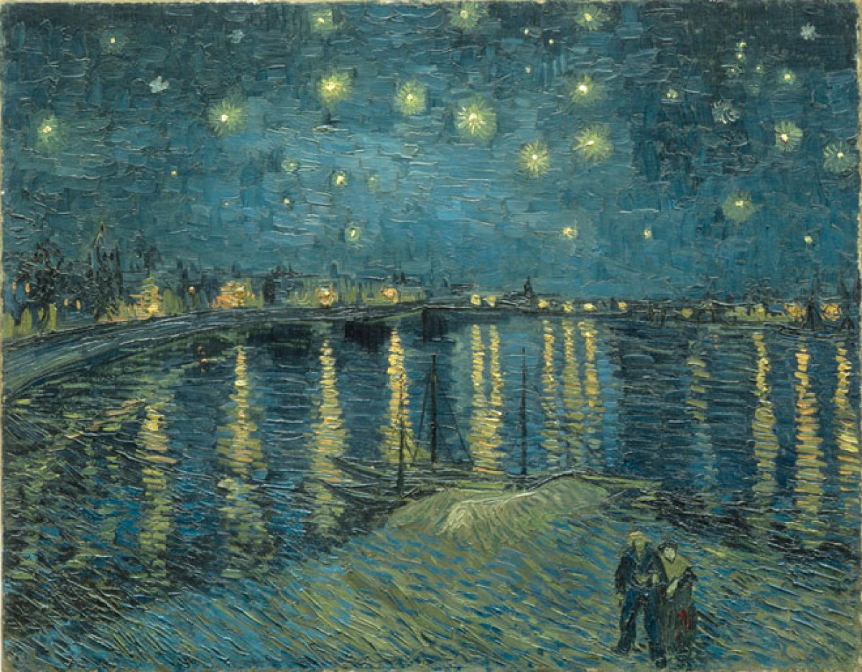

Slide 20
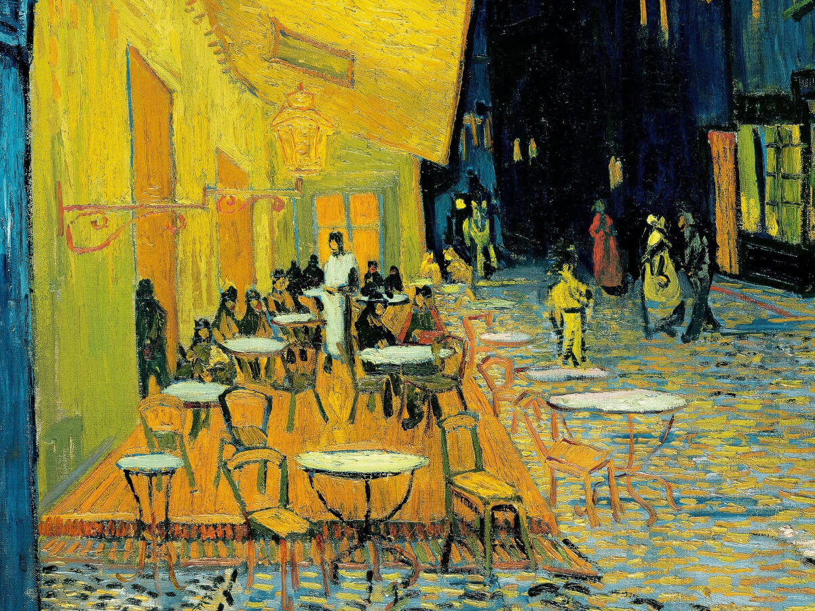

Slide 21
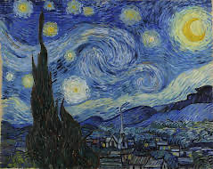

Slide 22
Ready to make art on the Santa Cruz River?

Slide 23
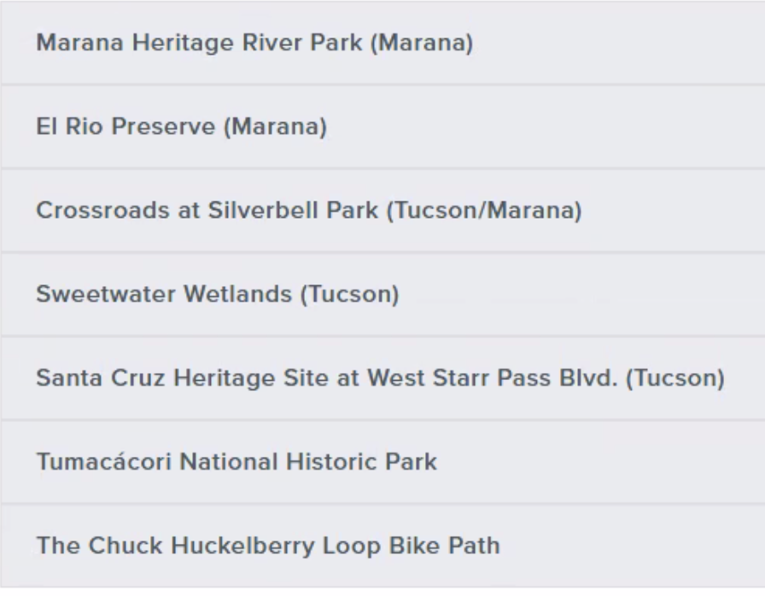
First, we’ll need to decide where we want to go! Some great locations on the river include:

Slide 24
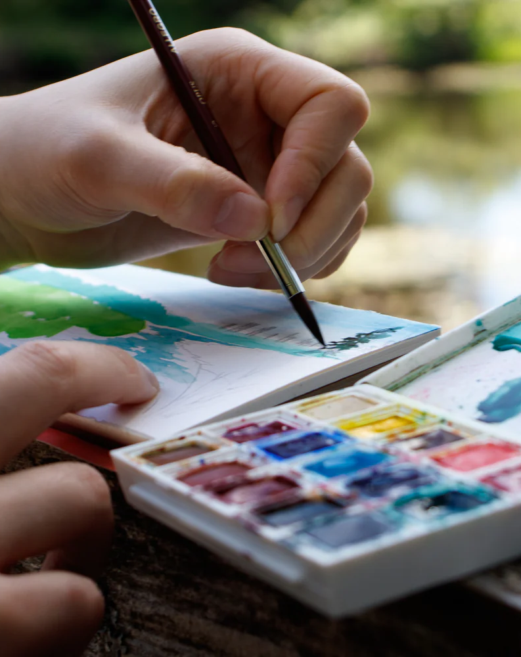
Materials you might want to bring:
Sketchbook or nature journal
Paints, pencils, or pens
Brushes, water cups, paper towels, and apron
Hats, sunscreen, and drinking water, and snacks

Slide 25
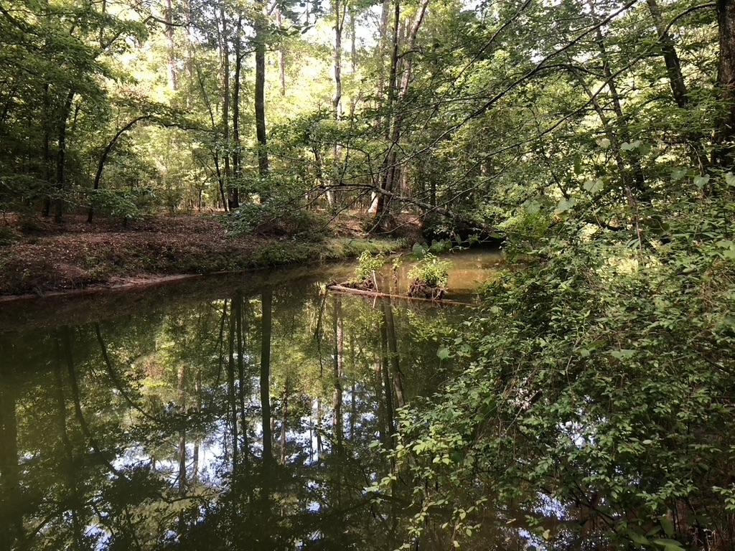
Outdoor safety and etiquette:
How is making art outdoors different from indoors?
How should we behave during plein air?
What kind of safety concerns should we have?
How can we show respect for the environment during our visit?
How can we assure a fun experience?

Slide 26
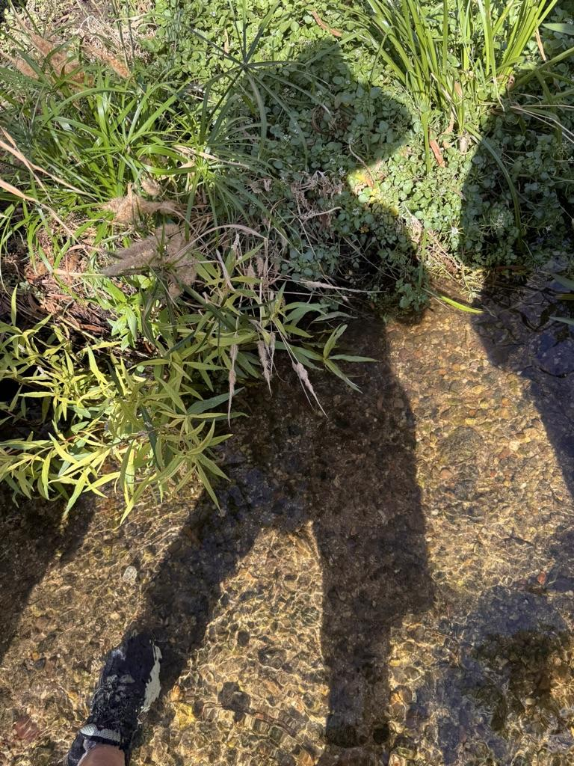
Happy Plein Air!
Ms. Conners
UHS
Pima College

