Slide 1
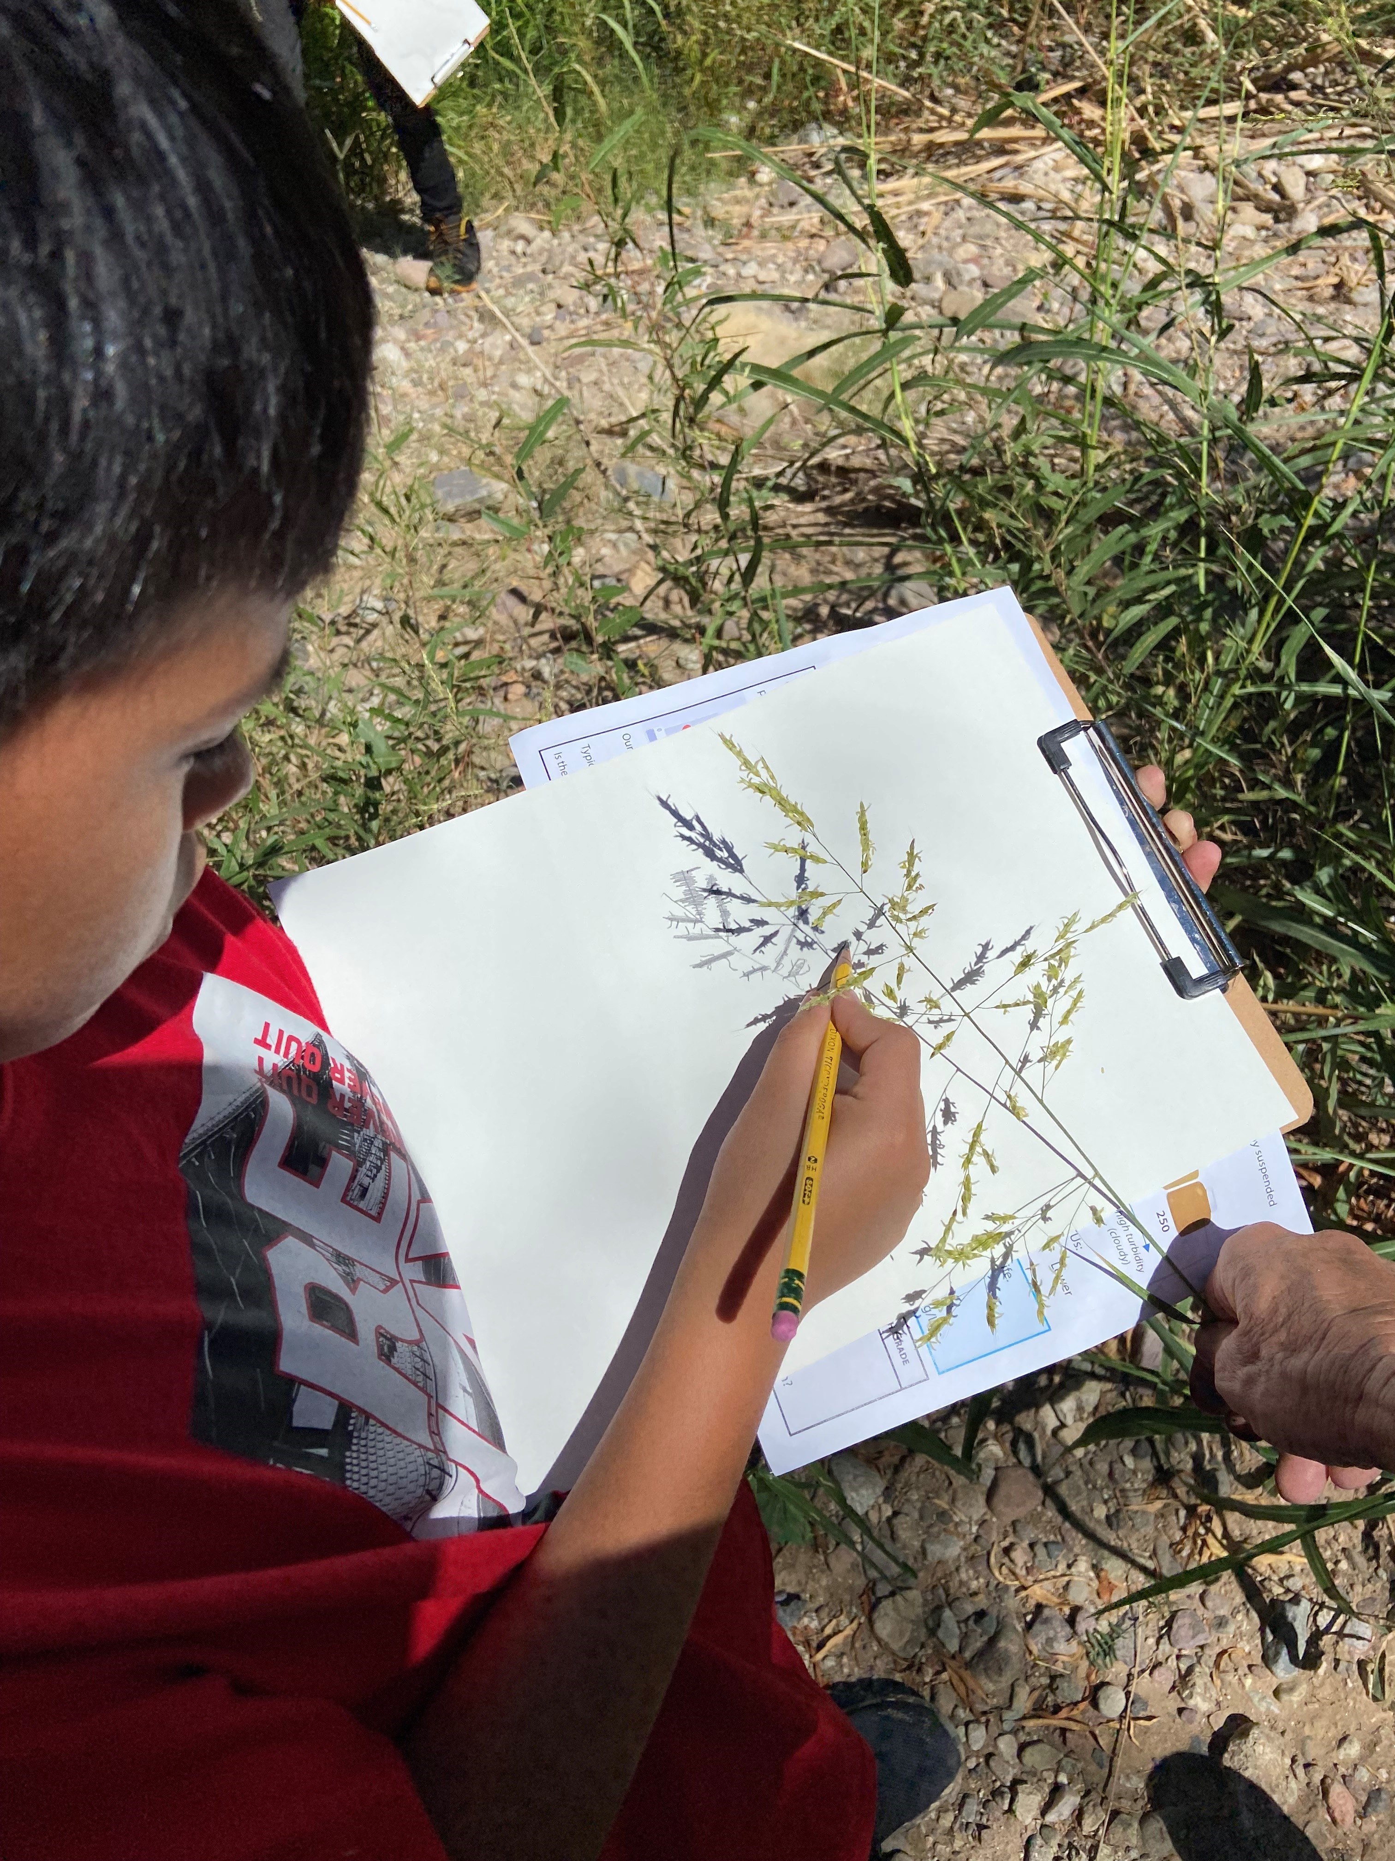
Shadow Art

Slide 2

Have you ever noticed the beautiful shadows around you?

Slide 3

Shadow art is a fun and easy way to capture the contour lines of shadows.

Slide 4
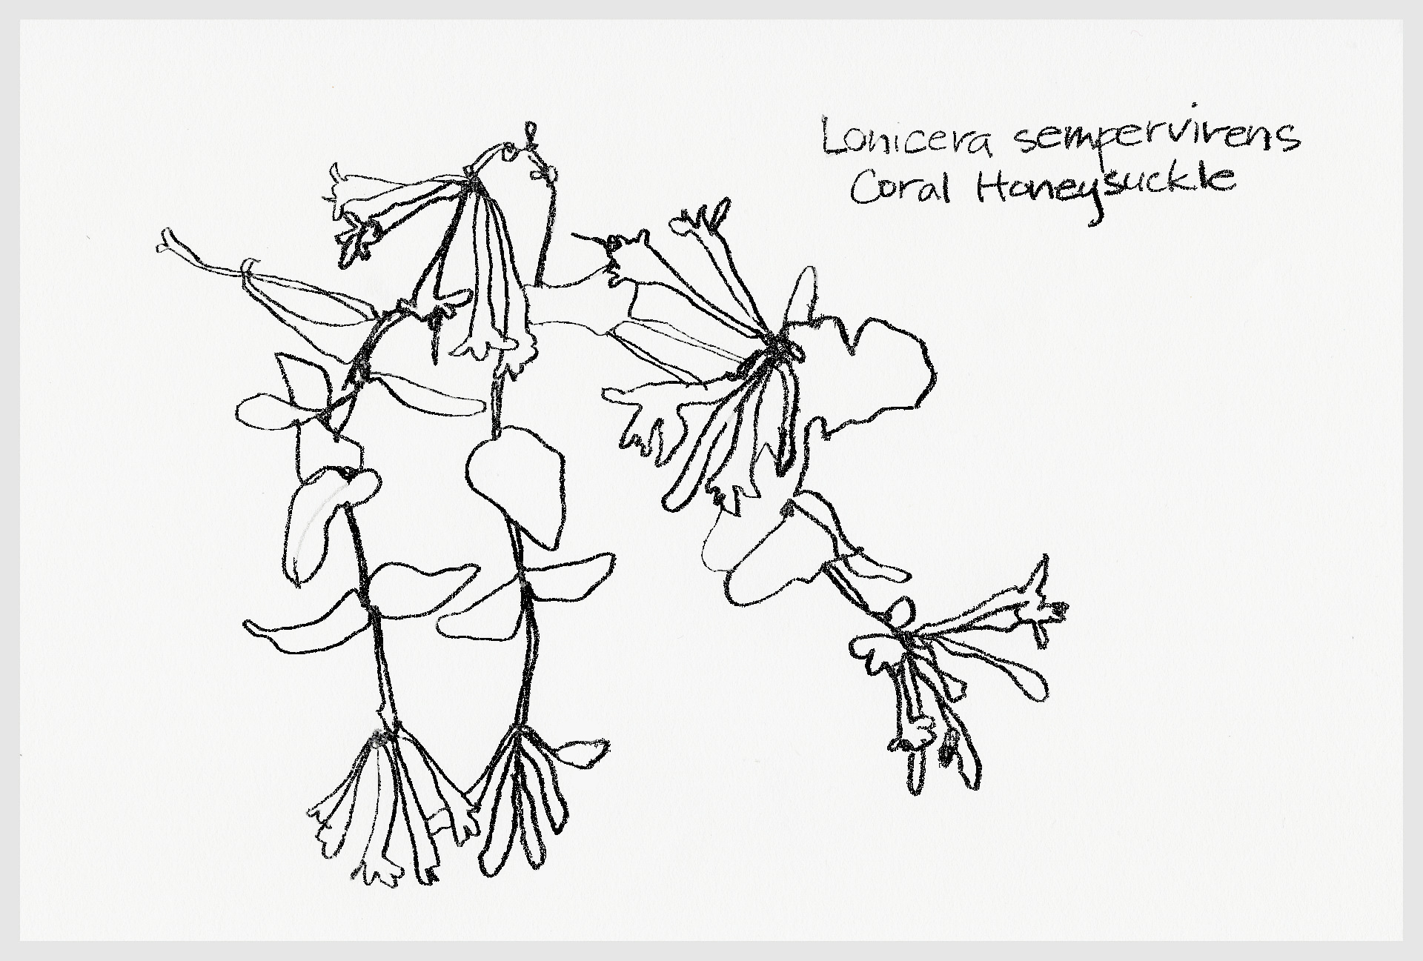
A contour line drawing is made with lines that show the edges and shapes of an object.

Slide 5
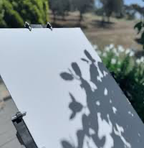
What you Need:
Pen or pencil
Multipurpose paper
Your choice:
paint
colored pencils
watercolor paints
watercolor pencils
pastels
pens
chalk

Slide 6
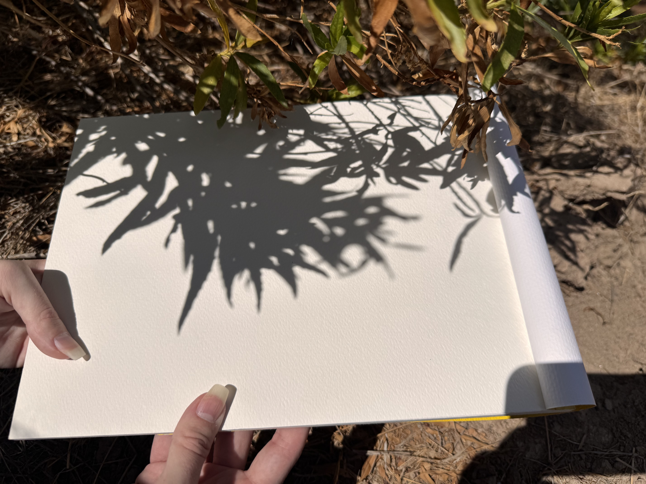
When you find an interesting plant or object, place your paper under the shadow.

Slide 7
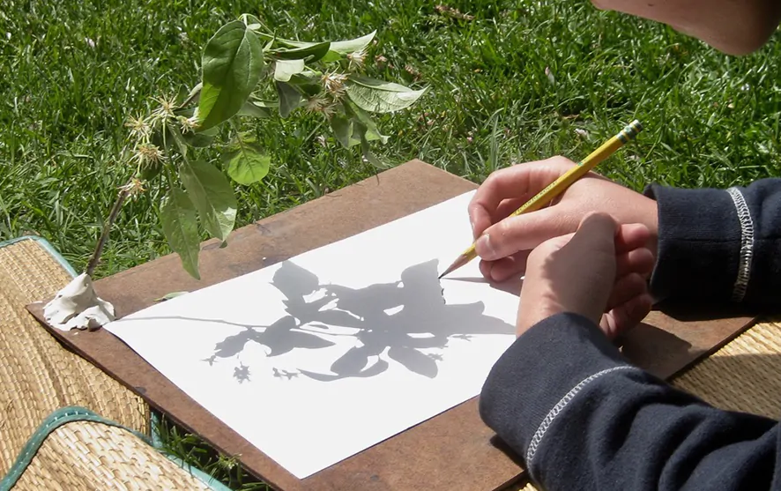
Composition is about how you position your image on the page.
Try to arrange the shadow on your page in a way that it looks nice and is not too busy.
Composition

Slide 8
Now take your pen or pencil and trace around the edges of the shadows. This will create contour lines or an outline of the shadows.

Slide 9
Contour lines are beautiful by themselves, but here’s a couple of other fun ideas you might want to try:

Slide 10
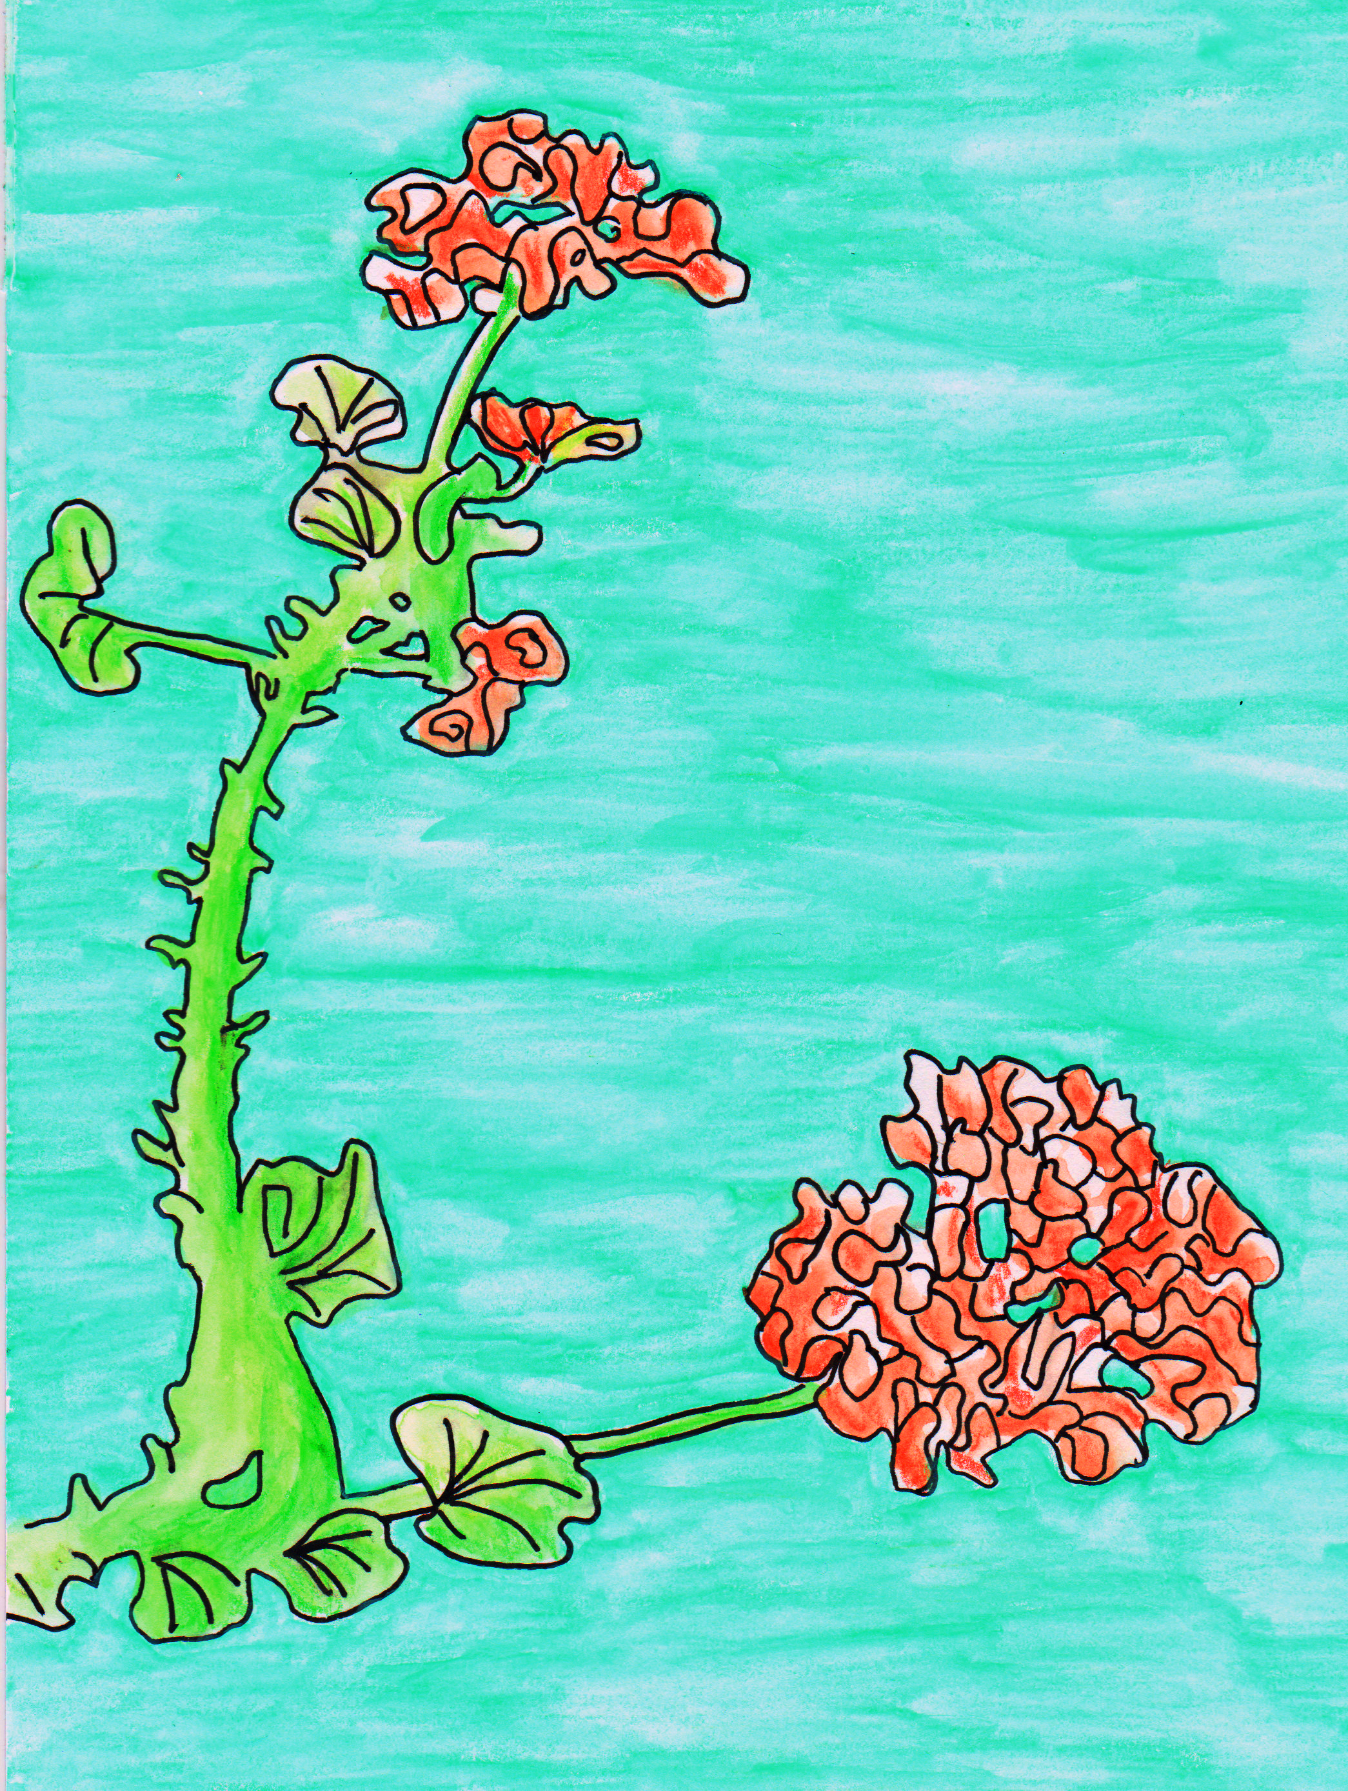
Naturalistic:
Naturalism is when artists try to make their art look as real as possible.
If you want to give this style a try, use the original plant as a reference and try to copy the colors, textures, and values as closely as you can.

Slide 11
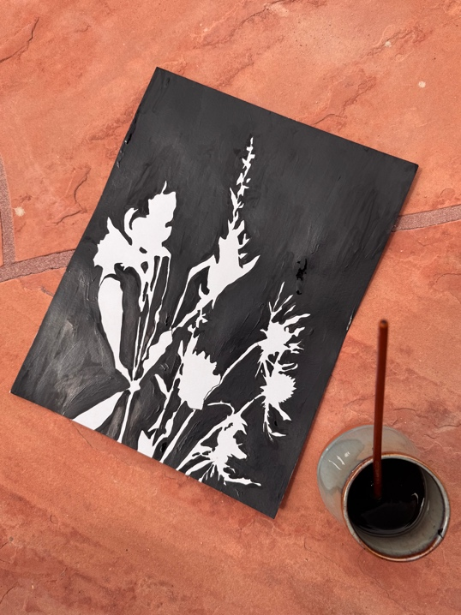
Negative Space:
Once you’ve captured the outline of your shadow, try painting or decorating only the negative space or background around the plant shadow. Leave the “positive” space where the object is, blank.

Slide 12
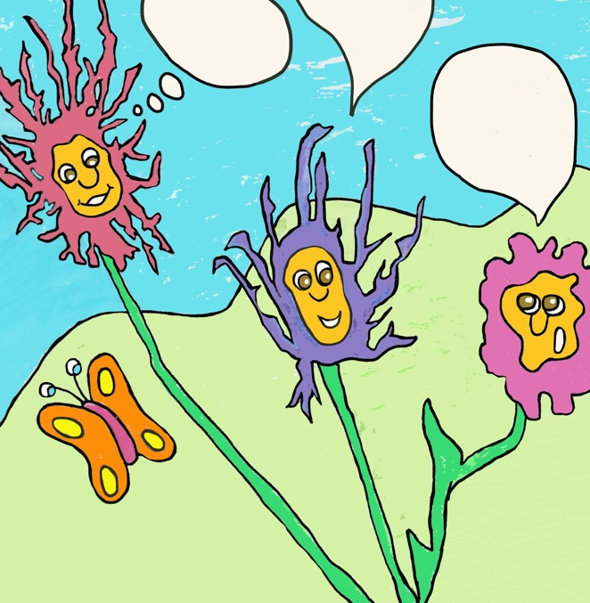
Pretend these flowers are having a funny conversation. What are they talking about??
Cartoon Style!
Use your shadows outlines to create silly cartoons!

Slide 13
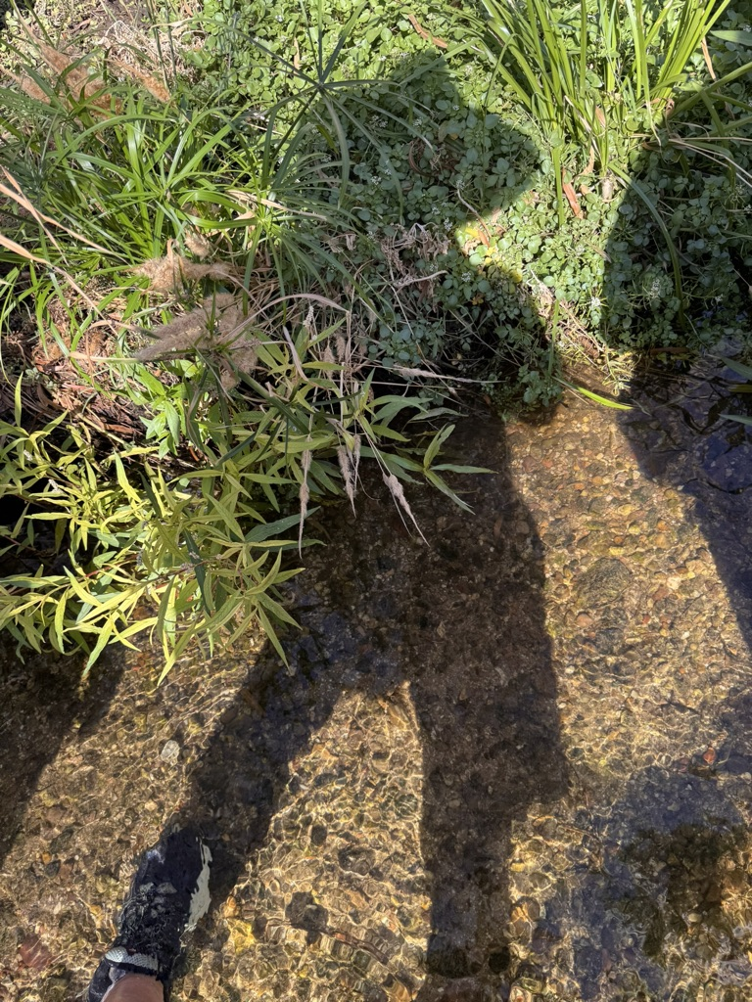
Stay Creative!
Ms. Conners
UHS
Pima College

