Slide 1

The Santa Cruz River Story
How Humans Change Our Ecosystems
8th Grade Science | Arizona Standard 8.E1U3.8

Slide 2






Our Mission This Week
Standard
Target
CER Goal
8.E1U3.8: Construct an argument about how human consumption of resources impacts the biosphere.
I can explain how water use changed the Santa Cruz River and describe restoration efforts.
I can construct a Claim-Evidence-Reasoning argument based on local river data.

Slide 3
DAY ONE
Where did the river go?
I Notice, I Wonder, It Reminds Me Of...

Slide 4


Photo Analysis: Notice & Wonder
Step 1: Observe
Look at the photos from 1900, 1980, and today.
What changed? Think about:
Flowing Water
Tree / Plant Life
Surrounding Land

Slide 5
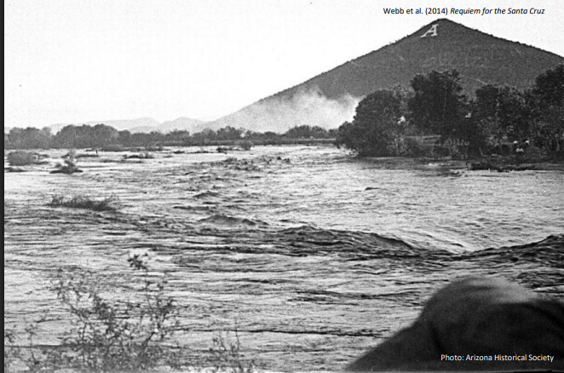
Notes:
1927

Slide 6
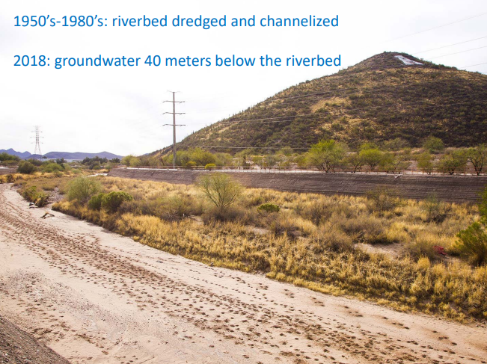
Notes:
1950s-1980s

Slide 7
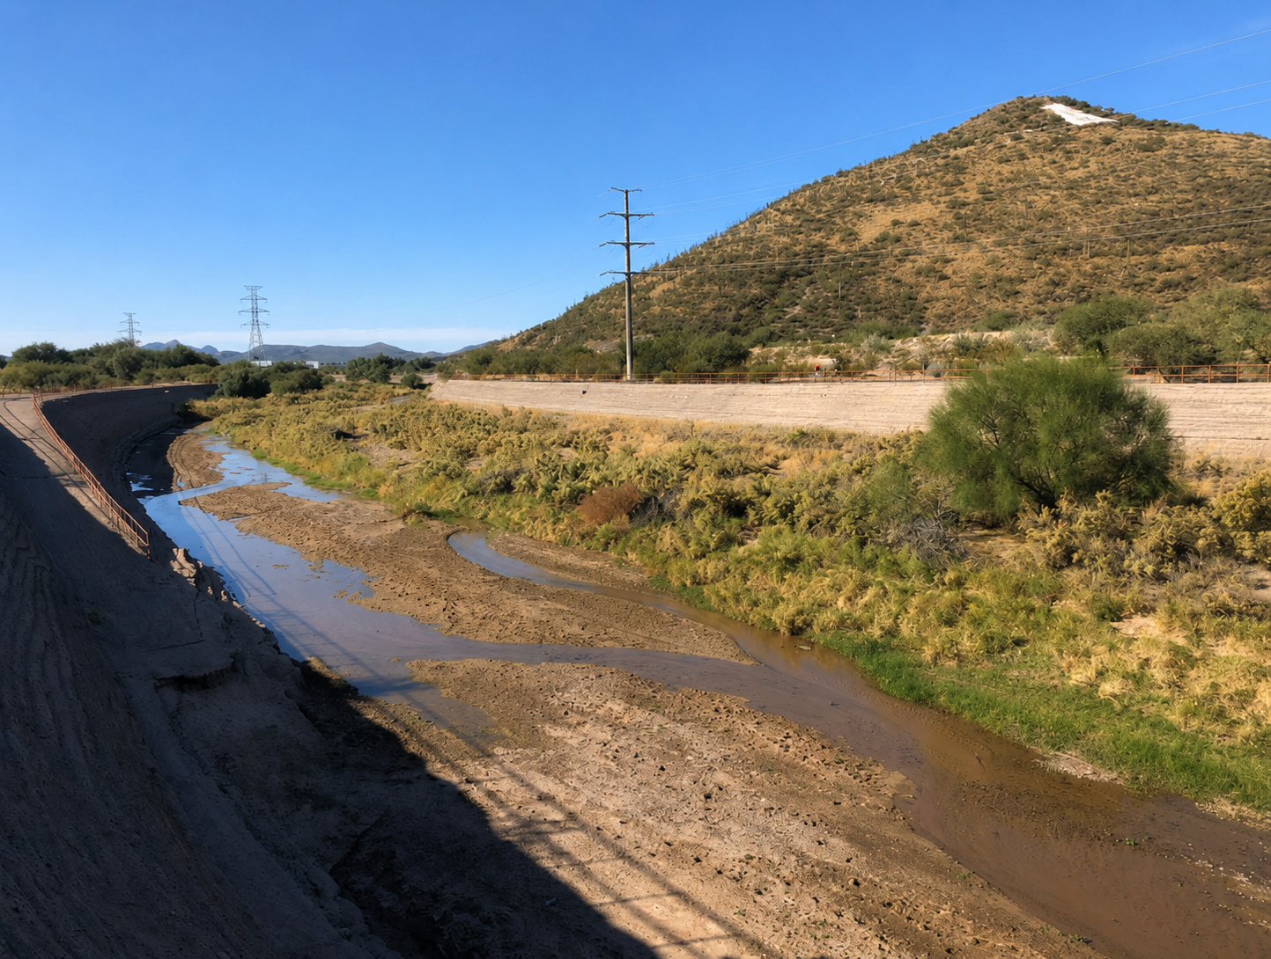
Notes:
2019

Slide 8


Photo Analysis: Notice, I Wonder, It Reminds Me Of
Step 2: Write
In your journal, create three sections and write down your observations, questions, and connections.
I Notice: (Observations)
I Wonder: (Questions)
It Reminds Me Of: (Connections)

Slide 9

Photo Analysis: Notice, I Wonder, It Reminds Me Of
Step 3: Partner Share
With your elbow partner, share your observations, questions, and connections.
Partner A shares observations, then partner B.
Partner A shares questions, then partner B.
Partner A shares connections, then partner B.

Slide 10
Photo Analysis: Notice, I Wonder, It Reminds Me Of
Step 4: Small Group
In your groups, work together to create an anchor chart for your assigned photo that includes
I Notice: (Observations)
I Wonder: (Questions)
It Reminds Me Of: (Connections)

Slide 11
Historical Data

Slide 12
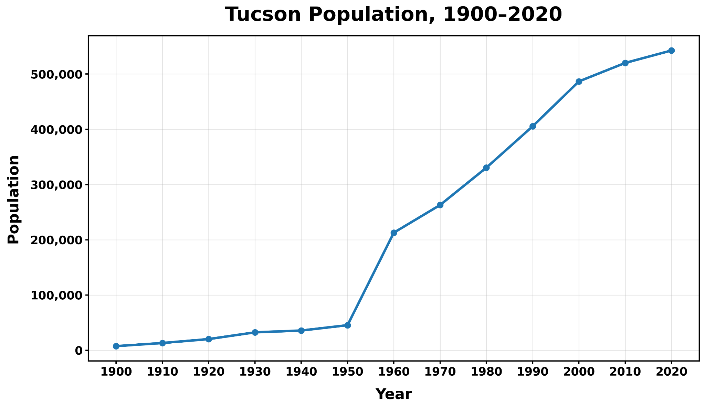
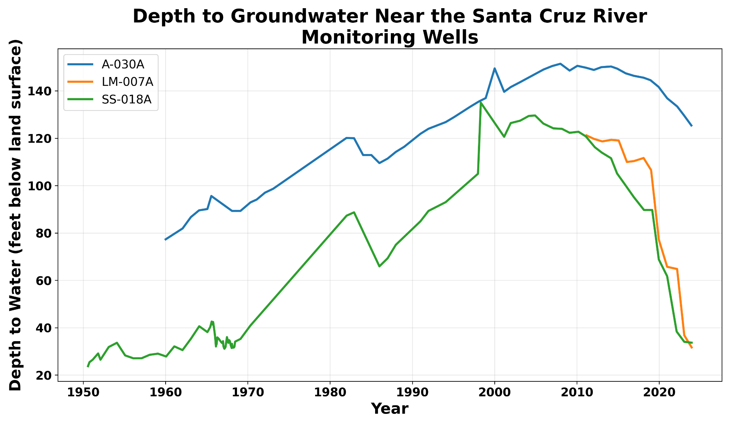
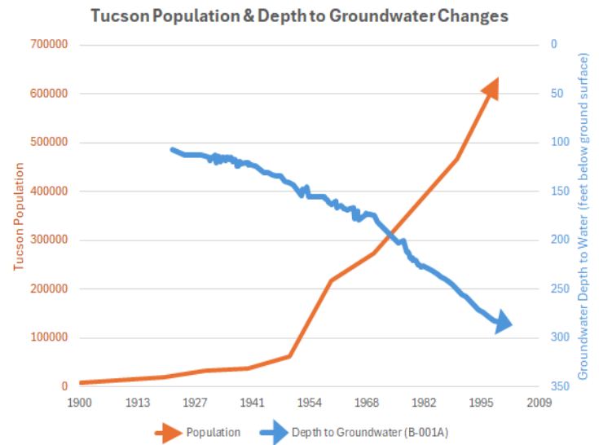
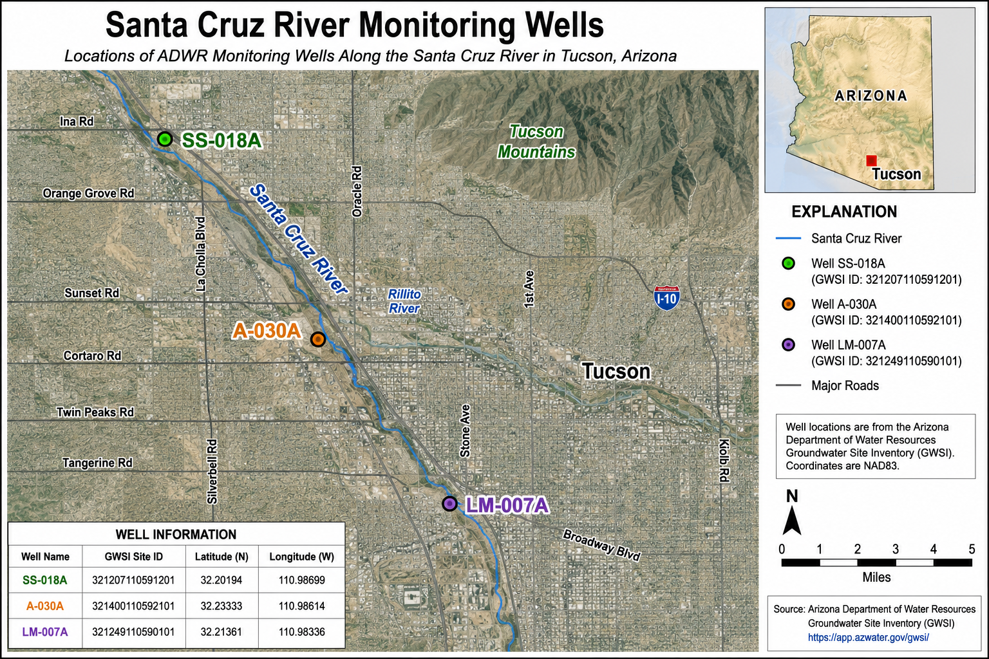
What story does the data tell?

Slide 17
Exit Ticket
Based on evidence from today, what do you think happened to the Santa Cruz River?

Slide 18
DAY TWO
How did humans change the river?
Data Investigation Stations

Slide 19
Steps for Analyzing a Graph
Read the Title & Labels — What is this graph about?
Describe the Data — What happens as one variable changes?
Draw a Conclusion — What claim can you make from this pattern?

Slide 20
Your Rotation Schedule
Station | Evidence Source | Key Question
1: Groundwater | Graphs | What trend do you notice in water levels?
2: Water Consumption | Usage Charts | How does population link to water use?
3: Riparian Habitats | Species Counts | How does water affect variety of life?
4: Biodiversity | Photo Comparison | How did vegetation change over time?

Slide 21
Station 1: Groundwater Levels
Directions: Analyze the graph about groundwater using the 3 steps. Then answer the questions below in your journal.
Questions
What trend do you notice?
What could be the cause of the trend?

Slide 23
Station 2: Water Consumption
Directions: Analyze the graphs about water consumption and population growth using the 3 steps. Then answer the questions below in your journal.
Questions
What trends do you notice?
What relationship exists between the two graphs?
Is there anything confusing to you?

Slide 25
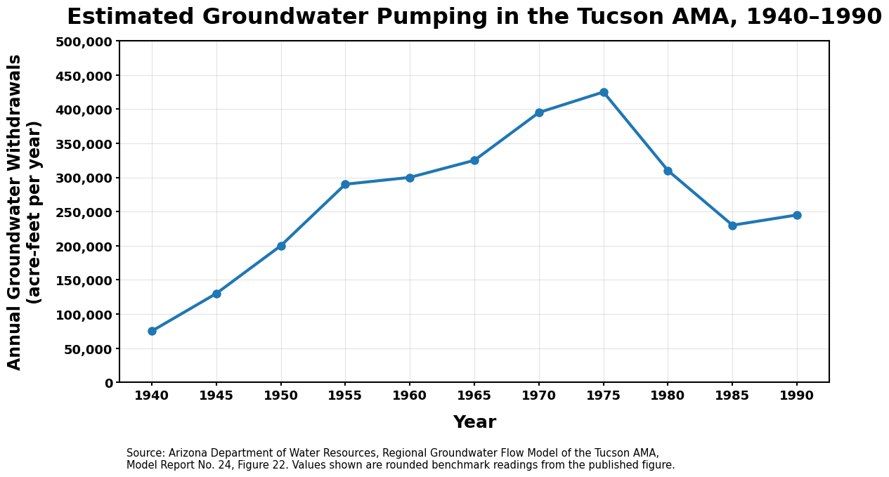

Slide 26
Station 3: River Flow
Directions: Analyze the graph about river flow using the 3 steps. Then answer the questions below in your journal.
Questions
What do you notice?
What has changed?

Slide 27
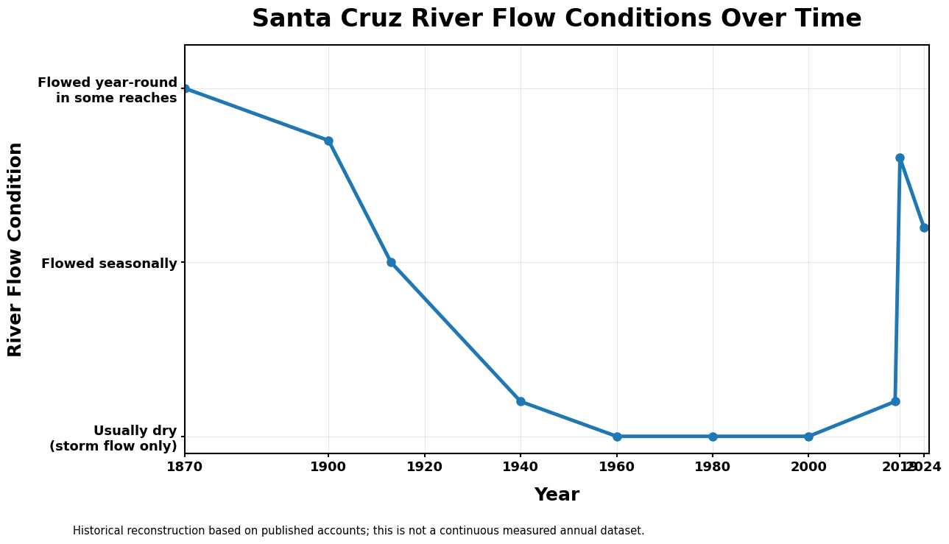

Slide 28
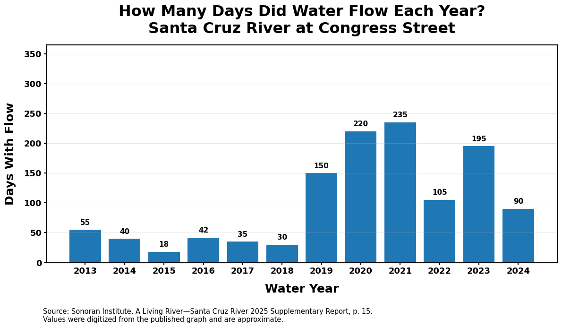

Slide 29
Station 4: Riparian Habitats
Directions: Compare photos of the same area, but different time periods.
Questions
How does the vegetation differ in each photo?
What do you predict the area might look like now?
What type of wildlife do you think might live here?

Slide 30
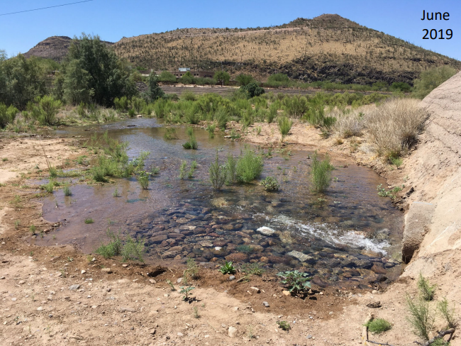

Slide 31
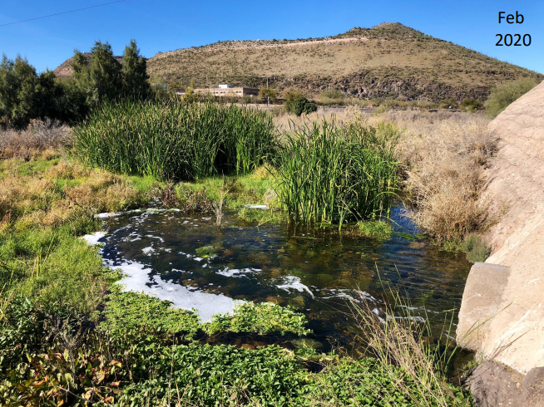

Slide 32
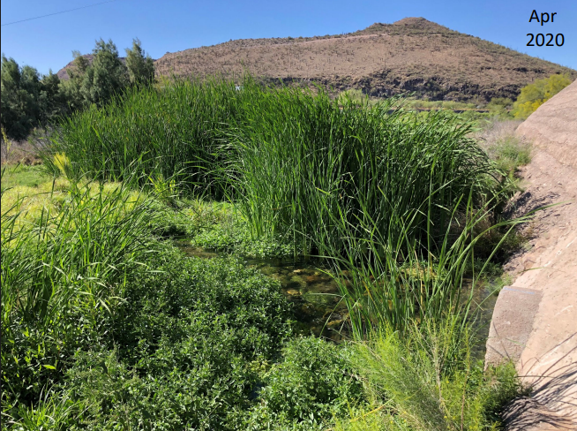

Slide 33
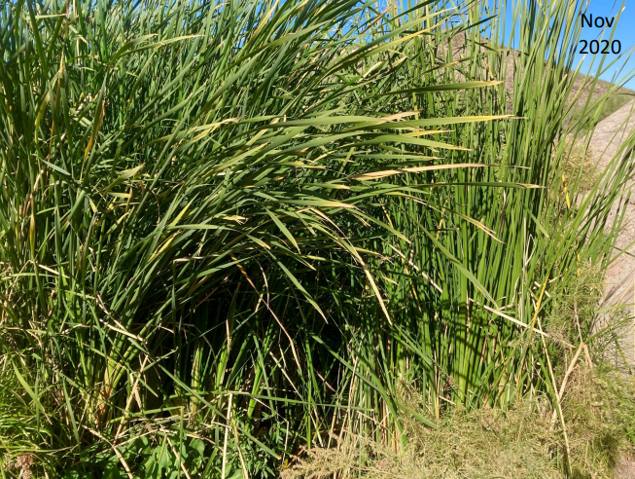

Slide 34
Station 5: Biodiversity
Directions: Analyze the biodiversity of the Santa Cruz River over time.
Questions
What trends do you notice?
What do you think this data tells us about water availability?

Slide 35
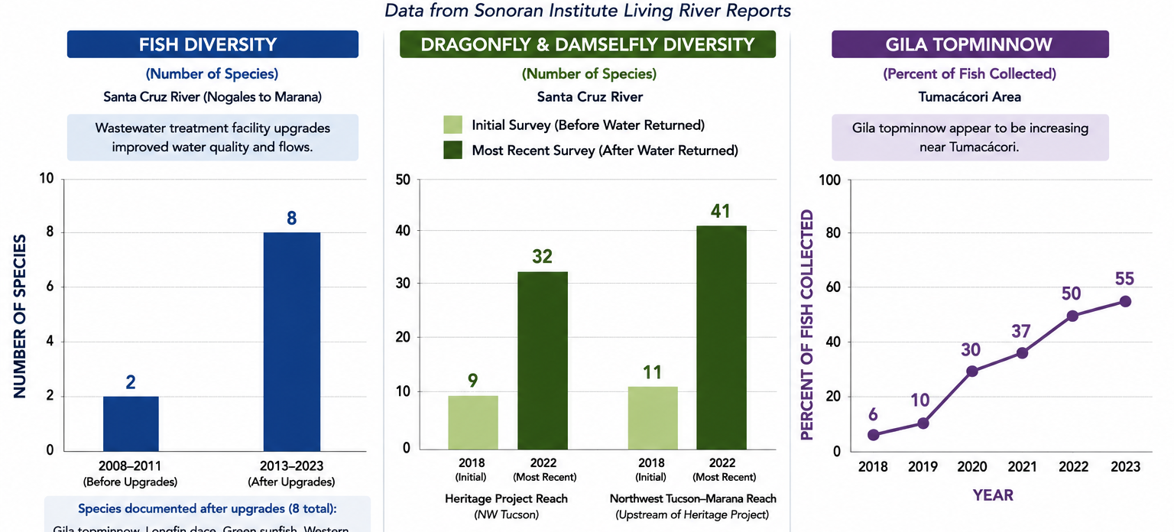

Slide 36
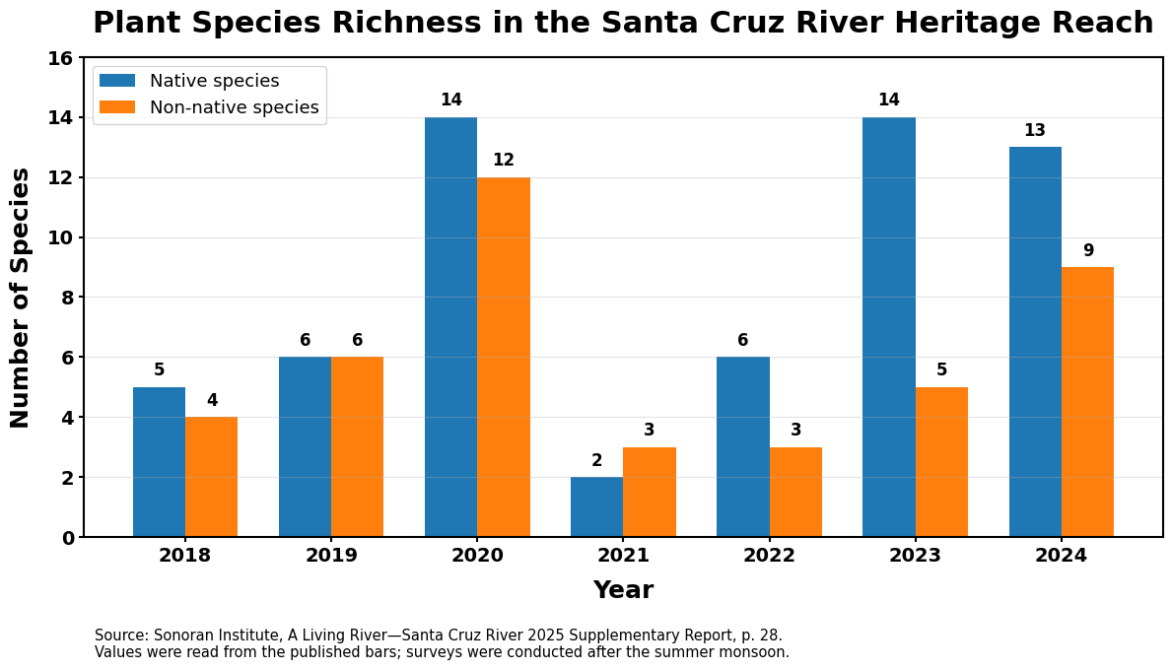

Slide 37
Discussion
After analyzing all of this data, what has happened to the Santa Cruz River? Be specific.
How are all of these events related?
In your journal, create a cause and effect chain that connects events that have affected the Santa Cruz River.

Slide 38
The Cause-and-Effect Chain
Let’s make a class consensus model of the cause and effect chain.
Now go back to your individual model and make improvements.

Slide 39
DAY THREE
Can humans restore it?
Ecosystem Discovery & Field Data

Slide 40
Field Trip

Slide 41
DAY FOUR
Can humans restore it?
Claim Evidence Reasoning

Slide 42
Constructing Your CER Argument
Prompt:
Construct an argument explaining how human consumption of water resources has impacted the Santa Cruz River.
CLAIM: A single sentence answering how humans impacted the river. (No "I think"!)
EVIDENCE: Use facts from photos, groundwater data, and biodiversity charts.
REASONING: Explain the evidence and how it supports your claim.
USE THE RUBRIC

Slide 43
"We do not inherit the earth from our ancestors, we borrow it from our children."

