Slide 1
MY YEAR IN DATA
Observation, Communication, and Science Storytelling
8th Grade Science | 2018 AZ Standards

Slide 2
ARIZONA SCIENCE STANDARDS
Dimension | Key Focus Areas
Practices (SEPs) | Analyzing and Interpreting Data; Obtaining, Evaluating, and Communicating Information; Using Mathematical and Computational Thinking
Concepts (CCCs) | Patterns; Cause and Effect; Scale, Proportion, and Quantity; Systems and System Models.
Core Ideas | U1: Explaining phenomena using evidence from observations.

Slide 3
LEARNING TARGETS
I can collect accurate data about my life and the world around me.
I can develop a method for recording my data.
I can identify patterns and trends within datasets.
I can create an original visualization to communicate data.
I can interpret and critique data visualizations.
I can reflect on bias or limitations in data collection.

Slide 4
WHAT IS "DEAR DATA"?
Our Inspiration for Scientific Storytelling

Slide 5
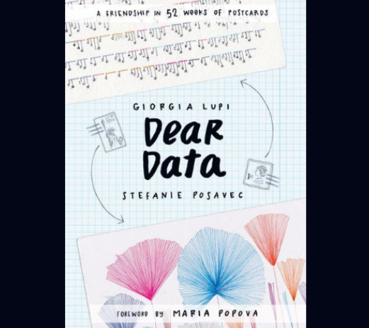
ARTISTIC DATA SCIENCE
Beyond the Bar Graph
Following the examples from this book, we will treat data as a creative material.
Instead of simple charts, we will use symbols, color, and layout to communicate our own experiences.

Slide 6
THE MONTHLY PROCESS
OBSERVE
COLLECT
CREATE
Focus on one specific topic for a full week. What do you notice?
Record your data accurately as it happens in your notebook.
Design your artistic visualization and build a "Secret Key."

Slide 7
PROJECT TIMELINE
Days 10-11
Days 2-8
Sketch & Final Artistic Visualization
Active Data Collection (Daily)
Day 1
Day 9
Day 12
Topic Reveal & Recording Sheet Design
Analyze Totals & Find Patterns
Gallery Walk & Class Critique

Slide 8
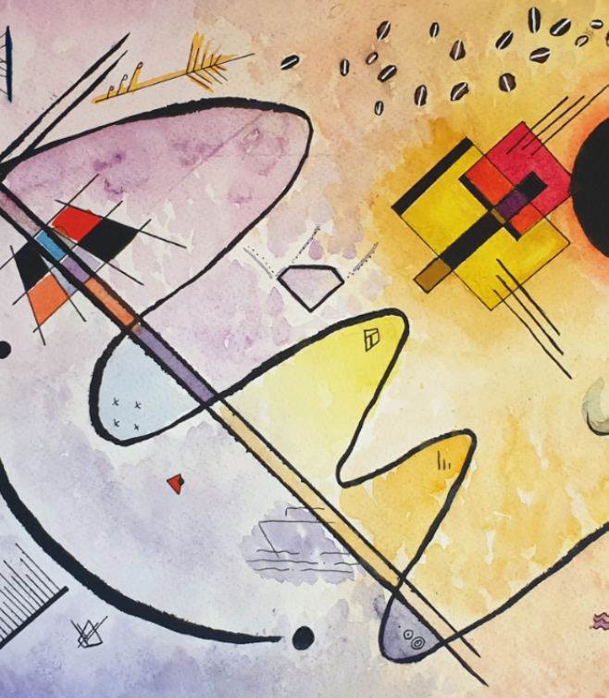
VISUAL SECRETS
The Power of the Key
In this project, every dot, line, and color has a specific meaning. Your "Key" or "Legend" is the secret code that allows your audience to decode your story.
Without the key, it's art. With the key, it's data science.

Slide 9
THE BIG PICTURE
Your Year in Review
12
By the end of the year, you will have 12 unique artistic datasets representing your 8th-grade journey.
This portfolio will showcase your growth in observation, creativity, and scientific communication.
DATASETS

Slide 10
GETTING STARTED: WEEK 1
What counts as data?
How to record it?
Anything that happens! Complaints, laughs, phone checks, bird sightings, or doors you walk through.
Design a tracking sheet that works for you. Consistency is the most important part of science!

Slide 11
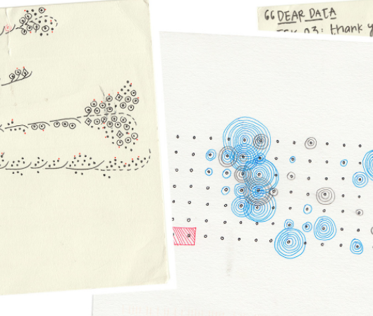
Day 1: What is "Dear Data"?
Personal Documentary
We are becoming data storytellers. We won't just make graphs; we will create symbols and art to share our lives.
Today's Task: Reveal our monthly topic!

Slide 12
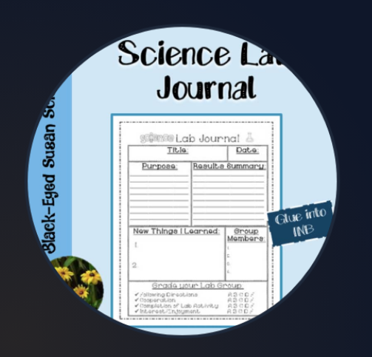
Discussion: What is Data?
What counts as data for our topic?
What should be recorded exactly?
How can we stay consistent?

Slide 13
Days 2-8: Data Collection
Record data for 5-10 minutes daily.
7
Use your recording sheet instantly.
DAYS OF COLLECTION
"Messy" data is valuable! Don't skip it.

Slide 14
Day 9: Finding the Pattern
Calculations & Trends
Total up your counts. Calculate percentages or daily averages. Look at your data as a whole system.

Slide 15
Discussion
"What surprised you about your own habits?
What questions do you have now?"
Analyze patterns before we draw.

Slide 16
Days 10-11: Visualization
Instructions:
1. Sketch your ideas first.
2. Create a KEY that explains your symbols, colors, shapes, and sizes.
3. Produce the final visualization on cardstock.

Slide 17
Discussion
What story does your data tell?
Would another week produce different results?
What limitations did you experience?

Slide 18
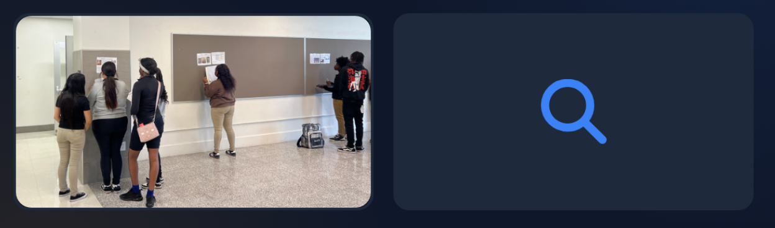
Day 12: Sharing Our Stories
Observe & Interpret
Critique & Question

Slide 19
Discussion
What worked well in your visualization?
What made it easy or difficult to understand?
How can we improve for next month?

