Slide 1
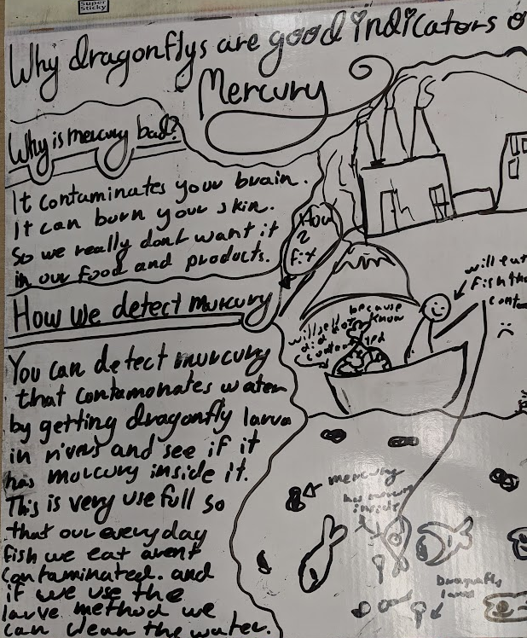
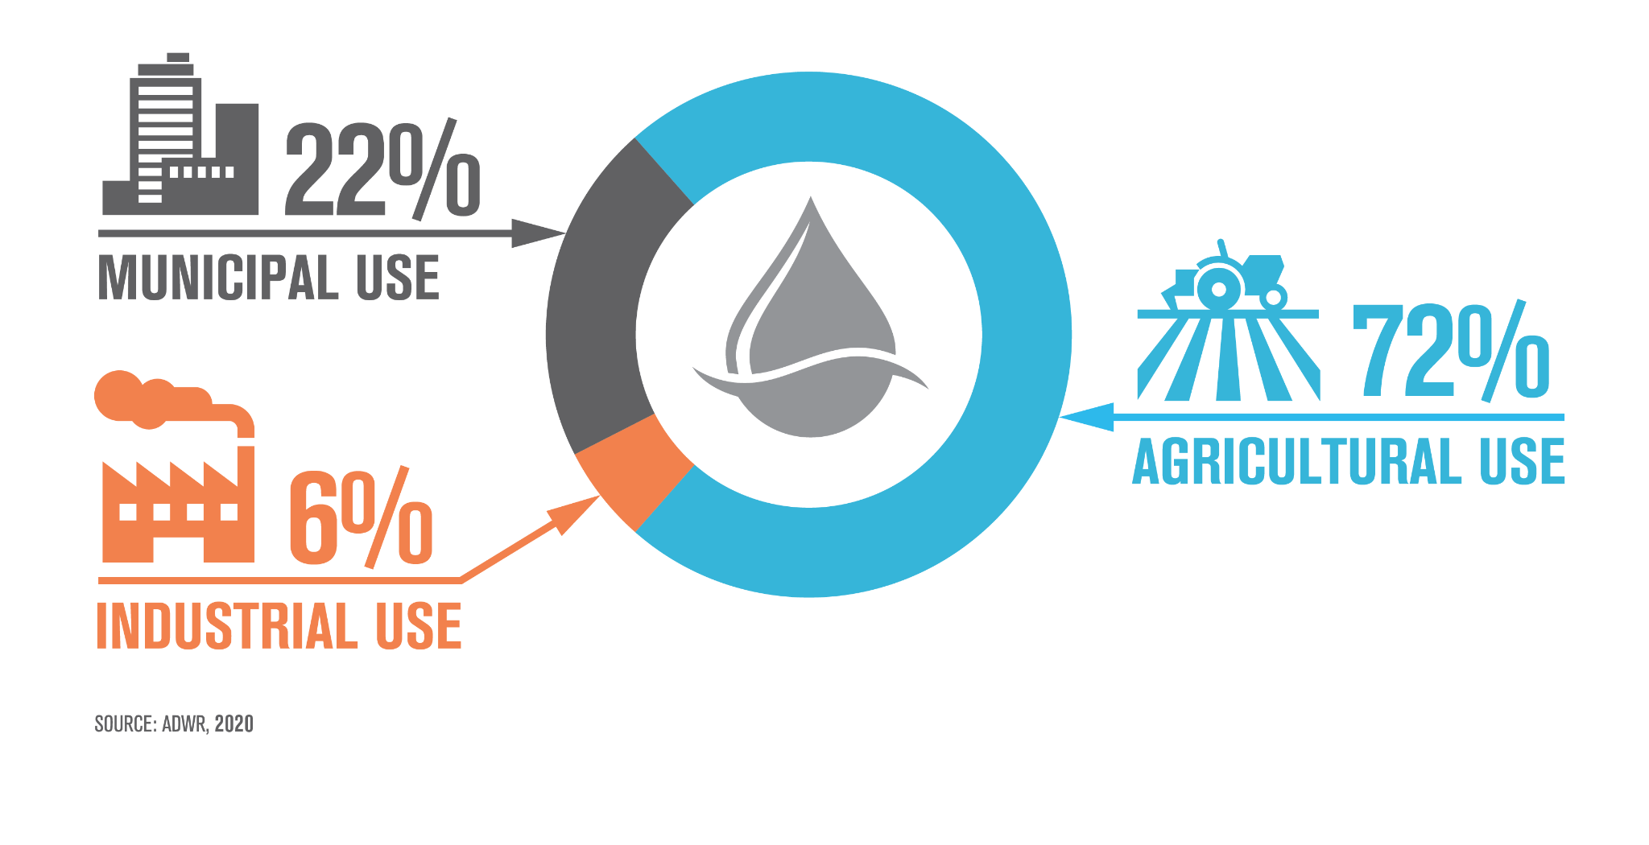
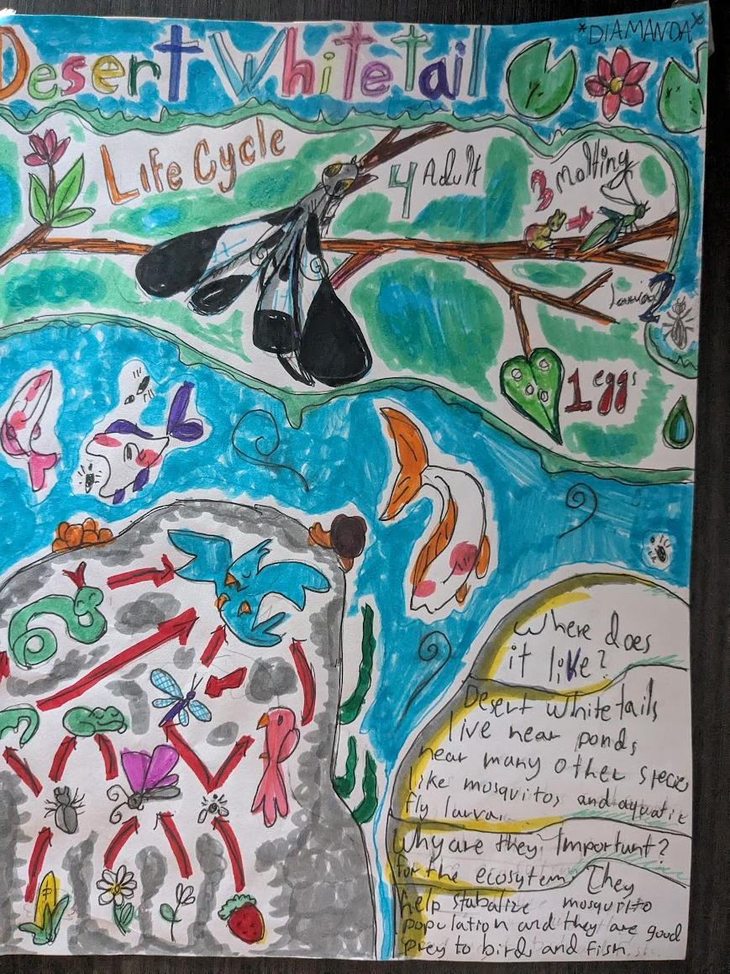
Local Issues With Global Significance
Developing Data Literacy Through Place-Based Learning

Slide 2
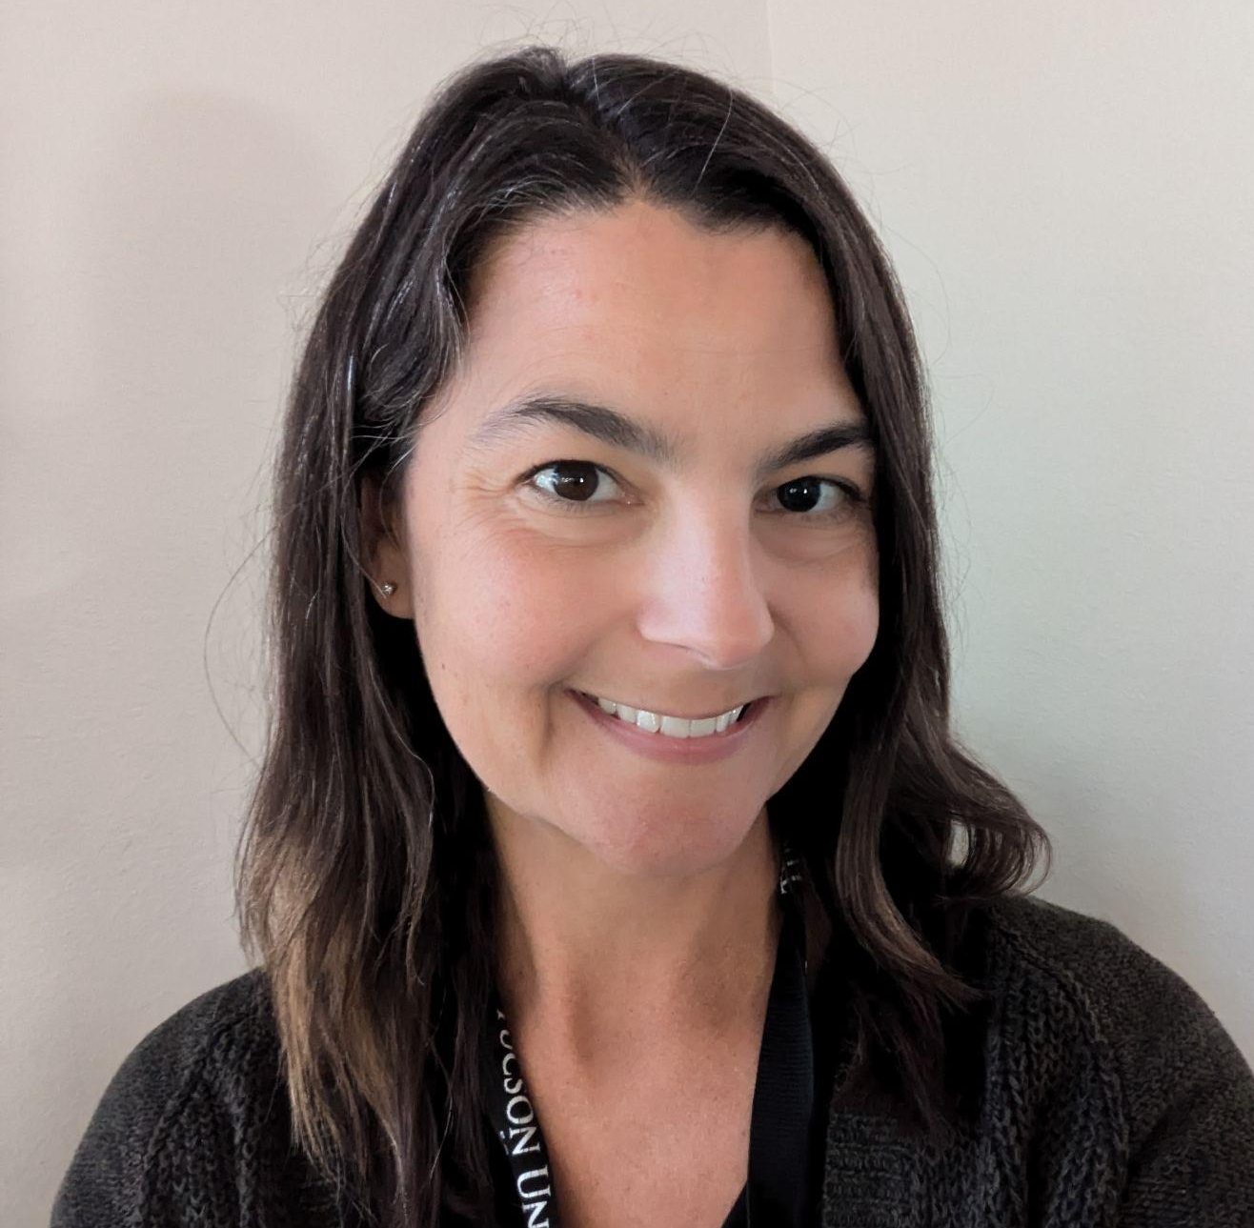


Rachel Carpenter
Master Science Teacher
Wakefield Middle School, Tucson, AZ
Master Teacher Fellow, Noyce Borderlands Education Center
BIORETS Teacher Fellow
The BIORETS Santa Cruz River program is for middle and high school science teachers. The focus is on teachers conducting ecological research alongside University of Arizona professors and graduate students on the Santa Cruz River.
Teachers learned from a wide array of stakeholder groups including county, city, and water utilities staff, and non-profit organizations working with the Santa Cruz River. Teachers worked concurrently to develop curriculum to bring the Santa Cruz River back to the classroom. Lessons and activities, including field trips, were implemented during the following school years.

Slide 3
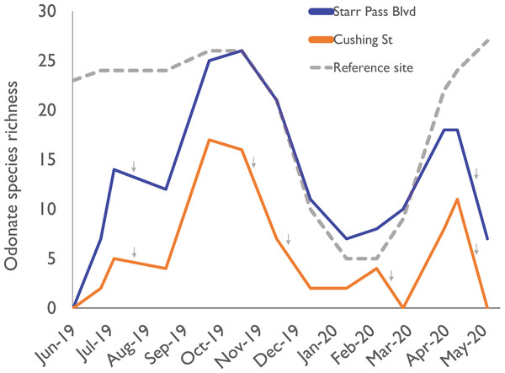
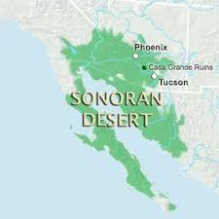
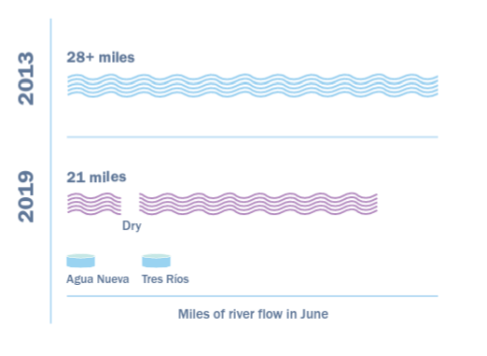
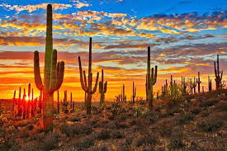
Essential Questions
How can we describe a place?
What stories do these data tell?

Slide 4
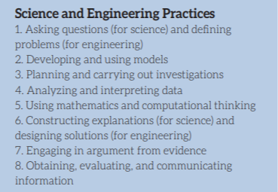
Standards
6.L2U3.11 Use evidence to construct an argument regarding the impact of human activities on the environment and how they positively and negatively affect the competition for energy and resources in ecosystems.
6.L2U3.12 Engage in argument from evidence to support a claim about the factors that cause species to change and how humans can impact those factors.
6.L2U1.13 Develop and use models to demonstrate the interdependence of organisms and their environment including biotic and abiotic factors.
P1: All matter in the Universe is made of very small particles.

Slide 5
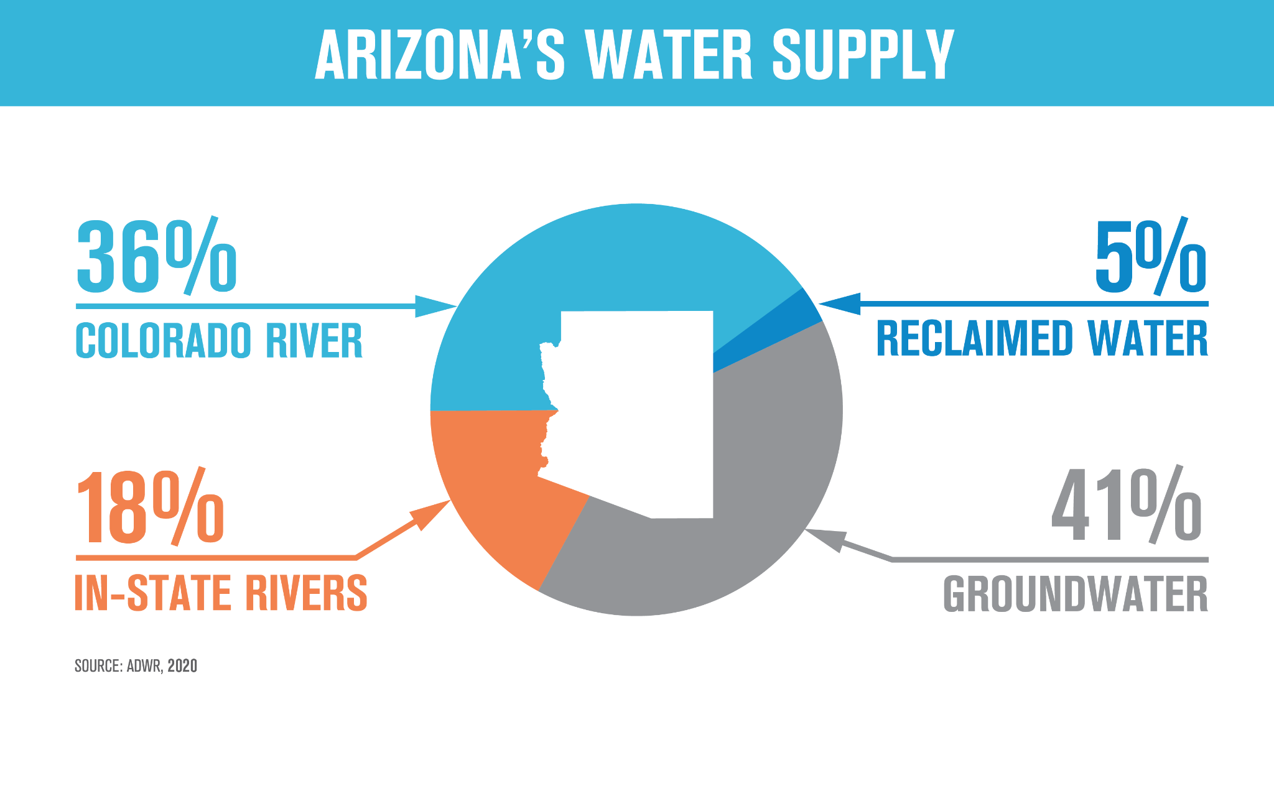
Warm Up: Study the image. Make two observations, one inference, and ask one question.

Slide 6
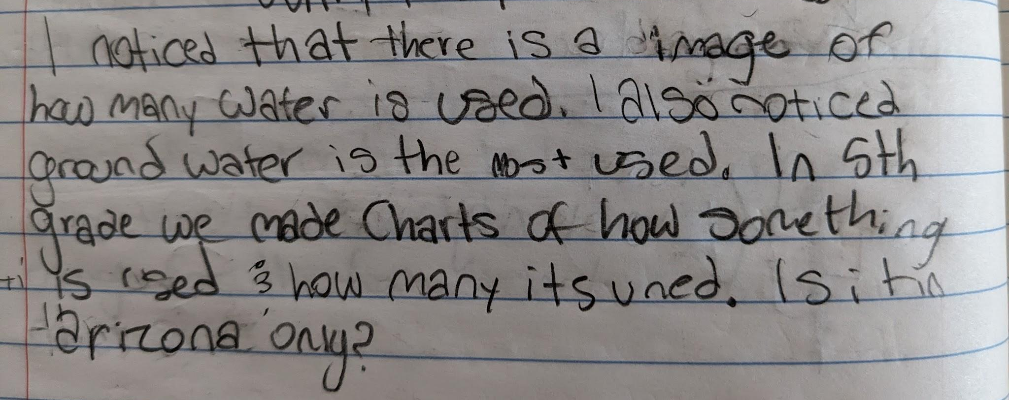
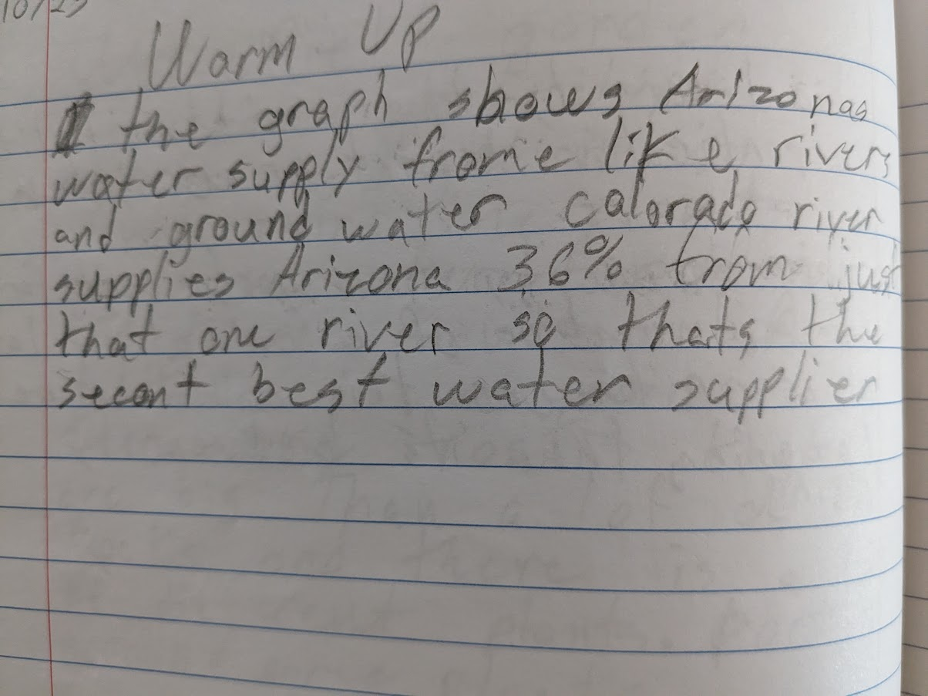
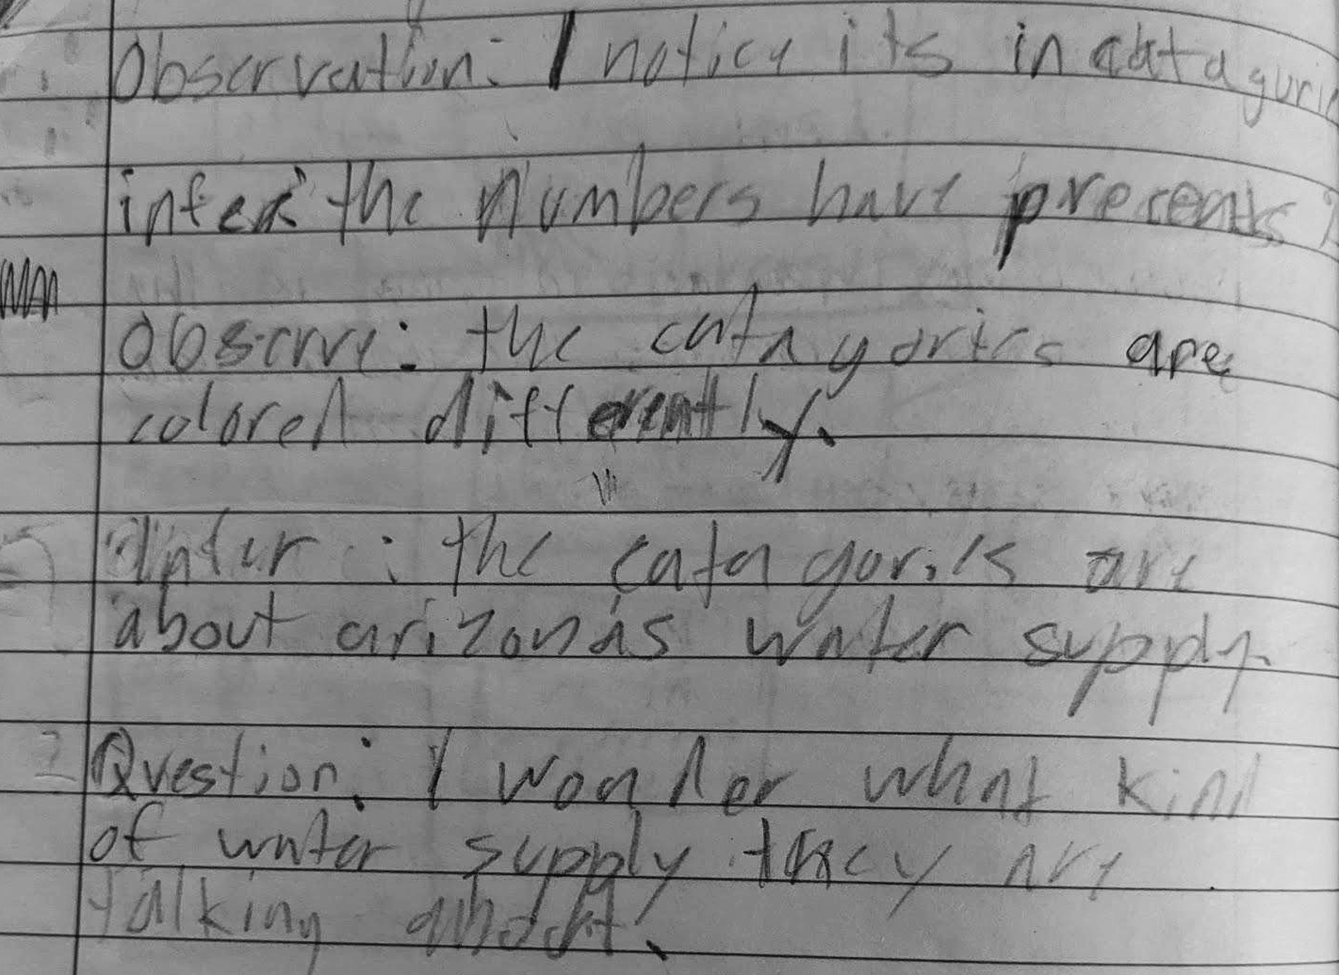
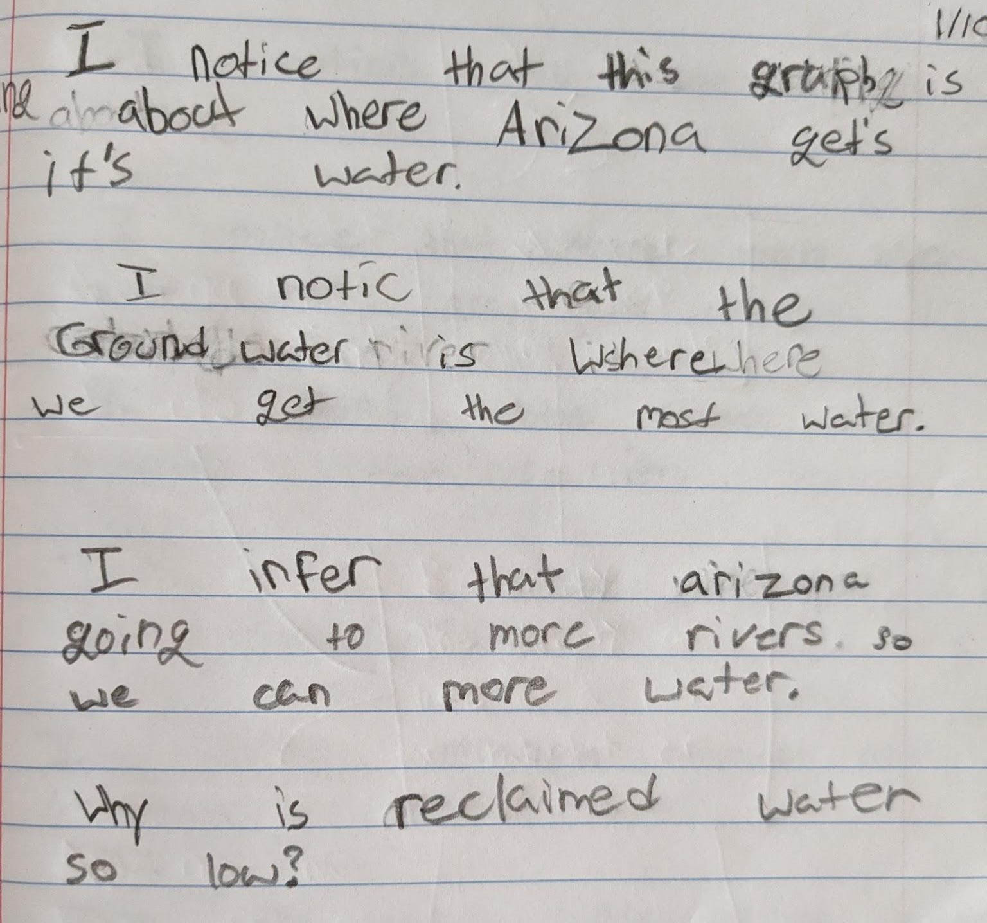

Slide 7
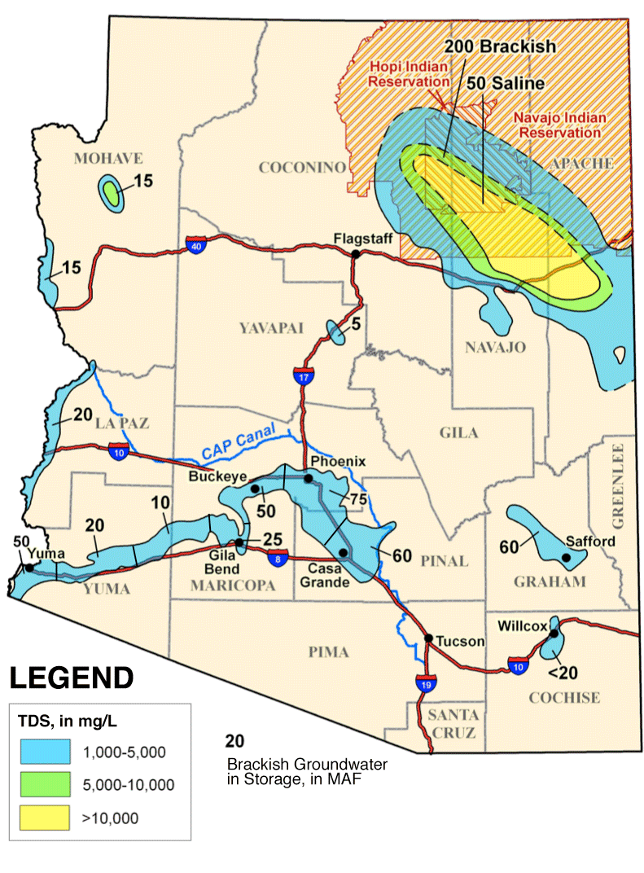
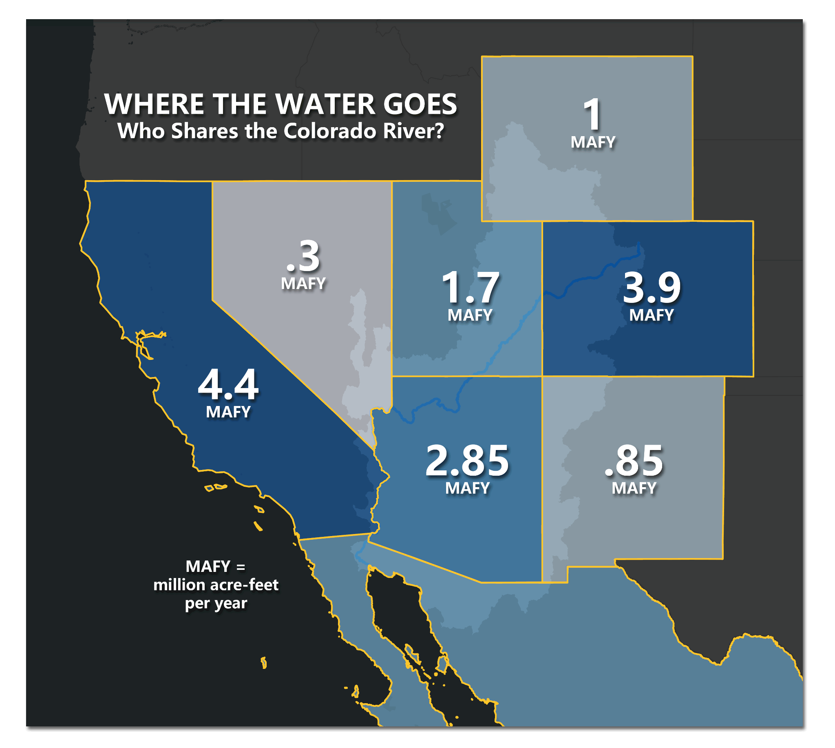
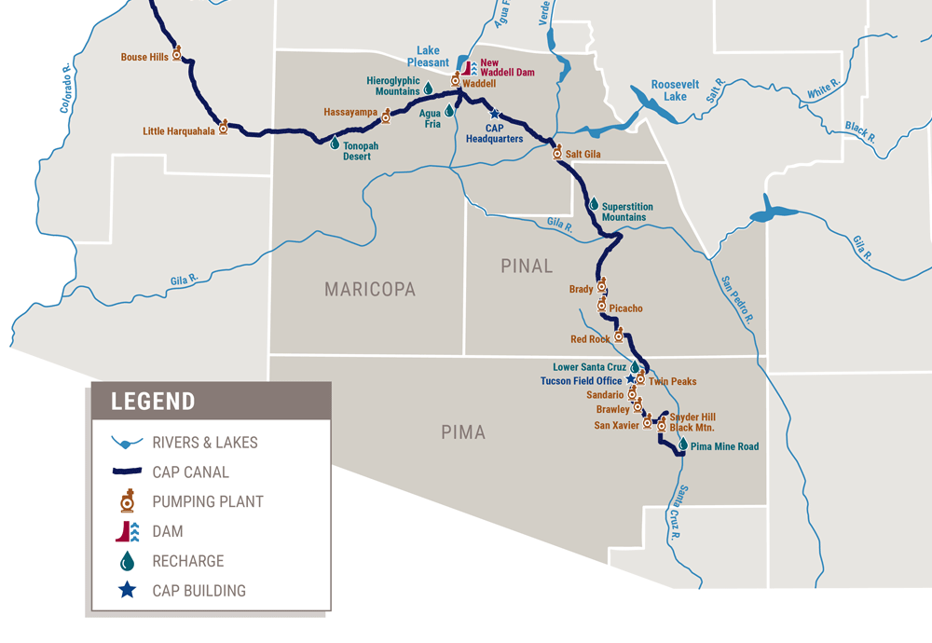
Central
Arizona Project (CAP)

Slide 8
What do you know about water in Arizona?
Where it comes from
How it is used
Water in Arizona

Slide 9
Study this graph of water use in Arizona. What do you notice? What do you think the different categories might represent?

Slide 10
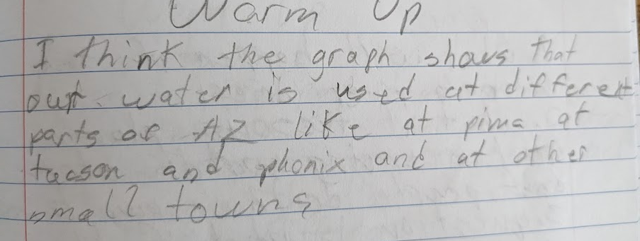
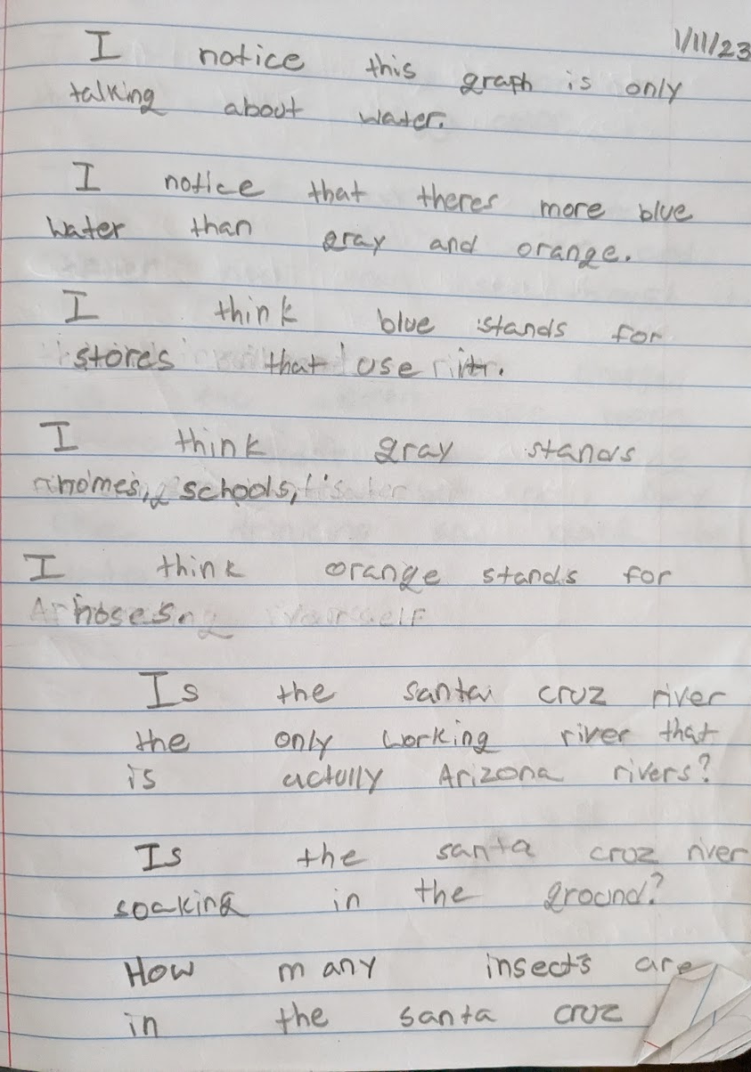
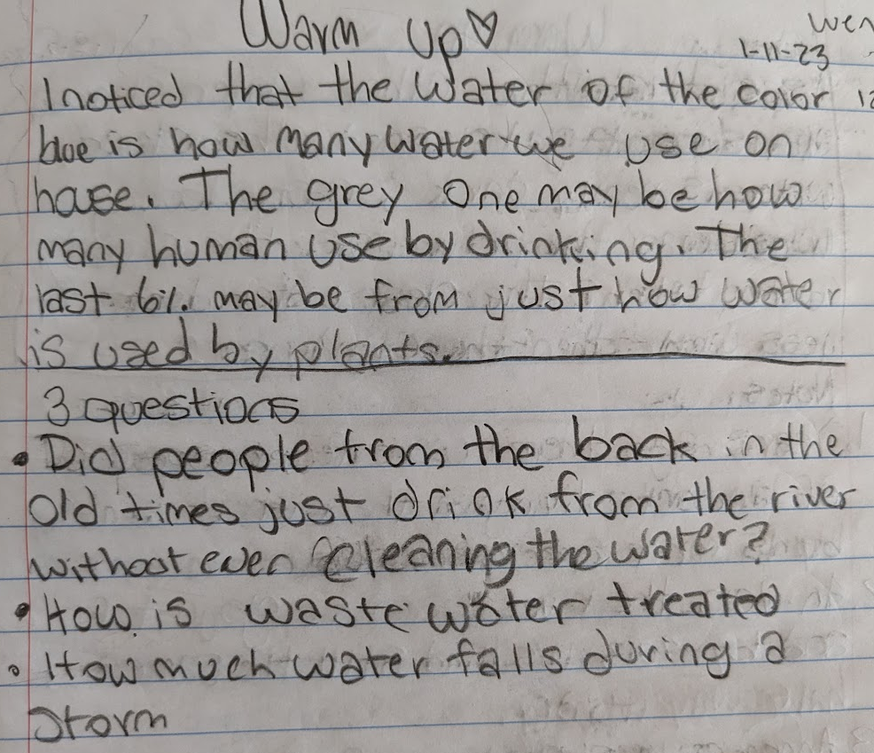

Slide 11
What do you notice? What questions do you have?

Slide 12
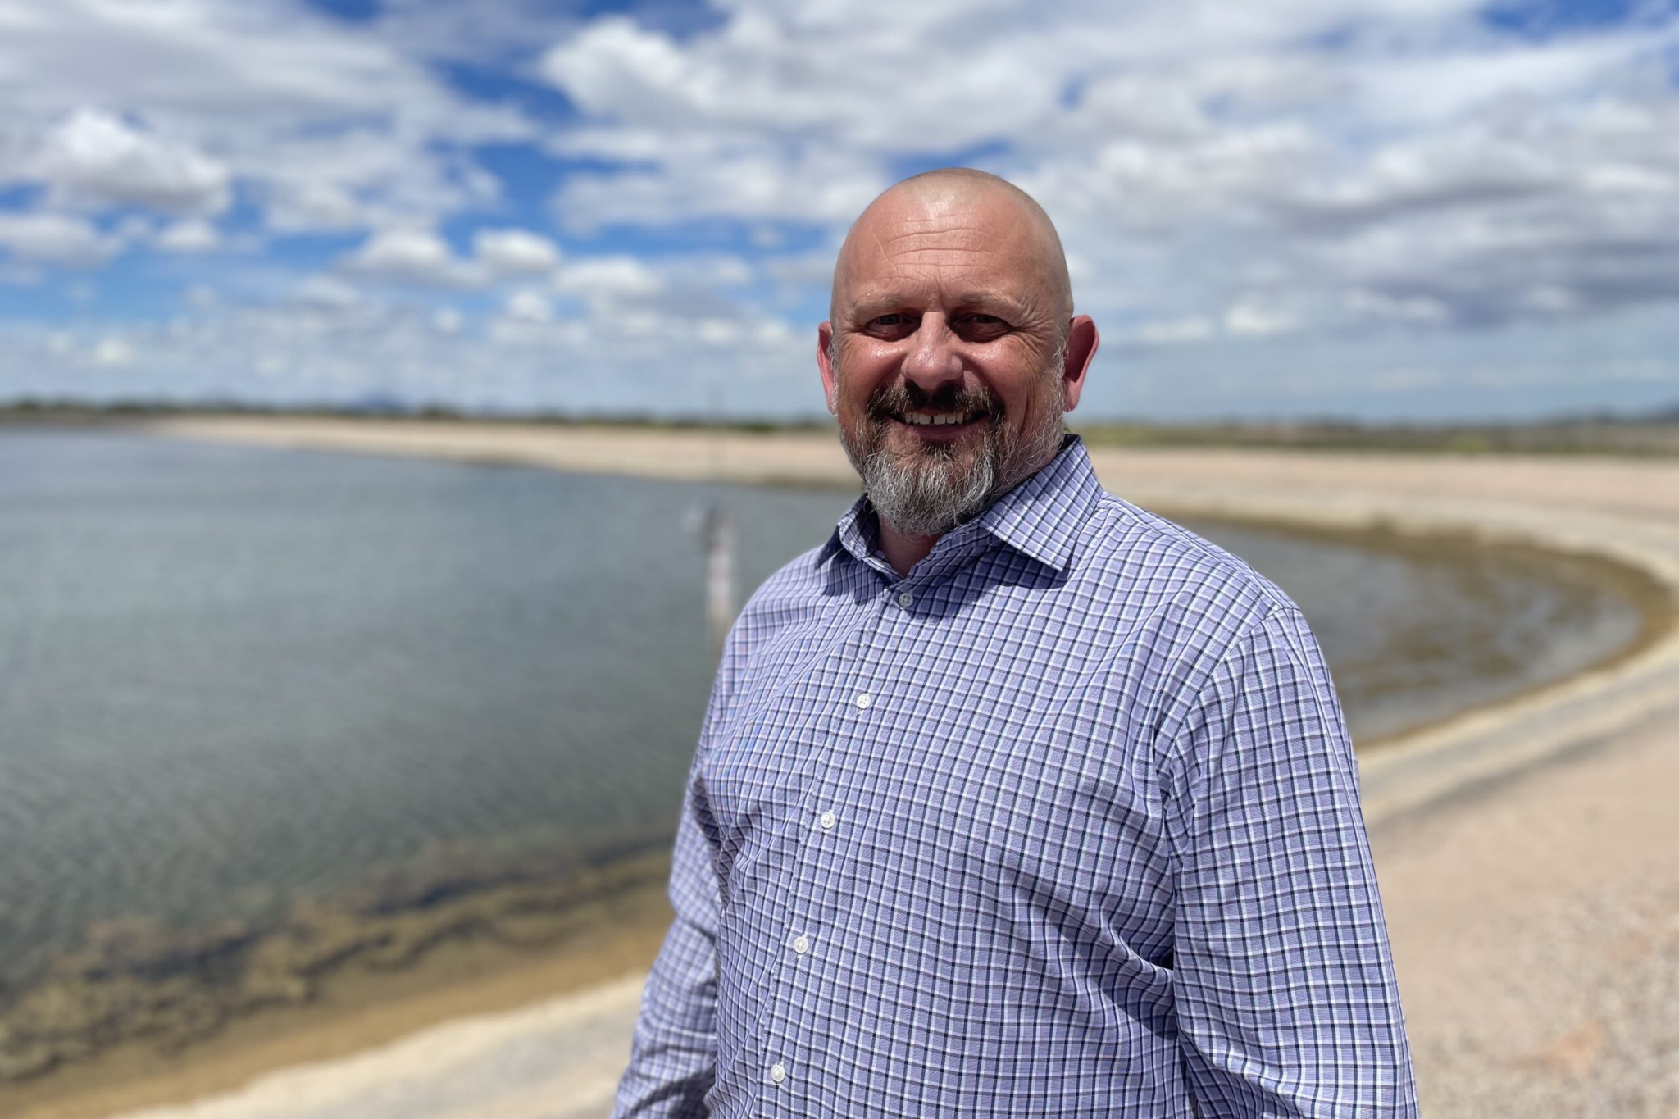
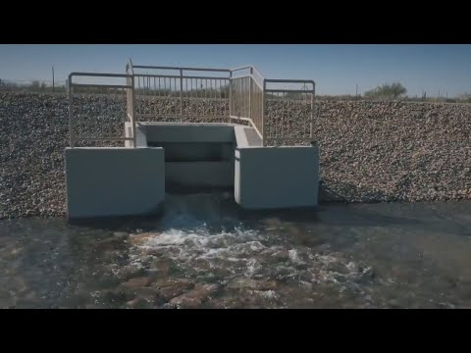

Tucson’s “secret” water storage

Slide 13
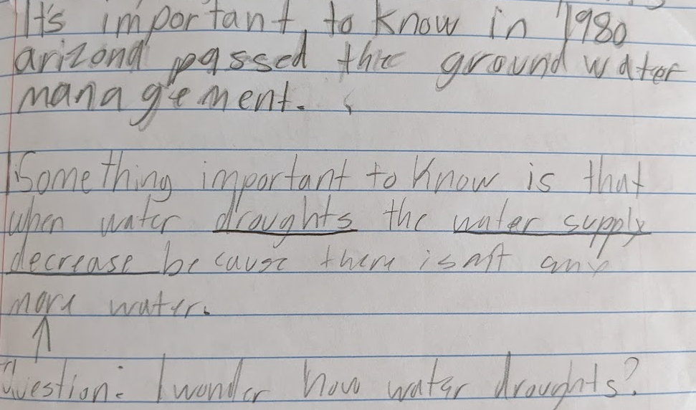
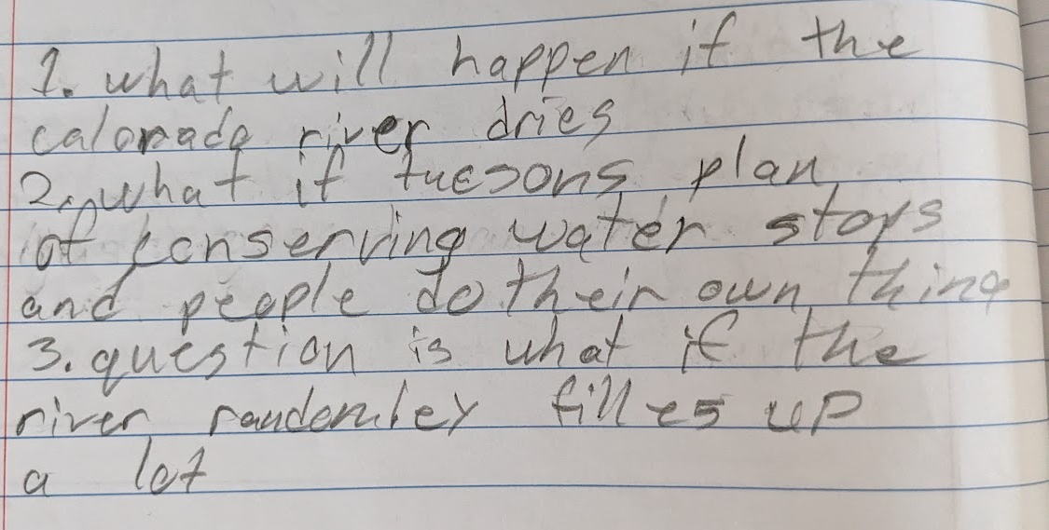
It’s important to know…
I’m still wondering…

Slide 14
I’m still wondering…
3rd period
Why is the Colorado River not considered surface water in the graph of Arizona water sources?
Why does most of our water come from groundwater?
How do our sources of water change throughout the seasons?
What do the reservoirs look like?
Why doesn’t Arizona collect the rainwater and use that as a source of water?
Can we take saltwater out of the ocean water and use that in Arizona?

Slide 15
I’m still wondering…
4th period
What percentage of Arizona water goes where?
Is the water in the reservoir purified?
Why is Colorado River water going down? Is it our fault?
How come Arizona can get so much water from the Colorado River?
Who else is using the water from the Colorado River?
How is reclaimed water used?

Slide 16
I’m still wondering…
5th period
How much water do we use per year?
Can we store water for the dry times?
Why don’t we use much reclaimed water (as a water source for Arizona)?
When will we run out of water?
What can we do in Arizona to prevent running out of water?

Slide 17
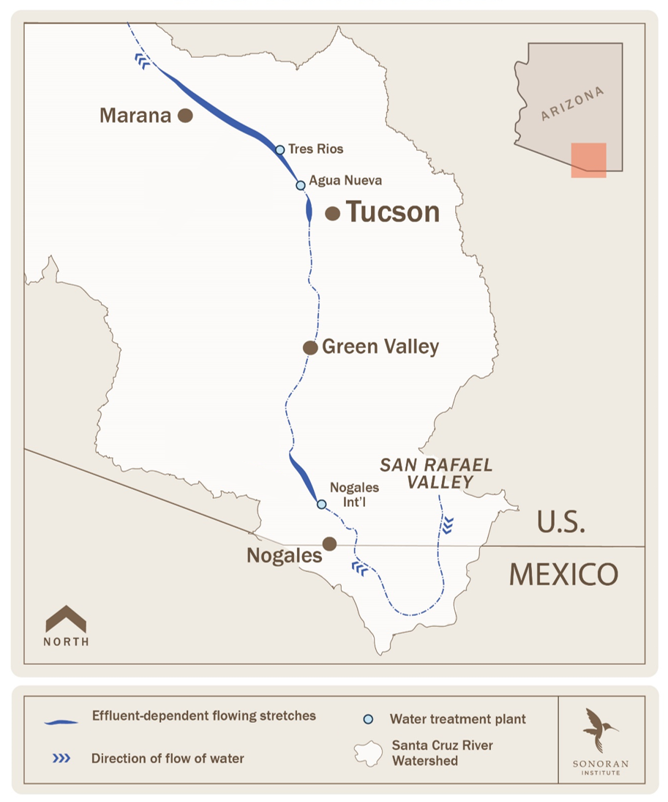
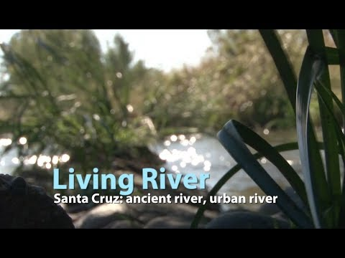

Slide 18
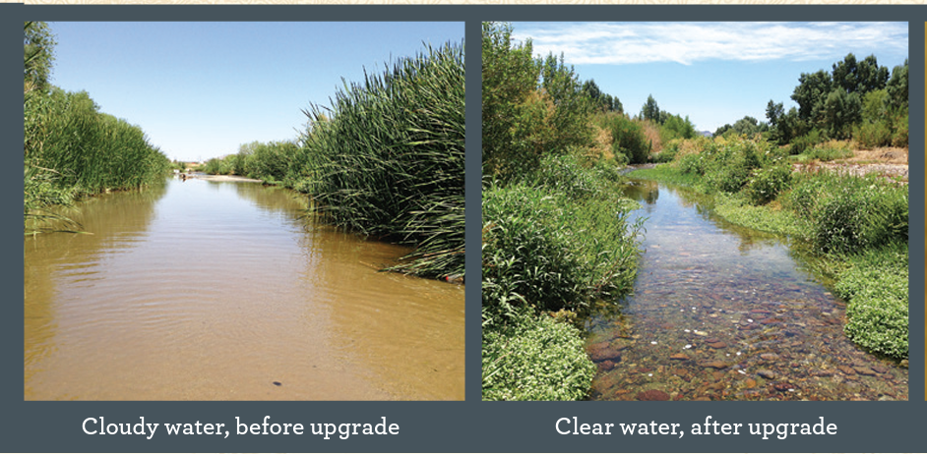
Warm Up: study these images of the Santa Cruz River before and after the water treatment plants were upgraded.
What changes can you observe? In what other ways do you think the ecosystem by the river changed?

Slide 19
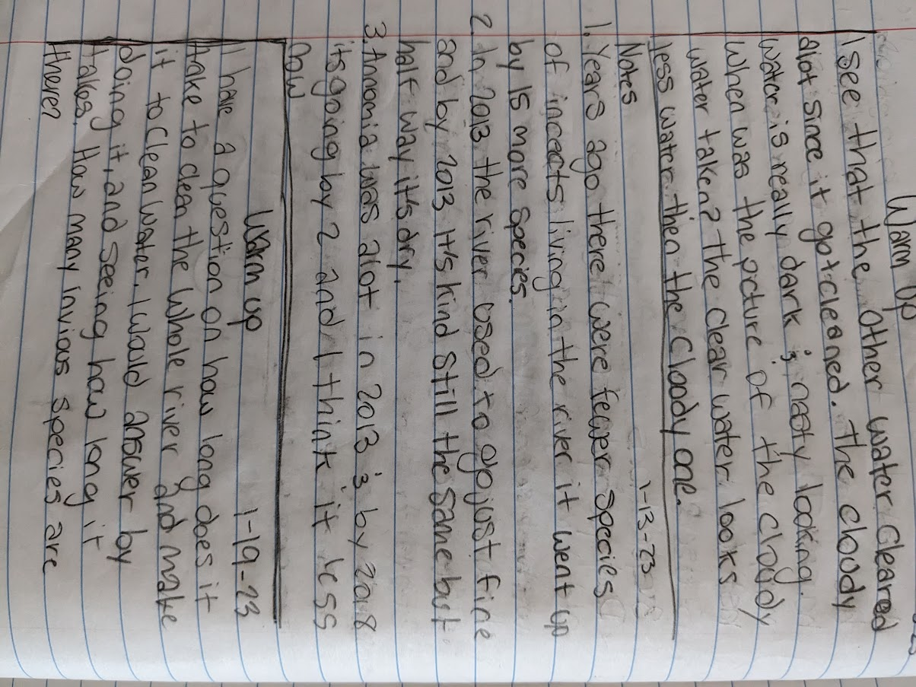
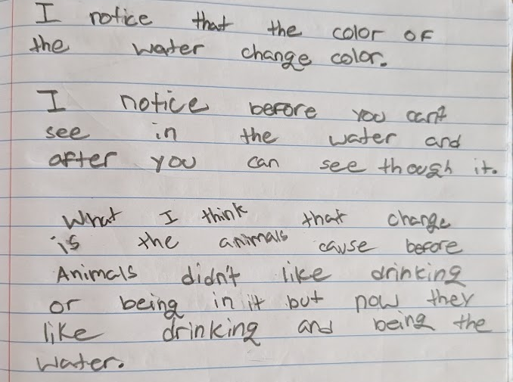
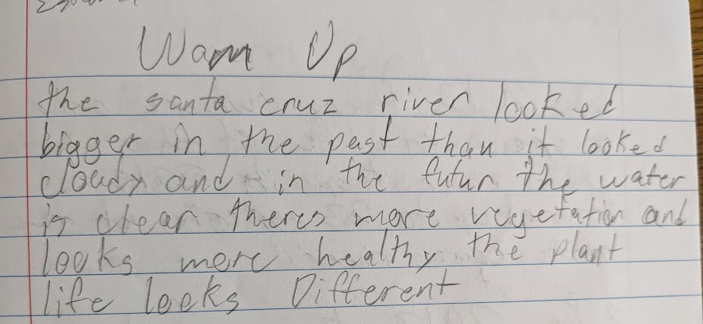
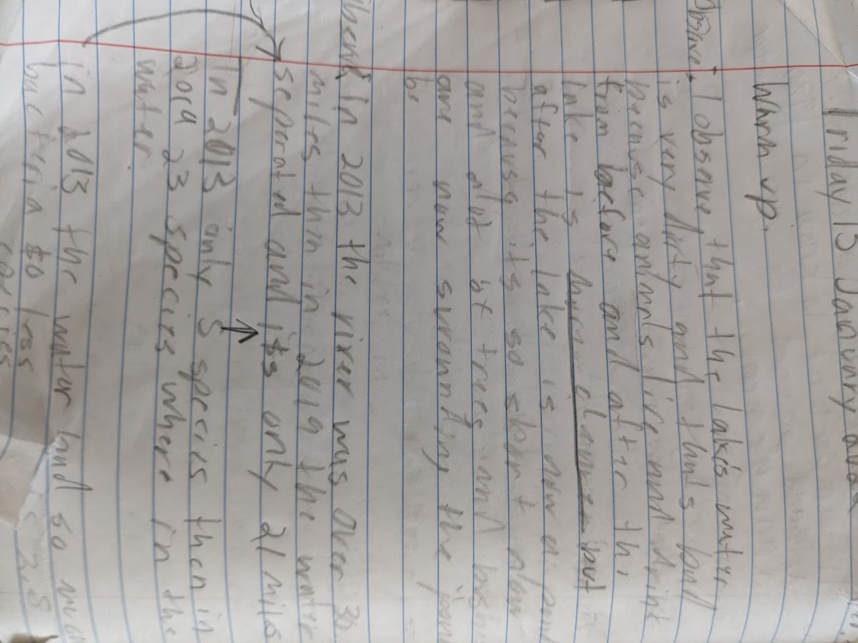

Slide 20
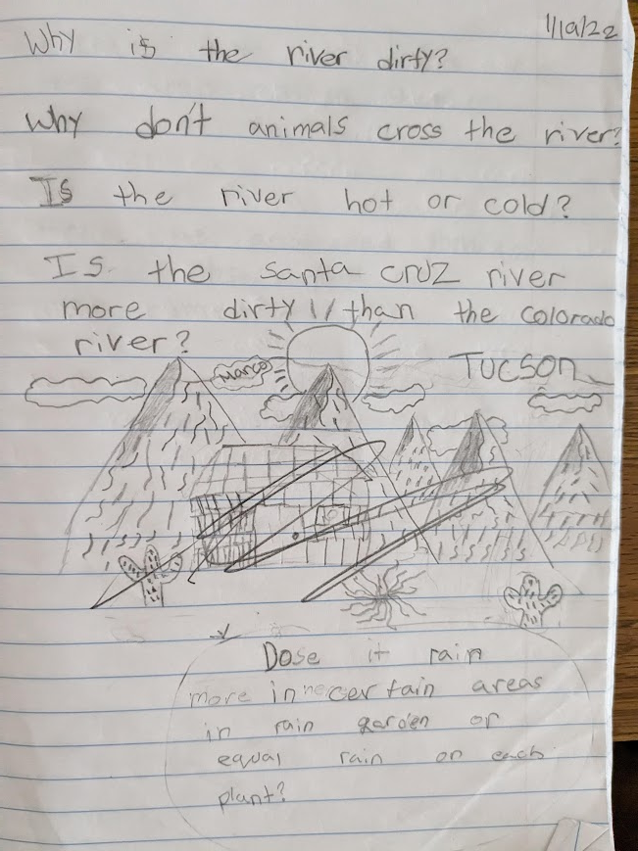

Slide 21
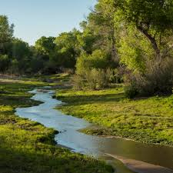
Warm Up
Why are rivers important?
Why is the Santa Cruz River important to us?

Slide 22
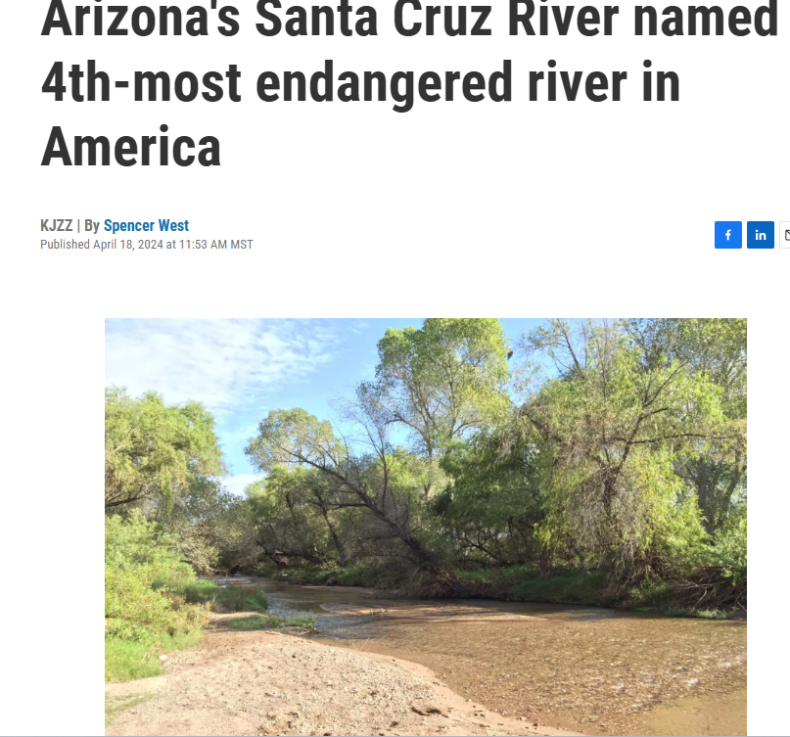
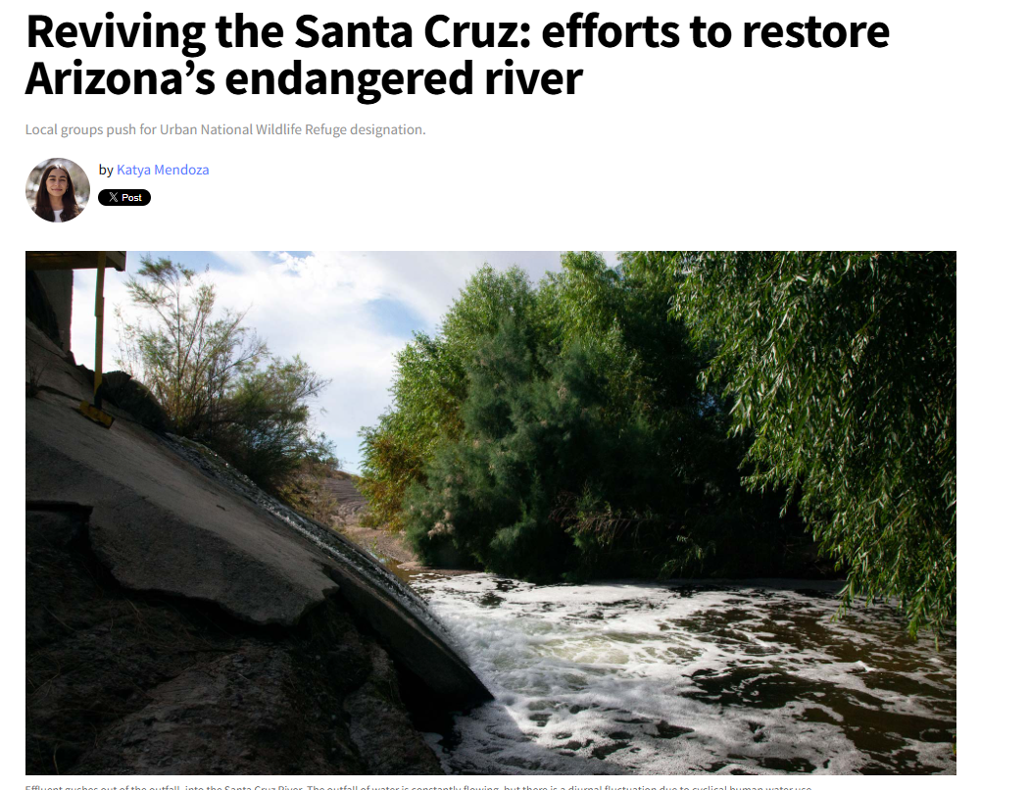
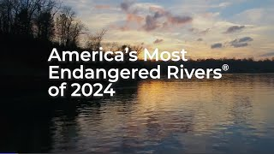

Slide 23
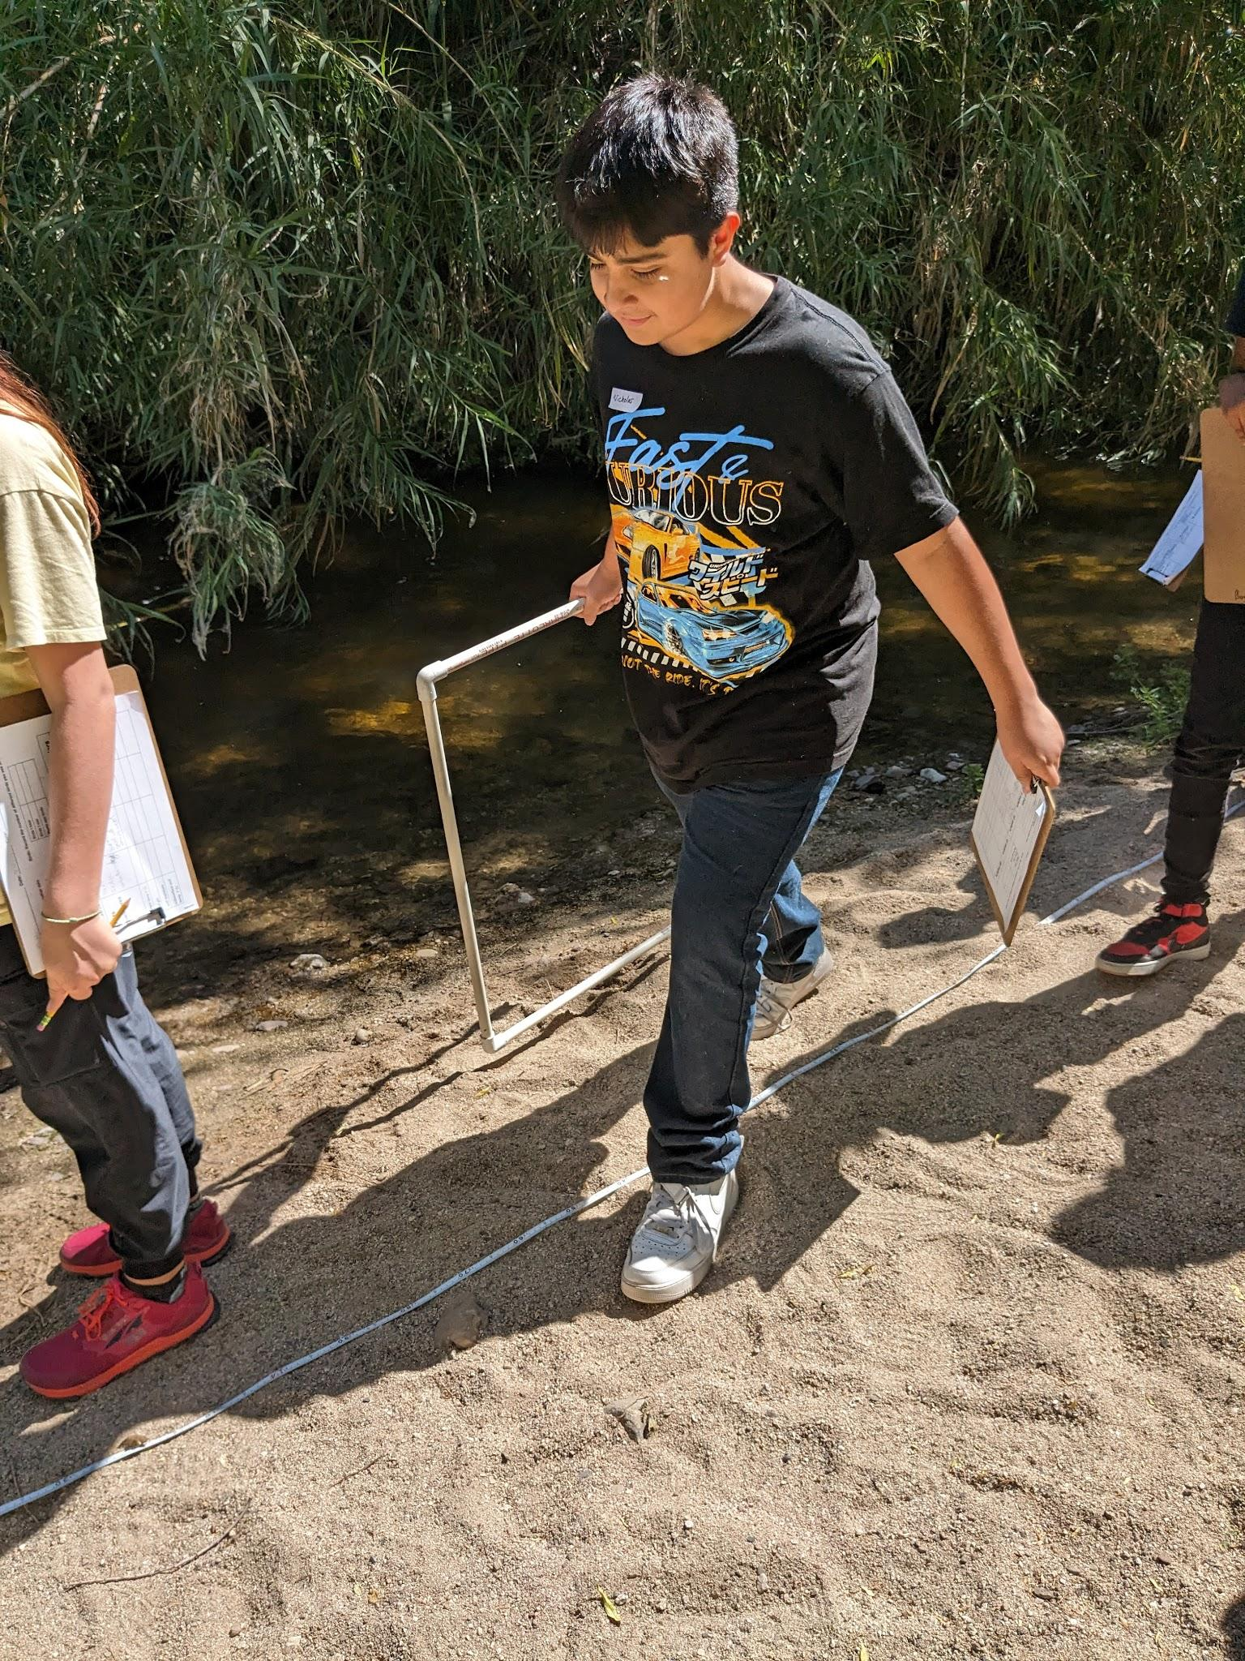
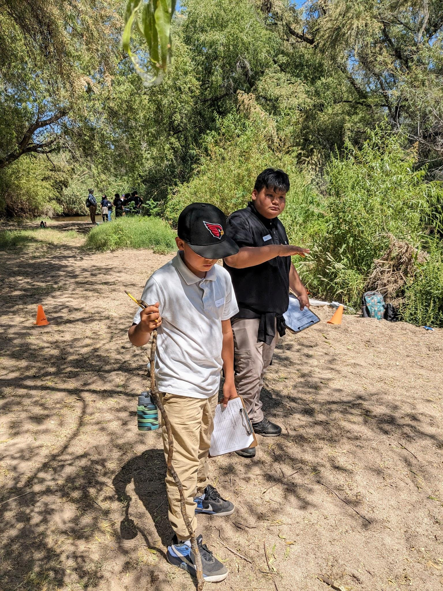
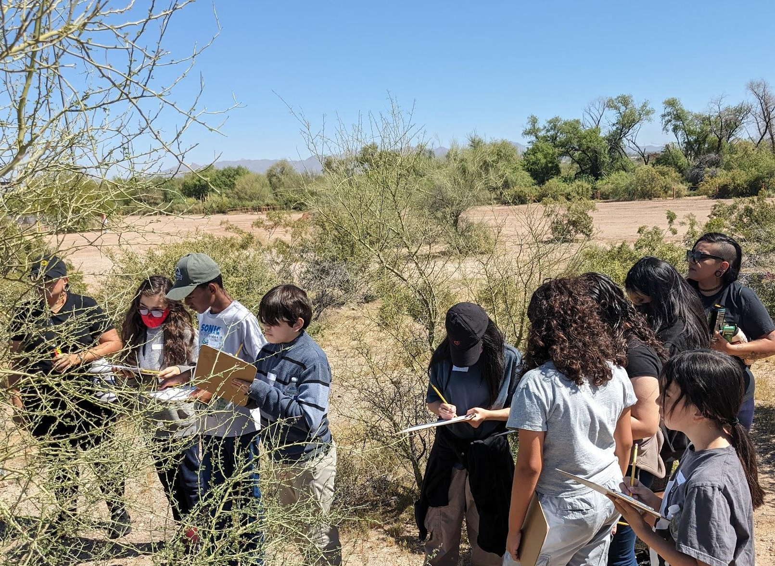

Slide 24
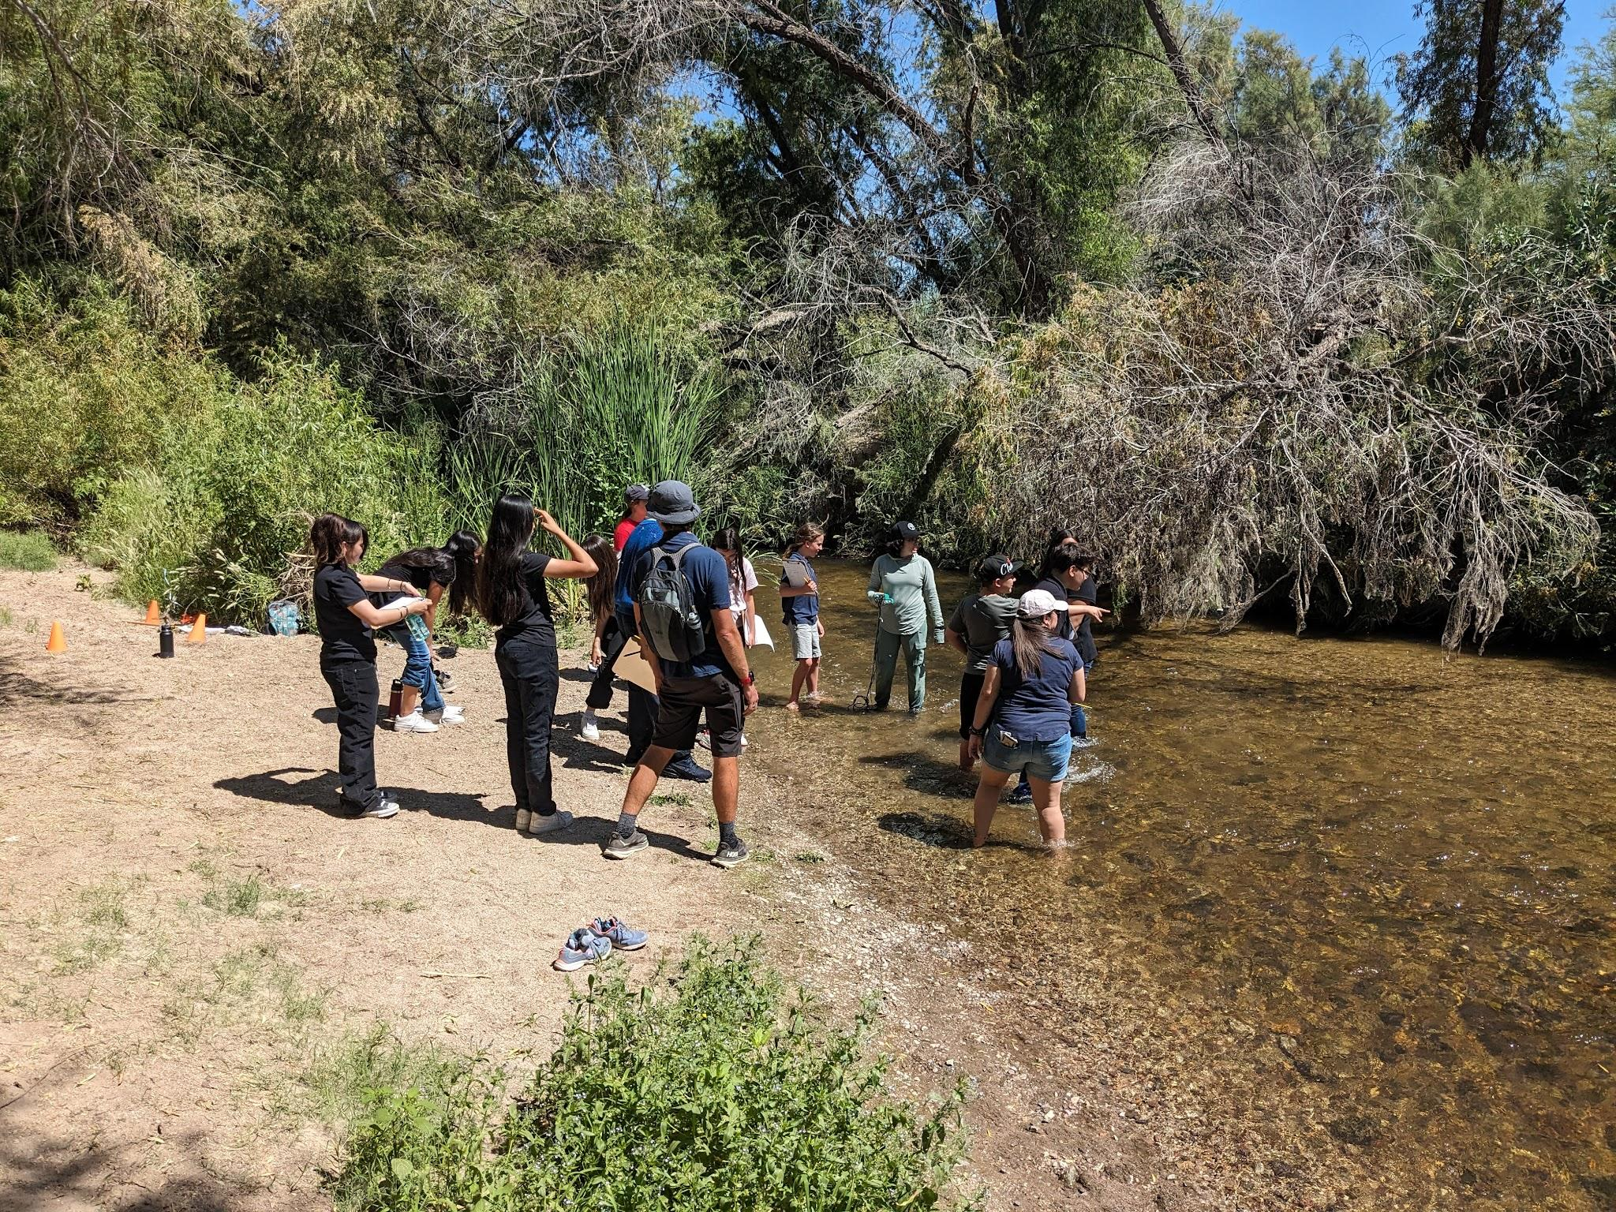
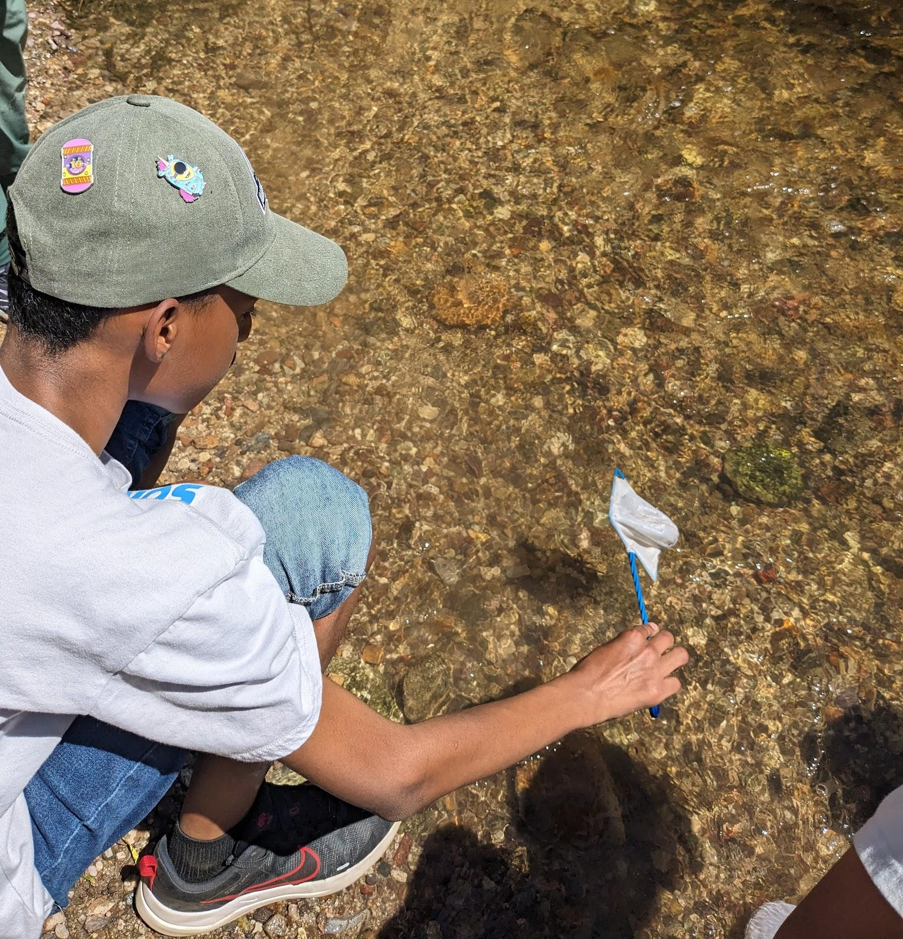
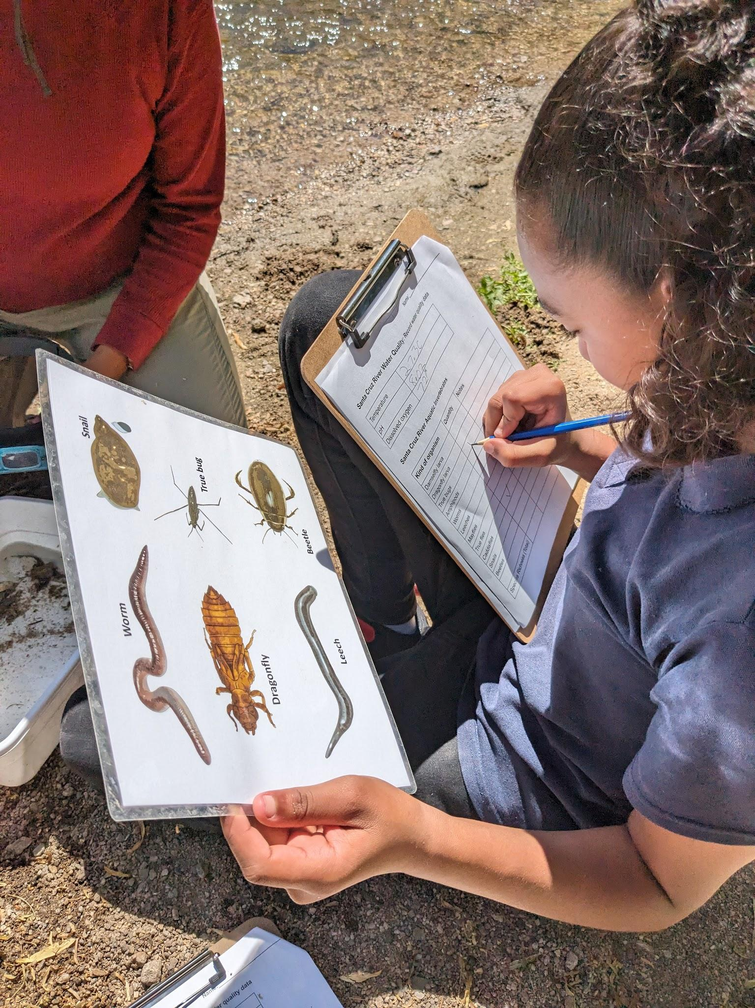
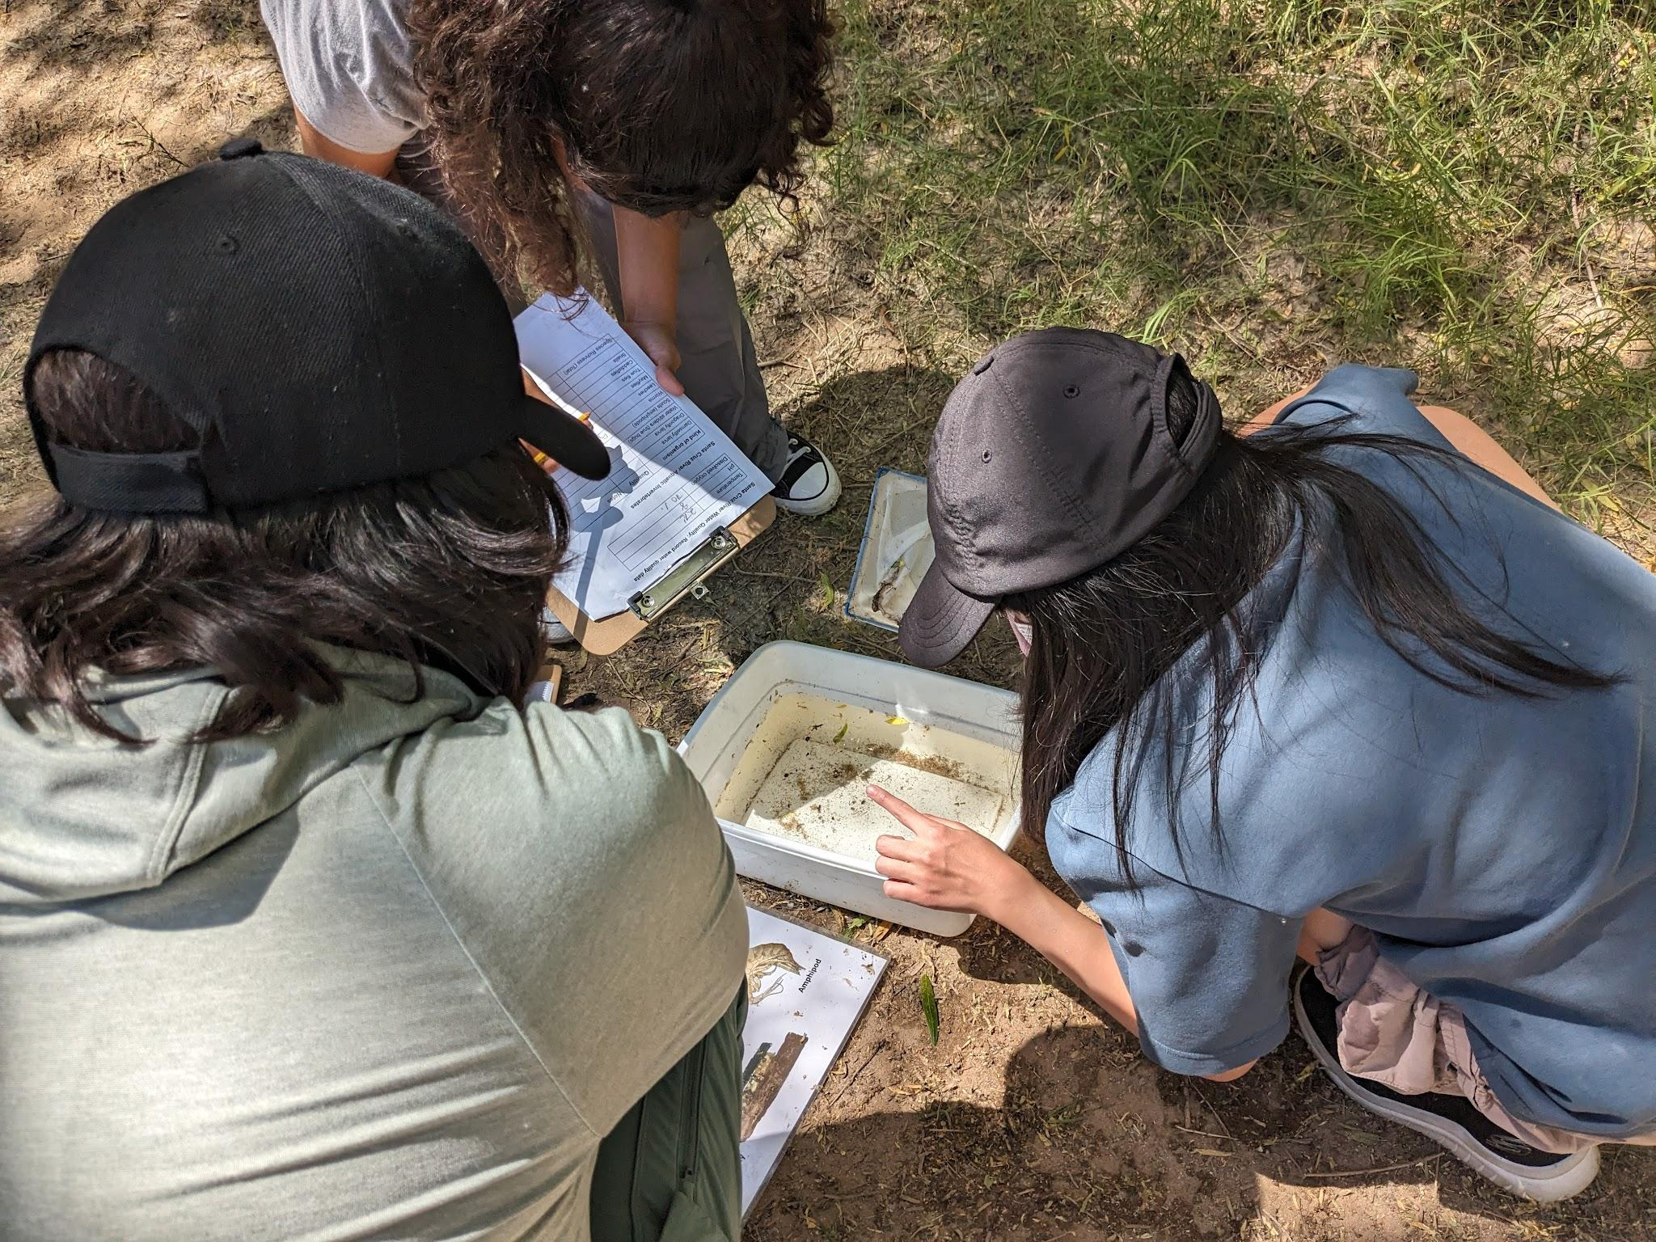

Slide 25
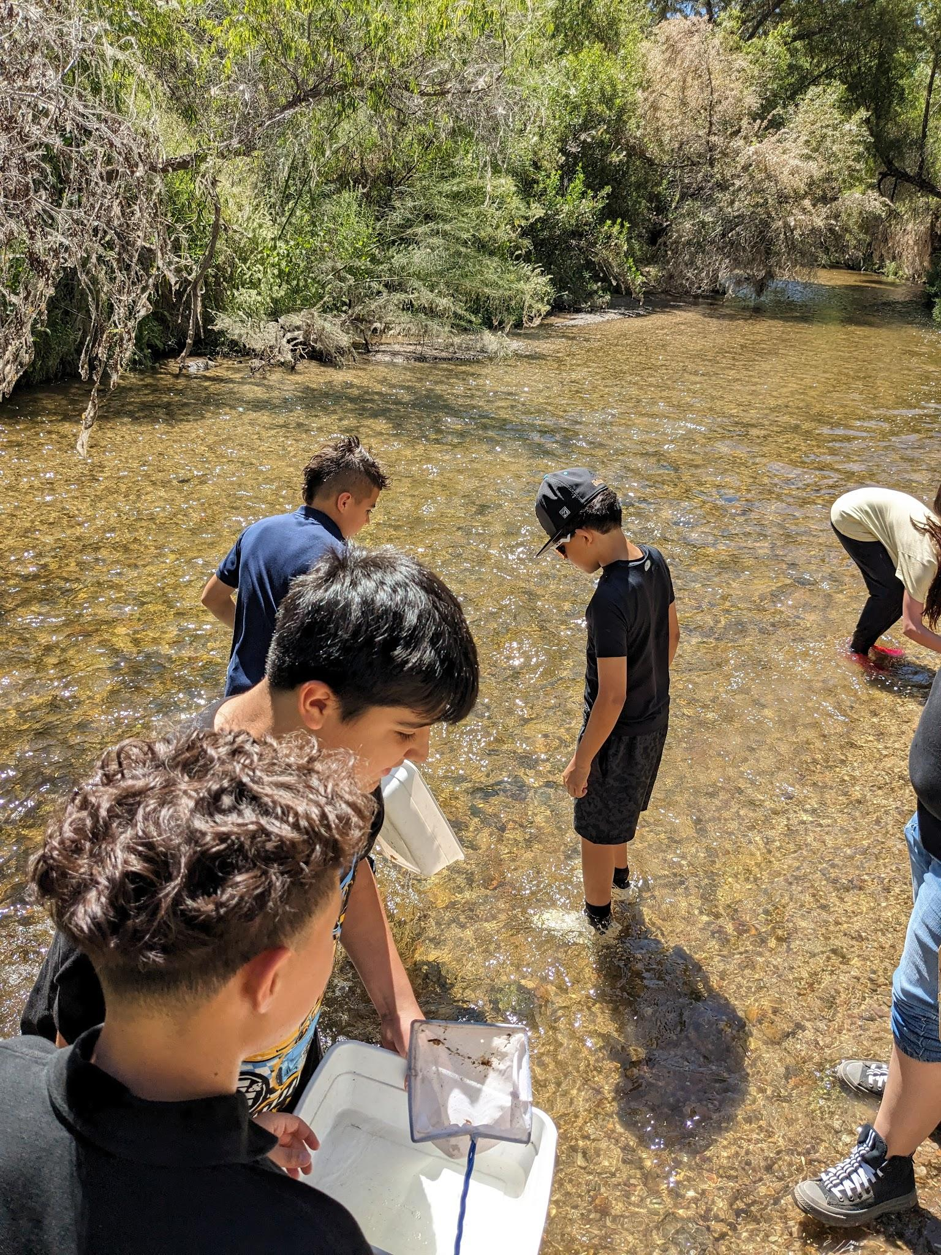
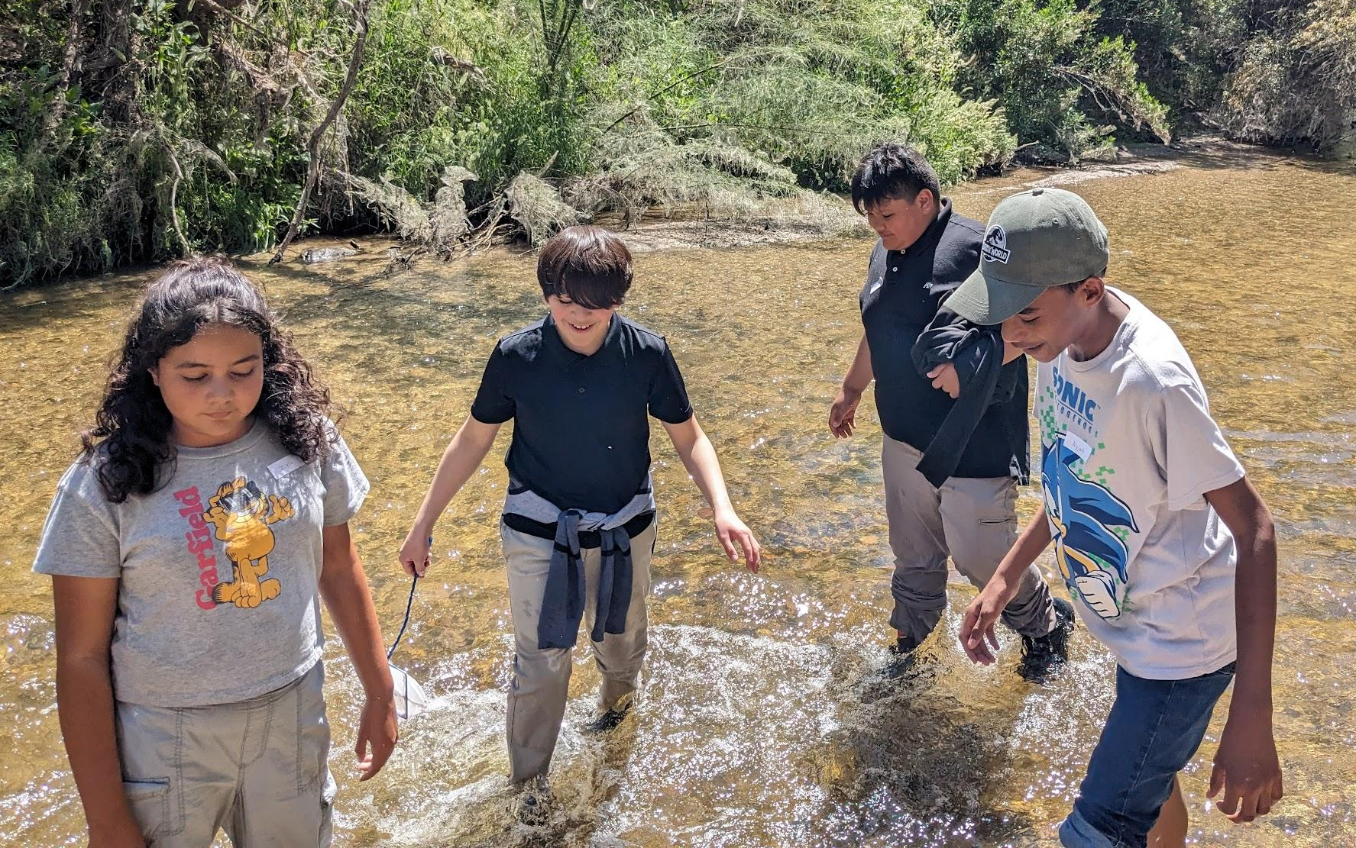
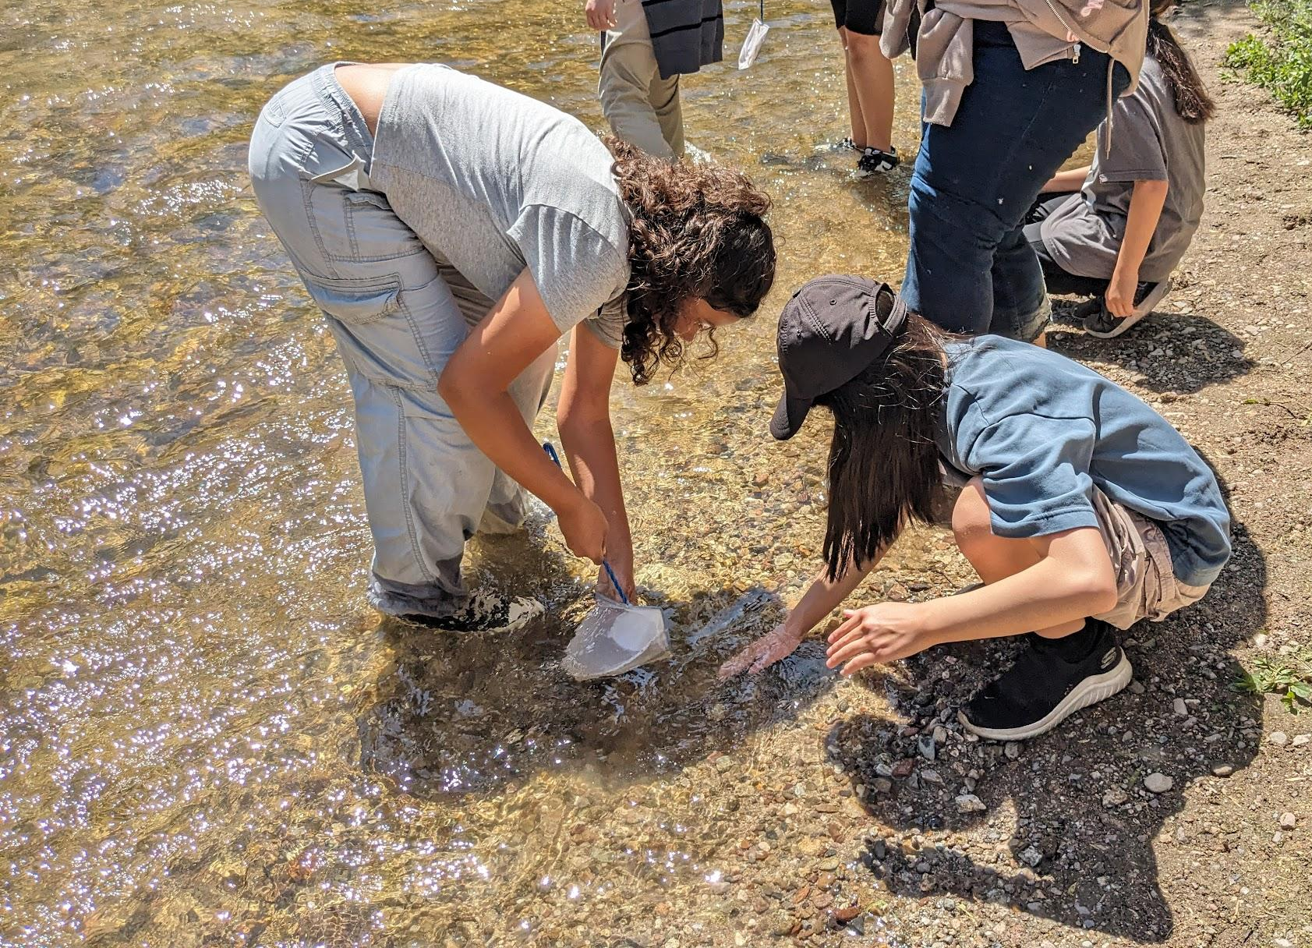

Slide 26
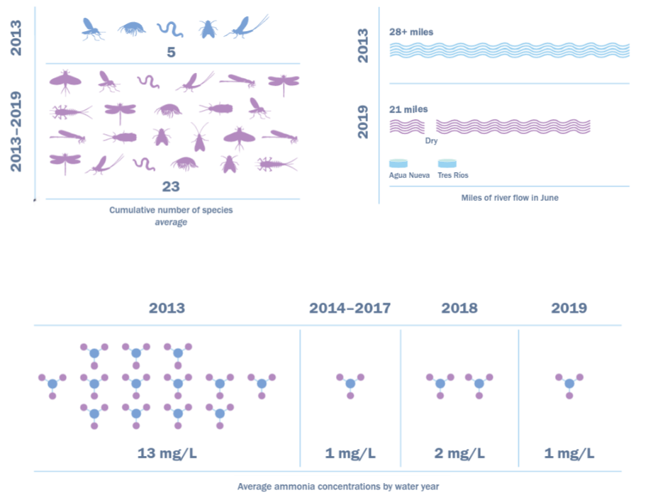
These graphs represent data collected from the Santa Cruz before the water treatment plants were upgraded in 2013 and in the years after.
1.
2.
Study the graphs.
What does each graph show and measure?
What does the data show?
What has changed?
Describe the changes.
3.

Slide 27
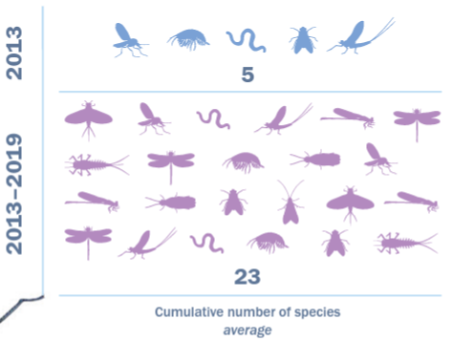
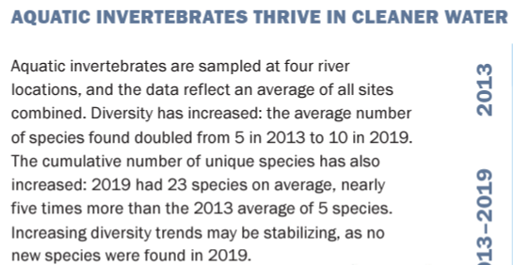

Slide 28
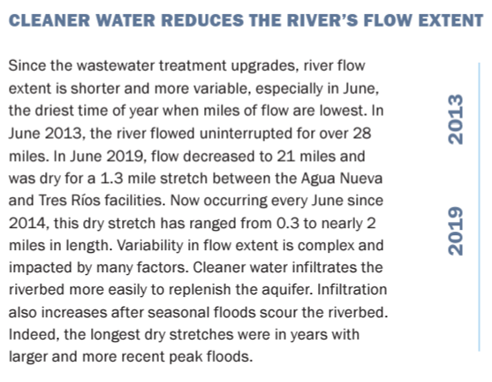

Slide 29



Slide 30


Slide 31

What do you know about water in Arizona?
Where it comes from
How it is used
How it affects biodiversity
Water in Arizona

Slide 32





Around 150 species of dragonflies have been found in Arizona
60 species have been seen along the Santa Cruz River

Slide 33


Slide 34

Dragonflies as Metal Detectors

Slide 35




Slide 36





Slide 37




Slide 38




Slide 39





Slide 40


Arizona Dragonfly Infographic
Scientific drawing of AZ dragonfly (draft in journals first)
food web/ place in ecosystem
life cycle
Importance of dragonflies
Other interesting info

Slide 41



Slide 42




Slide 43




Slide 44

Warm Up
What do you observe?
What do you wonder (question)?
Notes:
What do you notice? What do you wonder?
What might each different row mean?
https://peerj.com/articles/9856/
What might the thickness of the bars mean?
[source] [slow reveal by Eliseo Gomez] [more slow reveal graphs at slowrevealgraphs.com]

Slide 45
What might each different row mean?
What might the thickness of the bars mean?
Notes:
What do you notice? What do you wonder?
What might each different row mean?
What might the thickness of the bars mean?
[source] [slow reveal by Eliseo Gomez] [more slow reveal graphs at slowrevealgraphs.com]

Slide 46
What new information do you have?
Does this change any of your answers to the previous slide?
Notes:
What new information did you just learn?
Does this change any of your answers questions about the meaning of the rows or the thickness of the bars?
[source] [slow reveal by Eliseo Gomez] [more slow reveal graphs at slowrevealgraphs.com]

Slide 47
What new information do you have?
What can you infer?
What questions do you have?
Notes:
What new information did we just learn? How does it change your thinking?
[source] [slow reveal by Eliseo Gomez] [more slow reveal graphs at slowrevealgraphs.com]

Slide 48
Figure Caption: Phenology of selected dragonflies in a newly-flowing reach of the Santa Cruz River.
Phenology is the study of how seasonal and climate changes affect the life cycles of plants and animals. It involves observing and measuring recurring events, such as when leaves appear, flowers bloom, and birds migrate.
Notes:
What new information did we just learn? How does it change your thinking?
What phenological event it being observed and measured here?
(Phenology is the study of the timing and cyclical patterns of events in the natural world, particularly those related to the annual life cycles of plants, animals, and other living things.)
[source] [slow reveal by Eliseo Gomez] [more slow reveal graphs at slowrevealgraphs.com]

Slide 49
Phenology of selected dragonflies in a newly-flowing reach of the Santa Cruz River.
Phenology plot illustrating the presence and abundance of different dragonfly species through time in the newly flowing Heritage reach of the Santa Cruz River. Thin gray box = rare; medium gray box = uncommon but breeding; thick gray box = common and breeding. Some species rapidly colonized the new reach quickly and were abundant through the study (e.g., Enallagma civile) or were at least abundant during warmer weather (e.g., Sympetrum corruptum, Orthemis ferruginea). Other species took longer to colonize and had limited seasons of adult flight activity (e.g., Hetaerina americana, Perithemis intensa). Other species were vagrants that appeared once or twice but failed to establish populations (e.g., Libellula luctosa).
Notes:
[source] [slow reveal by Eliseo Gomez] [more slow reveal graphs at slowrevealgraphs.com]

Slide 50




Slide 51




Slide 52



Slide 53

Wakefield Ecosystem Testable Question
Question
How will you answer your question?
What data will you collect?
How will you collect your data?
  Number, times, tools, measurement, etc

Slide 54

scientific, testable questions:
can be answered through direct observation or experimentation
examine relationships between phenomena

Slide 55

Planning
Procedures (what will you do?)
Data sheet (how/ where to record data)
Roles (who is doing what)

Slide 56






Slide 57




Lucy’s Warbler Nesting Boxes

Slide 58





Desert Haven

Slide 59
Living River of Words
Rocco
I’m a rock under the river and sometimes the water runs too fast I move
Sometimes I see shoes like Nikes, Adidas, Vans and converse
I see tongues from animals that are thirsty
There was a time I saw an umbrella sedge from so small and short to big and tall
The river has changed throughout the years then I notice something
Everything doesn’t stay the same, everything changes
People lose thing and others receive things
And time goes by fast
One day your 5 years old
The next 17 years old.

Slide 60
Journey
As the water washes over me
And insects move around above me
And fish swim around me
And the sand is washing away under me
I am still
Though life is moving all around me
I am still
I wait
The water will take me away
Through twists and turns
Through rapid and through calm
I will move until the water lets me down
Then I stop
And I notice I am not a solid form
Rather many pieces
All unique
Yet all still me
I have changed
But I’m still me

Slide 61
MISS SUNFLOWER
I feed animals, see the sun
I produce food for myself
The river gives me water
As it becomes colder
I die
And have no meaning I leave my seeds
when I die
So they can grow .

Slide 62
The way of the river
As the river flows there’s change it can change its speed
It could Change its color but it can never change it’s sound
It could never change its helpful use for the plants and animals around it
But now that it is dry you can no longer try to get it back
As i could change my appearance or my actions
But i can never change my smile or my laugh
As if that part of me is gone you could try to put the water back in the river
As it’ll take years or even forever this chapter is for the better

Slide 63


Thank you!
Please reach out with questions, comments, or connections
Rachel Carpenter
rachel.carpenter@tusd1.org
Evaluation code

