Slide 1
Rain Gardens
Victoria Bodanyi

Slide 2
How does rainwater harvesting prevent flooding & positively impact Tucson’s groundwater levels?
WHAT: I will design and build a rain garden.
HOW: I’ll successfully do this by:
Researching water harvesting; its importance, the difference between passive and active.
Researching the importance of rain gardens; the pros and cons.
Researching the different elements of a rain garden and materials needed.
Determining a site to build a rain garden.
Planning the rain garden based on acquired knowledge.
Building a rain garden based on plans.
WHY: In order to prevent flooding and to help recharge the underground aquifer.

Slide 3
Standards
Science Standards:
HS.E1U3.14 Engage in argument from evidence about the availability of natural resources, occurrence of natural hazards, changes in climate, and human activity and how they influence each other.
HS+E.E1U3.9 Construct an explanation, based on evidence, for how the availability of natural resources, occurrence of natural hazards, and changes in climate have influenced human activity.
HS+E.E1U3.11 Develop and use a quantitative model to illustrate the relationship among Earth systems and the degree to which those relationships are being modified due to human activity
Science and Engineering Practices:
Developing and Using Models A practice of both science and engineering is to use and construct models as helpful tools for representing ideas and explanations.
Obtaining, Evaluating, and Communicating Information Scientists and engineers must be able to communicate clearly and persuasively the ideas and methods they generate.
Constructing Explanations and Designing Solutions The end-products of science are explanations and the end products of engineering are solutions. The goal of science is the construction of theories that provide explanatory accounts of the world. The goal of engineering design is to find a systematic solution to problems that is based on scientific knowledge and models of the material world.
Crosscutting Concepts:
Structure and Function The way an object is shaped or structured determines many of its properties and functions.
Systems and System Models A system is an organized group of related objects or components; models can be used for understanding and predicting the behavior of systems.
ELA Standards:
W.2 Write informative/explanatory texts to examine and convey complex ideas, concepts, and information clearly and accurately through the effective selection, organization, and analysis of content.
W.7 Conduct short as well as more sustained research projects to answer a question or solve a problem
SL.4 Present information, findings, and supporting evidence in an organized, developed style appropriate to purpose, audience, and task

Slide 4
Unit Hook
Create a poem about water. Options to help students brainstorm ideas:
Make a mind map about all of the things that come to mind from the word “water”. (5 minutes) Use these ideas to help you write a poem or narrative.
Start with the word “water” and write a list of words, never stopping. Let the last word inspire the next word. (The final word may not relate to water at all, and that’s ok!) (3 minutes) Use these ideas to write a poem or a narrative.
Write a story about your experience with water. It can be about anything: the rain, the beach, the pool, drinking water, drought, watering plants, etc. Make it personal.
Start with the title “Water is Life” or “Agua es vida” and write from there.

Slide 5
What is a water harvesting?
Why should we have rain gardens?
Learning Target: What am I learning today? | I am learning: definitions and examples of water harvesting; the difference between active and passive water harvesting; the benefits of rain water harvesting, and rain gardens in particular.
Success Criteria: How will I know that I have learned it? | I can: define water harvesting and identify examples; explain the difference between active and passive water harvesting; describe the benefits of rain water harvesting and rain gardens.
Why am I learning this? | This is important because as water becomes more scarce, it is important to know how to harvest rain and help to replenish the groundwater.

Slide 6
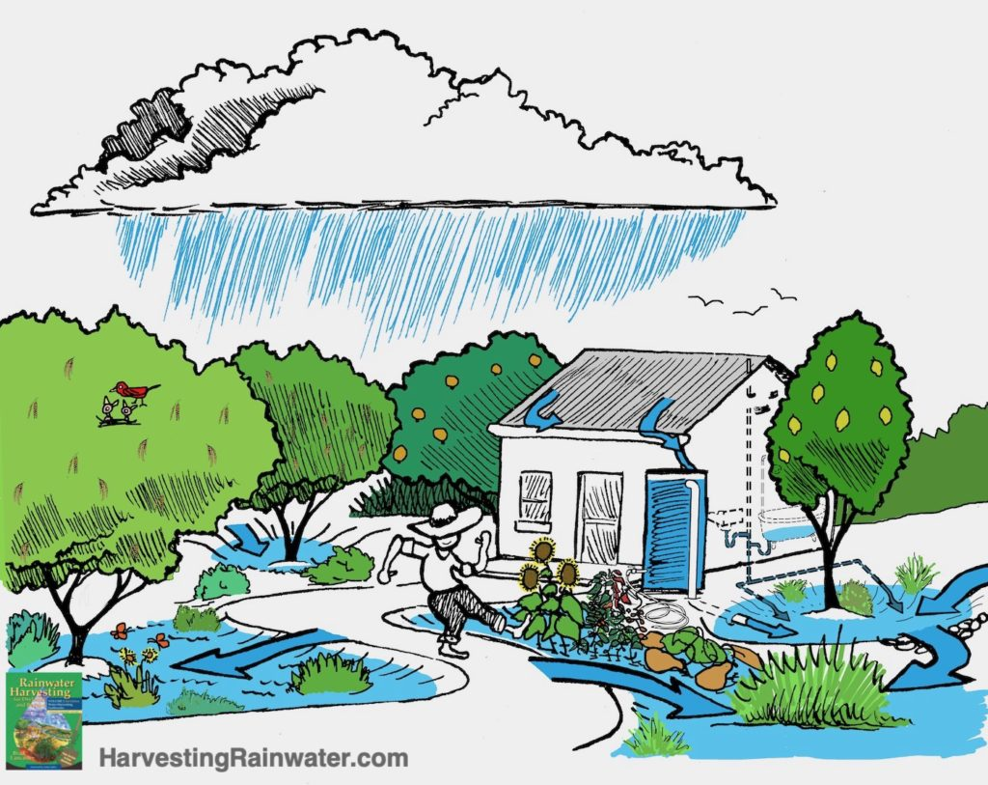
What is water harvesting?
the collection & storage of rain, instead of allowing it to run off.
two ways to harvest: active & passive

Slide 7
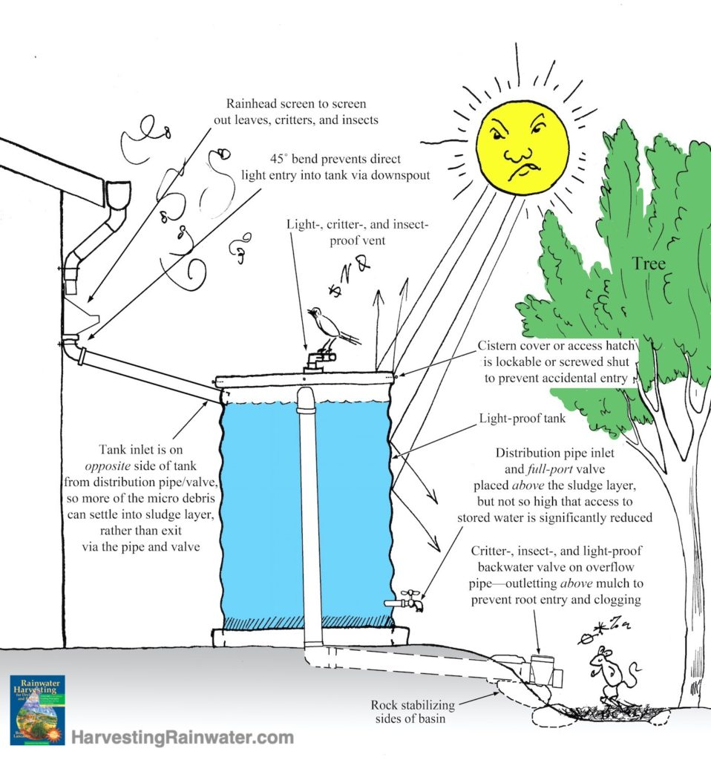
What is active rainwater harvesting?
when water is collected from the roof and stored for later use
water is collected in a tank or cistern
benefits: provides free water when there’s no rain

Slide 8
where have you seen active rainwater harvesting before?
what do you think the benefits would be?

Slide 9
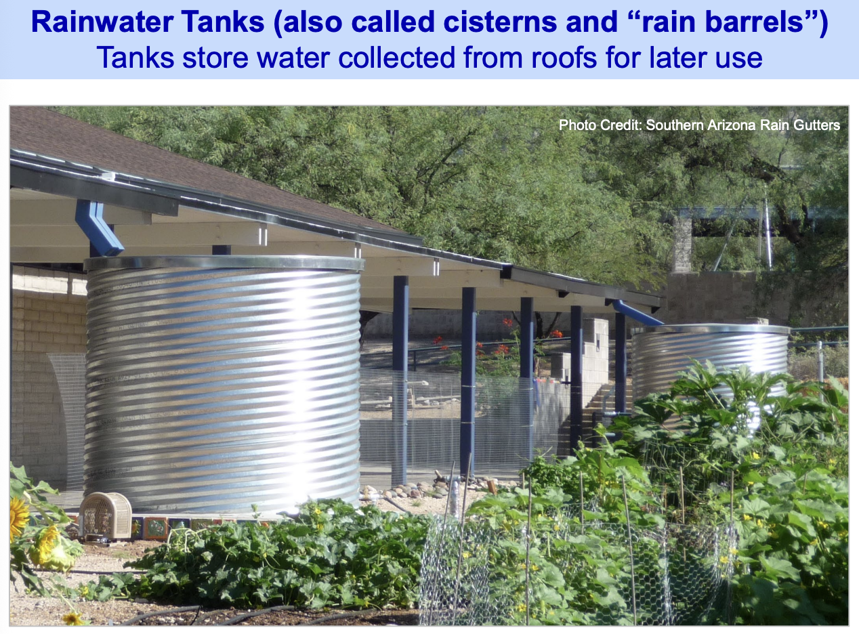

Slide 10
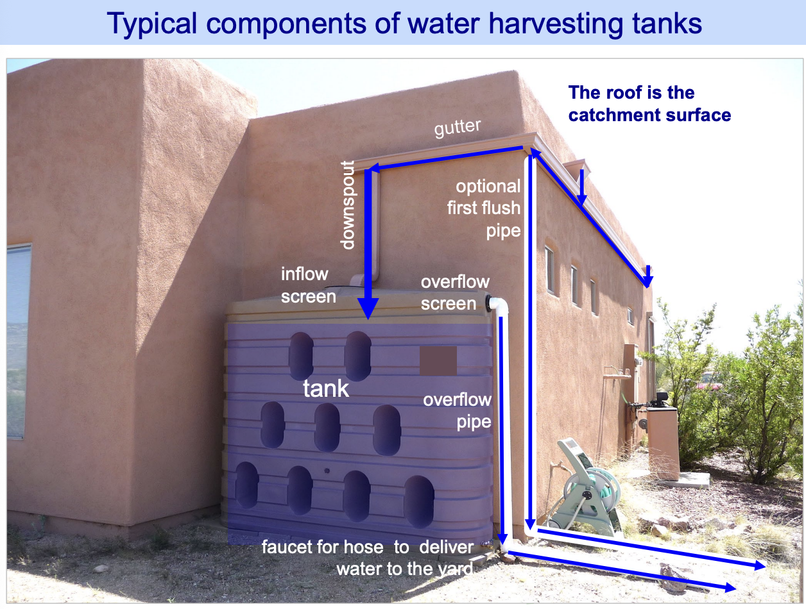

Slide 11
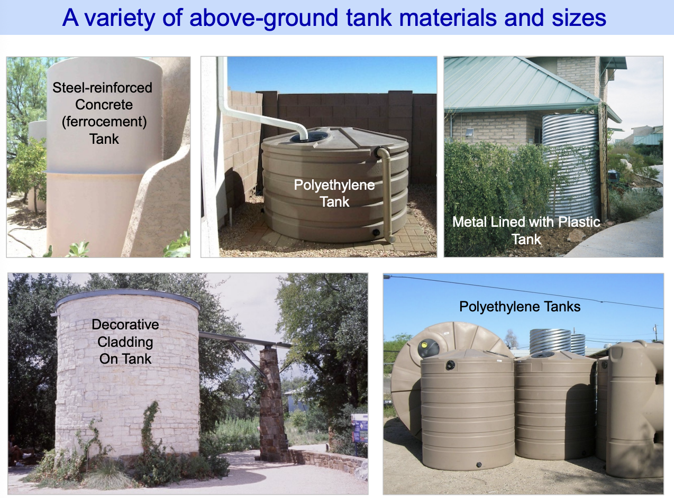

Slide 12
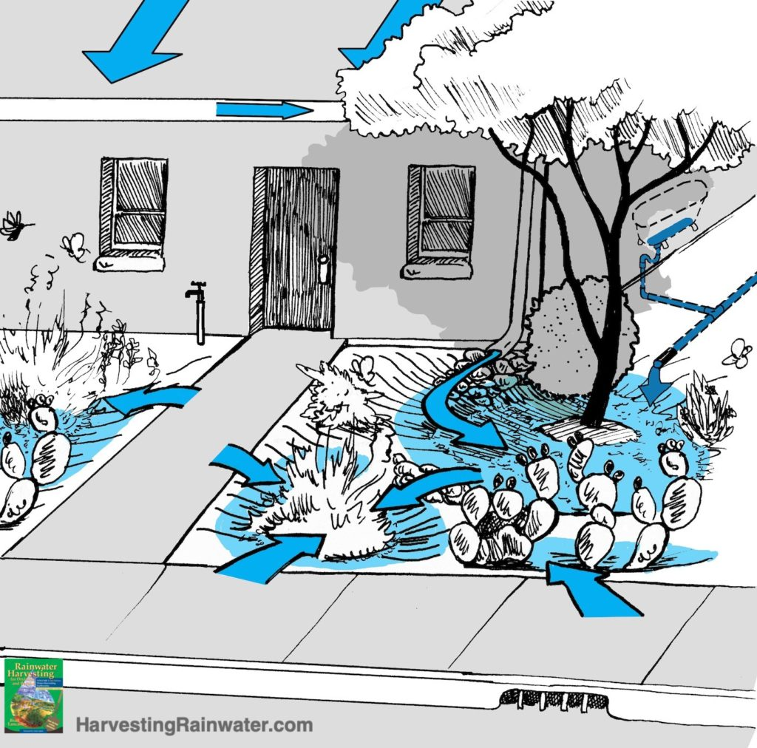
What is passive rainwater harvesting?
when water is collected via earthworks – basins, berms, dams, etc. – and infiltrates into the ground.
benefits: waters plants, replenishes groundwater

Slide 13
where have you seen passive rainwater harvesting before?
what do you think the benefits would be?

Slide 14
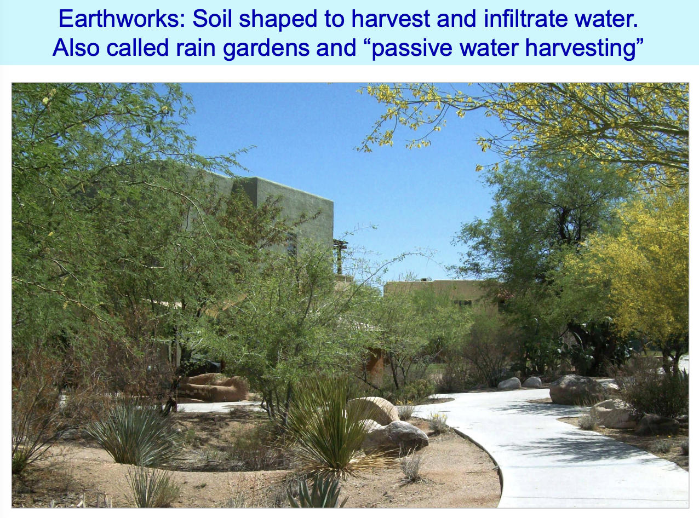

Slide 15
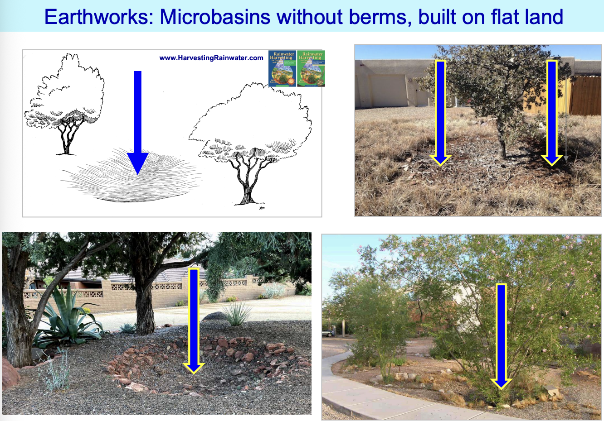

Slide 16
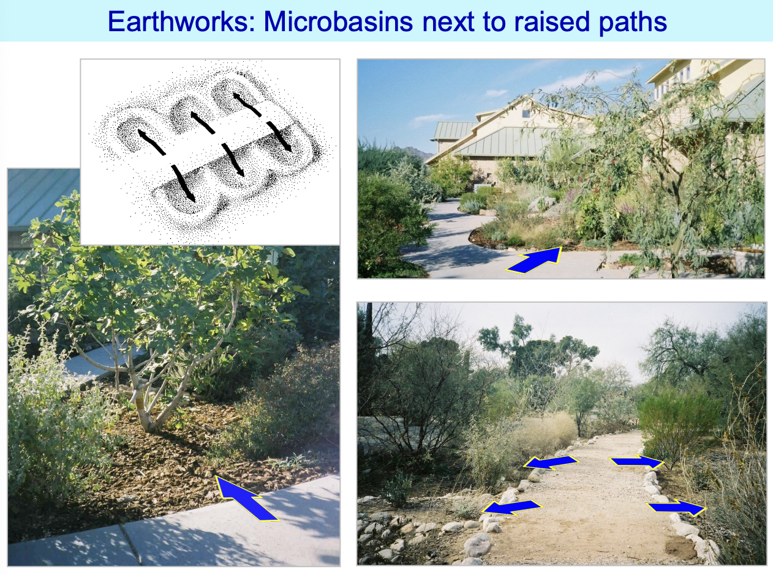

Slide 17
What is a rain garden?
rain gardens slow down, capture and absorb water into the ground, reducing runoff that can overload streams and cause flooding
this is passive rainwater harvesting
benefits: serves as a habitat, beautifies the landscape, protect water quality

Slide 18
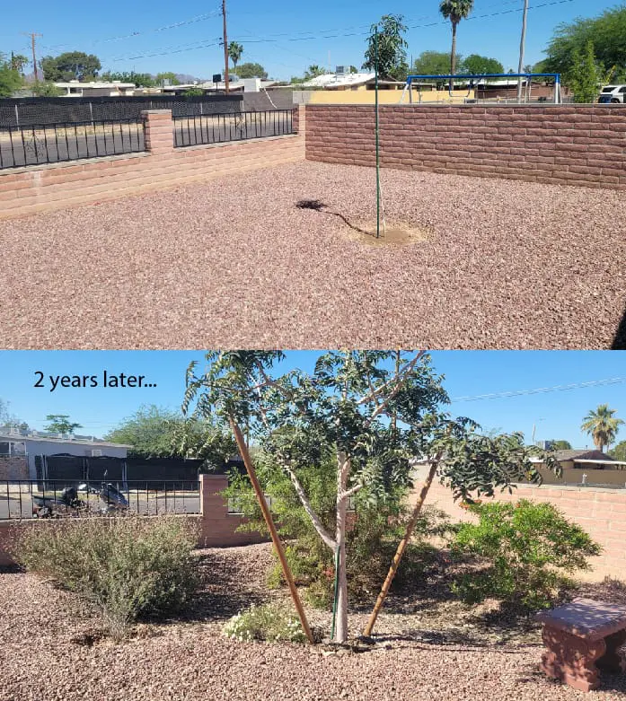
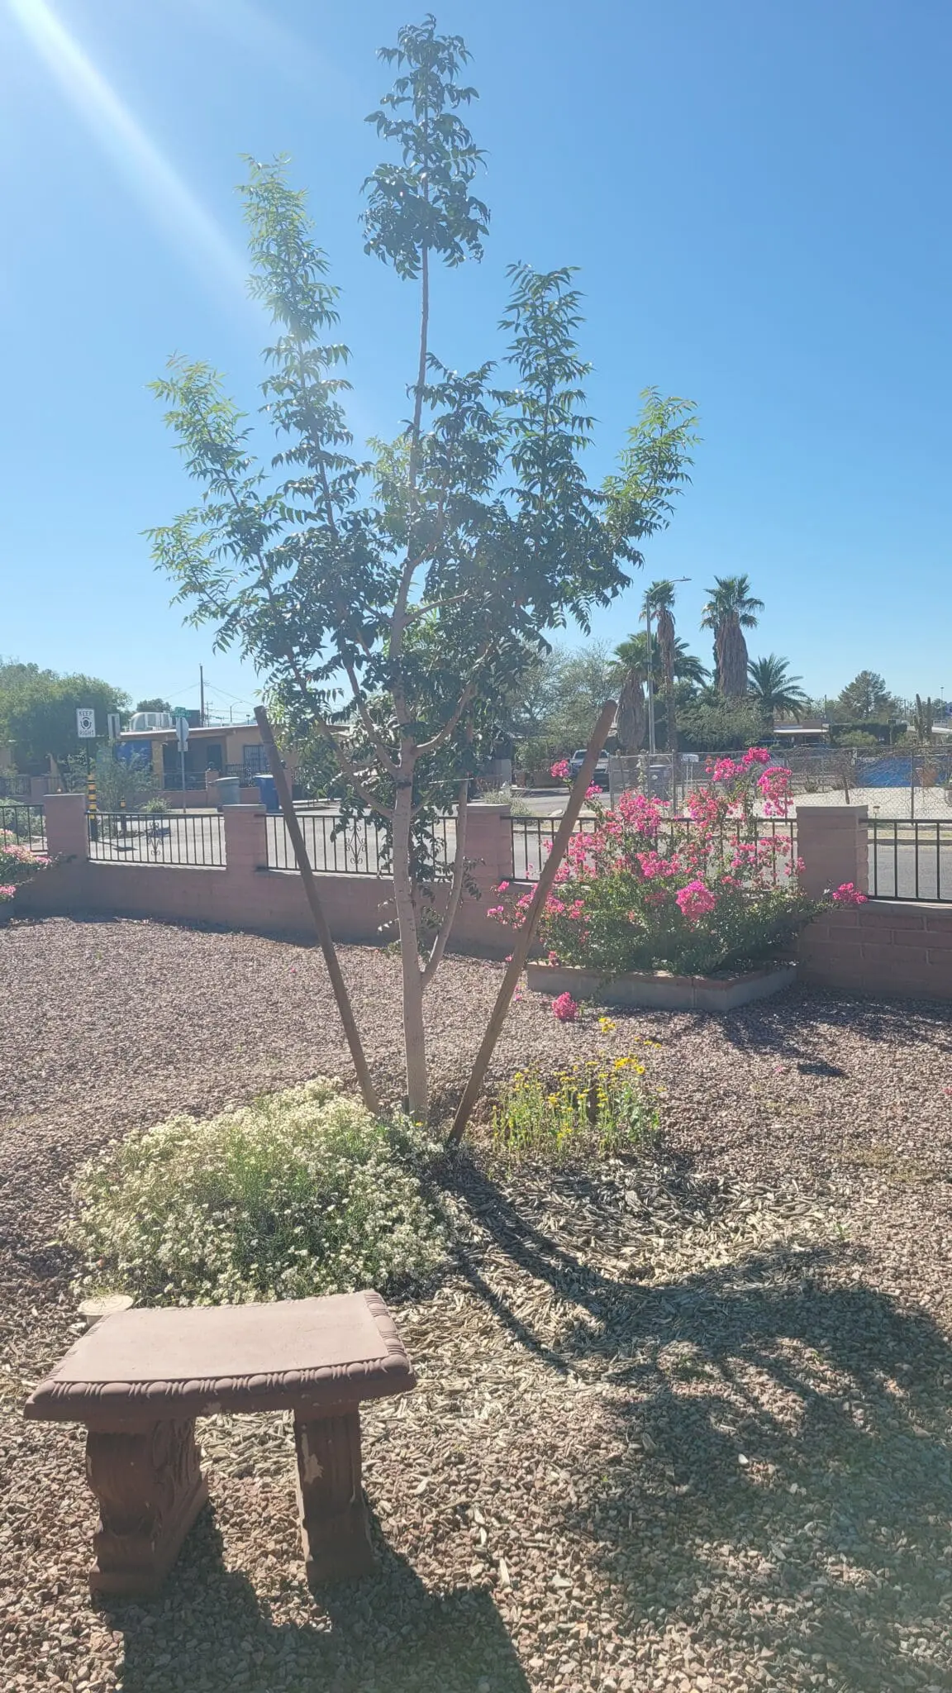

Slide 19
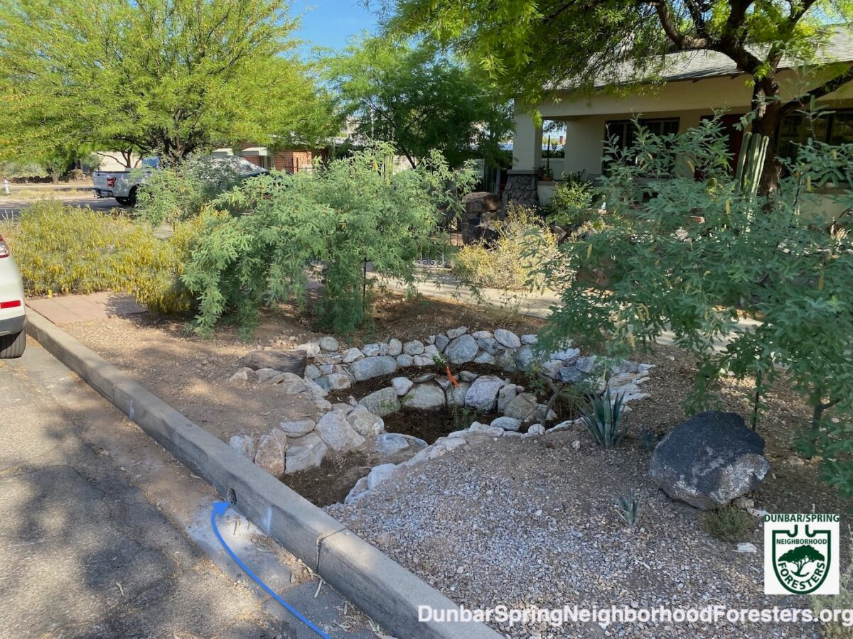

Slide 20
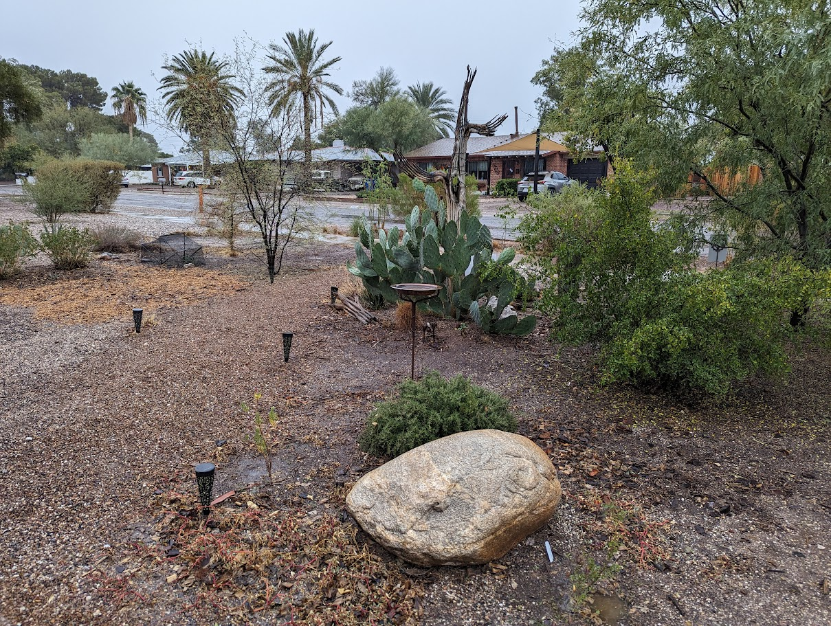

Slide 21
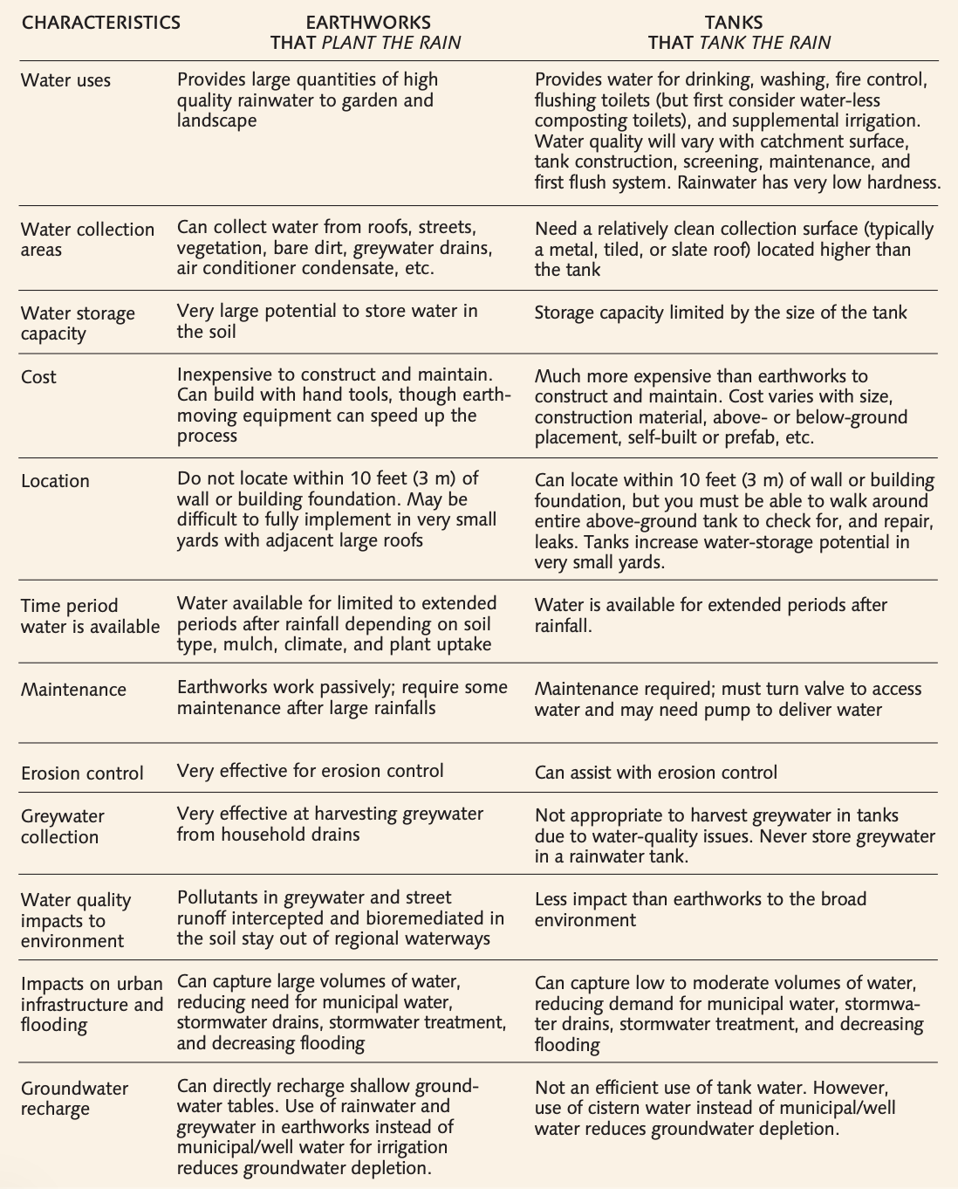
difference between active & passive rainwater harvesting

Slide 22
think-pair-share: what do you think the benefits of having a rain garden are?
think about the benefits for:
animals
people
the Santa Cruz River
think about the potential
economic benefits
environmental benefits
financial benefits

Slide 23
Benefits of rainwater harvesting
an efficient way to lower ones water usage
lessens the pressure on our municipal water systems and the infrastructure that supports them
can lower your water bill and conserve water
  reduce peak demands during summer months
recharges groundwater aquifers
  decreases our dependence on groundwater
prevents erosion
  reduces runoff and flooding
captures sediment & reduces contaminants
  helps the water quality of rivers, affecting riparian habitats
there is more vegetation counteracting the heat island effect
plants have deeper roots
can be used to irrigate during dry seasons
  source of water for plants and landscape irrigation
acts as a habitat for local wildlife
can be a backup water supply for emergency situations
  can be available for wildfires and help protect the house and property

Slide 24
Benefits of rainwater harvesting in Tucson
For you & your family: The City of Tucson provides up to a $2000 rebate for those who install rainwater harvesting systems

Slide 25
How will rain gardens affect the Santa Cruz River?
Groundwater Recharge: Instead of letting rainfall flash-flood through concrete storm drains into the riverbed unused, basins act as "sponges" that hold the water long enough for it to percolate downward to replenish depleted groundwater tables.
Water Quality Improvement: As stormwater sits in the basins, sediments and urban pollutants (such as motor oils or trash) settle out or are naturally broken down by desert plants. This keeps downstream flows cleaner when the water eventually reaches the main river channel.
Riparian Restoration: When basins are utilized as rain gardens, they nourish local vegetation like mesquite trees and cottonwoods. This revived canopy helps shade the area, cool the local microclimate, and stabilize the riverbanks against future flood erosion and bringing back natural riverbank ecology.

Slide 26
Assessment:
Goal: Persuade people in Tucson to build a rain garden or set up a rain tank on their property!
You can create a pamphlet, a PSA (for radio or TV), or create a poster. It should be creative, colorful, persuasive, and informative.
Your project must include:
the definition & benefits of rainwater harvesting
the difference between active and passive harvesting & what each entails
how rainwater harvesting would affect Tucson and the Santa Cruz River

Slide 27
Extension:
Ironwood Tree Experience W.A.T.E.R Field Study:
  Contact Deborah@ironwoodtreeexperience.org to set up a field trip. There are three options that would relate to this lesson: Mapping the Invisible and Park Connections; Sponge City could also relate.
AZ Project WET: Nature of Groundwater

Slide 28
How do you design and build a rain garden?
Learning Target: What am I learning today? | I am learning: the necessary elements of a rain garden, which plants are best to plant in a rain garden and why, what materials are necessary to construct a rain garden, and how to create a rain garden.
Success Criteria: How will I know that I have learned it? | I can: identify plants that will succeed in rain gardens, outline the steps of creating a rain garden, and identify what tools or materials that are needed to help build a rain garden.
Why am I learning this? | This is important because if someone is going to use your pamphlet to build a rain garden they should have all of the needed information to be successful.

Slide 29
Remind me:
What is a rain basin or rain garden?
Why do we need them?
How is the Santa Cruz affected by rainwater harvesting?

Slide 30
read background knowledge on water-efficient landscapes
read & mark the text
discuss with a partner
discuss as a class

Slide 31
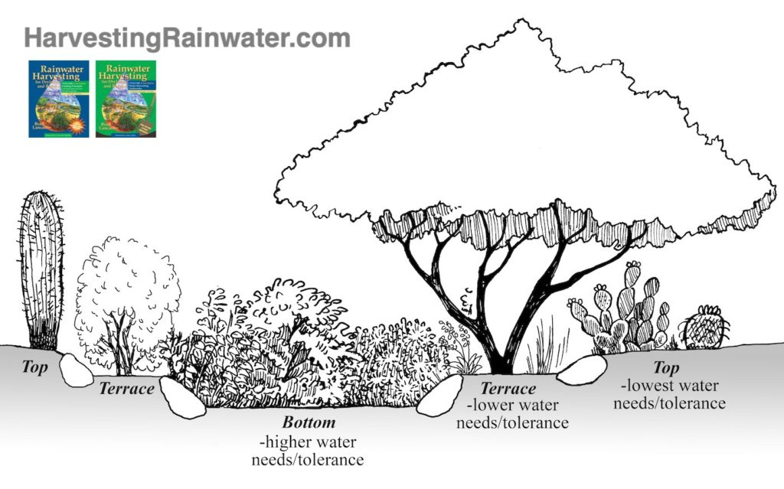
What are the different elements of a rain garden?
There are three rain-garden zones:
Top – the area beside a basin or on its banks, where plants’ roots can access water harvested in basin; top of berm.
Terrace – typically atop a terrace or pedestal within a basin or swale. Sometimes water pools here, but shallowly.
Bottom – typically the bottom of a basin or swale. Often has temporary pooling of water.

Slide 32
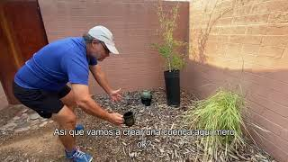
How do you build a rain garden?
A step-by-step guide on how to quickly and easily transform your landscape into one that harvests rain, grows shade trees, and supports a native habitat.

Slide 33
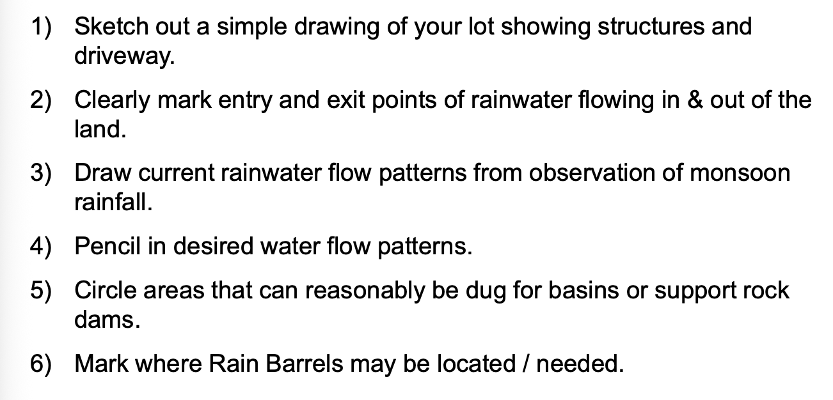
How do you build a rain garden?
Observe the rain - where does it pool? flow to or from?
Choose your basin location
Sketch
Dig your basin
Plan for overflow
Create gentle slopes
Plant like nature
Add mulch
Observe and adjust
give students this booklet to refer to

Slide 34
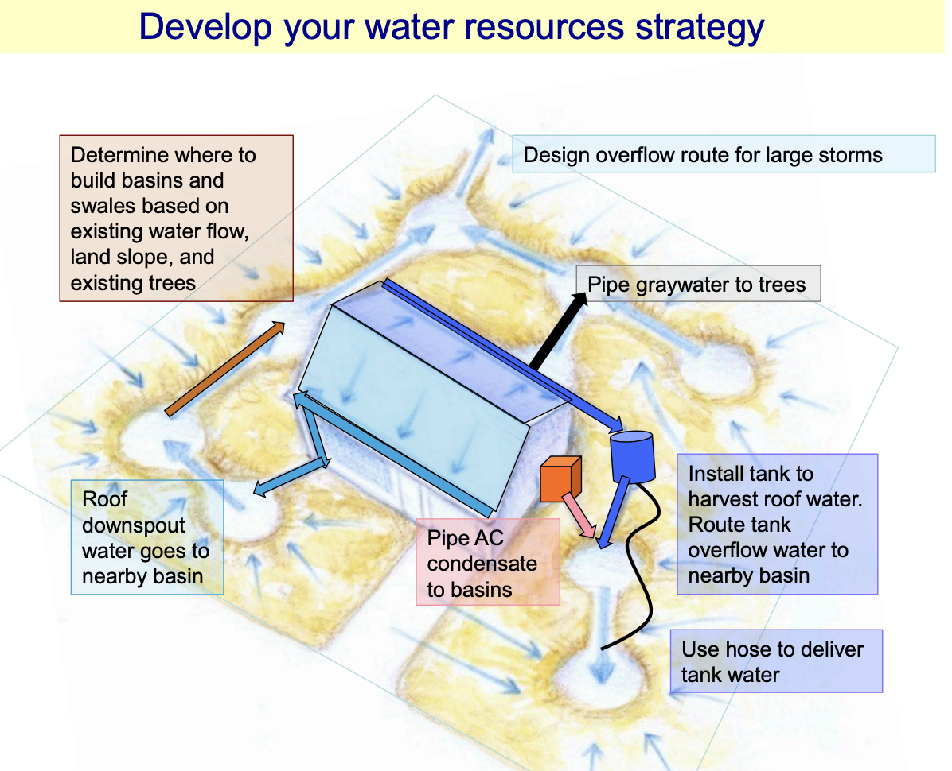

Slide 35
What plants would be good to have in a rain garden?
Native plants are best!
already adapted to climate & soil
best habitat for native life & pollinators
look at this worksheet or this booklet:
how many of these plants have you seen before?
which of these plants would you like to see on campus?

Slide 36
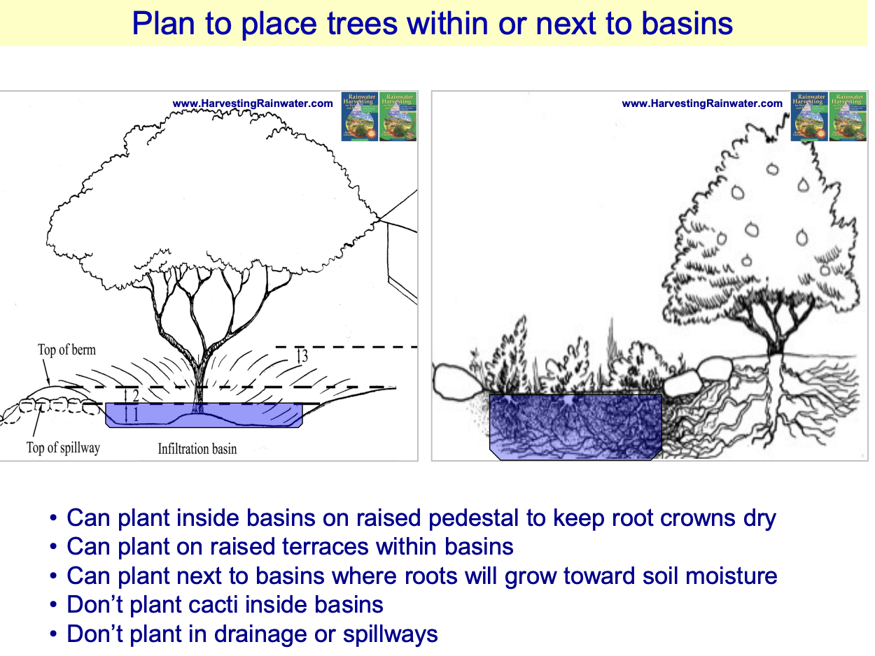

Slide 37
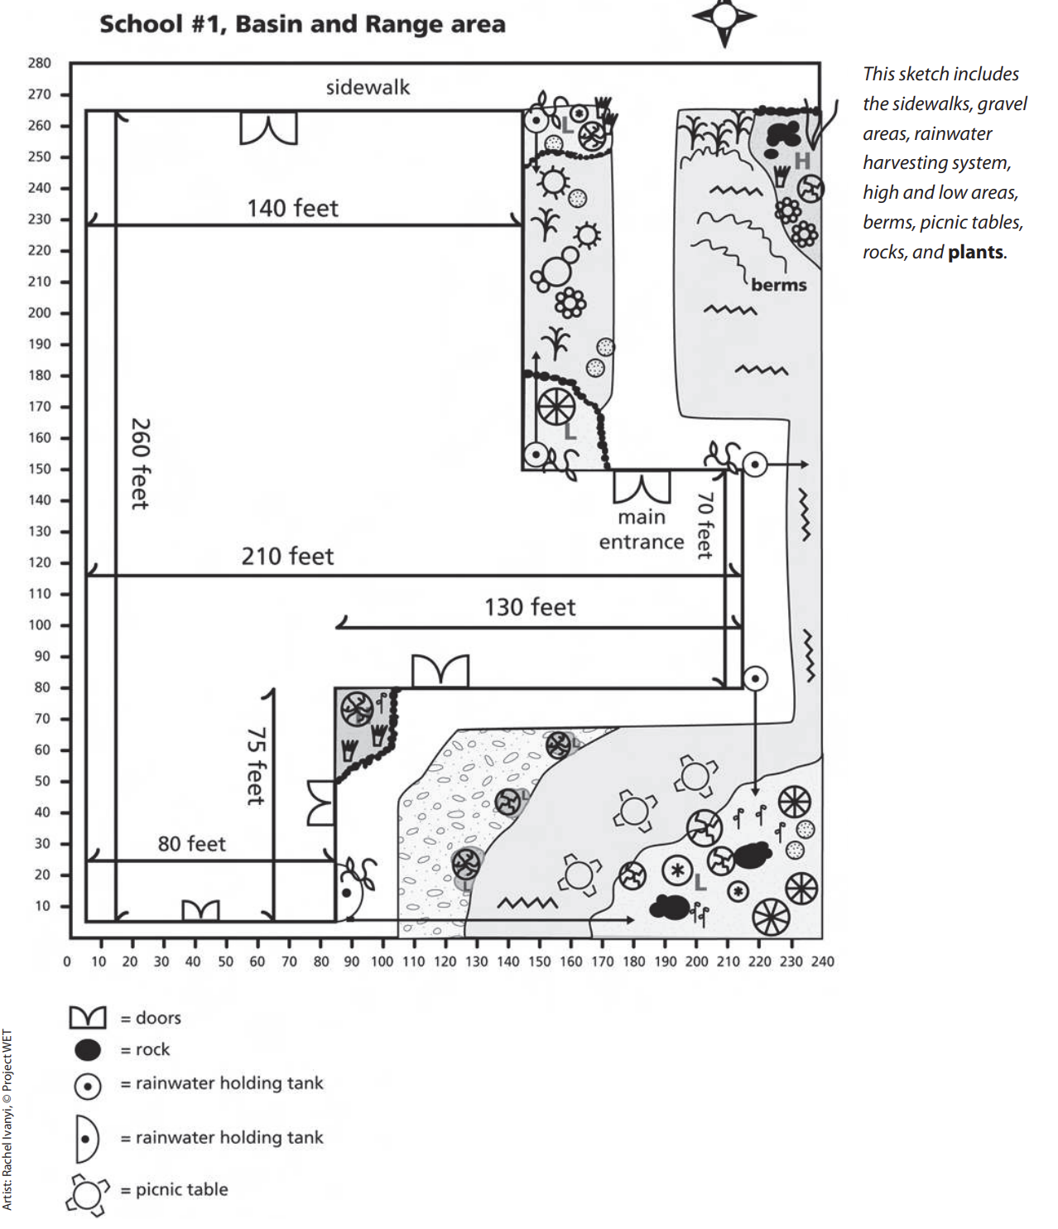
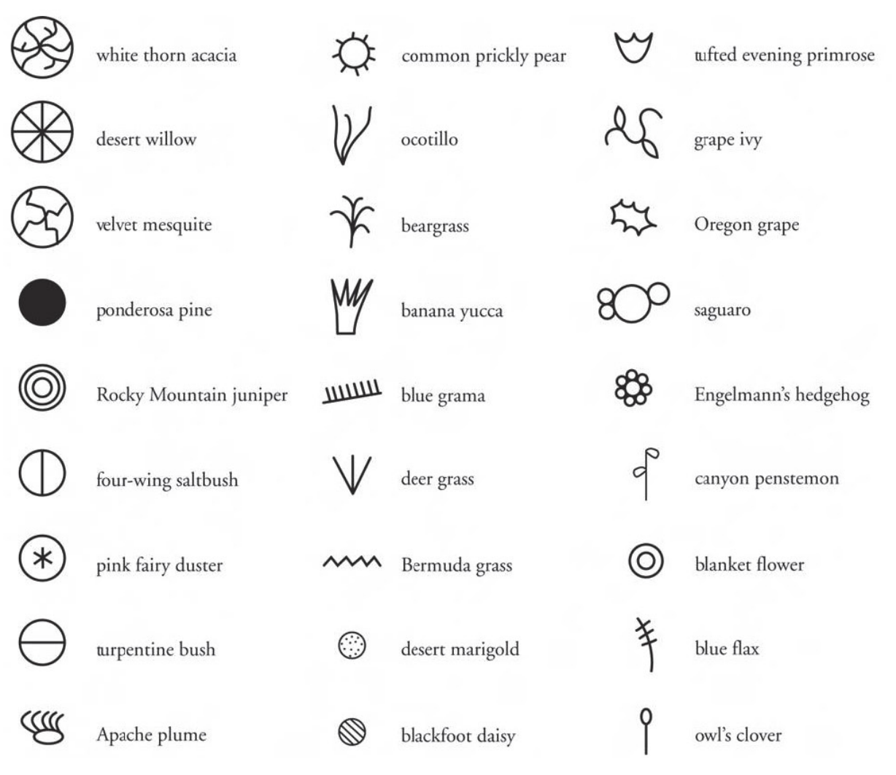
example:
key

Slide 38
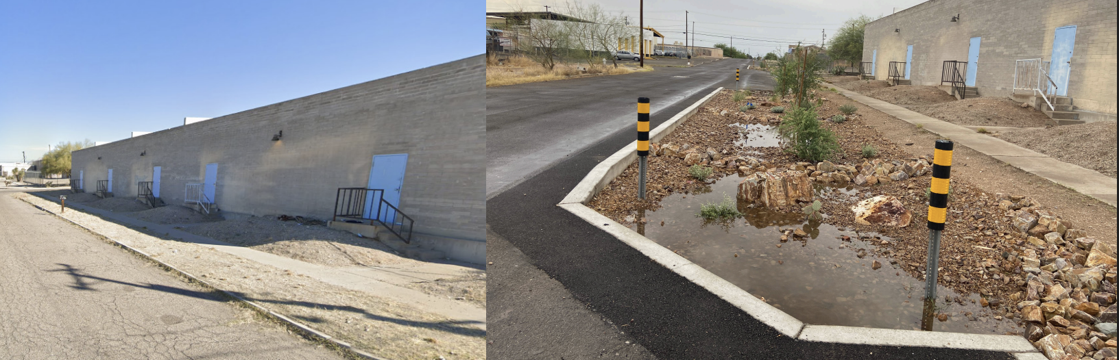

Slide 39
Assessment: continued
Goal: Persuade people in Tucson to build a rain garden or set up a rain tank on their property!
You can create a pamphlet, a PSA (for radio or TV), or create a poster. It should be creative, colorful, persuasive, and informative.
Add the following information to the project you’ve already started:
the necessary elements of a rain garden
materials needed
plants that are best to plant in rain gardens

Slide 40
Extension:
AZ Project WET: Planting for a Rainy Day (PfaRD)

Slide 41
How can we design a rain garden for our campus?
Learning Target: What am I learning today? | I am learning: how to design a rain garden that will help my school campus minimize areas of flooding.
Success Criteria: How will I know that I have learned it? | I can: identify good spots on campus for a rain garden, sketch out a plan for a rain garden that will (ideally) help prevent flooding.
Why am I learning this? | This is important because when rain water pools it can affect the quality of the road, but it also becomes hard to infiltrate into the ground helping to replenish the groundwater. By building a rain garden, I will help water soak in and replenish the aquifer.

Slide 42
Assessment:
Sketch out a rain garden plan. The plan should include:
  a map of the location
  what plants you want to plant
  where they will be planted
  what other materials you need to complete the rain garden
  what tools you need
  how long it should take to build it
Create a presentation that includes your sketch. You will present your idea to your classmates!
  The class will vote on the most thought out and completable rain garden so make sure you are thorough!

Slide 43
Procedure:
Get prepped
Walk around the campus and determine the best places to build rain gardens
Pick one spot & Brainstorm
Sketch
Share
Gallery Walk & Vote
Finalize the sketch
Prep
Construct a rain garden!
Celebrate & Make observations

Slide 44
Step 1: Get prepped
Get into a group of 4; determine tasks
Notetaker – makes a note of the location on the map
Time Keeper – makes sure the group returns on time
Cartographer – reads the map & makes sure the group doesn’t get lost
Scientist – observes different places that rain gardens could potentially be built
Notetaker should retrieve:
one clipboard for the group
2 campus maps – give one to the Cartographer
a pencil
Talk about what area of the campus you want to check out.

Slide 45
Step 2: Walk around the campus and determine the best places to build rain gardens
As a group, walk around the campus and determine at least 5 sites where we could build a rain garden.
Things to look for:
rain gardens that may already exist but need to be updated or maintained
areas of flooding
areas that may not flood, but could be prettier
On the campus map make a note of the 5+ sites. When your group is done, come back to the classroom. (You have 30 minutes)

Slide 46
Step 3: Pick one spot & Brainstorm
Pick one spot and start to sketch your rain garden.
Individually: Look at the map to help you, or if necessary, go back outside and make a sketch of the area in your nature journal.
Individually: Brainstorm how you’d like the rain garden to look, what plants you’d like to have
use this worksheet to help guide you
use this worksheet to pick out plants that you’d like

Slide 47
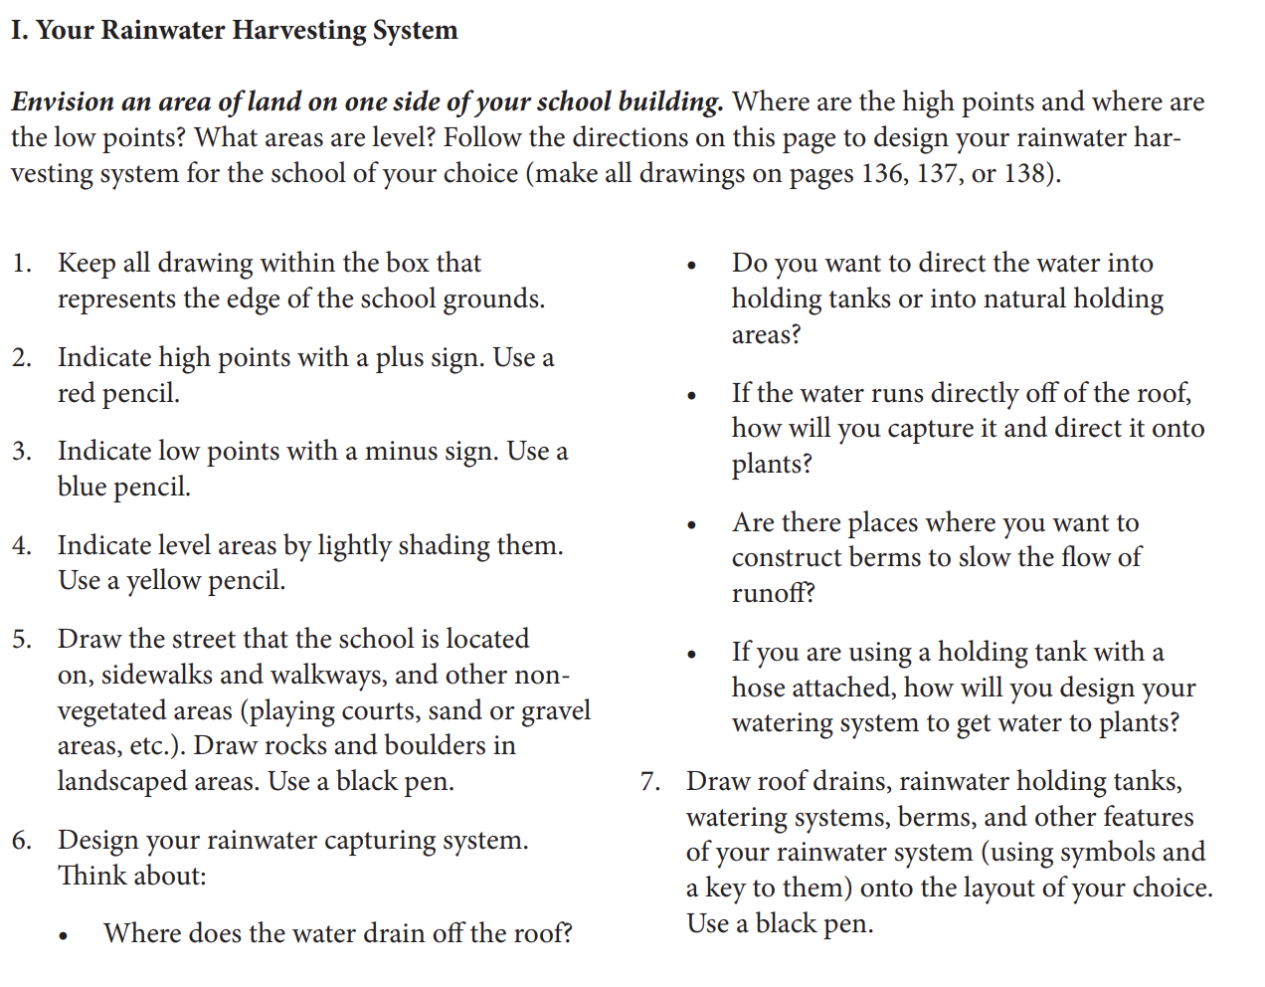

Slide 48
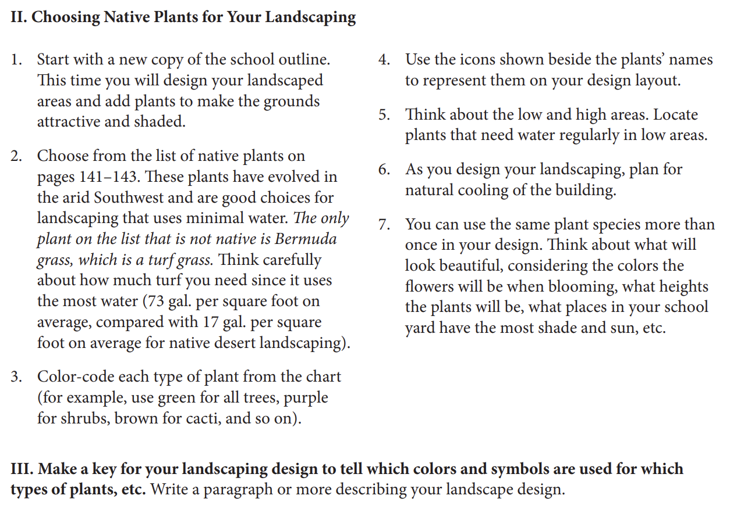

Slide 49
Step 4: Sketch
As a group: Share your preliminary sketches and decide which elements from each person’s design your group would like to incorporate.
Get a poster post-it and sketch the rain garden. Include:
what plants you want to plant
where they will be planted
what other materials you need to complete the rain garden
what tools you need
how long it should take to build it
Make it as detailed as possible!

Slide 50
Step 5: Share
Each group presents their sketch
As groups present, in your nature journals, write down ideas that you like and would want to incorporate into your sketch.

Slide 51
Step 6: Gallery Walk & Vote
Put out all of the sketches and walk around, looking at them, and decide which ones are the most viable, easiest, and/or the most fun to work on.
Put a sticky note on the sketch that you think we should build. If you have any comments, changes you’d make, etc., put those on the sticky note too.

Slide 52
Step 7: Finalize the Sketch
As a class, determine the final sketch:
location of the proposed rain garden
what plants will be planted
what materials are needed
what tools are needed

Slide 53
Step 8: Prep
Pick a date
Make a flyer
Promote the event
Reach out to community organizations (like Watershed Management) for help procuring materials and for the day of
Gather materials – plants, rocks, mulch, tools, etc.
Assign roles

Slide 54
Step 9: Construct a rain garden
Get outside and construct the rain garden!

Slide 55
Step 10: Celebrate & Make observations
When you are done, celebrate your hard work!
Throughout the year, make observations of the rain garden, particularly when it rains.
Other activities involving the rain garden:
conducting bird surveys
nature journaling
measuring rainfall
propose additions to the rain garden to increase biodiversity

Slide 56
How does rainwater harvesting prevent flooding & positively impact Tucson’s groundwater levels?
Learning Target: What am I learning today? | I am learning: about rain gardens, their importance and how to build them.
Success Criteria: How will I know that I have learned it? | I can: design and build a rain garden, after presenting my idea to my school administration.
Why am I learning this? | This is important because I am a steward of the land and want to help conserve water since we live in the Sonoran Desert and we’re in a drought.

Slide 57
Assessment
With the help of Watershed Management and your classmates, build the rain garden based on your design.
Reach out to Watershed Management (or another local organization) and ask for their help in building the rain garden and providing you with plants, tools, etc.

Slide 58
Extension:
Pick some sites around campus to set up active rain water harvesting (rain barrels).
Write a grant to get funds to purchase rain barrels. Set up active rain water harvesting at your school site.

Slide 59
YPAR Ideas:
Write a letter to the TUSD Governing Board asking for additional rain gardens to be constructed around TUSD school sites.
  governingboard@tusd1.org
Write a proposal for Budget de la Gente to get a rain garden built in your neighborhood, especially in areas that already flood.
  https://budgetdelagente.tucsonaz.gov/
Plan a rain garden for your own yard
  Rain Gardens · Tucson Clean & Beautiful

