Slide 1
Urban Biodiversity & Phenology
Victoria Bodanyi

Slide 2
How and why does our environment change over the course of a (school) year?
WHAT: I will map the different plants, animals, insects, etc. that are on my school campus over the course of the year, and what state they are in (phenology).
HOW: I’ll successfully do this by:
Learning about urban biodiversity & its importance.
Learn about phenology and how it applies to different species.
Taking urban biodiversity surveys of select locations around campus, at least 4 times throughout the school year (but ideally during each of the 5 seasons)
Create a map, graph, or other data visualization that summarizes the collected data.
WHY: In order to better understand what is living at our school (and how that may change from year to year)

Slide 3
Standards
Science Standards:
HS.L2U3.18 Obtain, evaluate, and communicate about the positive and negative ethical, social, economic, and political implications of human activity on the biodiversity of an ecosystem.
HS+B.L4U1.2 Engage in argument from evidence that changes in environmental conditions or human interventions may change species diversity in an ecosystem.
HS.L2U1.19 Develop and use models that show how changes in the transfer of matter and energy within an ecosystem and interactions between species may affect organisms and their environment.
HS+B.L2U1.3 Use mathematics and computational thinking to support claims for the cycling of matter and flow of energy through trophic levels in an ecosystem.
Science and Engineering Practices:
Analyzing and Interpreting Data Scientific investigations produce data that must be analyzed in order to derive meaning. Engineering investigations include analysis of data collected in the tests of designs.
Planning and Carrying Out Investigations Scientists and engineers plan and carry out investigations in the field or laboratory, working collaboratively as well as individually.
Asking Questions and Defining Problems A science practice is to ask and refine questions that lead to descriptions and explanations of how the natural and designed world works and can be empirically tested.
Crosscutting Concepts:
Patterns Observed patterns in nature guide organization and classification and prompt questions about relationships and causes underlying them.

Slide 4
Unit Hook
Take a walk around the campus, making a note of any plants, animals, insects, etc. that you know/see. It is ok if you don’t know a lot of their names! Mark the ones you do know down on a campus map.
Pick one area and create a detailed map of all of the plants in that area, even if you don’t know what they are called. How many different kinds of plants are there? Did you see any animals or insects? How many and what kind (if you know)? Create a key for your map.
Come back together as a class and share your area maps. Which areas of campus are the most diverse (in terms of plants, animals, insects)? Why do you think that is?

Slide 5
What is urban biodiversity?
Learning Target: What am I learning today? | I am learning: the definition and importance of biodiversity & urban biodiversity, how to do a bird/plant/animal survey, how to collect data
Success Criteria: How will I know that I have learned it? | I can: define biodiversity and its importance, do a bird/plant/animal survey, determine the best method for collecting data
Why am I learning this? | This is important because having a diverse ecosystem helps to sustain everything on Earth. Biodiversity supports food security, medicines, pollination, water conservation, etc.

Slide 6
What is biodiversity?
Biodiversity is all the different kinds of life you’ll find in one area—the variety of animals, plants, fungi, and even microorganisms like bacteria that make up our natural world.
All species and organisms in an ecosystem work together, like an intricate web, to maintain balance and support life. Everything in nature is connected and plays a role in keeping our ecosystems healthy and functioning. When one part of this web is weakened, changed, or lost, it can have ripple effects across the entire system.
Notes:
https://naturalhistory.si.edu/education/teaching-resources/life-science/what-biodiversity

Slide 7
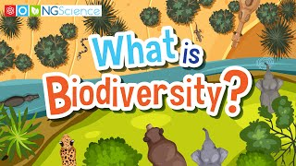
Notes:
https://www.youtube.com/watch?v=rVZktiOxsww

Slide 8
Three levels of diversity: species, genetic, & ecosystem
Species come in all shapes and sizes, from organisms so small they can only be seen with powerful microscopes to huge redwood trees. They include bacteria, protozoa, fungi, flowering plants, ants, beetles, butterflies, birds, fishes, and large animals such as elephants, whales, and bears. Each species is a group of organisms with unique characteristics.
Biodiversity includes the genes that every individual inherits from its parents and passes on to the next generation. Genetic diversity is found everywhere, from the variety of songs and feather colors of birds to the colors, tastes, and textures of apples and other foods. Genetic variation, which determines the extent to which individuals can adapt to their environments, is extremely important to their survival.
Genes determine the traits of individuals that form populations of a species. Individuals from different species interact to form communities. These interact dynamically with non-living environmental components, such as water or minerals, to form an ecosystem. Some ecosystems such as tropical forests and coral reefs are especially complex and host a large number of species. Other ecosystems such as deserts and Arctic regions have less complexity and thus a lower number of species, but all those species are ecologically important and some are endemic to that ecosystem.
Notes:
from: https://naturalhistory.si.edu/education/teaching-resources/life-science/what-biodiversity

Slide 9
Why is biodiversity important?
By enabling the natural processes that keep our ecosystems strong and resilient, biodiversity supports everything in nature that we need to survive. It grows the food we eat, purifies the water we drink and the air we breathe, and provides the natural resources we rely on for medicine, fuel, and shelter.
Biodiversity sustains nature’s contributions essential to our health, safety, and protection. It helps regulate climate, protect us from floods, storms, and other disasters, and support livelihoods and economies around the world.
Places that contain high biodiversity are able to cope better with changes. They are more resistant to natural or human-related disturbances.
The diversity of life also has significant economic value. Many industries, like tourism, agriculture, and pharmaceuticals, rely heavily on ecosystem services.
Biodiversity also has immense cultural, spiritual and aesthetic value. Certain animals and plants hold great significance in many cultures.
Notes:
from: https://www.worldwildlife.org/resources/explainers/what-is-biodiversity/

Slide 10
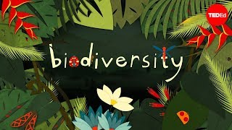
Notes:
https://www.youtube.com/watch?v=GK_vRtHJZu4

Slide 11

Notes:
https://www.youtube.com/watch?v=KPzpdwE2ic4

Slide 12
Threats to biodiversity
farming & livestock grazing
deforestation
  for agriculture, illegal logging, mining, building roads & dams
climate change & global warming
  using fossil fuels
habitat loss and fragmentation
overfishing & exploitation of the seas
  plastic pollution
extraction and use of fossil fuels
pollution of soil, air, and water
invasive species
Notes:
https://www.greenpeace.org/mena/en/what-is-biodiversity-and-why-is-it-important/

Slide 13
How can we protect against biodiversity loss?
Protecting, managing, and restoring forests
Preserving and restoring peatlands (wetlands such as marshes and swamps)
Protecting and preserving mangrove forests and sea grasses
Conserving and restoring natural spaces, both on land and in the water

Slide 14
What is urban biodiversity?
the variety of living organisms, including their genetic variations, and habitats in and around dense human settlements.
Notes:
https://wwf.ca/habitat/urban-areas/

Slide 15
What are ways to protect urban biodiversity?
protect and build green spaces
using green infrastructure
protect and build wildlife corridors
plant microforests
encourage native species
promote pollinator-friendly landscapes
community engagement
urban forestry
ecological design in new developments

Slide 16
Why protect urban biodiversity?
regulates temperatures
improves air and water quality
boosts carbon sequestration
reduces flooding
supports local wildlife
lessens the urban heat island effect

Slide 17
Looking at the definitions, does our campus have a lot of biodiversity? How do you know?

Slide 18
What (do you think) are different ways to track biodiversity?

Slide 19
Here are some tools to help us:
iNaturalist
Merlin Bird ID

Slide 20
How should we track our school’s biodiversity?
What should we track? Why?

Slide 21
Assessment:
Goal: Track our school’s biodiversity over the course of the year.
Pick 3-5 locations
Pick what we want to track
Take our surveys
Visualize our data
Repeat steps 3-4 during Q2, Q3, and Q4
Analyze the data, making comparisons & visualizing it for the year.

Slide 22
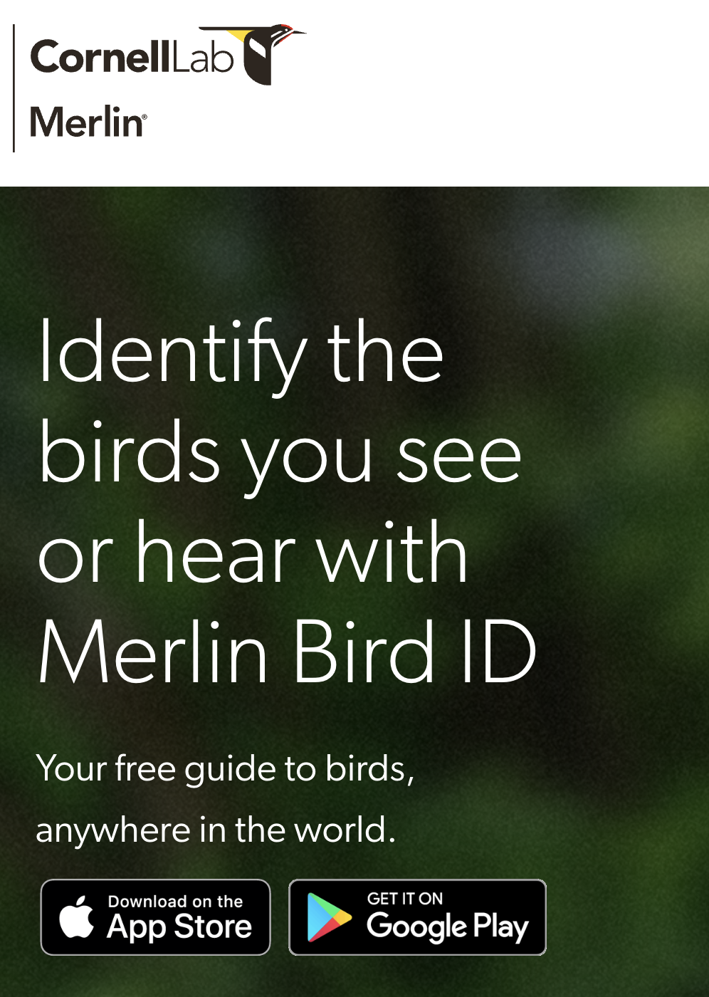
If we’re tracking birds…
download the app & create an account
make a list of the birds Merlin hears
share with the class
did Merlin hear the same birds for everyone? why do you think that is?

Slide 23
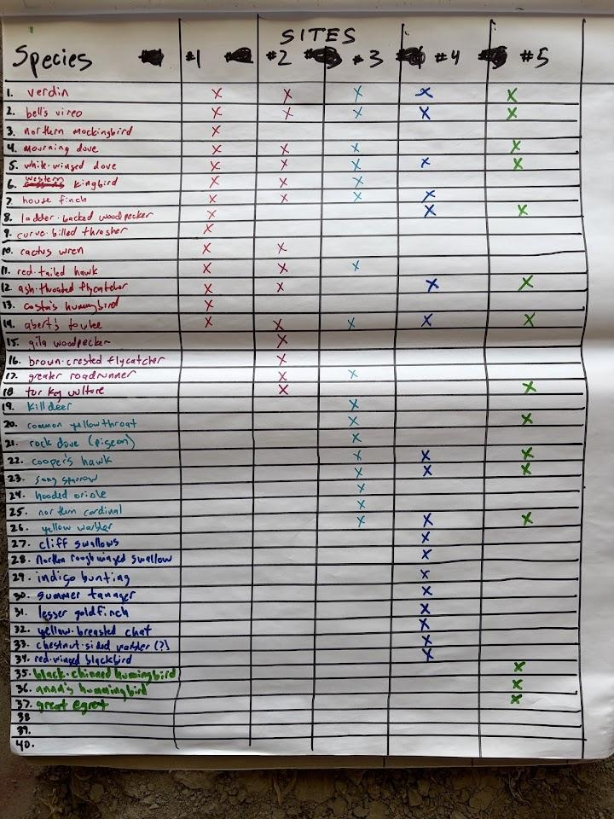

Slide 24
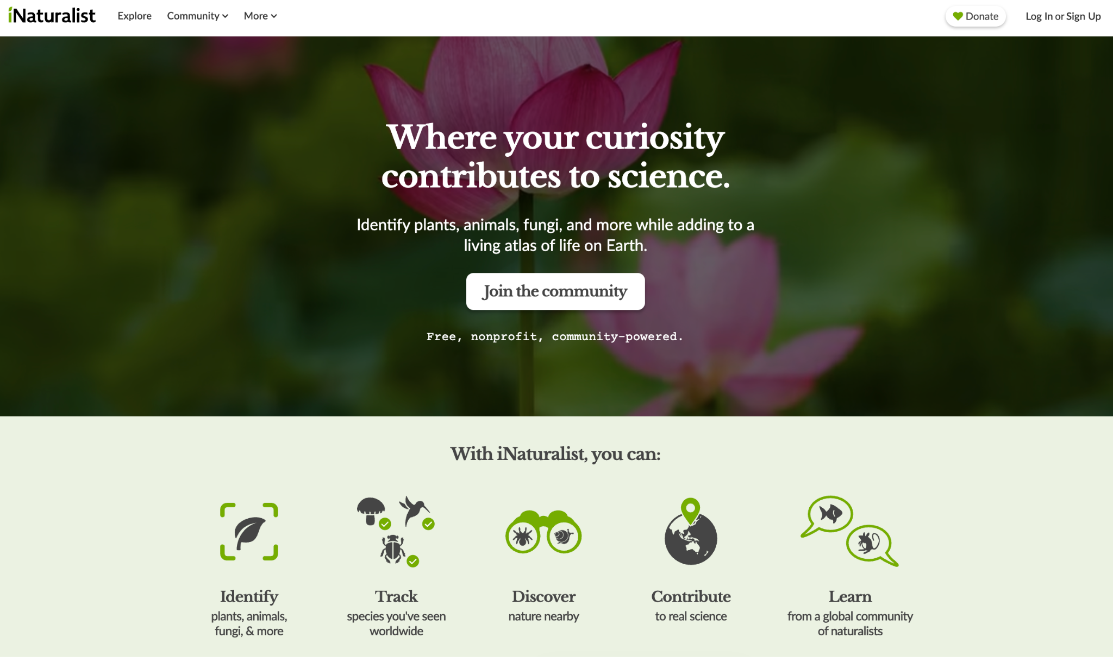
If we’re tracking plants, insects …
download the app & create an account
walk around the space & make a note of all of the plants
if you don’t know the plant, look it up!

Slide 25
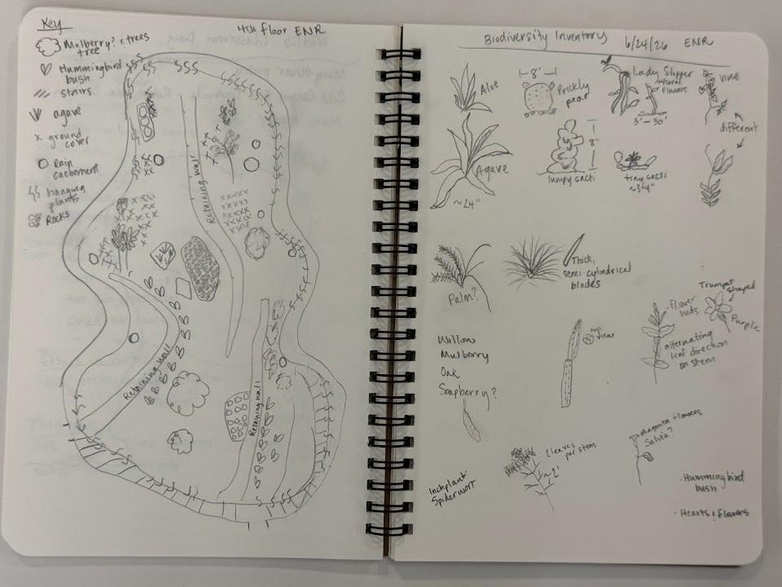
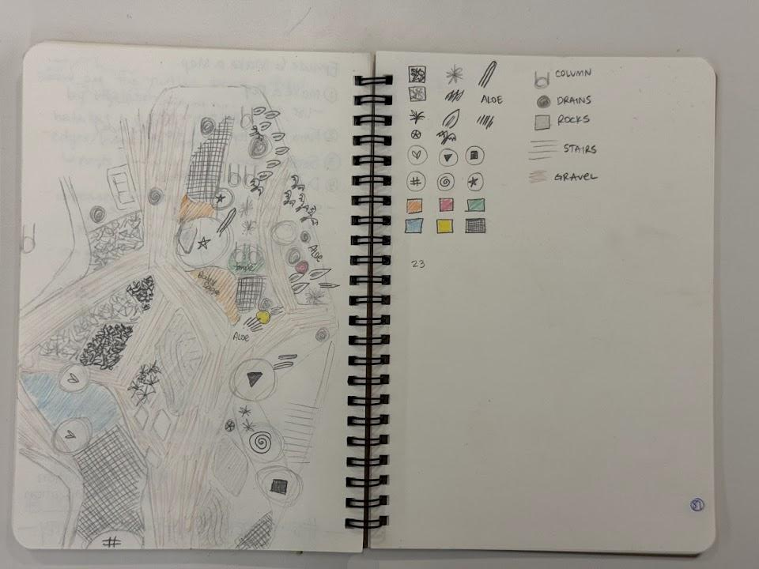

Slide 26
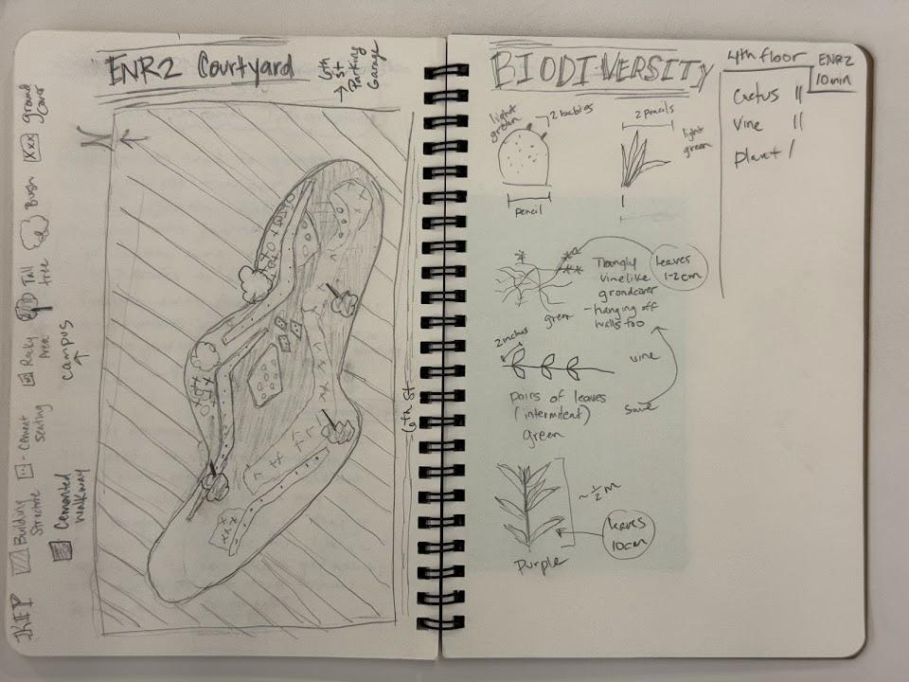
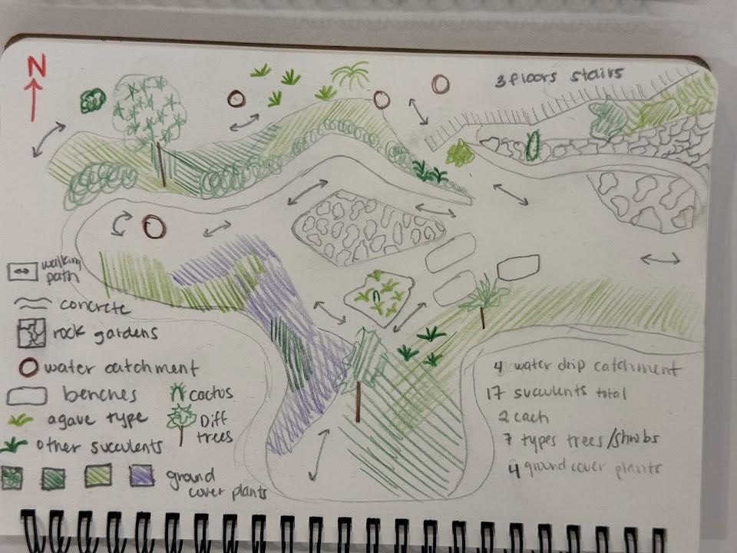

Slide 27
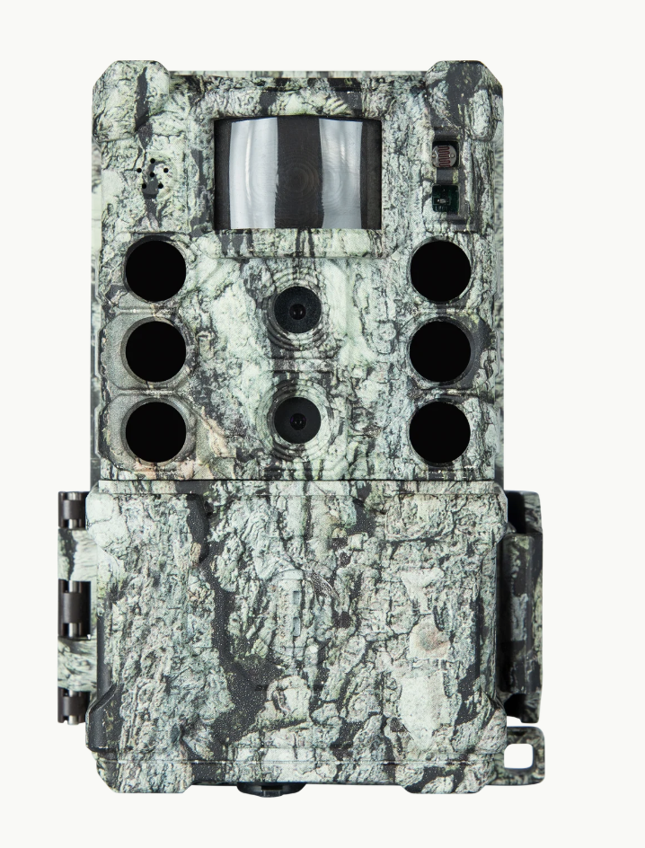
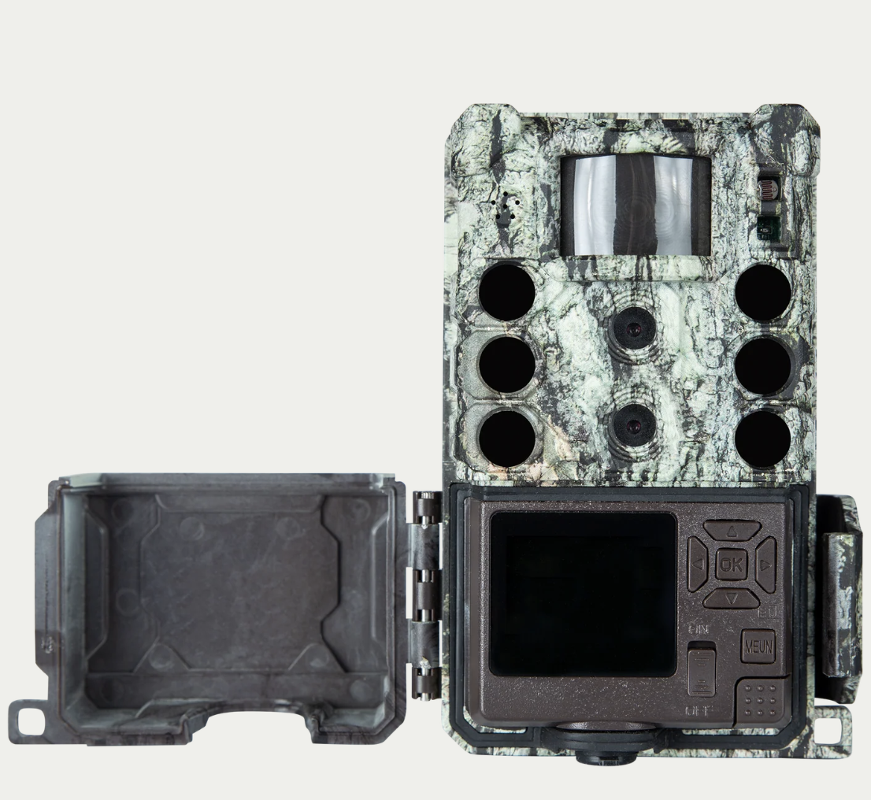
If we’re tracking animals…

Slide 28
Let’s go collect data!
bring your nature journals!
Question:
Data:

Slide 29
Extension
Ironwood Tree Experience W.A.T.E.R Field Study:
  Contact Deborah@ironwoodtreeexperience.org to set up a field trip. BioBlitz would be a good field trip for this topic.

Slide 30
How can we represent (this) data in a meaningful way?
Learning Target: What am I learning today? | I am learning: how to visualize data in interesting and unique ways
Success Criteria: How will I know that I have learned it? | I can: analyze data and represent it visually – either graphically or in a unique way.
Why am I learning this? | This is important because learning different ways to present data will aid in comprehension and communication. It also allows us to be creative in the ways that we present our data.

Slide 31
Assessment:
Goal: create a graph or some sort of data visualization that makes sense of the biodiversity data.

Slide 32
Now that we have our data, we need to make sense of it:
data analysis
  asking critical questions
  creating a “traditional” graph
  brainstorm ideas for a unique data visualization
visualization
  include a title & a key
  explain your visualization
present in a gallery walk
feedback & feed forward

Slide 33
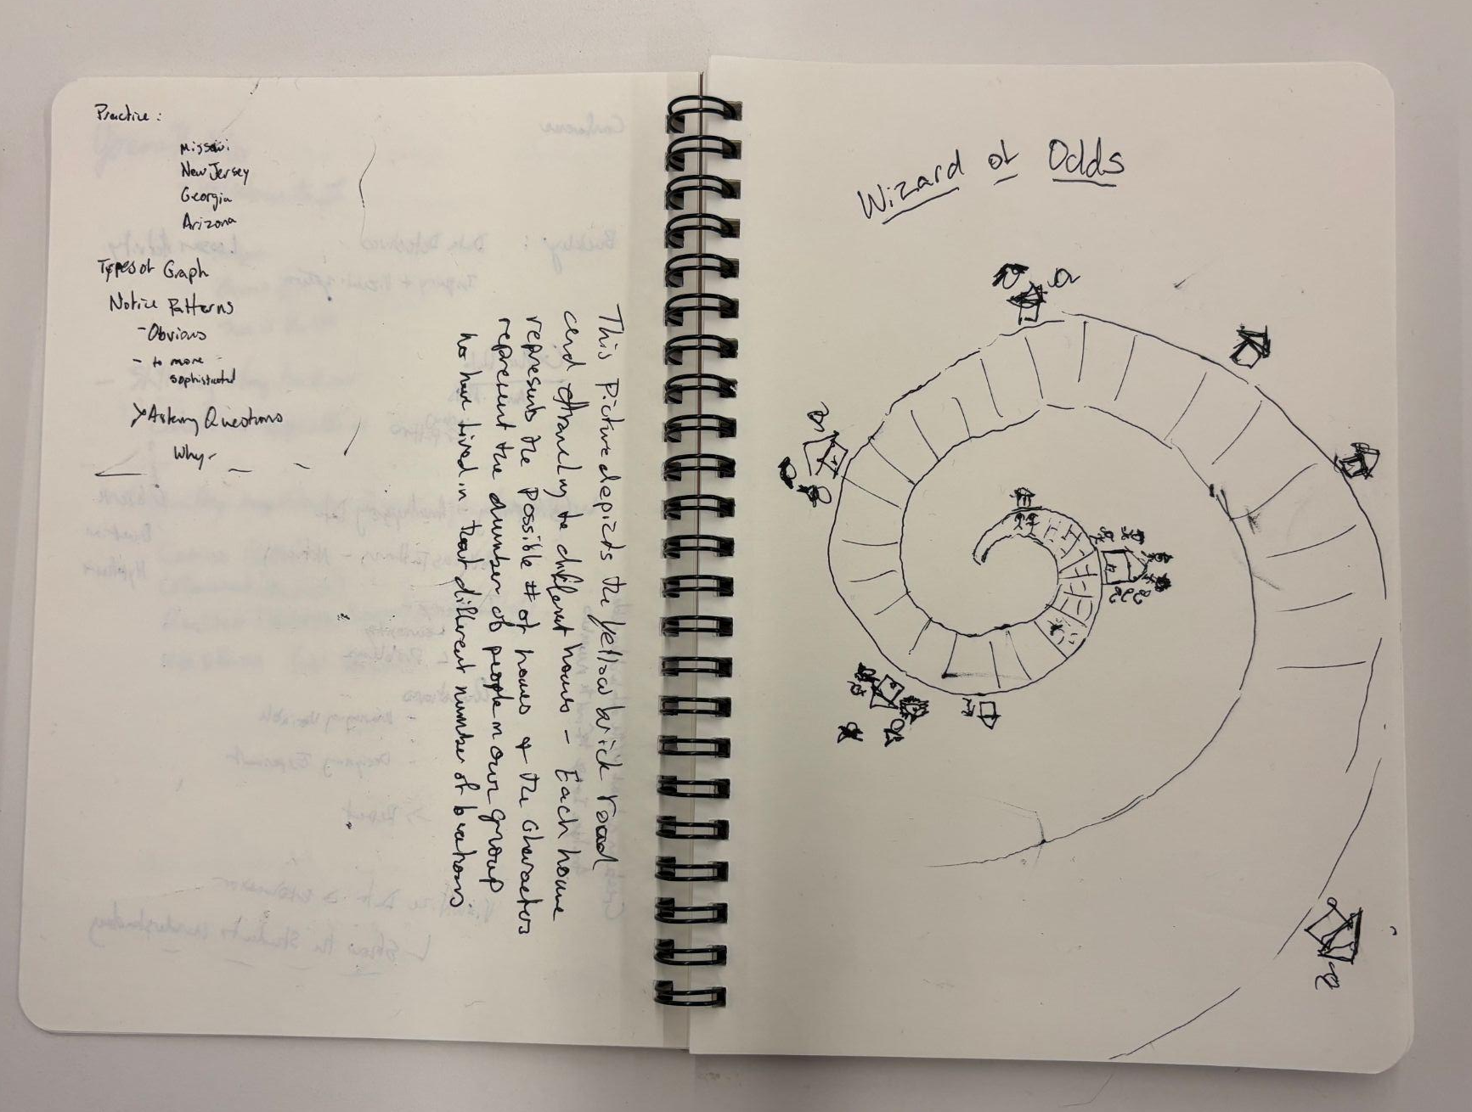
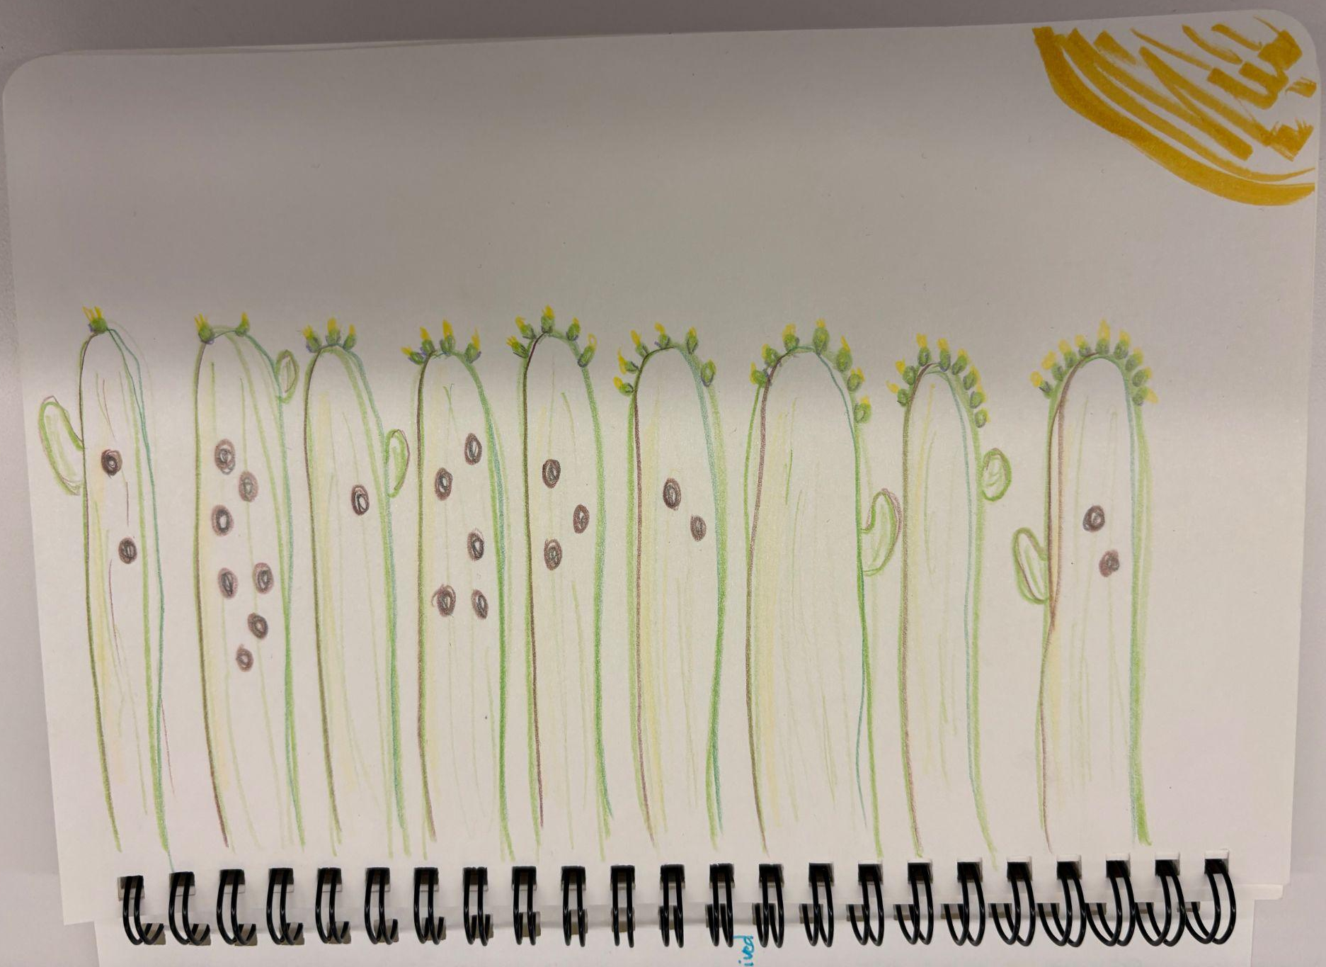
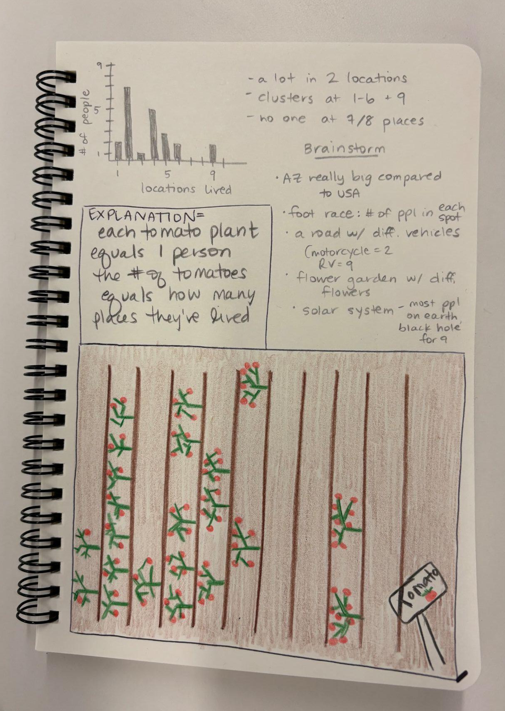
an example:
data: how many places have you lived?
1 place | 2 places | 3 places | 4 places | 5 places | 6 places | 7 places | 8 places | 9 places
2 | 7 | 1 | 5 | 3 | 2 |  |  | 2

Slide 34
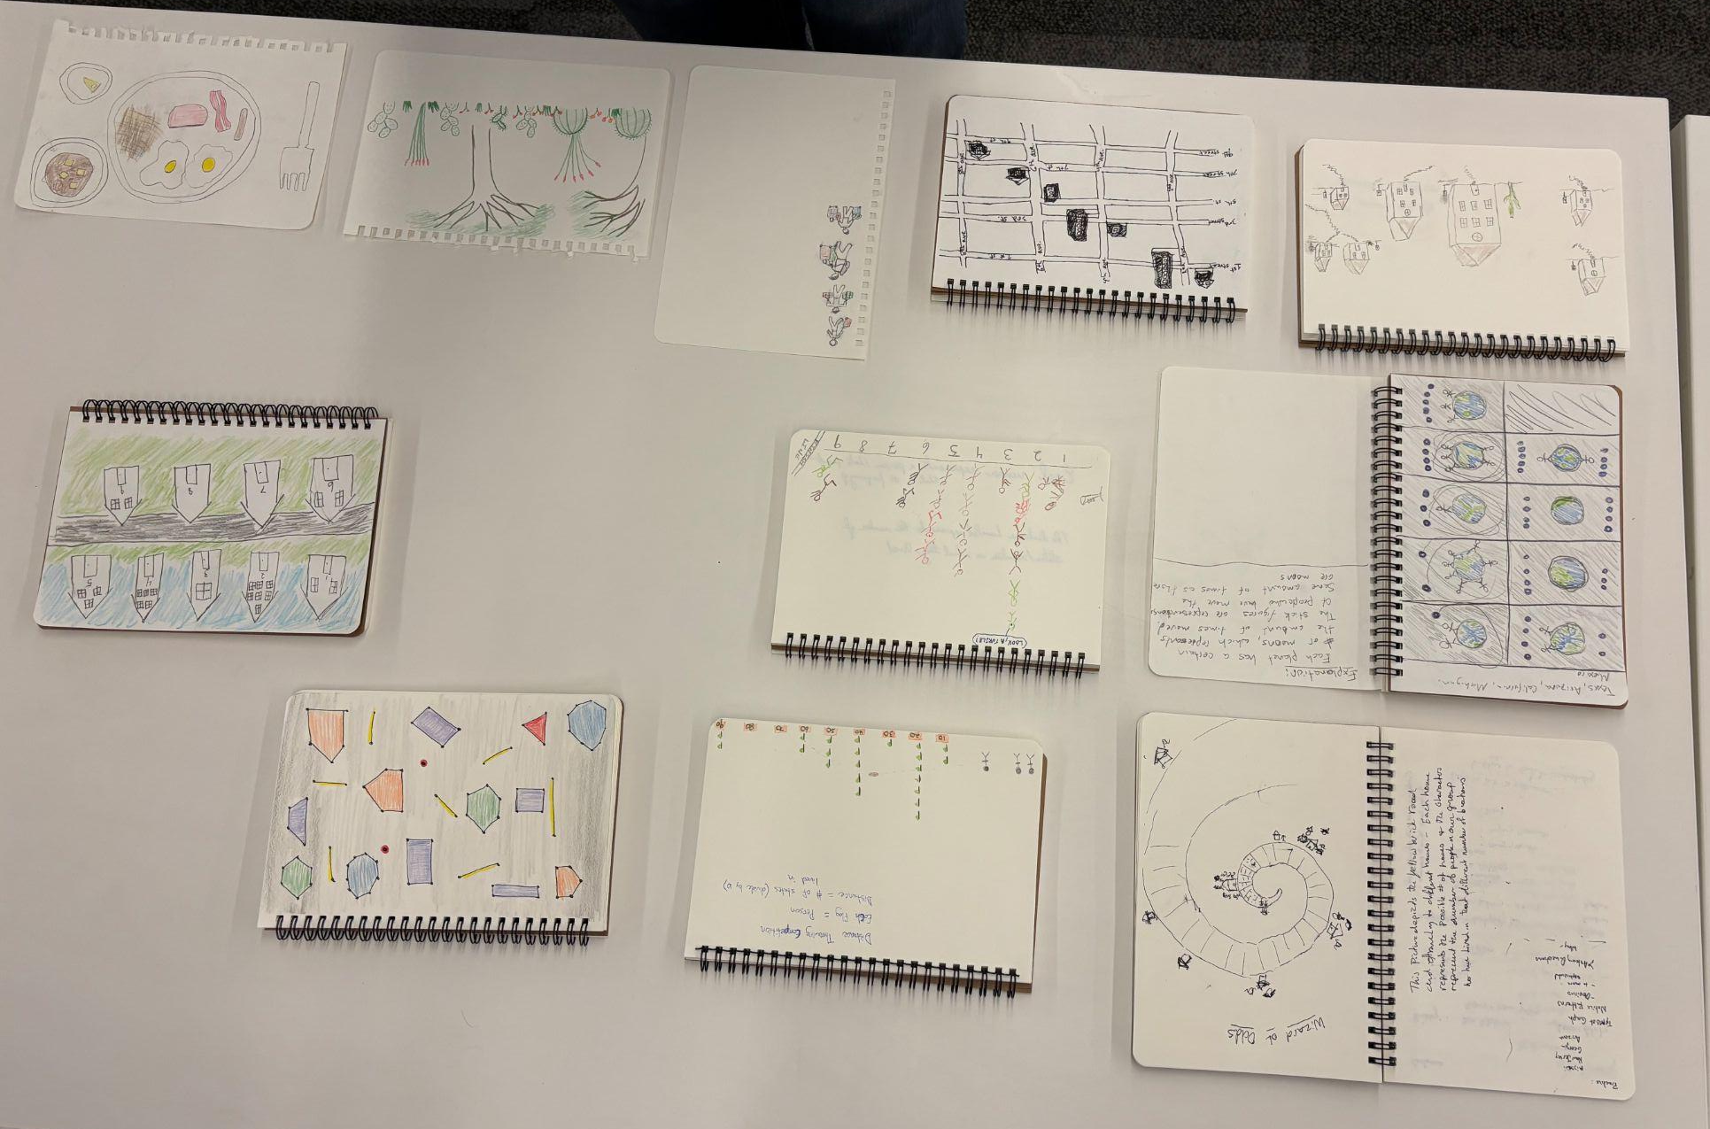

Slide 35
another example:
we visited 5 sites and listened for birds

Slide 36
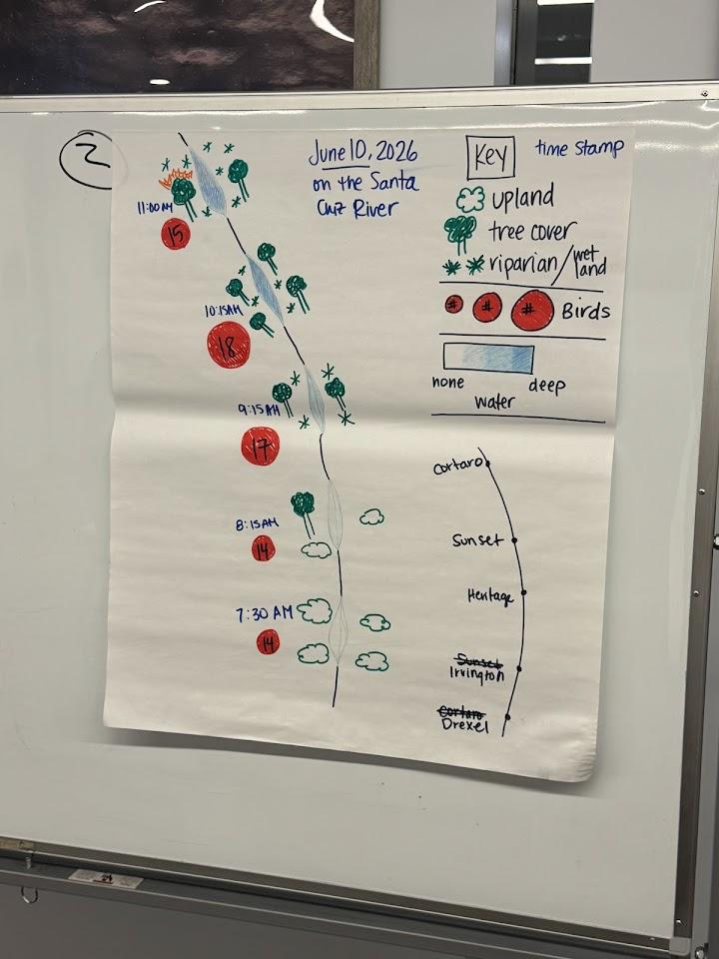
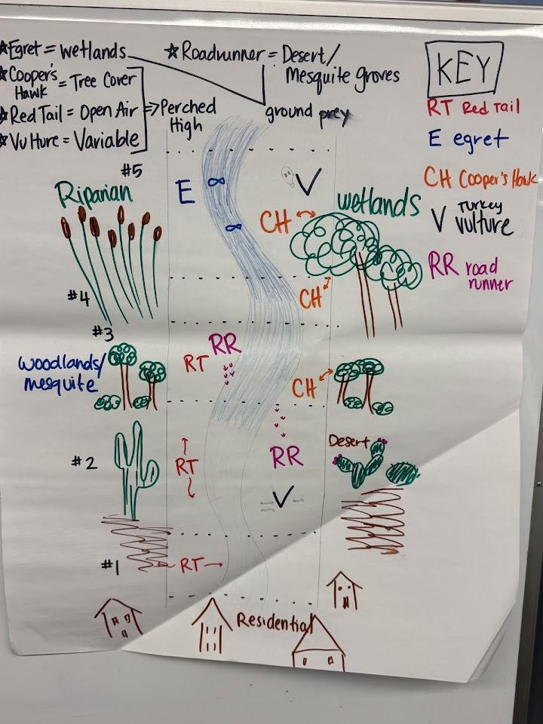

Slide 37
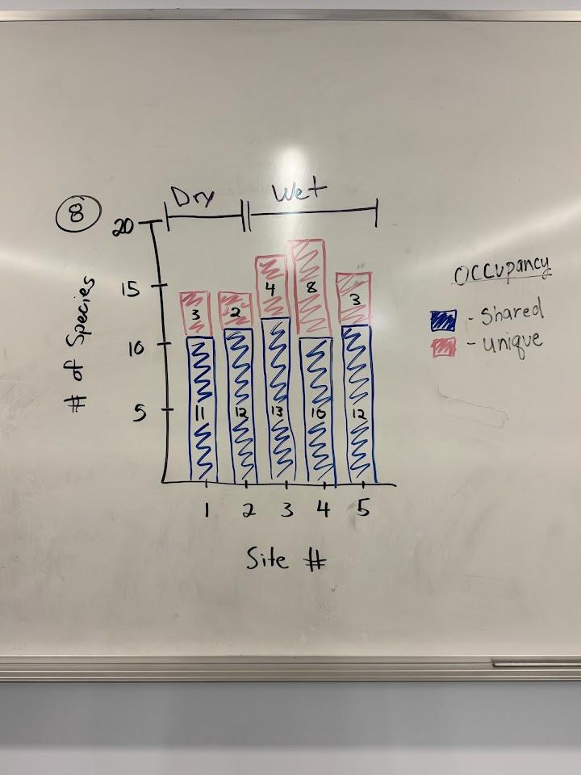
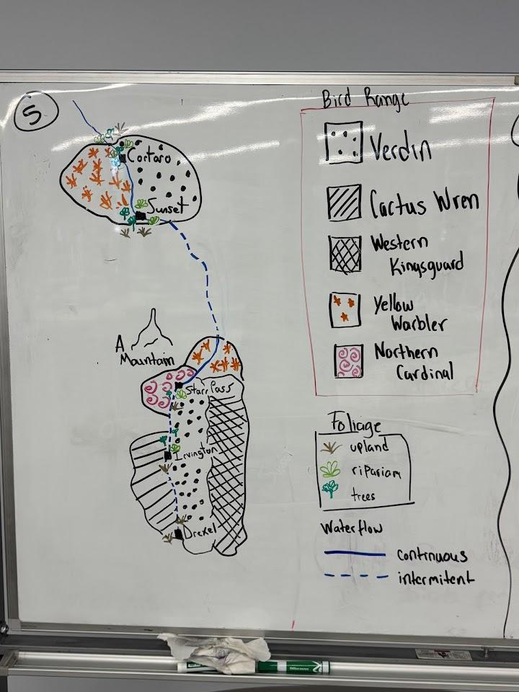

Slide 38
Now that we have our data, we need to make sense of it:
What do you see in the data?
Any patterns? Explain.

Slide 39
create a “traditional” graph with the data

Slide 40
brainstorm ideas for a unique data visualization

Slide 41
create your visualization!
include a title & a key
explain your visualization!

Slide 42
present! & feedback/feed forward
put out your visualization
walk around, looking at others’ visualizations
leave sticky notes with “feed forward” –
  what did they do well?
  what questions do you still have?
  are there any suggestions you have on how to make their visualization clearer or easier to read?
give yourself feedback: reflect on your visualization
  What would make the data easier to read?
  Which part of the representation is the most effective?
  How could you use what you have seen from others in your own visualization?

Slide 43
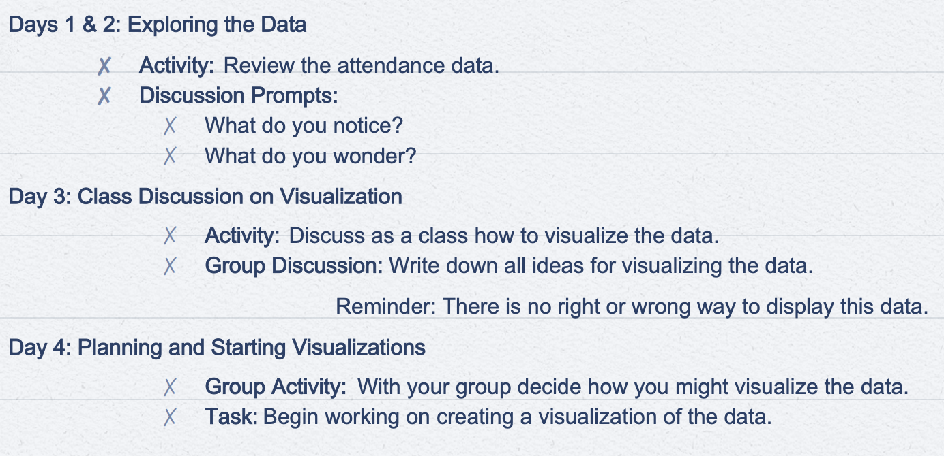
additional resources:
survey
Notes:
resource: data detectives
https://santacruz.arizona.edu/sites/default/files/2025-03/Data-Detectives-Q1_0.pdf

Slide 44
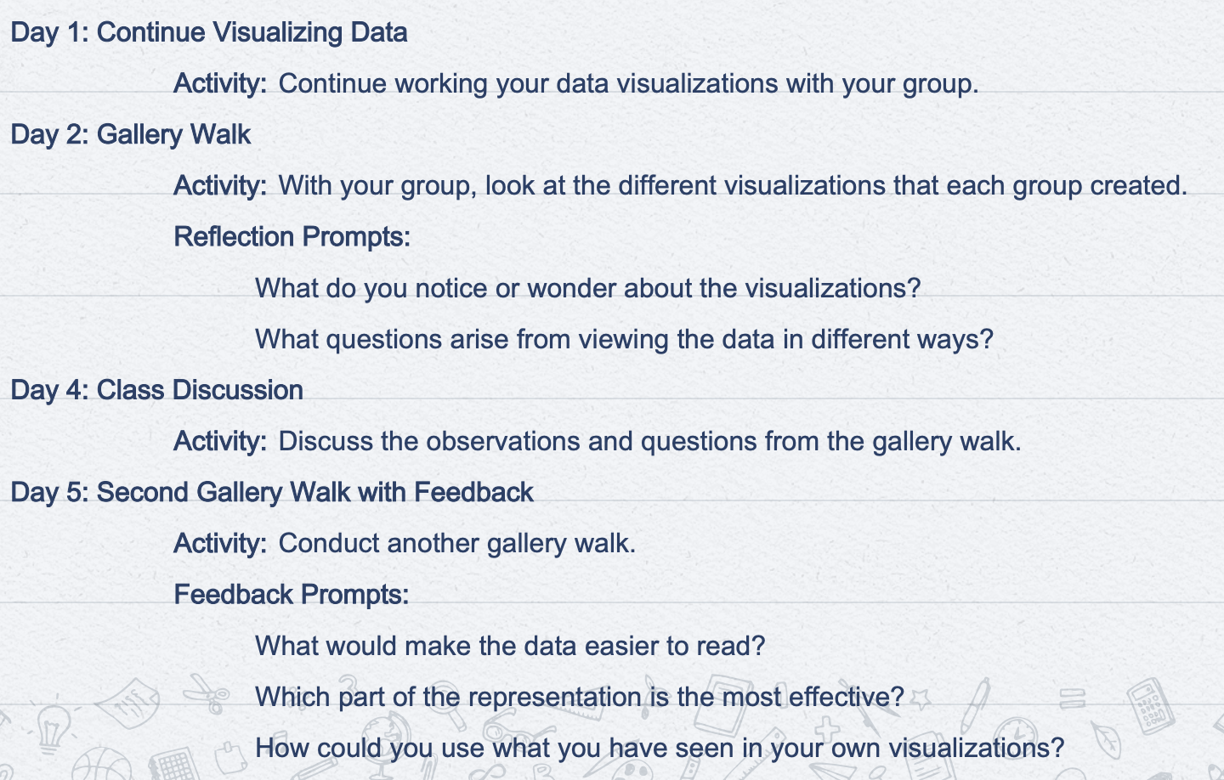
Notes:
resource: data detectives

Slide 45
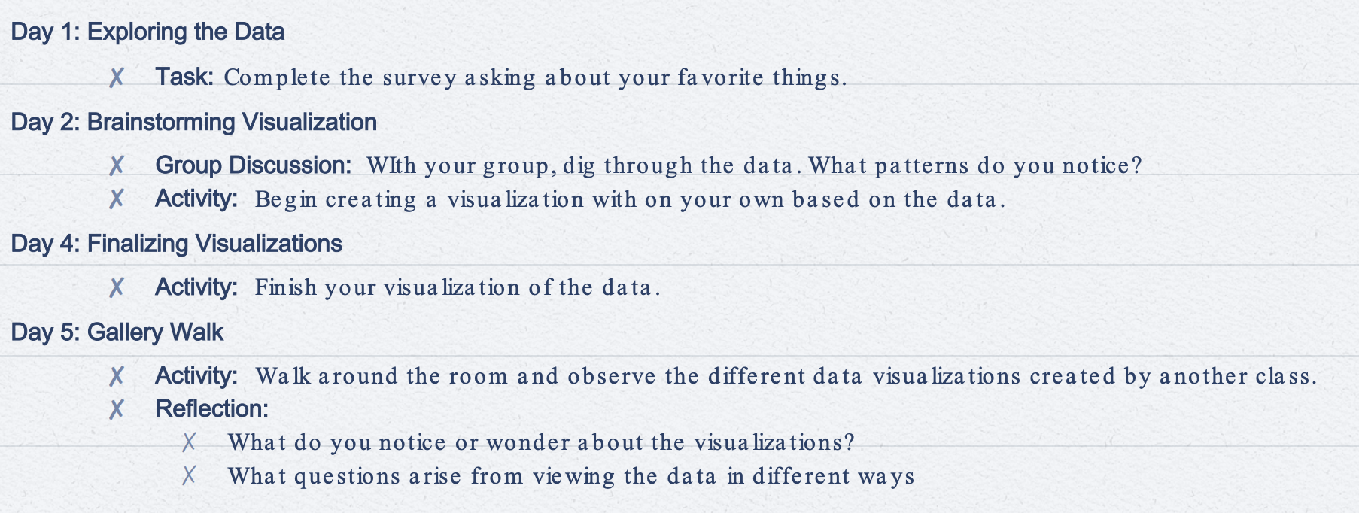
after you’ve done it once:
about campus biodiversity
Notes:
resource: data detectives

Slide 46
Extension:
Become pen pals with someone else (at your school or another school) and share your data via postcards (like in Dear Data). The data could be related to the campus surveys or they can be about different topics.

Slide 47
What is phenology?
Learning Target: What am I learning today? | I am learning: the definition of phenology, about the different phenological stages of animals, plants, and insects of the Sonoran Desert
Success Criteria: How will I know that I have learned it? | I can: define phenology, identify examples of different phenological stages of common plants and animals
Why am I learning this? | This is important because phenology helps us track climate change and its effect on the plants and animals in our environment. Phenology also helps us with agriculture; knowing when things are happening in our environment will help determine which plants to plant, harvest, etc.

Slide 48
note: this lesson can occur after all biodiversity lessons throughout the year have occurred. then students can choose from organisms that they have observed & nature journaled about over the year.

Slide 49
What is phenology?
"nature's calendar"
the study of the timing and cyclical patterns of events in the natural world, particularly those related to the annual life cycles of plants, animals, and other living things.
helps us understand how living organisms respond to environmental cues such as day length, temperature, and rainfall, and how climate change can impact these seasonal changes.
can include:
the budding of leaves in spring
the arrival of migratory birds
the flowering of plants
the onset of fruit ripening

Slide 50
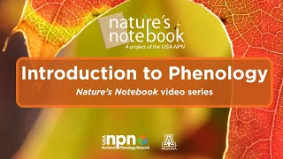
Notes:
https://www.youtube.com/watch?v=Eo3rVgEePfw

Slide 51
Why is studying phenology important?
informs crucial decisions about
  when to plant and harvest crops
  when to conduct rituals or ceremonies
  when to expect the arrival of specific animals for hunting or gathering
offers a window into the impacts of climate change and the consequences for ecosystems and human societies
  can gain valuable insights into how global warming is altering the timing of key biological events
  shifts can have cascading effects on ecosystems, disrupting the delicate balance between species and affecting agricultural practices and food security
aid in the development of more effective conservation strategies, enabling us to better anticipate and mitigate the challenges posed by changing environmental conditions
provides essential data for understanding, adapting to, and mitigating the ecological and societal consequences of a changing climate.

Slide 52
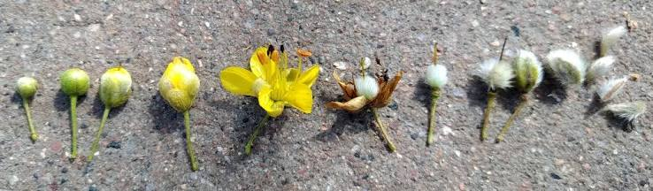
Examples of phenological stages:
Creosote
Notes:
picture from: https://commons.wikimedia.org/wiki/File:Creosote_Bush_Flower_Stages.jpg

Slide 53
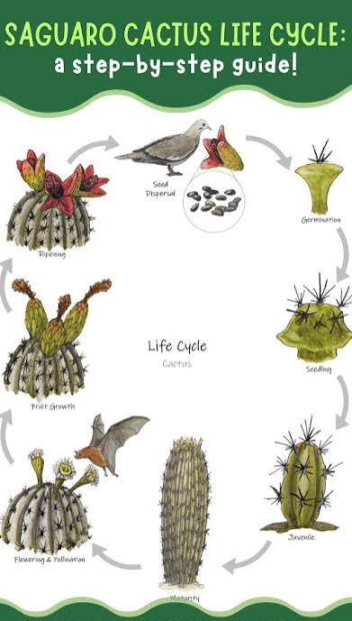
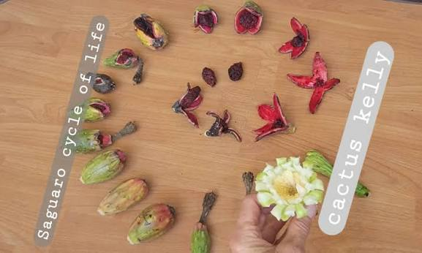
Notes:
pictures from:
https://www.facebook.com/groups/123250067720449/posts/24399815699637214/
https://wildearthlab.com/2023/11/01/cactus-life-cycle/

Slide 54
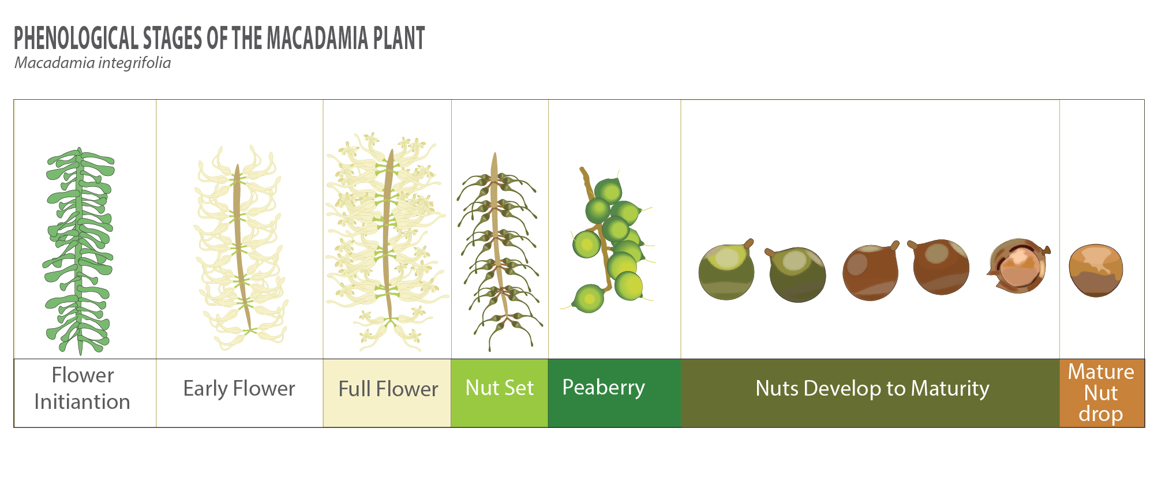
Notes:
picture from: https://www.biobee.com/crops/macadamia/phenological-stages-of-macadamia-plant/

Slide 55
Assessment:
Goal: to create an infographic of a desert dweller that focuses on the phenological stages.

Slide 56
Your infographic should include:
Research information about your desert dweller.
Draw a picture of your desert dweller.
  FOCUS ON 3+ PHENOLOGICAL STAGES
Include their predators and prey.
Include important adaptations.
Features it has to survive.
Unique traits or features.
Their location and typical shelter
As much information you can about your dweller.
a template for information gathering (does not include phenological cycles)
Notes:
https://santacruz.arizona.edu/sites/default/files/2025-03/Desert-Dweller-Research-Worksheet.pdf

Slide 57
desert dwellers to make an infographic on:
or anything we’ve seen on campus
or some other organism (pending approval)
anna’s hummingbird
greater roadrunner
great horned owl
gila woodpecker
vermillion flycatcher
verdin
yellow warbler
less goldfinch
cooper’s Hawk
butterfly weed
saguaro
palo verde
velvet mesquite
quail bush
desert willow
desert prickly pear
ocotillo
soaptree yucca
gila monster
gila topminnow
chuckwalla
western diamondback
packrat
honry toad
black widow spider
ground squirrel
bark scorpion
tarantula hawk
desert termites
pinacate beetles
desert blonde tarantula
flameskimmer
cochineal
apache cicada
crane fly
valley carpenter bee
Notes:
more insect options: https://extension.arizona.edu/sites/extension.arizona.edu/files/mblock/insect-discovery-backyardbugs2022.pdf

Slide 58
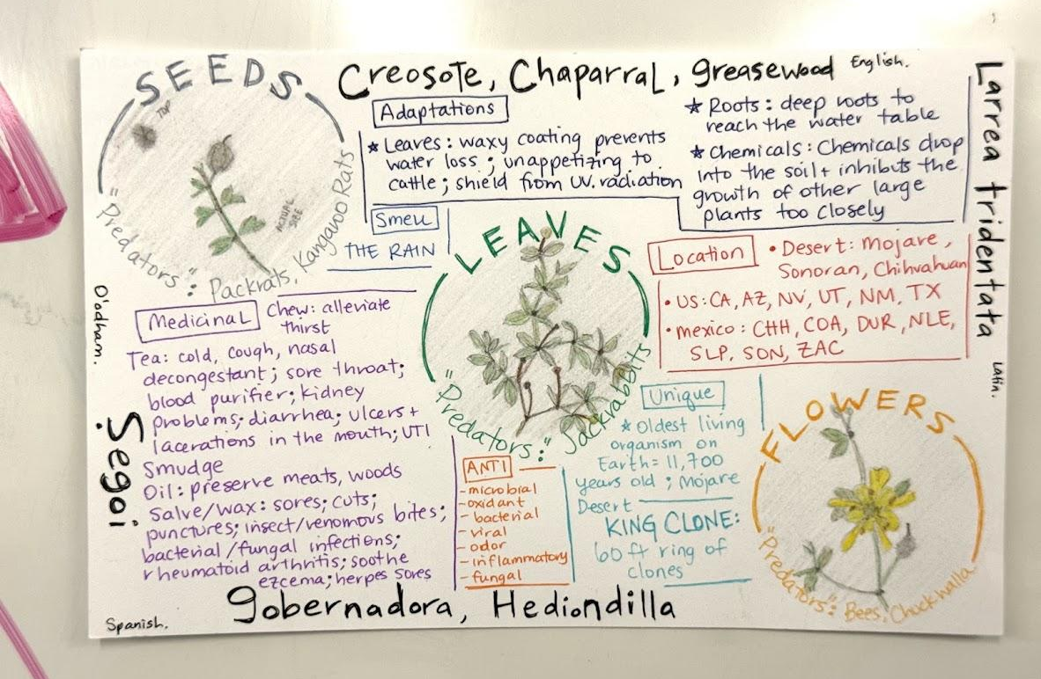
an example:
Notes:
from BIORETS, Victoria Bodanyi

Slide 59
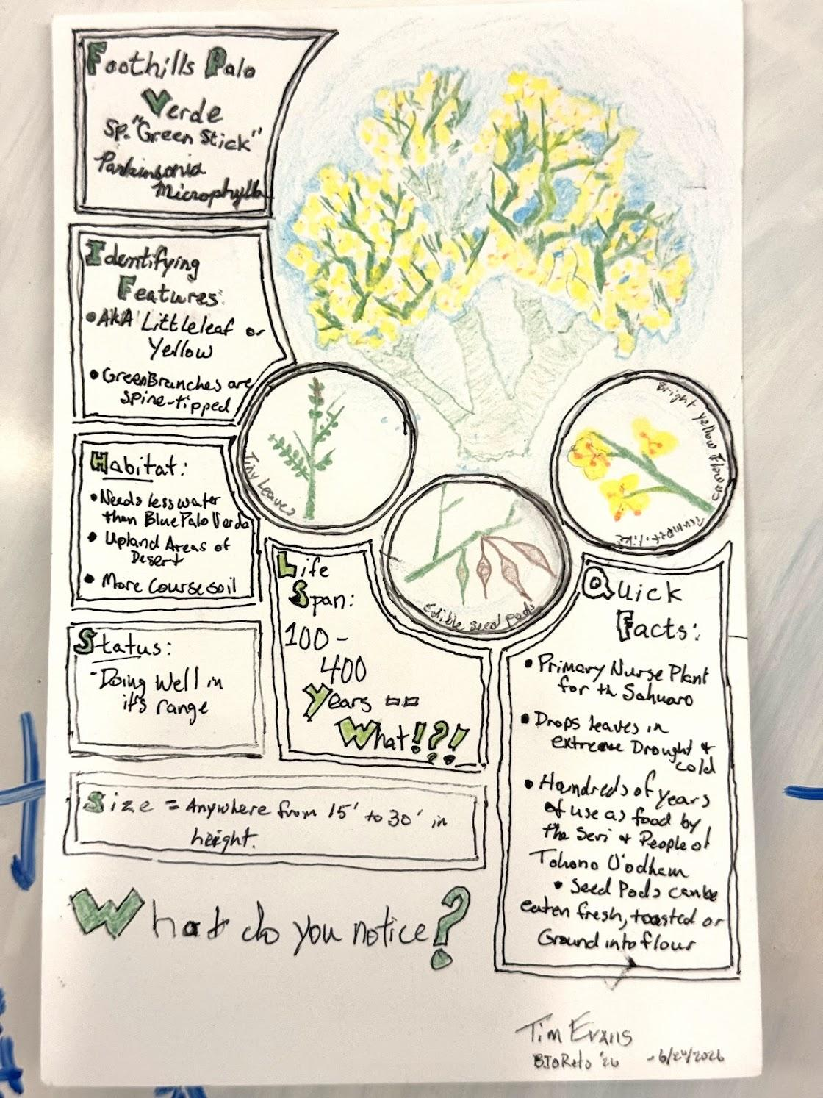
another example:
Notes:
from BIORETS, Tim Evans

Slide 60
Extension:
Have students create more than one infographic; perhaps one from each category
Create a food web using the infographics. Use this lesson to help: Desert Dwellers Food Web Activity

Slide 61
How and why does our environment change over the course of a (school) year?
Learning Target: What am I learning today? | I am learning: about urban biodiversity, phenology, and data visualization.
Success Criteria: How will I know that I have learned it? | I can: show the progression (phenological stages) of the different plants, animals, and birds on my school’s campus; determine biodiversity data trends from one quarter/season to the next & visually represent it.
Why am I learning this? | This is important because having a better understanding of the plants, animals, and birds that are on our campus will allow us to identify ways to increase biodiversity. And understanding the phenological stages will help us be better gardeners as well as be better stewards of the land since climate change is slowly affecting the timing of the phenological stages.

Slide 62
Assessment
Option 1: Create a map of the campus for each season, noting the biodiversity and phenology. Be sure to include drawings, words, and numbers – this map should be an extension of your Nature Journal. What stage should different plants and animals be in during each season?
Option 2: Create a calendar for the school year that denotes when different plants should be blooming, dropping fruit, animals and insects should be being born/hatching/mating, etc. Make a note of where on campus someone may find these plants, animals, etc.

Slide 63
Long term goal:
To continue doing this activity from year to year and study the shifts in phenological stages, shifts in biodiversity, etc.

Slide 64
option 1: create a map
get 4 campus maps, 1 for each quarter
for each of the 5 locations where biodiversity data was taken, choose 3-5 organisms to highlight
for each organism, include:
  elements from your nature journal: drawings, numbers, words
  phenological stages
  information from your infographic
what stage should different plants and animals be in during each season/quarter? show the shift in biodiversity and phenology over the course of the school year

Slide 65
option 2: create a calendar
options for time period:
by quarters (4)
by months of the school year (10)
by months of the year (12)
by seasons (5)
options for shape:
circle
traditional calendar
something else?
decide which kind of calendar you are going to make
  the time period
  the shape
choose 3-5 organisms to highlight
for each organism, include:
  elements from your nature journal: drawings, numbers, words
  phenological stages
  information from your infographic
  where it can be found on campus (its location)
what stage should different plants and animals be in during each season/quarter/month? show the shift in biodiversity and phenology over the course of the year
Notes:
templates can be found here: https://practicalpages.wordpress.com/2018/03/05/phenology-wheel/

Slide 66
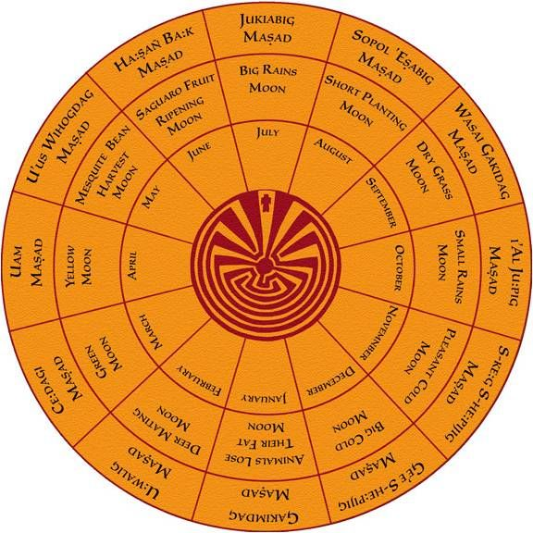
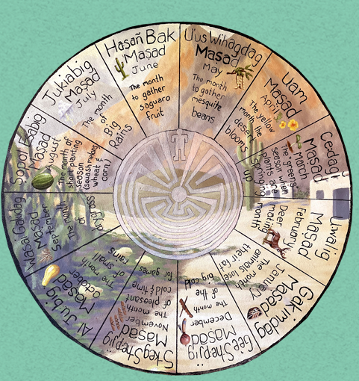
examples of phenological calendars:
Notes:
pictures fr0m: https://www.pinterest.com/pin/tohono-oodham-calendar--314477986451723793/
https://schoolgardens.arizona.edu/sites/schoolgardens.arizona.edu/files/220223%20Garden%20Almanac_SPREADS%20%281%29.pdf

Slide 67
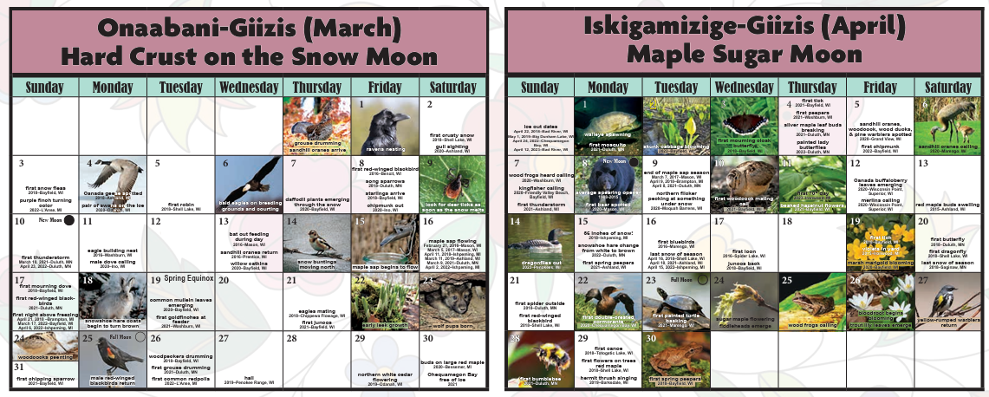
Notes:
pictures from: https://glifwc.org/sites/default/files/uploads/documents/2024-09/2024Phenology%20Calendarfinal.pdf

Slide 68
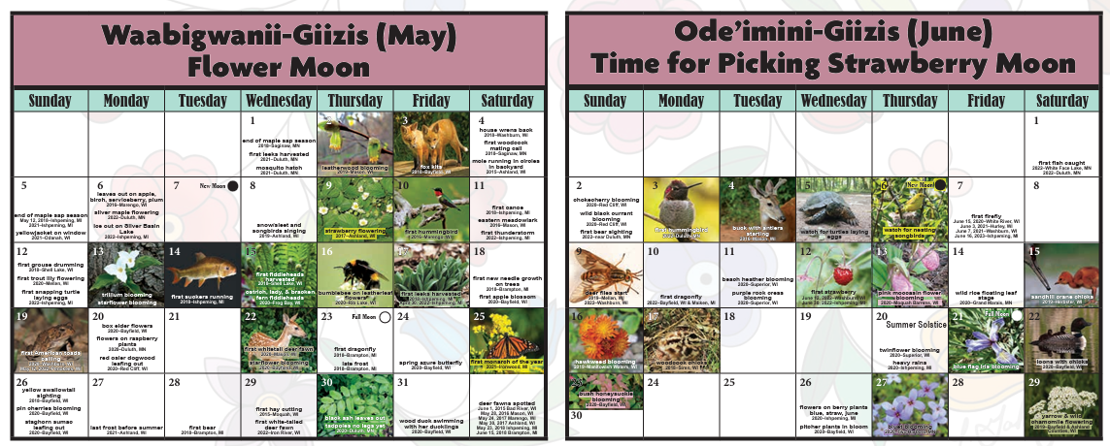
Notes:
pictures from: https://glifwc.org/sites/default/files/uploads/documents/2024-09/2024Phenology%20Calendarfinal.pdf

Slide 69
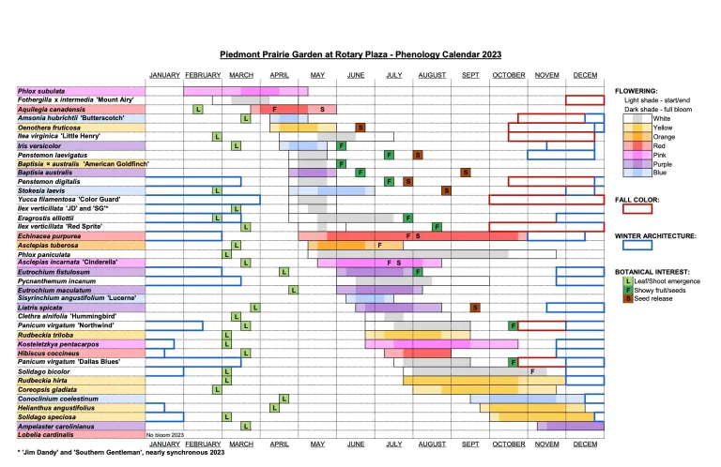
Notes:
picture from: https://durhammastergardeners.com/category/phenology-calendar/

Slide 70
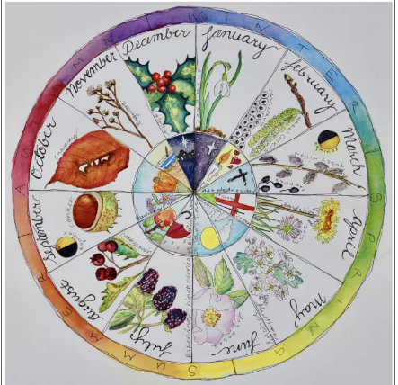
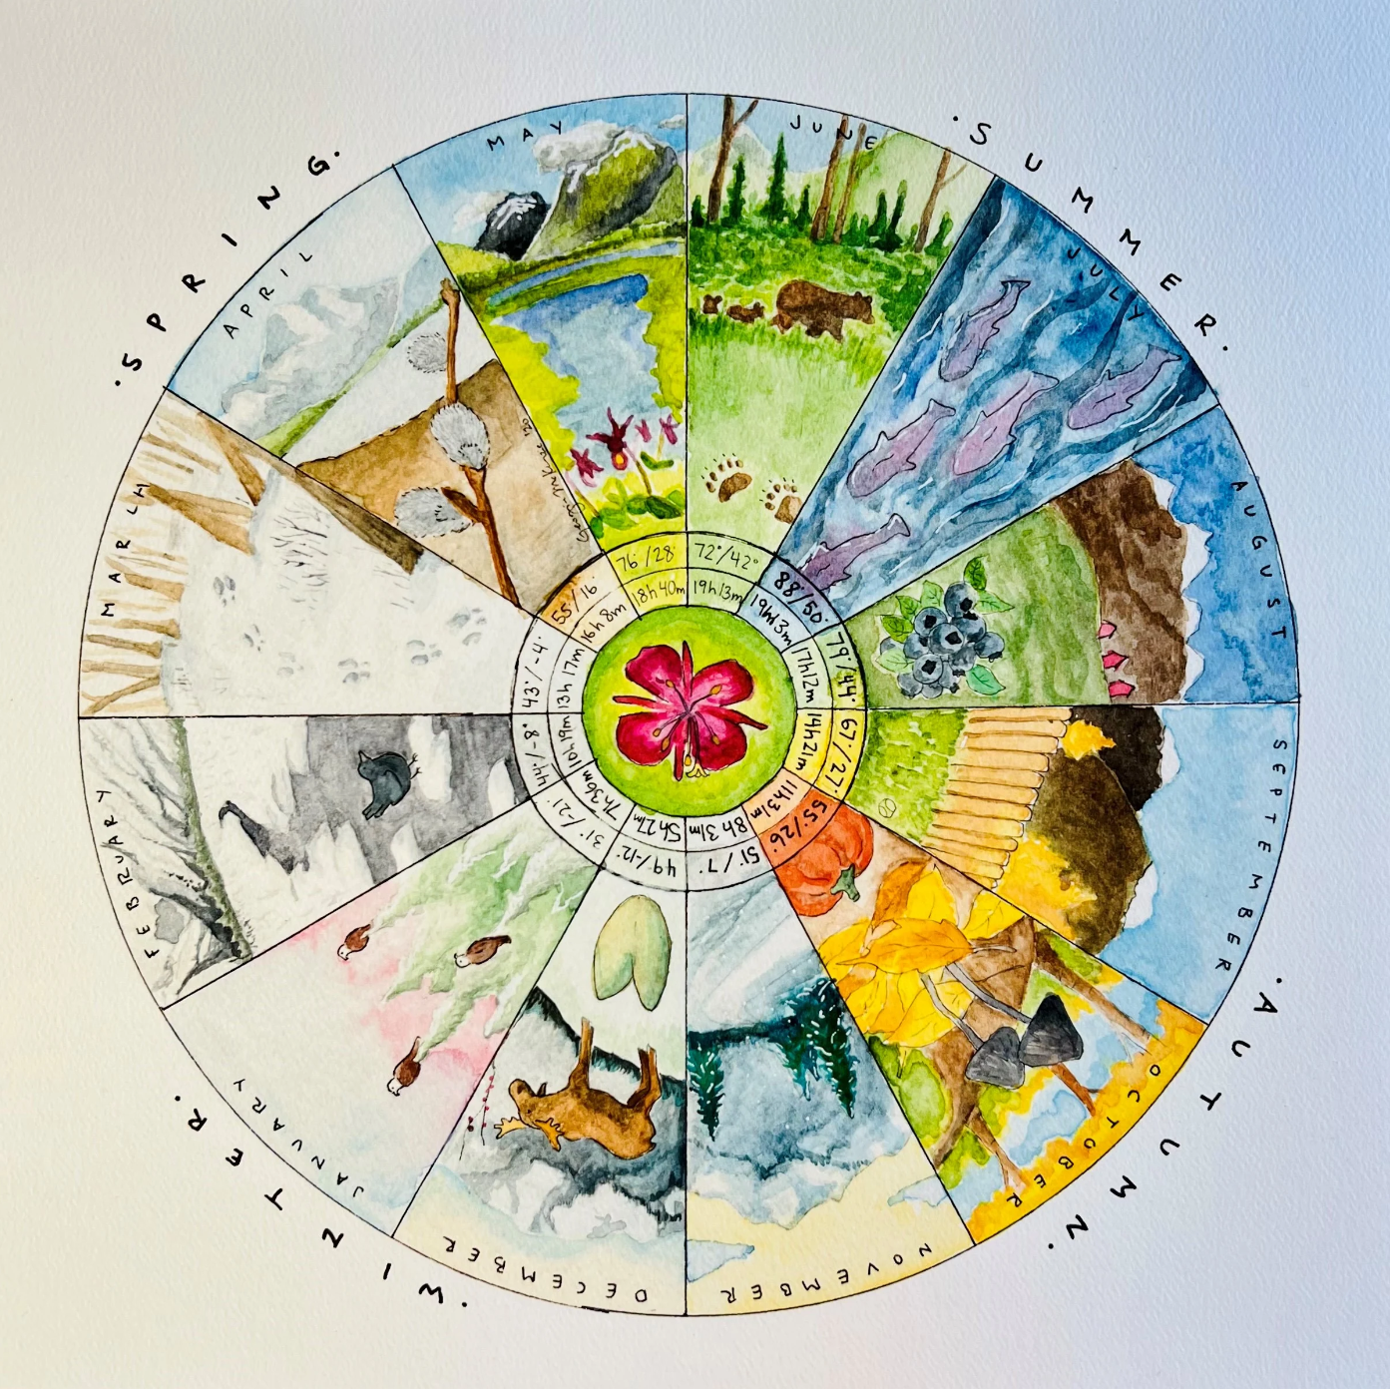
Notes:
pictures from: https://practicalpages.wordpress.com/2018/03/05/phenology-wheel/
https://www.woodbowl.com/products/year-in-alaska-phenology-wheel?srsltid=AfmBOop6ayEu0SUXfT2Ea7gNg3WYwpIG1FeXmvYygK27Zc2-6d05s2pR

Slide 71
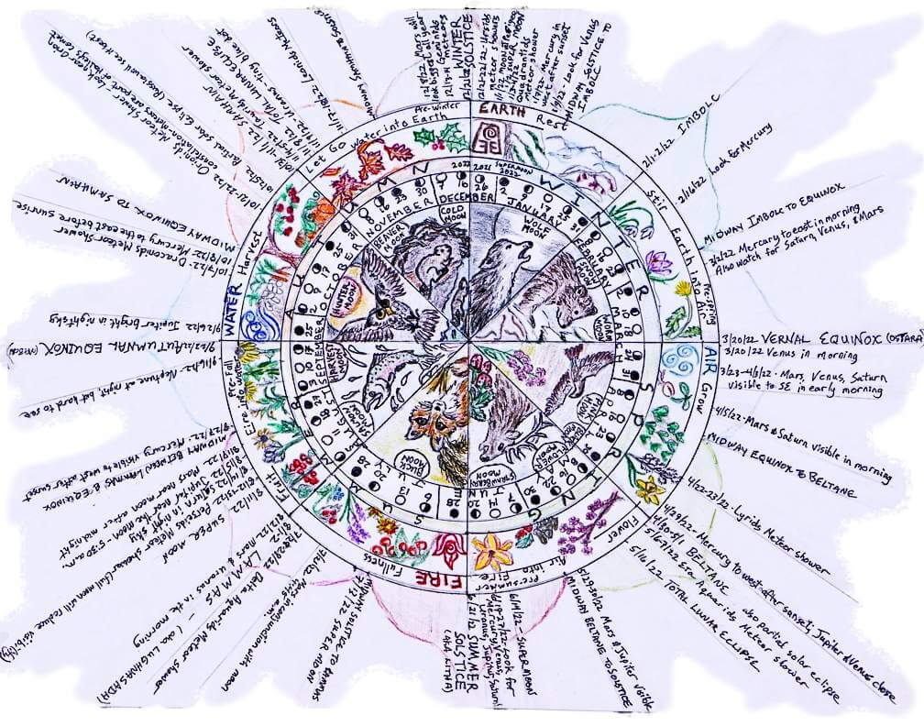
Notes:
picture from: https://barbolian.com/2022-phenology-wheel-calendar/

Slide 72
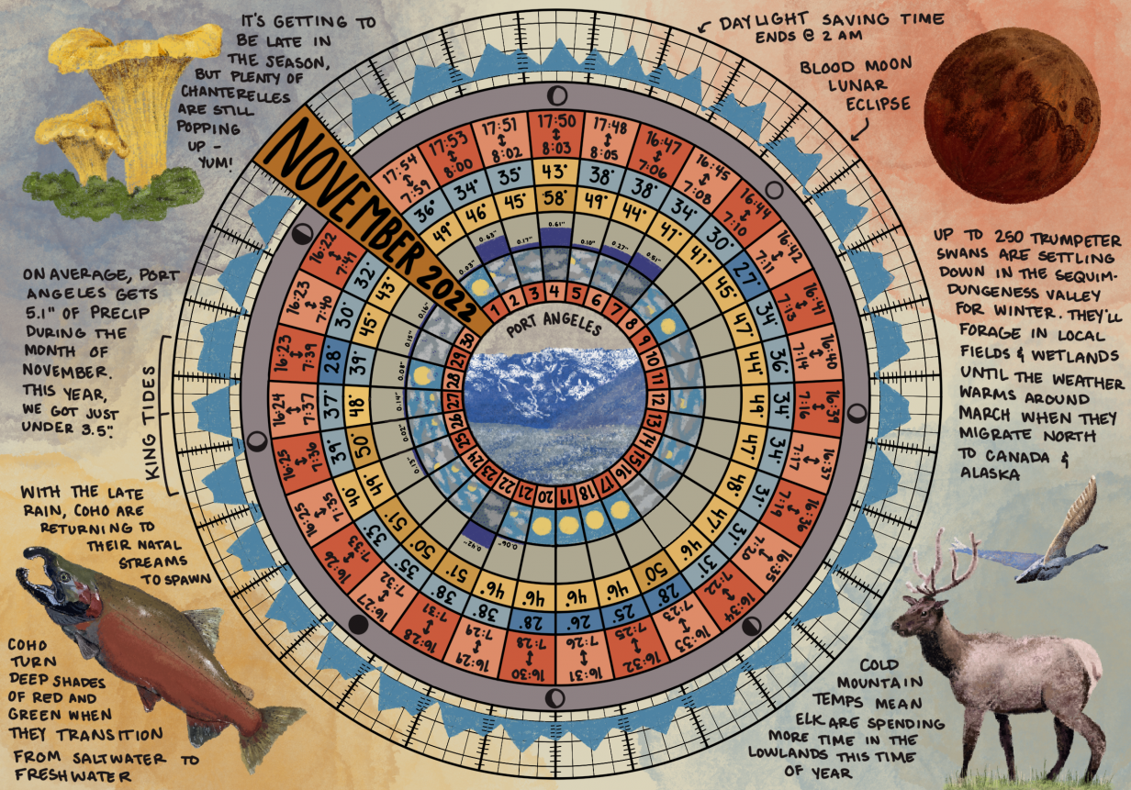
Notes:
picture from: https://northolympiclandtrust.org/event/phenology-wheel-workshop/

Slide 73
Extension:
Create a coloring page based on some of the plants and animals from each season that can be found on the school campus. Use the coloring pages in these School Garden Almanacs as a guide: The Sonoran Desert School Gardener's Almanac

Slide 74
YPAR Ideas:
Try to increase the biodiversity on your school campus by participating in “Creating Urban Habitat” with Pima County.
  Field Study Trips & Classroom Programs | Pima County, AZ
Research what kinds of plants would attract pollinators and birds and create a pollinator garden on campus.
  Habitat at Home Program Resources ⋆ Tucson Bird Alliance; How to design your Tucson pollinator garden
Build nest boxes for Lucy Warbler’s
  Lucy's Warbler Plans

