Slide 1
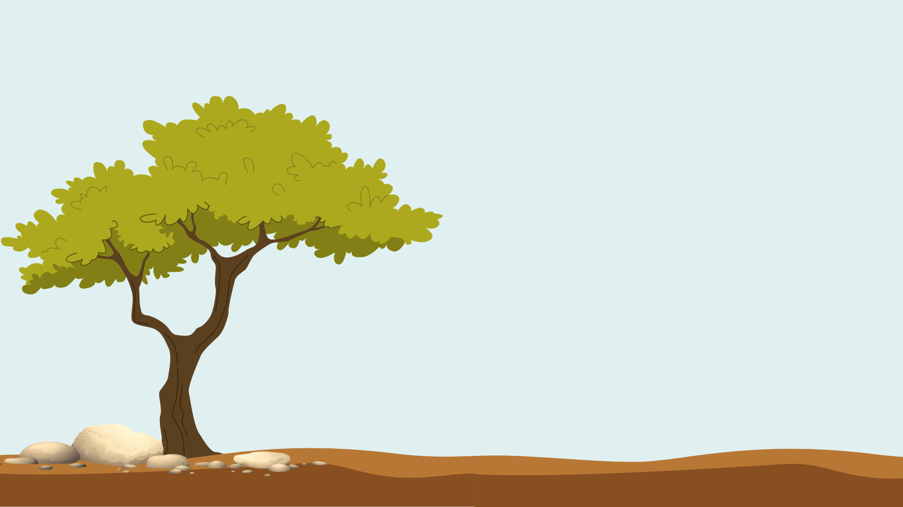
Be a Friend to Trees
Lesson 1
Why are trees important?

Slide 2

Objectives
In this lesson I will…
Understand the value and benefits of tree services
Describe the causes and effects of heat islands in urban areas
Explain tree equity scores and their importance

Slide 3
Brainstorm and Think-Pair-Share
Create a T-P-S chart in your journal. Answer the question on your own first. Then discuss with your partner and record your partner’s answers.
What are the benefits of having trees in our community, home, school, etc?
What I think | What my partner thinks | What we will share

Slide 4
Benefits of Trees
Notes:
Record student responses here or on chart paper

Slide 5
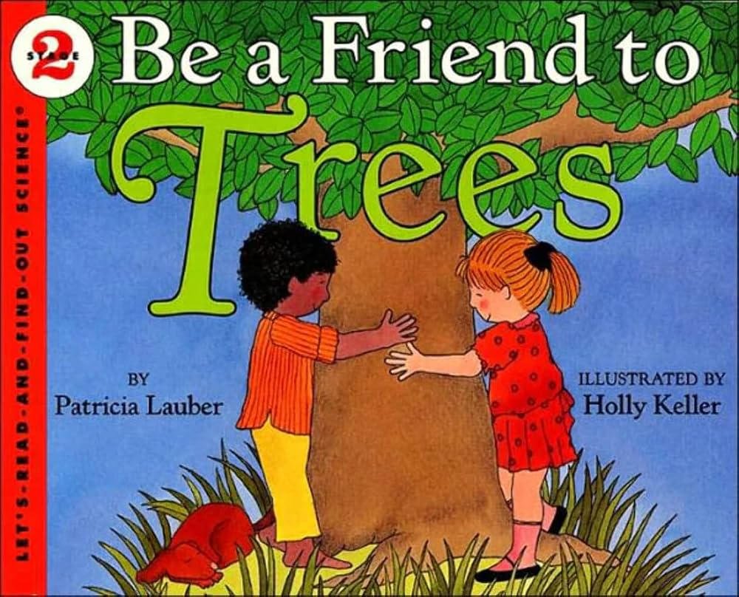
Listen for benefits of trees and take notes
Notes:
Read aloud book or go to next slide for YouTube read aloud.

Slide 6
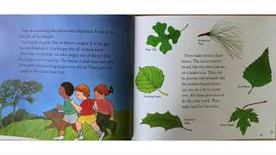
Video Link: https://youtu.be/AJG9KAVRTYc
Notes:
Recommend setting speed to 1.25x

Slide 7
Brainstorm and Think-Pair-Share
Add to your chart. Did you learn about any new benefits?
What are the benefits of having trees in our community, home, school, etc?
What I think | What my partner thinks | What we will share

Slide 8

What happens when we don’t have trees?
Create a new T-P-S chart in your journal and answer the question.
Write your responses first, then share with partner.
What I think | What my partner thinks | What we will share

Slide 9
What Happens Without Trees
Notes:
Record student responses here or on chart paper

Slide 10

Urban Heat Islands
Video Link: https://youtu.be/304Eo7Ux_wE?si=5IuUIV0aBjB6esMq
Notes:
Record student responses here or on chart paper

Slide 11
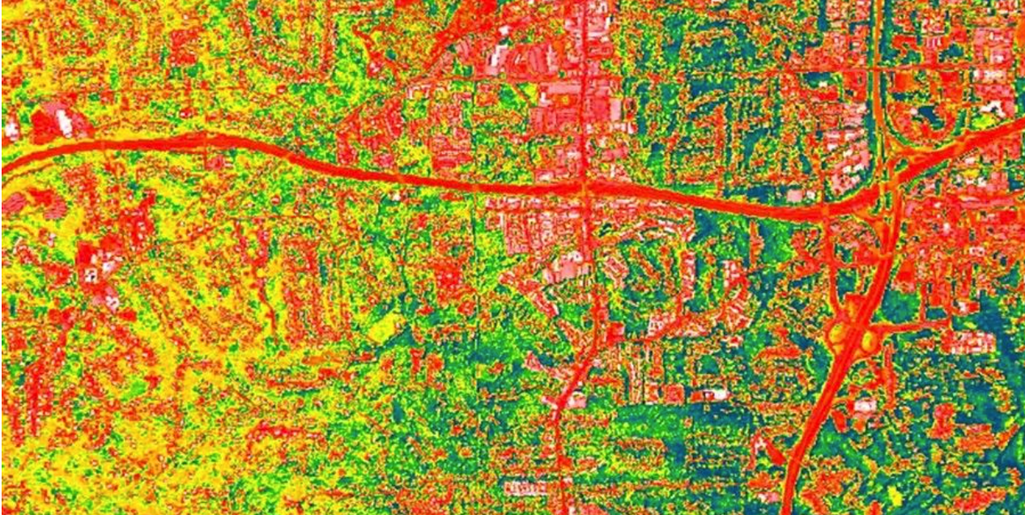
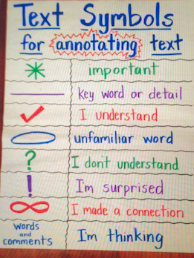
NASA: What is an Urban Heat Island?
Read and annotate the text.
Notes:
https://science.nasa.gov/kids/earth/what-is-an-urban-heat-island/

Slide 12
What is an Urban Heat Island? How can we help?
Notes:
Record responses on slide or chart paper

Slide 13

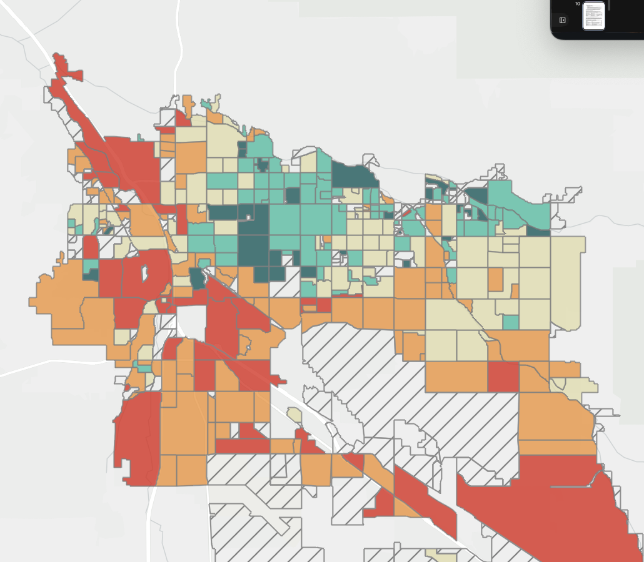
Tree Equity
What is our tree equity score?
What does it mean?
Notes:
https://climateaction.tucsonaz.gov/pages/milliontrees-tree-equity

Slide 14
Next time…
What do you think is involved in measuring tree canopy/shade cover?
Notes:
Record responses on slide or chart paper

